Slide 1




Sample-Efficiency and Reliability
in Reinforcement Learning
Romain Laroche @DataFest (11/05/2019))
Notes:
Добрый день!
Я очень рад быть сегодня с вами на этой сцене.
Надеюсь все хорошо провели праздники?
Сначала я хотел сделать презентацию на русском, но потом передумал.
По-русски у меня всё!
For your sake I switch to English.
My presentation will start with a brief introduction of Reinforcement Learning (RL) and an overview of its success.
Then, we will see, that even though its achievements are compelling, state-of-the-art algorithms require an unreasonable amount of data.
Moreover, they sometimes converge to terrible solutions.
These restrictions currently limit the application of Reinforcement Learning in the real world.
I will walk you through some of our contributions in Reinforcement Learning at Microsoft Research Montréal.
I will conclude spending some time to present the current hot topics in Reinforcement Learning research.

Slide 2


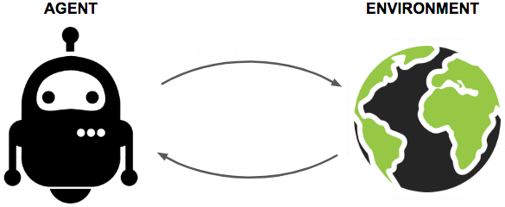






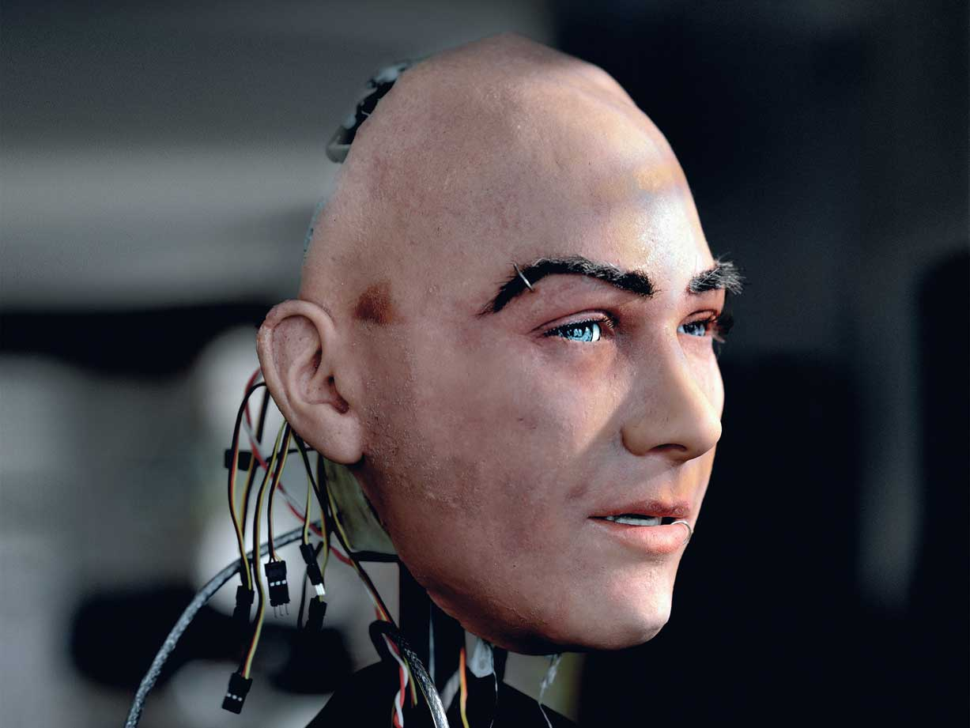


Short bio
Dialogue
Notes:
As I do not expect that most of you know me, I thought that presenting myself would help you understand why I am working on those subjects.
I’ve always been passionate about AI and I believe that its biggest challenge is to be able to sustain a dialogue with a human.
However, I do not think that AI’s goal should be to look like a human.
Why would a robot have legs if it can go faster on wheels?
I believe it is the same with dialogue.
And I have a nice story to support it.
I have been designing vocal applications for 13 years at Orange Labs in Paris.
And one unexpected result we got is that human-like speech synthesis yielded worse dialogues.
Why was it so?
When we used human-like speech synthesis, it looked better than it was, and the users were overexpecting from the system.
This is bad.
As a contrast, with robot-like speech synthesis, the users were talking simply, in a way that is understandable for a system.
So, I want my applications to be task oriented and find the system that is the most efficient at it.
This is where Reinforcement Learning comes into play.
At Orange, I mainly used Reinforcement Learning as a tool to do my research on dialogue.
Overtime, I developed an interest in its foundations to a point that I decided to switch and make it my main research area.
I had the opporutnity when I moved to Montreal at Microsoft two years and a half ago.
But I still keep the dialogue motivation in all my research.
Today’s subject is centered around Reinforcement Learning.

Slide 3



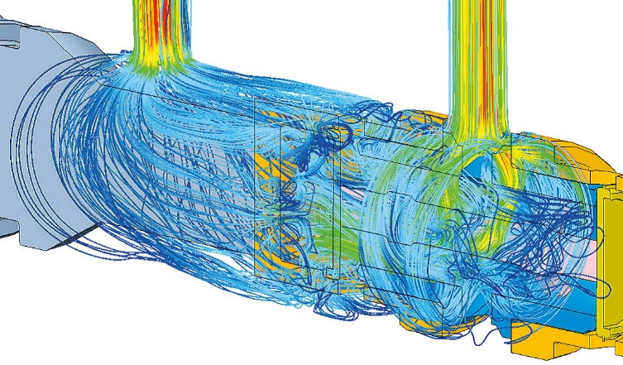

What is Reinforcement Learning?
Reinforcement Learning (RL) is learning to make sequential decisions
Potential RL applications list is expansive:
Notes:
Reinforcement Learning (RL) is learning to make sequential decisions
Potential RL applications list is expansive:
Robotics: drone control,
Dialogue systems: personal assistance, call centers,
Game industry: non-player characters, computer AI,
Treatments: pharmaceutical tests, crop management,
Complex systems control: resource allocation, flow optimization,
…

Slide 4

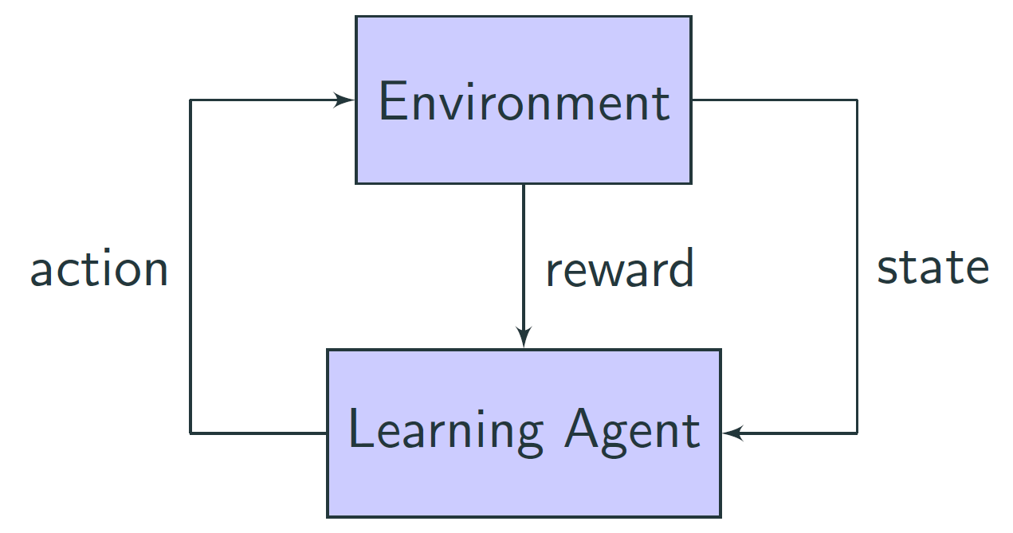
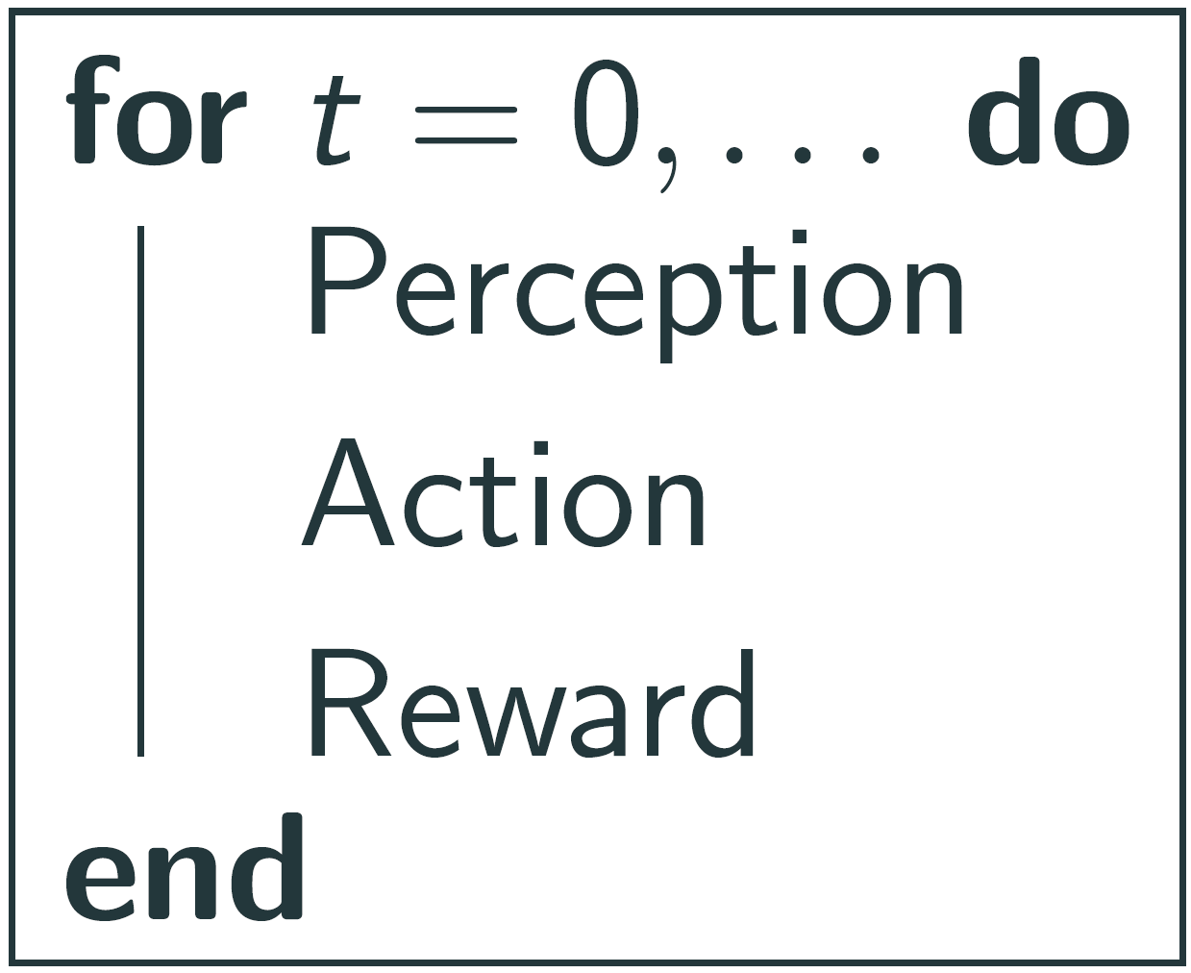
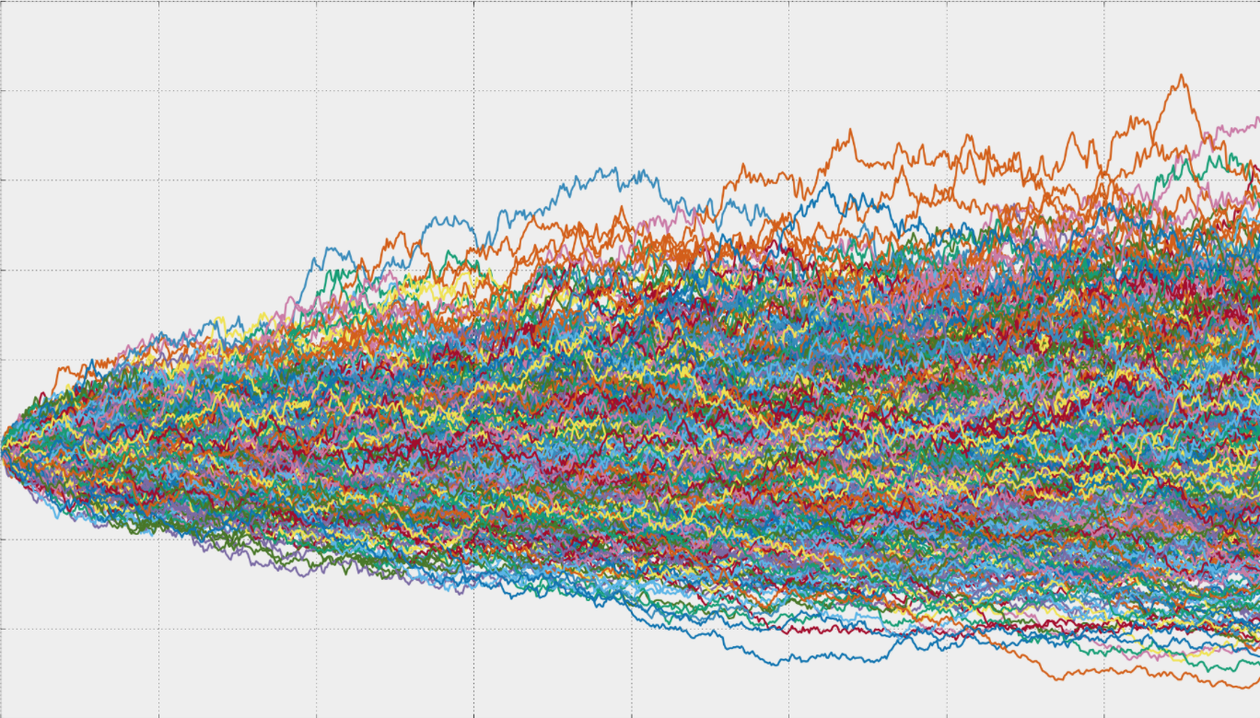

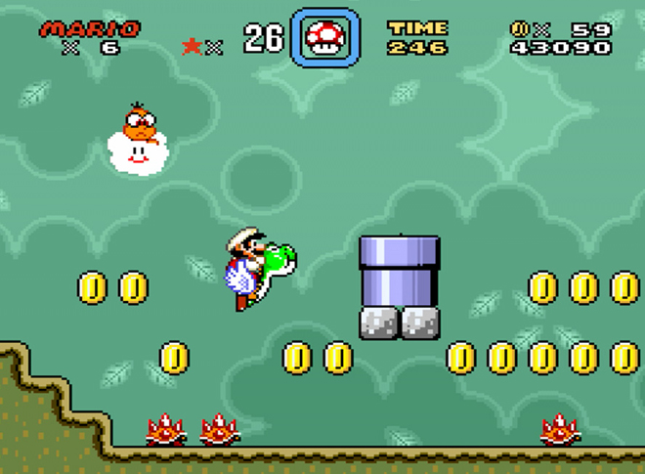
Reinforcement Learning (RL)
Objective:
Pick actions so that the cumulative rewards are maximized
Jargon:
Policy
Value of a policy
Notes:
Here is an illustration of the process:
The learning agent takes an action
This action has an effect on the environment
The agent perceives the new state of the environment
And receives an immediate reward
Let me illustrate it with a video game, Super Mario Bros:
This is the environment from the learning agent’s point of view.
The agent’s action is performed on a virtualized controller
The state is the video output of the game.
And finally the reward is the score, or rather should I say the points added to the score.
Algorithmically, is is very simple: perception, action, reward, and then it loops.
This is a stochastic process, meaning that two trajectories of the same agent in the same environment, starting from the same state, may be different.
Basically every step may have a random component:
The environment may react differently to the same actions. Easy to comprehend in a dialogue setting where every user would react differently, use different words, and say those words differently.
The agent may choose different actions in the same state.
The reward may also be randomized.
The objective of the learning agent is to pick actions so that the cumulative rewards are maximized.
In the Super Mario Bros example, we want to maximize the score.
RL mainly rests upon two functions:
The policy function determines the behavior of the agent: it returns an action, as a function of a state.
The value function of a policy determines how good is a policy in a given state.
It is the expectation of the cumulative reward.
The goal of Reinforcement Learning is to find a policy that maximizes the value.

Slide 5
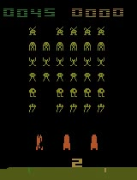
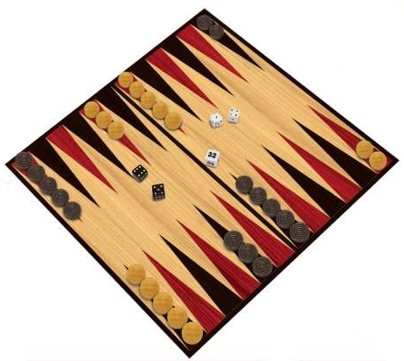

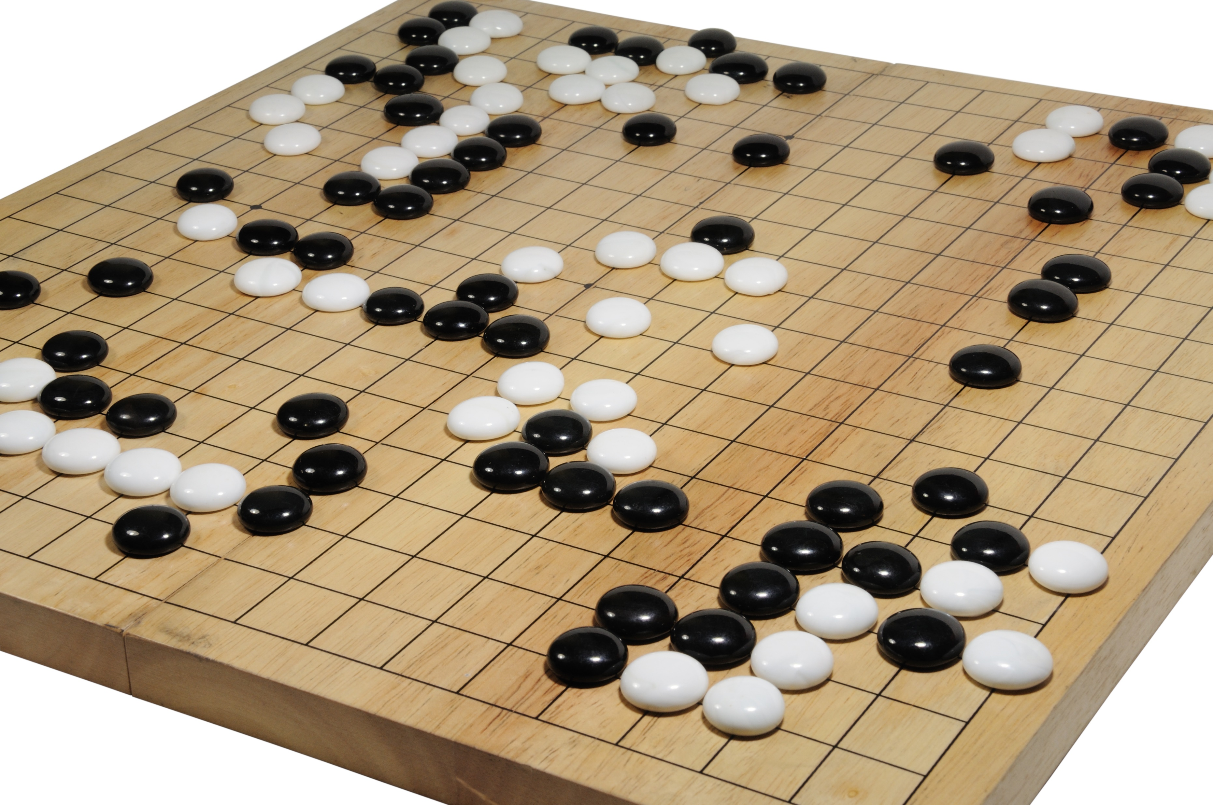
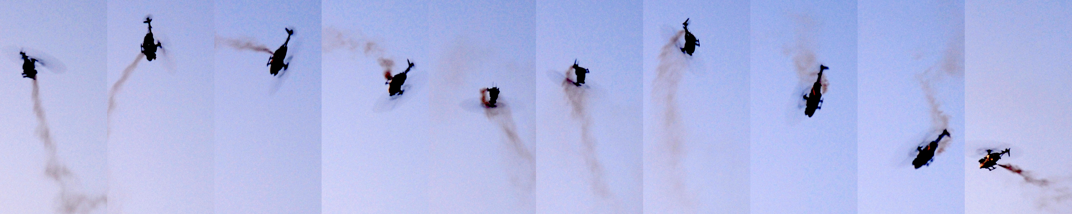
Some of the biggest RL achievements
Notes:
This slide recalls some of the biggest RL achievements so far. You may have heard about some of them.
In the early days of RL, in 92, IBM developed an AI capable of playing Backgammon.
It was almost as good as the best human Backgammon players at this time.
Between 2004 and 2008, Stanford RL team learnt how to control a reduced model helicopter, and learnt new acrobatics with it.
In this list because I was part of it, in 2010, Orange deployed the first commercial dialogue system optimized with RL.
Most of the dialogue was scripted.
The RL algorithm was only optimizing the system by choosing among several alternatives at each dialogue turn.
It improved by 15% the task completion.
In 2013, Deepmind invented DQN, an RL algorithm capable of playing Atari games from visual inputs.
DQN is the successful mix of Deep Learning and RL.
They obtained human level performance on a wide range of games.
Finally, in 2015, Deepmind started to have master-level performance in the game of Go.
To do so, they mixed deep RL and Monte Carlo Tree Search.
Their last learning architecture trains only by playing against itself, and is undefeated against humans.

Slide 6
Current RL limitations for real world application
Sample efficiency:
  Solving Ms. Pac-Man after 3,000 games
Reliability:
  Ensemble methods for RL
  Bootstrap with the baseline policy
Notes:
Despite these remarkable achievements, RL is still too limited to be applied to most real world applications.
First, the Deep RL algorithms are not sample efficient: they require billions of samples to obtain their results.
This is not reasonable to expect this number of samples in real world applications.
Our contribution to this issue is the following.
We induced some human prior knowledge into a Ms. Pac-Man agent.
We obtained state of the start performance with 1,000 times less data.
We finished the game in less than 3,000 games.
Another weakness of Deep RL algorithms is their unreliability.
Even worse, two runs with different random seeds may yield very different results because of the stochasticity in the reinforcement learning process.
We propose two ways of mitigating this.
First, if we cannot trust one algorithm, maybe we can run several algorithms in parallel and give control to the one with the highest performance.
This is an Ensemble method for RL.
Second, we observed that the system fails because it is over-optimistic in states where there is insufficient data.
In those uncertain states, we propose to just reproduce the policy that was used to get the data,
This way, we may guarantee the improvement of the policy.
We will walk through these contributions in detail.

Slide 7




The journey to beating Ms. Pac-Man
Harm van Seijen, Mehdi Fatemi, Joshua Romoff, Romain Laroche
Notes:
We start with Ms. Pac-Man.
This was actually a long journey, started without me by Harm, Mehdi, and Josh.

Slide 8
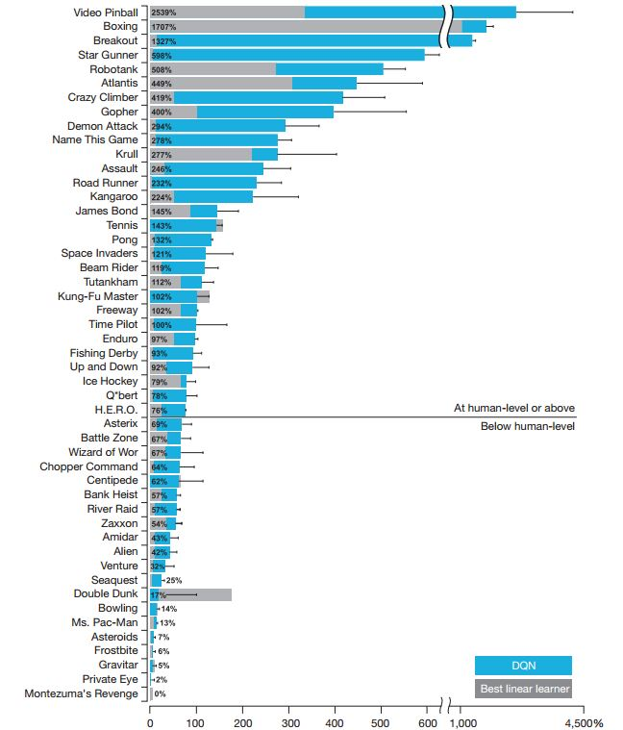
DQN on Atari 2600 games
Notes:
First, let me introduce Ms. Pac-Man and the state-of-the-art results.
The chart here represents the performance of the DQN algorithm over a benchmark of 50 games.
The scores obtained with DQN are compared with the scores obtained by a human.
Over the line are the games for which DQN is as good or better than the human.
Below are the hard games for DQN, and we can observe that Ms. Pac-Man is one of the hardest.

Slide 9
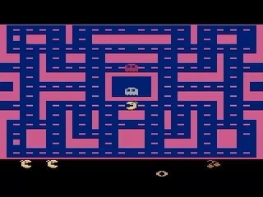
What is Ms. Pac-Man? Why is it hard?
~10⁵⁰ states, 9 actions
The value-function is not smooth
Notes:
Let me introduce the game.
The player is controlling the yellow circle head and the goal is to gather all the pellets on the screen, while escaping the ghosts.
There are also special objects like the power pellet that turn the ghost eatable during a short amount of time, and the fruits that grant some bonus points.
So, why is this such a hard problem?
1/ the number of states is enormous. More than on a chess board.
2/ The value-function is not smooth. Two close states may have a very different value.
Now, let’s start the journey to solving it.

Slide 10
Separation of Concerns
Main idea: Divide & Conquer
single task with multiple concerns → multiple agents
Actions
Action
Action
Action
1 task with 3 concerns
(A)
3 agents
(B)
3 agents
(C)
3+1 agents
Notes:
When I joined the group, they were already well advanced on the idea of Separation of Concerns.
The idea is similar to Divide and Conquer:
When a task is too complex to be solved, we might want to break it down into several subtasks of manageable size.
The subtasks are optimized with diverse agents, each one being responsible for one concern.
The agents may communicate and act on the environment.
Separation of concerns principle is very broad and allows for many learning structure.
Let’s say that we have one task with 3 concerns, for instance an agent that needs to eat, escape enemies, and sleep.
We may have 3 agents that are in charge of each concern, communicate together and each act on the environment.
But, it is generally preferable that one agent takes the final decision in order to enforce some consistency in the chosen actions:
In our previous example, the agent should not fall asleep while running away from an enemy.
Another structure is the one where the concerns are arbitrated by a 4th agent.
Now, the communication is unilateral towards this agent.
And we found that this is the structure that is the easiest to train.

Slide 11
Multi-Advisor RL
Main idea: Divide & Conquer
single task with multiple concerns → multiple agents
Action
Action
1 task with 3 concerns
3+1 agents
Notes:
We focused more precisely on this architecture which we called Multi-Advisor Reinforcement Learning, or MAd-RL in short.
The agents that are responsible for one concern are limited to a role of advisor, hence the name.
The top agent is called the aggregator and has for only purpose to choose the action to play thanks to the information provided by the advisors.

Slide 12

Pac-Boy (Fruit Collection)
Highest-value action
Divide & Conquer!
75 fruit advisors
2 enemy advisors
1 aggregator
sum
values
78 agents
Notes:
In order to test MAd-RL, we designed a small game similar to Ms. Pac-Man: Pac-Boy.
Let me introduce it to you.
The system controls the white square into a maze.
The walls are in grey.
The goal is to collect all the blue fruits.
But the agent has to avoid the red monsters.
They are moving randomly.
You are watching DQN playing right now.
As you can see, it is efficient at the beginning but fails to finish the board.
We propose to divide and conquer Pac-Boy.
We have 75 fruit advisors and 2 enemy advisors.
And of course the aggregator on top of it.
Now, the structure does not tell everything.
MAd-RL also dictates the following communication principle:
Each advisor predicts a value for each action with respect to its own concern
The aggregator makes the sums of the advisors value and selects the action with the highest sum.
You remember that the value of a state is dependent on the policy used in the future?
We will try out three versions.
Each version will consider a different policy for the advisors to compute the value of their concerns.

Slide 13






How to advise?
Egocentric
Agnostic
Empathic
Highest-value action
sum
values
Inconsistent planning
Fearful planning
Successful planning
78 agents
Notes:
Here, you can see the egocentric version play.
Each advisor returns the value of the optimal policy with respect of their concern.
It is called egocentric because the advisor does not care about the fact it is part of a larger system.
One can observe that the system is efficient at avoiding monsters but strangely stays in the middle.
This is because the pieces of advice consider inconsistent future actions.
In the end, the system believes it will be able to get all the rewards at the same time in the future which never happens.
This effect strongly prevents the task completion.
Here, you can see the agnostic version play.
Each advisor returns the value of the random policy.
It is called agnostic, because it considers uniformly every action that may be chosen next.
One can observe that the system is efficient at the start but it fails to finish the grid.
This is because it gets too fearful:
the small gain of eating the last fruit does not compete with the fear of getting hit by a monster, even when it is still far.
Here, you can see the empathic version play.
Each advisor returns the value of the system’s policy.
It is called empathic, because it tries to predict the next actions of the full system.
One can observe that the system is efficient from the start to the end.

Slide 14
Pac-Boy … … … Ms. Pac-Man
Highest-value action
Sum
Norm
ghosts
pellets
fruits
random
explore
~400 positions / map (4 maps)
1 agent / position
2 auxiliary agents for exploration
Normalization node to balance points vs survival
Notes:
Enough playing around with Pac-Boy.
Now, let us deal with the real challenge: Ms. Pac-Man.
Again, we Divide and Conquer.
400 agents: one for every position.
Two auxiliary agents are providing bonus values to improve the exploration.
Then, the positive agents are normalized to keep a good balance between the appetite for points and the fear for kill.
Finally, the positive and negative values are summed and the action with the highest value is selected.

Slide 15
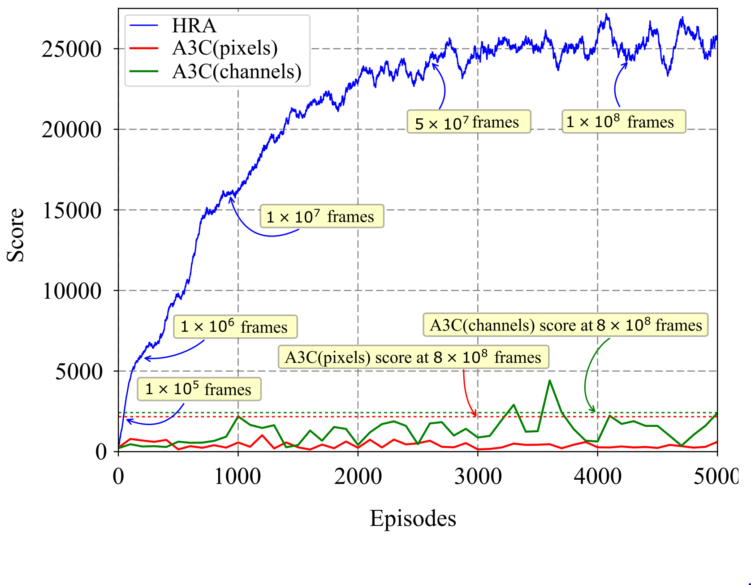
Learning curve
Highest-value action
Sum
Norm
ghosts
pellets
fruits
random
explore
Notes:
There is a lot of information on this figure.
Don’t worry, I’ll walk you through it.
The main information is that our Ms. Pac-Man agent, in blue, obtains a much better score than the state-of-the-art algorithms in red in green.
The dotted lines are their final performance after playing non-stop for 6 months.
Our system obtains the same performance after only playing 50 games.
The performance obtained by a mildly trained human is around 15k points.
This level of performance is obtained in less than 4 days of play.
****
However, we were nowhere close to the highest score ever obtained by a human which is ten times larger.
We have to use a new trick to achieve this level of performance.

Slide 16
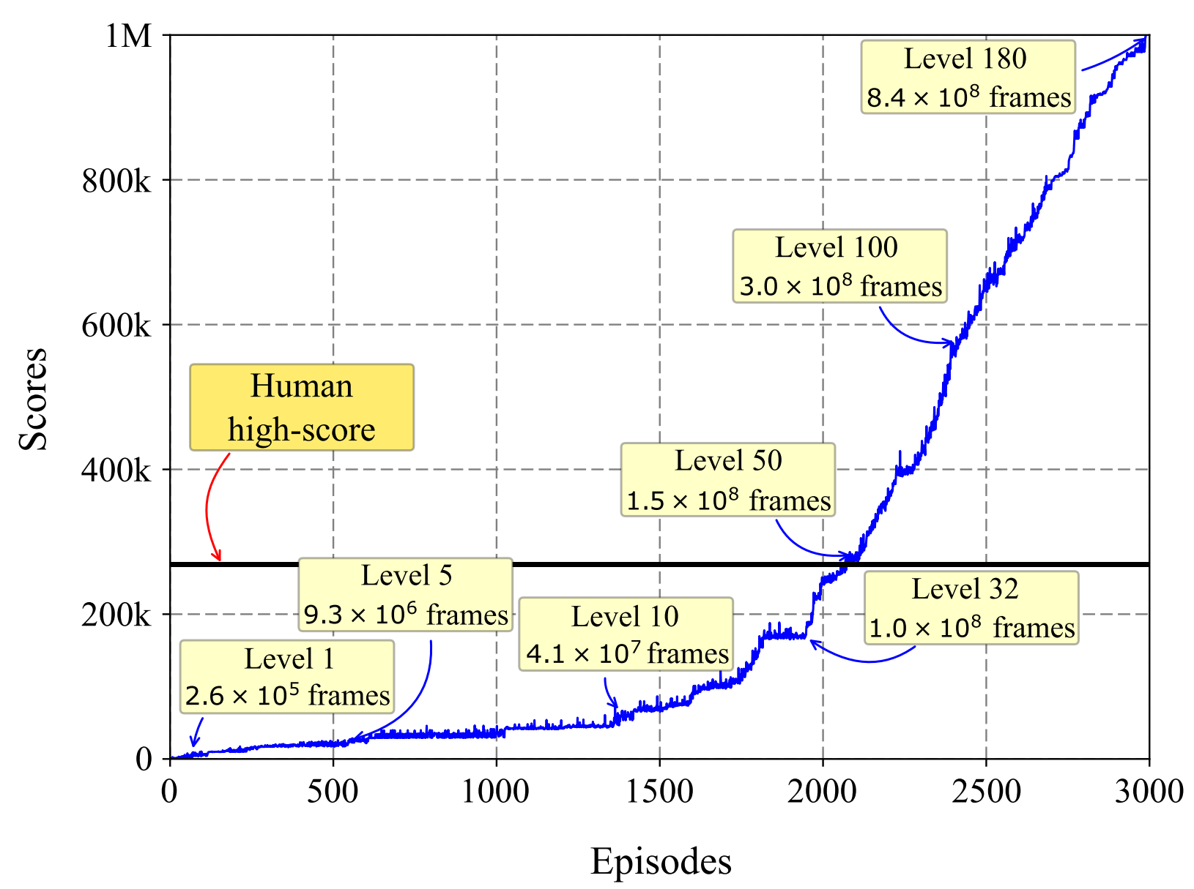
With executive memory
Highest-value action
Sum
memory
Norm
ghosts
pellets
fruits
random
explore
Notes:
We use the knowledge that the Ms. Pac-Man game is not stochastic.
It means that if you apply the same sequence of actions from the start of the episode, you will get exactly the same trajectory.
So we added an executive memory advisor:
Each time the system passes a level without being killed, this advisor records the sequence of action to perform it.
And then it forces it with a high value it in the next games.
After less than 3000 games, the agent was able to obtain the maximal score of 1,000,000.
One might argue that our agent is overdesigned for a learning agent.
But the fact is that our architecture allows to add a broad variety of expert knowledge while embedding Reinforcement Learning agents that optimize the system.

Slide 17




Make RL algorithms reliable again
Romain Laroche, Raphaël Féraud, Paul Trichelair, Kimia Nadjahi, Rémi Tachet des Combes
Notes:
Now, let us move to the second part of the keynote: reliability.
The reliability of an algorithm is its capacity to consistently deliver good results.
RL algorithms used to be reliable.
But, deep RL algorithms revolutionized the research with impressive empirical results.
Deep RL is clearly the future of RL, but it is dramatically unreliable.
The following section will present our contributions to making RL algorithms reliable again.
This is a joint work with Raphael, Paul, Kimia, and Remi.

Slide 18
Improve the Reliability with Ensemble Learning
Romain Laroche, Raphaël Féraud
Notes:
We introduced the idea of Ensemble of RL algorithms earlier:
If one algorithm is not reliable, then, we might use several of them and keep the best one.

Slide 19
Ensemble of RL algorithms with MAd-RL
Main idea: Select the best
MAd-RL idea: Divide and Conquer
Follow the best
Action
Action
1 concern
3 algorithms
Advisors
Notes:
This idea can actually be cast into the MAd-RL architecture.
Simply, instead of having one advisor per concern, we have several advisors in charge of the same concern.
Then, instead of having an aggregator, we have an algorithm selector on top of the advisors.
The algorithm selector chooses an algorithm to be in charge of the next episode.

Slide 20
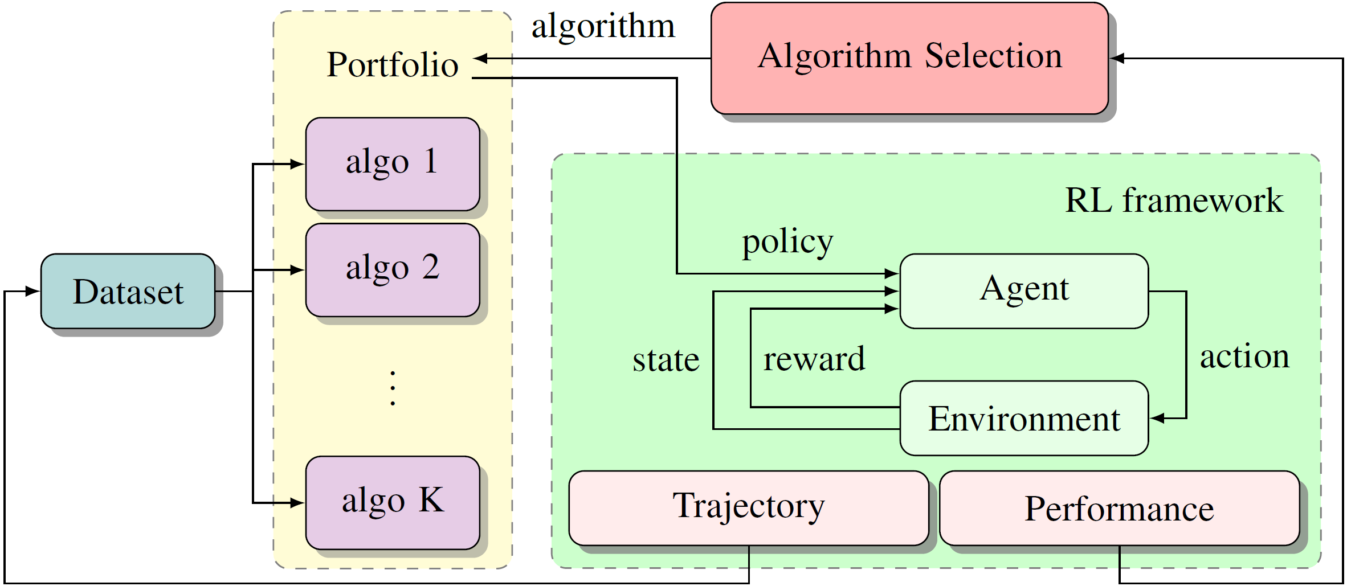
Ensemble of RL algorithms: architecture
Notes:
The algorithm selector is on the top in pink.
At the beginning of each episode, it selects an algorithm.
This algorithm outputs a policy that is going to be used during the whole next episode.
Then, in green, the standard RL loop runs until the end of the episode.
The trajectory is recorded and fed to the algorithms.
The performance measure is sent to the algorithm selector.
Based on previous performance of the algorithms, the algorithm selector then chooses again an algorithm for the next episode.

Slide 21
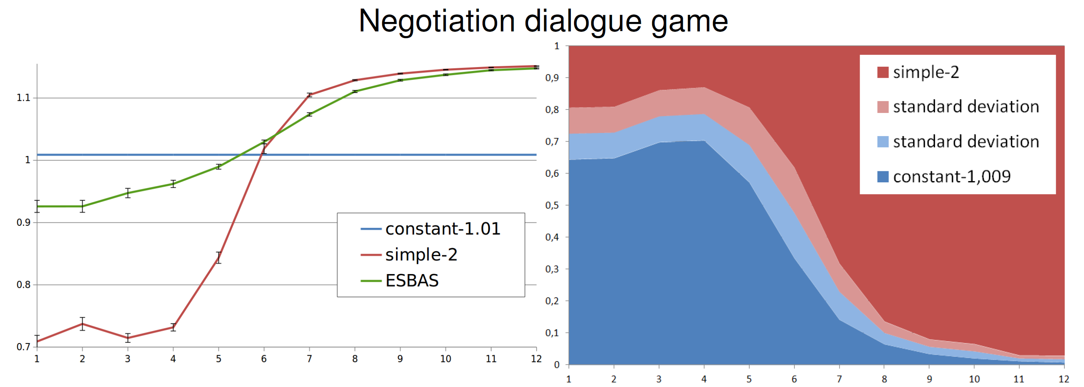
Ensemble: preliminary results
Follow the best
ESBAS
constant
learning
2 algorithms
time
time
Notes:
Now, let’s see the experiments.
The preliminary experiments were led on some negotiation dialogue game.
I will not have time to give details on the domain.
Let us focus one particular ensemble setting.
Our ensemble system, denoted by ESBAS, is composed of only two algorithms:
One algorithm that generates constantly the same policy with performance 1.
One algorithm that learns over time.
On this graph, one can see the performance of each algorithm over time:
The constant one in blue, which has a… constant performance
The learning one in red, which is improving over time.
ESBAS, in green, has a performance that is near of that of the best algorithm at each time step.
Overall, it has a better performance than any of the 2 algorithms.
The graph at the right shows the frequency of selection of each algorithm.
As expected, we observe that it selects the constant algorithm more often at the beginning of training, and then, the learning one as soon as it outperforms the constant algorithm.

Slide 22
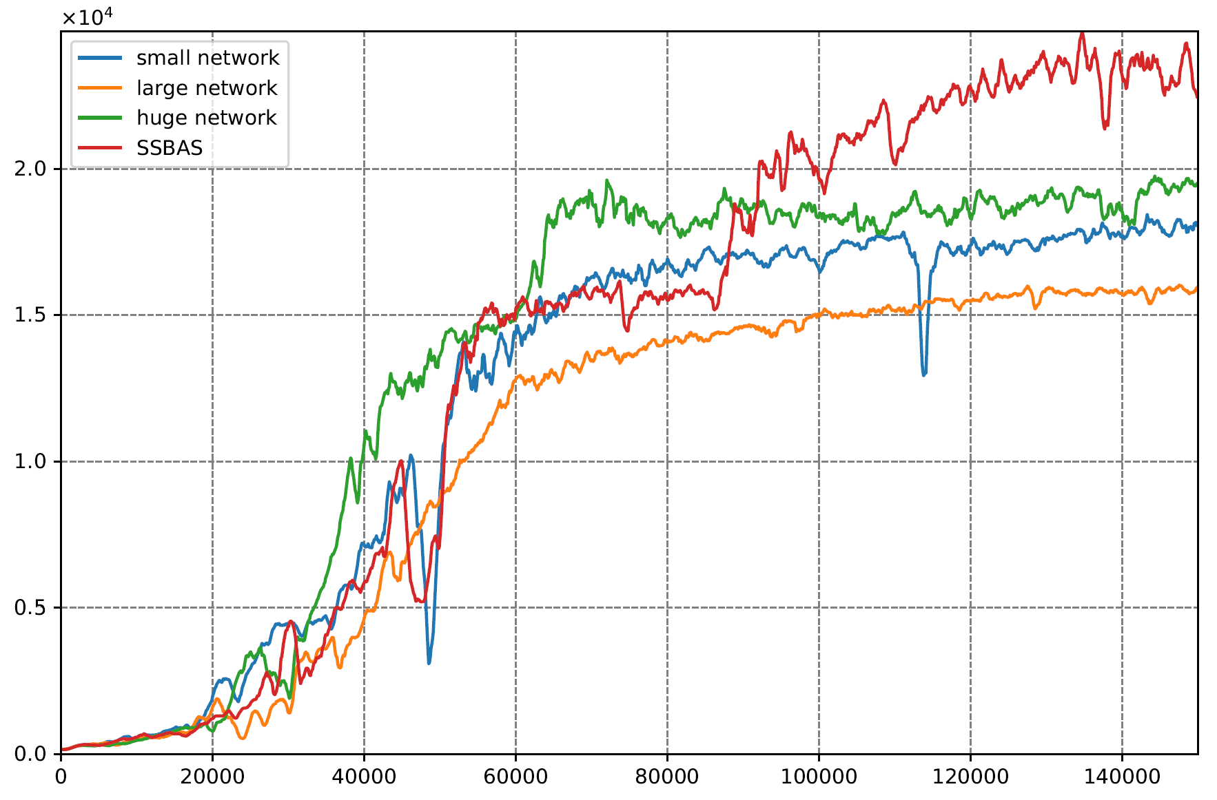
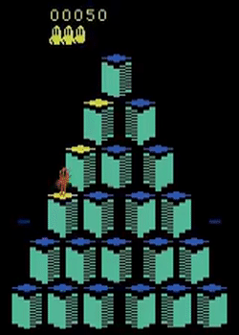
Ensemble: Q*bert
Ensemble
Staggered learning
Objective function
Diversity
Transfer
Notes:
We pursued the empirical validation on an Atari game called Q*bert.
We made several DQN architecture compete, and found out that our system, in red, yielded a better performance than any architecture on its own.
We have argued before that ESBAS improves the reliability of the RL algorithms, but it has actually a lot of other virtues:
It allows staggered learning: preferentially use the algorithm with the best policy at each time step.
It also allows to use objective function that may not be directly implemented as rewards. For instance it allows to enforce safety constraints.
Moreover, we observed that the ensemble of policies generate more diverse experience about the environment. And more diverse usually means richer in information.
And finally, as we have seen with the constant algorithm, it allows to transfer smoothly between a baseline policy and a learnt policy.
We will pursue on this last idea next.

Slide 23
Reliable Batch Reinforcement Learning
Romain Laroche, Paul Trichelair, Kimia Nadjahi, Rémi Tachet des Combes
Notes:
Our other take at improving the reliability of RL algorithms focuses on one specific setting, often encountered in real world applications: Batch reinforcement learning.

Slide 24

Batch Reinforcement Learning
Trajectories
New policy
Baseline
Standard RL algorithm cannot reliably improve the baseline.
Reliability is crucial because if a policy is bad, it will be for many trajectories.
Reliability performance: CVaR.
Notes:
As compared to the classical setting presented in the introduction of my talk,
the learning agent does not interact directly with the environment.
Instead, it is a baseline agent.
It is fixed and is used to collect data.
The trajectories are stored.
And then fed to an algorithm to generate a new policy.
The batch setting is a constraint that we commonly encounter in the real world scenarios:
Dialogue systems are generally deployed on personal devices, which makes it difficult to update too frequently.
It is the same with video games.
In other settings such as pharmaceutical tests , the time scale is so long, we are talking about several years, that you need to run the trajectories in parallel, hence with the same policy.
It is the same with crop management.
Classic RL algorithm improve on average the baseline, but unfortunately, cannot do it reliably.
Reliable policy improvement is crucial because if a policy is bad, it will remain bad for many trajectories,
Since the updates are rare.
We want the algorithms to almost always improve the baseline policy.
In order to look at the worst-case scenarios, we look at the CVaR.
CVaR, for conditional value at risk, is actually a simple concept: it is the average of the worst runs.
Here, a run is defined as the batch process shown on this slide: data collection and policy training.
1%-CVaR therefore means the average of performance over the 1% worst runs.

Slide 25
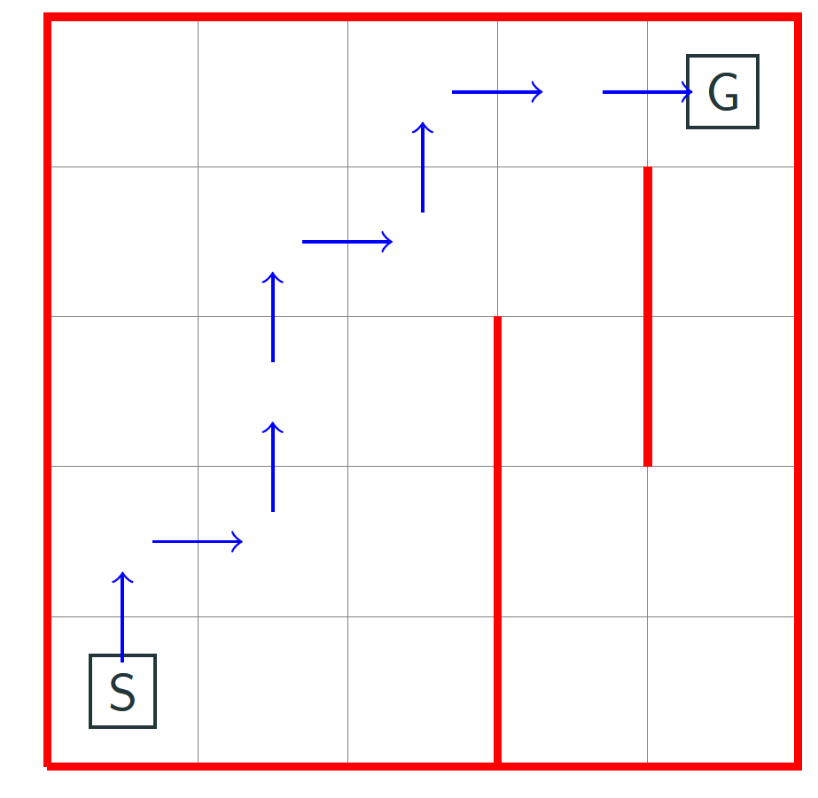
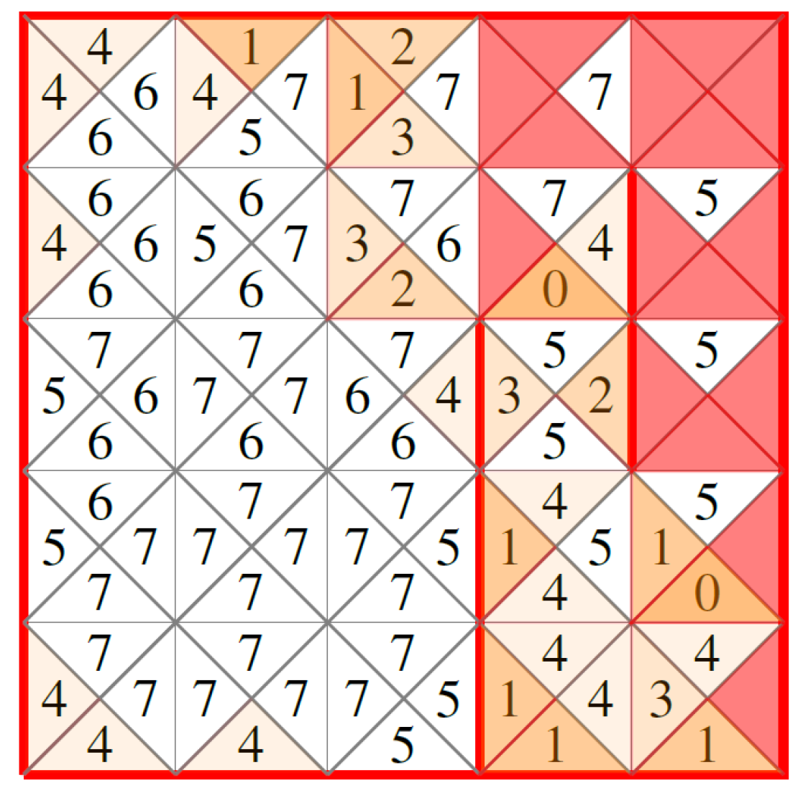
Illustration of Policy Improvement failure
Stochastic gridworld:
5x5 states, 4 actions
Reward: +1 when reaching the goal
Transitions:
  75% chance in the chosen direction
  10% chance each sideway
  5% chance backward
Log₁₀ counts after 12 millions trajectories
Notes:
We provide now an illustration of why it fails.
First, let me describe the gridworld environment we consider.
25 states, 4 actions
The agent starts from its initial position, marked with the letter S.
A reward is obtained when reaching the goal, marked with the letter G.
The transitions are made stochastic so that it has:
75% chance of going in the specified direction
10% chance of going each sideway
And 5% chance of going backward.
When it hits a wall, it simply does not move, without penalty.
Our baseline policy, which is used to collect the dataset is a randomized policy around the optimal policy, such that it avoids hitting too often the walls.
Now, we look at the state-action counts after generating 12 million trajectories with this baseline.
The numbers are the log10 counts.
Here is how it reads.
Every square state is split into 4 triangles, one for each action.
For instance, from the initial state, there are more than 10 millions records of actions going up.
Because of stochasticity, it does not mean the agent really went up, but it was its decision.
We observe that some actions are played much more often than others.
There are even actions that were never played: the red triangles.
One therefore observe a very unbalanced distribution over the state-action pairs.
As a consequence, the learning algorithm that only has the dataset for information, has many blind spots, on which it might rely too much.
And as a results, classic RL occasionally trains policies that are very bad in the true environment.
****
Actually, it is worse than that.
Reinforcement Learning will search and find a way to optimize the objective function.
It has been showed to be effective at finding and exploiting glitches in games, which is fun in this context.
But in a batch setting, you do not want your algorithm to exploit glitches,
because the glitches are likely to be fantasized from the blind spots in your data.
And the more complex the domain is, the more blind spots you get.
Therefore, we need to make sure that our algorithm is careful with the blind spots.

Slide 26
Baseline Bootstrapping
SPIBB main idea:
  If you don’t know what you are doing, just don’t do it.
  More precisely:
    if there is sufficient data to support the policy change
      ➔ It is allowed to change and improve the policy
    Otherwise:
      ➔ It is forced to reproduce the baseline policy
Soft-SPIBB main idea:
  Same idea, except the policy is allowed changes inversely proportional to the measured uncertainty
Notes:
We solve this by designing a new algorithm called SPIBB.
It consists in implementing the following rule to the policy update:
If you don’t know what you’re doing, just don’t do it.
More precisely:
If there is sufficient data to support the policy change, then it is allowed to do so
Otherwise, just reproduce the baseline policy that was used during the data collection.
Soft-SPIBB is a variant of the same idea with a softer rule:
- The policy change is allowed to be inversely proportional to the measured uncertainty.

Slide 27
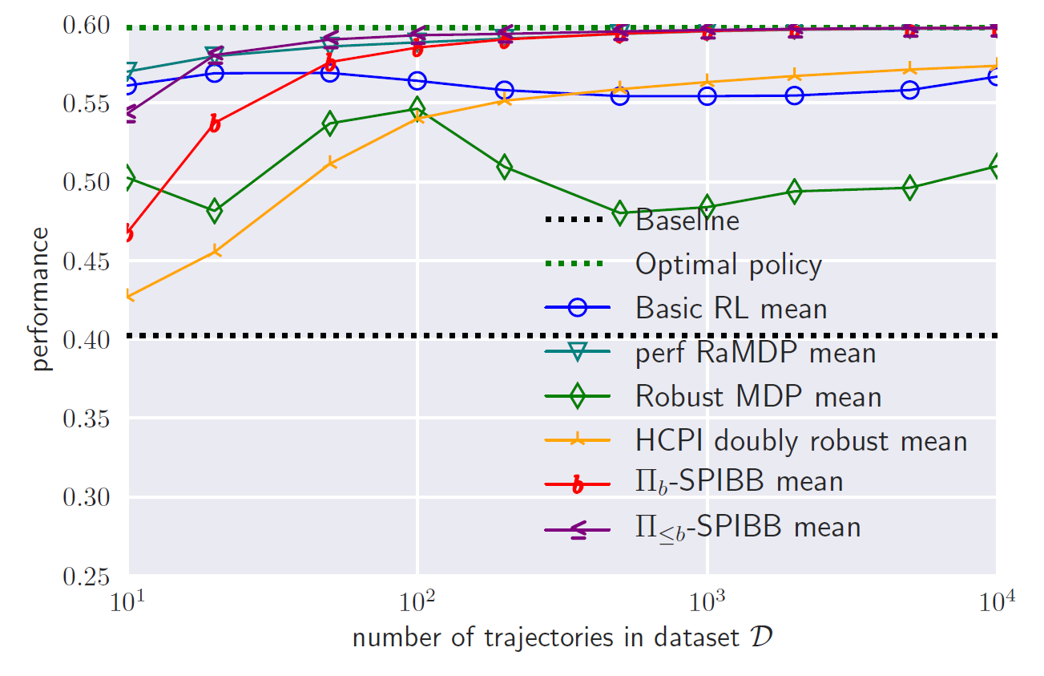
Gridworld benchmark (mean score)
Notes:
We perform a benchmark on the gridworld environment.
Depending on the size of the dataset, displayed on the x-axis on a log-scale, we observe the average performance of several algorithms in the literature.
The baseline performance is shown as a black dotted line in the middle of the figure.
All the algorithms improve it, on average.
We display two variants of the SPIBB algorithm, in red and in purple.
Both are among the best algorithms in mean score.
In particular, we observe that the classic RL, showed in blue, surprisingly does not really improve with the size of the dataset.
The only algorithm on-par or even arguably better than SPIBB is RaMDP, in light blue, which has two shortcomings:
- It relies on a hyperparameter that needs to be very finely tuned.
- And it is not as reliable as the SPIBB algorithms. We will elaborate on that right now.

Slide 28
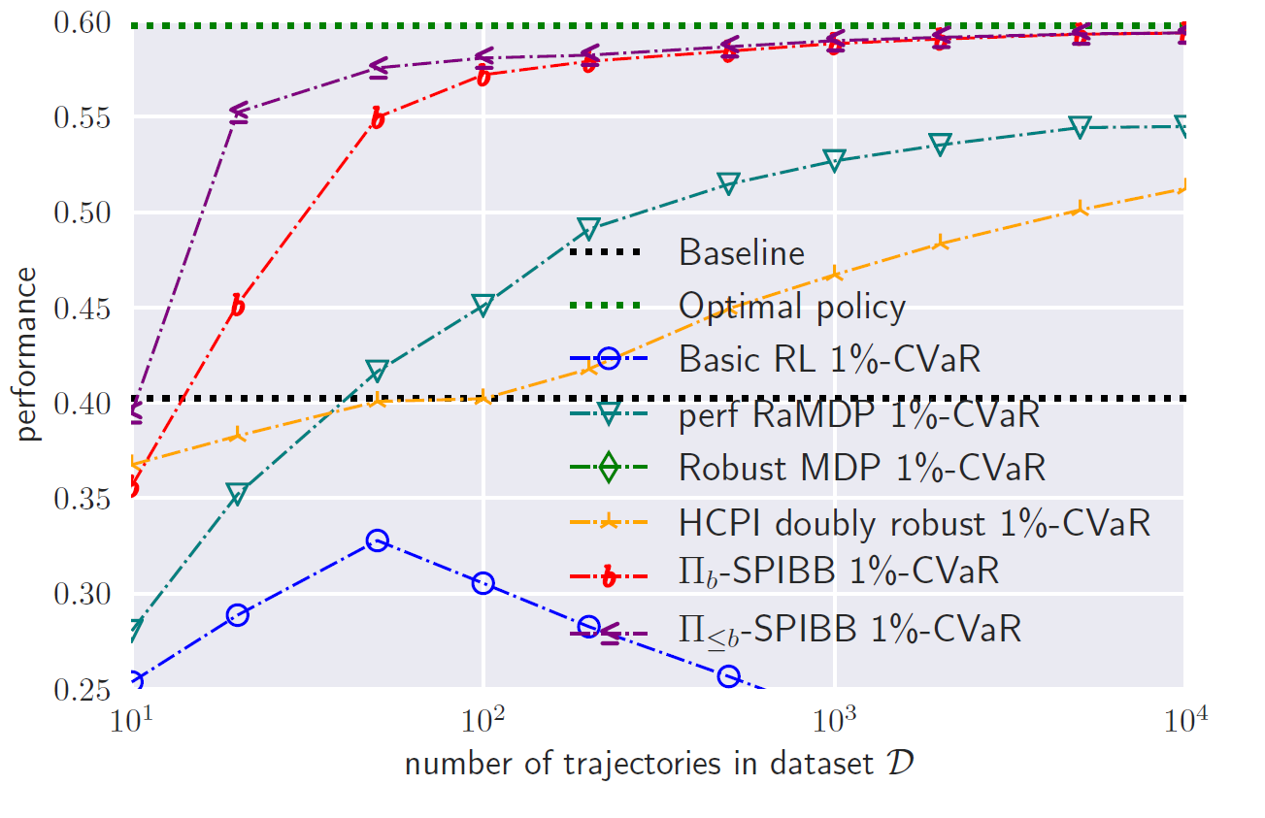
Gridworld benchmark (1%-CVaR)
Notes:
Last figure was the mean performance, but we are more interested in the reliability of the trained policies.
We show on this figure the 1% CVaR.
We observe that basic RL, in blue, is absolutely unreliable.
The best algorithms are the versions of SPIBB by a wide margin.
As announced earlier, RaMDP is unreliable with small datasets.
We have obtained similar results on small random environments, with random baselines.
We also have formal proofs of the reliability of SPIBB.
Finally, we demonstrated SPIBB efficiency and reliability on a larger continuous navigation task, using Deep RL with even better results in comparison with the other algorithms.

Slide 29


Concluding remarks: still a lot to do
?
B
B
?
?
A
C
A
D
Structure Learning
Transfer Learning
A
B
A
B
A
C
Curriculum / Lifelong Learning
Notes:
Still a lot to do:
In structure learning: to automatically infer the efficient structure for learning and solving a new, complex task,
In transfer learning: to use the knowledge from previous tasks to speed up the learning,
In curriculum / lifelong learning: to continuously learn new knowledge without forgetting, and to build up from elementary tasks to more and more complex tasks,
In safety: to be able to learn in the real environment without risking lives/equipment,
In fairness: to ensure that policies are not discriminating against people.
We currently work on all these subjects at Microsoft Research Montreal.

Slide 30
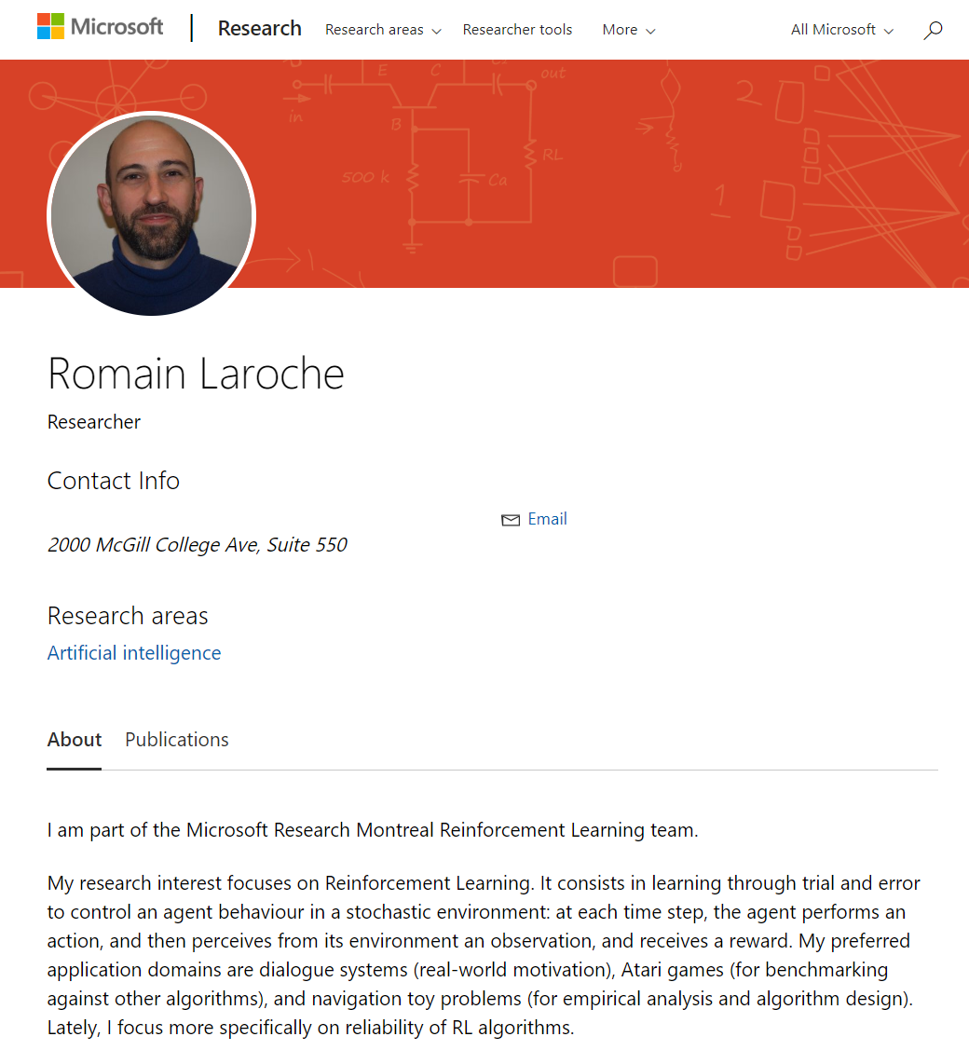

Concluding remarks: follow-up
On my page: http://aka.ms/rl, you can:
  Find and read my papers:
    the ones I presented today,
    and the older ones (lots on dialogue),
E-mail me at romain.laroche@microsoft.com:
  for any question,
  for job application, we are recruiting:
    interns,
    postdocs,
    full-time ML researchers,
    and full-time ML engineers.
Notes:
On my Microsoft research page aka.ms/rl, you can:
Find the papers I presented today,
Discover my other papers, a lot on dialogue systems,
And you can find my e-mail, which you can use:
for any question,
for job application, we are recruiting interns, postdocs, full-time ML researchers, and engineers.

Slide 31


^{Microsoft Learn for Free!}
Новые технические интерактивные тренинги, step-by-step инструкции и Hands on Labs.
Новый подход к обучению AI.
Зарабатывайте баллы, переходите на новые уровни и добивайтесь отличных результатов!
Start today at Microsoft.com/Learn
Notes:
And to finish, a small advertisement for Microsoft Learn.
You can build your skills fast with free, interactive tutorials at Microsoft Learn, a new training experience for technical users.
Step-by-step training to fit your schedule
Interactive coding environments for hands-on experience
Earn achievements and recognition for your Azure skills

Slide 32
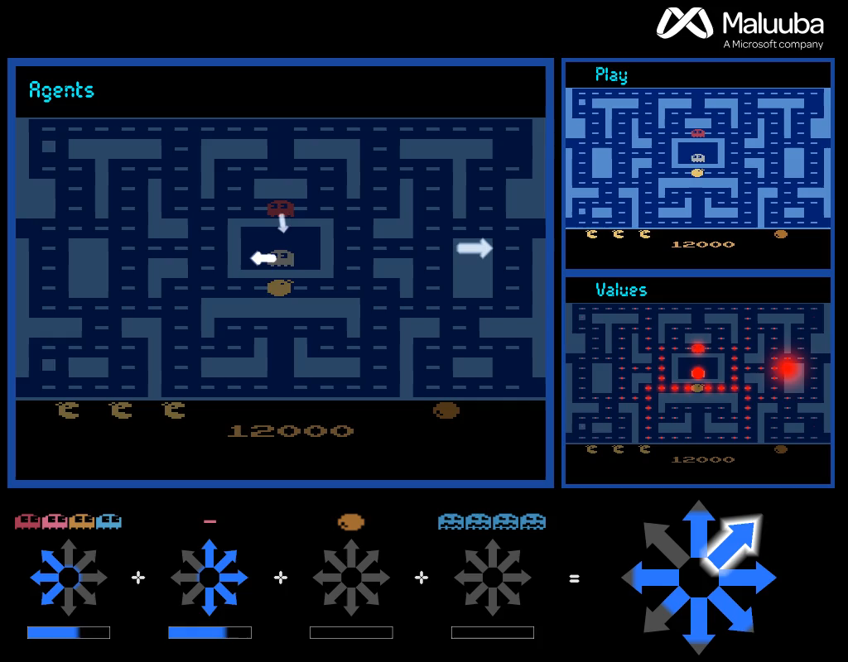

Questions ?
Notes:
Thanks again to my colleagues without whom none of this would have been possible.
Thanks to the organizers for inviting me.
And thank you all for your attention.

