Slide 1

Microsoft Design Expo

Slide 2
Design Expo
Goal:
  Awareness of trends/themes across students & international design community
  Foster long term relationships with top design schools.
2008 Topic: Learning & Education
Notes:
You are invited to the 4th annual Microsoft Research Design Expo!!!!
The 2007 design expo explores how health and wellness can be improved via use of technology, from promoting wellness and life balance, to addressing difficult health related issues, to addressing healthcare systems and tools. Projects reflect the local culture and healthcare issues, from Brazil, to Hongkong, to India, to the Netherlands, to the United States.
The goal of the Microsoft Research Design Expo is to build long term relationships with top design schools around the world, and identify trends in a particular topic of interest.
Each school holds a class, where student teams identify problems and prototype solutions.
Participating schools then choose one team per school, to come to Microsoft to present their work at the Microsoft Research Faculty Summit.
This program is sponsored by MSR, and is run in collaboration with the design & user research community across Microsoft.
Please feel free to forward this mail, and please come and show your support for the design community!
Thanks!
Lili, Curtis, Bill, Steve, Surya, Kentaro, Marieke, Brian, Georg, & Mike

Slide 3
Art Center College of Design
Brian Boyl, Steve Montgomery, Marty Smith<>Craig Hally-XDR
Technische Universiteit Eindhoven, Dept. of Industrial Design, Netherlands
Oscar Tomico, Joep Frens, Caroline Hummels, <> Sanders Viegers-Office
Central Academy of Fine Arts, Beijang
Dean Ma Jong, Fei Jun Dave <> Vronay-ATC Beijang
Rhode Island School of Design
Lorna Ross, <> Adrienne Gibson (O’Donnell)-XDR , Daniel Robbins-MSR Redmond
Carnegie Mellon, Department of Design
Shelley Evenson, <> Monica Gonzales- Office
University of Washington, Interaction Design Division of Design
Axel Roesler , Sharon Oviatt <> Georg Petschnigg-Pioneer Labs
Universidad Iberoamericana, Mexico City
Jorje Meza Aguilar, <> Andy Cargile-Hardware
Srishti School of Art, Design, and Technology, Bangalore
Gabriel Harp, Geetah Narayanan <> Leo Burd-Learning
Dundee University, Scotland, UK
Polly Duplock, Jon Rogers <> Richard Banks-MSR Cambridge

Slide 4
Process
Select schools, MSFT liaisons, & topic
Schools receive small $ grant
Semester long course
Team-based interdisciplinary projects
  9 schools, 3-8 team based projects per school
  Iterative design process
Today’s presentation
  One team selected by school to present @ Microsoft
  Feedback from Microsoft liaisons
Notes:
Each school holds a class, where student teams identify problems and prototype solutions.
Participating schools then choose one team per school, to come to Microsoft to present their work at the Microsoft Research Faculty Summit.
This program is sponsored by MSR, and is run in collaboration with the design & user research community across Microsoft.

Slide 5
Agenda
Students team present 10 minute “elevator pitch”
Product concepts not products ;-)
Feedback from our critics:
  Joy Mountford: IDBIAS
  Michael Kasprow: founder Trapeze
  Anoop Gupta: Corporate VP, Education, Developing Economies & Technical Strategy @ Microsoft

Slide 6
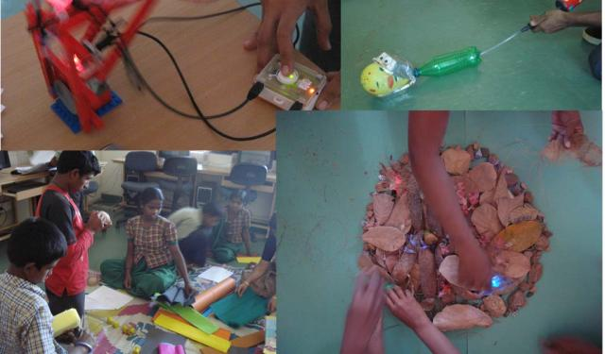

Slide 7


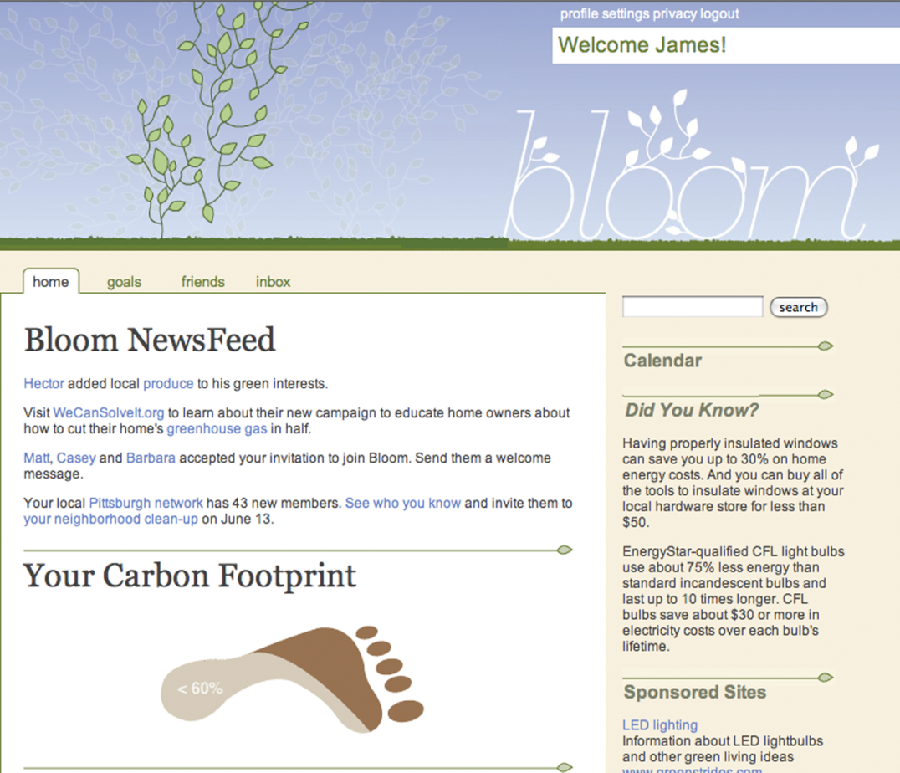
A software service and social
networking tool that connects users
with other people and trusted
information, so they can learn to be
more green.
Leanne Libert, Phil Robinson,
Kara Tennant, and Alexander Cheek

Slide 8
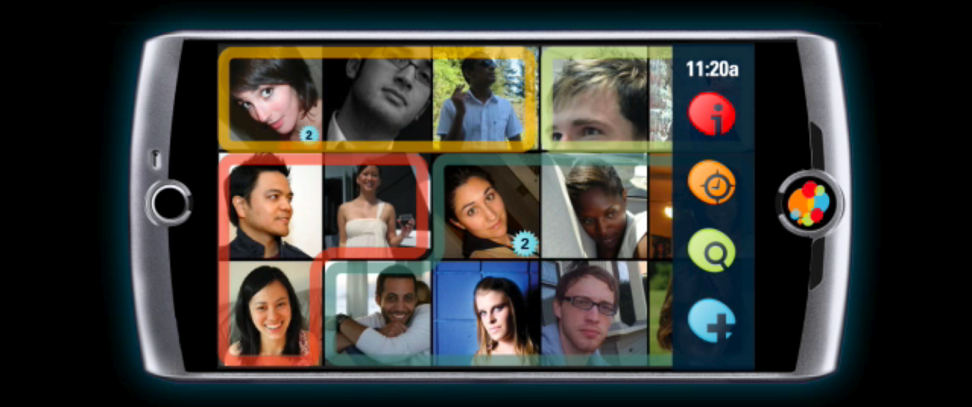
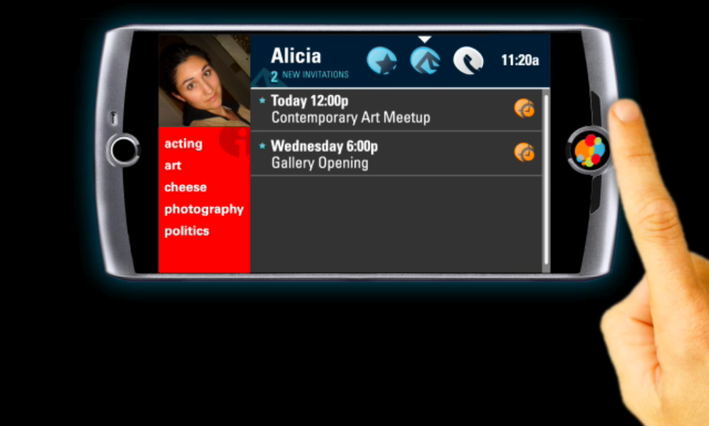
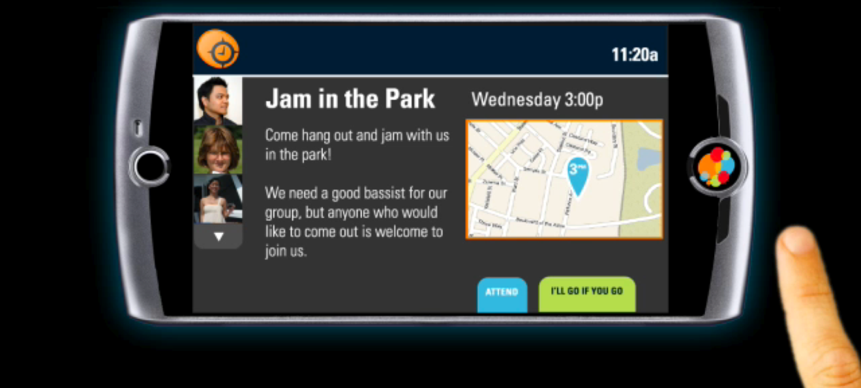
indigo
A communication service that connects people to the ideas and events they want to learn about through other people, context awareness, and direct manipulation interface
Renna Alyassini, Julina Golze,
Paul Robare, Steve Selzer, and
Kyle Vice

Slide 9
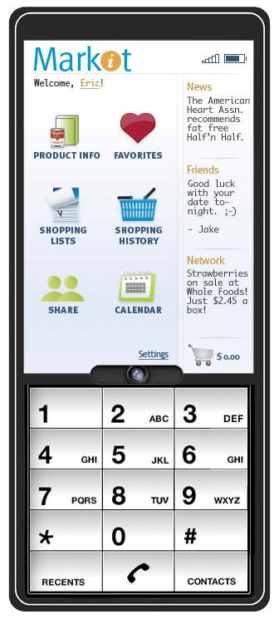
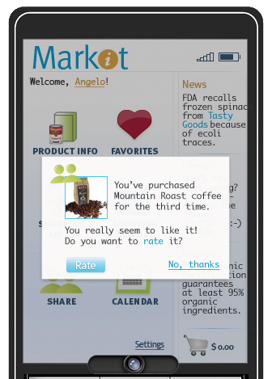
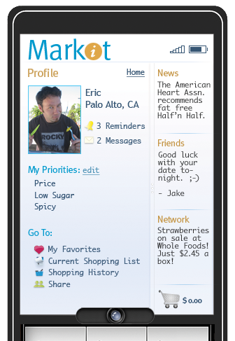
markit
An application that helps users reflect on their consumer behavior, & align shopping decisions with priorities… even as their priorities change over time
Chris Michaelides, Wiebke Poerschke, Wei Zhou, and
Marina Posniak

Slide 10
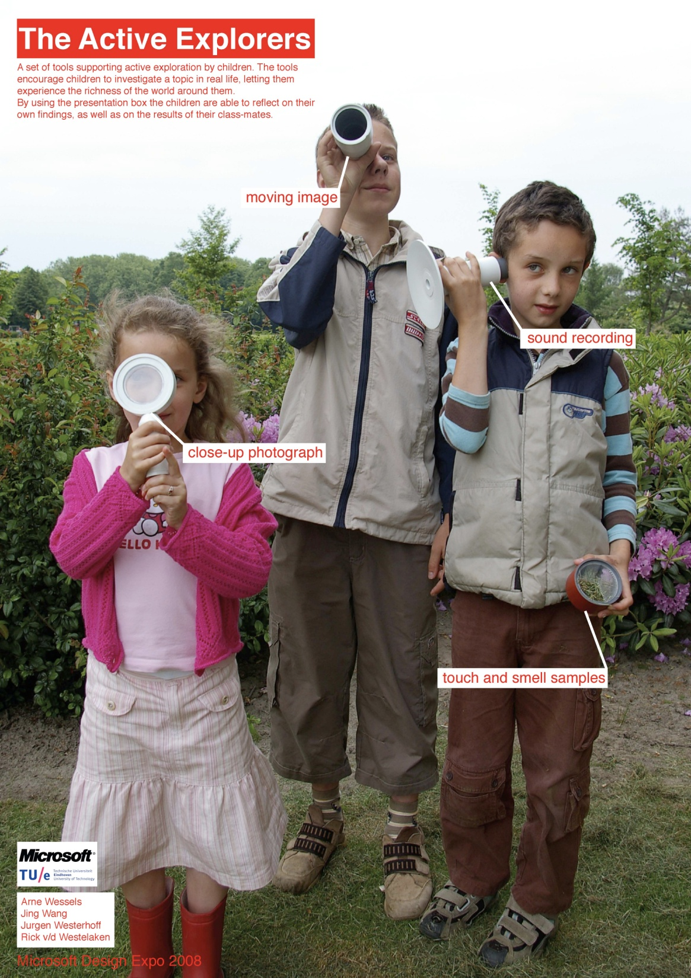

Slide 11
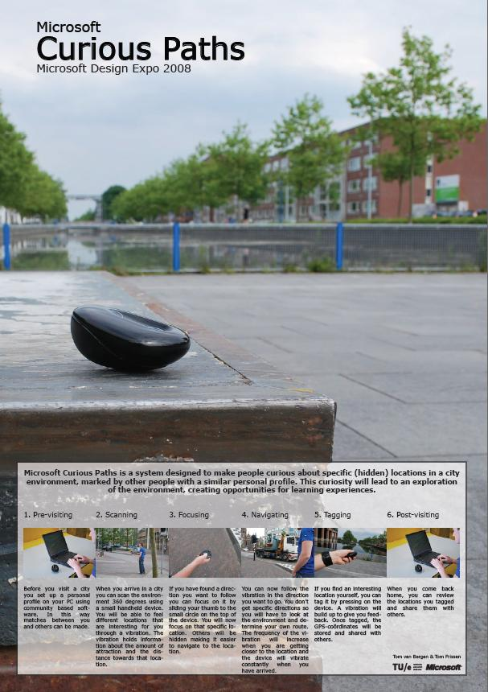
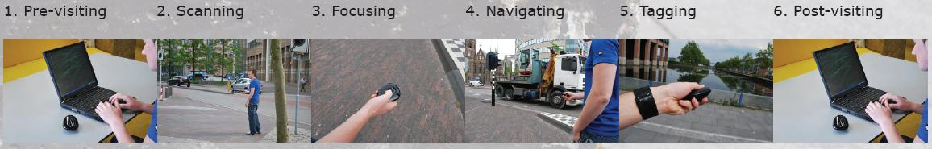

Slide 12
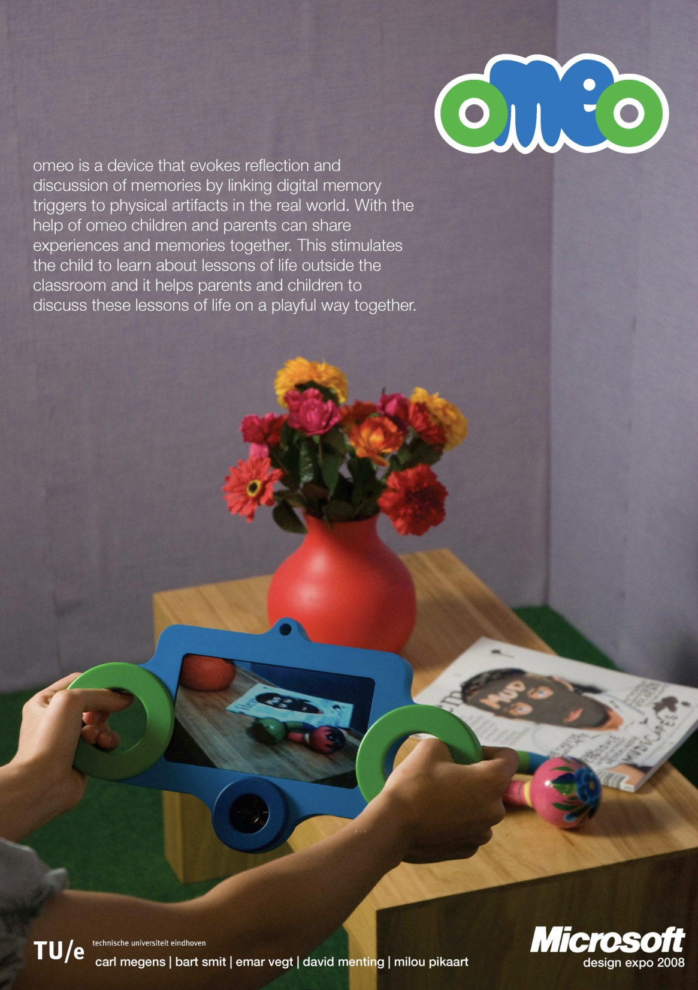

Slide 13
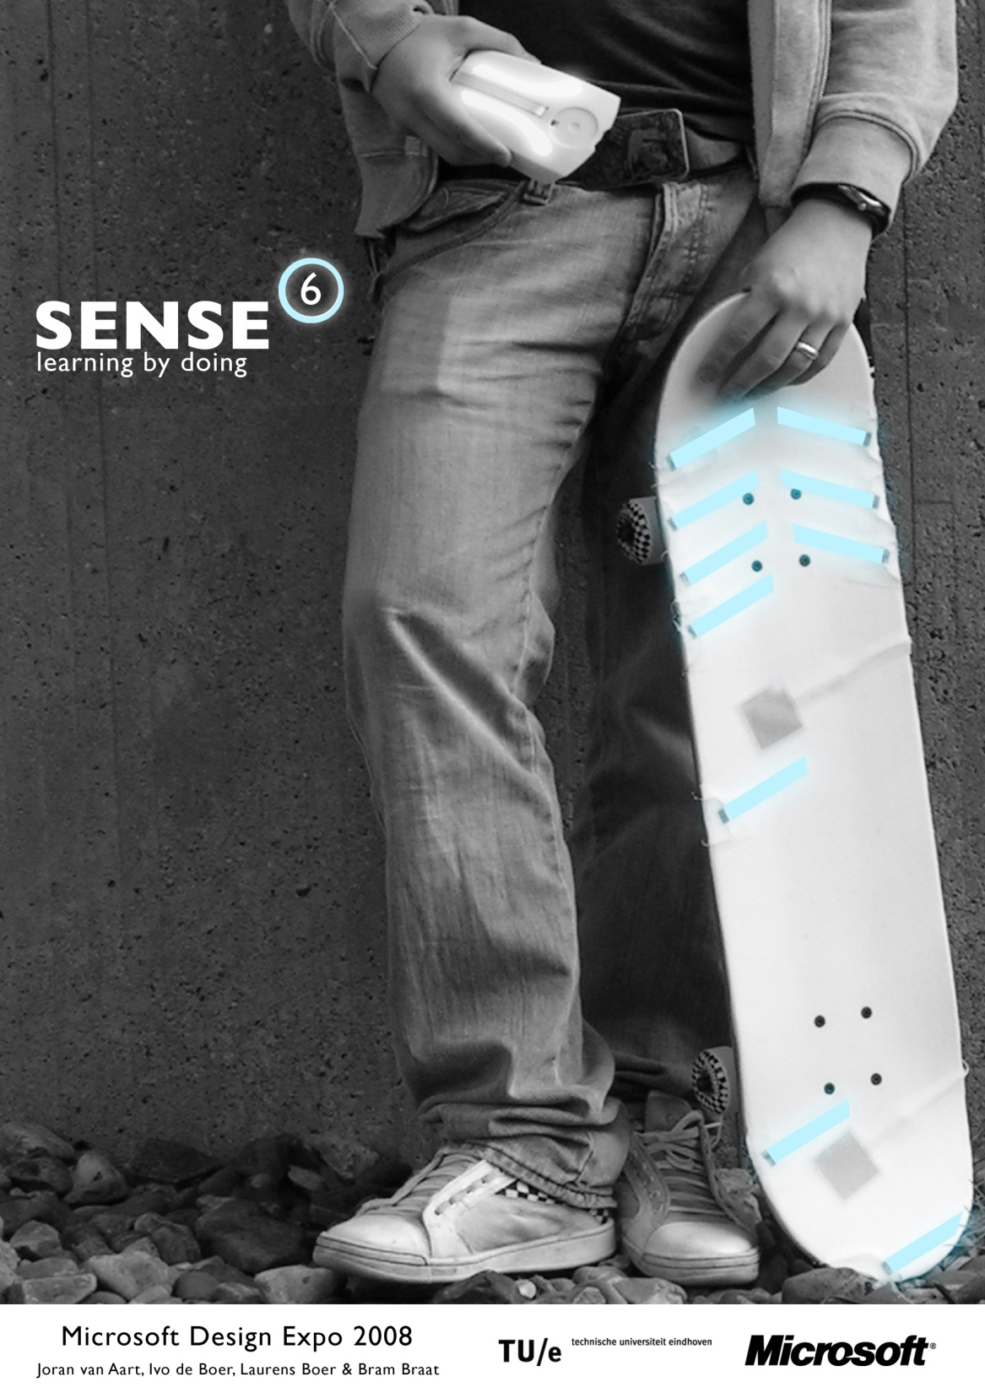

Slide 14
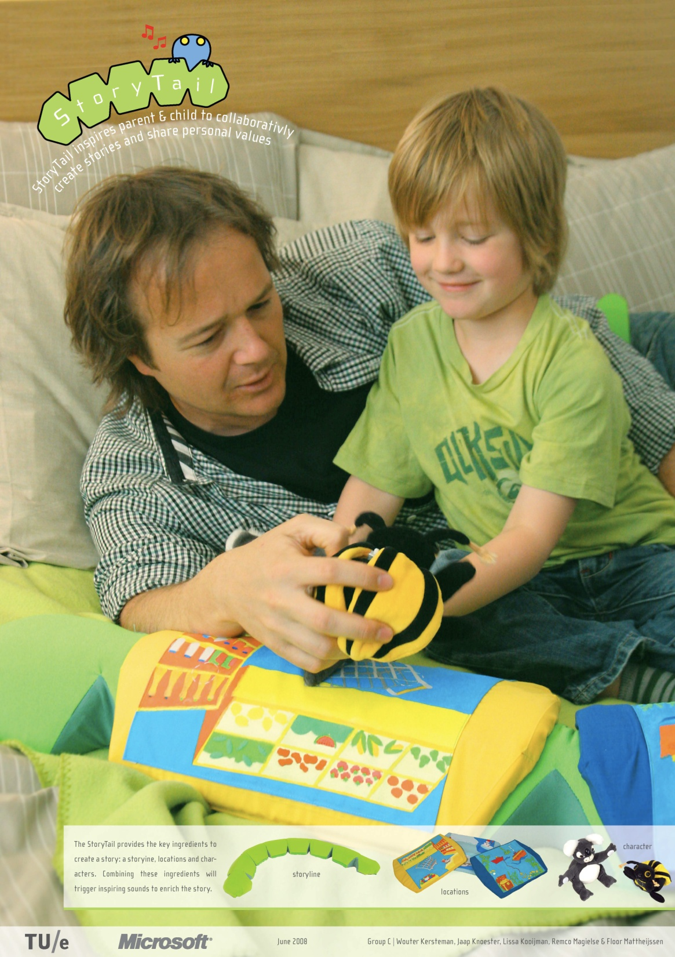

Slide 15
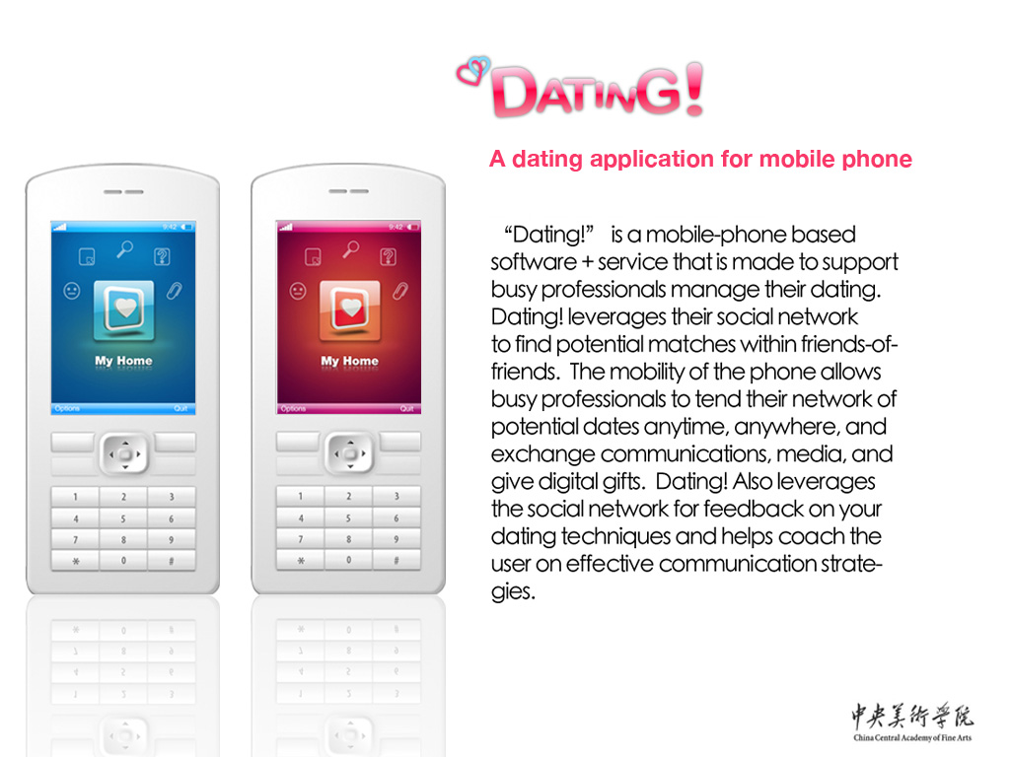

Slide 16
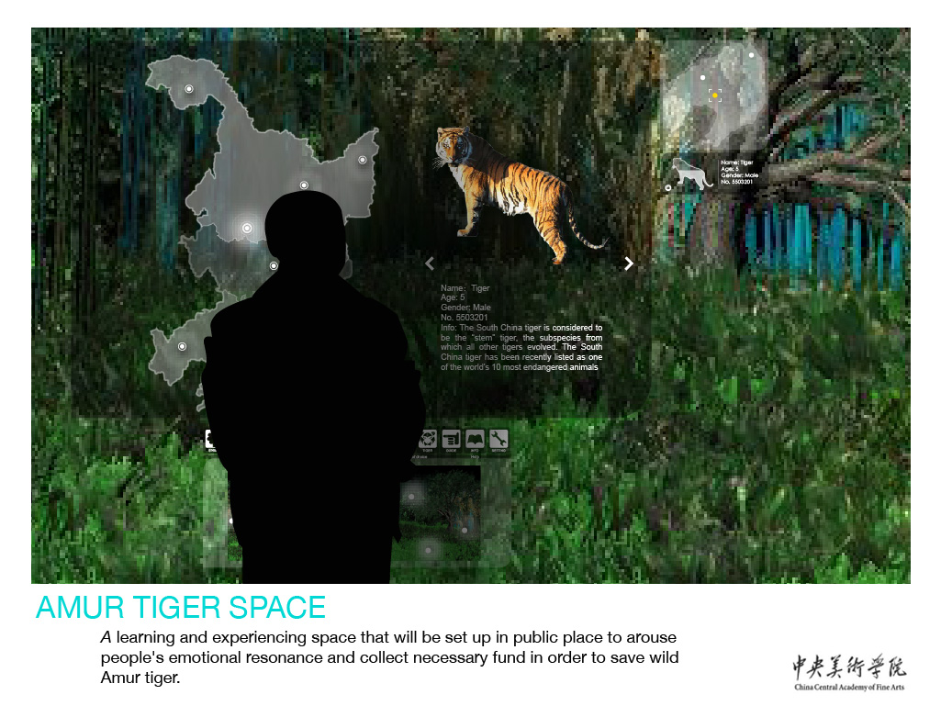

Slide 17
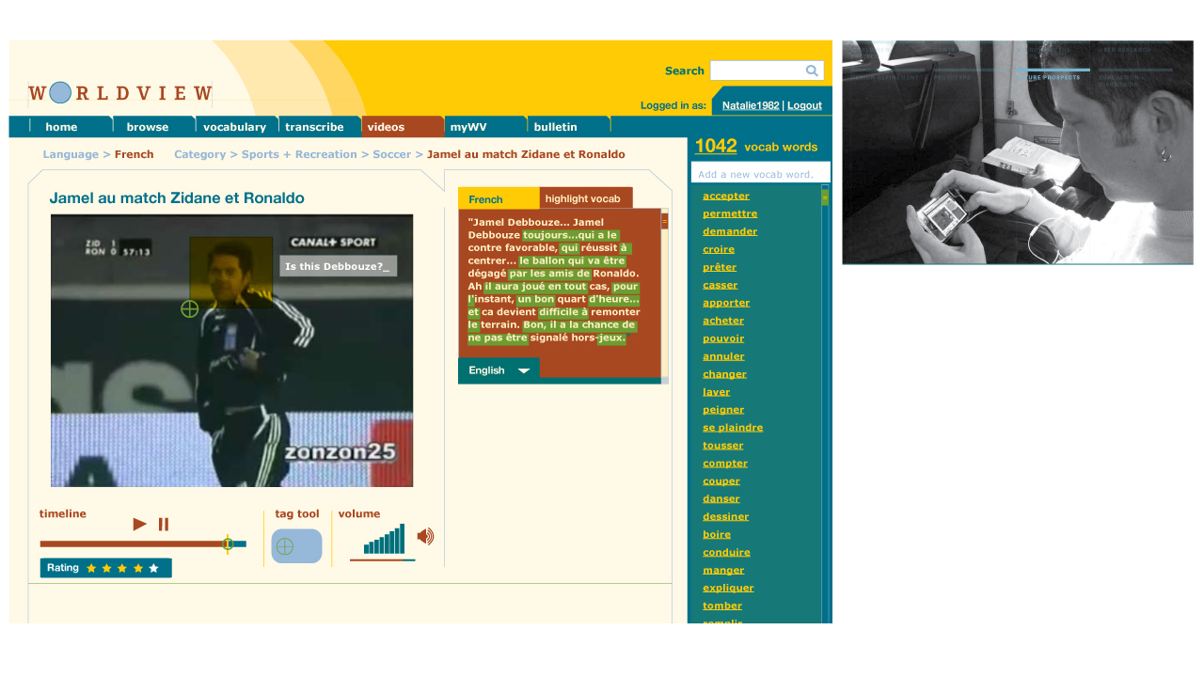

Slide 18
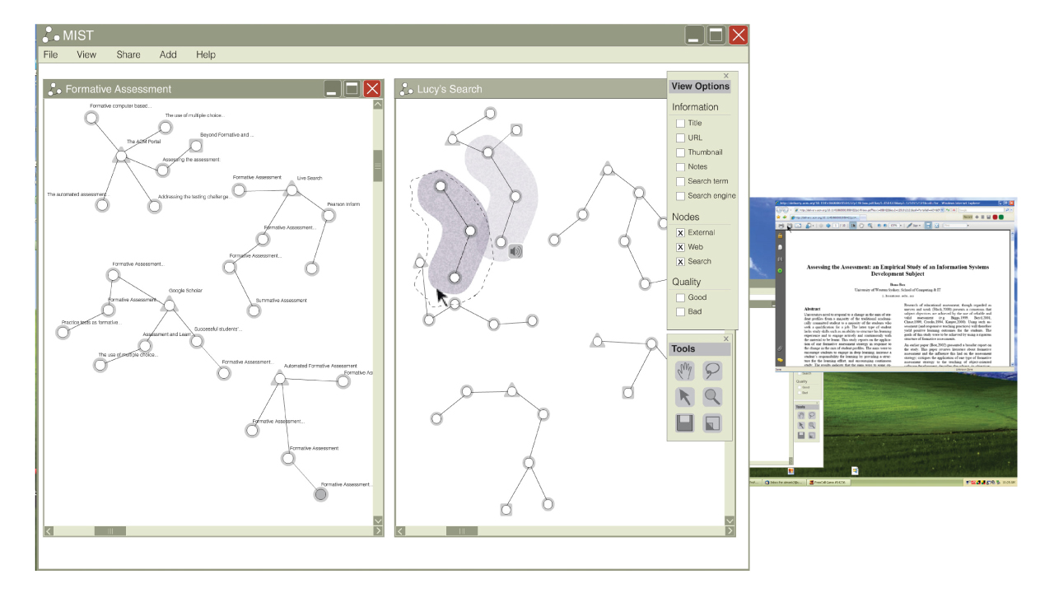

Slide 19
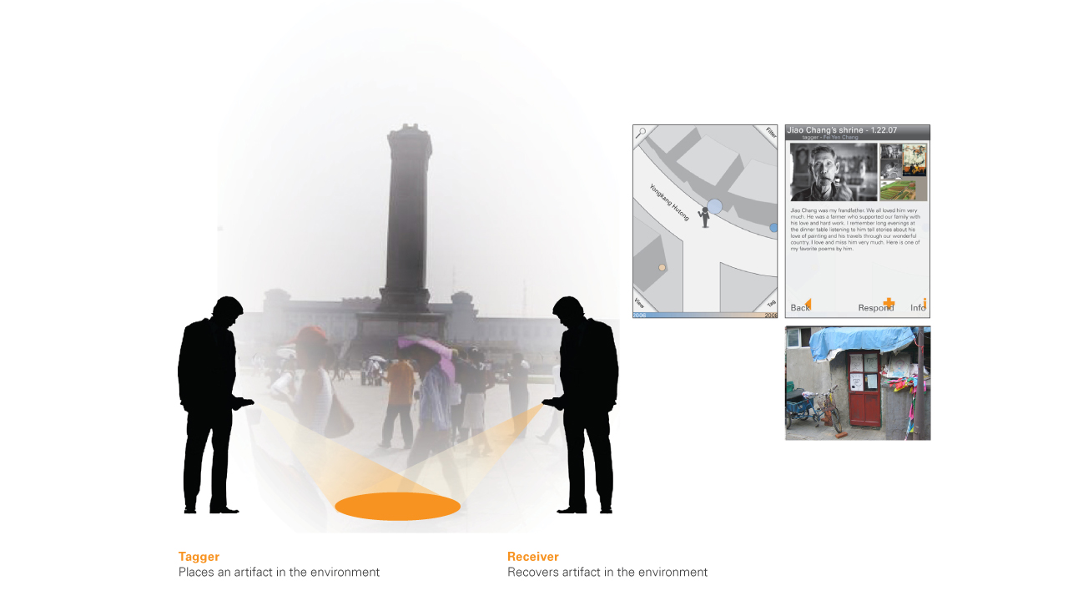

Slide 20
http://micropedia/Design_Expo_2008
Lili Cheng- MSR
Curtis Wong- MSR
Andy Cargile –Hardware Design Group
Craig Hally-XDR
Sanders Viegers-Office
Dave Vronay-ATC Beijang
Adrienne Gibson (O’Donnell)-XDR
Daniel Robbins-MSR
Monica Gonzales- Office
Georg Petschnigg-Pioneer Labs
Leo Burd-Learning
Richard Banks-MSR Cambridge
Bill Buxton, Steve Kaneko, Surya Vanka, Brad Weed

Slide 21
Microsoft Design Expo

