Slide 1

Using Social Network Sites in Education
Cliff Lampe

Slide 2
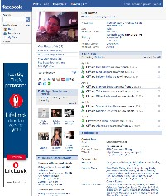
Facebook

Slide 3
Talk Outline
General reflections on “proffing” and social network sites
Some findings from surveys of Facebook users
Social network sites for rural youth

Slide 4
How Does Facebook Change the Instructor-student Relationship?
Strategies for friending students
Common experiences for students
Increased “cohort” effects

Slide 5
How Are Students Using Facebook for Education and Social Activities?

Slide 6
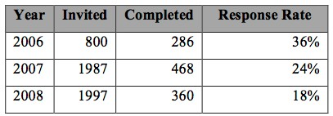
Methods
Cohort survey
Interviews
  18 respondents to surveys in 2007

Slide 7
I Use Facebook To…
Arrange a study group or meeting
  43%
Collaborate on an assignment in a way that your instructor would like
  30%
Collaborate on an assignment in a way that your instructor might not like
  8%

Slide 8
I Use Facebook To…
View the profile of another student in one of your classes
  79%
View the profile of a professor or TA
  20%
Contact another student with a question related to a class or schoolwork
  63%

Slide 9
I Use Facebook To…
Discuss class or schoolwork
  49%
Do something on Facebook as part of an assigned class exercise
  8%

Slide 10
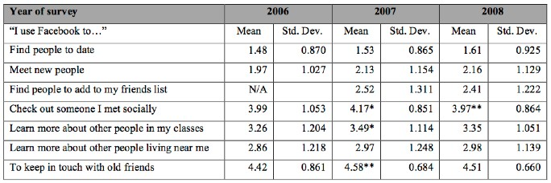
Changes in Other Reported FB Uses

Slide 11
Changes in Use Over Time
“I would say when I first got [Facebook], it was such a novelty that I was on a lot just searching kind of in awe, looking at everyone’s profile to see what they’re really about. And now after being on it a couple of years, all my close friends, I’ve looked at their profiles before.”

Slide 12
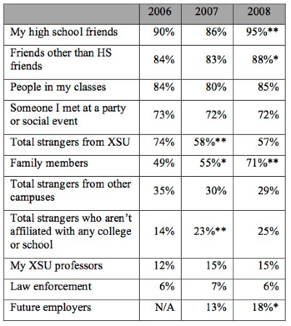
Changes in Audience Perception

Slide 13
Narratives of “Surveillance”
“I’ve heard rumors – many people have told me that employers and people – admission committees look at your Facebook profiles and see what you put in them. And any pictures of me at a party, I’ve untagged myself in. I don’t really want to convey a message of – which I’m not a big partier at all – but I just don’t want somebody getting the wrong impression.”

Slide 14
Users Report Profile Management Strategies
“ I definitely wipe out my feed, not a lot shows on it. If it does, it’s new pictures that I’ve posted or something like that. But, yes, I’ve definitely become aware of it, I think as it’s gotten a lot bigger. Before, it was so small it didn’t really matter and people - but now it’s getting a little bit more invasive, so yes, I keep – that.”

Slide 15
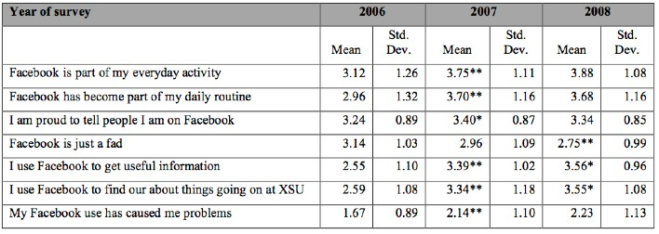
Changes in Attitudes towards FB

Slide 16
SNS for Rural Youth

Slide 17
“Bright Flight” from Rural Michigan
Look back, rather than come back.
http://cloverlink.org/wiki/
http://tcwest.tism.msu.edu/

Slide 18
Obligatory promotional slide
Online Social Network Use, Self-esteem, and Social Capital: A Longitudinal Analysis
  Steinfield, Ellison, Lampe (Journal of Developmental Psychology)
Changes in Participation and Perception of Facebook
  Lampe, Ellison, Steinfield (CSCW)
Social Network Sites and Society: Current Trends and Future Possibilities
  Ellison, Lampe, Steinfield (Interactions)

Slide 19
Thanks!
Cliff Lampe
  lampecli@msu.edu
Nicole Ellison
  nellison@msu.edu
Charles Steinfield
  steinfie@msu.edu

