Slide 2
Environmental Monitoring 2.0
Sebastian Michel
Ecole Polytechnique Fédérale de Lausanne (EPFL)
Switzerland

Slide 3
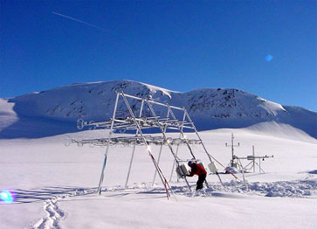

The Swiss Experiment
Objectives
    understanding implications of environmental change from local to regional scales
    data access for users from academia to general public
Approach
    develop novel wireless sensor networks and sensors
    design an integrated data and meta-data infrastructure
  Extraordinary
    Scale: variety of experiments and instruments
    Coverage: experiments in multiple locations and widespread sensor networks across the alps
    Team: research, industry, community, stakeholders

Slide 4
Science Workflow
Running
experiments
Factors limiting scientific progress:
Limited data and metadata sharing and reuse
Limited real-time data access
Limited data accessibility and visualization
Data logging
Data
Metadata
Models
Visualization
Planning
experiments
Analysis, Models
Knowledge
Email, desktop, …
Ad-hoc file-based

Slide 5
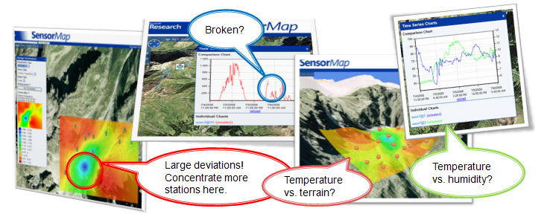
Application Scenarios of SensorMap
Experiment Planning
Deployment Monitoring
Data Analysis
To view sensor layout and visualize measurements in real-time to decide the placement of sensors
To inspect real-time output of sensors, and to discover and fix broken sensors
To visualize dependencies among different measurements and correlations with topological terrains

Slide 6
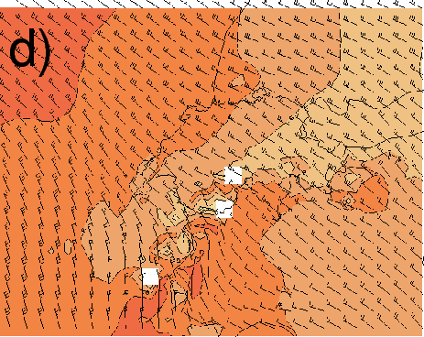
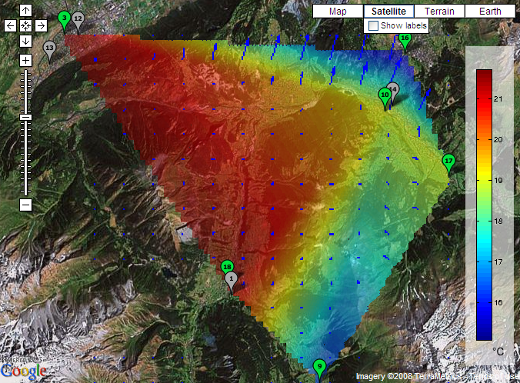
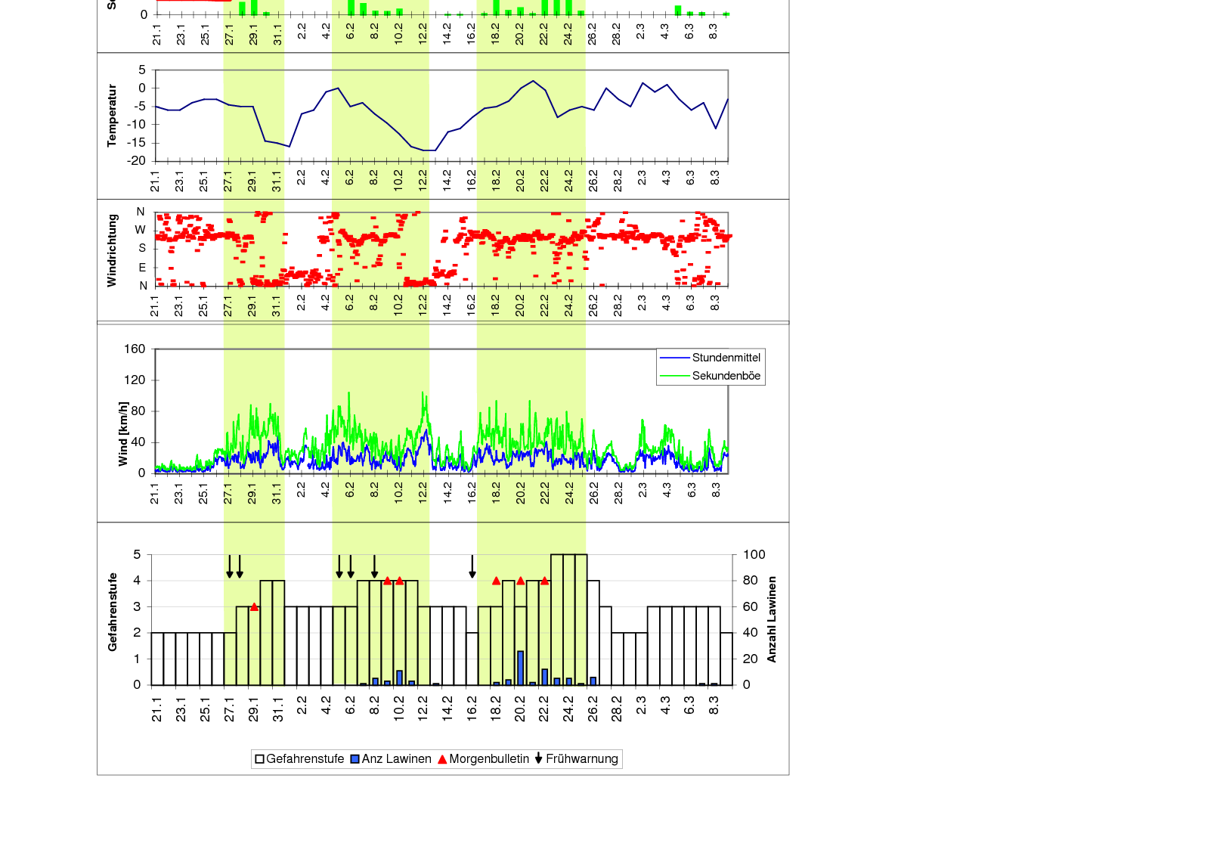
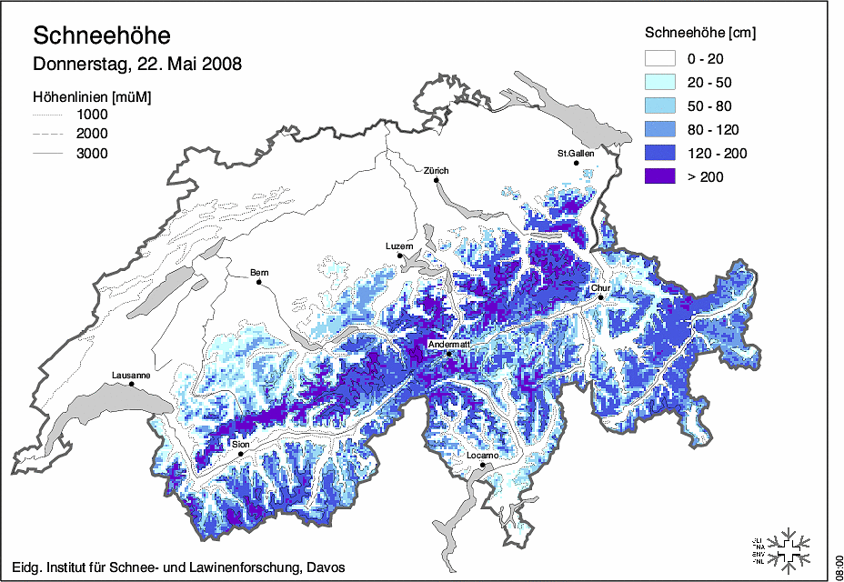
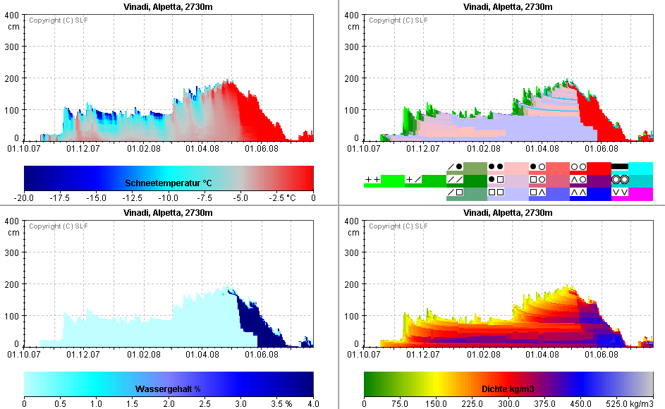

Advanced Plots

Slide 7
Towards Environmental Monitoring 2.0
Previous State
(Near) Future
Lack of communication
Information Sharing in online communities
Randomly distributed data files
Data repository with single access point
Data loss
No data loss
Loss of knowledge on data collection
Provenance tracking
Waste of resources replicating data collection
Data reuse
Small user community
Open access

Slide 8

© 2008 Microsoft Corporation. All rights reserved. Microsoft, Windows, Windows Vista and other product names are or may be registered trademarks and/or trademarks in the U.S. and/or other countries. The information herein is for informational purposes only and represents the current view of Microsoft Corporation as of the date of this presentation. Because Microsoft must respond to changing market conditions, it should not be interpreted to be a commitment on the part of Microsoft, and Microsoft cannot guarantee the accuracy of any information provided after the date of this presentation. MICROSOFT MAKES NO WARRANTIES, EXPRESS, IMPLIED OR STATUTORY, AS TO THE INFORMATION IN THIS PRESENTATION.

