Slide 1
(Excel) .NetMap
A toolkit for
Social Network Analysis
Microsoft Research
Marc Smith (MSR Silicon Valley)
Tony Capone (MSR Redmond)
Natasa Milic-Frayling (MSR Cambridge)
Eduarda Mendes Rodrigues (MSR Cambridge)
Eric Gleave (U Washington)
Adam Perer (U Maryland)
Ben Shneiderman (U Maryland)

Slide 2
Goal: Make SNA easier
Existing Social Network Tools are challenging for many novice users
Tools like Excel are widely used
Leveraging a spreadsheet as a host for SNA lowers barriers to network data analysis and display

Slide 3
Social Network Science of Science
Study social network structure of email and web boards of
different scientific communities
Sociologist
“What are the structures of communication in scientific discussions?”
User Experience Information Visualization
“What are the best UI/UX workflows for network analysis tools?”
Computer Scientist Algorithmicist for Social Network Measures
“What are the measures and algorithms needed for understanding networks?”

Slide 4
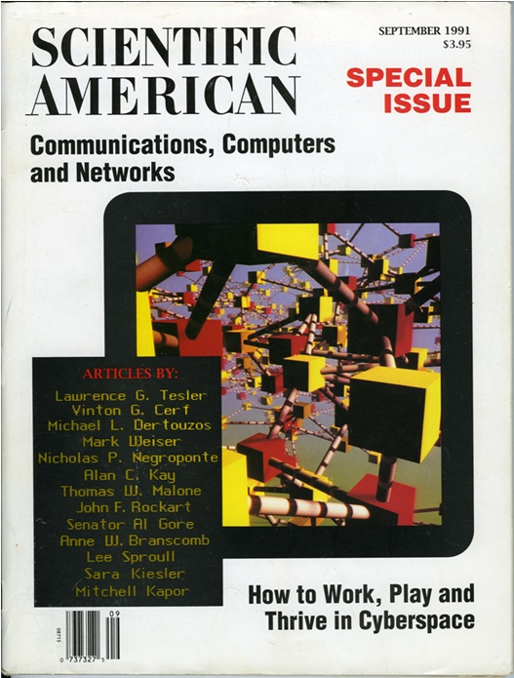
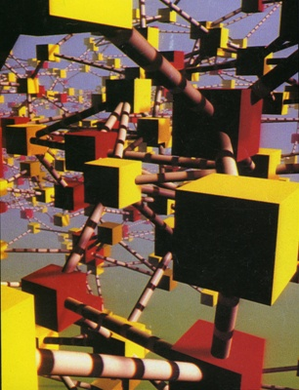

Slide 5
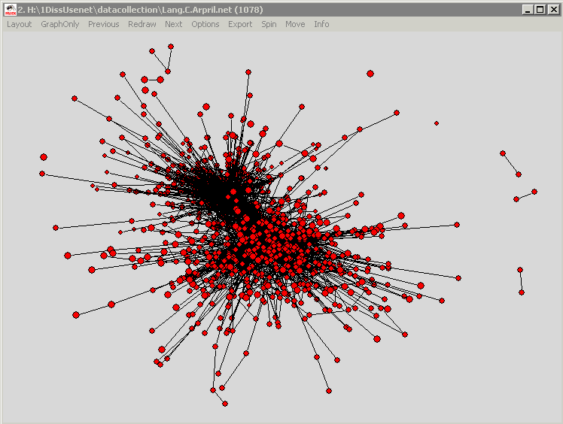
The Ties that Blind?

Slide 6
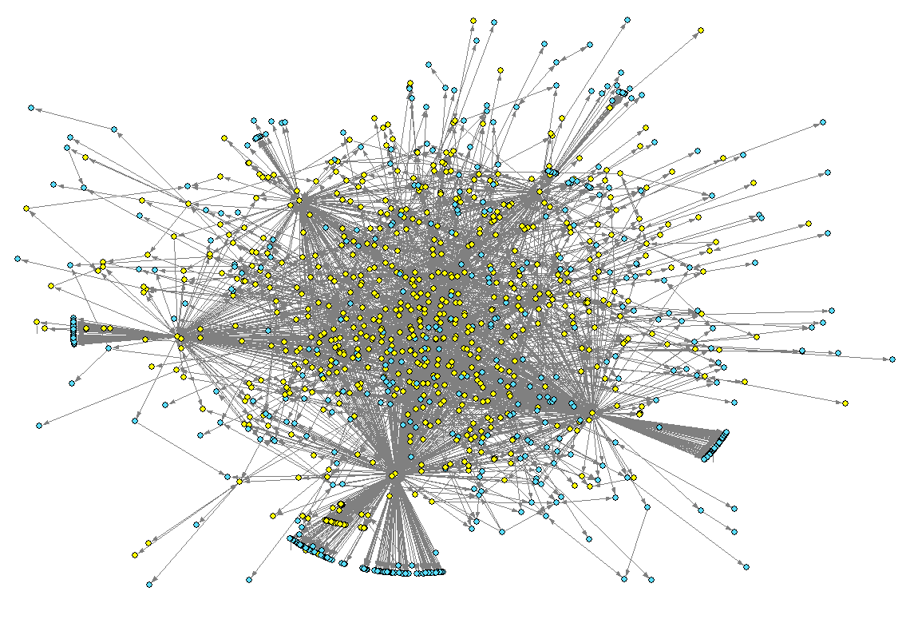
The Ties that Blind?
Reply-To Network
Network at distance 2 for the most prolific author of the microsoft.public.internetexplorer.general newsgroup

Slide 7
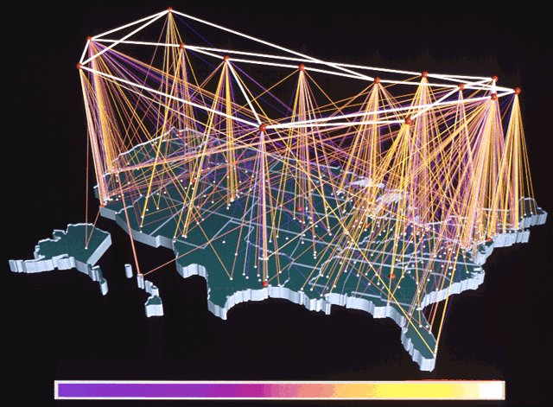
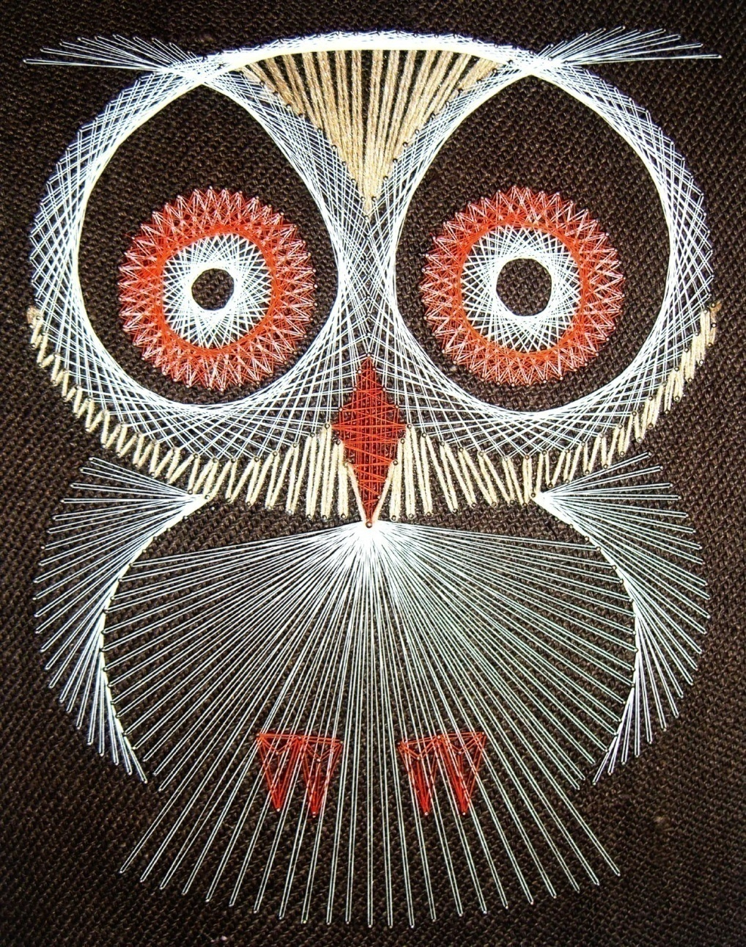
Darwin Bell

Slide 8
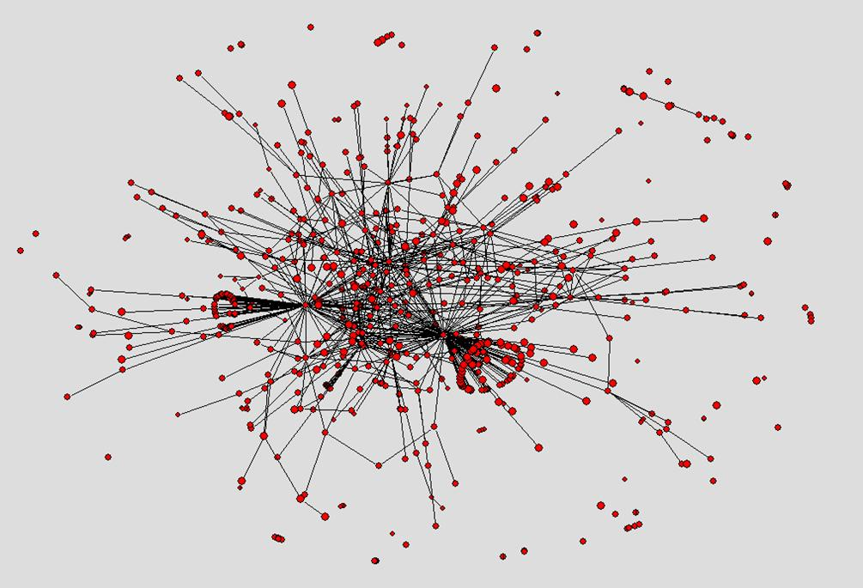
The Ties that Blind?
Pajek without modification can
sometimes reveal structures of great interest.

Slide 9
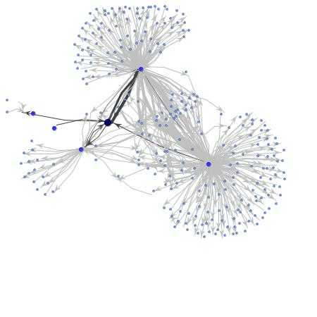


Mapping
Newsgroup
Social
Ties
Microsoft.public.windowsxp.server.general
Two “answer people” with an emerging 3rd.
Notes:
9

Slide 10
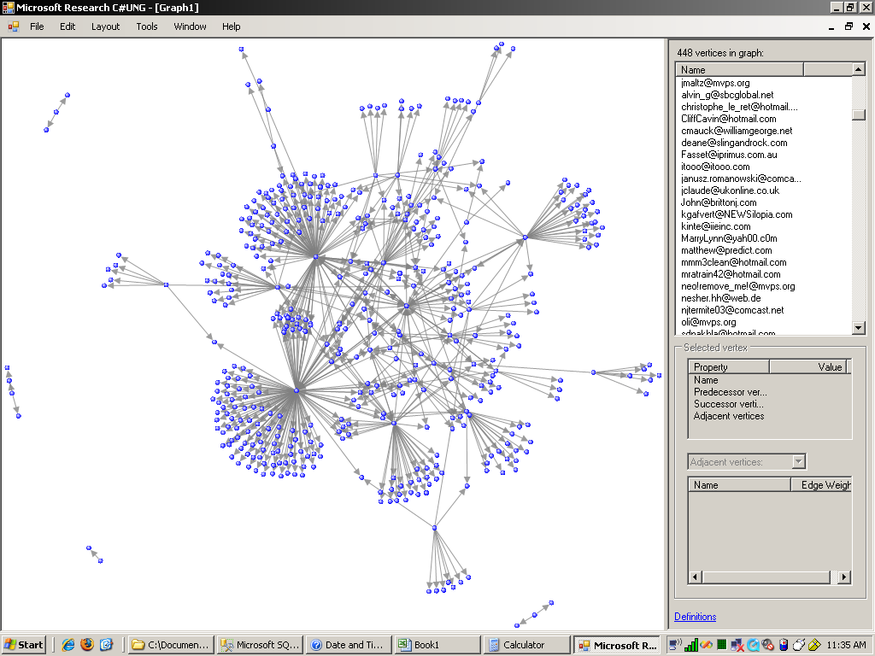

Slide 11
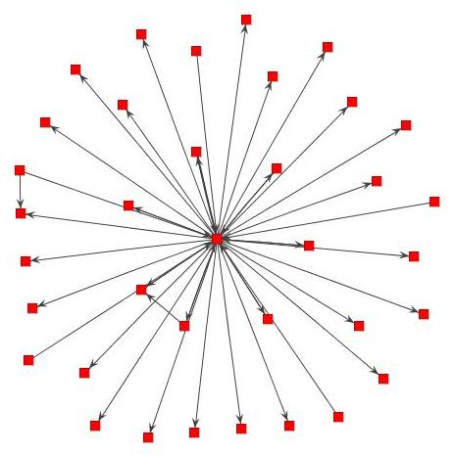
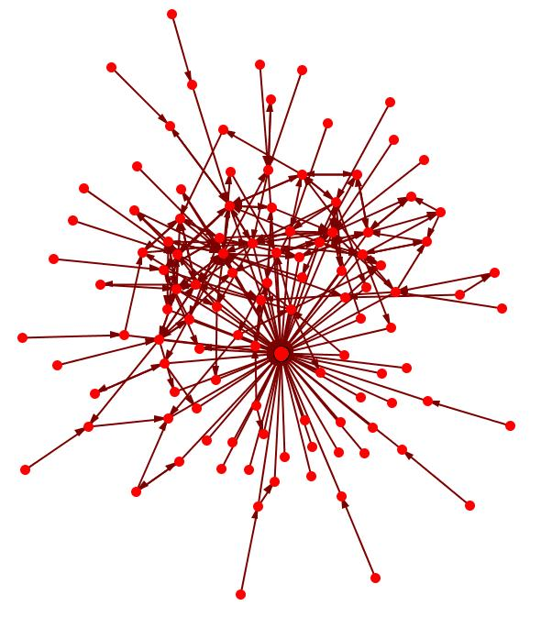
Distinguishing attributes:
Answer person
  Outward ties to local isolates
  Relative absence of triangles
  Few intense ties
Reply Magnet
  Ties from local isolates often inward only
  Sparse, few triangles
  Few intense ties

Slide 12
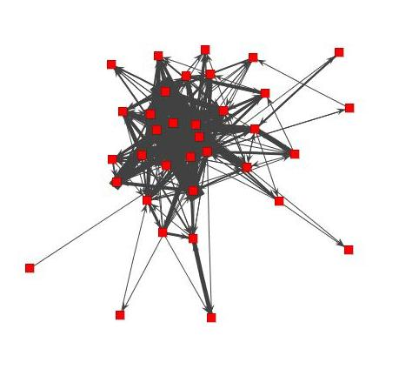
Distinguishing attributes:
Answer person
  Outward ties to local isolates
  Relative absence of triangles
  Few intense ties
Discussion person
  Ties from local isolates often inward only
  Dense, many triangles
  Numerous intense ties

Slide 13
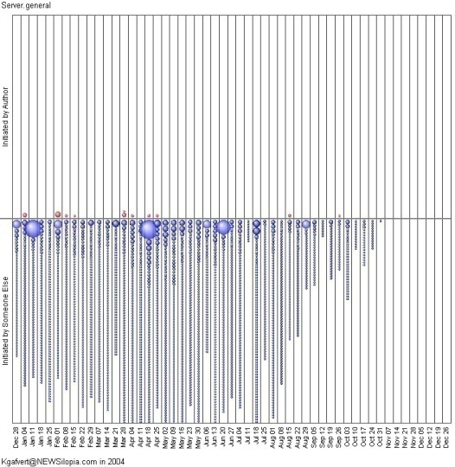
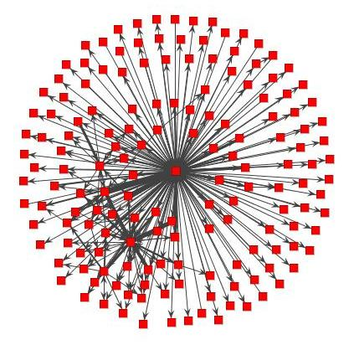
Clear and consistent signatures of an “Answer Person”
Light touch to numerous threads initiated by someone else
Most ties are outward to local isolates
Many more ties to small fish than big fish

Slide 14
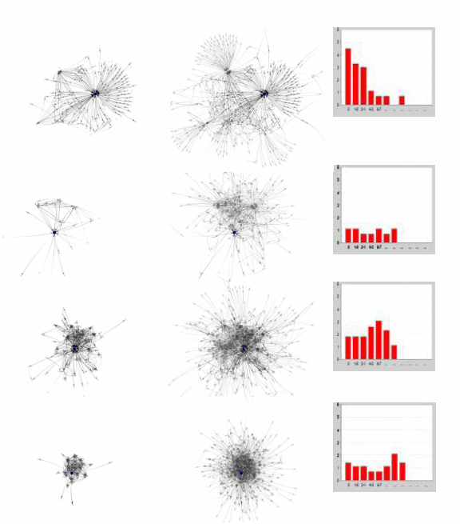






Roles Project
Using Netscan data to derive social roles in Usenet
Next steps: quantify & explore in more depth
Answer Person, microsoft.public.windows.server.general
Discussion, rec.kites
Flame, alt.flame
Social Support, alt.support.divorce
PUBLISHED in HICSS, JCMC, JoSS, IEEE Internet Communications (special issue on Social Networks)

Slide 15

Problem: No network chart in Excel

Slide 16
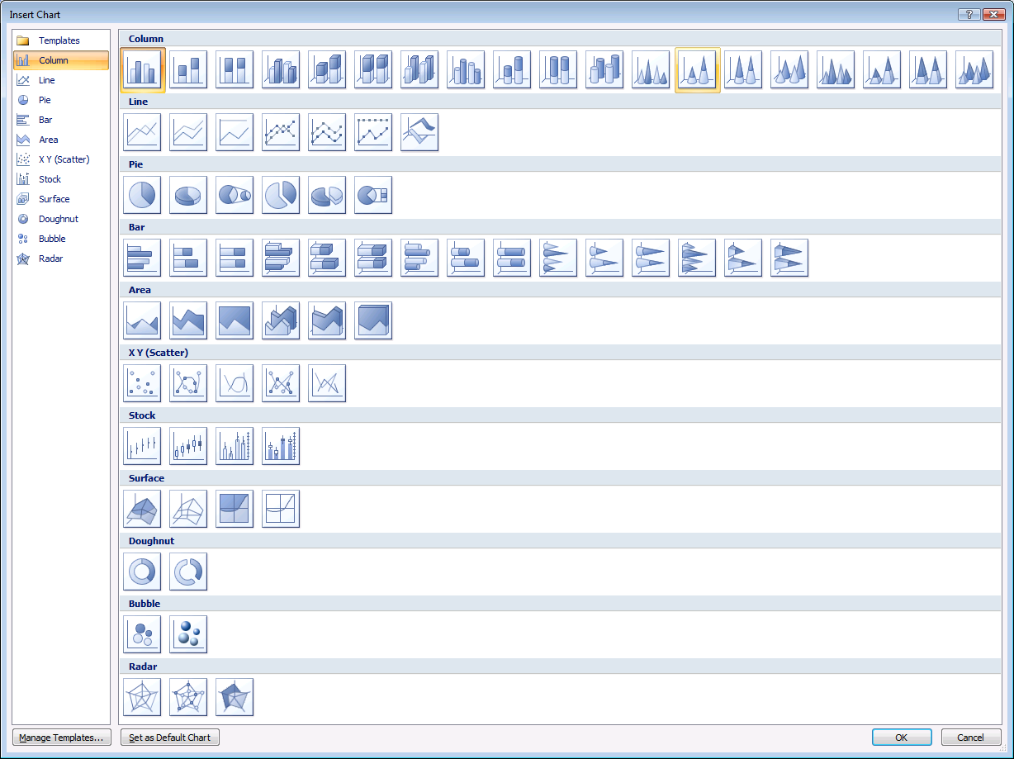
Problem: No network chart in Excel

Slide 17
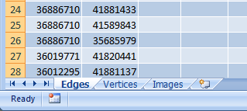
.NetMap: Worksheets

Slide 18
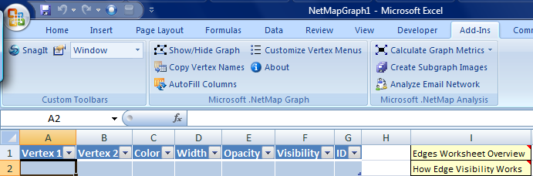
.NetMap: Edges Worksheet

Slide 19
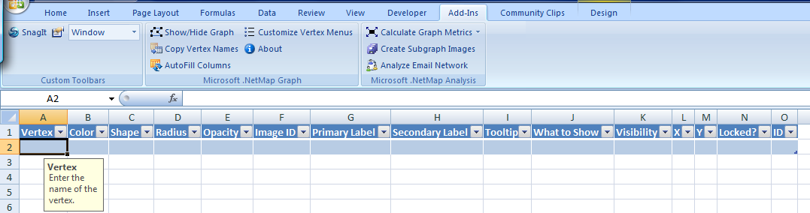
.NetMap: Vertices Worksheet

Slide 20
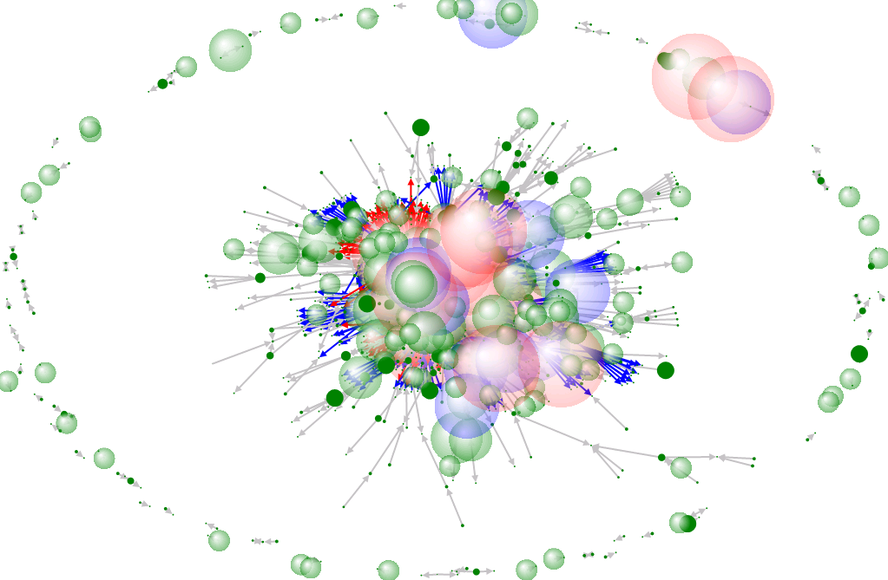

Slide 21
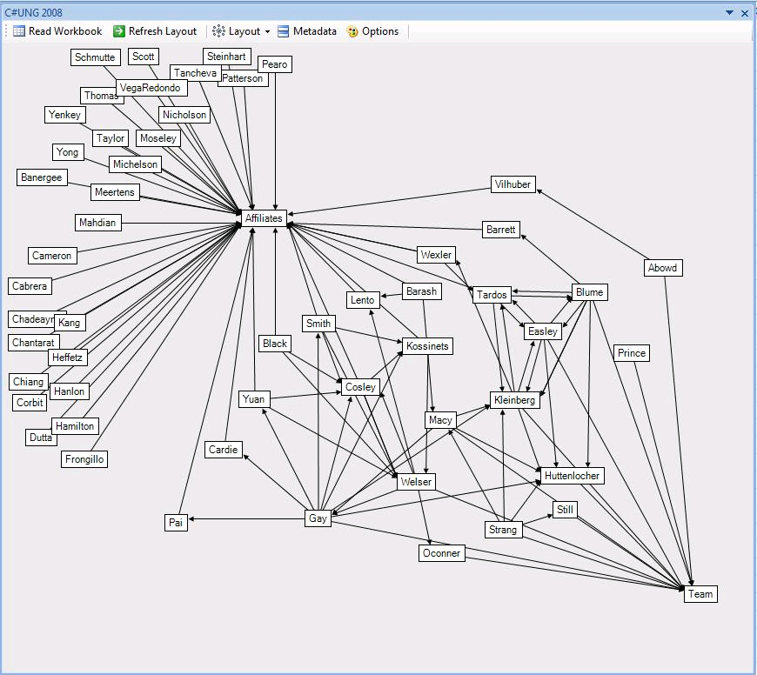

Slide 22
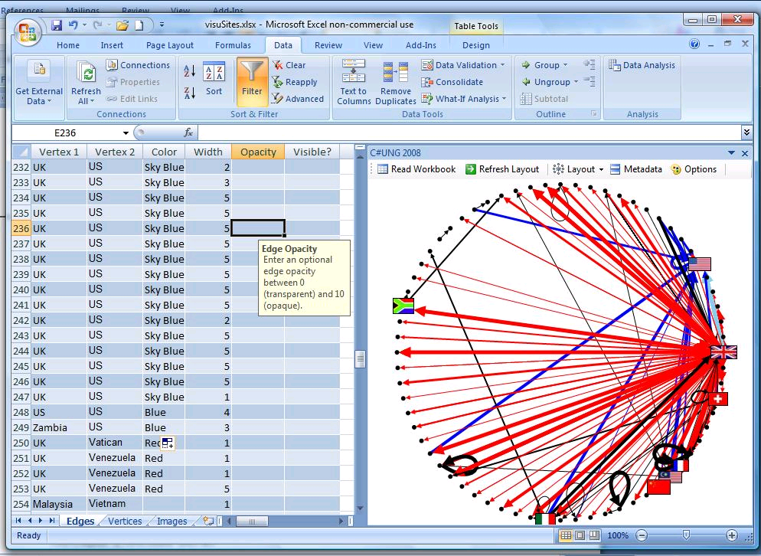

Slide 23
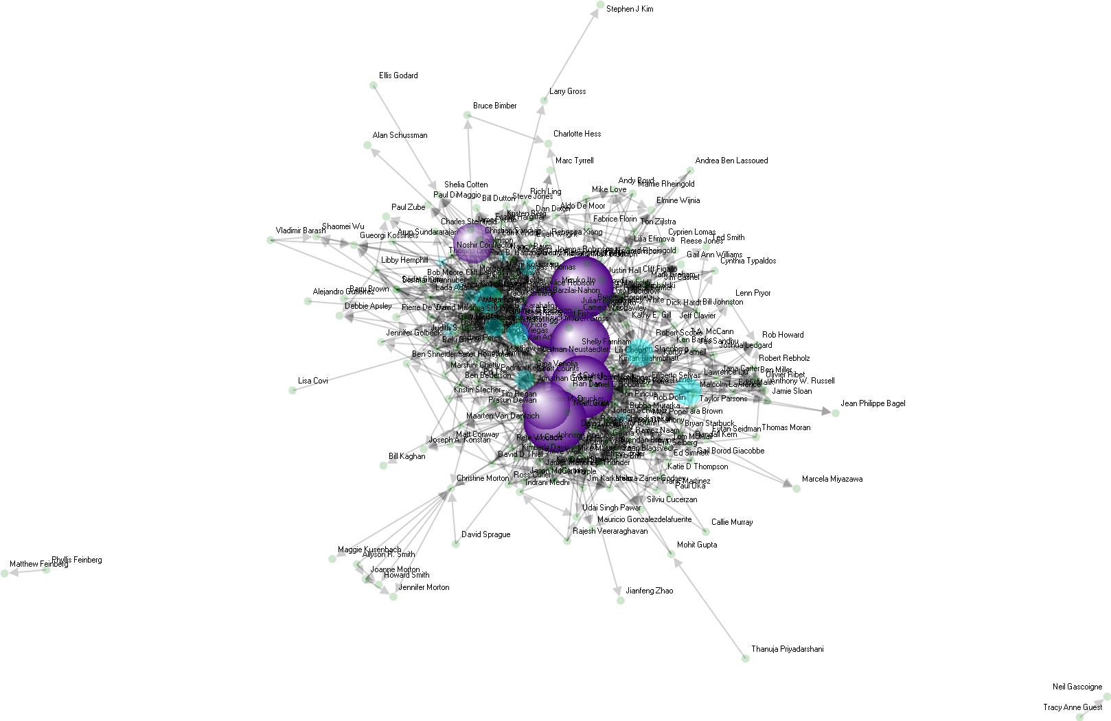
Marc’s Facebook Graph

Slide 24
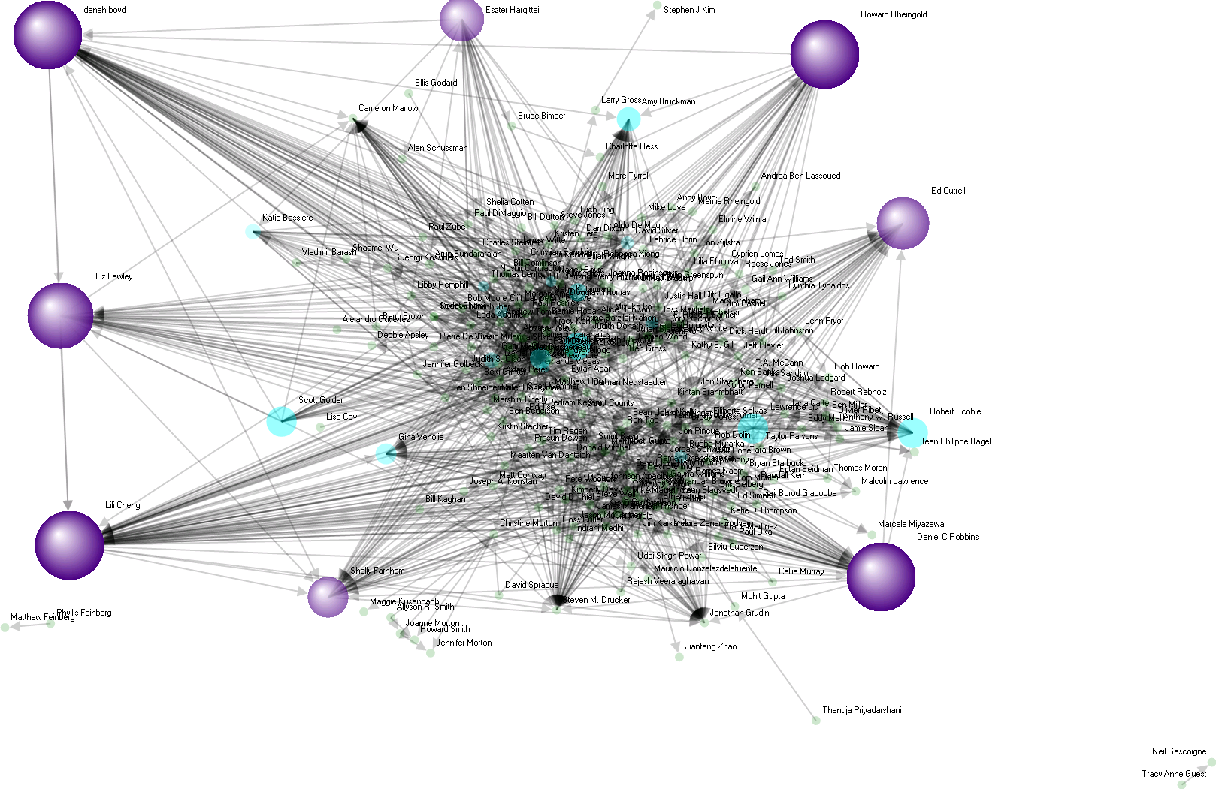
Marc’s Facebook Graph

Slide 25
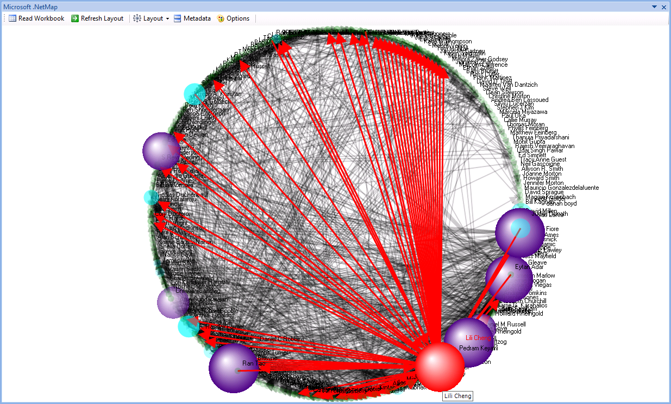

Slide 26
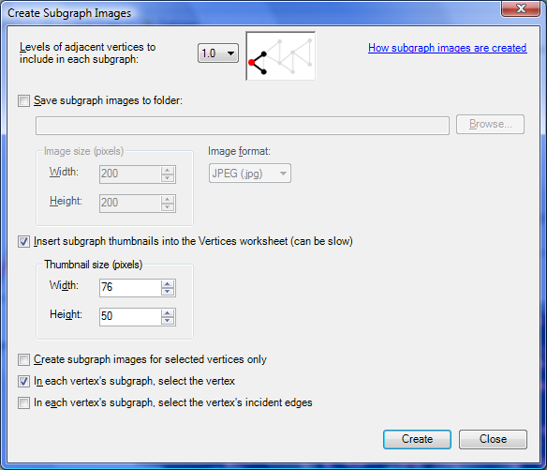
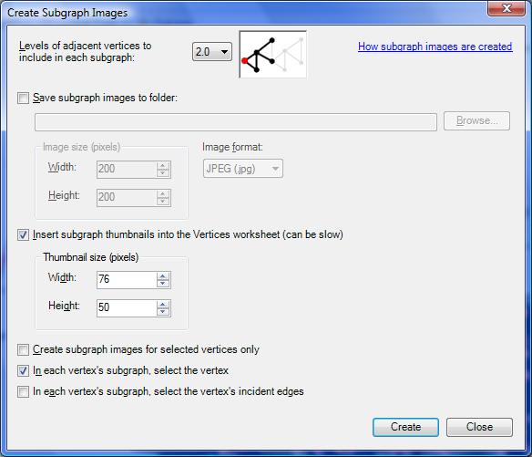
Create Subgraph Images

Slide 27
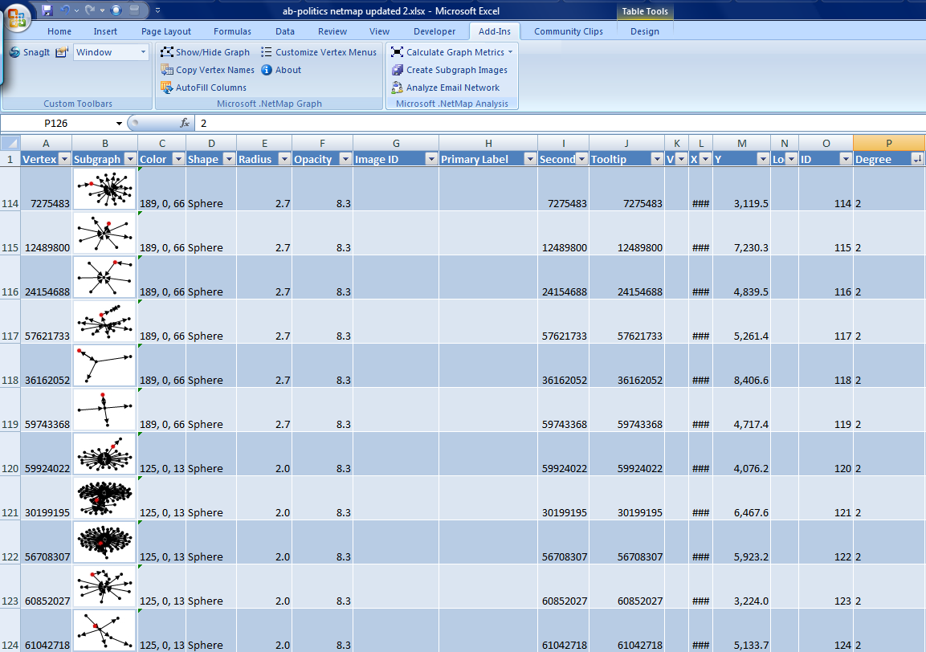

Slide 28
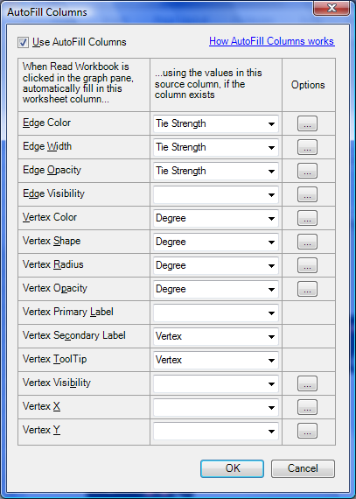

Slide 29
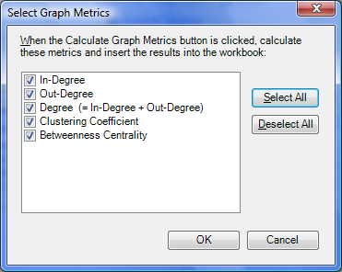
Select Graph Metrics

Slide 30
.NetMap Next Steps
Enhanced layout controls
  Smart selection of nodes
Clustering and composite nodes
  Add/remove a node to/from a cluster
  Add/remove a node to/from a composite
Zoom and scale networks
Right-click behaviors
Social Network data sources:
  Facebook, Outlook, Messenger, etc.

Slide 31
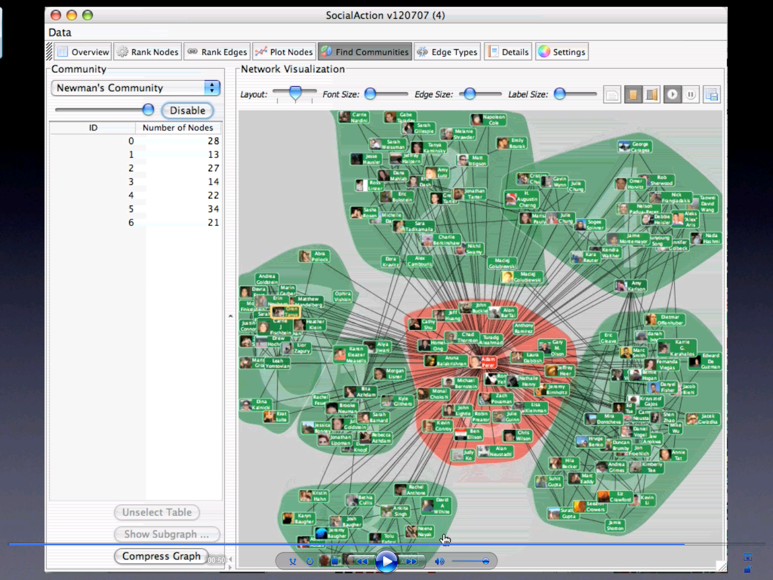
Social Action – Adam Perer

Slide 32
(Excel) .NetMap
Microsoft Research
http://www.codeplex.com/netmap
masmith@microsoft.com

