Slide 1
REAssess: Resources for Educational Assessment
Steve Tanimoto, Professor, Dept. of Computer Science & Engineering
Steve Kerr, Professor, Dept. of Curriculum and Instruction
University of Washington, Seattle
Tyler Robison, University of Washington, Seattle
Brad Goring, University of Washington, Seattle
Eliana Medina, University of Washington, Seattle
Yen-Ling Lee, University of Washington, Seattle
Mikhail Manyak, University of Washington, Seattle
Jamie Cromack, Microsoft Research
Laura Bofferding, Stanford University
Turadg Aleahmad, Carnegie-Mellon Univ.
James Wen, Positive Motion

Slide 2
Outline
Origins of the REAssess project
Goals of the REAssess project
Assessment Framework
What is REAssess?
REAssess Demonstration
Issues & Feedback

Slide 3
Origins of the REAssess Project
Wanted to determine impact of funded projects on students
Created a document-based “assessment toolkit” for use on a small scale (Arizona State University)
Recognized the value of deploying a web-based site to support all STEM faculty
Identified team of PIs to head the project (University of Washington)
REAssess the future of assessment and learning in science, technology, math and engineering with searchable annotated resources, tools and templates focused on the STEM disciplines

Slide 4
  Goals of the REAssess Project
Engage the science, technology, engineering and math teaching (STEM) communities in deeper thinking about educational assessment
Offer useful, annotated, well-organized, targeted resources for educational assessment
Provide a clearinghouse for educational assessment-related activities (search, contribute, communicate, learn)
Host assessment-related services (future)

Slide 5
Assessment Framework
Traditional assessment landscape
  “Measure whether they can recall facts and do procedures”
    Standardized tests
    Short-answer tests
    Essay tests
  Summative privileged over formative
  Provide valuable information
    But are only part of the picture

Slide 6
Assessment Framework
Growing concerns over traditional assessment approaches
  How People Learn (NRC/NAP 1999)
  National Action Plan for … STEM Education (NSF, 2007)
  ABET 2008-09 Criteria for Accrediting Computing Programs
  Commission on … Higher Education (Miller-Malandra, 2006)
Quality of US higher education system
  The Post-American World (Zakaria, 2008)

Slide 7
Assessment Framework
Contemporary Assessment Approaches
  “Assess in order to see how much they understand and can do”
  Authentic assessment (“in context”)
    Real world settings, simulations, portfolios
  Group learning
    Projects, presentations, role-plays
  Identifying components of competence
    Adaptive expertise and self assessment
  Continuous unobtrusive assessment
  Regular formative feedback to learners
    And to improve instruction!

Slide 8
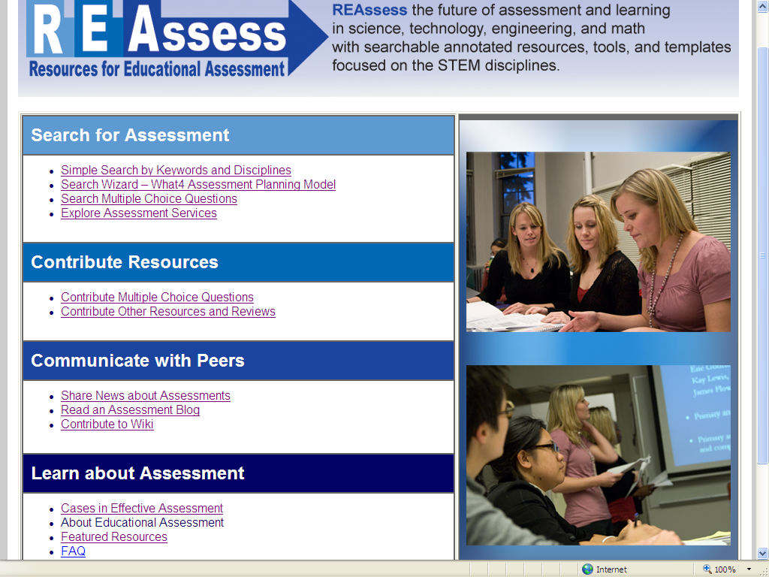
What is REAssess?
Search
Contribute
Communicate
Learn

Slide 9
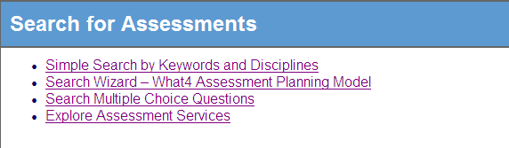
What is REAssess?
Search
  Simple Search by Keywords and Discipline
  Search by Wizard
  Search Multiple Choice Questions
  Explore Assessment Services

Slide 10
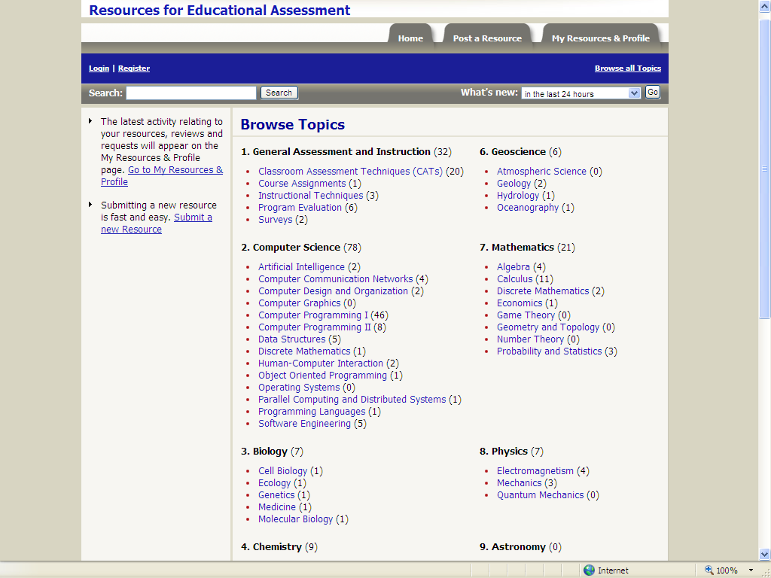

Slide 11
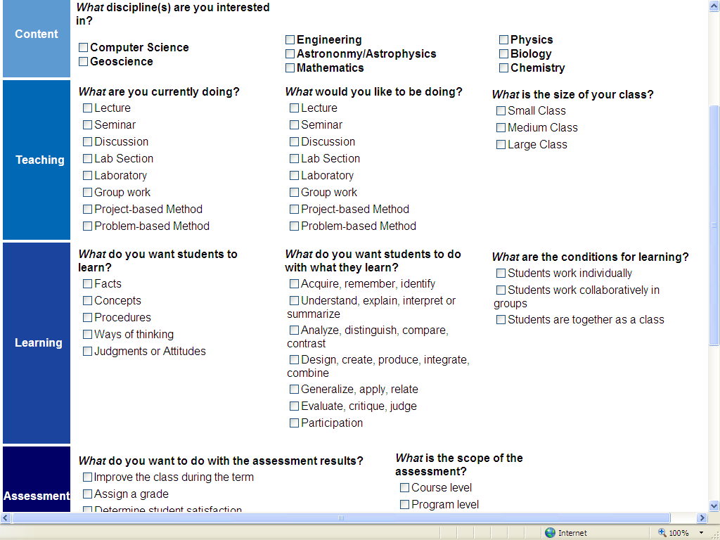

Slide 12
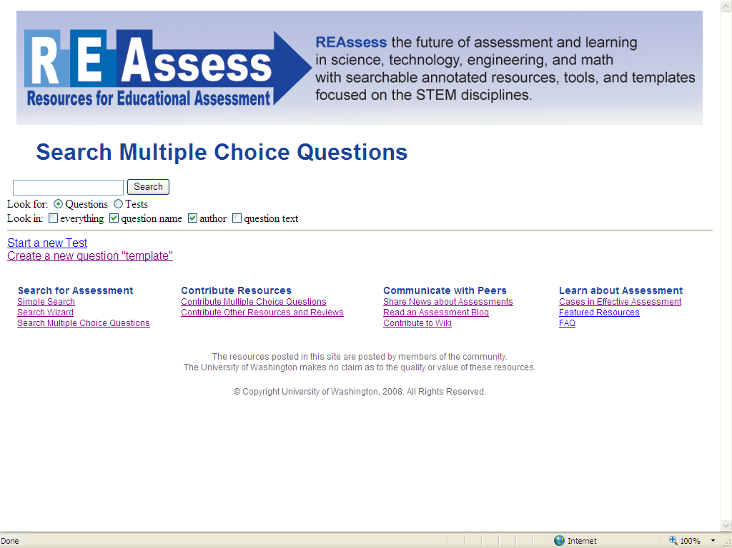

Slide 13
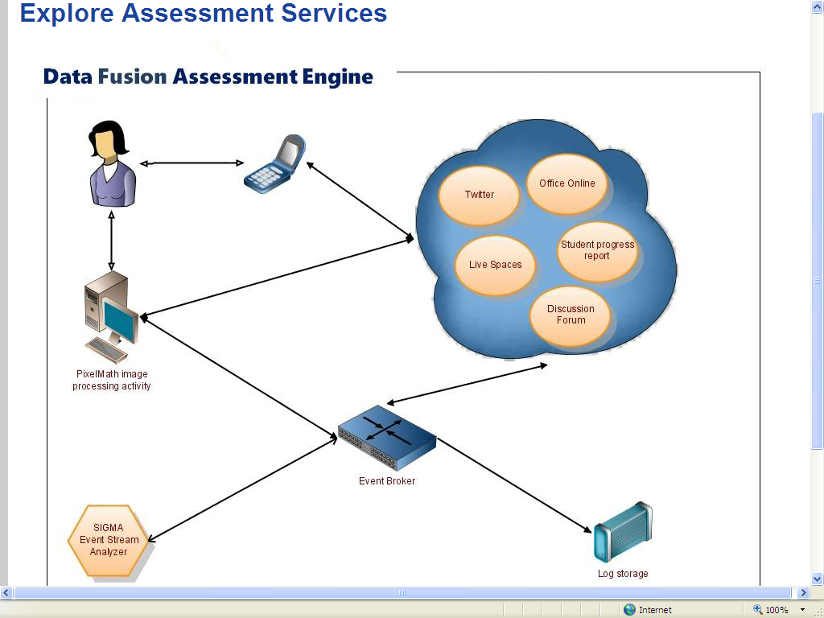

Slide 14
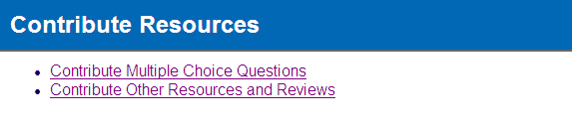
What is REAssess?
Contribute
  Contribute Multiple Choice Question
  Contribute Other Resources & Reviews

Slide 15
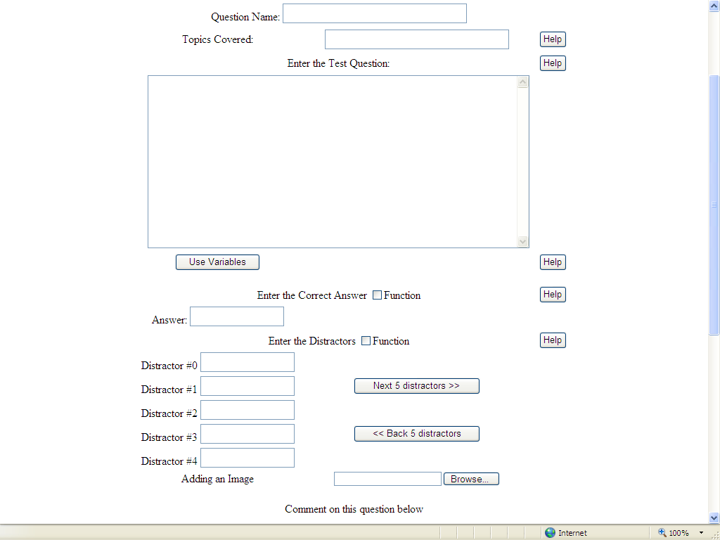

Slide 16
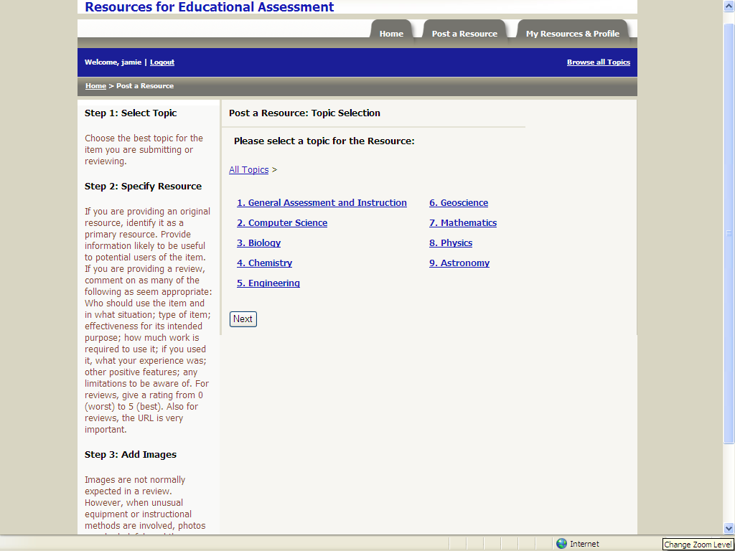

Slide 17
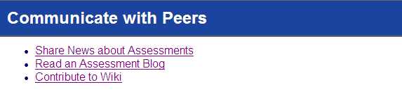
What is REAssess?
Communicate
  Share News about Assessment
  Read the Assessment Blog
  Contribute to the Assessment Wiki

Slide 18
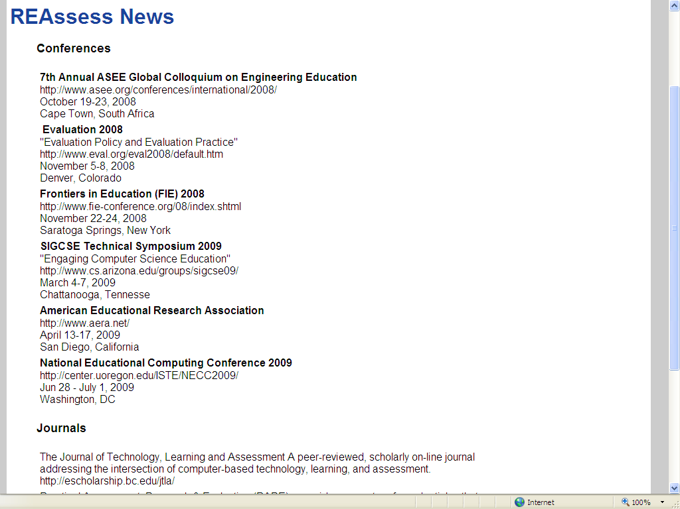
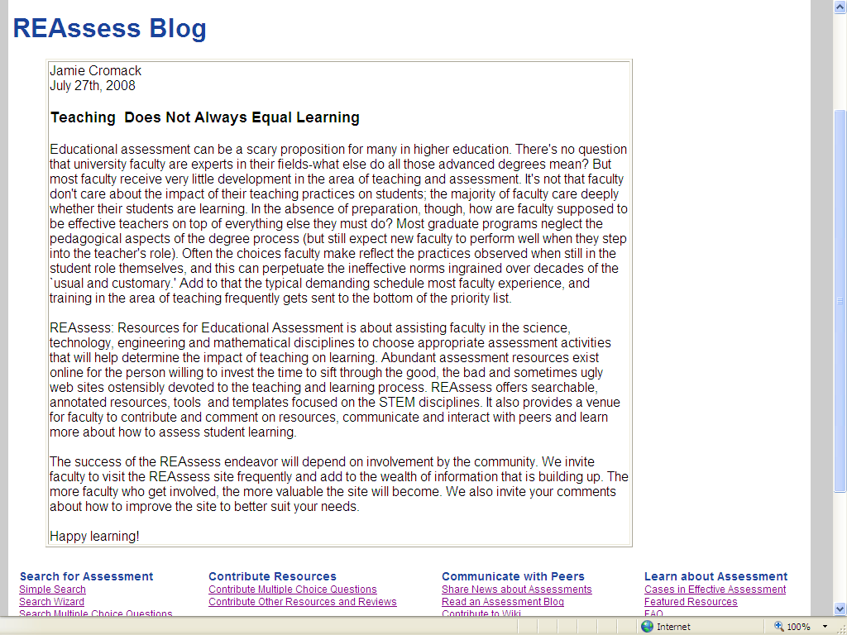

Slide 19
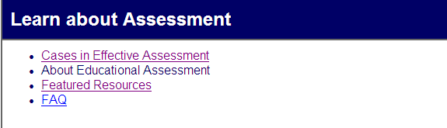
What is REAssess?
Learn
  Cases in Effective Assessment
  About Educational Assessment
  Featured Resources
  FAQ

Slide 20
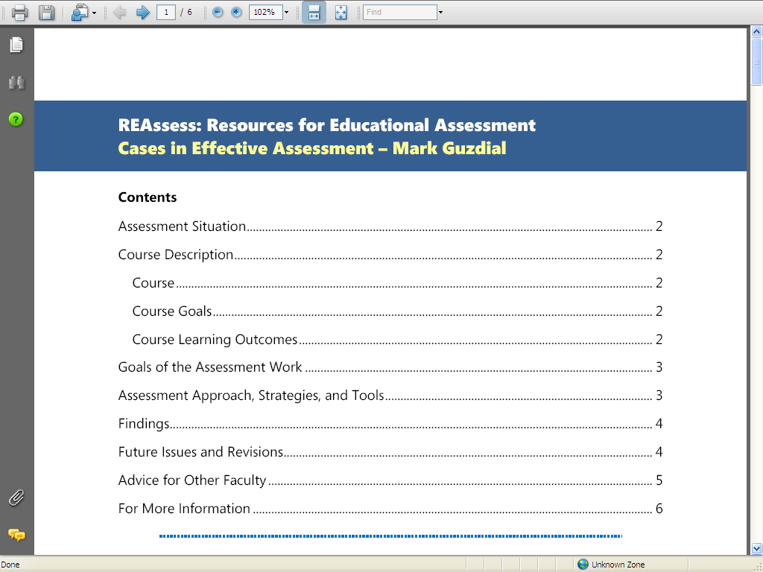
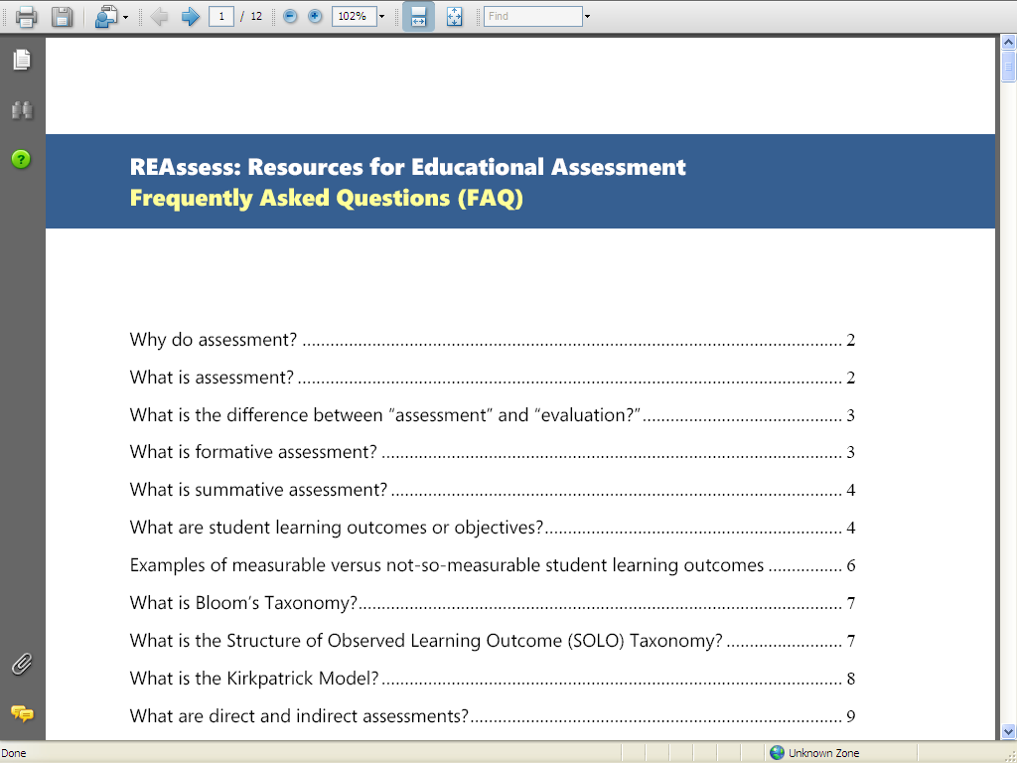
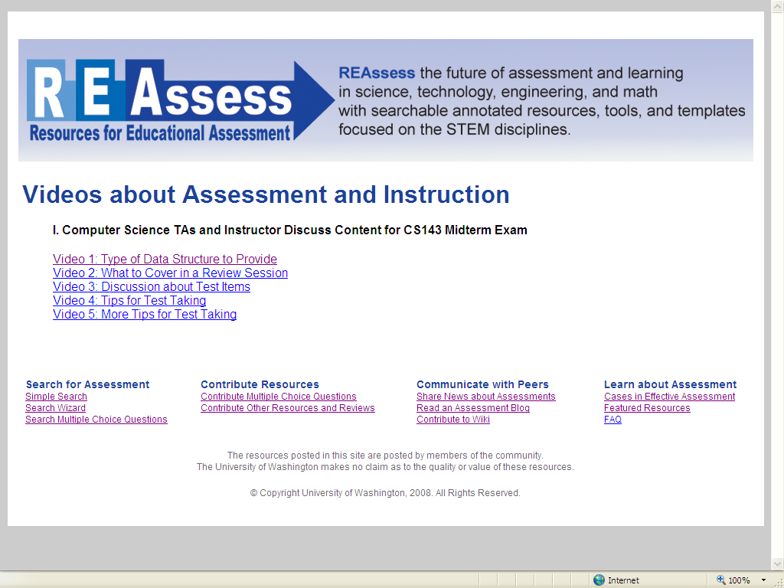

Slide 21
REAssess demo:
search
Eliana Medina
Notes:
7/29/2008 1:34 PM
© 2007 Microsoft Corporation. All rights reserved. Microsoft, Windows, Windows Vista and other product names are or may be registered trademarks and/or trademarks in the U.S. and/or other countries.
The information herein is for informational purposes only and represents the current view of Microsoft Corporation as of the date of this presentation. Because Microsoft must respond to changing market conditions, it should not be interpreted to be a commitment on the part of Microsoft, and Microsoft cannot guarantee the accuracy of any information provided after the date of this presentation.
MICROSOFT MAKES NO WARRANTIES, EXPRESS, IMPLIED OR STATUTORY, AS TO THE INFORMATION IN THIS PRESENTATION.
21

Slide 22
REAssess demo:
multiple choice questions
Tyler Robison
Notes:
7/29/2008 1:34 PM
© 2007 Microsoft Corporation. All rights reserved. Microsoft, Windows, Windows Vista and other product names are or may be registered trademarks and/or trademarks in the U.S. and/or other countries.
The information herein is for informational purposes only and represents the current view of Microsoft Corporation as of the date of this presentation. Because Microsoft must respond to changing market conditions, it should not be interpreted to be a commitment on the part of Microsoft, and Microsoft cannot guarantee the accuracy of any information provided after the date of this presentation.
MICROSOFT MAKES NO WARRANTIES, EXPRESS, IMPLIED OR STATUTORY, AS TO THE INFORMATION IN THIS PRESENTATION.
22

Slide 23
REAssess illustration:
Data Fusion Assessment Engine
Turadg Aleahmad
Notes:
7/29/2008 1:34 PM
© 2007 Microsoft Corporation. All rights reserved. Microsoft, Windows, Windows Vista and other product names are or may be registered trademarks and/or trademarks in the U.S. and/or other countries.
The information herein is for informational purposes only and represents the current view of Microsoft Corporation as of the date of this presentation. Because Microsoft must respond to changing market conditions, it should not be interpreted to be a commitment on the part of Microsoft, and Microsoft cannot guarantee the accuracy of any information provided after the date of this presentation.
MICROSOFT MAKES NO WARRANTIES, EXPRESS, IMPLIED OR STATUTORY, AS TO THE INFORMATION IN THIS PRESENTATION.
23

Slide 25
Issues & Feedback

Slide 26
Which of these REAssess Features is Most Important to You?
Promote sharing and reuse
Reviews and ratings of assessment resources
Easily adaptable tools and templates
Attract and promote cutting-edge assessments
Assessment tutorials & information
Respect for authorship of materials
Options for peer communication / interaction
Free access to assessment materials

Slide 27
Under Which Circumstance Would You be Likely to Use the REAssess Multiple Choice Question Generator for Tests?
Only if new question instances are automatically generated.
Only if “use with variation” is encouraged
Only with limited access by students
Only if it is restricted to use by faculty
Only for practice tests, not for real tests

Slide 28
How Would Student Access Change Your Level of Contribution of Materials?
I would contribute much more
I would contribute more
No effect
I would contribute less
I would contribute much less

Slide 29
What Would be a Realistic way to have Separate Access for Faculty & Students?
Bona-fide faculty vetted through detailed application process
Bona-fide faculty vetted through a return-email process
Access to resources increases with level of involvement with REAssess site
Other

Slide 30
Should REAssess Resources be Associated with Particular Textbooks or Publishers?
Yes
No

