Slide 2
Panel: Browsing the Physical World in Real-Time
Feng Zhao and Stewart Tansley
Microsoft Research
July 29, 2008

Slide 3
Presenters
Introduction, Feng Zhao, MSR
Event detection and notification, Magda Balazinska, UW
Participatory SensorWeb, Tarek Abdelzaher, UIUC
SwissEx, Sebastian Michel, EPFL
SenseWeb/SensorMap, Liqian Luo, MSR
Catalog scientific data, Bora Beran, MSR
Manage meta data, Prashant Doshi, U Georgia
Virtual Earth, Evelyne Viegas/Bill Chen, Microsoft

Slide 4
SenseWeb: Wikipedia of Sensors
Enable sharing of deployed instrumentation and data for communities of scientists and hobbyists
Share sensors
  Each deploys at small scale; everyone can use shared instrumentation
  Larger real-time, spatio-temporal coverage than any single system
  Cost amortized over multiple experiments
Share Data
  Same datasets used for multiple analyses
SensorMap as the portal
  Three major releases in the past 3 years
  http://atom.research.microsoft.com/sensewebv3/sensormap

Slide 5
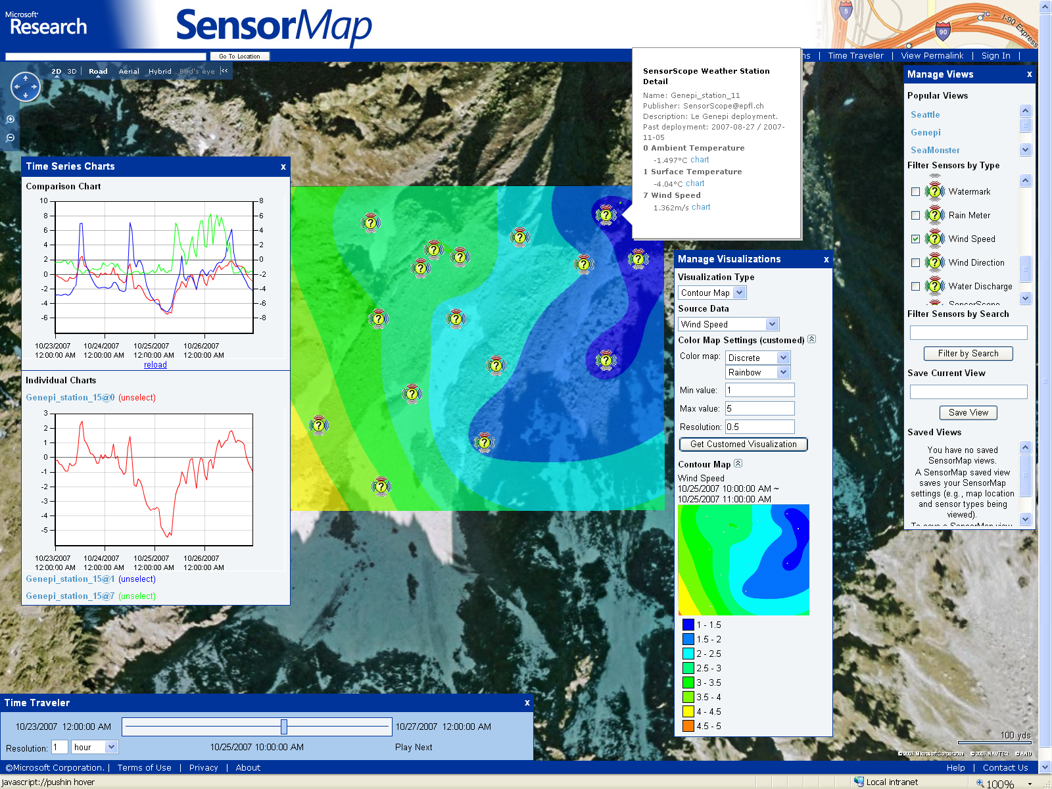
Data from Swiss Experiment

Slide 6
List of SensorMap RFP Projects
Marmite: End-User Programming for Large Sets of Real-Time Sensor Data, CMU
Leveraging the SensorMap Infrastructure for Large-Scale Urban Monitoring, Harvard
SensorMap for the National Weather Study Project, NTU, Singapore
Real-Time Debris Flow Monitoring and Warning via SensorMap, NTHU et al., Taiwan
Through the looking glass: On human mobility and equipment health, Ohio State
Semantic Reconciliation with Disparate Sensor Meta-Data for Automatic Publication, U Georgia
Action Web: Towards Viewing a Mobile World in the First Person, UIUC
SensorMap for the Great Barrier Reef, U Melbourne et al., Australia
Publishing and Searching Private Sensor Data Streams: Integration with the SensorMap Platform, UVA
Event Detection and Notification in the World-Wide Sensor Web, UW
Mobile Air Quality Monitoring Network, Vanderbilt
http://research.microsoft.com/ur/us/fundingopps/rfps/SensorMap_RFP_Awards_2007.aspx

Slide 7
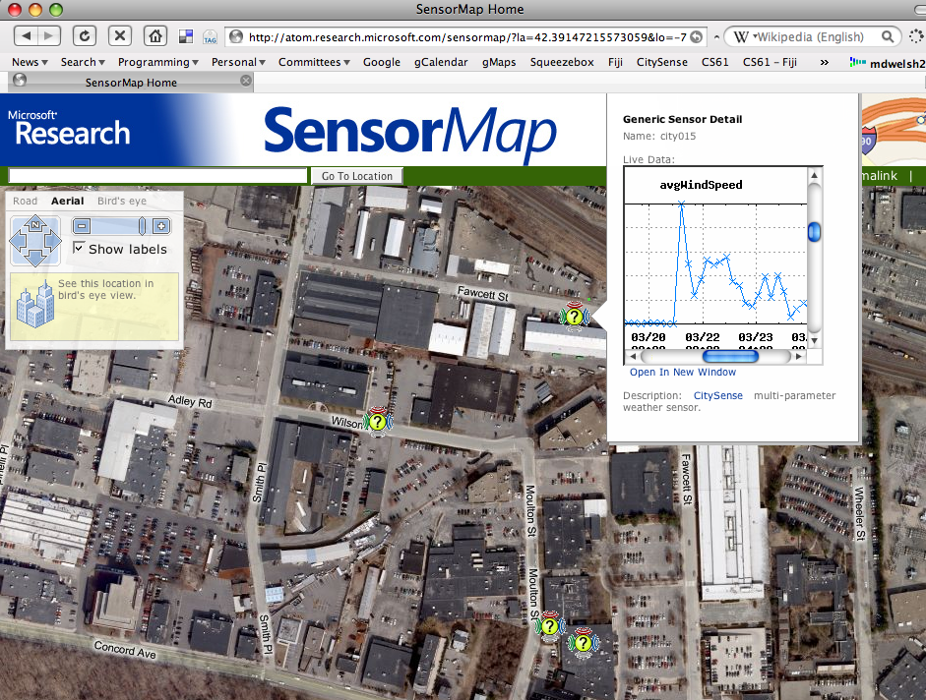
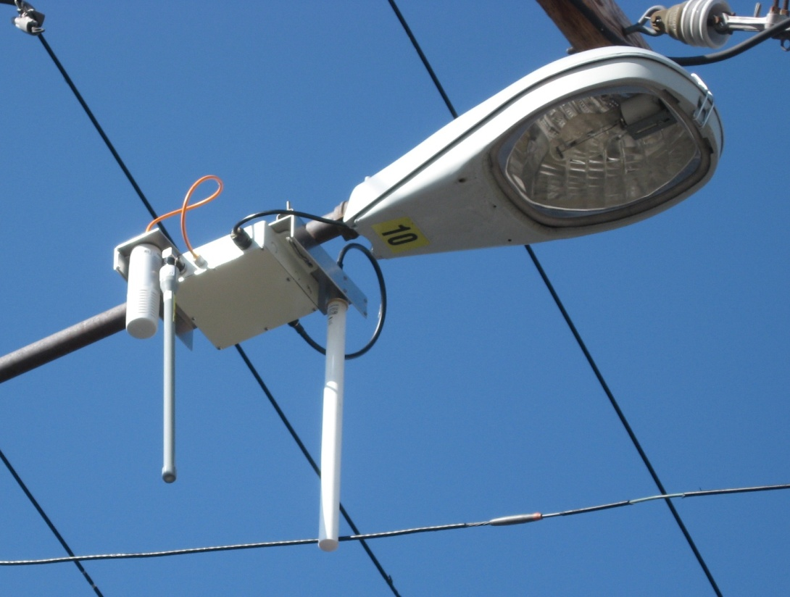
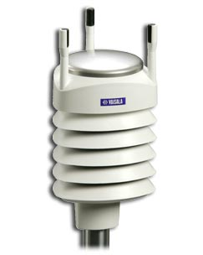
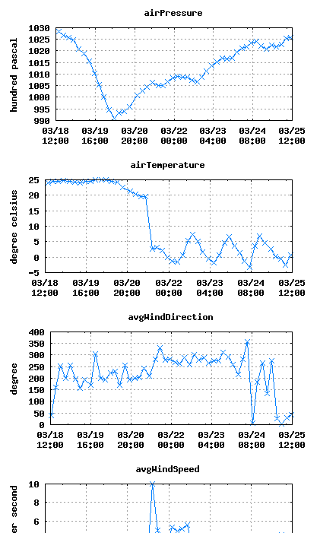
CitySense (Harvard)
Open sensor network testbed in Cambridge MA
Single-board computers with dual WiFi mounted
on streetlights
12 nodes currently deployed, 100 nodes planned.
Weather, CO2, noise pollution sensors
Eventually programmable by anyone
Source: Matt Welsh et al., Harvard

Slide 8
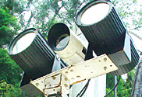
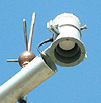
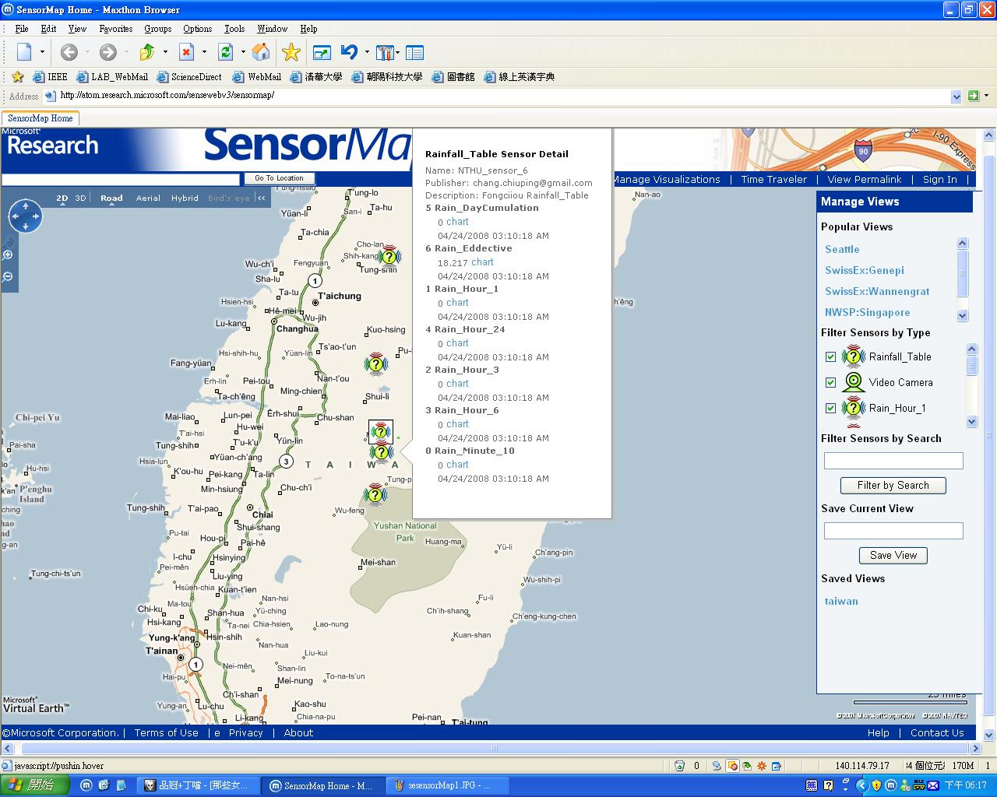
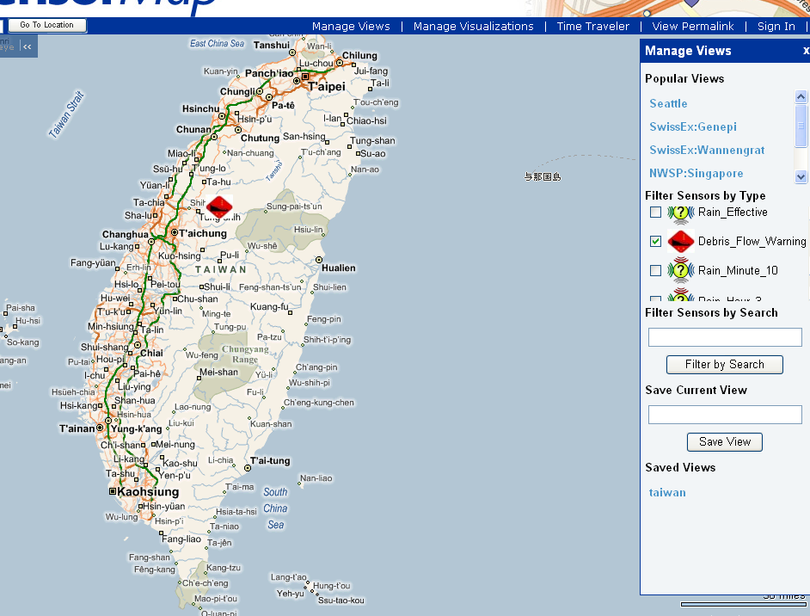
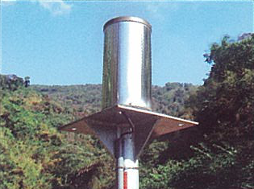
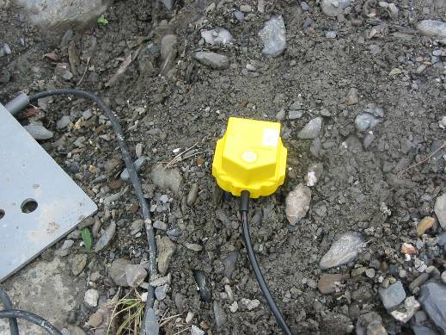
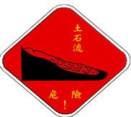

Real-Time Debris Flow Monitoring and Warning via SensorMap, NTHU et al., Taiwan
Add-on
Service
Warning?
NO
YES
Source: Pai Chou, NTHU, Taiwan

Slide 9
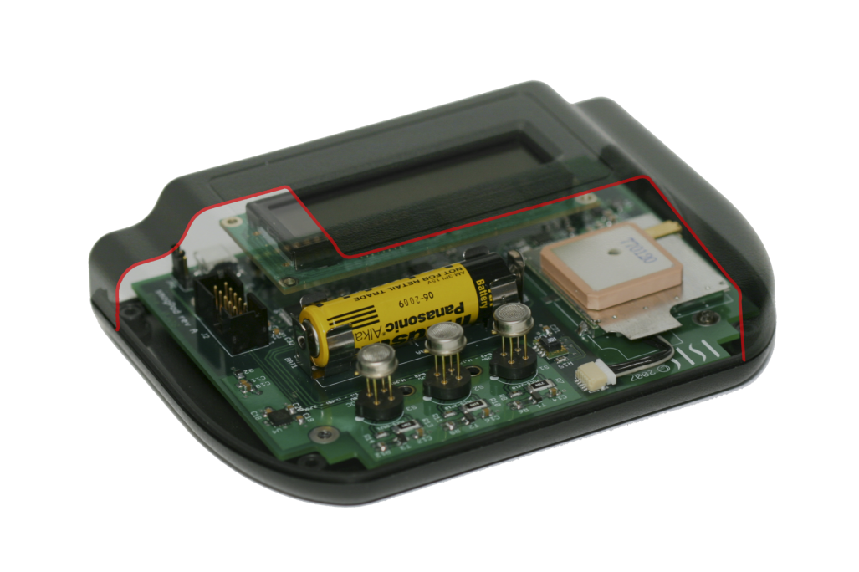
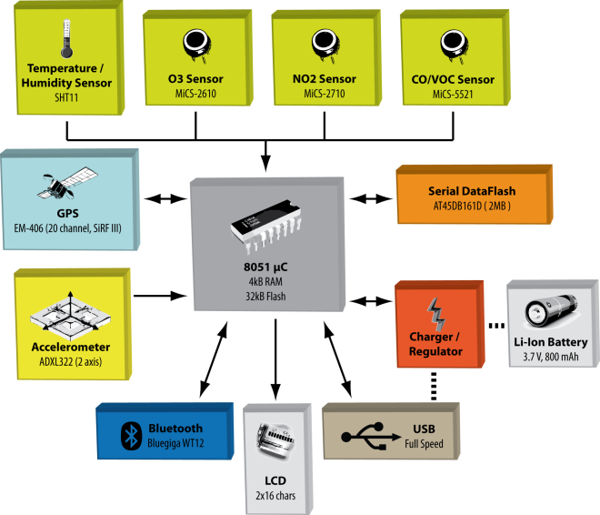
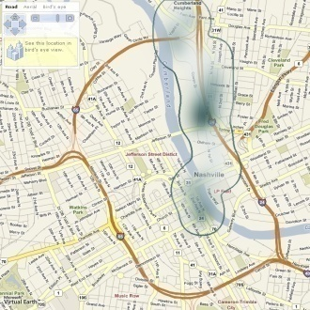
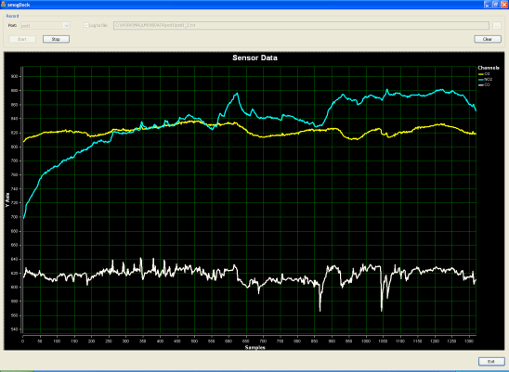
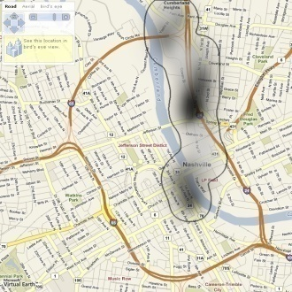
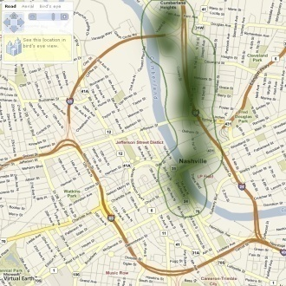
Mobile Air Quality Monitoring Network
Péter Völgyesi, András Nádas, Xenofon Koutsoukos, Ákos Lédeczi
akos.ledeczi@vanderbilt.edu
Autonomous data collection (car mounted)
On-board GPS
Bluetooth® and USB connectivity
Gas sensors: O3, NO2, CO/VOC
Temperature, relative humidity sensors
(sensor compensation)
Li-Ion battery
Smart power management
(MEMS accelerometer)
Integrated with SensorMap 1.0
Local gateway, database server, web server
Client
SensorMap
Web
O3
CO
Consistent view with different sensors
Short survey in a limited area
(East Nashville)
Sensor
Gateway
DB
Web Server
NO2

Slide 10
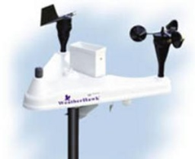
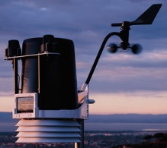



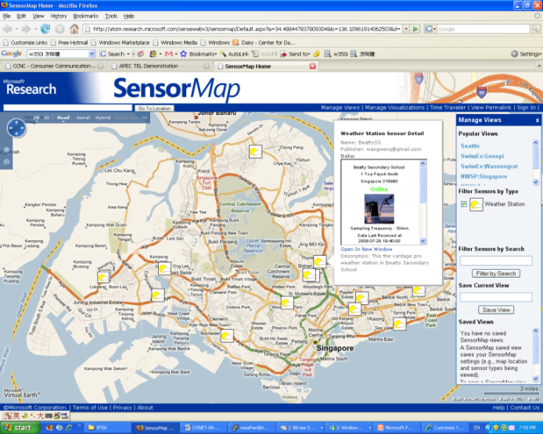
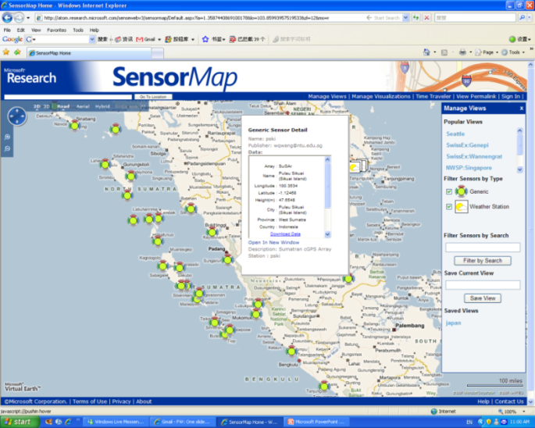
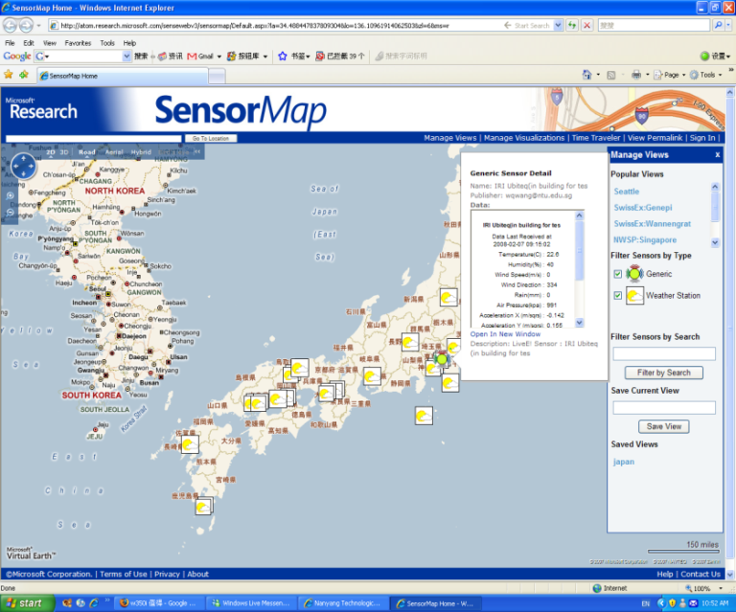
National Weather Sensor Grid
Research
  Sensor grid architecture for the integration of sensor networks and grid computing.
  Service-oriented middleware design for sensor grids.
  Data management techniques for sensor grids.
Integration with SensorMap
  Helped to define the weather multi-modal sensor type and icon.
  Developed tools for publishing sensors on SensorMap.
  Published the sensors deployed in several large-scale environmental monitoring projects on SensorMap.
(a) National Weather Study Project
(b) Sumatran cGPS Array (SuGAr)
(c) APEC Environmental Sensor Grid
Source: Hock Beng Lim (PI), Wenqiang Wang, Mudasser Iqbal, Yuxia Yao, Nanyang Technological University, Singapore. http://www.ntu.edu.sg/intellisys
Notes:
10

Slide 11
Presenters
Event detection and notification, Magda Balazinska, UW
Participatory SensorWeb, Tarek Abdelzaher, UIUC
SwissEx, Sebastian Michel, EPFL
SenseWeb/SensorMap, Liqian Luo, MSR
Catalog scientific data, Bora Beran, MSR
Manage meta data, Prashant Doshi, U Georgia
Virtual Earth, Evelyne Viegas/Bill Chen, Microsoft

