Slide 1

Wireless Networking in the TV Bands
Ranveer Chandra
Collaborators:
Thomas Moscibroda, Srihari Narlanka, Victor Bahl, Yunnan Wu, Yuan Yuan

Slide 2
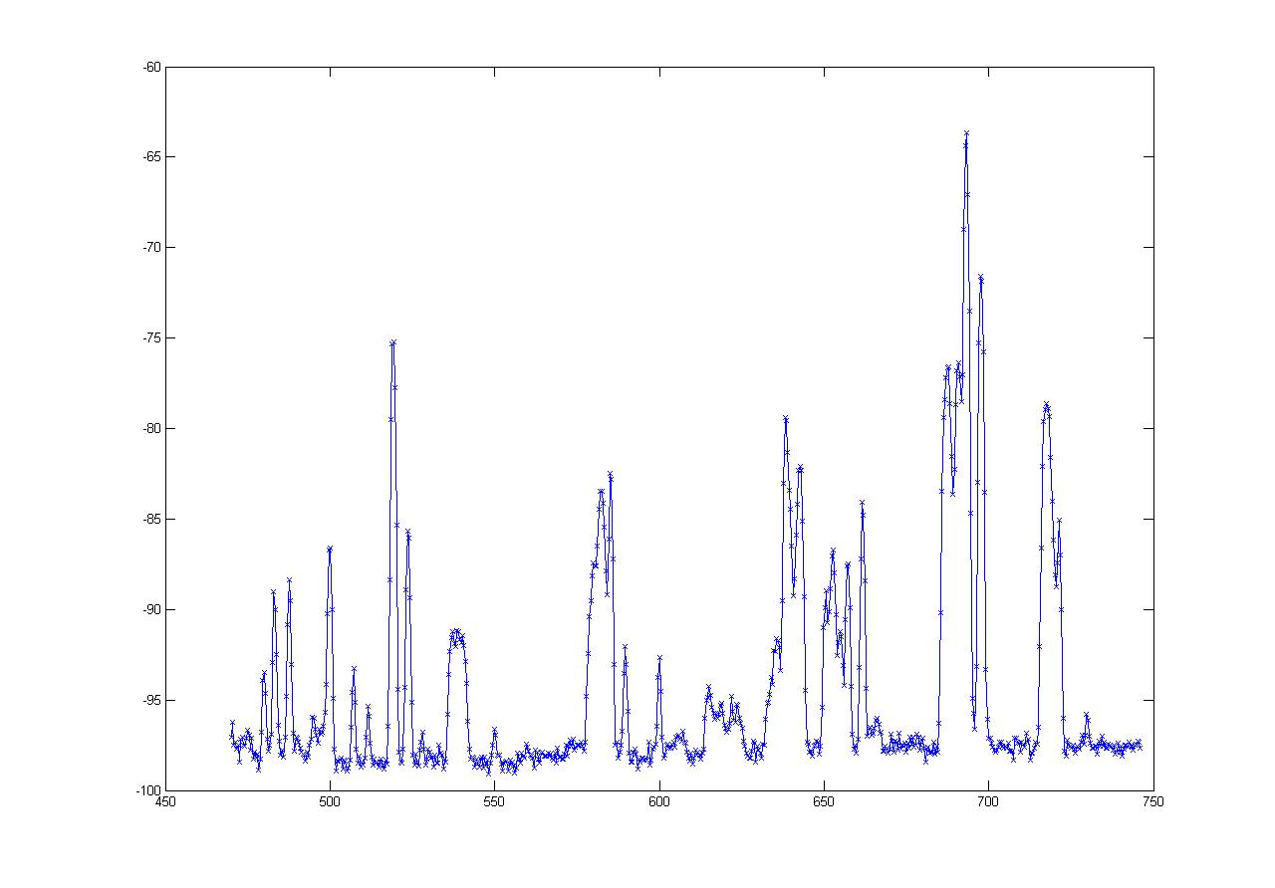
Motivation
Number of wireless devices in ISM bands increasing
  Wi-Fi, Bluetooth, WiMax, City-wide Mesh,…
  Increasing interference → performance loss
Other portions of spectrum are underutilized
Example: TV-Bands
-60
“White spaces”
dbm
-100
470 MHz
Frequency
750 MHz

Slide 3
Motivation
FCC approved NPRM in 2004 to allow unlicensed devices to use unoccupied TV bands
  Rule still pending
Mainly looking at frequencies from 512 to 698 MHz
  Except channel 37
Requires smart radio technology
  Spectrum aware, not interfere with TV transmissions

Slide 4



Cognitive (Smart) Radios
Dynamically identify currently unused portions of spectrum
Configure radio to operate in available spectrum band
  → take smart decisions how to share the spectrum
Signal Strength
Signal Strength
Frequency
Frequency

Slide 5
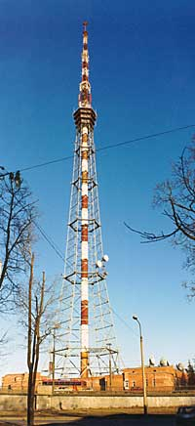

Challenges
Hidden terminal problem in TV bands
518 – 524 MHz
521 MHz
interference
TV Coverage Area

Slide 6
Challenges
Hidden terminal problem in TV bands
Maximize use of fragmented spectrum
  Could be of different widths
-60
“White spaces”
dbm
-100
470 MHz
Frequency
750 MHz

Slide 7
Challenges
Hidden terminal problem in TV bands
Maximize use of available spectrum
Coordinate spectrum availability among nodes
Signal Strength
Signal Strength
Frequency
Frequency

Slide 8
Challenges
Hidden terminal problem in TV bands
Maximize use of available spectrum
Coordinate spectrum availability among nodes
MAC to maximize spectrum utilization
Physical layer optimizations
Policy to minimize interference
Etiquettes for spectrum sharing

Slide 9
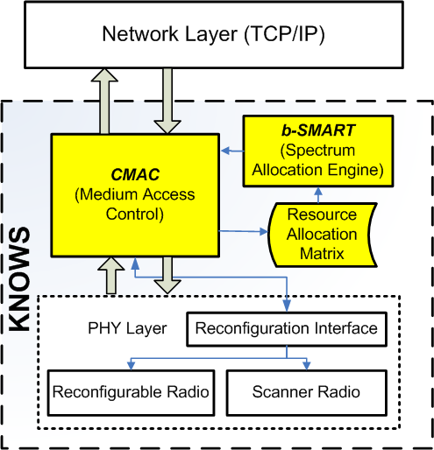
Our Approach: KNOWS
DySpan 2007, LANMAN 2007, MobiHoc 2007
Maximize Spectrum Utilization [MobiHoc’07]
Coordinate spectrum availability [DySpan’07]
Reduces hidden terminal, fragmentation [LANMAN’07]

Slide 10
Outline
Networking in TV Bands
KNOWS Platform – the hardware
CMAC – the MAC protocol
B-SMART – spectrum sharing algorithm
Future directions and conclusions

Slide 11
Hardware Design
Send high data rate signals in TV bands
  Wi-Fi card + UHF translator
Operate in vacant TV bands
  Detect TV transmissions using a scanner
Avoid hidden terminal problem
  Detect TV transmission much below decode threshold
Signal should fit in TV band (6 MHz)
  Modify Wi-Fi driver to generate 5 MHz signals
Utilize fragments of different widths
  Modify Wi-Fi driver to generate 5-10-20-40 MHz signals

Slide 12
Operating in TV Bands
DSP Routines detect TV presence
Scanner
UHF Translator
Wireless Card
Set channel for data communication
Modify driver to operate in 5-10-20-40 MHz
Transmission in the
TV Band

Slide 13
KNOWS: Salient Features
Prototype has transceiver and scanner
Use scanner as receiver on control channel when not scanning
Data Transceiver Antenna
Scanner Antenna

Slide 14
KNOWS: Salient Features
Can dynamically adjust channel-width and center-frequency.
Low time overhead for switching (~0.1ms)
→ can change at very fine-grained time-scale
Transceiver can tune
to contiguous spectrum
bands only!
Frequency

Slide 15
Changing Channel Widths
Scheme 1: Turn off certain subcarriers ~ OFDMA
10 MHz
20 MHz
Issues: Guard band? Pilot tones? Modulation scheme?

Slide 16
Changing Channel Widths
Scheme 2: reduce subcarrier spacing and width!
⇒ Increase symbol interval
10 MHz
20 MHz
Properties: same # of subcarriers, same modulation

Slide 17
Adaptive Channel-Width
20Mhz
5Mhz
Why is this a good thing…?
Fragmentation
→ White spaces may have different sizes
→ Make use of narrow white spaces if necessary
Opportunistic, load-aware channel allocation
→ Few nodes: Give them wider bands!
→ Many nodes: Partition the spectrum in narrower bands
Frequency

Slide 18
Outline
Networking in TV Bands
KNOWS Platform – the hardware
CMAC – the MAC protocol
B-SMART – spectrum sharing algorithm
Future directions and conclusions

Slide 19

MAC Layer Challenges
Crucial challenge from networking point of view:
How should nodes share the spectrum?
Which spectrum-band should two
cognitive radios use for transmission?
Channel-width…?
Frequency…?
Duration…?
Determines network
throughput and overall
spectrum utilization!
We need a protocol that efficiently allocates
time-spectrum blocks in the space!

Slide 20
Allocating Time-Spectrum Blocks
View of a node v:
Primary users
Frequency
f+Δf
f
Time
t
t+Δt
Node v’s time-spectrum block
Neighboring nodes’
time-spectrum blocks
Time-Spectrum Block
Within a time-spectrum block,
any MAC and/or communication
protocol can be used
ACK
ACK
ACK

Slide 21
Context and Related Work
Context:
Single-channel → IEEE 802.11 MAC allocates on time blocks
Multi-channel → Time-spectrum blocks have fixed channel-width
Cognitive channels with variable channel-width!
time
Multi-Channel MAC-Protocols:
[SSCH, Mobicom 2004], [MMAC, Mobihoc 2004],
[DCA I-SPAN 2000], [xRDT, SECON 2006], etc…
Existing theoretical or practical work
does not consider channel-width
as a tunable parameter!
MAC-layer protocols for Cognitive Radio Networks:
[Zhao et al, DySpan 2005], [Ma et al, DySpan 2005], etc…
Regulate communication of nodes
on fixed channel widths

Slide 22
CMAC Overview
Use common control channel (CCC) [900 MHz band]
  Contend for spectrum access
  Reserve time-spectrum block
  Exchange spectrum availability information
  (use scanner to listen to CCC while transmitting)
Maintain reserved time-spectrum blocks
  Overhear neighboring node’s control packets
  Generate 2D view of time-spectrum block reservations

Slide 23

CMAC Overview
RTS
  Indicates intention for transmitting
  Contains suggestions for available time-spectrum block (b-SMART)
CTS
  Spectrum selection (received-based)
  (f,Δf, t, Δt) of selected time-spectrum block
DTS
  Data Transmission reServation
  Announces reserved time-spectrum block to neighbors of sender
Sender
RTS
Receiver
CTS
DTS
Waiting Time
t
DATA
ACK
DATA
Time-Spectrum Block
ACK
DATA
ACK
t+Δt

Slide 24
Network Allocation Matrix (NAM)
Nodes record info for reserved time-spectrum blocks
Time-spectrum block
Frequency
Control channel
IEEE 802.11-like
Congestion resolution
Time
The above depicts an ideal scenario
  1) Primary users (fragmentation)
  2) In multi-hop → neighbors have different views

Slide 25
Network Allocation Matrix (NAM)
Nodes record info for reserved time-spectrum blocks
Primary Users
Frequency
Control channel
IEEE 802.11-like
Congestion resolution
Time
The above depicts an ideal scenario
  1) Primary users (fragmentation)
  2) In multi-hop → neighbors have different views

Slide 26
B-SMART
Which time-spectrum block should be reserved…?
  How long…? How wide…?
B-SMART (distributed spectrum allocation over white spaces)
Design Principles
1. Try to assign each flow
blocks of bandwidth B/N
B: Total available spectrum
N: Number of disjoint flows
2. Choose optimal transmission duration Δt
Long blocks:
Higher delay
Short blocks:
More congestion on control channel

Slide 27
B-SMART
Upper bound T_{max}~10ms on maximum block duration
Nodes always try to send for T_{max}
1. Find smallest bandwidth Δb
for which current queue-length
is sufficient to fill block Δb ΔT_{max}
Δb
Δb=⎡B/N⎤
T_{max}
T_{max}
2. If Δb ≥ ⎡B/N⎤ then Δb := ⎡B/N⎤
3. Find placement of ΔbxΔt block
that minimizes finishing time and does
not overlap with any other block
4. If no such block can be placed due
prohibited bands then Δb := Δb/2

Slide 28
Example
Number of valid reservations in NAM → estimate for N
Case study: 8 backlogged single-hop flows
T_{max}
80MHz
2(N=2)
4 (N=4)
8 (N=8)
2 (N=8)
5(N=5)
1 (N=8)
40MHz
3 (N=8)
1 (N=1)
3 (N=3)
7(N=7)
6 (N=6)
1
2
3
4
5
6
7
8
1
2
3
Time

Slide 29
B-SMART
How to select an ideal T_{max}…?
Let Λ be maximum number of disjoint channels
(with minimal channel-width)
We define T_{max}:= Λ⋅ΔT₀
We estimate N by #reservations in NAM
→ based on up-to-date information → adaptive!
We can also handle flows with different demands
(only add queue length to RTS, CTS packets!)
T_{O}: Average time spent on one successful handshake on control channel
Prevents control channel
from becoming a bottleneck!
Nodes return to control
channel slower than
handshakes are completed

Slide 30
Performance Analysis
In the paper only…
Markov-based performance model for CMAC/B-SMART
  Captures randomized back-off on control channel
  B-SMART spectrum allocation
We derive saturation throughput for various parameters
  Does the control channel become a bottleneck…?
  If so, at what number of users…?
  Impact of T_{max} and other protocol parameters
Analytical results closely match simulated results
Even for large number of flows, control channel can be prevented from becoming a bottleneck
Provides strong validation for our choice of T_{max}

Slide 31
Simulation Results - Summary
Simulations in QualNet
Various traffic patterns, mobility models, topologies
B-SMART in fragmented spectrum:
  When #flows small → total throughput increases with #flows
  When #flows large → total throughput degrades very slowly
B-SMART with various traffic patterns:
  Adapts very well to high and moderate load traffic patterns
  With a large number of very low-load flows
  → performance degrades (→ Control channel)

Slide 32
KNOWS in Mesh Networks
More in the paper…
Aggregate Throughput of Disjoint UDP flows
Throughput (Mbps)
b-SMART finds the best allocation!
# of flows

Slide 33
Summary
Possible to build hardware that does not interfere with TV transmissions
CMAC uses control channel to coordinate among nodes
B-SMART efficiently utilizes available spectrum by using variable channel widths

Slide 34
Future Work & Open Problems
Integrate B-SMART into KNOWS
Address control channel vulnerability
Integrate signal propagation properties of different bands
Build, demonstrate large mesh network!

Slide 35
Questions

Slide 36
MobiHoc 2007

Slide 37
Allocating Dynamic
Time-Spectrum Blocks in
Cognitive Radio Networks
Victor Bahl
Ranveer Chandra
Thomas Moscibroda
Yunnan Wu
Yuan Yuan

Slide 38
Cognitive Radio Networks
Number of wireless devices in the ISM bands increasing
  Wi-Fi, Bluetooth, WiMax, City-wide Mesh,…
  Increasing amount of interference → performance loss
Other portions of spectrum are underutilized
Example:
TV-Bands
-60
“White spaces”
dbm
-100
470 MHz
Frequency
750 MHz

Slide 39
Cognitive Radios
Dynamically identify currently unused portions
of the spectrum
Configure radio to operate in free spectrum band
  → take smart (cognitive?) decisions how to share the spectrum
Signal Strength
Signal Strength
Frequency
Frequency

Slide 40
KNOWS-System
This work is part of our KNOWS project at MSR
(Cognitive Networking over White Spaces) [see DySpan 2007]
Prototype has transceiver and scanner
Can dynamically adjust center-frequency and channel-width
Data Transceiver Antenna
Scanner Antenna

Slide 41
KNOWS System
Can dynamically adjust channel-width and center-frequency.
Low time overhead for switching (~0.1ms)
→ can change at very fine-grained time-scale
Transceiver can tune
to contiguous spectrum
bands only!
Frequency

Slide 42
Adaptive Channel-Width
20Mhz
5Mhz
Why is this a good thing…?
Fragmentation
→ White spaces may have different sizes
→ Make use of narrow white spaces if necessary
Opportunistic and load-aware channel allocation
→ Few nodes: Give them wider bands!
→ Many nodes: Partition the spectrum in narrower bands
Frequency

Slide 43
Cognitive Radio Networks - Challenges
Crucial challenge from networking point of view:
How should nodes share the spectrum?
Which spectrum-band should two
cognitive radios use for transmission?
Channel-width…?
Frequency…?
Duration…?
Determines network
throughput and overall
spectrum utilization!
We need a protocol that efficiently allocates
time-spectrum blocks in the space!

Slide 44
Allocating Time-Spectrum Blocks
View of a node v:
Primary users
Frequency
f+¢f
f
Time
t
t+¢t
Node v’s time-spectrum block
Neighboring nodes’
time-spectrum blocks
Time-Spectrum Block
Within a time-spectrum block,
any MAC and/or communication
protocol can be used
ACK
ACK
ACK

Slide 45

Cognitive Radio Networks - Challenges
Practical Challenges:
Heterogeneity in spectrum availability
Fragmentation
Protocol should be…
- distributed, efficient
- load-aware
- fair
- allow opportunistic use
Protocol to run in KNOWS
Modeling Challenges:
In single/multi-channel systems,
→ some graph coloring problem.
With contiguous channels of variable channel-width, coloring is not an appropriate model!
Need new models!
Theoretical Challenges:
New problem space
Tools…? Efficient algorithms…?

Slide 46
Contributions
Outline
Formalize the Problem
→ theoretical framework for dynamic spectrum allocation in cognitive radio networks
Study the Theory
→ Dynamic Spectrum Allocation Problem
→ complexity & centralized approximation algorithm
Practical Protocol: B-SMART
→ efficient, distributed protocol for KNOWS
→ theoretical analysis and simulations in QualNet
Modeling
Theoretical
Practical

Slide 47
Context and Related Work
Context:
Single-channel → IEEE 802.11 MAC allocates only
time blocks
Multi-channel → Time-spectrum blocks have
pre-defined channel-width
Cognitive channels with variable channel-width!
time
Multi-Channel MAC-Protocols:
[SSCH, Mobicom 2004], [MMAC, Mobihoc 2004],
[DCA I-SPAN 2000], [xRDT, SECON 2006], etc…
Existing theoretical or practical work
does not consider channel-width
as a tunable parameter!
MAC-layer protocols for Cognitive Radio Networks:
[Zhao et al, DySpan 2005], [Ma et al, DySpan 2005], etc…
Regulate communication of nodes
on fixed channel widths

Slide 48
Problem Formulation
Network model:
Set of n nodes V={v₁, … , v_{n}} in the plane
Total available spectrum S=[f_{bot},f_{top}]
Some parts of spectrum are prohibited (used by primary users)
Nodes can dynamically access any
contiguous, available spectrum band
Simple traffic model:
Demand D_{ij}(t,Δt) between two neighbors v_{i} and v_{j}
→ v_{i} wants to transmit D_{ij}(t, Δt) bit/s to v_{j} in [t,t+Δt]
Demands can vary over time!
Goal: Allocate non-overlapping time-spectrum blocks to nodes to satisfy their demand!

Slide 49

Time-Spectrum Block
Frequency
f+¢f
If node v_{i} is allocated
time-spectrum block B
Amount of data it can transmit is
f
Time
t
t+¢t
Capacity of Time-Spectrum Block
Channel-Width
Overhead
(protocol overhead,
switching time,
coding scheme,…)
Signal propagation
properties of band
Time Duration
Capacity linear in
the channel-width
In this paper:
Constant-time overhead
for switching to new block

Slide 50
Problem Formulation
Can be separated in:
Time
Frequency
Space
Dynamic Spectrum Allocation Problem:
Given dynamic demands D_{ij}(t,¢t), assign non-interfering time-spectrum blocks to nodes, such that the demands are satisfied as much as possible.
Interference Model:
Problem can be studied in any interference model!
Captures MAC-layer and
spectrum allocation!
Different optimization functions are possible:
Total throughput maximization
¢-proportionally-fair throughput maximization
Min max fair
over any time-window ¢
Throughput T_{ij}(t,¢t) of a link in [t,t+¢t] is
minimum of demand D_{ij}(t,¢ t) and capacity C(B) of allocated time-spectrum block

Slide 51
Overview
Motivation
Problem Formulation
Centralized Approximation Algorithm
B-SMART
  CMAC: A Cognitive Radio MAC
  Dynamic Spectrum Allocation Algorithm
  Performance Analysis
  Simulation Results
Conclusions, Open Problems

Slide 52
Illustration – Is it difficult after all?
Assume that demands are static and fixed
→ Need to assign intervals to nodes such that neighboring intervals do not overlap!
Self-induced fragmentation
2
6
2
5
2
1. Spatial reuse
(like coloring problem)
1
2
2. Avoid self-induced fragmentation
(no equivalent in coloring problem)
Scheduling even static demands is difficult!
The complete problem more complicated
External fragmentation
Dynamically changing demands
etc…
More difficult than coloring!

Slide 53
Complexity Results
Theorem 1: The proportionally-fair throughput maximization problem is NP-complete even in unit disk graphs and without primary users.
Theorem 2: The same holds for the total throughput maximization problem.
Theorem 3: With primary users, the proportionally-fair throughput maximization problem is NP-complete even in a single-hop network.

Slide 54
Centralized Algorithm - Idea
Any gap in the
allocation is
guaranteed to be
sufficiently large!
Simplifying assumption - no primary users
Algorithm basic idea
4
1. Periodically readjust
spectrum allocation
4
2. Round current demands
to next power of 2
16
3. Greedily pack demands
in decreasing order
4. Scale proportionally to
fit in total spectrum
Avoids harmful self-induced
fragmentation at the cost
of (at most) a factor of 2

Slide 55
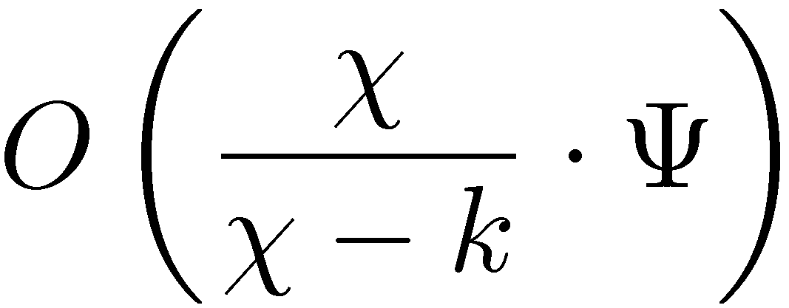
Centralized Algorithm - Results
Consider the proportional-fair throughput
maximization problem with fairness interval ¢
For any constant 3· k· Â, the algorithm is within a factor of
of the optimal solution with fairness interval ¢ = 3Â¯/k.
1) Larger fairness time-interval → better approximation ratio
2) Trade-off between QoS-fairness and approximation guarantee
3) In all practical settings, we have O(ª) → as good as we can be!
Very large constant in practice
Demand-volatility factor

Slide 56
Overview
Motivation
Problem Formulation
Centralized Approximation Algorithm
B-SMART
  CMAC: A Cognitive Radio MAC
  Dynamic Spectrum Allocation Algorithm
  Performance Analysis
  Simulation Results
Conclusions, Open Problems

Slide 57
KNOWS Architecture [DySpan 2007]
This talk!

Slide 58
CMAC Overview
Use a common control channel (CCC)
  Contend for spectrum access
  Reserve a time-spectrum block
  Exchange spectrum availability information
  (use scanner to listen to CCC while transmitting)
Maintain reserved time-spectrum blocks
  Overhear neighboring node’s control packets
  Generate 2D view of time-spectrum block reservations
Distributed, adaptive, localized reconfiguration

Slide 59
CMAC Overview
Sender
Receiver
RTS
RTS
  Indicates intention for transmitting
  Contains suggestions for available time-spectrum block (b-SMART)
CTS
  Spectrum selection (received-based)
  (f,¢f, t, ¢t) of selected time-spectrum block
DTS
  Data Transmission reServation
  Announces reserved time-spectrum block to neighbors of sender
CTS
DTS
Waiting Time
t
DATA
ACK
DATA
Time-Spectrum Block
ACK
DATA
ACK
t+¢t

Slide 60
Network Allocation Matrix (NAM)
Nodes record info for reserved time-spectrum blocks
Time-spectrum block
Frequency
Control channel
IEEE 802.11-like
Congestion resolution
Time
The above depicts an ideal scenario
  1) Primary users (fragmentation)
  2) In multi-hop → neighbors have different views

Slide 61
Network Allocation Matrix (NAM)
Nodes record info for reserved time-spectrum blocks
Primary Users
Frequency
Control channel
IEEE 802.11-like
Congestion resolution
Time
The above depicts an ideal scenario
  1) Primary users (fragmentation)
  2) In multi-hop → neighbors have different views

Slide 62
B-SMART
Which time-spectrum block should be reserved…?
  How long…? How wide…?
B-SMART (distributed spectrum allocation over white spaces)
Design Principles
1. Try to assign each flow
blocks of bandwidth B/N
B: Total available spectrum
N: Number of disjoint flows
2. Choose optimal transmission duration ¢t
Long blocks:
Higher delay
Short blocks:
More congestion on control channel

Slide 63
B-SMART
Upper bound T_{max}~10ms on maximum block duration
Nodes always try to send for T_{max}
1. Find smallest bandwidth ¢b
for which current queue-length
is sufficient to fill block ¢b ¢ T_{max}
¢b
¢b=dB/Ne
T_{max}
T_{max}
2. If ¢b ¸ dB/Ne then ¢b := dB/Ne
3. Find placement of ¢bx¢t block
that minimizes finishing time and does
not overlap with any other block
4. If no such block can be placed due
prohibited bands then ¢b := ¢b/2

Slide 64
Example
Number of valid reservations in NAM → estimate for N
Case study: 8 backlogged single-hop flows
T_{max}
80MHz
2(N=2)
4 (N=4)
8 (N=8)
2 (N=8)
5(N=5)
1 (N=8)
40MHz
3 (N=8)
1 (N=1)
3 (N=3)
7(N=7)
6 (N=6)
1
2
3
4
5
6
7
8
1
2
3
Time

Slide 65
B-SMART
How to select an ideal T_{max}…?
Let ¤ be maximum number of disjoint channels
(with minimal channel-width)
We define T_{max}:= ¤¢ T₀
We estimate N by #reservations in NAM
→ based on up-to-date information → adaptive!
We can also handle flows with different demands
(only add queue length to RTS, CTS packets!)
T_{O}: Average time spent on one successful handshake on control channel
Prevents control channel
from becoming a bottleneck!
Nodes return to control
channel slower than
handshakes are completed

Slide 66
Questions and Evaluation
Is the control channel a bottleneck…?
  Throughput
  Delay
How much throughput can we expect…?
Impact of adaptive channel-width on UDP/TCP...?
Multiple-hop cases, mobility,…? (Mesh…?)
In the paper, we answer by
1. Markov-based analytical performance analysis
2. Extensive simulations using QualNet

Slide 67
Performance Analysis
In the paper only…
Markov-based performance model for CMAC/B-SMART
  Captures randomized back-off on control channel
  B-SMART spectrum allocation
We derive saturation throughput for various parameters
  Does the control channel become a bottleneck…?
  If so, at what number of users…?
  Impact of T_{max} and other protocol parameters
Analytical results closely match simulated results
Even for large number of flows, control channel can be prevented from becoming a bottleneck
Provides strong validation for our choice of T_{max}

Slide 68
Simulation Results
Control channel data rate: 6Mb/s
Data channel data Rate : 6Mb/s
Backlogged UDP flows
T_{max}=Transmission duration
We have developed
techniques to make
this deterioration
even smaller!

Slide 69
Simulation Results - Summary
More in the paper…
Simulations in QualNet
Various traffic patterns, mobility models, topologies
B-SMART in fragmented spectrum:
  When #flows small → total throughput increases with #flows
  When #flows large → total throughput degrades very slowly
B-SMART with various traffic patterns:
  Adapts very well to high and moderate load traffic patterns
  With a large number of very low-load flows
  → performance degrades (→ Control channel)

Slide 70
Conclusions and Future Work
Summary:
  Spectrum Allocation Problem for Cognitive Radio Networks
  Radically different from existing work for fixed channelization
  B-SMART → efficient, distributed protocol for sharing white spaces
Future Work / Open Problems
  Integrate B-SMART into KNOWS
  Address control channel vulnerability
  Integrate signal propagation properties of different bands
  Better approximation algorithms
  Other optimization problems with variable channel-width
  → wide open - with plenty of important, open problems!
Practice
Theory

