Slide 1
Specification techniques for verifying object-oriented software
K. Rustan M. Leino
Research in Software Engineering (RiSE)
Microsoft Research, Redmond, WA, USA
3 December 2008
U. Lugano
Lugano, Switzerland

Slide 2
Collaborators most relevant to this talk
Mike Barnett
Manuel Fähndrich
Bart Jacobs
Peter Müller
Wolfram Schulte
Jan Smans
Herman Venter
Angela Wallenburg

Slide 3
Software engineering problem
Problem
  Building and maintaining programs that are correct
Approach
  Specifications record design decisions
    bridge intent and code
  Tools amplify human effort
    manage details
    find inconsistencies
    ensure quality

Slide 4
Verified Software Initiative
Hoare, Joshi, Leavens, Misra, Naumann, Shankar, Woodcock, et al.
“We envision a world in which computer programs are always the most reliable component of any system or device that contains them” [Hoare & Misra]

Slide 5
Spec# programming system
Spec# language
  Object-oriented .NET language
  Superset of C# 2.0, adding:
    more types (e.g., non-null types)
    specifications (e.g., pre- and postconditions)
Usage rules (methodology)
Checking:
  Static type checking
  Run-time checking
  Static verification (optional)

Slide 6
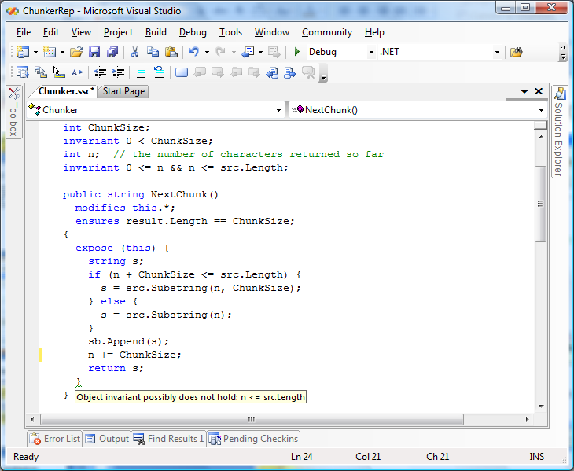
Spec# demo

Slide 7
Spec# verifier architecture
Spec#
Spec# compiler
MSIL (“bytecode”)
Translator
Boogie
Inference engine
V.C. generator
verification condition
SMT solver
“correct” or list of errors

Slide 8
Boogie – a verification tool bus
Spec#
C with HAVOC specifications
C with vcc specifications
Dafny
Chalice
Your language here
Boogie
Boogie-to-Boogie transformations:
Inference engines
Program transformations
Logic optimizers
Your prover here
Simplify
Z3
SMT Lib

Slide 9
Comparison of some specification techniques
Spec#
  Boogie methodology
Dafny
  dynamic frames
Chalice
  implicit dynamic frames (permission model)

Slide 10
Example: Composite object
:RockBand
songs
invariant:
r.songs = r.gt.solos
gt
:Guitar
solos

Slide 11
Problem:
Invariants don't always hold
:RockBand
r.gt.solos := r.gt.solos + 1;
r.songs := r.songs + 1;
songs
invariant:
r.songs = r.gt.solos
gt
:Guitar
solos

Slide 12
Problem:
Overlapping representations
:RockBand
:RockBand
songs
songs
5
6
5
gt
gt
:Guitar
solos
5
6

Slide 13
Boogie methodology
invariant declarations
To address that invariants don’t always hold:
  ghost field inv
  methodology guarantees that
  (∀o • o.inv ⇒ Inv(o)) always holds
  inv is changed by: expose (o) { … }
To control overlapping representations:
  ghost field owner
  methodology guarantees that
  (∀o • o.owner.inv ⇒ o.inv) always holds
  rep modifiers indicate ownership intentions

Slide 14
RockBand in Boogie methodology
class RockBand {
int songs;
rep Guitar gt;
invariant songs == gt.solos;
public void Play()
requires inv ∧¬owner.inv;
modifies this.*;
{
expose (this) {
gt.Strum();
songs++;
} }
…

Slide 15
Spec# demo: RockBand
public class RockBand {
int songs;
[Rep] Guitar gt;
invariant songs == gt.solos;
public void Play() {
expose (this) {
gt.Strum();
songs++;
}
}
…
Notes:
using Microsoft.Contracts;
public class RockBand {
int songs;
[Rep] Guitar gt;
invariant songs == gt.solos;
public void Play() {
expose (this) {
gt.Strum();
songs++;
}
}
public RockBand() {
songs = 0;
gt = new Guitar();
}
}
public class Client {
public void Main() {
RockBand b = new RockBand();
b.Play();
b.Play();
}
}
public class Guitar {
public int solos;
public Guitar()
ensures solos == 0;
{
}
public void Strum()
modifies solos;
ensures solos == old(solos) + 1;
{
solos++;
}
}

Slide 16
Dynamic frames [Kassios 2006]
A dynamic frame is a set of memory locations
Functions, which used to decribed invariants, are defined over dynamic frames
Methods operate over dynamic frames
In Dafny: dynamic frames are usually specified using a programmer-defined ghost field footprint

Slide 17
Dafny demo: RockBand
class RockBand {
var footprint: set<object>;
var songs: int;
var gt: Guitar;
function Valid(): bool
reads {this}, footprint;
{
this in footprint &&
gt != null && gt in footprint &&
gt.footprint <= footprint && !(this in gt.footprint) &&
gt.Valid() &&
songs == gt.solos
}
method Play()
requires Valid();
modifies footprint;
ensures Valid() && fresh(footprint - old(footprint));
{
call gt.Strum();
songs := songs + 1;
footprint := footprint + gt.footprint;
}
…
Notes:
class RockBand {
var footprint: set<object>;
var songs: int;
var gt: Guitar;
function Valid(): bool
reads {this}, footprint;
{
this in footprint &&
gt != null && gt in footprint &&
gt.footprint <= footprint && !(this in gt.footprint) &&
gt.Valid() &&
songs == gt.solos
}
method Play()
requires Valid();
modifies footprint;
ensures Valid() && fresh(footprint - old(footprint));
{
call gt.Strum();
songs := songs + 1;
footprint := footprint + gt.footprint;
}
method Init()
modifies {this};
ensures Valid() && fresh(footprint - {this});
{
songs := 0;
var g := new Guitar; call g.Init();
gt := g;
footprint := {this};
footprint := footprint + {gt} + gt.footprint;
}
}
class Client {
method Main() {
var b := new RockBand;
call b.Init();
call b.Play();
call b.Play();
}
}
class Guitar {
var footprint: set<object>;
var solos: int;
function Valid(): bool
reads {this}, footprint;
{ this in footprint && !(null in footprint) }
method Init()
modifies {this};
ensures Valid() && fresh(footprint - {this});
ensures solos == 0;
{
solos := 0;
footprint := {this};
}
method Strum()
requires Valid();
modifies footprint;
ensures Valid() && fresh(footprint - old(footprint));
ensures solos == old(solos) + 1;
{
solos := solos + 1;
}
}

Slide 18
Implicit dynamic frames [Smans et al. 2008]
Like in separation logic, define dynamic frames as part of specification predicates
acc(o.f) specifies the ability to read/write o.f
modifies specifications implicitly follow from accessibility predicates in preconditions

Slide 19
Chalice demo: RockBand
class RockBand {
var songs: int
var gt: Guitar
predicate Valid {
acc(songs) &&
acc(gt) && gt != null && gt.Valid && acc(gt.solos) &&
songs == gt.solos
}
method Play()
requires Valid
ensures Valid
{
call gt.Strum()
songs := songs + 1
}
…
Notes:
class RockBand {
var songs: int
var gt: Guitar
predicate Valid {
acc(songs) &&
acc(gt) && gt != null && gt.Valid && acc(gt.solos) &&
songs == gt.solos
}
method Play()
requires Valid
ensures Valid
{
call gt.Strum()
songs := songs + 1
}
method Init()
requires acc(this.*)
ensures Valid
{
songs := 0
gt := new Guitar
call gt.Init()
}
}
class Client {
method Main() {
var b := new RockBand
call b.Init()
call b.Play()
call b.Play()
}
}
class Guitar {
var solos: int
predicate Valid { true }
method Init()
requires acc(this.*)
ensures Valid && acc(solos) && solos == 0
{
solos := 0
}
method Strum()
requires Valid && acc(solos)
ensures Valid && acc(solos) && solos == old(solos) + 1
{
solos := solos + 1
}
}

Slide 20
Chalice with -autoMagic
class RockBand {
var songs: int
var gt: Guitar
predicate Valid {
gt.Valid && songs == gt.solos
}
method Play()
requires Valid
ensures Valid
{
call gt.Strum()
songs := songs + 1
}
…
Notes:
class RockBand {
var songs: int
var gt: Guitar
predicate Valid {
gt.Valid && songs == gt.solos
}
method Play()
requires Valid
ensures Valid
{
call gt.Strum()
songs := songs + 1
}
method Init()
requires acc(this.*)
ensures Valid
{
songs := 0
gt := new Guitar
call gt.Init()
}
}
class Client {
method Main() {
var b := new RockBand
call b.Init()
call b.Play()
call b.Play()
}
}
class Guitar {
var solos: int
predicate Valid { true }
method Init()
requires acc(this.*)
ensures Valid && acc(solos) && solos == 0
{
solos := 0
}
method Strum()
requires Valid && acc(solos)
ensures Valid && acc(solos) && solos == old(solos) + 1
{
solos := solos + 1
}
}

Slide 21
Comparison: Spec#
Spec# (Boogie methodology)
  specifications are simple, many defaults
  invariant declarations
  admissibility restrictions control overlapping representations
  restrictive

Slide 22
Comparison: Dafny
Dafny (dynamic frames)
  flexible
  overlapping representations allowed
    errors reported when they would cause problems
  simple language design
  verbose specifications
  manual updates of footprints

Slide 23
Comparison: Chalice
Chalice (permission accounting)
  flexible
  overlapping representations allowed
    these must be specified with partial permissions
  verbose specifications, but -autoMagic helps
  thinking through partial permissions is complicated

Slide 24
Conclusions
Difficult: designing a programming methodology that
  fits common programming idioms
  is easy to use and teach
  can be handled well by automatic provers
invariant declarations come at a price
Wanted: better presentation of errors
http://research.microsoft.com/specsharp
http://research.microsoft.com/rise

