Slide 1


Learning Semantic String Transformations from Examples
Rishabh Singh and Sumit Gulwani

Slide 2
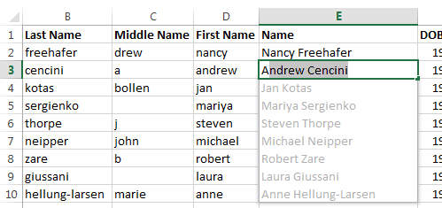


FlashFill
Notes:
Say “a data transformation and cleaning tool by examples”
Give a brief demo

Slide 3





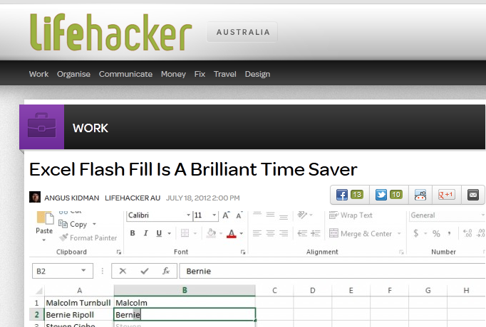




Slide 4
Transformations
Syntactic Transformations
  Concatenation of regular expression based substring
  “VLDB2012” → “VLDB”
Semantic Transformations
  More than just characters
  “1/5/2010” → “May 1st 2010”
Notes:
Example of syntactic and semantics
Grey out the previous work

Slide 5
Semantic Transformations
Semantic information as relational tables
  1 → January, 2 → February
Learn table lookup queries
  VLOOKUP macro 2nd most problematic

Slide 6
Outline
Lookup Transformations
Lookup + Syntactic Transformations
Case Studies
Notes:
Lookup,
String
Lookup + string

Slide 7
Table Lookup Transformations
Demo

Slide 8
Learning Framework
Input
Strings
Output String
F
…
F₁
F_{n}
1. Domain-specific Language L
2. Algorithm to learn all Fs from (i,o)

Slide 9
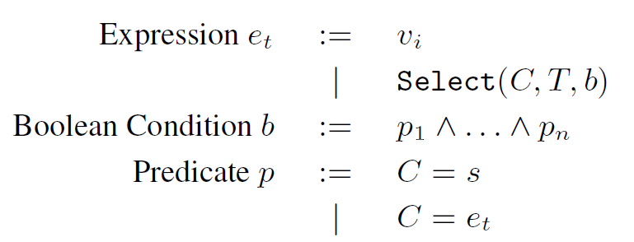

Lookup Transformation Language $L_{t}$

Slide 10
Example - Lookup
Select(Name, EmpRecord, (SSN = v₁))
Input v₁ | Output
044-58-3429 | Steve Russell
Emp Record
SSN | EmpId | Name
027-36-4557 | 1254 | John Henry
034-83-7683 | 2412 | William Johnson
044-58-3429 | 1125 | Steve Russell
018-45-8949 | 4257 | Ian Jordan
023-34-3254 | 6418 | Mary Dina
Notes:
Input-output table, background table

Slide 11
Example – Transitive Lookup
Select(Price, PriceRec, (ItemId =
Select(ItemId, ItemRec, Item = v₁))
Input v₁ | Output
Stroller | $145.67
ItemRec
ItemId | Item
ST-340 | Stroller
BI-567 | Bib
DI-328 | Diapers
WI-989 | Wipes
AS-469 | Aspirator
PriceRec
ItemId | Price
ST-340 | $145.67
BI-567 | $3.56
DI-328 | $21.45
WI-989 | $5.12
AS-469 | $2.56
Notes:
Show single tuple program
Relational functions → short example (substring matches)

Slide 12
Learn Query
Input v₁ | Output
Stroller | $145.67
ItemRec
ItemId | Item
ST-340 | Stroller
BI-567 | Bib
DI-328 | Diapers
WI-989 | Wipes
AS-469 | Aspirator
PriceRec
ItemId | Price
ST-340 | $145.67
BI-567 | $3.56
DI-328 | $21.45
WI-989 | $5.12
AS-469 | $2.56
Select(Price, PriceRec, (ItemId =
Select(ItemId, ItemRec, Item = v₁))

Slide 13
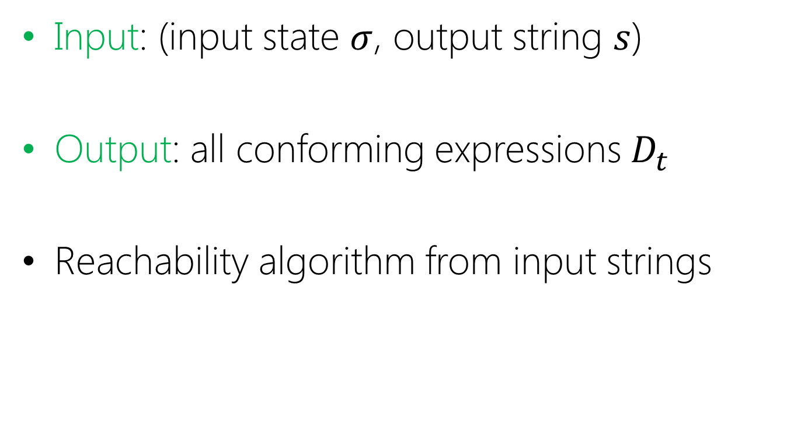

Synthesis Algorithm : $GenerateStr_{t}$
  Input: (input state $σ$, output string $s$)
Output: all conforming expressions${ D}_{t}$
Reachability algorithm from input strings

Slide 14





$$GenerateStr_{t}$$
$$η_{1}$$
$$η_{2}$$
$$η_{3}$$
$$Progs\left[η_{1}\right]=\left\{v_{1}\right\}$$
Strings reachable from input row
044-58-3429
Emp Record
SSN | EmpId | Name
027-36-4557 | 1254 | John Henry
034-83-7683 | 2412 | William Johnson
044-58-3429 | 1125 | Steve Russell
018-45-8949 | 4257 | Ian Jordan

Slide 15
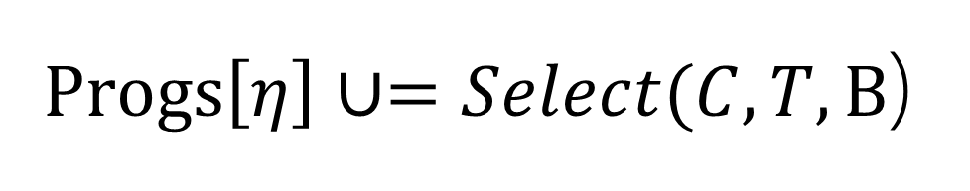

$$GenerateStr_{t}$$
$Progs\left[η\right]∪=Select(C,T, B$)
$$B≡\left.{\left\{∧C_{i}=\left\{val^{−1}\left(T\left[C_{i},r\right]\right)\right\}\right\}}_{j}\right.$$
strings in table rows of visited nodes
044-58-3429 | 1125 | Steve Russell

Slide 16
$$GenerateStr_{t}$$
……..
Repeat until k steps or fixpoint

Slide 17

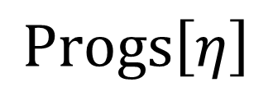
$$GenerateStr_{t}$$
……..
Steve Russell
$$η$$
$$Progs\left[η\right]$$

Slide 18
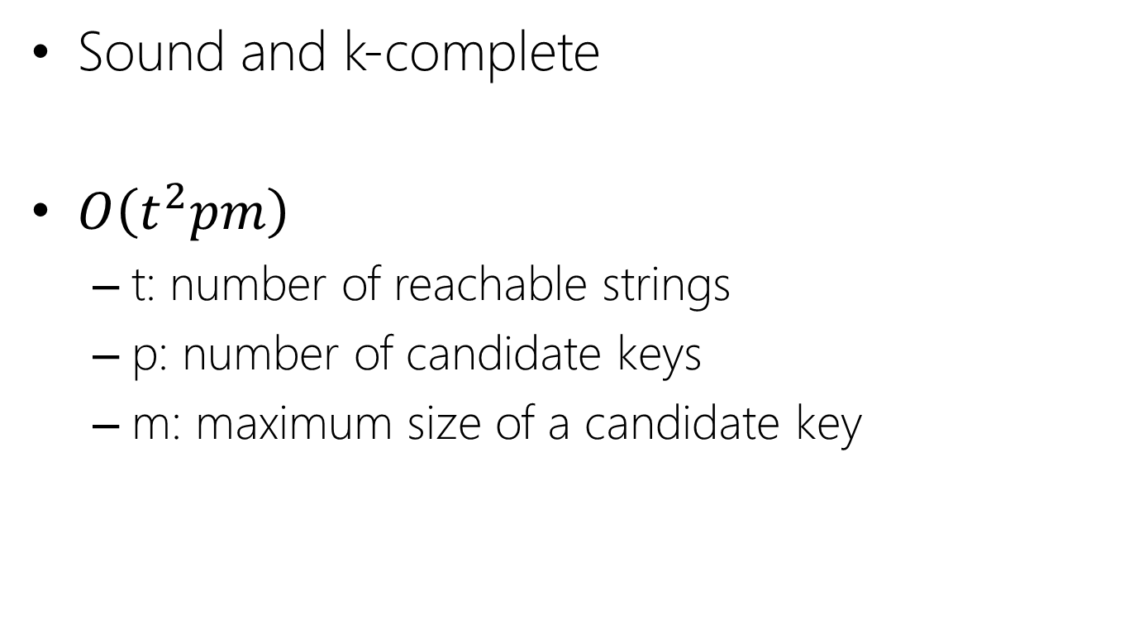
$$GenerateStr_{t}$$
Sound and k-complete
$O\left(t^{2}pm\right)$
  t: number of reachable strings
  p: number of candidate keys
  m: maximum size of a candidate key

Slide 19

Data structure $D_{t}$
Maintains tree structure
  share common sub-expressions
CNF of Boolean Conditionals
  independent column predicates

Slide 20



$${Intersect}_{t} : D_{t_{1}}∧ D_{t_{2}}$$
$$∧$$
$$≡$$

Slide 21
Synthesize Procedure
Synthesize((i₁,o₁), …, (i_{n},o_{n}))
P = GenerateStr_{t}(i₁,o₁)
for j = 2 to n:
P’ = GenerateStr_{t}(i_{j},o_{j})
P = Intersect_{t}(P’, P)
return P

Slide 22
Semantic String Transformations
Demo

Slide 23
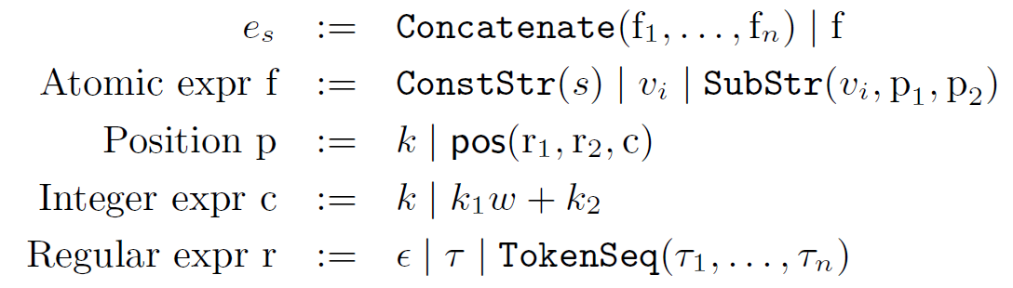

Syntactic String Language $L_{s}$
[GulwaniPOPL11]

Slide 24
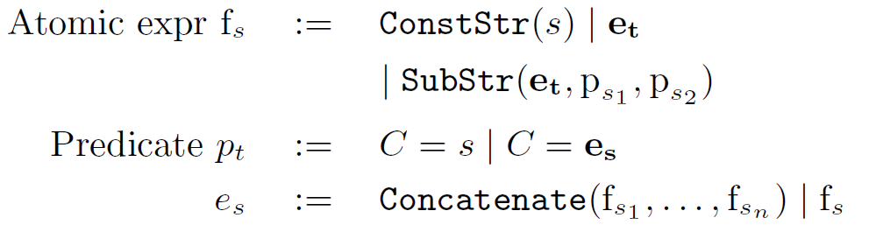

Combined Language $L_{u}$
Syntactic manipulations over lookup outputs
Syntactic manipulations before indexing

Slide 25
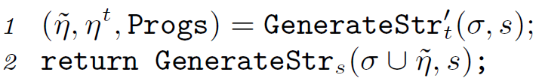
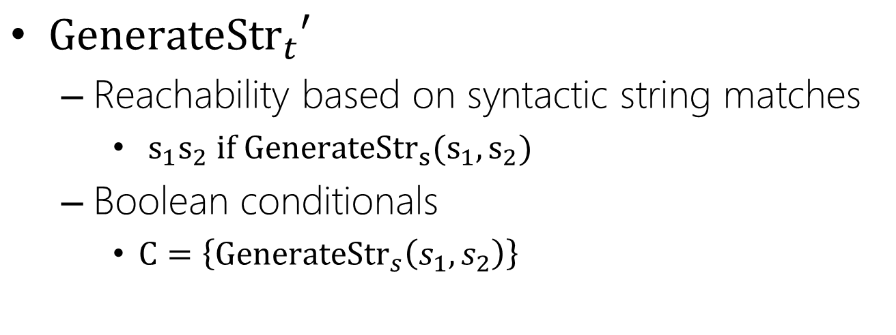
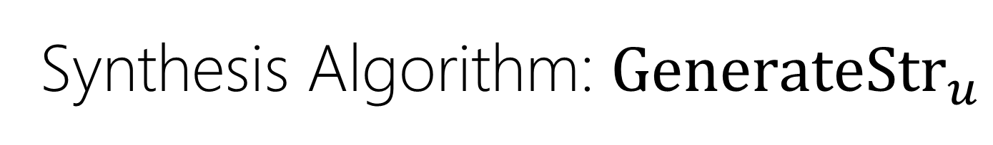
Synthesis Algorithm: $GenerateStr_{u}$
$GenerateStr_{t}′$
  Reachability based on syntactic string matches
    $s_{1}s_{2} if {GenerateStr}_{s}(s_{1},s_{2})$
  Boolean conditionals
    $C=\left\{GenerateStr_{s}\left(s_{1},s_{2}\right)\right\}$

Slide 26

$$GenerateStr_{u}$$
SSN: 044-58-3429
Mr. Steve Russell
Emp Record
SSN | EmpId | Name
027-36-4557 | 1254 | John Henry
034-83-7683 | 2412 | William Johnson
044-58-3429 | 1125 | Steve Russell
018-45-8949 | 4257 | Ian Jordan

Slide 27
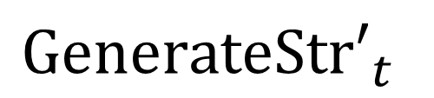
$$GenerateStr_{u}$$
SSN: 044-58-3429
Emp Record
SSN | EmpId | Name
027-36-4557 | 1254 | John Henry
034-83-7683 | 2412 | William Johnson
044-58-3429 | 1125 | Steve Russell
018-45-8949 | 4257 | Ian Jordan
$$GenerateSt{r′}_{t}$$

Slide 28
$$GenerateStr_{u}$$
SSN: 044-58-3429
Emp Record
SSN | EmpId | Name
027-36-4557 | 1254 | John Henry
034-83-7683 | 2412 | William Johnson
044-58-3429 | 1125 | Steve Russell
018-45-8949 | 4257 | Ian Jordan
$$GenerateSt{r′}_{t}$$

Slide 29
$$GenerateStr_{u}$$
{ “SSN: 044-58-3429”, “044-58-3429”, “1125”, “Steve Russell” }
Set of reachable strings

Slide 30


$$GenerateStr_{u}$$
{ “SSN: 044-58-3429”, “044-58-3429”, “1125”, “Steve Russell” }
$$GenerateStr_{s}$$
Mr. Steve Russell
${Intersect}_{u}$ and $D_{u}$in paper

Slide 31
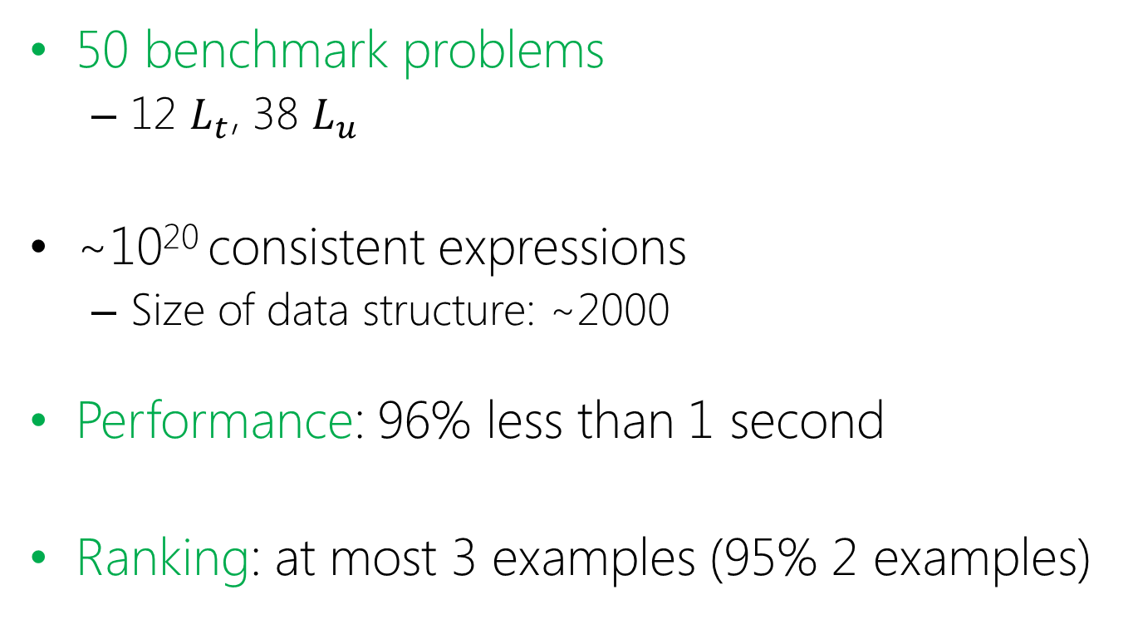
Experiments
50 benchmark problems
  12 $L_{t}$, 38 $L_{u}$
~10²⁰ consistent expressions
  Size of data structure: ~2000
Performance: 96% less than 1 second
Ranking: at most 3 examples (95% 2 examples)

Slide 32
Related Work
Matching strings for table joins
  Record Matching [Elmagarmid et. al. 07, Koudas et. al. SIGMOD06]
  Schema Matching [Dhamankar et. al. SIGMOD04, Warren & Tompa VLDB06]
Query Synthesis
  from representative view [Das Sharma et.al. ICDT10, Tran et.al. SIGMOD09]
Text-editing by example
  QuickCode[Gulwani POPL11]
  SMARTedit[Lau et.al. ML03], Simulatenous Editing[Miller et.al. USENIX01]

Slide 33
Thanks!
Algorithm
Designers
Software Developers
End-Users
Large potential
Notes:
End-users Excel millions of users

Slide 34
Backup slides

Slide 35
Semantic String Transformations
Time (12 Hr) | Time (24 Hr)
0930 | 9:30 AM
1520 | 3:20 PM
1648
0830
1015
2010
1012
1425
=TEXT(C,”00 00”)+0

Slide 36
Semantic String Transformations
Date | Formatted Date
06-03-2008 | Jun 3rd, 2008
03-26-2010
08-01-2009
09-24-2007
05-14-2010
07-20-1998
10-24-2004
08-24-1972

Slide 37
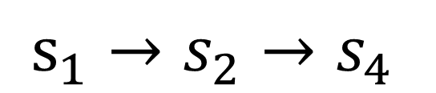
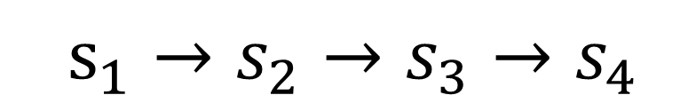
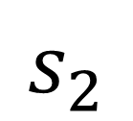
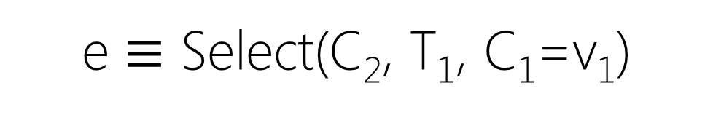
Idea 1: Share sub-expressions
T₁
C₁ | C₂ | C₃
s₁ | s₂ | s₃
T₂
C₁ | C₂ | C₃
s₂ | s₃ | s₄
T₃
C₁ | C₂ | C₃
s₃ | s₄ | s₅
$$s_{2}$$
e $≡$ Select(C₂, T₁, C₁=v₁)
$s_{1}→s_{2}→s_{4}$
Select(C₃, T₂, C₁=e)
$s_{1}→s_{2}→s_{3}→s_{4}$
Select(C₂, T₃, C₁=Select(C₂,T₂,C₁=e)

Slide 38
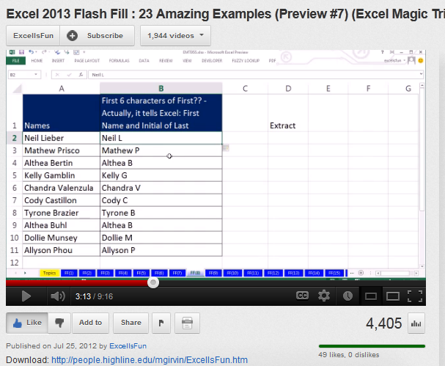
Youtube Videos
French
Polish
Urdu
German
Serbian
Russian
http://bit.ly/flashfill

Slide 39
Idea 2: CNF conditionals
T
C₁ | C₂ | C₃ | … | C_{n} | C_{n+1}
s | s | s |  | s | t
v₁ | v₂ | … | v_{m} | Out
s | s |  | s | t

Slide 40
No. of Consistent Expressions

Slide 41
Succinct Representation

Slide 42
Performance

Slide 43
Ranking

Slide 44
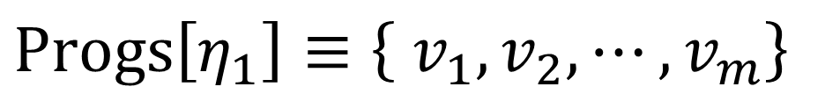

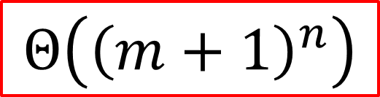
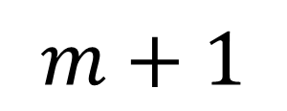
Idea 2: CNF conditionals
$$\{\left\{η_{1}, η_{2}\right\}, η_{2}, Progs\}$$
$$Progs\left[η_{1}\right]≡\left\{ v_{1}, v_{2}, ⋯,v_{m}\right\}$$
$$Progs\left[η_{2}\right]=\{Select\left(C_{n+1},T, { ∧_{i}C}_{i}=\left\{s,η_{1}\right\}\right)\}$$
$$m+1$$
$$Θ\left({\left(m+1\right)}^{n}\right)$$

Slide 45

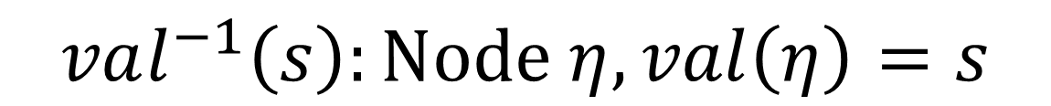


$$GenerateStr_{t}$$
$$η$$
$val\left(η\right)$ : string value
$Progs(η)$ : set of lookup programs to generate $val\left(η\right)$
$$val^{−1}\left(s\right):Node η, val\left(η\right)=s$$

Slide 46
Related Work
Record Matching
  Similarity functions for matching [Elmagarmid et. al. 07, Koudas et. al. SIGMOD06]
  Customizable similarity function [Arasu et. al. VLDB09]
Learning Schema Matches
  iMAP [Dhamankar et. al. SIGMOD04] concat. of column strings using domain-specific knowledge
  [Warren & Tompa VLDB06] concatenation of column substrings, single table

Slide 47
Related Work
Query Synthesis [Das Sharma et.al. ICDT10, Tran et.al. SIGMOD09]
  Infer relation from large representative example view
  no joins or projections
Text-editing using examples
  QuickCode[Gulwani POPL11] string transformations
  SMARTedit[Lau et.al. ML03], Simulatenous Editing[Miller et.al. USENIX01] programming by demonstration

Slide 48
General Framework
A Domain-specific Transformation Language L
  Expressive and succinct
Efficient Data structures for set of expressions
  Version-space algebra
GenerateStr
  All sets of expressions from I-O example
Intersect
  Intersect two sets of expressions
Notes:
Animation
Data Xfrom examples Xfrom can be in any language -> Excel macros,
Overlap -> representation collapse
Interface
Domain specific
User interface => transformation language => data structure as tree
Multiple examples → examples multiple trees.
Animation

Slide 49
Example - Lookup
Emp Record
SSN | EmpId | Name
027-36-4557 | 1254 | John Henry
034-83-7683 | 2412 | William Johnson
044-58-3429 | 1125 | Steve Russell
018-45-8949 | 4257 | Ian Jordan
023-34-3254 | 6418 | Mary Dina
Input v₁ | Output
044-58-3429 | Steve Russell
023-34-3254
Select(Name, EmpRecord, (SSN = v₁))
Notes:
Input-output table, background table

Slide 50
Example – Transitive Lookups
ItemRec
ItemId | Item
ST-340 | Stroller
BI-567 | Bib
DI-328 | Diapers
WI-989 | Wipes
AS-469 | Aspirator
PriceRec
ItemId | Price
ST-340 | $145.67
BI-567 | $3.56
DI-328 | $21.45
WI-989 | $5.12
AS-469 | $2.56
Input v₁ | Output
Stroller | $145.67
Bib
Aspirator
Wipes
Select(Price, PriceRec, (ItemId =
Select(ItemId, ItemRec, Item = v₁))
Notes:
Show single tuple program
Relational functions → short example (substring matches)

Slide 51
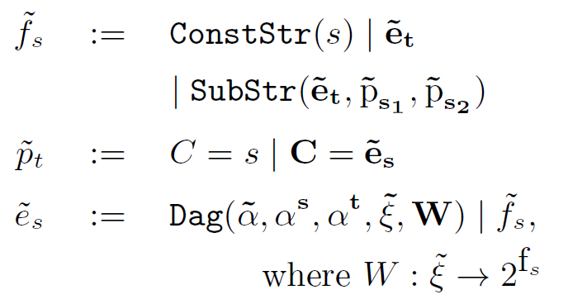

Data Structure $D_{u}$

Slide 52

Data structure for $L_{t}$ expressions
Notes:
Learn not write programs

Slide 53
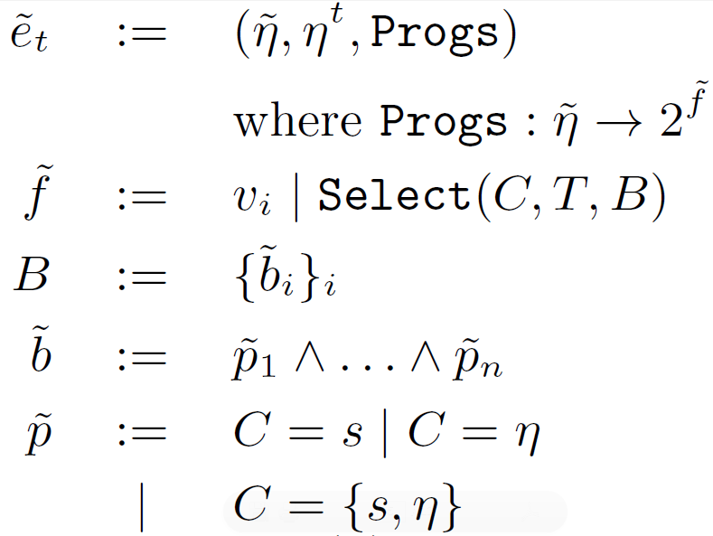
Data structure $D_{t}$

Slide 54
Data structure $D_{t}$

Slide 55
Data structure $D_{t}$

Slide 56
Example
T₁
C₁ | C₂ | C₃
s₁ | s₂ | s₃
T₂
C₁ | C₂ | C₃
s₂ | s₃ | s₄
T_{i}
C₁ | C₂ | C₃
s_{i} | s_{i+1} | s_{i+2}
…
T_{m}
Input v₁ | Output
s₁ | s_{m}
Notes:
Add real words
Based on graphs →path counting

Slide 57

Sub-expression Sharing
T_{i-1}
C₁ | C₂ | C₃
s_{i-1} | s_{i} | s_{i+1}
$${ s}_{i}$$
T_{i-2}
C₁ | C₂ | C₃
s_{i-2} | s_{i-1} | s_{i}

Slide 58
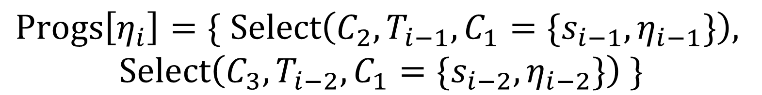

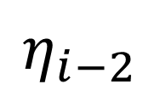

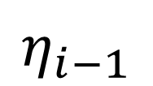
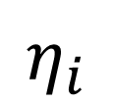

Sub-expression Sharing
$${ s}_{i−1}$$
$$η_{i−1}$$
$${ s}_{i}$$
$$η_{i}$$
$${ s}_{i−2}$$
$$η_{i−2}$$
$$Progs\left[η_{i}\right]=\{ Select\left(C_{2}, T_{i−1}, C_{1}={\{s_{i−1},η}_{i−1}\}\right),$$
$$Select\left(C_{3},T_{i−2}, C_{1}={\{s_{i−2},η}_{i−2}\}\right) \}$$

Slide 59

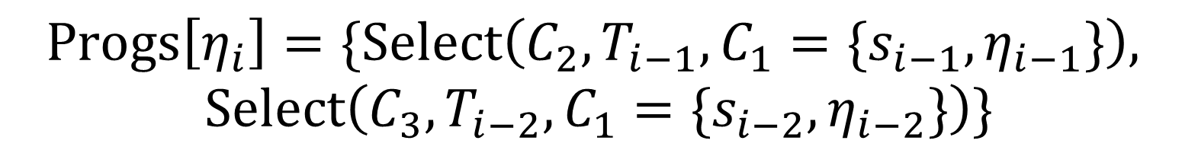
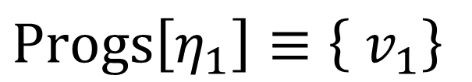
Sub-expression Sharing
$$\{\left\{η_{1}, η_{2}, ⋯, η_{m}\right\}, η_{m}, Progs\}$$
$$Progs\left[η_{i}\right]=\{Select\left(C_{2}, T_{i−1}, C_{1}={\{s_{i−1},η}_{i−1}\}\right),$$
$$Select\left(C_{3},T_{i−2}, C_{1}={\{s_{i−2},η}_{i−2}\}\right)\}$$
$$Progs\left[η_{1}\right]≡\left\{ v_{1}\right\}$$
$$Progs\left[η_{2}\right]=\{Select\left(C_{2},T_{1}, C_{1}=\left\{s_{1},η_{1}\right\}\right)\}$$

Slide 60
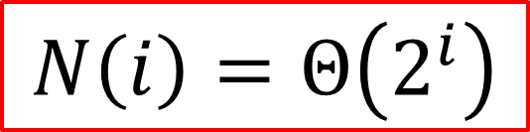
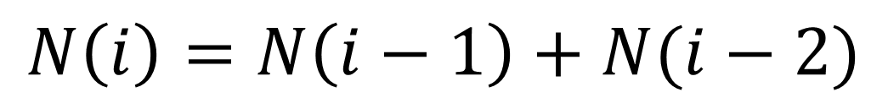
Sub-expression Sharing
$$N\left(i\right)=N\left(i−1\right)+N(i−2)$$
$$\{\left\{η_{1}, η_{2}, ⋯, η_{m}\right\}, η_{m}, Progs\}$$
$$N\left(i\right)=Θ\left(2^{i}\right)$$
$$Progs\left[η_{i}\right]=\{Select\left(C_{2}, T_{i−1}, C_{1}={\{s_{i−1},η}_{i−1}\}\right),$$
$$Select\left(C_{3},T_{i−2}, C_{1}={\{s_{i−2},η}_{i−2}\}\right)\}$$
$$Progs\left[η_{1}\right]≡\left\{ v_{1}\right\}$$
$$Progs\left[η_{2}\right]=\{Select\left(C_{2},T_{1}, C_{1}=\left\{s_{1},η_{1}\right\}\right)\}$$

Slide 61
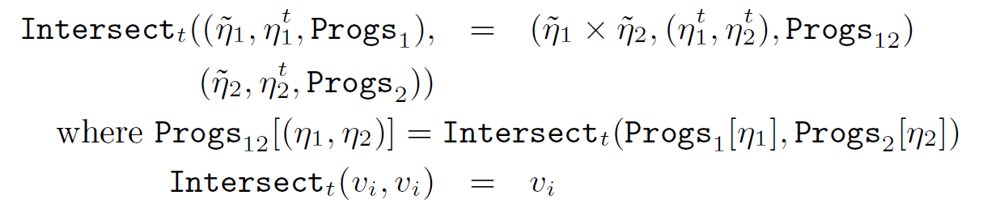
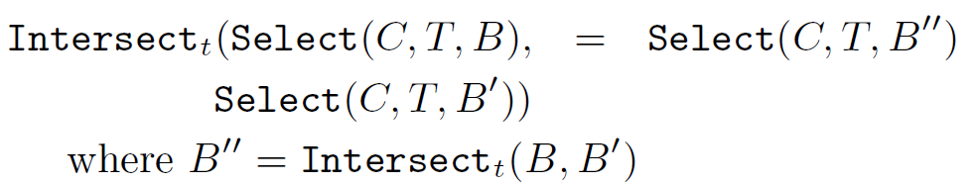
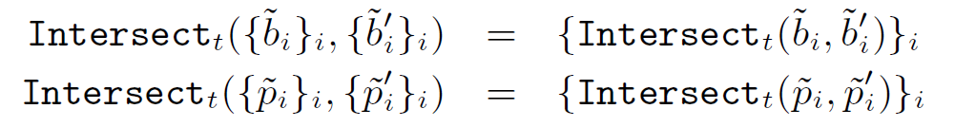
$${Intersect}_{t} : D_{t_{1}}∧ D_{t_{2}}$$

Slide 62
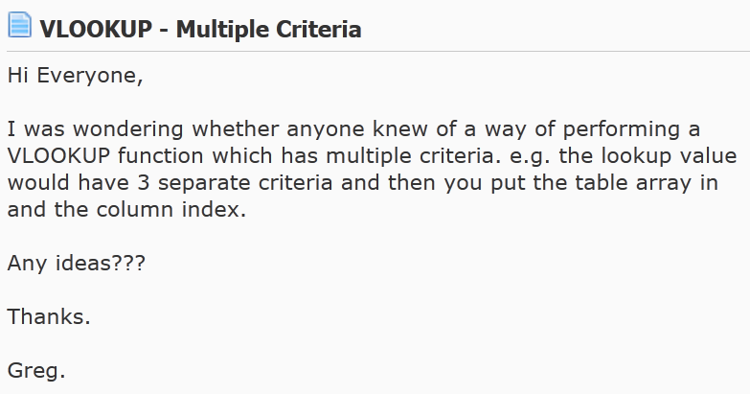
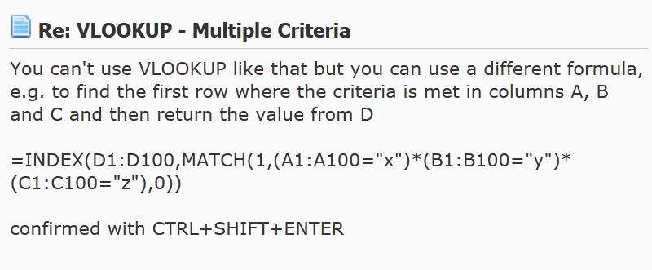
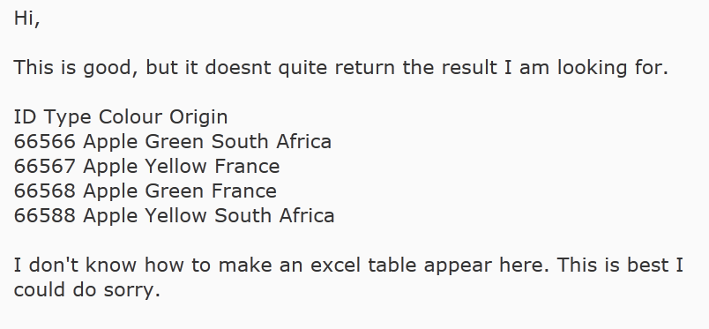
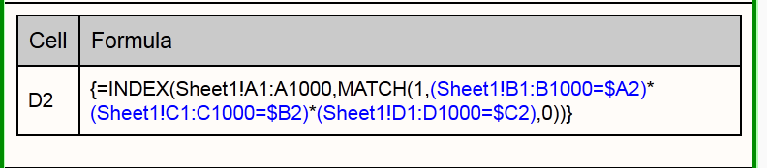
Current State of the Art: Help forums
Notes:
Need?

Slide 63
Observations
Semantic string transformations
Input-output examples based interaction
  New disambiguating inputs
Add-in with the same interface

