Slide 1
Optimus: A Dynamic Rewriting Framework for Data-Parallel Execution Plans
Qifa Ke, Michael Isard, Yuan Yu
Microsoft Research Silicon Valley
EuroSys 2013
Notes:
Optimus, a framework to rewrite data-parallel execution plans at runtime.

Slide 2
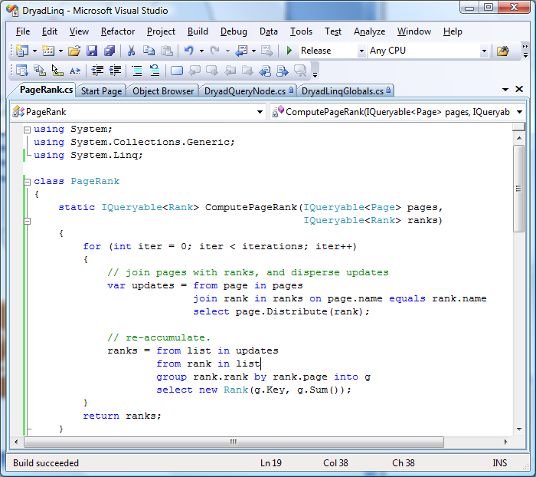
Distributed Data-Parallel Computing
Distributed execution plan generated by query compiler (DryadLINQ)
Automatic distributed execution (Dryad)
Notes:
Today in many data-parallel computing platforms, a developer writes a program on a single computer. The query compiler compiles the user program into a distributed execution plan and ships it to the cluster. The distributed execution engine manages the execution on the cluster.

Slide 3
Execution Plan Graph (EPG)
EPG: distributed execution plan represented as a DAG:
  Representing computation and dataflow of data-parallel program
Core data structure in distributed execution engines
  Task distribution
  Job management
  Fault tolerance
Map
Distribute
Merge
GroupBy
Reduce
EPG of MapReduce
Notes:
The execution plan is typically represented by a directed acyclic graph (DAG). We call it execution plan graph, or EPG. Here is the EPG for MapReduce. Each box is a vertex representing some computation, and the edges are the data flow. MapReduce EPG contains three major stages, the mapping stage M, the data shuffling stage repartitioning mapper outputs, and the reduce stage R.
EPG is also the core data structure used by the distributed execution engine for task distribution, job management, and fault tolerance.

Slide 4
Outline
Motivational problems
Optimus system
Graph rewriters
Experimental evaluation
Summary & conclusion
Notes:
I will first present some problems for motivation. Later I will show how Optimus addresses these problems.

Slide 5
Problem 1: Data Partitioning
Basic operation to achieve data parallelism
Example: MapReduce
  Number of partitions = number of reducers
    More reducers: better load balancing but more overheads in scheduling and disk I/O
  Data skew: e.g., popular keys
Require statistics of Mapper outputs
  Hard to estimate at compile time
  But available at runtime
We need dynamic data partitioning.
Notes:
The first problem is data partitioning. It is a basic operation to achieve data parallelism. There are two issues here. We use map-reduce as an example to explain. First, we need to specify the number of partitions (or reducers) when re-partitioning the mappers output. More reducers give better load balancing but also more overheads in task scheduling and disk I/O. The second issue is data skew among the partitions. This is often seen in data partitioning, especially when there are popular keys. To handle these two issues we need data statistics of mapper outputs, which usually are available only at runtime. This means we need dynamic data partitioning.
------------

Slide 6
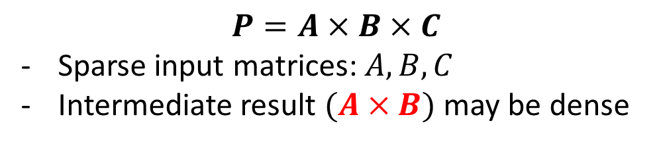
Problem 2: Matrix Computation
Widely used in large-scale data analysis
Data model: sparse or dense matrix?
  Compile-time: unknown density of intermediate matrices
$$P=A×B×C$$
Sparse input matrices: $A, B, C$
Intermediate result $(A×B)$ may be dense
Alternative algorithms for a given matrix computation
  Chosen based on runtime data statistics of input matrices
How to dynamically choose data model and alternative algorithms ?
Notes:
The second problem is matrix computation, which is widely used in large-scale data analysis. There are two issues here. First, we need to choose a data model to represent matrices, either sparse or dense matrix representation. This is actually non-trivial. Let us say we want to compute the multiplication of three matrices. The input matrices (A, B, C) are sparse, but the intermediate matrix from A times B could become dense. Using wrong data model could introduce large performance penalties. The second issue is for a given matrix computation, there are often multiple alternative algorithms. Choosing the right data model and algorithms again require data statistics of intermediate results, which often are available only at runtime.
-------------

Slide 7
Problem 3: Iterative Computation
Required by machine learning and data analysis
Problem: stop condition unknown at compile time
  Each job performs N iterative steps
  Submit multiple jobs and check convergence at client
How to enable iterative computation in one single job ?
  Simplifies job monitoring and fault-tolerance
  Reduces job submission overhead
Job 1
Job 2
Notes:
The third problem is iterative computation. This is required by machine learning applications. The issue is the stop condition is known only at runtime. A common practice is to submit a job for some fixed number of iterations. Get the result to check the stop condition, and issue more jobs for more iterations if needed. If we can enable iterative computation in one single job. it will simplify job monitoring and fault tolerance, and reduce job submission overheads.
------------

Slide 8
Problem 4: Fault Tolerance
Intermediate results can be re-generated by re-executing vertices
Important intermediate results: expensive to regenerate when lost
  Compute-intensive vertices
  Critical chain: a long chain of vertices reside in same machine due to data locality
How to identify and protect important intermediate results at runtime?
C
B
A
X
Notes:
Fault tolerance is another problem we address. When an intermediate result is lost, we can back-track the EPG and re-execute vertices to re-compute the result. It would be expensive to re-execute compute-intensive vertices, or when a long critical chain of vertices are needed to re-generate the data. Here is an example, vertex A,B, and C were executed on a single computer. When the input to X is loss, A is re-run, which caused B and C to re-run.
One option is to replicate all intermediate results, which is expensive. Instead, we want to identify and protect important intermediate results for more efficient fault tolerance using runtime information.
---------------

Slide 9
Problem 5: EPG Optimization
Compile-time query optimization
  Using data statistics available at compile time
  EPG typically unchanged during execution
Problems with compile-time optimization:
  Data statistics of intermediate stages hard to estimate
    Complicated by user-defined functions
How to optimize EPG at runtime?
Notes:
Another problem, Execution plan optimization, this is usually done at compile time. EPG optimization requires data statistics. For multi-stage EPG, the statistics of intermediate stages are unknown at compile time, and thus the optimization is often not effective. How to optimize EPG at runtime?
--------------

Slide 10
Optimus: Dynamic Graph Rewriting
Dynamically rewrite EPG based on:
  Data statistics collected at runtime
  Compute resources available at runtime
Goal: extensible
  Implement rewriters at language layer
    Without modifying execution engine (e.g., Dryad)
  Allows users to specify rewrite logic
Notes:
Optimus is designed to address all these problems. It collects data statistics at runtime, and use them to rewrite EPG dynamically. Our design goal is to make it extensible. The graph rewriters are implemented at language layer. New graph rewriters can be added without modifying the execution engine. Users are also able to specify their own rewrite logic at user program.
----------------------

Slide 11
Example: MapReduce
Statistics collection at data plane
Rewrite message sent to graph rewriter at control plane
Merge small partitions
Split popular keys
Notes:
I will use map-reduce as an example to illustrate the EPG rewriting. Optimus inserts vertices “H” into data plane to collect data statistics, which are then merged to generated a rewrite message, that is sent to the control plane and trigger the graph rewriter. The rewriter then modifies the EPG accordingly. In this example, the rewriter merges small partitions, and isolates out some very popular keys.
--------------------

Slide 12
Outline
Motivational problems
Optimus system
Graph rewriters
Experimental evaluation
Summary & conclusion
Notes:
In the following I will describe Optimus system.

Slide 13
Optimus System Architecture
User Program
User-defined Rewrite Logic
User-defined Statistics
Build on DryadLINQ and Dryad
Modules
  Statistics collecting
  Rewrite messaging
    Data plane →control plane
  Graph rewriting
Extensible
  Statistics and rewrite logic at language/user layers
  Rewriting operation at execution layer
Client computer
DryadLINQ Compiler with Optimus Extensions
EPG
Worker Vertex Code
Rewrite Logic
Statistics
Dryad Job Manager (JM)
Core Execution Engine
Rewriter Module
Rewrite Logic
Cluster
…..
Worker Vertex Harness
Messaging
Statistics
Worker Vertex Code
Dryad Worker Vertex
Notes:
Optimus is built on top of DryadLINQ and Dryad, a data-parallel platform in Microsoft. We add a rewriter module in the Job manager. Users can define their own statistics and rewrite logic. In the compiler, the rewrite logic are specified for built-in operators. The compiler generates code for statistics collection and graph rewriting, which are shipped to worker vertices and Job manager. The statistics collected at each vertex are merged in the data plane to generate a rewriting message, which is then sent to the rewriter in the job manager to trigger the graph rewriting.

Slide 14
Estimate/Collect Data Statistics
Low overhead: piggy-back into existing vertices
  Pipelining “H” into “M”
Extensible
  Statistics estimator/collector defined at language layer or user-level
All at data plane: avoid overwhelming control plane
  “H”: distributed statistics estimation/collection
  “MG” and “GH”: merge statistics into rewriting message
Notes:
The statistics collection has very low overhead, as it is piggy-backed into existing vertices. This is done by pipelining the statistics vertex, in this example H, into the same process containing the mapper “M”.
The statistics collection is extensible, as they are implemented in the language layer or user level.
All statistics estimation and collection are at data plane. This also avoids adding overhead to control plane.
-------------

Slide 15
Graph Rewriting Module
A set of primitives to query and modify EPG
Rewriting operation depends on vertex state:
  INACTIVE: all rewriting primitives applicable
  RUNNING: killed and transited to INACTIVE, discarding partial results
  COMPLETED: redirect vertex I/O
Notes:
Graph rewriting module provides a set of primitives to query and modify the EPG owned by the job manager. Rewriting operation depends on vertex state.
For an INACTIVE vertex, all rewriting primitives can be applied.
For a RUNNING vertex, Optimus first kills the vertex to transit its state to INACTIVE, and then apply the rewrite. Partial results are discarded.
For COMPLETED vertex, Optimus only redirects its inputs and outputs.

Slide 16
Outline
Motivational problems
Optimus system
Graph rewriters
Experimental evaluation
Summary & conclusion
Notes:
I will now describe some graph rewriters we implemented.

Slide 17
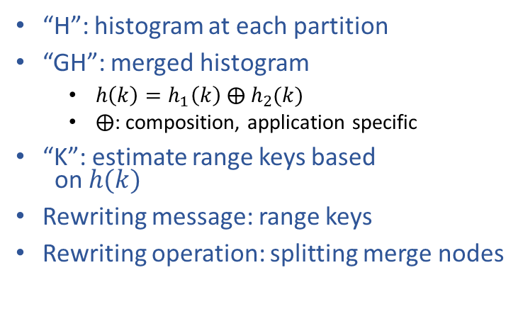
Dynamic Data (Co-)Partitioning
Co-partitioning:
  Use a common parameter set to partition multiple data sets
  Used by multi-source operators, e.g., Join
Co-range partition in Optimus:
“H”: histogram at each partition
“GH”: merged histogram
  $h\left(k\right)=h_{1}\left(k\right) ⨁{ h}_{2}(k)$
  $⨁$: composition, application specific
“K”: estimate range keys based
on $h(k)$
Rewriting message: range keys
Rewriting operation: splitting merge nodes
Notes:
Data co-partitioning is to use a common set of parameters to partition multiple data sets. It is used by multi-source operators, such as Join.
Below is the co-range partitioner for two inputs. Here “H” estimates data histograms at each vertex. “GH” merges the all histograms into a single global histogram . The composition operator in this merge is application-dependent and can be specified by user. The merged histogram is used by vertex “K” to computed the range keys, which are also included in the rewrite message. Upon receiving the rewriting message, the graph rewriter then splits the merge nodes for co-range partitioning.

Slide 18
Hybrid Join
I
I
I
I
I
Co-partition to prepare data for partition-wise Join
Skew detected at runtime
Re-partition skewed partition
  Local broadcast join
H
H
H
H
H
GH
K
D
D
D
D
D
MG
MG
MG
MG
MG
MG
MG
MG
D1
J
J
J
J
J
J
Notes:
We implements a dynamic hybrid join in Optimus. First we use co-partition to prepare the data for partition-wise Join. Since estimating key histogram is sometimes hard, there could still be data skew. The skew is detected at runtime. Optimus further divides this skewed partition into two, and constructs a broadcast Join locally for this pair of skewed partitions. The overall Join is thus a hybrid of partition-wise join and broadcast join.

Slide 19
Iterative Computation
Optimus: enables iterative computation in a single job
  “C”: check stop condition
  Construct another loop if needed
Notes:
Optimus enables iterative computation in a single job. A vertex “C” is added to check the stop condition specified in the user program. The stop condition is sent to the rewriter, which will construct a new iteration if needed.

Slide 20
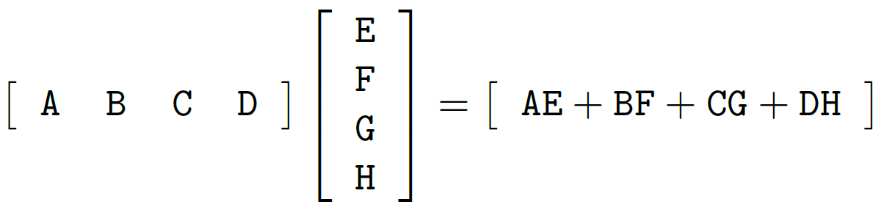
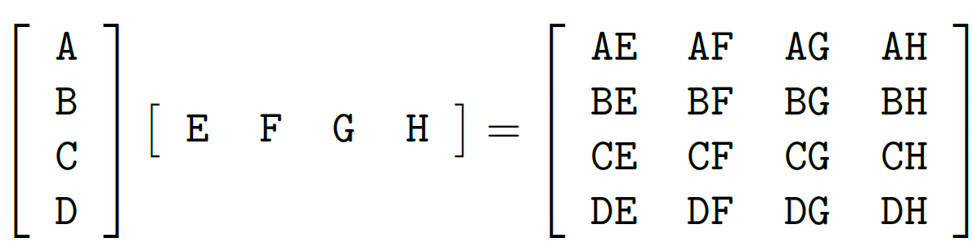
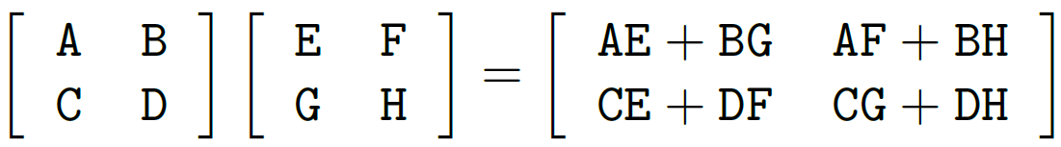
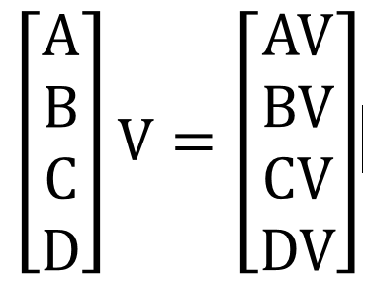

Matrix Multiplication
Different ways to do $P=U×V$
  Choose based on matrix sizes and density
Notes:
Matrix multiplication is a building block in matrix computation. There are multiple ways to multiply two matrices, as we shown here. To choose the right way, we need input matrix sizes and density. Often such information is available only at runtime.

Slide 21
Matrix Computation
Systems dedicated to matrix computations: MadLINQ
Optimus: extensibility allows integrating matrix computation with general-purpose DryadLINQ computations
Runtime decisions
  Data partitioning: subdivide matrices
  Data model: sparse or dense
  Implementation: a matrix operation often has many algorithmic implementations
Notes:
In contrast to systems dedicated to matrix computations, the extensibility of Optimus allows us to implement a matrix library at the user layer using general-purpose DryadLINQ computations. This library makes several runtime decisions, including data partitioning to subdivide matrices, choosing sparse or dense matrix representation, choosing alternative algorithms for a given matrix computation.

Slide 22
Reliability Enhancer for Fault Tolerance
Replication graph to protect important data generated by “A”:
“C” vertex:
  copy output of “A” to another computer
“O” vertex:
  allow “B” choose one of two inputs to “O”
Notes:
We implement a reliability enhancer in Optimus for fault tolerance. It inserts replication sub-graph to protect important intermediate data. In this example, A and B has been completed. Optimus decides to protect A’s output. It inserts the copy vertex “C” to replicate the output of A to another computer. It then inserts vertex “O” to allow “B” to take either the original copy or the replicated copy.

Slide 23
Outline
Motivational problems
Optimus system
Graph rewriters
Experimental evaluation
Summary & conclusion
Notes:
Experiments.

Slide 24
Evaluation: Product-Offer Matching by Join
Input: 5M products + 4M offers
  Matching function: compute intensive
Algorithms:
  Partition-wise GroupJoin
  Broadcast-Join
  CoGroup: specialized solution
  Optimus
Aggregated CPU utilization
Baseline | CoGroup | Broadcast | Optimus
0.82 | 0.72 | 0.55 | 0.81
Job completion time
Cluster (machine) utilization
Notes:
We use a real application to evaluate optimus. Here the task is to match 4 million merchant items to 5 million products. This is done by Join with a matching function that is compute-intensive.
We compare Optimus with three other implementations. Optimus achieved the best performance.
To understand the reason, we plot the cluster utilization. The baseline partition-wise Join has a few long running vertices, caused by data skew. CoGroup is a specialized solution for this application. It requires 3 pre-processing stages, causing about 300 seconds overhead. Optimus quickly utilizes the cluster resources, but so is broadcast join.
We further investigated CPU utilization, we found broadcast join has low CPU utilization, due to threads blocking on intensive network I/O.
--------------------------------------

Slide 25
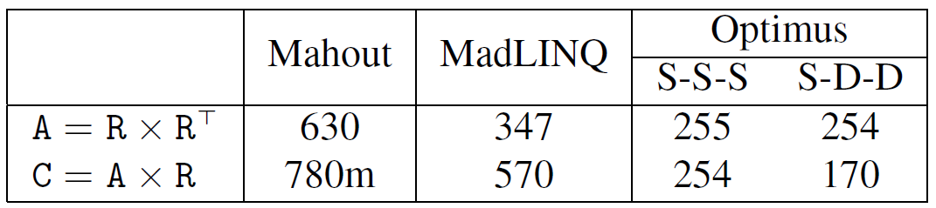
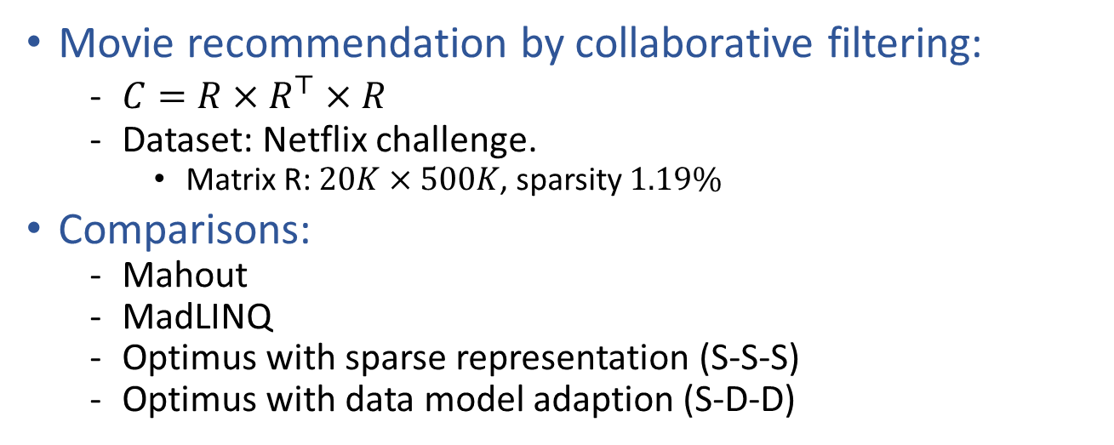
Evaluation: Matrix Multiplication
Movie recommendation by collaborative filtering:
  $C=R×R^{⊤}×R$
  Dataset: Netflix challenge.
    Matrix R: $20K×500K$, sparsity $1.19\%$
Comparisons:
  Mahout
  MadLINQ
  Optimus with sparse representation (S-S-S)
  Optimus with data model adaption (S-D-D)
46800
Job completion time in seconds
Notes:
We used movie recommendation application to evaluate matrix multiplication. The dataset is from Netflix challenge. We compare 4 implementations. The numbers in the table shows the job completion time. The numbers of Mahout and MadLINQ are borrowed from the MadLINQ paper, we used same hardware as MadLINQ. Optimus takes the least time to complete the task, as it is able to choose the matrix multiplication algorithm at runtime. It is further improved by adapting the data model.

Slide 26
Related Work
Dryad: system-level rewriting without semantics of code and data
Database: dynamic graph rewriting in a single server environment
  Eddies: fine-grain (record-level) optimization
  Eddies + Optimus: combine record-level and vertex-level optimization
CIEL: programming/execution model different from DryadLINQ/Dryad
  Dynamically expands EPG by scripts running at each worker
  Hard to achieve some dynamic optimizations:
    Replacing a running task with a subgraph
    Reliability enhancer.
  Ciel can incorporate Optimus-like components to support dynamic optimizations.
RoPE: uses statistics of previously-executed queries to optimize new jobs using same queries
Notes:
Related work. Drayd has some system-level rewriting without semantics of code and data.
In database community, dynamic graph rewriting is done in single server environment.
CIEL is another system that has different programming and execution model. CIEL can incorporate Optimus-like components to support dynamic optimization.
Finally, RoPE is another system in Microsoft. It uses statistics of previously executed queries to optimize new jobs using the same query.

Slide 27
Summary & Conclusion
A flexible/extensible framework to modify EPG at runtime
Enable runtime optimizations and specializations hard to achieve in other systems
A rich set of graph rewriters
  Substantial performance benefit compared to statically generated plan
A versatile addition to a data-parallel execution framework
Notes:
In summary, Optimus is a flexible and extensible framework to modify EPG at runtime. We have shown substantial performance benefits. We think Optimus is a versatile addition to existing data-parallel execution frameworks.

Slide 28
Thanks!

