Slide 1


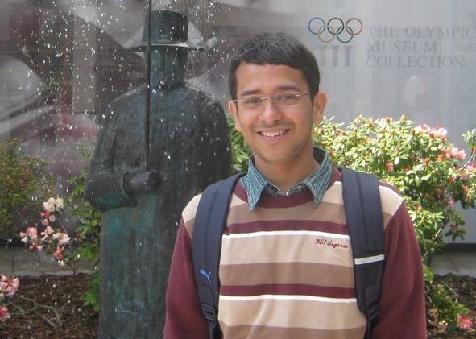


Virtualizing Traffic Shapers
Gautam Kumar, Srikanth Kandula, Peter Bodik, Ishai Menache

Slide 2
Network allocation in datacenters
To improve datacenter application performance and lower cost, the network is increasingly the weak link
Need new ways to allocate the network resource
  Performance isolation in clouds (e.g., per-tenant virtual network)
  Differentiated service to align with business priorities (or pricing)
  Low and predictable latency (e.g., deadlines) for cluster-as-a-computer
  Trough filling to improve long-term utilization between datacenters

Slide 3
Two classes of existing methods to realize this
1. “blue sky”: require new support in switches (e.g., diff. packet processing)
2. “end host-based”: infer network state; perf. penalty; total compliance
Can we achieve desired allocations by leveraging existing support in network devices?
Yes! Use shapers in switches.
bandwidth carving ∼ map traffic to WFQueues*
low latency ∼ map traffic to priority queues*
* good as a building block; complete solution is a bit more involved
Notes:
Introduce shapers
Nobody uses them… (use this on next slide)
Describe asterisk.

Slide 4
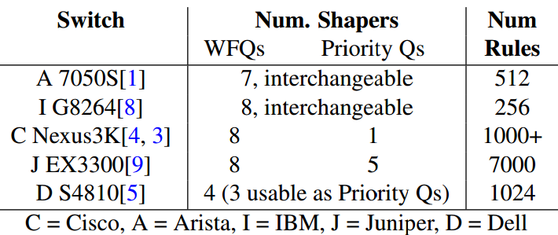
But, need as many shapers as classes
100s of tenants, 1000s of VMs, 10000s of flows
about 8 shapers in today’s switches
Could you build better devices? Maybe.
Do you need to? No

Slide 5
the Virtualizing Traffic Shapers problem:
mimic the shaping behavior
of a device that has arbitrarily many shapers
with those that have just a handful
packets
n classes
packets
n classes
n shapers
k << n shapers
error
Example:
Root mean square error between the bandwidth achieved by the different classes
Difference in the probability of meeting flow deadlines
Notes:
So, how do we do it?
Fix the + and -.

Slide 6
vShaper Overview
Control
Adaptation logic
TCAM Rules
packets
Match | Est. Demand | Shaper
class x | 100MBps | S2
class y | 10MBps | S1
… | … | …
n classes
k << n shapers
Challenges
How to map classes onto shapers so as to minimize shaping error?
Coping with imprecise demand estimates
Leveraging the multiple switches that exist along a path*

Slide 7
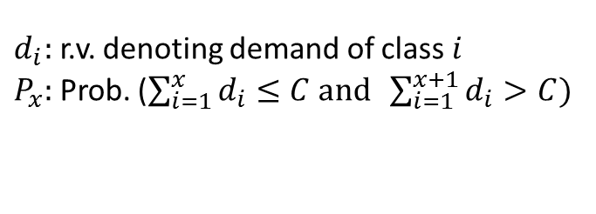
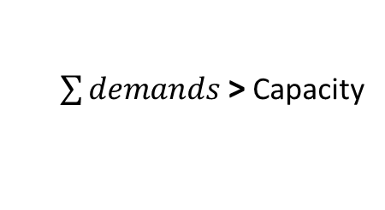
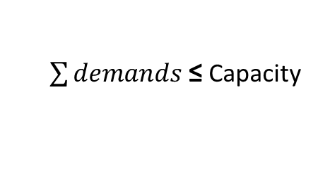


Error-minimizing mapping from classes to available shapers
Example 1: Using priority queues for strictly preferential access to the network bandwidth
$\sum{demands}$ ≤ Capacity
But, demand estimates can be wrong or change quickly
Algorithm sketch:
$\sum{demands}$ > Capacity
$d_{i}:$ r.v. denoting demand of class $i$
$P_{x}:$ Prob. ($\sum_{i=1}^{x}{d_{i}≤C and \sum_{i=1}^{x+1}{d_{i}>C})}$
$$P_{x}$$
vShaper
find k-1 partition points that minimize exp. error
Decreasing priority
1
$$x$$
n
ideal
$$E\left(error\right)=\sum_{y=1}^{n}{P_{y}}\sum_{z∈classes in same partition as y}{Error({class}_{z})}$$

Slide 8
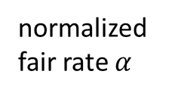
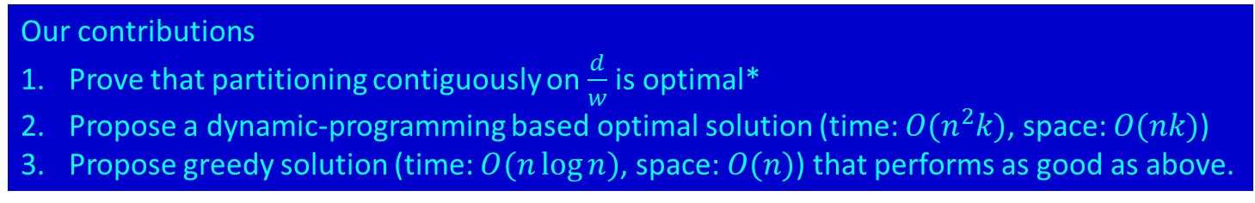

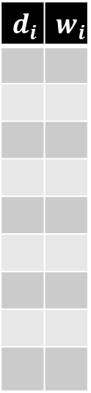
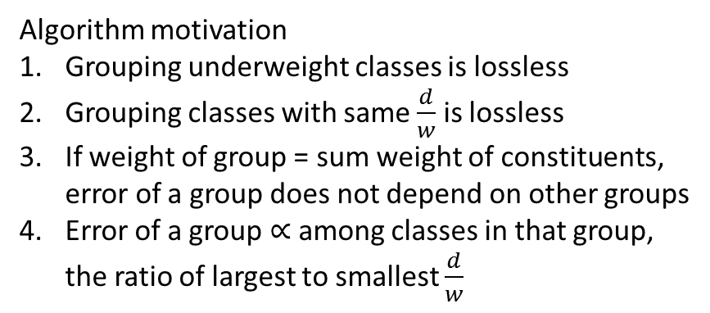


Error-minimizing mapping from classes to available shapers
Example 2: Using WFQs to achieve weighted fair share bandwidth allocation
demand, weight
Algorithm motivation
Grouping underweight classes is lossless
Grouping classes with same $\frac{d}{w}$ is lossless
If weight of group = sum weight of constituents, error of a group does not depend on other groups
Error of a group $∝$among classes in that group, the ratio of largest to smallest $\frac{d}{w}$
$$d_{i}$$ | $$w_{i}$$
normalized fair rate $α$
1
underweight
2
$r_{i}$=$d_{i}$
overweight
3
$r_{i}$=$αw_{i}$
4
5
6
7
normalized demands $\frac{d}{w}$
8
Our contributions
Prove that partitioning contiguously on $\frac{d}{w}$ is optimal*
Propose a dynamic-programming based optimal solution (time: $O(n^{2}k)$, space: $O(nk)$)
Propose greedy solution (time: $O(n\log{n)}$, space: $O(n)$) that performs as good as above.
9
ideal

Slide 9
Evaluation

Slide 10
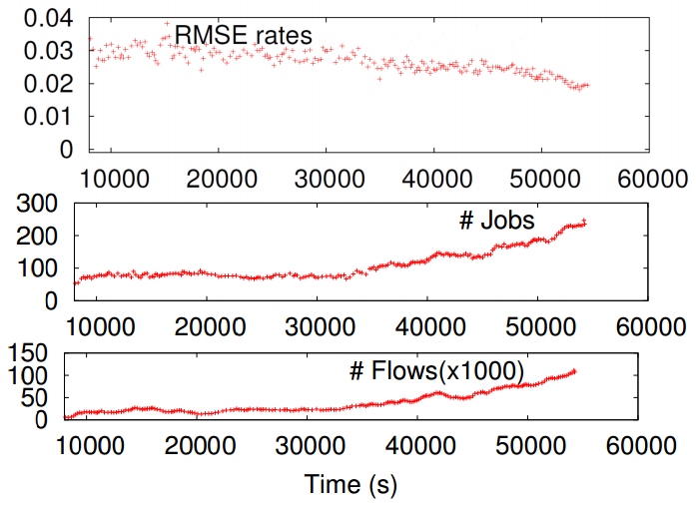
Feasibility on a Production trace
Traffic from a ToR uplink in a production data-parallel cluster at Bing
Goal: Equitable allocation across jobs given 8 WFQs
On production traffic,
vShaper approximates ideal shaping to within 3% error with just 8 WFQs
To compare:
No shaping has much more error because jobs vary in #flows
Naïve mapping onto WFQs requires as many shapers as #Jobs

Slide 11
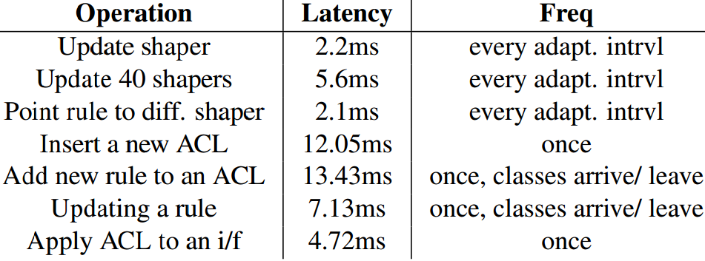
Experiments on an Arista 7048S 48x10G
Python code atop the Arista EOS
Implementation Feasibility
vShaper requires:
Counting demands/class
Every adaptation interval, adjust map from class to shaper
a TCAM rule per class; can tag along with the routing rule
change weight on the shaper, edit rule to point at diff. shaper

Slide 12
Simulated dataset:
#classes: exp(mean=10);
class demands, weights: pareto(shape=0.4)
Goal = weighted fair share
Comparing alt. groupings

Slide 13
Related Work
Existing network traffic management relies on end-host enforcement or needs new hardware in switches
  Within datacenters
    Network bandwidth: Gatekeeper[HP labs TR], Seawall [N’12], FairCloud [S’12], eyeQ [N’13]
    Latency: pFabric [S’13], PDQ [S’12], D3 [S’11]
    Virtual network topology: Oktopus [S’11]
  Wide area network between datacenters
    Policy-based route assignment: B4 [S’13], SWAN [S’13]
NetShare [UCSD TR] proposes using traffic shapers
vShaper shows how to use the small number of available shapers

Slide 14
Summary: Virtualizing Traffic Shapers
First step towards mimic’ing the behavior of many shapers with the handful that are available on commodity devices
An alternative to endhost-based and blue-sky solutions that
  builds upon in-network components
  leading to simpler logic, stronger guarantees and better performance.
A few open issues remain
  Why are a few shapers enough?
  How to effectively use multiple switches along a path?
  Easy to implement/ deploy?

Slide 15
the Virtualizing Traffic Shapers problem:
mimic the shaping behavior of a switch
having arbitrarily many shapers
with those
that have just a handful

Slide 16
mimic the shaping behavior of a switch
having arbitrarily many shapers
with those
that have just a handful
the Virtualizing Traffic Shapers problem:
Control
Adaptation logic
TCAM Rules
packets
packets
Match | Est. Demand | Shaper
class x | 100MBps | S2
class y | 10MBps | S1
… | … | …
n classes
n classes
k shapers
n shapers
error

Slide 17
Control
Adaptation logic
packets
packets
Match | Est. Demand | Shaper
class x | 100MBps | S2
class y | 10MBps | S1
… | … | …
n classes
n classes
k shapers
TCAM Rules
n shapers

