Slide 1
A Scalable Approach to Using DNN-Derived Features in GMM-HMM Based Acoustic Modeling For LVCSR
Zhijie Yan, Qiang Huo and Jian Xu
Microsoft Research Asia
InterSpeech-2013, Aug. 26, Lyon, France

Slide 2
Research Background
Deep learning (especially DNN-HMM) has become new state-of-the-art in speech recognition
  Good performance improvement (10% - 30% relative WER Reduction)
  Service deployment by many companies
Research problems
  What are the main contributing factors to DNN-HMM?
  What are the implications to GMM-HMM?
  Is GMM-HMM out of date, or even dead?

Slide 3
Parallel Study of DNN-HMM and GMM-HMM
Factors contributed to the success of DNN-HMM for LVCSR
  Long-span input features
  Discriminative training of tied-states of HMMs
  Deep hierarchical nonlinear feature mapping

Slide 4
Parallel Study of DNN-HMM and GMM-HMM
Factors contributed to the success of DNN-HMM for LVCSR
  Long-span input features
  Discriminative training of tied-states of HMMs
  Deep hierarchical nonlinear feature mapping
The first two can also be applied to IVN transform learning in GMM-HMM framework
  Z.-J. Yan, Q. Huo, J. Xu, and Y. Zhang, “Tied-state based discriminative training of context-expanded region-dependent feature transforms for LVCSR,” Proc. ICASSP-2013

Slide 5
Parallel Study of DNN-HMM and GMM-HMM
Factors contributed to the success of DNN-HMM for LVCSR
  Long-span input features
  Discriminative training of tied-states of HMMs
  Deep hierarchical nonlinear feature mapping
The first two can also be applied to IVN transform learning in GMM-HMM framework
  Z.-J. Yan, Q. Huo, J. Xu, and Y. Zhang, “Tied-state based discriminative training of context-expanded region-dependent feature transforms for LVCSR,” Proc. ICASSP-2013
  Best GMM-HMM achieves 19.7% WER using spectral features
  DNN-HMM can easily achieve 16.4% WER with CE training

Slide 6
Parallel Study of DNN-HMM and GMM-HMM
Factors contributed to the success of DNN-HMM for LVCSR
  Long-span input features
  Discriminative training of tied-states of HMMs
  Deep hierarchical nonlinear feature mapping
The first two can also be applied to IVN transform learning in GMM-HMM framework
  Z.-J. Yan, Q. Huo, J. Xu, and Y. Zhang, “Tied-state based discriminative training of context-expanded region-dependent feature transforms for LVCSR,” Proc. ICASSP-2013
  Best GMM-HMM achieves 19.7% WER using spectral features
  DNN-HMM can easily achieve 16.4% WER with CE training

Slide 7
Combining the Best of Both Worlds
DNN-GMM-HMM
  DNN as hierarchical nonlinear feature extractor
  GMM-HMM as acoustic model

Slide 8
Why DNN-GMM-HMM
Leverage the power of deep learning
  Train DNN feature extractor by using a subset of training data
  Mitigate the scalability issue of DNN training
Leverage GMM-HMM technologies
  Train GMM-HMMs on the full-set of training data
  Well-established training algorithms, e.g., ML / tied-state based feature-space DT / sequence-based model-space DT
  Scalable training tools leveraging big data
  Practical unsupervised adaptation / personalization methods, e.g., CMLLR

Slide 9
Prior Art: TANDEM Features
(Deep) TANDEM features
  H. Hermansky, D. P. W. Ellis, and S. Sharma, “Tandem connectionist feature extraction for conventional HMM systems,” Proc. ICASSP-2000
  Z. Tuske, M. Sundermeyer, R. Schluter, and H. Ney, “Context-dependent MLPs for LVCSR: Tandem, hybrid or both?” Proc. InterSpeech-2012
Input layer
Output layer
Hidden layers

Slide 10
Prior Art: Bottleneck Features
(Deep) bottleneck features
  F. Grezl, M. Karafiat, S. Kontar, and J. Cernocky, “Probabilistic and bottle-neck features for LVCSR of meetings,” Proc. ICASSP-2007
  D. Yu and M. L. Seltzer, “Improved bottleneck features using pretrained deep neural networks,” Proc. InterSpeech-2011
Input layer
Output layer
Hidden layers

Slide 11
Proposed: DNN-Derived Features
DNN-derived features
  All hidden layers → feature extractor
  Softmax output layer → log-linear model
Input layer
Output layer
Hidden layers

Slide 12
DNN-Derived Features
Advantages
  Keep as much discriminative information as possible (different from bottleneck features)
  Shared DNN topology with full-size DNN-HMM (different from TANDEM features)
More could be done
  Language-independent DNN feature extractor
  …
Combined with GMM-HMM modeling
  + Discriminative training (e.g., RDLT+MMI, as shown latter)
  + Adaptation / personalization
  + Adaptive training
  …

Slide 13
Combined With Best GMM-HMM Techniques
DNN-derived features
PCA
HLDA
Tied-state WE-RDLT
MMI sequence training
CMLLR unsupervised adaptation
GMM-HMM modeling of DNN-derived features

Slide 14
Experimental Setup
Training data
  309hr Switchboard-1 conversational telephone speech
  2,000hr Switchboard+Fisher conversational telephone speech
Training combinations
  309hr DNN + 309hr GMM-HMM
  309hr DNN + 2,000hr GMM-HMM
  2,000hr DNN + 2,000hr GMM-HMM
Testing data
  NIST 2000 Hub5 testing set

Slide 15
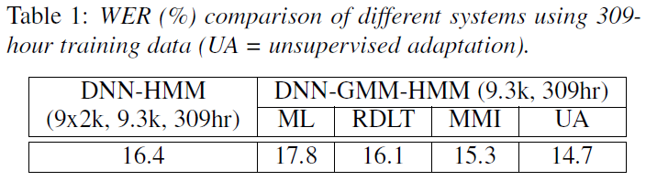
Experimental Results
309hr DNN + 309hr GMM-HMM
  RDLT – tied-state based region dependent linear transform (refer to our ICASSP-2013 paper)
  MMI – lattice based sequence training
  UA – CMLLR unsupervised adaptation

Slide 16
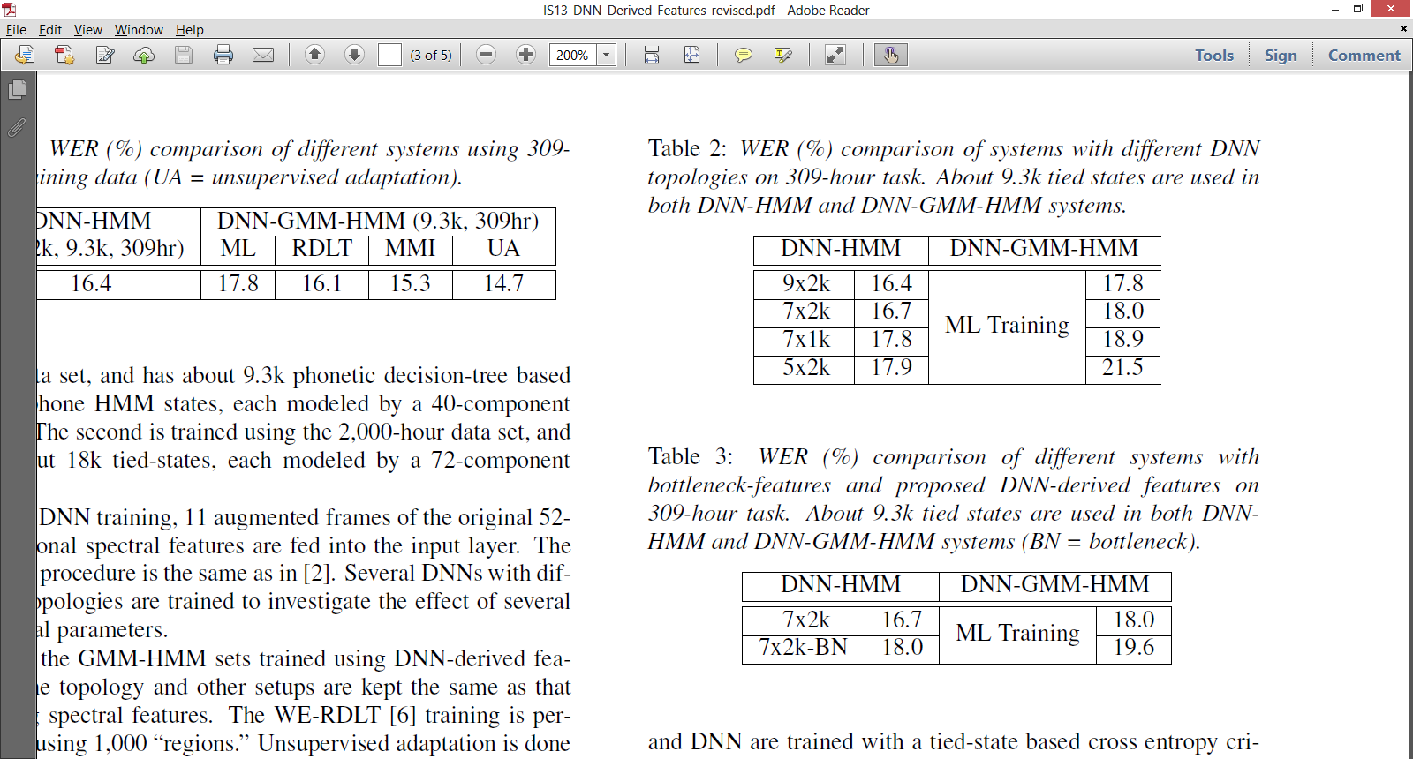
Experimental Results
309hr DNN + 309hr GMM-HMM
  Deep hierarchical nonlinear feature mapping is the key

Slide 17
Experimental Results
309hr DNN + 309hr GMM-HMM
  DNN-derived features vs. bottleneck features

Slide 18
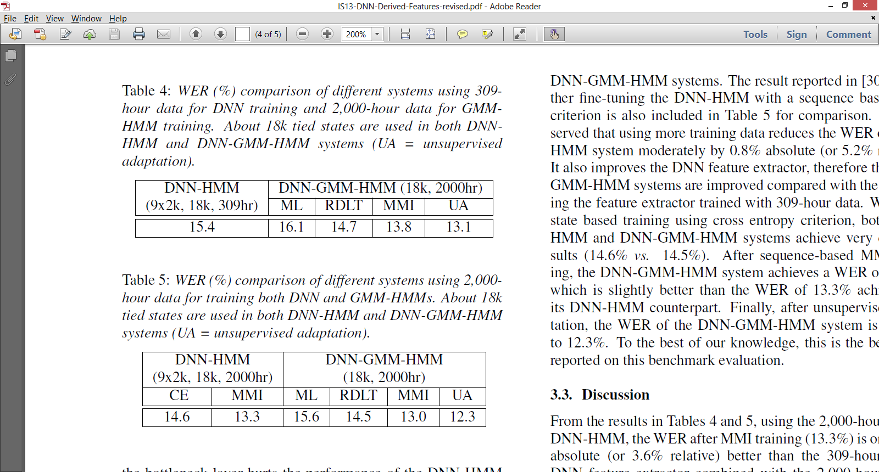
Experimental Results
309hr DNN + 2,000hr GMM-HMM

Slide 19
Experimental Results
309hr DNN + 2,000hr GMM-HMM
2,000hr DNN + 2,000hr GMM-HMM

Slide 20
Experimental Results
309hr DNN + 2,000hr GMM-HMM
2,000hr DNN + 2,000hr GMM-HMM
0.5% absolute (or 3.6% relative gain), at cost of significantly increased training time of DNN

Slide 21
Conclusion
Use a new way of deriving features from DNN
  DNN-derived features from last hidden layer
Combine with best techniques in GMM-HMM
  Tied-state based RDLT training
  Sequence based MMI training
  CMLLR unsupervised adaptation
Achieve promising results with DNN-GMM-HMM
  Scalable training + practical unsupervised adaptation
  Similar results using CNN have been reported by IBM researchers (refer to their ICASSP-2013 paper)

Slide 22
Thanks!
Q&A

