Slide 1
Ziria: Wireless Programming for Hardware Dummies
Božidar Radunović, Dimitrios Vytiniotis
joint work with
Gordon Stewart, Mahanth Gowda, Geoff Mainland
http://research.microsoft.com/en-us/projects/ziria/

Slide 2
Layout
Introduction
WiFi in Ziria
Compiling and Optimizing Ziria
Hands-on
Conclusions

Slide 3
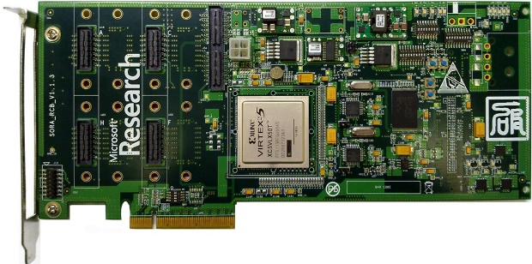
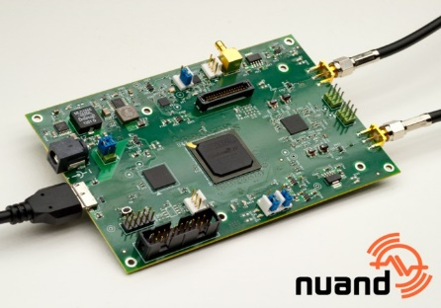
Prelude: Software Defined Radios
FPGA:
  Programmable digital electronics
  Traditionally used for prototyping and development in wireless industry
  Examples: WARP (all on FPGA), Zyng (SoC: Arm + FPGA)
DSP:
  One or more VLIW cores optimized for signal processing
  Prototyping, but also commercially (many small cells on DSP)
  Examples: TI, Freescale
CPUs:
  Digital interface between a radio and a CPU
  Prototyping and some deployments ($2k GSM base-station)
  Examples: USRP (easy to program but slow),
  SORA (fast, μs latency), bladeRF (cheap and portable)
BladeRF USB card

Slide 4
Why do we care about wireless research?
Lots of innovation in PHY/MAC design
  New protocols/standards: 5G, IoT
  New PHY features: localization
  Fast, cheap and flexible deployments: (GSM, small cells)
  Security/hacking
Popular experimental platform: GNURadio
  Relatively easy to program but slow, no real network deployment
Modern wireless PHYs require high-rate DSP
Real-time platforms [SORA, WARP, …]
  Achieve protocol processing requirements, difficult to program, no code portability, lots of low-level hand-tuning

Slide 5
Issues for wireless researchers
CPU platforms (e.g. SORA)
  Manual vectorization, CPU placement
  Cache / data sizing optimizations
FPGA platforms (e.g. WARP)
  Latency-sensitive design, difficult for new students/researchers to break into
Multi-core DSP (e.g. Freescale, TI)
  Heterogeneous architecture, implying data coherency and sync. problems
Portability/readability
  Manually highly optimized code is difficult to read and maintain
  Also: practically impossible to target another platform
Difficulty in writing and reusing code
hampers innovation
Notes:
Lots of things one needs to know about a platform, in addition to understanding signal processing and running experiments

Slide 6
What is wrong with current tools?

Slide 7
Current SDR Software Tools
Portable (FPGA/CPU), graphical interface:
  Simulink, LabView
CPU-based: C/C++/Python
  GnuRadio, SORA
Control and data separation
  CodiPhy [U. of Colorado], OpenRadio [Stanford]:
Specialized languages (DSL):
  Stream processing languages: StreamIt [MIT]
  DSLs for DSP/arrays, Feldspar [Chalmers]: we put more emphasis on control
  Spiral
Notes:
By no means an exhaustive list

Slide 8
Issues
Programming abstraction is tied to execution model
  Programmer has to reason about how the program will be executed/optimized while writing the code
Verbose programming
Shared state
Low-level optimization
We next illustrate on Sora code examples
(other platforms are have similar problems)

Slide 9
Running example: WiFi receiver
removeDC
Packet
start
Channel
info
Detect
Carrier
Channel
Estimation
Invert
Channel
Invert
Channel
Packet
info
Decode Header
Decode Packet
Notes:
Describe the issues of execution model.
Each block is a vertex.
What do we execute first? In which order will we execute?
But in reality, I don’t care which block gets run where, and which gets processed first, as long as they all get processed in the correct order.

Slide 10
How do we execute this on CPU?
removeDC
Packet
start
Channel
info
Detect
Carrier
Channel
Estimation
Invert
Channel
Invert
Channel
Packet
info
Decode Header
Decode Packet
Notes:
Describe the issues of execution model.
Each block is a vertex.
What do we execute first? In which order will we execute?
But in reality, I don’t care which block gets run where, and which gets processed first, as long as they all get processed in the correct order.

Slide 11
Shared state
static inline
void CreateDemodGraph11a_40M (ISource*& srcAll, ISource*& srcViterbi, ISource*& srcCarrierSense)
{
CREATE_BRICK_SINK (drop, TDropAny, BB11aDemodCtx );
CREATE_BRICK_SINK (fsink, TBB11aFrameSink, BB11aDemodCtx );
CREATE_BRICK_FILTER (desc, T11aDesc, BB11aDemodCtx, fsink );typedef T11aViterbi <5000*8, 48, 256> T11aViterbiComm;
CREATE_BRICK_FILTER (viterbi,T11aViterbiComm::Filter, BB11aDemodCtx, desc );
CREATE_BRICK_FILTER (vit0, TThreadSeparator<>::Filter, BB11aDemodCtx, viterbi);
// 6M
CREATE_BRICK_FILTER (di6, T11aDeinterleaveBPSK, BB11aDemodCtx, vit0 );
CREATE_BRICK_FILTER (dm6, T11aDemapBPSK::filter, BB11aDemodCtx, di6 );
…
…
CREATE_BRICK_SINK (plcp, T11aPLCPParser, BB11aDemodCtx );
CREATE_BRICK_FILTER (sviterbik, T11aViterbiSig, BB11aDemodCtx, plcp );
CREATE_BRICK_FILTER (dibpsk, T11aDeinterleaveBPSK, BB11aDemodCtx, sviterbik );
CREATE_BRICK_FILTER (dmplcp, T11aDemapBPSK::filter, BB11aDemodCtx, dibpsk );
CREATE_BRICK_DEMUX5 ( sigsel,TBB11aRxRateSel, BB11aDemodCtx,dmplcp, dm6, dm12, dm24, dm48 );
CREATE_BRICK_FILTER (pilot, TPilotTrack, BB11aDemodCtx, sigsel );CREATE_BRICK_FILTER (pcomp, TPhaseCompensate, BB11aDemodCtx, pilot );
CREATE_BRICK_FILTER (chequ, TChannelEqualization, BB11aDemodCtx, pcomp );
CREATE_BRICK_FILTER (fft, TFFT64, BB11aDemodCtx, chequ );;
CREATE_BRICK_FILTER (fcomp, TFreqCompensation, BB11aDemodCtx, fft );
CREATE_BRICK_FILTER (dsym, T11aDataSymbol, BB11aDemodCtx, fcomp );
CREATE_BRICK_FILTER (dsym0, TNoInline, BB11aDemodCtx, dsym );
Shared state
Notes:
Lots of shared state
It is unclear who uses which state, where and why
How do we check whether it is initialized

Slide 12
Separation of control and data
void Reset()
{
Next0()->Reset();
// No need to reset all path, just reset the path we used in this frame
switch (data_rate_kbps) {
case 6000:
case 9000:
Next1()->Reset();
break;
case 12000:
case 18000:
Next2()->Reset();
break;
case 24000:
case 36000:
Next3()->Reset();
break;
case 48000:
case 54000:
Next4()->Reset();
break;
}
}
Resetting whoever* is downstream
*we don’t know who that is when we write this component ☺

Slide 13
Verbosity
DEFINE_LOCAL_CONTEXT(TBB11aRxRateSel, CF_11RxPLCPSwitch, CF_11aRxVector );
template<TDEMUX5_ARGS>
class TBB11aRxRateSel : public TDemux<TDEMUX5_PARAMS>
{
CTX_VAR_RO (CF_11RxPLCPSwitch::PLCPState, plcp_state );
CTX_VAR_RO (ulong, data_rate_kbps ); // data rate in kbps
public:
…..
public:
REFERENCE_LOCAL_CONTEXT(TBB11aRxRateSel);
STD_DEMUX5_CONSTRUCTOR(TBB11aRxRateSel)
BIND_CONTEXT(CF_11RxPLCPSwitch::plcp_state, plcp_state)
BIND_CONTEXT(CF_11aRxVector::data_rate_kbps, data_rate_kbps)
{}
Declarations are written in host language
Language is not specialized, so often verbose
Hinders fast prototyping
Notes:
All this is just to declare interface for a component, without specifying it

Slide 14
Manual optimizations
SORA_EXTERN_C SELECTANY extern
const unsigned long gc_XXXLUT[256] =
{
0x00000000, 0x77073096, 0xEE0E612C, 0x990951BA,
0x076DC419, 0x706AF48F, 0xE963A535, 0x9E6495A3,
0x0EDB8832, 0x79DCB8A4, 0xE0D5E91E, 0x97D2D988,
0x09B64C2B, 0x7EB17CBD, 0xE7B82D07, 0x90BF1D91,
0x1DB71064, 0x6AB020F2, 0xF3B97148, 0x84BE41DE,
...
0xBAD03605, 0xCDD70693, 0x54DE5729, 0x23D967BF,
0xB3667A2E, 0xC4614AB8, 0x5D681B02, 0x2A6F2B94,
0xB40BBE37, 0xC30C8EA1, 0x5A05DF1B, 0x2D02EF8D
}
FINL void CalcXXXIncremental(IN UCHAR input, IN OUT PULONG pXXX)
{
*pXXX = (*pXXX >> 8) ^
gc_XXXLUT[input ^ ((*pXXX) & 0xFF)];
}
FINL ULONG
CalcXXX(PUCHAR pByte, ULONG Length)
{
ULONG XXX = 0xFFFFFFFF;
ULONG Index = 0;
for (Index = 0; Index < Length; Index++)
{
XXX = ((XXX ) >> 8 ) ^ gc_XXXLUT[( pByte[Index] )
^ (( XXX ) & 0x000000FF )];
}
return ~XXX;
}
What is this code doing?
Hand-written bit-fiddling code to create lookup tables for specific computations that must run very fast

Slide 15
Vectorization
removeDC
Packet
start
Channel
info
Detect
Carrier
Channel
Estimation
Invert
Channel
Invert
Channel
Packet
info
Decode Header
Decode Packet
Beneficial to process items
in chunks
But how large can chunks be?
Notes:
Describe the issues of execution model.
Each block is a vertex.
What do we execute first? In which order will we execute?
But in reality, I don’t care which block gets run where, and which gets processed first, as long as they all get processed in the correct order.

Slide 16
My Own Frustrations
Implemented several PHY algorithms in FPGA
Never been able to reuse them:
  Complexity of interfacing (timing and precision) was higher than rewriting!
Implemented several PHY algorithms in Sora
Better reuse but still difficult
  Spent 2h figuring out which internal state variable I haven’t initialized when borrowed a piece of code from other project.
I want tools to allow me to write reusable code
and incrementally build ever more complex systems!

Slide 17
Improving this situation
New wireless programming platform
  Code written in a high-level language: reusable and easy to understand
  Compiler deals with low-level code optimization
  Same code compiles on different platforms (not there just yet!)
Challenges
  Design PL abstractions that are intuitive and expressive
  Design efficient compilation schemes (to multiple platforms)
What is special about wireless
  … that affects abstractions: large degree of separation b/w data and control
  … that affects compilation: need high-throughput stream processing

Slide 18
Our Choice: Domain Specific Language
What are domain-specific languages?
Examples:
  Make
  SQL
Benefits:
  Language design captures specifics of the task
  This enables compiler to optimize better
Notes:
Ask question: what are domain-specific languages?

Slide 19
Why is wireless code special?
Wireless = lots of signal processing
Control vs data flow separation
Data processing elements:
  FFT/IFFT, Coding/Decoding, Scrambling/Descrambling
  Predictable execution and performance, independent of data
Control flow elements:
  Header processing, rate adaptation
Notes:
DSL has to extract special features of the task
So what are the special features of wireless PHY processing?

Slide 20
Programming model
removeDC
Packet
start
Channel
info
Detect
Carrier
Channel
Estimation
Invert
Channel
Invert
Channel
Packet
info
Decode Header
Decode Packet
Notes:
Separation of control and data flow
Blocks are data flow, arrows are control flow

Slide 21
How do we want code to look like?
SORA_EXTERN_C SELECTANY extern
const unsigned long gc_XXXLUT[256] =
{
0x00000000, 0x77073096, 0xEE0E612C, 0x990951BA,
0x076DC419, 0x706AF48F, 0xE963A535, 0x9E6495A3,
0x0EDB8832, 0x79DCB8A4, 0xE0D5E91E, 0x97D2D988,
0x09B64C2B, 0x7EB17CBD, 0xE7B82D07, 0x90BF1D91,
0x1DB71064, 0x6AB020F2, 0xF3B97148, 0x84BE41DE,
...
0xBAD03605, 0xCDD70693, 0x54DE5729, 0x23D967BF,
0xB3667A2E, 0xC4614AB8, 0x5D681B02, 0x2A6F2B94,
0xB40BBE37, 0xC30C8EA1, 0x5A05DF1B, 0x2D02EF8D
}
FINL void CalcXXXIncremental(IN UCHAR input, IN OUT PULONG pXXX)
{
*pXXX = (*pXXX >> 8) ^
gc_XXXLUT[input ^ ((*pXXX) & 0xFF)];
}
FINL ULONG
CalcXXX(PUCHAR pByte, ULONG Length)
{
ULONG XXX = 0xFFFFFFFF;
ULONG Index = 0;
for (Index = 0; Index < Length; Index++)
{
XXX = ((XXX ) >> 8 ) ^ gc_XXXLUT[( pByte[Index] )
^ (( XXX ) & 0x000000FF )];
}
return ~XXX;
}
for i in [0, CRC_X_WIDTH] {
if (start_state[i] == '1) then {
for j in [0, CRC_S_WIDTH - 1] {
out[i+1+j] := out[i+1+j] ^ base[1+j];
}
for j in [0,CRC_X_WIDTH-i-1] {
start_state[i+1+j] := start_state[i+1+j] ^ base[1+j];
}
}
}

Slide 22
What do we not want to optimize?
We assume efficient DSP libraries:
  FFT
  Viterbi/Turbo decoding
Same are used in many standards:
  WiFi, WiMax, LTE
This is readily available:
  FPGA (Xilinx, Altera)
  DSP (coprocessors)
  CPUs (Volk, Sora libraries, Spiral)
Most of PHY design is in connecting these blocks

Slide 23
Layout
Introduction
WiFi in Ziria
Compiling and Optimizing Ziria
Hands-on
Conclusions

Slide 24
Ziria and OFDM network basics
Orthogonal Frequency Division Multiplexing
The basis of industrial successful communication standards
802.11a, WiMAX, 4G LTE, …
Advantages: good use of spectrum with easy channel inversion
Will show you next some basics of OFDM networks using WiFi as a case study, along with corresponding code fragments in Ziria …

Slide 25
Complex data and signals
Q
(I,Q)
φ
Represents signal
I
φ
t
$$\sqrt{Q^{2}+I^{2}}$$
If $s=I+jQ$ then signal is: $s⋅e^{2πjf}$for a frequency $f$ of our choice

Slide 26
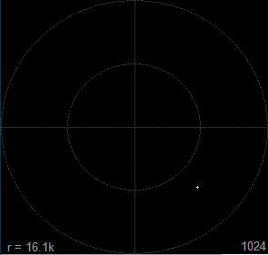
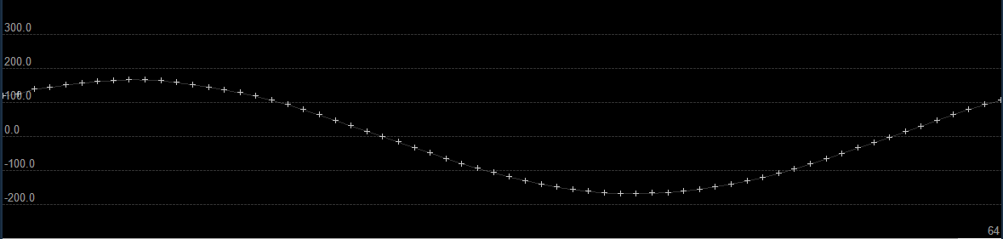
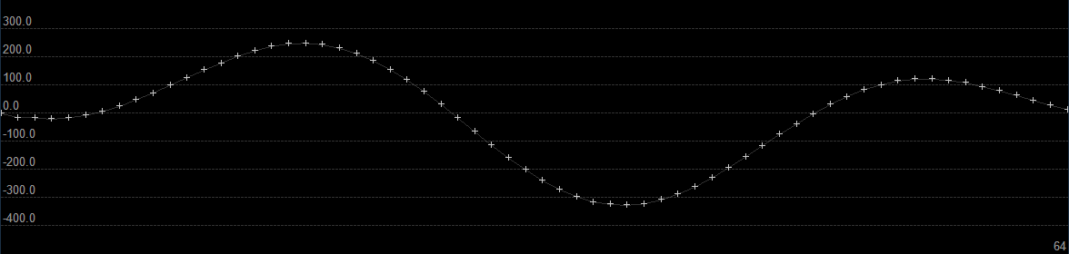
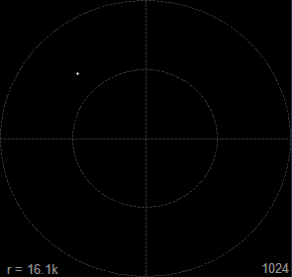
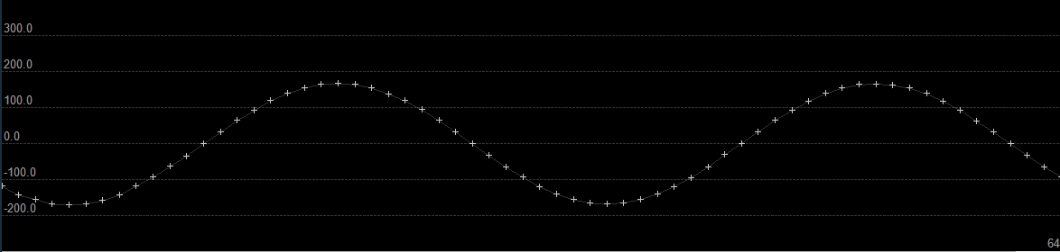
Superimposing signals for transmission
Note we used different frequencies

Slide 27
Transmitting OFDM symbols
Consider N input complex samples
$$s_{1}=\left(q_{1},i_{1}\right)$$ | $$s_{2}$$ | … | … | … | … | … | $$s_{N}$$
Pick different carrier $f_{k}$ for
each slot and superimpose (add) signals
OFDM basic idea:
pick “orthogonal” $f_{k}=k⋅f_{o}$
$$y\left(n\right)=Σ_{k}s_{k}e^{2πjf_{k}n}$$
Inverse FFT
$$y_{1}$$ | $$y_{2}$$ | … | … | … | … | … | $$y_{N}$$

Slide 28
Receiving OFDM symbols
Due to orthogonality, FFT can recover the original vector
$$y_{1}$$ | $$y_{2}$$ | … | … | … | … | … | $$y_{N}$$
FFT
$$x_{1}$$ | $$x_{2}$$ | … | … | … | … | … | $$x_{N}$$

Slide 29
Why IFFT/FFT?
We could after all directly send the data ...
$$x_{1}$$ | $$x_{2}$$ | … | … | … | … | … | $$x_{N}$$
Answer: IFFT/FFT gives easy way to estimate and correct channel effects
IFFT
FFT
Channel

Slide 30

OFDM and channel estimation
IFFT
FFT
$$τ_{1}$$
$$τ_{2}$$
$$τ_{3}$$
Multipath
Channel effect: $h(τ)$ where $τ$ is the delay of each path compared to direct path.
Overall received signal:
$$y_{recv}\left(t\right)= Σ_{τ}y\left(t−τ\right)⋅h\left(τ\right)$$
Pass that through FFT:
$$Y_{recv}\left(f\right)=Y\left(f\right)⋅H\left(f\right)$$
Hence, to undo channel effects we need to calculate the
coefficient vector $H\left(f_{k}\right)$ and divide received signal
Channel estimation algorithm:
Send known fixed preamble $P_{k}$
Receive a $P_{k}^{recv}$
$H\left(f_{k}\right)=\frac{P_{k}^{recv}}{P_{k}}$
So Simple!!

Slide 31
Actual WiFi 802.11a OFDM transmission
Data
Pilots: used to estimate channel changes from one symbol transmission to the next
Guard bands: unused slots to better control interference
IFFT
Prefix affected from delayed version of previous signal
Solution: “cyclic prefix” replicate prefix of signal in the end

Slide 32
Modulation and demodulation
IFFT
FFT
Modulator
De-Modulator
00 01 11 10
Channel
00 01 11 10
01
11
Example is QPSK, but other schemes used as well: BPSK, QAM16, QAM64, etc.
00
10

Slide 33
QPSK modulation in Ziria
A new stream “computation”
fun comp modulate_qpsk () {
repeat [8, 4] {
(x : arr[2] bit) <- takes 2;
emit (
if (x[0] == bit(0) && x[1] == bit(1)) then
complex16{re=-qpsk_mod_11a;im= qpsk_mod_11a }
else
if (x[0] == bit(0) && x[1] == bit(0)) then
complex16{re=-qpsk_mod_11a;im=-qpsk_mod_11a}
else
if (x[0] == bit(1) && x[1] == bit(1)) then
complex16{re=qpsk_mod_11a;im=qpsk_mod_11a}
else
complex16{re=qpsk_mod_11a;im=-qpsk_mod_11a}
)
}
}
Take 2 bits from input
into array of size 2 …
IFFT
Modulator
00 01 11 10
Repeatedly
…
01
11
Emit …
… this complex16 value
qpsk_mod_11a
00
10
Github link here

Slide 34
Rest of TX pipeline
Connect blocks like a pipe
(“on the data path”)
Github link here
scrambler(default_scrmbl_st) >>> encode12() >>> interleaver_qpsk() >>> modulate_qpsk())
IFFT
Scrambler
Encoder
Interleaver
Modulator
..011010
Scrambler: spread input sequence to avoid peaks
Encoder: encodes input adding redundancy for automatic error correction, e.g. 1-2 encoding, 2-3 encoding, 3-4 encoding
Interleaver: calculates a (fixed) permutation of the input. To avoid bursty errors

Slide 35
Details of transmitting OFDM symbols in Ziria
fun comp ifft() {
var symbol:arr[FFT_SIZE] complex16;
var fftdata:arr[FFT_SIZE+CP_SIZE] complex16;
do { zero_complex16(symbol); }
repeat {
(s:arr[64] complex16) <- takes 64;
do {
symbol[FFT_SIZE-32,32] := s[0,32];
symbol[0,32] := s[32,32];
fftdata[CP_SIZE,FFT_SIZE] := sora_ifft(symbol);
-- Add CP
fftdata[0,CP_SIZE] := fftdata[FFT_SIZE,CP_SIZE];
}
emits fftdata;
}
}
map_ofdm()
ifft()
Emit array
Call to C function (here SORA FFT)
through “external function interface”
Local mutable
variables
do { … } : execute non-streaming statements
Array slices

Slide 36
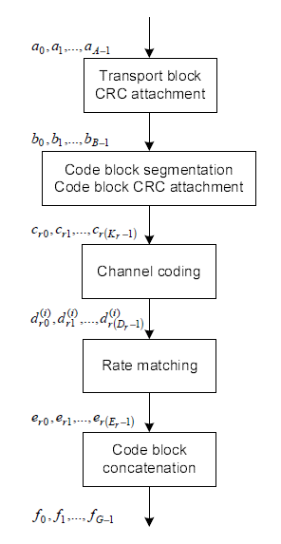
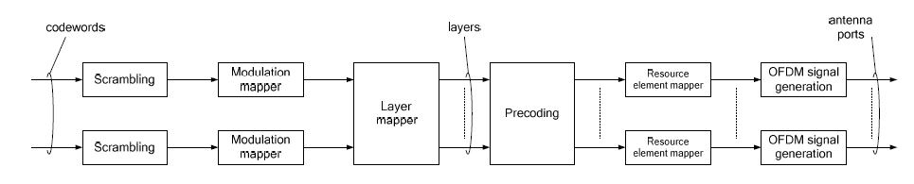
4G LTE is based on similar blocks
LTE uses similar design principles as WiFi
  But much more complex (100s of pages of specs)
MAC and PHY are much more intertwined
  Any MAC modification likely implies PHY changes
Figures from 3GPP 36.211, 36.212

Slide 37
Blocks that maintain internal state: scrambler
scrambler(default_scrmbl_st) >>> ...
Scrambler
Encoder
Interleaver
Modulator
..011010
…
fun comp scrambler(init_scrmbl_st: arr[7] bit) {
var scrmbl_st: arr[7] bit := init_scrmbl_st;
repeat [8,8] {
x <- take;
var tmp : bit;
do {
tmp := (scrmbl_st[3] ^ scrmbl_st[0]);
scrmbl_st[0:5] := scrmbl_st[1:6];
scrmbl_st[6] := tmp;
};
emit (x^tmp)
}
}
Initialize state
Spread input sequence
to avoid peaks
State persists through all repetitions
Update state
Raises the question: When is the state of a block initialized?
Answer: when block becomes active in a processing path
Next: activation of processing paths through the example of WiFi receiver pipeline ...

Slide 38
WiFi receiver
Ziria key aspect
Explicit handover of control and passing of control parameters
Handover of control introduces and initializes new pipeline path
Detect transmission
Active path
removeDC()
cca()
Estimate channel
Invert effects
of channel
LTS(…)
Fixup
cyclic prefix
params
DataSymbol()
FFT()
ChannelEqualization(params)
parseHeader()
Decode
Deinterleave
DemodBPSK()
GetData()
PilotTrack()
h:HeaderInfo
Remove guard
band elements
Remove pilots
descramble()
Decode(h)
Deinterleave
Demod(h)
011010 … to MAC layer

Slide 39
WiFi receiver in Ziria code
fun comp detectSTS() {
removeDC() >>> cca()
}
fun comp receiveBits() {
seq { (h : HeaderInfo) <- DecodePLCP()
; Decode(h)
} }
fun comp receiver() {
seq { det <- detectSTS()
; params <- LTS(det)
; DataSymbol(det) >>> FFT()
>>> ChannelEqualization(params)
>>> PilotTrack()
>>> GetData()
>>> receiveBits() } }
Ziria control handover :
seq { x <- some-block
; next-block
}
DetectSTS()
removeDC()
cca()
det
LTS(det)
params
DataSymbol(det)
FFT()
ChannelEqualization(params)
DecodePLCP()
parseHeader()
Decode
Deinterleave
DemodBPSK()
GetData()
PilotTrack()
Transfer control
to new block. Control parameter x scopes over next-block
h:HeaderInfo
Keep running some-block until it returns x
Decode(h)
“in sequence”
descramble()
Decode(h)
Deinterleave
Demod(h)
011010 … to MAC layer

Slide 40
Ziria computers versus transformers
Ziria type system ensures that the first block in seq
is a computer
(eventually returns)
Ziria control handover :
seq { x <- some-block
; next-block
}
Keep running some-block until it returns x
Transfer control
to new block. Control parameter x scopes over next-block
A transformer block (like the scrambler)
repeat { x <- takes 64
; ... do stuff ...
; emit e }
A computer block: eventually returns control
seq { x <- takes 64;
; do more stuff
; return e
}

Slide 41
A typical computer block: transmission detection
DetectSTS()
seq { … do stuff …
; until (detected == true) {
x <- takes 4;
… do stuff …
… try to detect …
}
; … do stuff …
; return ret;
}
removeDC()
cca()
Detect high correlation with known sequence
=>
someone is transmitting
Let us examine the code on Github

Slide 42
Layout
Introduction
WiFi in Ziria
Compiling and Optimizing Ziria
Hands-on
Conclusions

Slide 43
Interfacing with other layers
RF interface – synchronous 16-bit complex input
  Radio: Sora, BladeRF
  File: test samples, radio captures
MAC interface
  IP, memory buffer (interfacing with MAC)
External C libraries
  Vector library (v_add, v_sub, v_mul, v_correlate, etc)
  Communication library (fft, Viterbi decoder)
  Simple calling convention to add more functions

Slide 44
CPU execution model
B1
tick()
Actions:
Return values:
YIELD (data_val)
YIELD
tick()
process(x)
B2
SKIP
DONE
process(x)
DONE (control_val)
B2.tick() while it YIELDs or is DONE
When B2 SKIPs go upstream
  B1.tick() while it SKIPs or is DONE
  When YIELD(x)
  call B2.process(x);
  goto 1
Q: Why do we need ticks?
A: Example: emit 1; emit 2; emit 3

Slide 45
AST transformations to eliminate overheads
fun comp test1() =
repeat {
(x:int) <- take;
emit x + 1;
}
in
read[int]
>>> test1()
>>> test1()
>>> write[int]
read >>>
(let auto_map_6(x: int32) = x + 1
in
map auto_map_6) >>>
(let auto_map_7(x: int32) = x + 1
in map auto_map_7) >>> write
buf_getint32(pbuf_ctx, &__yv_tmp_ln10_7_buf);
__yv_tmp_ln11_5_buf = auto_map_6_ln2_9(__yv_tmp_ln10_7_buf);
__yv_tmp_ln12_3_buf = auto_map_7_ln2_10(__yv_tmp_ln11_5_buf);
buf_putint32(pbuf_ctx, __yv_tmp_ln12_3_buf);

Slide 46
Converting pipeline loops to tight in-node loops
let block_VECTORIZED (u: unit) =
var y: int;
repeat let vect_up_wrap_46 () =
var vect_ya_48: arr[4] int;
(vect_xa_47 : arr[4] int) <- take1;
__unused_174 <- times 4 (\vect_j_50. (x : int) <- return vect_xa_47[0*4+vect_j_50*1+0];
__unused_1 <- return y := x+1;
return vect_ya_48[vect_j_50*1+0] := y);
emit vect_ya_48
in vect_up_wrap_46 (tt)
Dataflow graph iteration
converted to tight loop!
In this case we got x3 speedup
let block_VECTORIZED (u: unit) =
var y: int;
repeat let vect_up_wrap_46 () =
var vect_ya_48: arr[4] int;
(vect_xa_47 : arr[4] int) <- take1;
emit let __unused_174 = for vect_j_50 in 0, 4 {
let x = vect_xa_47[0*4+vect_j_50*1+0]
in let __unused_1 = y := x+1
in vect_ya_48[vect_j_50*1+0] := y }
in vect_ya_48
in vect_up_wrap_46 (tt)

Slide 47
Further optimizations
Responsible for most
performance benefits
Static partial evaluation, aggressive inlining
Reuse memory, avoid redundant mem-copying
Compile expressions to lookup tables (LUTs)
Pipeline vectorization transformation
Programmer guided top-level pipeline parallelization

Slide 48
Pipeline vectorization
Problem statement: increase the width of pipelines (input and output size of each block)
Benefits of vectorization
Fatter pipelines => lower dataflow graph interpretive overhead
Array inputs vs individual elements => more data locality
Especially for bit-arrays, enhances effects of LUTs
NB: A manual optimization in SDR platforms, makes code incompatible with and non-reusable in different pipelines

Slide 49
Vectorization challenges
M: special “mitigator” blocks that convert widths
How to find the correct and optimal widths: key novelty of Ziria
Static analysis of input and outputs of every block
Search of “uniform fat pipelines” solution
Difficulty: must not take more elements nor emit fewer elements when control flow switches
Interested in details? Please read ASPLOS’15 paper
DetectSTS()
4
removeDC()
16
cca()
Actual vector sizes computed automatically on WiFi receiver
det
4
M
16
M
LTS(det)
144
params
M
80
DataSymbol(det)
64
FFT()
64
ChannelEqualization(params)
64
DecodePLCP()
parseHeader()
24
Decode
48
Deinterleave
48
DemodBPSK()
48
GetData()
PilotTrack()
64
Decode(h)
h:HeaderInfo
8
descramble()
Decode(h)
96
Deinterleave
96
Demod(h)
8
011010 … to MAC layer

Slide 50
Vectorization and LUT synergy
let comp scrambler() =
var scrmbl_st: arr[7] bit :=
{'1,'1,'1,'1,'1,'1,'1};
var tmp,y: bit;
repeat {
(x:bit) <- take;
do {
tmp := (scrmbl_st[3] ^ scrmbl_st[0]);
scrmbl_st[0:5] := scrmbl_st[1:6];
scrmbl_st[6] := tmp;
y := x ^ tmp
};
emit (y)
}
let comp v_scrambler () =
var scrmbl_st: arr[7] bit :=
{'1,'1,'1,'1,'1,'1,'1};
var tmp,y: bit;
var vect_ya_26: arr[8] bit;
let auto_map_71(vect_xa_25: arr[8] bit) =
LUT for vect_j_28 in 0, 8 {
vect_ya_26[vect_j_28] :=
tmp := scrmbl_st[3]^scrmbl_st[0];
scrmbl_st[0:+6] := scrmbl_st[1:+6];
scrmbl_st[6] := tmp;
y := vect_xa_25[0*8+vect_j_28]^tmp;
return y
};
return vect_ya_26
in map auto_map_71
Vectorization
Automatic lookup-table-compilation
Input-vars = scrmbl_st, vect_xa_25 = 15 bits
Output-vars = vect_ya_26, scrmbl_st = 2 bytes
IDEA: precompile to LUT of 2^15 * 2 = 64K

Slide 51
Highlights of performance evaluation
(experiments on i7 )

Slide 52
Throughput (WiFi RX)
WiFi
Notes:
Better than sora due to vectorization, particularly for cross-thread

Slide 53
Throughput (WiFi TX)
WiFi

Slide 54
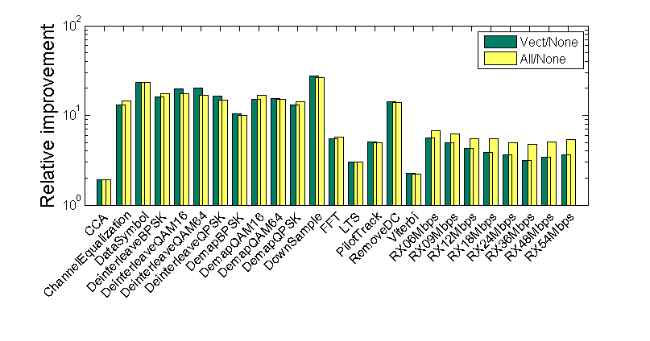
Effects of optimizations (WiFi RX)

Slide 55
Effects of optimizations (WiFi TX)
Vectorization alone not great (reason: bit array addressing) but enables LUTs!

Slide 56
Latency & real-world performance
Throughput only gives average latency
We also evaluate tail latency:
see ASPLOS paper for details
Real-world experiments on SORA hardware 98% packet success rate

Slide 57
Layout
Introduction
WiFi in Ziria
Compiling and Optimizing Ziria
Hands-on
Conclusions

Slide 58
Ziria Toolchain

Slide 59
Interfacing with other layers
RF interface – synchronous 16-bit complex input
  Radio: Sora, BladeRF
  File: test samples, radio captures
MAC interface
  IP, memory buffer (interfacing with MAC)
External C libraries
  Vector library (v_add, v_sub, v_mul, v_correlate, etc)
  Communication library (fft, Viterbi decoder)
  Simple calling convention to add more functions

Slide 60
Flexibility of the toolchain
fun comp transmitter() {
seq{ emits createSTSinTime()
; emits createLTSinTime()
; (transform_w_header()
>>> map_ofdm() >>> ifft())
}
}
Easy to create unit tests
Easy to profile
fun comp encdec_atten(c:int16) {
repeat {
(x:complex16) <-take;
emit complex16{re=x.re/c; im=x.im/c}
}
}
fun comp receiver() {
seq{ det<-detectPreamble(1000)
; params <- (LTS(det.shift, det.maxCorr))
; DataSymbol(det.shift)
>>> FFT()
>>> ChannelEqualization(params)
>>> PilotTrack()
>>> GetData()
>>> receiveBits()
}
}
let comp main = read[bit] >>> scrambler() >>> write[bit];
./test_scramble.out --input=file --input-file-name=test_scramble.infile --input-file-mode=dbg \
--output=file --output-file-name=test_scramble.outfile --output-file-mode=dbg
./test_scrambler.out --input=dummy --dummy-samples=1000000000 --output=dummy
PERFORMANCE
Total input items (including EOF): 1000000008 (1000000008 B), output items: 1000000000 (1000000000 B)
Time Elapsed: 1514276 us
Total input items (including EOF): 25 (25 B), output items: 24 (24 B)
Time Elapsed: 201396 us
Bytes copied: 0
../../../../tools/BlinkDiff -f test_scramble.outfile -g test_scramble.outfile.ground -d -v -n 0.9
Matching! (EOF) (Accuracy 100.0%)
TEST
let comp main = read
>>> transform_w_header()
>>> encdec_atten(16*5)
>>> receiveBits()
>>> write
Notes:
Contrast this with Sora/GnuRadio: you need a new project, makefile, etc

Slide 61
Debugging
Ziria compiler guarantees same execution of
optimized and un-optimized code
Debugging in C easy
if (iEnergy > energy_threshold &&
noInc > no_consec_increases &&
(oldCorr > maxCorr || oldInd != maxInd) &&
normMaxCorr > 96) then {
detected := true;
}
if (oldOldCorr < oldCorr && oldCorr < maxCorr &&
oldOldInd == oldInd && oldInd == maxInd) then {
noInc := noInc + 1;
} else {
noInc := 0;
}
oldOldCorr := oldCorr;
oldCorr := maxCorr;
oldOldInd := oldInd;
oldInd := maxInd;
if (iEnergy_ln124_187 > 1000L && noInc_ln118_183 > 4L &&
(oldCorr_ln115_180 > maxCorr_ln109_174 || oldInd_ln116_181 !=
maxInd_ln110_175) && normMaxCorrln223_319 > 96L) {
detected_ln119_184 = 1U;
}
if (oldOldCorr_ln114_179 < oldCorr_ln115_180 && oldCorr_ln115_180 <
maxCorr_ln109_174 && oldOldInd_ln117_182 == oldInd_ln116_181 &&
oldInd_ln116_181 == maxInd_ln110_175) {
noInc_ln118_183 = noInc_ln118_183 + 1L;
} else {
noInc_ln118_183 = 0L;
}
oldOldCorr_ln114_179 = oldCorr_ln115_180;
oldCorr_ln115_180 = maxCorr_ln109_174;
oldOldInd_ln117_182 = oldInd_ln116_181;
oldInd_ln116_181 = maxInd_ln110_175;
iterind_ln120_185 = iterind_ln120_185 + 1L;
bounds_check(7, 3 + 0, "../scramble.blk:38:25-26");
bitRead(scrmbl_st, 3, &bitres11);
bounds_check(7, 0 + 0, "../scramble.blk:38:40-41");
bitRead(scrmbl_st, 0, &bitres12);
tmp_blk_r17 = bitres11 ^ bitres12;
UNIT;
bounds_check(7, 0 + 5, "../scramble.blk:39:7-39");
bounds_check(7, 1 + 5, "../scramble.blk:39:34-39");
bitArrRead(scrmbl_st, 1, 6, bitarrres13);
bitArrWrite(bitarrres13, 0, 6, scrmbl_st);
UNIT;
bounds_check(7, 6 + 0, "../scramble.blk:40:7-26");
bitWrite(scrmbl_st, 6, tmp_blk_r17);
UNIT;
return x_blk_r15 ^ tmp_blk_r17;
tmp := (scrmbl_st[3] ^ scrmbl_st[0]);
scrmbl_st[0:5] := scrmbl_st[1:6];
scrmbl_st[6] := tmp;

Slide 62
Hands-on experience

Slide 63
Before We Start: Useful Locations
Github repository:
https://github.com/dimitriv/Ziria
User guide:
<github>/blob/master/doc/UserGuide/language.md
Grammar:
<github>/blob/master/doc/UserGuide/grammar.md
Windows path:
C:\Users\Demo\Ziria\compiler\code
Cygwin path:
/cygdrive/c/Users/Demo/Ziria/compiler/code/

Slide 64
Before We Start: Refresh Ziria distro
Start Cygwin
Go to:
cd /cygdrive/c/Users/Demo/Ziria/compiler
Pull latest release from GitHub
git pull
Copy latest binaries:
cp binaries/wplc-win64-110515.exe wplc.exe
cp binaries/BlinkDiff-win64-110515.exe tools/BlinkDiff.exe

Slide 65
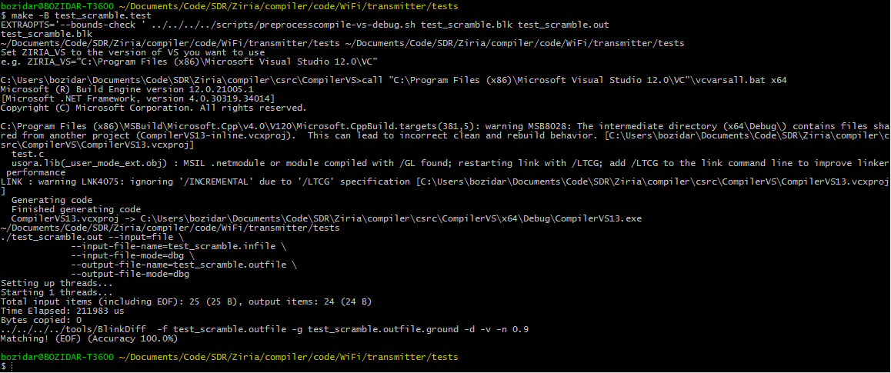
Let’s test Scrambler
Go to: <Ziria-path>/WiFi/transmitter/tests
Edit test_scramble.blk
Type: make –B test_scramble.test

Slide 66
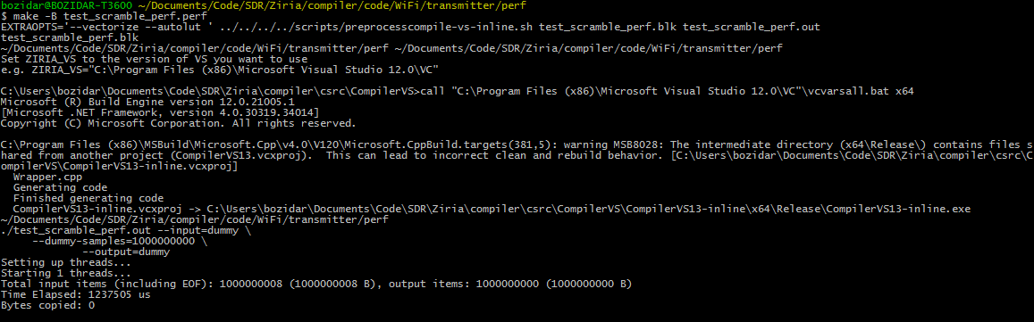
How about performance?
Go to: <Ziria-path>/WiFi/transmitter/perf
Edit test_scramble_perf.blk
Type: make –B test_scramble_perf.perf

Slide 67
Hello World
Go to: /cygdrive/c/Users/Demo/Ziria/compiler/code/examples
First Ziria program – flip bits in input stream – test.blk:
fun comp flip() {
repeat {
x <- take;
emit (x ^ ‘1);
}
}
let comp main = read >>> flip() >>> write
Input file (test.infile): 0,1,1,1,0,1
Run: make –B test.outfile && cat test.outfile

Slide 68



Performance
Run: make –B test.out
Profile with: ./test.out --input=dummy --dummy-samples=100000000 --output=dummy
Run: EXTRAOPTS=‘—vectorize’ make –B test.perf
Run: EXTRAOPTS=‘—vectorize —autolut’ make –B test.perf

Slide 69
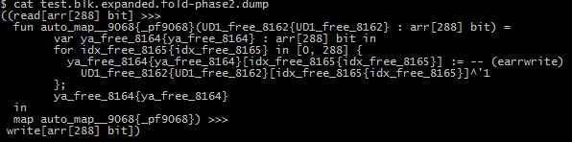
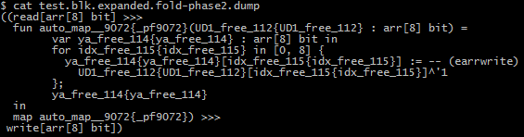


Why AutoLUT didn’t work
Vectorizer is too aggressive! (use —ddump-fold)
We can use annotations
Run: make –B test.perf
Run: EXTRAOPTS=‘—vectorize’ make –B test.perf
Run: EXTRAOPTS=‘—vectorize —autolut’ make –B test.perf
fun comp flip() {
repeat [8,8] {
x <- take;
emit (x ^ ‘1);
}
}
let comp main = read >>> flip() >>> write

Slide 70
More serious example
We want to double the size of LTS preamble in WiFi to improve estimation
Modify WiFi transmitter (transmitter.blk) to send two LTS preambles
Modify WiFi receiver (receiver.blk) to still receive packets
(for simplicity we ignore the second preamble, taking 2 x 80 samples)
Transmitter: <Ziria-path>/WiFi/transmitter/transmitter.blk
Receiver:<Ziria-path>/WiFi/receiver/receiver.blk
Test:
make -B test_tx.outfile
cp test_tx.outfile test_rx.infile
make -B test_rx.test

Slide 71
Solution
fun comp transmitter() {
seq{ emits createSTSinTime()
; emits createLTSinTime()
; emits createLTSinTime()
; (transform_w_header()
>>> map_ofdm()
>>> ifft())
}
}
fun comp receiver() {
seq{ det<-detectPreamble(1000)
; params<-(LTS(det.shift,det…))
; x <- takes 160
; DataSymbol(det.shift)
>>> FFT()
>>> ChannelEqualization(params)
>>> PilotTrack()
>>> GetData()
>>> receiveBits()
}}
Notes:
Discuss how to do it in Sora

Slide 72
WiFi Sniffer Demo

Slide 73
Layout
Introduction
WiFi in Ziria
Compiling and Optimizing Ziria
Hands-on
Conclusions

Slide 74
Status
Released to GitHub under Apache 2.0
WiFi implementation included in release
Currently:
  RF: SORA, BladeRF
  Architectures: CPU/SIMD
Looking into porting to other CPU-based SDRs
https://github.com/dimitriv/Ziria

Slide 75
Conclusions
More wireless innovations will happen at intersections of PHY and MAC levels
We need prototypes and test-beds to evaluate ideas
PHY programming in its infancy
  Difficult, limited portability and scalability
  Steep learning curve, difficult to compare and extend previous works
Wireless programming is easy and fun – go for it!
http://research.microsoft.com/en-us/projects/ziria/

Slide 76
Thank you!
http://research.microsoft.com/en-us/projects/ziria/
https://github.com/dimitriv/Ziria

