Slide 1
Programming by Example using Least General Generalizations
Mohammad Raza, Sumit Gulwani & Natasa Milic-Frayling
Microsoft Research

Slide 2
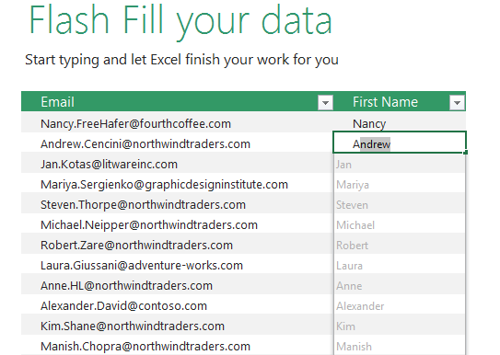
Introduction
Programming by Example (PBE) has made significant advances recently, e.g. Excel Flash Fill (Gulwani’11)
Addressing transformations on small unstructured text strings

Slide 3
Introduction
Existing approaches do not scale to more complex editing scenarios e.g. richly formatted document editing
PBE paradigm is well-suited to rich formatting scenarios:
  Styles, templates are restrictive and require premature commitment from the user
  Macro programming languages are expressive but too advanced for most users
  Discoverability of specialised features is difficult in complex UIs

Slide 4
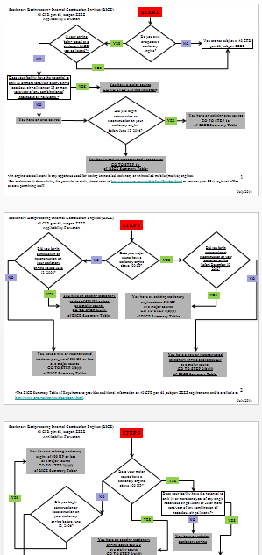
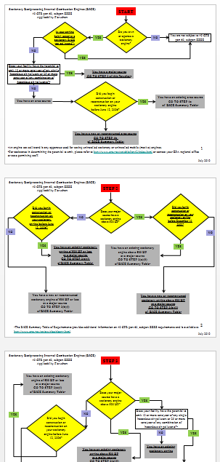
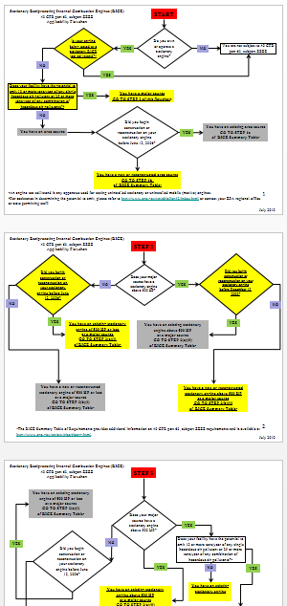
Repetitive formatting scenarios
Initial state
Colour all diamond-shaped objects
Colour all objects with underlined text

Slide 5



Repetitive formatting scenarios
Initial state
Shift all pictures
Align all pictures

Slide 6
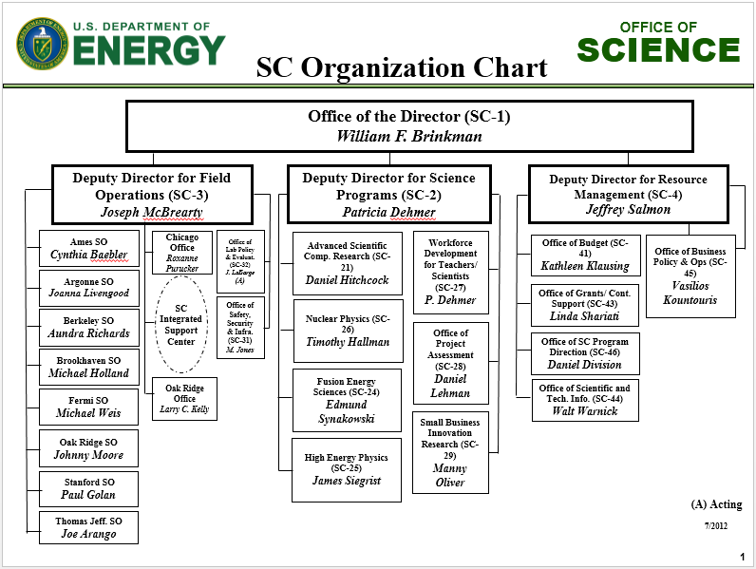
Repetitive formatting scenarios
Change all first names to initials

Slide 7
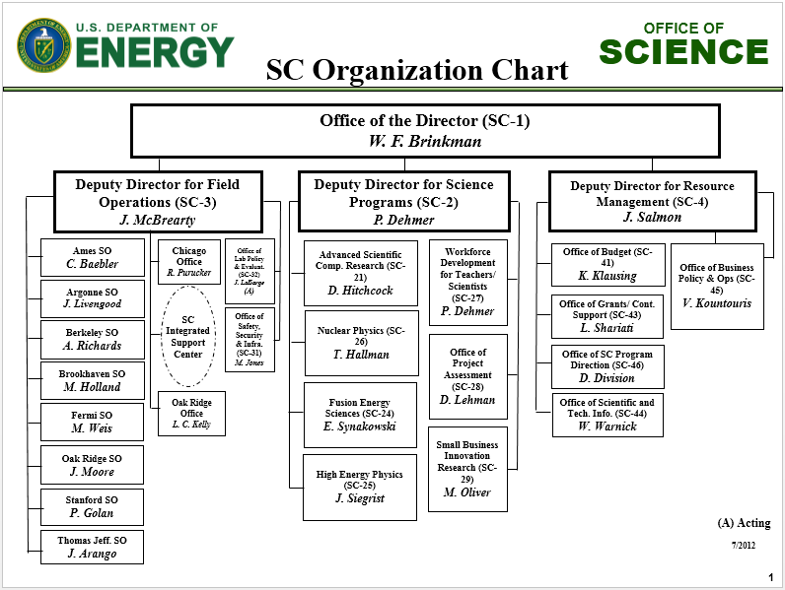
Repetitive formatting scenarios
Change all first names to initials

Slide 8
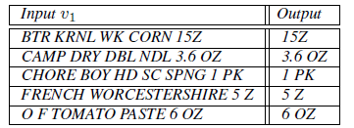
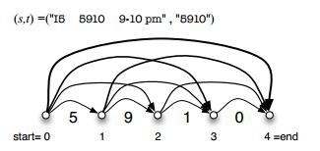
Challenges & existing approaches
General PBE ingredients:
  Domain specific language (DSL) - space of possible programs
  Synthesis algorithm - given input-output examples, infer a satisfying program in the DSL
Trade offs between expressivity of DSL, efficiency and accuracy of synthesis algorithm
Recent DAG-based approaches:
  Construct an explicit representation of all possible programs followed by ranking within this space
1 P K

Slide 9
A different approach to PBE
Since goal is to find a single program, can we incorporate the ranking strategy implicitly into the synthesis algorithm?
Adopting the notion of least general generalization from inductive inference (Plotkin’70):
  Design a DSL equipped with a natural subsumption ordering on programs
  Design an algorithm that efficiently generates programs that are minimal with respect to the subsumption ordering
  Avoid exhaustive enumeration of the search space

Slide 10
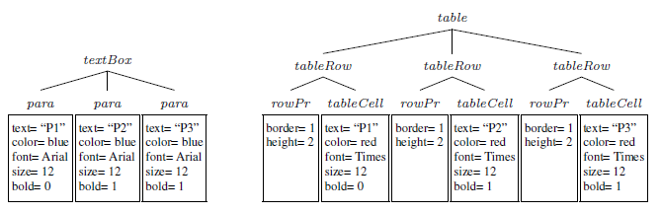
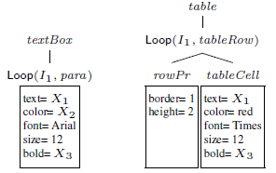
Domain Specific Language
Structured representation of richly formatted content (XML)
DSL programs express conditional transformations on XML trees:
Change all text boxes that have Arial font of size 12 into a red coloured table
Example input state
Example output state
Input expression
Output expression

Slide 11


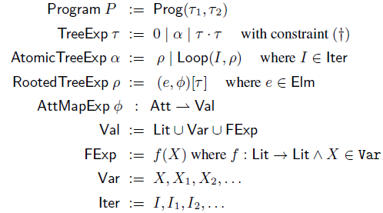
Domain Specific Language
Data model
XML represented as ordered trees
Each node labelled by
  an element name
  a mapping of attributes to literal values
Programs defined by input and output tree expressions
Attribute value expressions may be specified by literals, variables or function expressions e.g. numeric or text transformations
Loop expressions using iterators
  Expressing structural variations
  May be nested
  Unique loop expression per element in a sibling composition
DSL

Slide 12


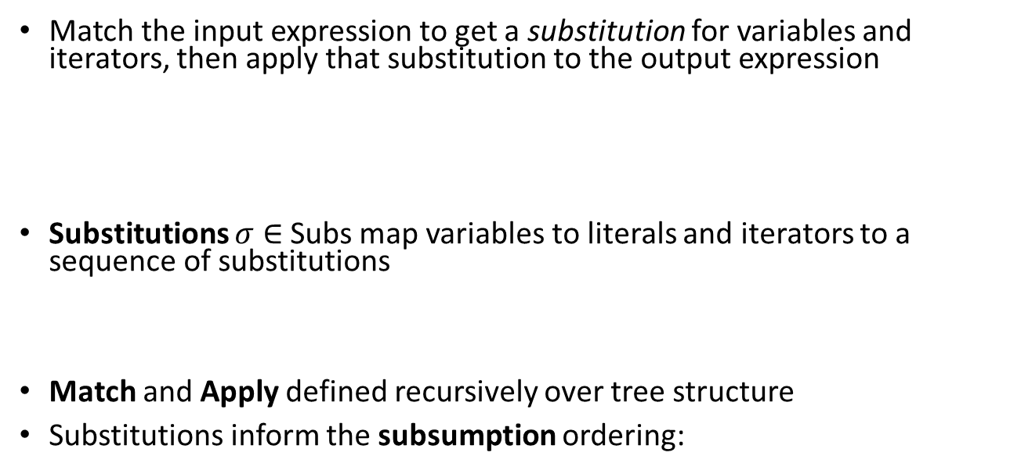
Semantics
Match the input expression to get a substitution for variables and iterators, then apply that substitution to the output expression
Substitutions $σ$ $∈$ Subs map variables to literals and iterators to a sequence of substitutions
Match and Apply defined recursively over tree structure
Substitutions inform the subsumption ordering:

Slide 13



Synthesis algorithm
Given a set of input-output examples, generate a program satisfying all the examples that is minimal in the subsumption ordering
Based on syntactic anti-unification (Plotkin’70)
  Using scopes to represent nested loop contexts:
  maintain injective maps for generating variables and iterators within scopes

Slide 14
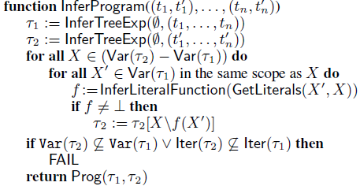
Synthesis algorithm – top level
Overall approach
  Generalize over inputs
  Generalize over outputs
  Relate variables between input and output

Slide 15
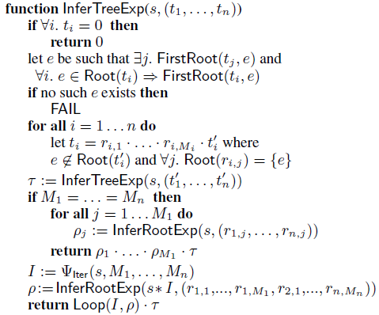
Synthesis algorithm
Inferring tree expressions
  Select next element e from top level siblings
  Call recursively on remaining siblings
  If e has fixed number occurrences then infer rooted tree expression
  Otherwise introduce a new iterator and infer loop expression

Slide 16
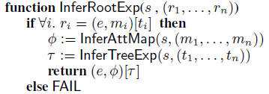
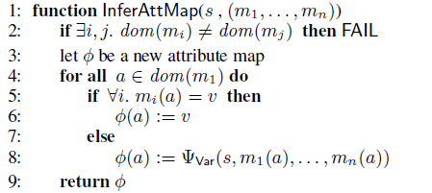
Synthesis algorithm
Infer rooted tree expression
  Follows inductive structure
Infer attribute map expression (base case)
  Introduce new variable if attribute values not consistent

Slide 17
Evaluation
Implemented an add-in for Microsoft PowerPoint, based on OOXML file format
Evaluated with questions from online help forums
  Questions covered wide range of PowerPoint features
    e.g. shapes, images, charts, tables, bullets, margins, fonts, borders, size, positioning, scaling, colors, styles, indents…
    “indent any text of a certain font if it appears inside a table”
    “change only red coloured circular shapes”
    “change only text of a certain font and size”
    “borders around all pictures”
    “change paragraphs to table rows”
Some tasks involving ranges not expressible
Average of 4.2 examples required for task completion

Slide 18
Conclusion
Extended applicability of PBE to domain of rich formatting transformations
LGG provides a different approach to PBE where
  DSL is designed with respect to a target subsumption relation
  ranking bias is implicit in the synthesis algorithm
Next steps:
  Targeting more expressive domains (e.g. ranges in conditionals, loop conditions)
  Faster convergence (customizing XML formats)
  Natural interaction techniques, e.g. NL input from user to target more expressive domains with fewer examples

