Slide 1
Predicting a Correct Program in PBE
Rishabh Singh, Microsoft Research
Sumit Gulwani, Microsoft Research

Slide 2

Programming By Examples
Ambiguity!
Intuitive
Natural
Accessible

Slide 3




Excel Forums
300_w1_aniSh_c1_b → w1
=MID(“300_w1_aniSh_c1_b”,5,2)

Slide 4

Excel Forums
300_w30_aniSh_c1_b → w30
=MID($B:$B,FIND(“_”,$B:$B)+1, FIND(“_”,REPLACE($B:$B,1,FIND(“_”,$B:$B),””))-1)

Slide 5


FlashFill [Gulwani POPL2011][Gulwani,Harris,Singh CACM 2012]
Benchmarks
Heuristics
Program
VSA
DSL

Slide 6


Benchmarks
Ranking
Program
VSA
DSL

Slide 7
Handling Ambiguity
Input | Output
Rick Rashid | Mr. Rick
Satya Nadella

Slide 8
Prefer non-constants
Input | Output
Rick Rashid | Mr. Rick
Satya Nadella | Ms. Satya
Prefer smaller substrings as constants

Slide 9
Prefer smaller constants
Input | Output
Satya Nadella | S. Nadella
Bill Gates
2nd word, last word, 2nd capital followed by 2nd lowercase string….

Slide 10

Machine Learning for Ranking
“With great power comes great responsibility.”

Slide 11
Three Challenges
Labelled Training Data
Machine Learning Algorithm
Efficient Ranking Algorithm

Slide 12
Training Data Generation
Input | Output
Rick Rashid | Mr. Rashid
Satya Nadella | Mr. Nadella
Peter Lee | Mr. Lee

Slide 13
Structuring Hypothesis Space with Sharing in Version-space
Associative Expressions
DAG-based sharing
f(e₁, f(e₂, f(e₃, e₄)))
Fixed-arity Expressions
Set-based sharing
f(e₁, e₂, e₃, e₄)

Slide 14
Ranking Function f(p)
Assume Linear Function
f(p) = w₁* f₁ + w₂*f₂ + … + w_{k}*f_{k}

Slide 15

Learning To Rank
Listwise Approach
Logistic Regression
All relevant pages over irrelevant
Didn’t work well ☹
Too strong a constraint

Slide 16


Training Phase
Input | Output
Rick Rashid | Mr. Rick
Satya Nadella | Mr. Satya
Peter Lee | Mr. Lee
Goal: Find ranking function f(p) over program features that ranks positive programs higher than negative programs
Lower 1st uppercase letter
Constant “r”
Lower 2nd upper case letter
….

Slide 17


























Learn DAGs
$$γ_{50}$$
$$γ_{9}$$
$$γ_{10}$$
$$γ_{12}$$
$$γ_{13}$$
$$γ_{11}$$
0
1
2
3
4
5
6
7
8
$$γ_{1}$$
$$γ_{2}$$
$$γ_{3}$$
$$γ_{4}$$
$$γ_{5}$$
$$γ_{6}$$
$$γ_{7}$$
$$γ_{8}$$
Rick Rashid → Mr. Rashid
$$γ_{50}$$
$$γ_{12}$$
$$γ_{13}$$
$$γ_{11}$$
0
1
2
3
4
5
6
7
8
$$γ_{1}$$
$$γ_{2}$$
$$γ_{3}$$
$$γ_{4}$$
$$γ_{5}$$
$$γ_{6}$$
$$γ_{7}$$
$$γ_{8}$$
Satya Nadella → Mr. Satya

Slide 18


Intersect DAGs
Rick Rashid → Mr. Rick
$$∩$$
Satya Nadella → Mr. Satya
$$≡$$

Slide 19
Assign Positive Labels
Rick Rashid → Mr. Rick
$$∩$$
Satya Nadella → Mr. Satya
$$≡$$

Slide 20
Assign Negative Labels
Rick Rashid → Mr. Rick
$$∩$$
Satya Nadella → Mr. Satya
$$≡$$

Slide 21
Rick Rashid → Mr. Rick
Satya Nadella → Mr. Satya
Learn ranking function f(p) that ranks
programs higher than programs.

Slide 22
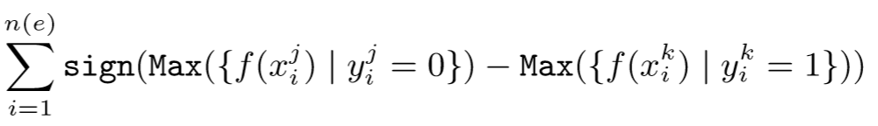
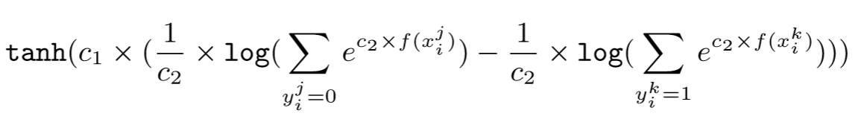
Training Phase
Rank any positive program over all negative programs
Negative Programs
Positive Programs

Slide 23
Hierarchical Ranking
Substring Expression
Frequency of tokens, context, neighborhood,…
Atomic Expression
Length of substring, input, output, constant,…
Concat Expression
Number of Arguments, sum, max, min, prod

Slide 24
Evaluation
175 benchmarks
30-70 train-test partition
Baseline (Occam’s razor):
Smallest & Simplest programs

Slide 25
Ranking Evaluation
LearnRank learns from 1 example for 79% benchmarks

Slide 26
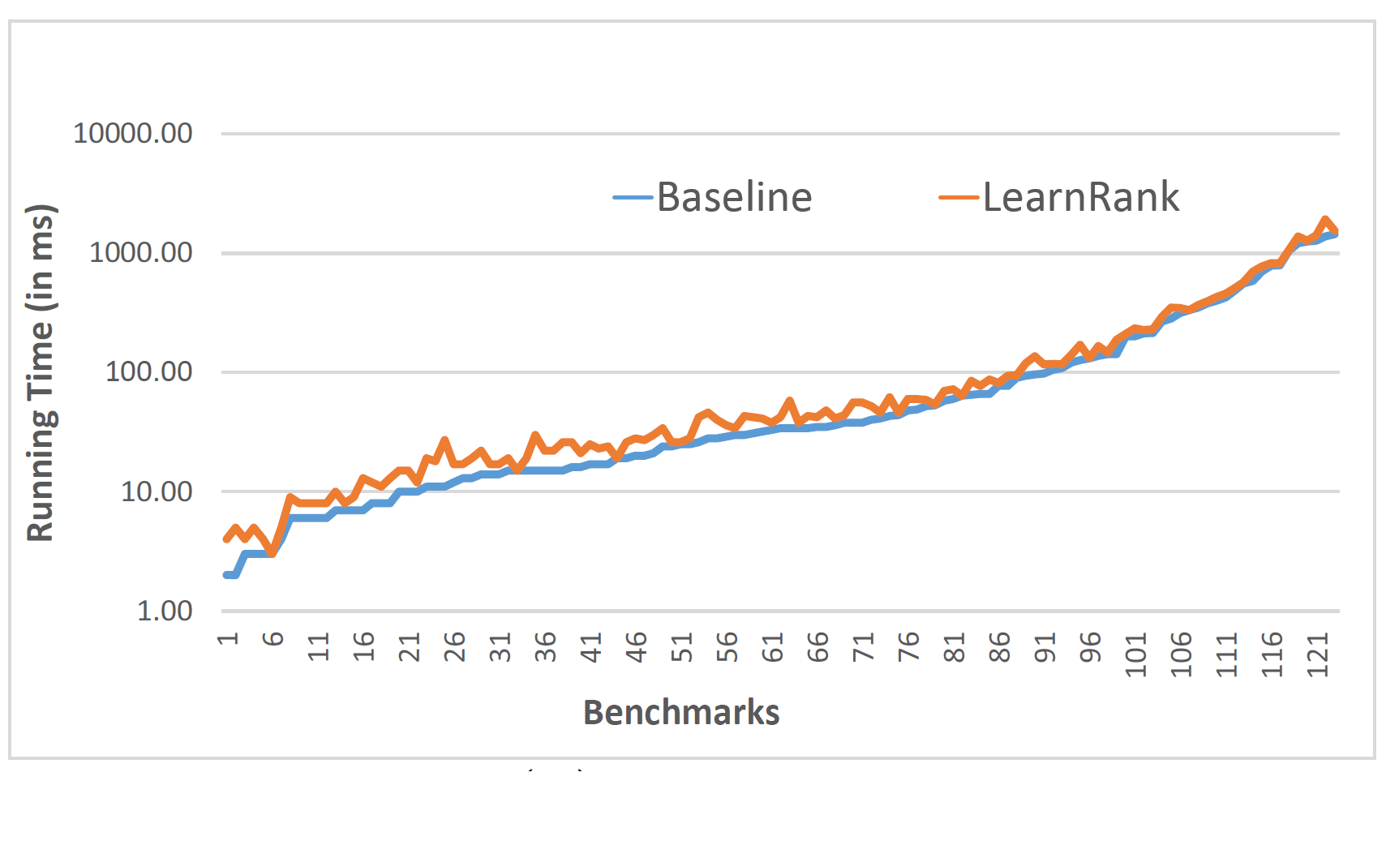
Efficiency of Ranking

Slide 27
Ranking for PBE
Machine Learning + Synthesis
General Loss Function for PBE
VSA Sharing Formalization
Efficient Features & Algorithms
Thanks! risin@microsoft.com

