Slide 1
Effective and Efficient: Large-scale Dynamic City Express
Siyuan Zhang †, Lu Qin‡, Yu Zheng*, Hong Cheng†
† The Chinese University of Hong Kong, China
‡Centre for QCIS, FEIT, University of Technology, Sydney, Australia
*Microsoft Research, Beijing, China

Slide 2
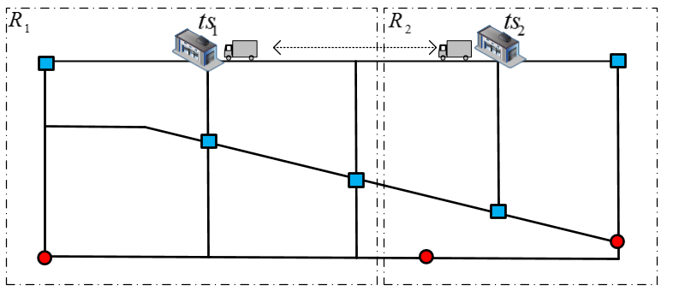

Current city express services works as follows:

Slide 3
Background
Drawbacks of current systems:
  Boundary requests are ignored.
  Process each pickup request individually and immediately
We study the dynamic city express problem (DCEP) and aim to design a better central dispatch system
Notes:
e.g., request r_7 is ignored by courier c_1 and request r_5 will be first assigned to nearest courier c_1.

Slide 4
DCEP Problem and Our Solution
The Dynamic City Express Problem (DCEP):
Effectiveness: using Smallest Incurred Distance First (SIDF) for assignment.
Efficiency: using two-level priority queue structure to speed up.
l(r₁): location; d(r₁): deadline
NP-complete
1. Must deliver
2. Pickup request as many as possible
3. Come back on time

Slide 5
Step 1: Candidate Courier Generation using NVD index
Candidate Voronoi regions: ts₀, ts₁, ts₂
  cost(l(ts_{j}),l(r₁))-radius(ts_{j})<d(r₁)-t_{cur}
radius(ts_{j}) is service range of ts_{i}
Candidate couriers: c₂, c₄, c₅
      cost(l(c₂),l(r₁))<d(r₁)-t_{cur}
        cost(l(c₂),l(r₁))=d₀₂-cost(l(ts₀), l(c₂))-cost(l(r₁),l(ts₂))

Slide 6
Step 2: Assign a batch of requests using Smallest Incurred Distance First (SIDF) algorithm
The basic algorithm assigns requests according to arrival time
c₂
r₇
c₁
r₆
Basic route:
r₀
r₁
r₅
r₂
SIDF route:
r₀
r₆
r₁
r₇
r₂
Our solution first collects requests every t_{r} minutes
Notes:
The requests arrival sequence are r_5, r_6 and r_7. Basic algorithm assign a request to courier with smallest incurred distance on a first come first serve strategy. We consider request in a batch every t_r minutes.

Slide 7
Efficiency improvement: Two-level priority queue
2nd iteration
Initialization: initialize and
No exact distance calculations
Satisfy r₇
3rd iteration
Get cost(r₀,r₆) and cost(r₆,r₁)
1st iteration
4th iteration
Satisfy r₆
Get cost(r₁,r₇) and cost(r₇,r₂)
Notes:
Each entry in the priority queues denotes an assignment related to courier and requests. \delta dist is the incurred distance of this assignment. False means the incurred distance is a lower bound calculated based on NVD index.
In the initialization step, all possible entries whose lower bound satisfy spatio-temporal constraints are push into local priority queue. Then a global priority queue is build based on local priority queue.

Slide 8
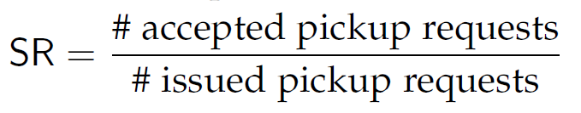

PERFORMANCE STUDIES
We perform simulations on the road network of Beijing
Measurements:
  Satisfaction Ratio(SR):
  Average incurred distance(AID):
  Average process time per request
Algorithm:
  Nearest
  Basic
  SIDF* (our solution with efficiency improvement)
Notes:
Nearest means we always assign a new request to its nearest courier with smallest incurred distance and reject the request if we fail due to constraints.
SIDF and SIDF* have the same effectiveness. SIDF first calculates the exact incurred distance of each request, satisfies request with smallest incurred distance, then update the exact incurred distance of other requests. No global priority queue to reduce distance calculation and local priority queues to keep calculated results.

Slide 9
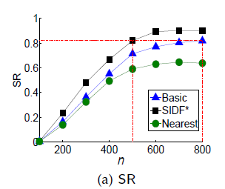
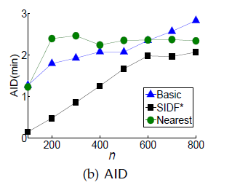
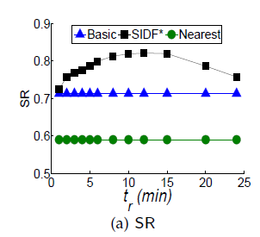
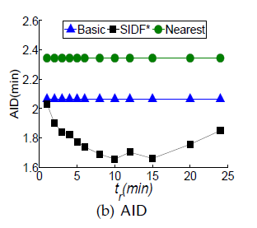
Effectiveness
n: courier number t_{r}: batch time
Notes:
Our solution can increase the SR by 10% compared to Basic and 30% compared to Nearest.
Basic and Nearest are stream algorithms. So there are no change related to t_r.
The experiment are simulation on a road network with 8840 nodes between northeastern 4th ring road and 5th ring road of Beijing

Slide 10
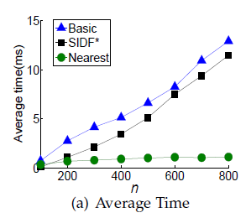
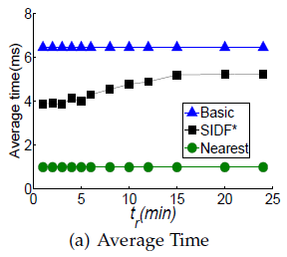
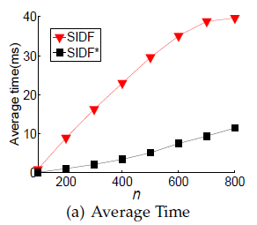
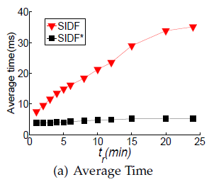
Efficiency
SIDF* is much more efficiency than SIDF!
Notes:
The comparison between SIDF and SIDF* demonstrate the power of two level priority queue structure.
SIDF* is 6 times faster than SIDF.
On average, we can process a request in less than 15ms, suitable for real-time application.

Slide 11
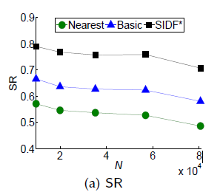
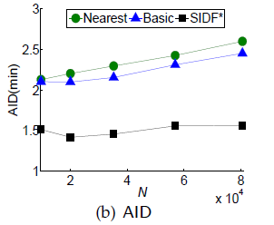
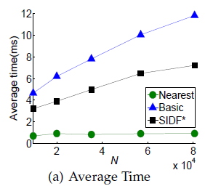
Scalability
N: number of nodes on the road network.
The largest road network consists of
81,000 nodes and 104,000 edges.
Notes:
We perform simulation on the 2nd ,3rd,4th,5th, 6th ring road of Beijing. The size of the road network varies from 8,400 nodes to 81,000 nodes, our solution still has the highest SR, lowest AID and less average process time than the streaming algorithm Basic.
The SR decreases when road network size is 81,000 because it takes more time to travel between nodes outside the fifth ring region of Beijing.

