Slide 1



Analyze This! 145 Questions for Data Scientists in Software Engineering
Andrew Begel, Thomas Zimmermann
Microsoft Research, USA
June 4, 2014, ICSE 2014

Slide 2
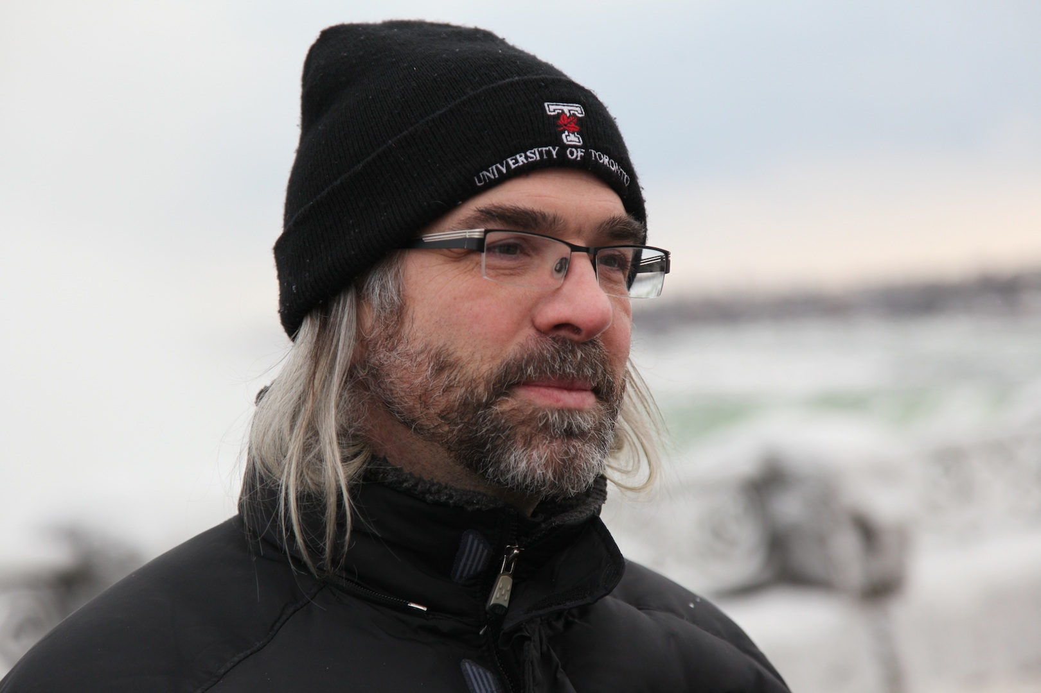
Meet
Greg Wilson
(Mozilla)
The plural of anecdote is not evidence.

Slide 3
It will never work… in theory.
Blog post on August 22, 2012
Ten Questions for Researchers
  Greg asked a software developer friend at Mozilla, “Give me a list of 10 questions that you’d really like software engineering researchers to answer.”

Slide 4
Find me some evidence!
emacs vs. vi vs. IDEs: which one makes me more productive?
Is it really twice as hard to debug as it is to write the code in the first place?
When does it make sense to reinvent the wheel vs. use an existing library?
Are conferences worth the money?
How much do they help junior, intermediate, or senior programmers?
(and 6 more…)

Slide 5

Tom and Andrew:
Let’s ask Microsoft engineers what they would like to know!

Slide 6
http://aka.ms/145Questions

Slide 7
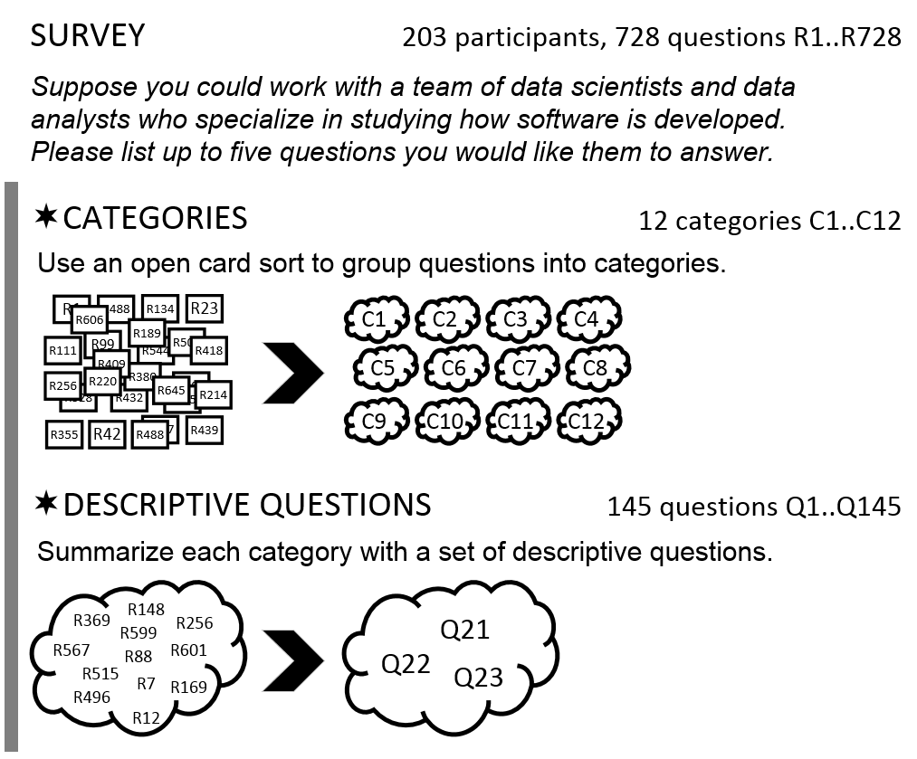
❶

Slide 8
❶

Slide 9
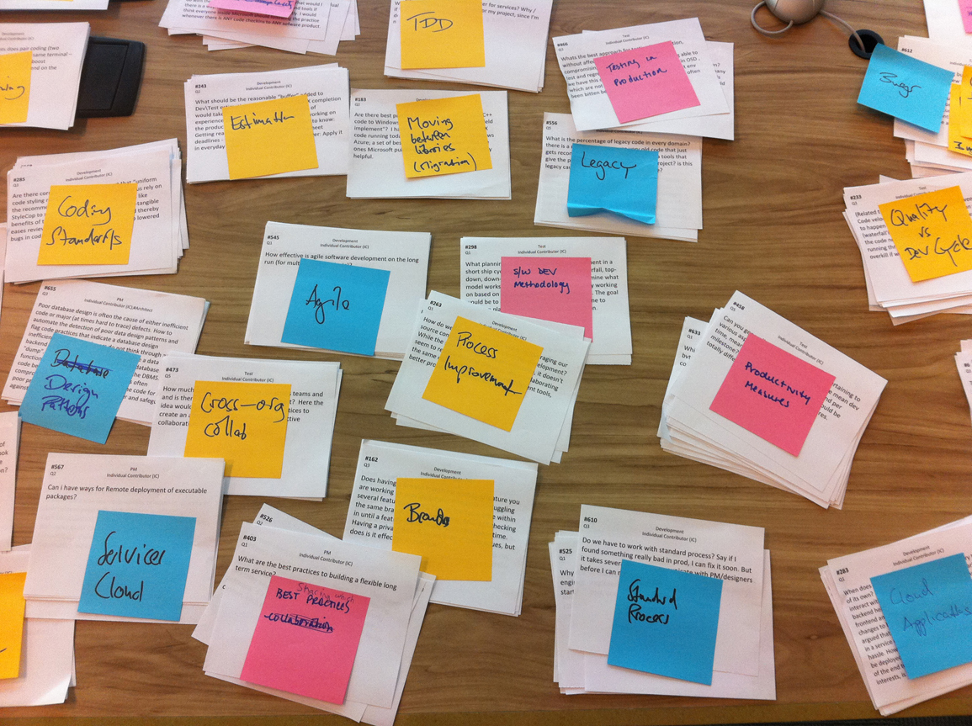

Slide 10
categories
Analyze This! 145 Questions for Data Scientists in Software Engineering.
Andrew Begel, Thomas Zimmermann.

Slide 11
raw questions (provided by the respondents)
“How does the quality of software change over time – does software age?
I would use this to plan the replacement of components.”

Slide 12
raw questions (provided by the respondents)
“How does the quality of software change over time – does software age?
I would use this to plan the replacement of components.”
“How do security vulnerabilities correlate to age / complexity / code churn / etc. of a code base? Identify areas to focus on for in-depth security review or re-architecting.”

Slide 13
raw questions (provided by the respondents)
“How does the quality of software change over time – does software age?
I would use this to plan the replacement of components.”
“How do security vulnerabilities correlate to age / complexity / code churn / etc. of a code base? Identify areas to focus on for in-depth security review or re-architecting.”
“What will the cost of maintaining a body of code or particular solution be? Software is rarely a fire and forget proposition but usually has a fairly predictable lifecycle. We rarely examine the long term cost of projects and the burden we place on ourselves and SE as we move forward.”

Slide 14
raw questions (provided by the respondents)
“How does the quality of software change over time – does software age?
I would use this to plan the replacement of components.”
“How do security vulnerabilities correlate to age / complexity / code churn / etc. of a code base? Identify areas to focus on for in-depth security review or re-architecting.”
“What will the cost of maintaining a body of code or particular solution be? Software is rarely a fire and forget proposition but usually has a fairly predictable lifecycle. We rarely examine the long term cost of projects and the burden we place on ourselves and SE as we move forward.”
descriptive question (which we distilled)
How does the age of code affect its quality, complexity, maintainability, and security?

Slide 15
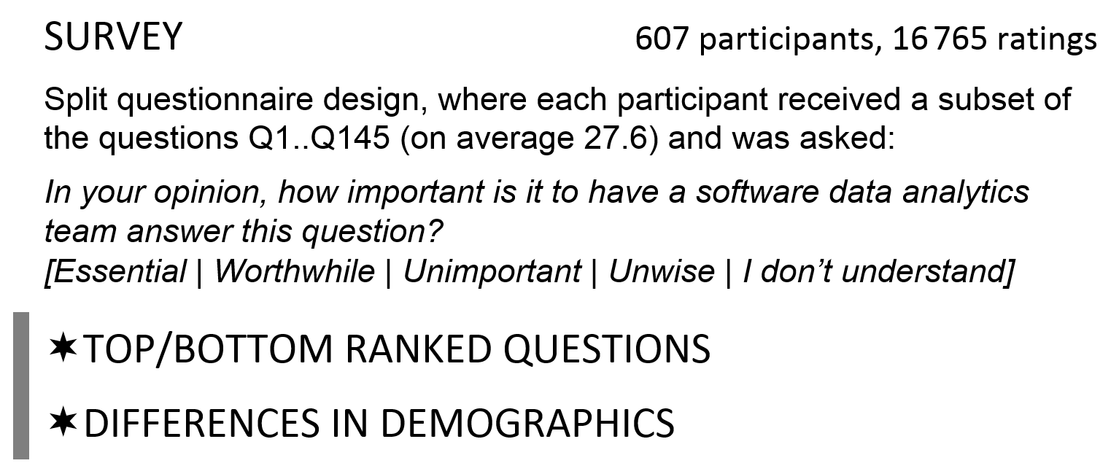
❷
Discipline: Development, Testing, Program Management
Region: Asia, Europe, North America, Other
Number of Full-Time Employees
Current Role: Manager, Individual Contributor
Years as Manager
Has Management Experience: yes, no.
Years at Microsoft
Notes:
The asymmetric survey response scale was inspired by a model for product development and customer satisfaction created by Professor Noriaki Kano [31]. It measures three aspects: must have (Essential), nice to have (Worthwhile), and detraction (Unwise).

Slide 16
Microsoft’s Top 10 Questions | Essential | Essential + Worthwhile
1. How do users typically use my application? | 80.0% | 99.2%
2. What parts of a software product are most used and/or loved by customers? | 72.0% | 98.5%
3. How effective are the quality gates we run at checkin? | 62.4% | 96.6%
4. How can we improve collaboration and sharing between teams? | 54.5% | 96.4%
5. What are the best key performance indicators (KPIs) for monitoring services? | 53.2% | 93.6%
6. What is the impact of a code change or requirements change to the project and its tests? | 52.1% | 94.0%
7. What is the impact of tools on productivity? | 50.5% | 97.2%
8. How do I avoid reinventing the wheel by sharing and/or searching for code? | 50.0% | 90.9%
9. What are the common patterns of execution in my application? | 48.7% | 96.6%
10. How well does test coverage correspond to actual code usage by our customers? | 48.7% | 92.0%

Slide 17
Microsoft’s 10 Most Unwise Questions | Unwise
1. Which individual measures correlate with employee productivity (e.g. employee age, tenure, engineering skills, education, promotion velocity, IQ)? | 25.5%
2. Which coding measures correlate with employee productivity (e.g. lines of code, time it takes to build software, particular tool set, pair programming, number of hours of coding per day, programming language)? | 22.0%
3. What metrics can use used to compare employees? | 21.3%
4. How can we measure the productivity of a Microsoft employee? | 20.9%
5. Is the number of bugs a good measure of developer effectiveness? | 17.2%
6. Can I generate 100% test coverage? | 14.4%
7. Who should be in charge of creating and maintaining a consistent company-wide software process and tool chain? | 12.3%
8. What are the benefits of a consistent, company-wide software process and tool chain? | 10.4%
9. When are code comments worth the effort to write them? | 9.6%
10. How much time and money does it cost to add customer input into your design? | 8.3%

Slide 18
Discipline Differences (Essential %) | Dev | Test | PM
How many new bugs are introduced for every bug that is fixed? | 27.3% | 41.9% | 12.5%
When should we migrate our code from one version of a library to the next? | 32.6% | 16.7% | 5.1%
How much value do customers place on backward compatibility? | 14.3% | 47.1% | 18.3%
What is the tradeoff between frequency and high quality when releasing software? | 22.9% | 48.5% | 14.5%
Role Differences (Essential %) | Manager | Individual Contributor
How much legacy code is in my codebase? | 36.7% | 65.2%
When in the development cycle should we test performance? | 63.3% | 81.4%
How can we measure the productivity of a Microsoft employee? | 57.1% | 77.3%
What are the most commonly used tools on our software team? | 95.8% | 67.8%

Slide 19
Region Differences (Essential %) | Asia | Europe | North America
How can we measure the productivity of a Microsoft employee? | 52.9% | 30.0% | 11.0%
How do software methodologies affect the success and customer satisfaction of shrinkwrapped and service-oriented products? | 52.9% | 10.0% | 24.7%
Can I generate 100% test coverage? | 60.0% | 0.0% | 9.0%
What is the effectiveness, reliability, and cost of automated testing? | 71.4% | 12.5% | 23.6%
Mgmt Experience Differences | Years as Manager (change in odds per year)
How much cloned code is ok to have in my codebase? | (Essential) 36%
How does the age of code affect its quality, complexity, maintainability, and security? | (Essential + Worthwhile) -28%

Slide 20
MSFT Experience Differences | Years at Microsoft (change in odds per year)
What criteria should we use to decide when to use managed code or native code (e.g., speed, productivity, functionality, newer language features, code quality)? | (Essential) -23%
What are the best tools and processes for sharing knowledge and task status? | (Essential) -18%
Should we do Test-Driven Development? | (Essential) -19%
How much distinction should there be between developer and tester roles? | (Essential + Worthwhile) -14%
Who should write unit tests, developers or testers? | (Essential + Worthwhile) -13%
How much time went into testing vs. development? | (Essential + Worthwhile) -12%

Slide 21
Takeaway: Focus on Important Questions
Research:
  Academic-industry collaborations
  Tech Transfer
  Guidance for academic research
Practice:
  Collect metrics and build tools at large scale
  Spread knowledge of existing tools
  Make tools more applicable and easier to use.
Education:
  Contextualize data science education
  Illustrate real-life challenges of software professionals
  Model analytics process for students: pose high-quality, specific, actionable questions, write up coherent reports, follow up with teams to help them implement improvements
Please replicate our study at your company!

