Slide 1

ACE:
Exploiting Correlation for
Energy-Efficient and
Continuous Context Sensing
Suman Nath
Microsoft Research

Slide 2








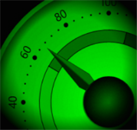

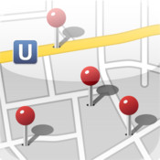









Continuous Context-Aware Apps
How much do I jog?
Mute phone in meeting
Alert when at grocery shop
Monitor indoor location
Custom message on driving
Jog Tracker
Phone Buddy
Geo-Reminder
Batphone
Phone Buddy
Continuous sensing of user’s context

Slide 3
Sensing Context is Expensive
Context | Sensors | Sensing Energy (mJ)
IsWalking, IsDriving, IsJogging, IsSitting | Accelerometer (10 sec)
AtHome, AtOffice | WiFi
IsIndoor | GPS + WiFi
IsAlone | Mic (10 sec)
InMeeting, IsWorking | WiFi + Mic (10 sec)
259
605
1985
2995
3505
Three orders of magnitude difference

Slide 4
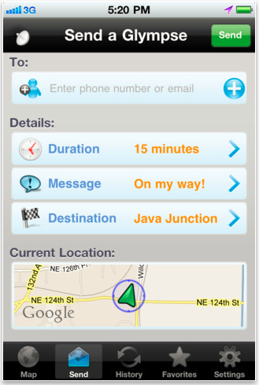

Sensing Context is Expensive
Three orders of magnitude difference
  Some apps limit how long to sense
Our goal: push the limit

Slide 5
Our Approach
Approach: Opportunistically infer expensive attributes from cheap attributes
  Similar to ‘strength reduction’ in compiles
Conjecture: Relationship of expensive and cheap attributes can be learnt automatically
Intuition: Human activities constrained by physical constraints
  Behavior invariants: Driving implies Not At Home
ACE: Acquisitional Context Engine
Low-energy continuous sensing middleware

Slide 6
ACE Big Picture
App1
App2
App3
App4
ACE
Get(attribute)
Raw Sensor Data

Slide 7
ACE Big Picture
Get(Driving)
=True
App1
App2
App3
App4
Sensing
Get(attribute)
Running
Contexters
Inference Cache
Driving
AtHome
InMeeting
Driving
Running
Correlation Miner
Driving ⇒ ¬AtHome
Running ⇒ ¬InMeeting
Raw Sensor Data

Slide 8
ACE Big Picture
Get(Driving)
=True
Get(Driving)
=True
Get(AtHome)
=False
App1
App2
App3
App4
Sensing
Hit
Inference Hit
Get(attribute)
Running
Contexters
Inference Cache
Driving
AtHome
InMeeting
Driving
Running
Correlation Miner
Driving ⇒ ¬AtHome
Running ⇒ ¬InMeeting
Raw Sensor Data

Slide 9
ACE Big Picture
Get(Driving)
=True
Get(Driving)
=True
Get(AtHome)
=False
Get(InMeeting)
=False
App1
App2
App3
App4
Sensing
Hit
Inference Hit
Proxy sensing
Get(attribute)
Running
Contexters
Inference Cache
Running
Speculative Sensing
miss
AtHome
InMeeting
Driving
Running
Correlation Miner
Driving ⇒ ¬AtHome
Running ⇒ ¬InMeeting
Raw Sensor Data

Slide 10
ACE Big Picture
Get(Driving)
=True
Get(Driving)
=True
Get(AtHome)
=False
Get(InMeeting)
=False
App1
App2
App3
App4
Sensing
Hit
Inference Hit
Proxy sensing
Get(attribute)
Running
Contexters
Inference Cache
Running
Speculative Sensing
miss
AtHome
InMeeting
Driving
Running
Automatic process
No semantic meaning needed
Easy to extend with new Contexters
Rule Miner
Driving ⇒ ¬AtHome
Running ⇒ ¬InMeeting
Raw Sensor Data

Slide 11
Key Questions
Feasibility: Do useful correlations exist and can they be efficiently learnt?
System design: How to systematically exploit the correlations?
Effectiveness: How much energy savings?

Slide 12
Disclaimers
Not for apps requiring 100% accurate contexts
  Experiments show ~4% inaccuracy
Current prototype
  Boolean attributes (categorical attributes)
  Uses correlations at the same time
    E.g., Driving ⇒ Not at home
    Ignores temporal aspects of rules

Slide 13
Feasibility: Datasets
MIT Reality Mining Dataset
MSR Dataset
95 students and staffs at MIT
Nokia 6600 phones, 2004-2005
min/avg/max: 14/122/269 days
10 interns and researchers
Android phones
min/avg/max: 5/14/30 days
Context Attributes
Location: AtHome, InOffice, IsIndoor,
Task: InMeeting, IsWorking, IsUsingApp, IsCalling,
Transportation mode: IsWalking, IsBiking, IsDriving, IsSitting,
Group: IsAlone
….
10:23:34 am AtHome
10:23:35 am Walking,Outdoor
10:23:36 am Driving,Outdoor
10:23:55 am Walking
10:23:59 am InOffice
….

Slide 14
Mining Behavior Invariants
….
10:23:34 am AtHome
10:23:35 am Walking
10:23:36 am Driving
10:23:50 am Driving
10:23:55 am Walking
10:23:59 am InOffice
….
…
Driving ⇒ Not AtHome
{Indoor, Alone, Not AtHome} ⇒ InOffice
…
Rules = Patterns that almost always hold
Rules may be person-specific
We use association rule mining algorithms
Challenges
Streaming data
Capture rare rules
(Several hours on phone)
Redundant rules
(~700 per person)
Bootstrapping
See the paper for details

Slide 15
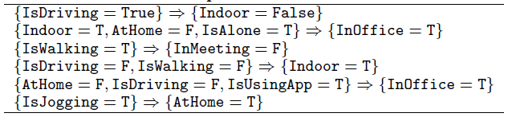
Correlation Miner on Two Traces
Useful correlations exist in our traces
  Avg. ~44 non-redundant rules per person
Errors can be kept reasonably low (~ 4%)
  Take only rules with high confidence (~ 99%)
  Frequent cross-validation (1 in 20)

Slide 16
Key Questions
Feasibility: Are there useful rules? Can we learn them?
System design: Systematically exploiting correlation
  Inference Cache
  Speculative Sensing
Effectiveness: How much energy savings?

Slide 17
Inference Caching
Get(Indoor)
AND-OR Expression Tree
Indoor
√
Cache
¬Driving
¬Walking
OR
¬Jogging
¬Alone
√
Indoor
InMeeting
AtHome
InOffice
AND
Indoor → Indoor
InMeeting → Indoor
InOffice → Indoor
AtHome → Indoor
√
√
Sitting
¬ Alone
AND
Sitting AND ¬ Alone → InMeeting
√
√
√
¬ Driving
¬ Walking
¬ Jogging
¬ Driving AND ¬ Walking
AND ¬ Jogging → Sitting

Slide 18
Speculative Sensing
Goal: speculatively sense a cheap attribute to determine value of an expensive attribute
  Infer AtHome from IsRunning
Challenge:
  Choose the next attribute to sense
    If infers target attributes, save energy
    If not, waste energy
  Goal: minimize expected cost
    Choose attributes with low c and high p
← Cost c
← Prob p

Slide 19
Speculative Sensing
Problem: Select next attributes to sense that minimizes the expected total sensing cost
NP Hard in general
We provide: (see paper for details)
  Dynamic programming : usable for <10 attributes
  Heuristic: Fast, close to optimal

Slide 20
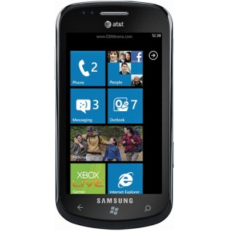
Evaluation Setup
  Prototype on Windows Phone
How much do I jog?
Mute phone in meeting
Alert when at grocery shop
Three apps
Jog Tracker
Phone Buddy
Geo-Reminder
  Effectiveness with MSR and Reality Mining traces
  Performance on Samsung Focus Win 7 phone

Slide 21
Savings in Sensing Energy
4x
Sensing Energy only
Sample once per 2 minutes
~4% inaccuracies

Slide 22
End-to-end Latency

Slide 23
Conclusion
Useful correlations exist across context attributes
ACE uses two key ideas to exploit correlation
  Inference caching
  Speculative sensing
Automatically avoids sensing as much as possible, without requiring semantic information
Significant sensing energy savings (4.2x) at the cost of small inaccuracies (~4%)

