Slide 1
Answering Similar Region Search Queries
Chang Sheng, Yu Zheng

Slide 2
A region specified by a user
Objective :
Given a query region on a map, return the top-k similar regions on this map
Expected Results
An Irrelevant Result

Slide 3
Motivation
Possible applications
  Location recommendation: recommending similar shopping malls, movie centers or travel spots
Challenges
  How to define the similarity between geo-regions
  How to retrieve the similar region based on a user-specified region
    Different scales (as big as a shopping street or as small as a cinema)
    Different shapes (rectangles of different size)

Slide 4
What we do
Devise a similarity measure between geo-regions
  Content similarity: Representative categories located in a region
  Spatial similarity: geo-spatial distribution of representative categories
Design a fast K-NN search algorithm
  Retrieve the top-k similar regions accords to user-specified query region
  The algorithm can ensure the returned regions
    have similar shape and scale as the query (basic criteria);
    have the top-k similarity scores in terms of the defined similarity measure
    Fast enough for online search

Slide 5
Similarity Measures
Geometric properties
  Scales and shapes
Content properties
  POI (point of interest) categories
  Representative categories
Spatial properties
  Distribution of POIs of representative categories.
  Reference points
A query region
(c) Shopping area

Slide 6




Content similarity
Detect the representative categories: CF-IRF
  Category Frequency (CF) of the category C_{i} in region R_{j}, denoted as Cf_{ij} , is the fraction of the number of PoIs with category C_{i} occurring in region R_{j} to the total number of PoIs in region R_{j}
  The Inverse Region Frequency (IRF) of category C_{i}, denoted as IRF_{i}, is the logarithm of the fraction of the total number of grids to the number of grids that contain PoIs with category C_{i}.
  The significance of a category C_{i} in region R_{j,} is

Slide 7
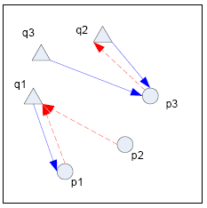
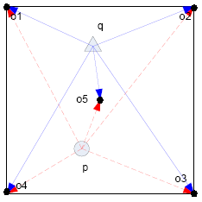


Spatial Similarity
Two methods
  Mutual distance
  Reference distance:
    The average distance of all the points in P/Q to each of the reference points
    The distance of K categories to the reference point O_{i} is a vector of K entries.

Slide 8
Fast Retrieval Algorithm
Offline process
  Quad-tree-based space partition
  Detect the representative categories
  Extract the feature vectors
  Indexing features and feature bounds
Online process
  Detect representative categories
  Category-based pruning
  Spatial-based pruning
  Expanding

Slide 9
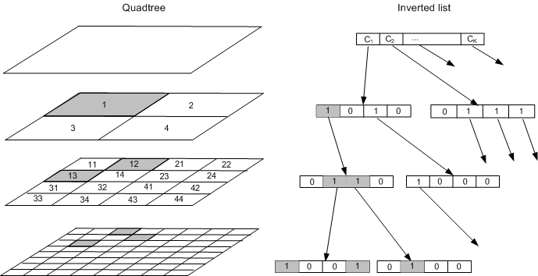
Quadtree and inverted list
Partition geo-spaces into grids based on quadtree
Each quadtree node stores
  the features bound of its four adjacent children
  The feature bound is calculated in a bottom-up manner

Slide 10
System overview

Slide 11
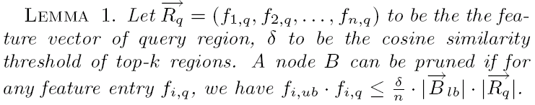
Pruning
Category-based Pruning
  A candidate region must have some overlaps of representative categories with the query region
  The cosine similarity should exceed a threshold
Spatial feature-based pruning
To speed up the pruning process

Slide 12
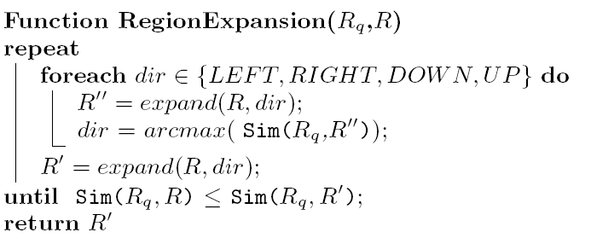
Expand Region
Select the seed regions which do not be pruned
Expand the seed regions

