Slide 1





Detecting Urban Black Holes Based on Human Mobility Data
Liang Hong, Wuhan University, China
Yu Zheng, Microsoft Research
Duncan Yung, University of Pittsburg, USA
Jingbo Shang, Shanghai Jiao Tong University, China
Lei Zou, Peking University, China

Slide 2
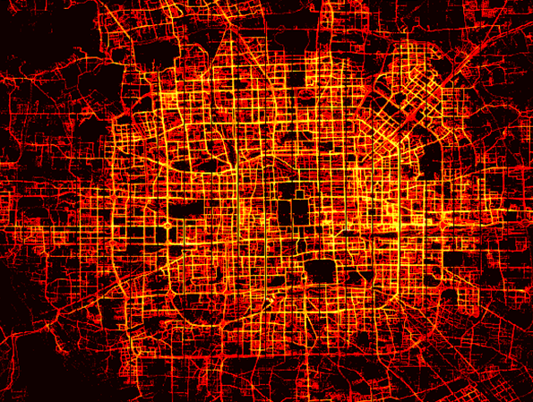

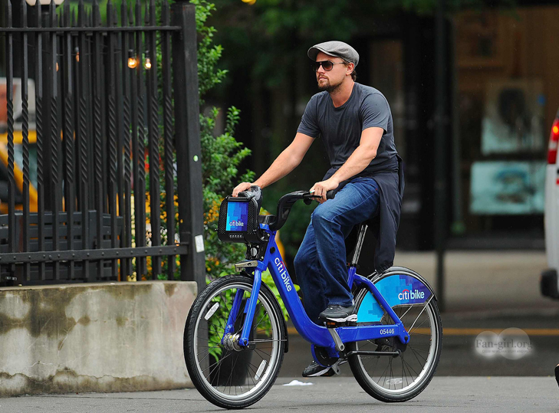
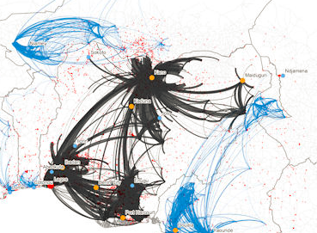
Background
Human Mobility Data
  Flows of taxicabs
  Card swiping data of subways
  Bike trip data
  Call Details Records (CDR)
Spatio-Temporal Graph
  Directed graph
  vertices have geospatial positions
  edges have spatial lengths
  vertex/edge attributes varying in time
Goal: Instantly and Continuously Detect
  Human Mobility Pattern
  Urban Anomalies
Example of STG: Road Network + Traffic Flow

Slide 3


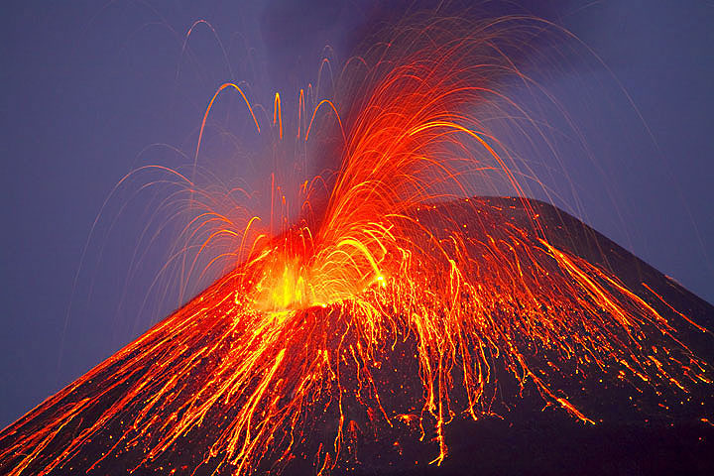
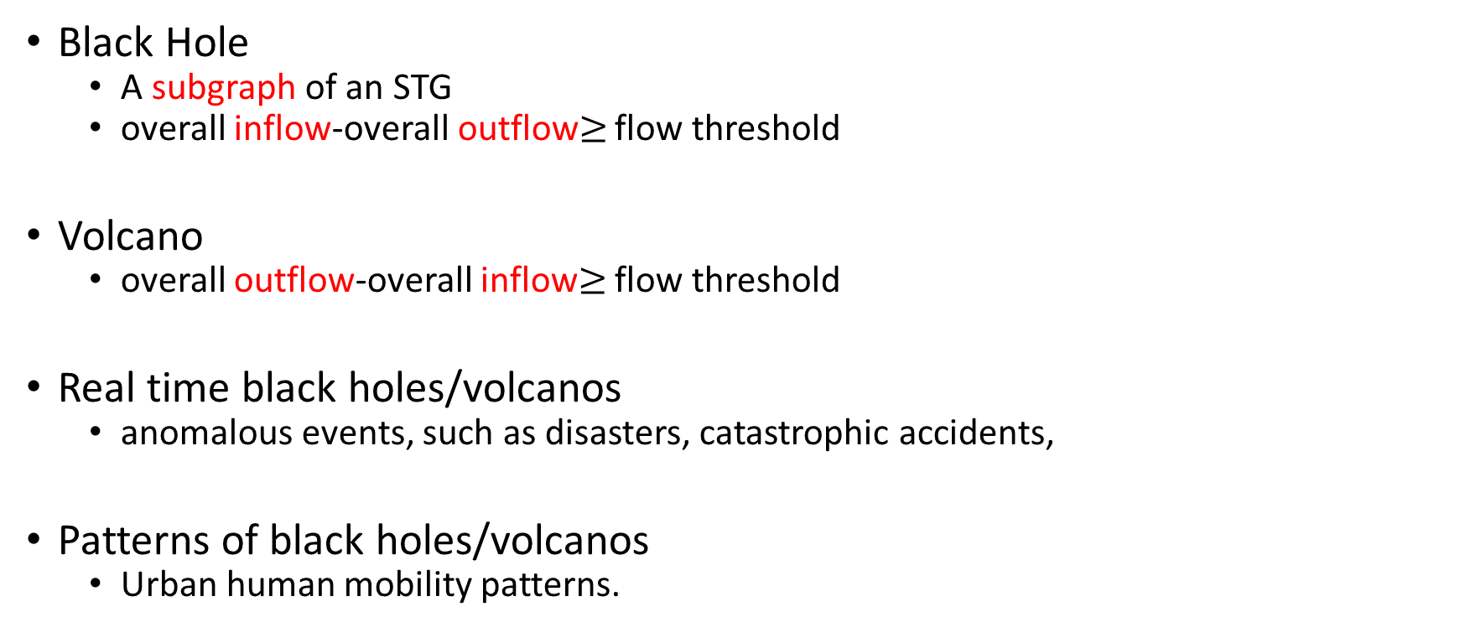
Urban Black holes and volcanos
Black Hole
  A subgraph of an STG
  overall inflow-overall outflow$≥$ flow threshold
Volcano
  overall outflow-overall inflow$≥$ flow threshold
Real time black holes/volcanos
  anomalous events, such as disasters, catastrophic accidents,
Patterns of black holes/volcanos
  Urban human mobility patterns.

Slide 4
Motivating Examples
Early warning based on real-time black hole
  Street-side screen
  Traffic control
Real-time volcano (E): Temporary scheduling
Pattern of volcano (D): System design optimization

Slide 5
Framework
[1] J. Yuan, Y. Zheng, C. Zhang, X. Xie, and G.-Z. Sun. An interactive-voting based map matching algorithm. In MDM ’10.

Slide 6

Preliminaries
Definitions:
  An STG S is a black hole iif: and
  An STG S is a volcano iif: and
Theorems:
  Detection of black holes in an STG is equivalent to that of volcanos.
  Detecting black holes from an STG is NP-Complete.
Problem:
  Find a complete set of black holes of an STG G.
  , is not a black hole.
actual flow $f_{a}$ =inflow-outflow
Flow constraint
Spatial constraint

Slide 7
Detection in a Time Interval
positive actual flow :
Edges in a grid cell
Adjacent list
Vehicle IDs sorted by arrival time
Vehicle IDs sorted by leaving time
Grid-partitioned STG
STG Index

Slide 8
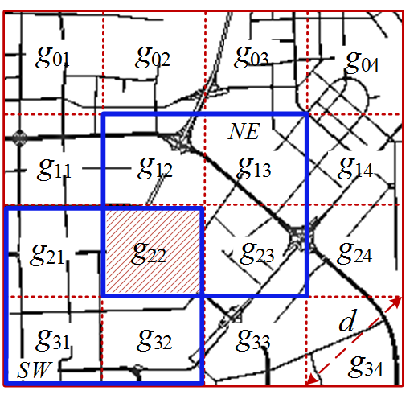

Candidate Cell Selection
By setting size of grid cell = d, a black hole intersects at most four cells
If in four-cell combinations (northwest (NW), northeast (NE), southeast (SE), southwest (SW)), g is not a candidate cell.
Flow Upper Bound Updating
  Update and candidate cell after some edges included in detected BHs.
Theorem: For an STG S=(V, E), the actual flow
Upper bound of actual flow

Slide 9
Spatial Expansion
Start from g with maximum g.F, initial edge e with largest
Add neighboring edge by priority score.
large actual flow, small

Slide 10
Continuous Detection
Detection from an existing subgraph other than an initial edge
BH(t+1) BH(t), VC(t+1) VC(t)
BH (t+1) VC(t), VC(t+1) BH(t)
Black Hole Patterns BP_{t+1}
If , , then S is a black hole
If , then add or remove neighboring edges
BV_{t}
Non-overlapping

Slide 11
Evaluation
Beijing Taxicab Data: (~ 25% of traffic flow on Beijing road network)
Bike Trip Data: Citibike sharing system (113,000 bike trips daily in NYC)
data duration | Nov. 2012
# of taxi Trajectories # of days Total distance | 33,000 30 180,000,000 km
# of road segments Roads # of road nodes Total length Spatial area | 96,307 148,110 21,895 km 2,507 km²
data duration | Oct. 2013
# of bikes # of stations # of trips | 6,376 330 1,037,712

Slide 12
Case study of Beijing City
10 black holes, 9 volcanos
Anomalies: traffic control, event detection

Slide 13
Patterns of Black Holes/Volcanos
Heavy snow in north China
Regular appearance
Dynamic area of influence
and duration
Delay

Slide 14
Case Study of New York City
Anomalies
  Union Square Greenmarket ⑤
  Deliver bikes from one station to another
Patterns of BHs/VCs
  Union Square (A), Wall Street (C)
  Beyond Knowledge of locals
  Optimize deployment , add or remove docks or bikes
  Optimize site selection of bike stations

Slide 15
Performance
Reduce at least 68% running time and detecting 10 times more black holes
  Continuous algorithm saves more than 9% total computational cost

Slide 16
Conclusion
Model human mobility data as Spatio-Temporal Graph (STG)
Black Holes and Volcanos
  Urban Anomalies
  Human Mobility Patterns
Continuous detection algorithm
  Detect instantly and continuously
  Source Code is released! datasci.whu.edu.cn
  early warning of traffic congestions, temporary traffic control; real-time scheduling of bikes
  improve urban planning, optimize the deployment and site selection of bike stations

Slide 17

Q & A

