Slide 1




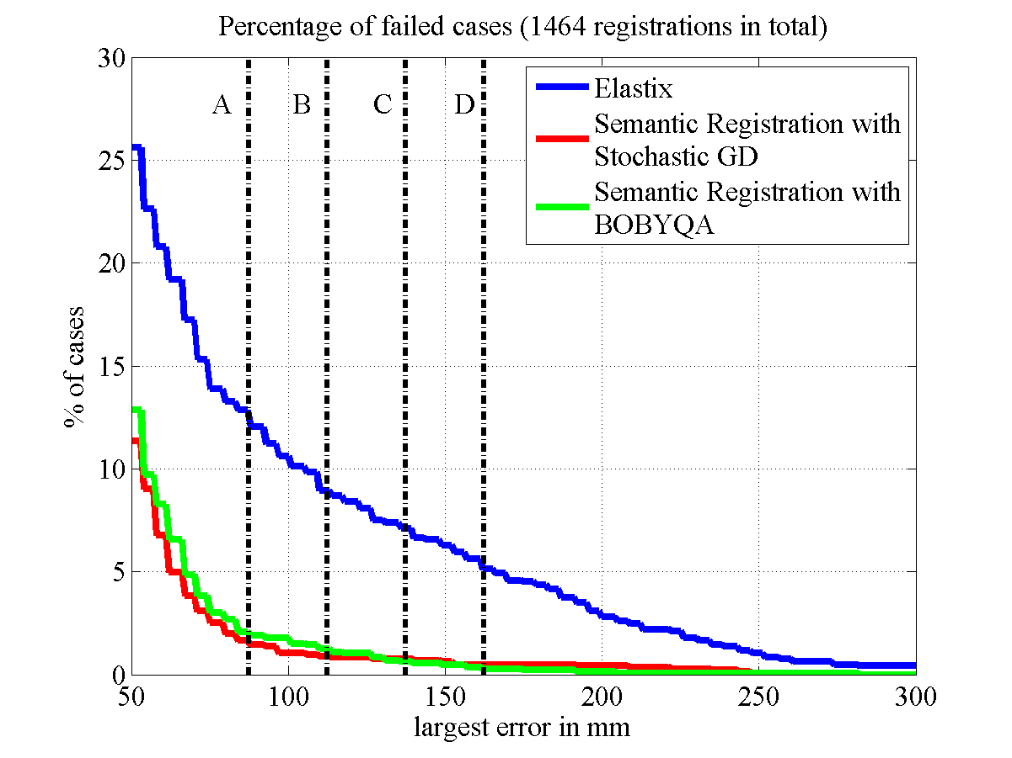
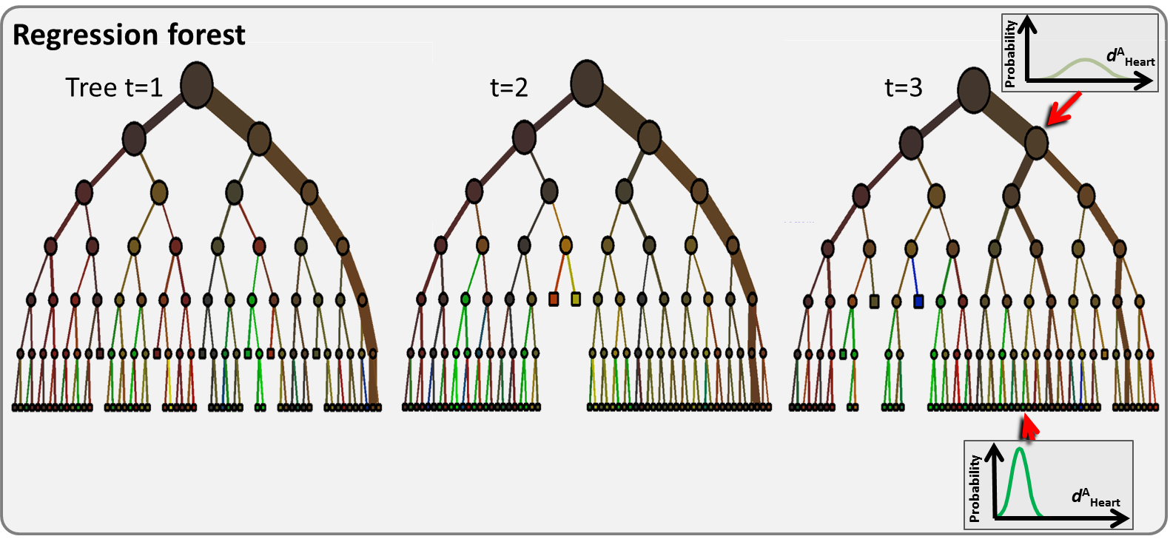
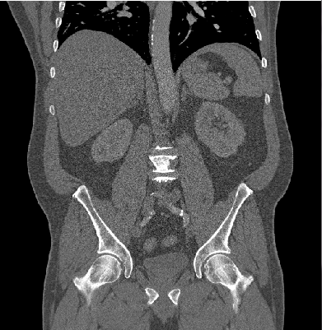

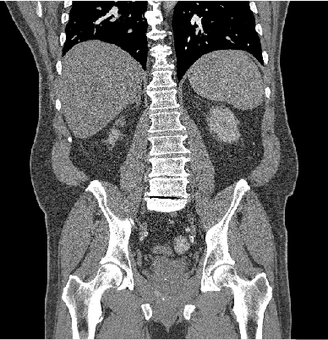
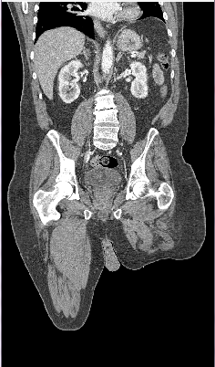
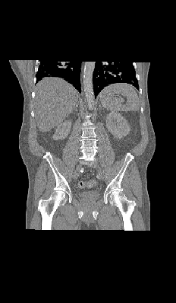
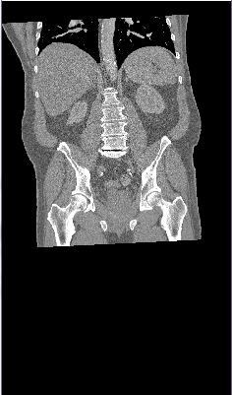
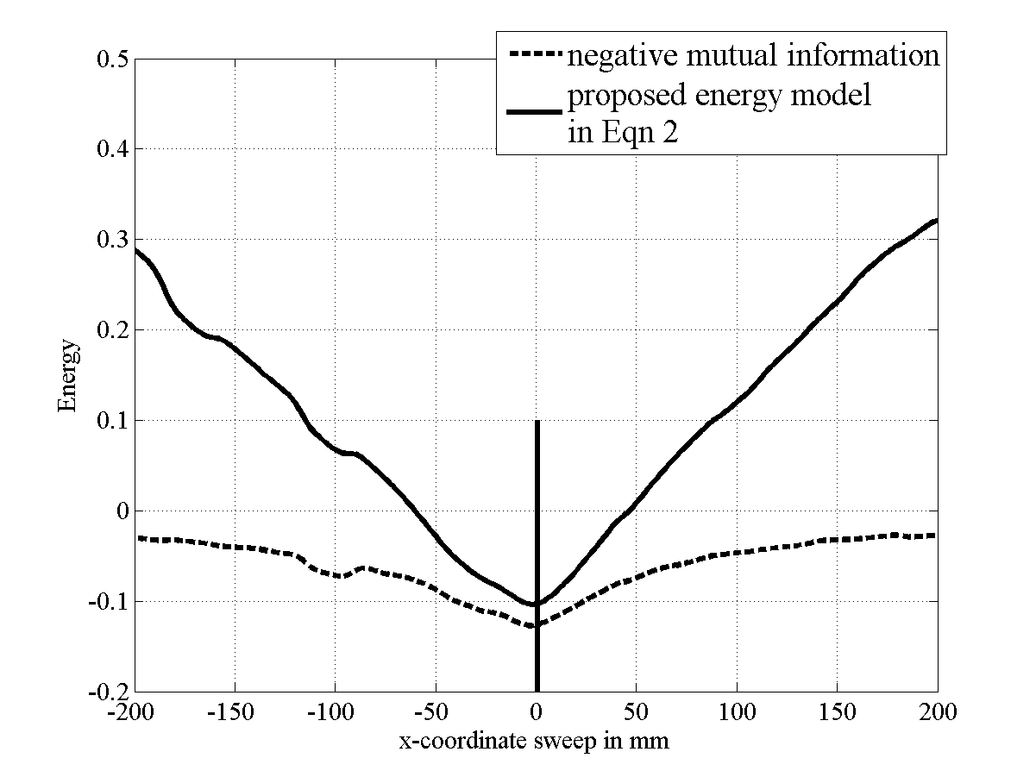
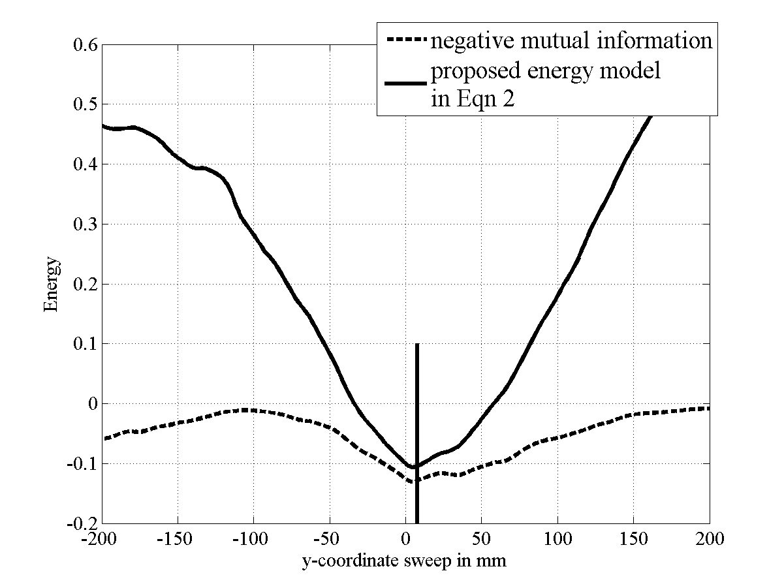
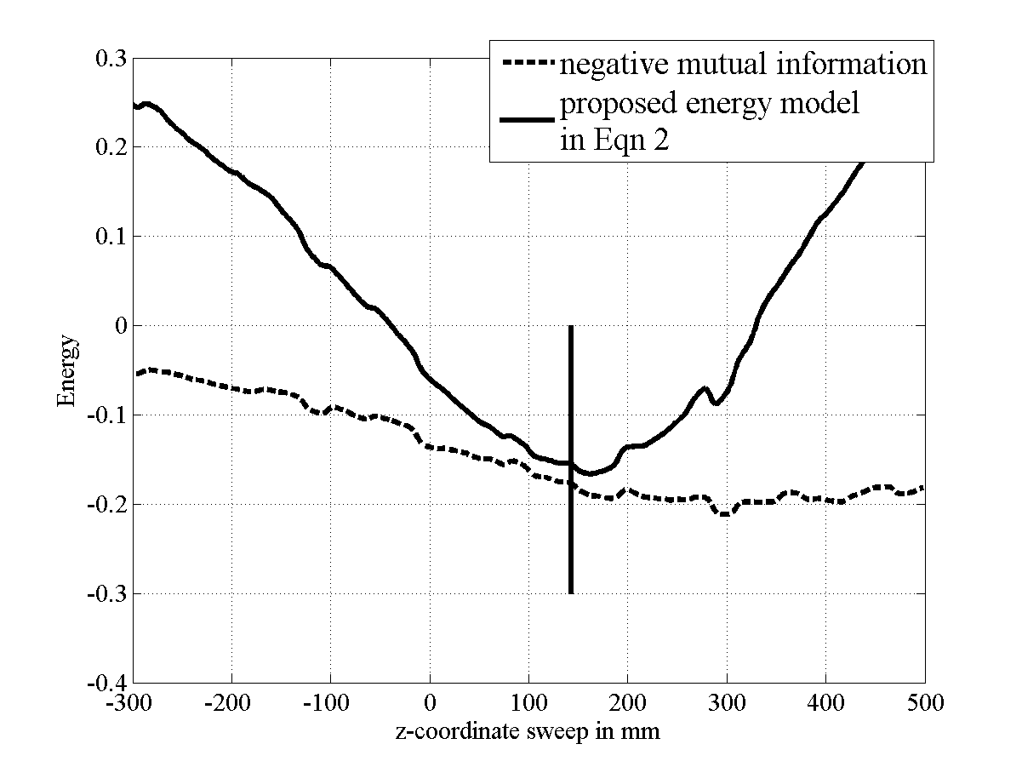
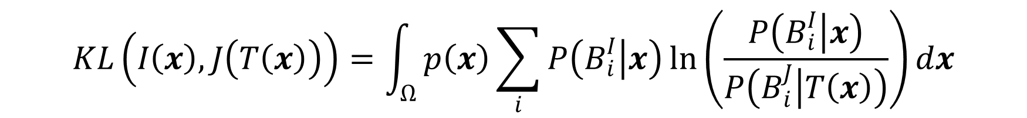
Robust Linear Registration of CT images using Random Regression Forests
Ender Konukoglu¹, Antonio Criminisi¹, Sayan Pathak², Duncan Robertson¹, Steve White², David Haynor³ and Khan Siddiqui²
¹Microsoft Research Cambridge, ²Microsoft Corporation, ³University of Washington
PROBLEM DEFINITION: Global linear registration is a necessary pre-processing step in many different tasks in medical image analysis. Robustness and efficiency of this step is crucial.
Previous methods
  Fully automatic methods are not robust enough [1].
  Up to now robustness have been achieved using interactions [2].
OBJECTIVE: Construct a robust and fully automatic registration algorithm by marrying modern object recognition algorithms with efficient linear registration techniques.
EVALUATION:
180 highly varying clinical images, e.g. Fig 4.b.
Forest training: 130 images.
Testing: 50 images -> 1464 pair-wise registration problems ( similitude – 7 DOF)
Registration error: Largest Euclidean distance between the ground-truth bounding boxes on the target image and the corresponding boxes of the transformed image amongst 9 organs: heart, l/r lung, liver, spleen, l/r kidney, l/r pelvis. Distances are measured for each surface separately.
N(τ): percentage of total pair-wise registrations with error larger than τ.
Comparison with registration using only image intensity implemented by the state-of-the-art method Elastix [4]
METHOD:
I. Organ Localization with Random Regression Forests, Figure 1.a and 1.b.
Random regression forest algorithm automatically estimates locations of bounding boxes around organs in a given 3D CT scan. Estimated box faces and associated uncertainties are computed within a few hundred milliseconds [3].
Figure 3. N(τ ) vs. τ : % of failed pair-wise image registrations for different error thresholds.
% (#) failed cases | Only image intensity (Elastix) | Semantic Registration with BOBYQA | Semantic Registration with St. Grad.
A (87.5 mm) | 12.5% (183) | 1.9% (28) | 1.4% (20)
B (112.5 mm) | 8.8% (129) | 1.2% (18) | 0.9% (13)
C (137.5 mm) | 6.9% (101) | 0.5% (7) | 0.8% (12)
D (162.5 mm) | 5.3% (78) | 0.3% (4) | 0.5% (7)
a
b
c
Figure 1. Organ Localization (a,b) and Semantic Probability maps (c)
II. From box posteriors to voxel probabilities, Figure 1.c
$$P\left(B_{i} | x\right)=\frac{1}{Z}\prod_{j=1}^{3}{{\left(1+\exp\left(\frac{x_{j}− u_{i}^{j}}{σ_{i}^{u}}\right)\right)}^{−1}{\left(1+\exp\left(\frac{l_{i}^{j}−x_{j}}{σ_{i}^{l}}\right)\right)}^{−1}}$$
Table I. : % of failed pair-wise image registrations for error thresholds A, B, C and D indicated in Figure 3.
III. Robust Registration Energy with Organ Location Posteriors
$$E\left(T\right)=−MI\left(I\left(x\right),J\left(T\left(x\right)\right)\right)+KL\left(I\left(x\right),J\left(T\left(x\right)\right)\right)$$
$$KL\left(I\left(x\right),J\left(T\left(x\right)\right)\right)=\int_{Ω}^{ }{p\left(x\right)\sum_{i}{P\left(B_{i}^{I} | x\right)\ln\left(\frac{P\left(B_{i}^{I} | x\right)}{P\left(B_{i}^{J} | T\left(x\right)\right)}\right)dx}}$$
a
b
c
d
Figure 4. Example registration problem. (a) Moving image, (b) Target image, (c) Registered image using ony intensity information (Elastix), (d) using Semantic registration
CONCLUSIONS:
Improved robustness.
Fully automatic.
No need for user interaction.
No overhead in computation time.
Figure 2. Energy Profiles for x, y and z translations of the registration problem given in Figure 4.
REFERENCES:
[1] Hill, D., Batchelor, P.,et al., “Medical image registration,” Phys. Med. Biol. 46, (2001).
[2] D’Agostino, E., Maes. F., et al., “An information theoretic approach for non-rigid image registration using voxel class probabilities,” MedIA. 10, (2006).
[3] Criminisi, A., Shotton, J., et al., “Regression Forests for efficient anatomy detection and localization in CT studies,” MICCAI-MCV Workshop, (2010).
[4] Klein, S., Staring., M., et al., “Elastix: a toolbox for intensity based medical image registration”, IEEE TMI, 29, (2010).
[5] Bordes, A., Bottour, L., Gallinari,. P., “SGD-QN: Careful Quasi-Newton Stochastic Gradient Descent,” JMLR, 10, (2009).
[6] M.J.D. Powell, “The BOBYQA algorithm for bound constrained optimization without derivatives,” Dep. App. Math. and Th. Physics, Cambridge, England, technical report NA2009/06, (2009).
IV. Optimization
Energy function is well behaved. We have implemented with two different techniques:
Gradient Free: BOBYQA [4]
Stochastic Gradient Descent [5]

