Slide 1
Data-Parallel Finite-State Machines
Todd Mytkowicz, Madanlal Musuvathi, and Wolfram Schulte
Microsoft Research

Slide 2
New method to break data dependencies
Preserves program semantics
Does not use speculation
Generalizes to other domains, but this talk focuses on FSM
Notes:
A new method to break data dependencies across loops
Our method preserves a program’s semantics
It does not speculate and therefore has predictable performance
And, we have been able to generalize it to other domains, notably some important dynamic programming algorithms.

Slide 3
FSMs contain an important class of algorithms
Unstructured text (e.g., regex matching or lexing)
Natural language processing (e.g., Speech Recognition)
Dictionary based decoding (e.g., Huffman decoding)
Text encoding / decoding (e.g., UTF8)
Want parallel versions to all these problems, particularly in the context of large amounts of data
Notes:
Why do we care about Finite State Machines?
Well, FSMs are an important class of algorithms and particularly in the relm of large amounts of data, creating structure from unstructured text through regular expressions is an important problem.
And we would like to have low-power parallel approaches to all these problems, particularly in the context of large amounts of data

Slide 4
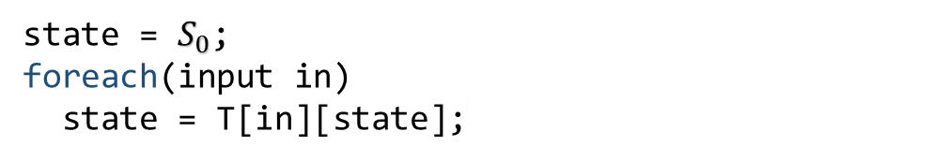
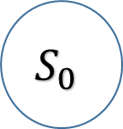
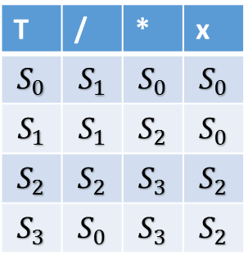

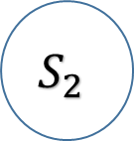
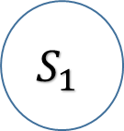
*x
/
/x
*
/
*
$$S_{0}$$
$$S_{1}$$
*
$$S_{2}$$
$$S_{3}$$
x
x
/
T | / | * | x
$$S_{0}$$ | $$S_{1}$$ | $$S_{0}$$ | $$S_{0}$$
$$S_{1}$$ | $$S_{1}$$ | $$S_{2}$$ | $$S_{0}$$
$$S_{2}$$ | $$S_{2}$$ | $$S_{3}$$ | $$S_{2}$$
$$S_{3}$$ | $$S_{0}$$ | $$S_{3}$$ | $$S_{2}$$
state = $S_{0}$;
foreach(input in)
state = T[in][state];
Data Dependence limits ILP, SIMD, and multicore parallelism
Notes:
So why is this hard: Let’s take a look at a simple FSM to help explain why breaking data dependencies is difficult
Here I am displaying a FSM that accepts or rejects C style comments. The details of what this FSM does are not important but the idea is that the FSM encodes how to recognize C style comments
Traditionally, an FSM is represented by a table, such as the one on the left here. The way to read this table is to look at the first column and find the current state; then when reading a character, find that character along the top row. The FSM will transition to the state in the table for the intersection of the row and column.
The code here on the right is a simple abstraction for how one traditionally processes input with an FSM. Given a table, called T, and a current state, the code walks through each character in the input and updates the current state based on the current input symbol.
Sometimes programmers use switch statements to represent the table, but the end result is the same:
There is little to no parallelism in this code. It is difficult to exploit ILP, SIMD and Multicore hardware because of the state variable is a loop carried data dependence

Slide 5
Demo UTF-8 Encoding
Notes:
OK before I get to the meat of our talk I want to give a quick demo to show we execute the prior loop in parallel
This demo uses a slightly more complicated FSM: UTF-8 encoding. UTF-8 encoding is the process of transforming a sequence of Unicode into bytes. It is a variable width encoding and is based on a state machine so it fits almost exactly our model from the prior slide.
Do demo…
This machine has 4 logical processors but only 2 cores and we get about a 2X speedup over the sequential C# implementation
The rest of this talk is about how we make this happen

Slide 6










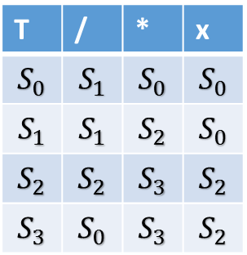
Breaking data dependences with enumeration
$$P_{0}$$
$$P_{1}$$
/ | * | X | X | X | * | * | / | X | X
$$S_{0}$$
$$S_{1}$$
$$S_{2}$$
$$…$$
$$S_{0}$$
$$S_{1}$$
$$S_{2}$$
$$S_{3}$$
$$S_{0}$$
$$S_{2}$$
$$S_{3}$$
$$S_{3}$$
$$S_{0}$$
$$S_{3}$$
$$S_{3}$$
$$S_{3}$$
$$S_{1}$$
$$S_{0}$$
$$S_{0}$$
$$S_{0}$$
T | / | * | x
$$S_{0}$$ | $$S_{1}$$ | $$S_{0}$$ | $$S_{0}$$
$$S_{1}$$ | $$S_{1}$$ | $$S_{2}$$ | $$S_{0}$$
$$S_{2}$$ | $$S_{2}$$ | $$S_{3}$$ | $$S_{2}$$
$$S_{3}$$ | $$S_{0}$$ | $$S_{3}$$ | $$S_{2}$$
Enumeration breaks data dependences but how do we make it scale?
- Overhead is proportional to # of states
Notes:
Let’s go back to our simple C style FSM to see how we break data dependences
Suppose we have 2 processors, each working on half of the input.
The first processor computes normally as it would in the sequential case
Clearly the second processor needs the result of the first processor to continue;
Rather than wait, or speculate, we have the second processor start on its section of the input on ALL states in the FSM. It reads the first character in its section of the input and finds how that character transitions ALL states.
We call this “Enumeration” because the 2nd processor is enumerating all possible solutions.
When the first processor finishes with its section of the input we plug that value into the enumeration of the 2nd processor to get the final state of the FSM in parallel.
Clearly the overhead of our approach is proportional to the number of states.
When the # of states is small---which we found to be often----this approach works great. However, the real challenge is getting our enumerative approach to scale with the number of states in the FSM is large.

Slide 7












Intuition: Exploit convergence in enumeration
$$P_{0}$$
$$P_{1}$$
/ | * | X | X | X | * | * | / | X | X
$$S_{2}$$
$$…$$
$$S_{0}$$
$$S_{2}$$
$$S_{3}$$
$$S_{3}$$
$$S_{0}$$
$$S_{3}$$
$$S_{3}$$
$$S_{3}$$
$$S_{1}$$
$$S_{0}$$
$$S_{0}$$
$$S_{0}$$
$$S_{0}$$
$$S_{1}$$
$$S_{0}$$
$$S_{1}$$
$$S_{2}$$
$$S_{3}$$
$$S_{0}$$
$$S_{3}$$
$$S_{1}$$
$$S_{0}$$
After 2 characters of input, FSM converges to 2 unique states
- Overhead is proportional to # of unique states
Notes:
How do we do that?

Slide 8
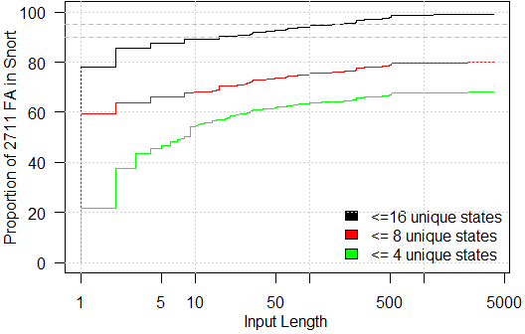
Convergence for worst case inputs
Almost all (90%) FSMs converge to <= 16 states after 10 steps on adversarial inputs
However, many FSM take thousands of steps to converge to <= 4 states

Slide 9
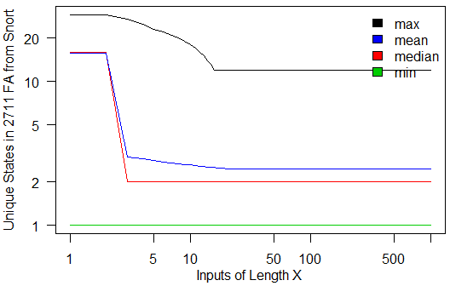
Convergence for real inputs
All FSM converge to less than 16 states after 20 steps on real input

Slide 10










Why convergence happens
$$P_{0}$$
$$P_{1}$$
/ | * | X | X | X | * | * | / | X | X
$$S_{0}$$
$$S_{1}$$
$$S_{2}$$
$$…$$
$$S_{0}$$
$$S_{1}$$
$$S_{2}$$
$$S_{3}$$
$$S_{0}$$
$$S_{2}$$
$$S_{3}$$
$$S_{3}$$
$$S_{0}$$
$$S_{3}$$
$$S_{3}$$
$$S_{3}$$
$$S_{1}$$
$$S_{0}$$
$$S_{0}$$
$$S_{0}$$
FSM has structure
  Many states transition to an error state on a character
  FSM often transition to “homing” states after reading sequence of characters
    e.g., after reading */ the FSM is very likely, though not guaranteed, to reach the “end-of-comment” state.

Slide 11
Contributions
Enumeration, a method to break data dependencies
Enumeration for FSM is gather
  Gather is a common hardware primitive
  Our approach should scale with faster support for gather
Paper introduces two optimizations, both in terms of gather which exploit convergence
  Reduces overhead of enumerative approach
  See paper for details
Notes:
Contribution slide:
Entire paper describes all optimizations in terms of Gather
Translating FSM into gather – a common hardware primitive.
Optimizations in terms of Gather
Implementing Gather on hardware which lacks it as intrinsic.
Gather is primitive on new hardware: our approach should scale with faster and faster support for Gather.
(make these bullet points)

Slide 12
How do we implement enumerative FSMs with gather?

Slide 13


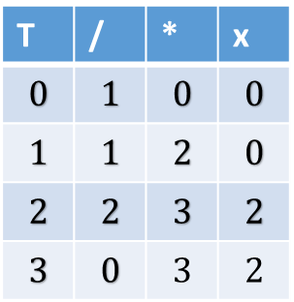



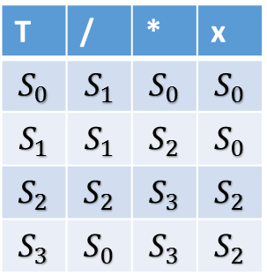









Implementing Enumeration with Gather
$$P_{0}$$
$$P_{1}$$
/ | * | X | X | X | * | * | / | X | X
$$S_{0}$$
$$S_{1}$$
$$S_{2}$$
$$…$$
$$1$$
$$0$$
$$0$$
$$0$$
$$0$$
$$2$$
$$3$$
$$3$$
$$0$$
$$3$$
$$3$$
$$3$$
$$S_{1}$$
$$S_{0}$$
$$S_{0}$$
$$S_{0}$$
$$0$$
$$1$$
$$2$$
$$3$$
$$S_{0}$$
$$S_{2}$$
$$S_{3}$$
$$S_{3}$$
$$S_{0}$$
$$S_{3}$$
$$S_{3}$$
$$S_{3}$$
$$S_{0}$$
$$S_{1}$$
$$S_{2}$$
$$S_{3}$$
T | / | * | x
$$S_{0}$$ | $$S_{1}$$ | $$S_{0}$$ | $$S_{0}$$
$$S_{1}$$ | $$S_{1}$$ | $$S_{2}$$ | $$S_{0}$$
$$S_{2}$$ | $$S_{2}$$ | $$S_{3}$$ | $$S_{2}$$
$$S_{3}$$ | $$S_{0}$$ | $$S_{3}$$ | $$S_{2}$$
T | / | * | x
$$0$$ | $$1$$ | $$0$$ | $$0$$
$$1$$ | $$1$$ | $$2$$ | $$0$$
$$2$$ | $$2$$ | $$3$$ | $$2$$
$$3$$ | $$0$$ | $$3$$ | $$2$$
Current states are addresses used to gather from T[input]

Slide 14
Enumeration makes FSMs embarrassingly parallel
Some hardware has gather as a primitive
  Our approach will scale with that hardware
Some hardware lacks gather
Paper shows how to use:
  _mm_shuffle_epi8 to implement gather in x86 SIMD
  ILP because gather is associative
  Multicore with openmp

Slide 15
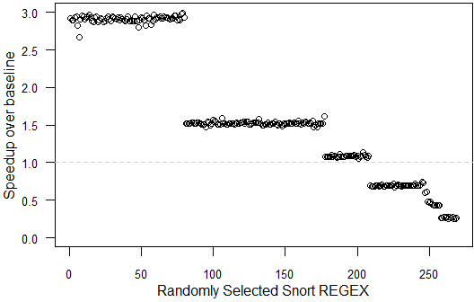
Single-Core performance
Good performance
Not so good performance
More hardware to help scaling
Hardware gather or multicore parallelism

Slide 16
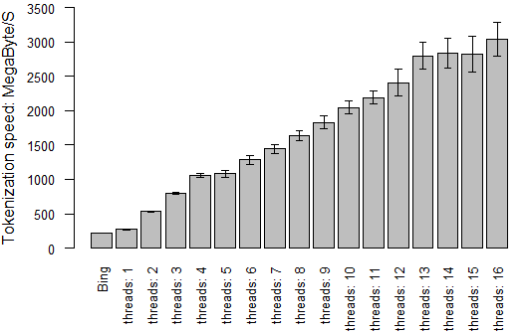
Bing Tokenization

Slide 17
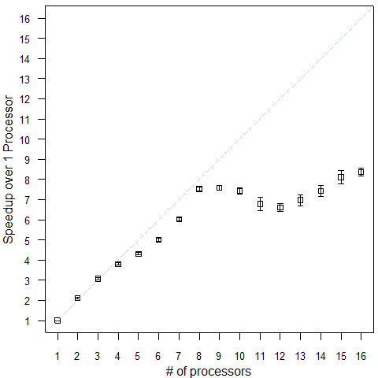
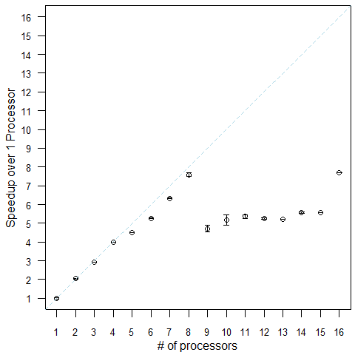
Case Studies
SNORT Regular Expressions
Huffman Decoding

Slide 18
Related Work
Prior parallel approaches
  Ladner and Fischer (1980) – Cubic in number of states
  Hillis and Steele (1986) – Linear in number of states
Bit Parallelism
  Parabix – FSM to sequence of bit operations
Speculation
  Prakash and Vaswani (2010) – “Safe speculation” as programming construct

Slide 19
Conclusion
Enumeration: A new method to break data dependencies
  Not speculation and preserves semantics
  Exploits redundancy, or convergence, in computation to scale
  Generalizes to other domains (Dynamic Programming in PPOPP 2014)
Enumeration for FSM is gather
  Scales with new hardware implementations of gather
  Paper demonstrates how to use SIMD, ILP, and Multicore on machines which lack intrinsic support for gather

