Slide 1
Using Embodied Social Proxies to connect hub-and-satellite teams
Gina Venolia
John Tang
Ruy Cervantes
Sara Bly
George Robertson
Bongshin Lee
Kori Inkpen
Microsoft Research
Microsoft Research
UC Irvine
Sara Bly Consulting
Microsoft Research
Microsoft Research
Microsoft Research

Slide 2
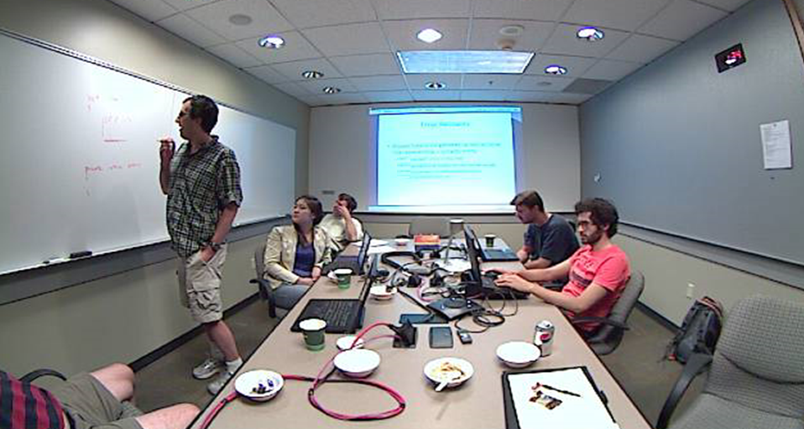
Where’s Noah?
Notes:
Look at setting many of us are familiar with: Meeting with one remote participant (Noah) over the phone.
How is this participant represented? How do you address comments to him? How can you discern his reactions?
If only representation is the speakerphone, very hard to have those natural interactions

Slide 3
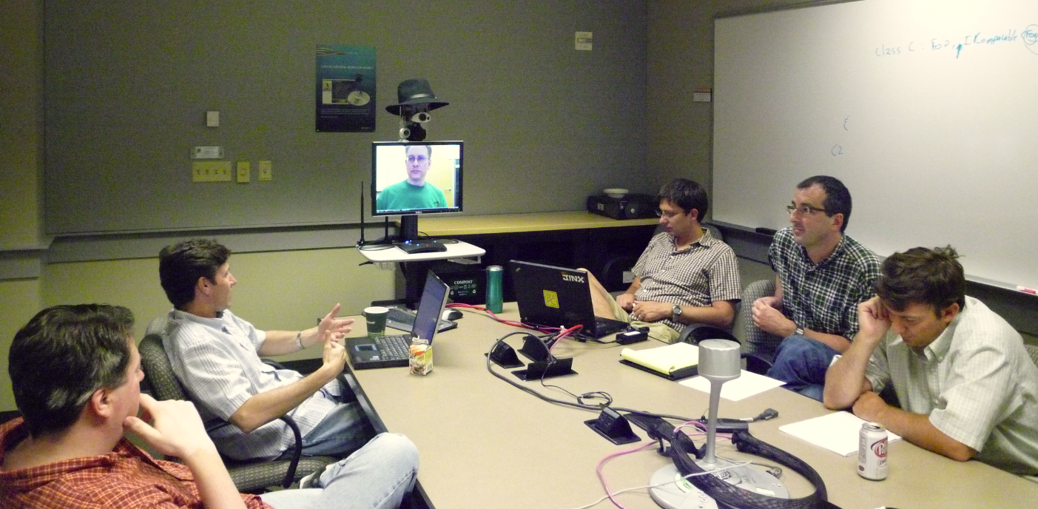
Noah is in the room
Notes:
Contrast with when we gave Noah an Embodied Social Proxy, a telepresence prototype for representing Noah.
Here we can see how Noah can more fully participate in meetings:
People were reminded that he was there, because his cart occupied a space in the table.
People could see when he wanted to say something and interrupt when it matter.
He was able to see the reactions
He was able to see what was written on the whiteboard and follow the context of the discussion

Slide 4
Hub-and-satellite teams
Collocated team except for one remote member
Occur because of strategic hiring and retention, outsourcing, long-term consultants, etc.
Approximately 13% of development teams in MS are hub-and-satellite
  By far the most common team distribution pattern
The asymmetry of hub-and-satellite teams leads to out-of-sight, out-of mind
Notes:
Embodied Social Proxy designed to support hub and satellite teams are teams where all members are collocated, except for one remote member.
I’m an example of a satellite team member that works out of Silicon Valley, CA
Many reasons for hub and satellite teams
Turns out that this is the most common distribution pattern among feature crews at Microsoft
Challenging topology, under-studied, because it leaves the satellit out of sight/out of mind

Slide 5
Embodied Social Proxy (ESP)
A device representing the satellite coworker in the hub location 24x7
Videoconferencing terminal during meetings
Awareness of the satellite worker between meetings
Notes:
ESP represents satellite 24/7
Serves as video conferencing terminal within meetings
Constant physical presence between meetings serves to increase awareness and social status of satellite

Slide 6
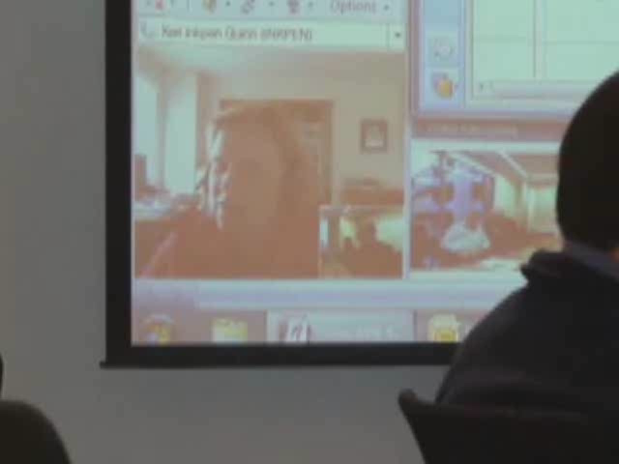
Contrasting video conference with ESP
Notes:
Example clip of meeting with participants using traditional video conferencing over RoundTable and using ESP. Note the difference of attention, engagement.

Slide 7
ESP Prototype
Deployment Study
Future Work and Conclusions

Slide 8
“Underdesign” to scratch our own itch
We became a hub-and-satellite team
Started with a laptop and webcam
Used it continually
Fixed only what was most broken

Slide 9
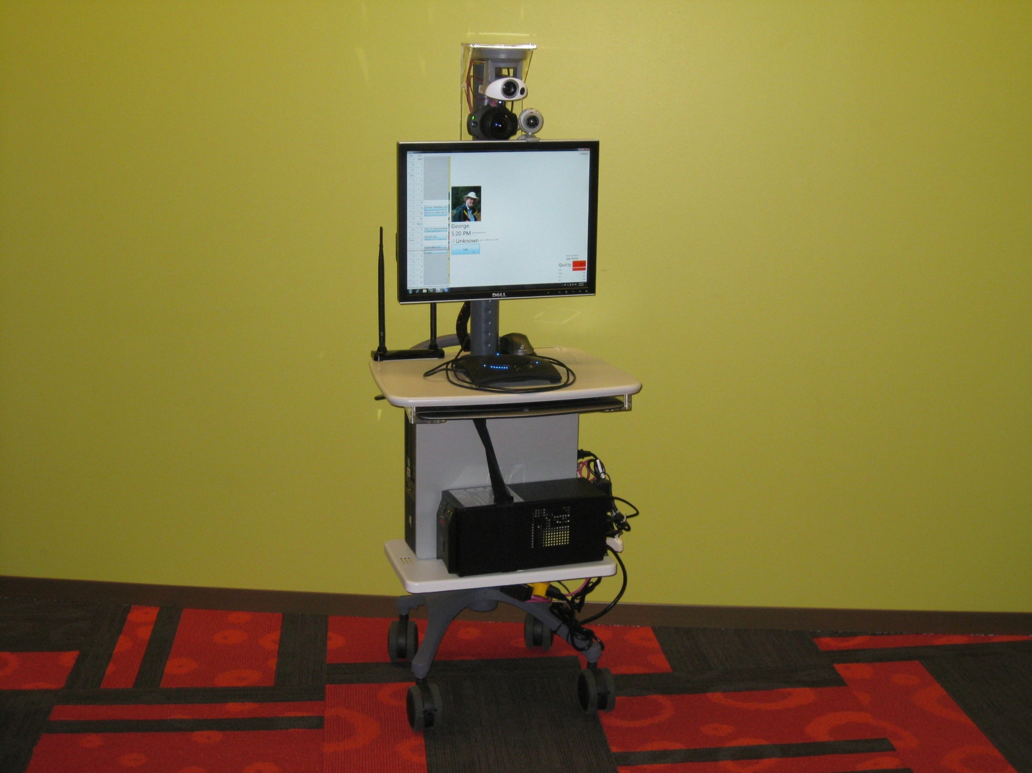
Current design
Pan-tilt-zoom camera
140° fisheye camera
Webcam
20” LCD
Speakerphone
Computer
Battery backup
Wheels

Slide 10
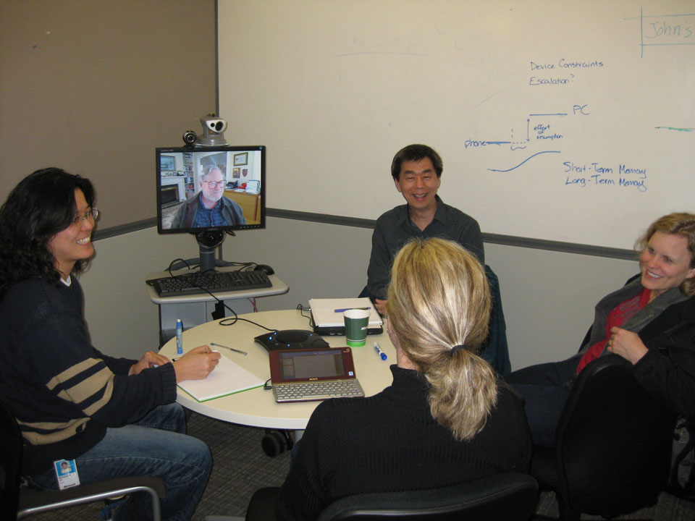
Hub’s view

Slide 11
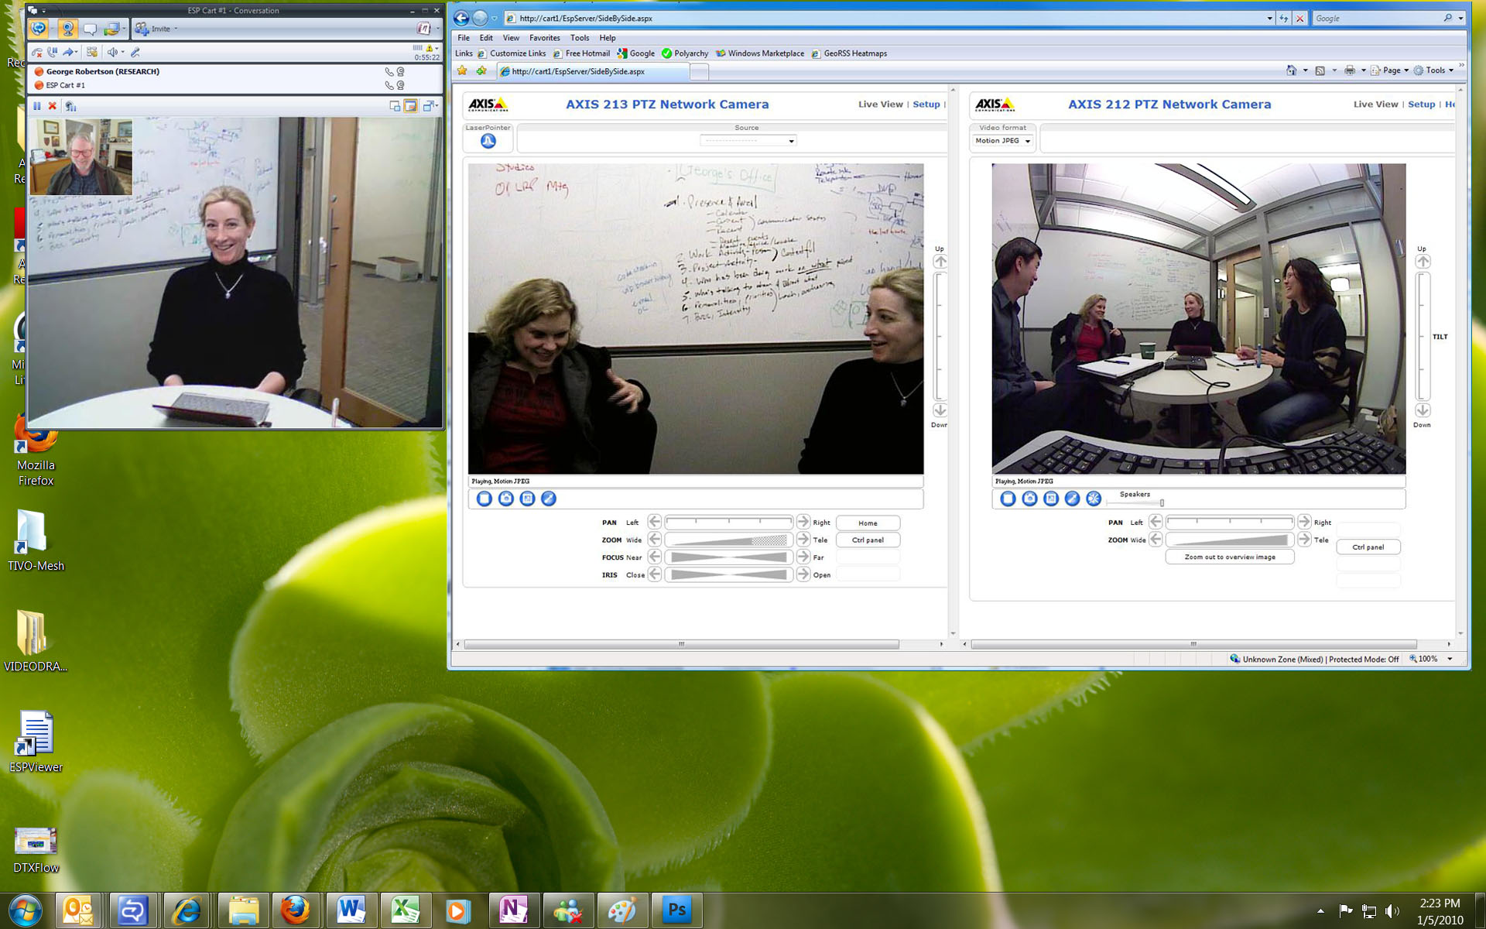
Satellite’s view

Slide 12
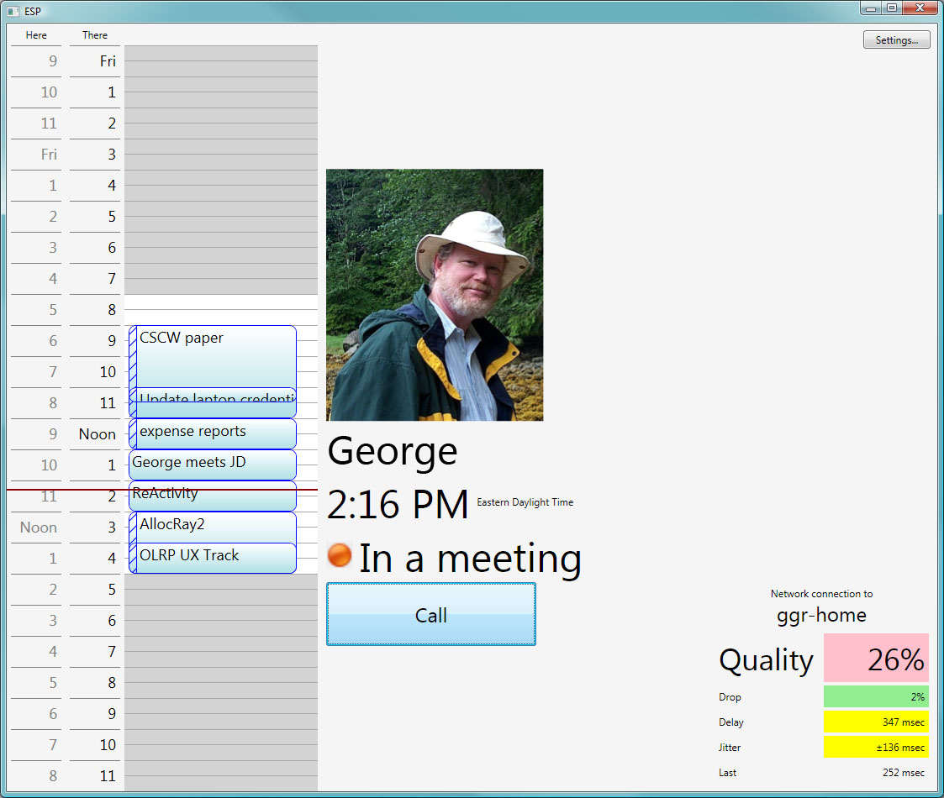

Slide 13
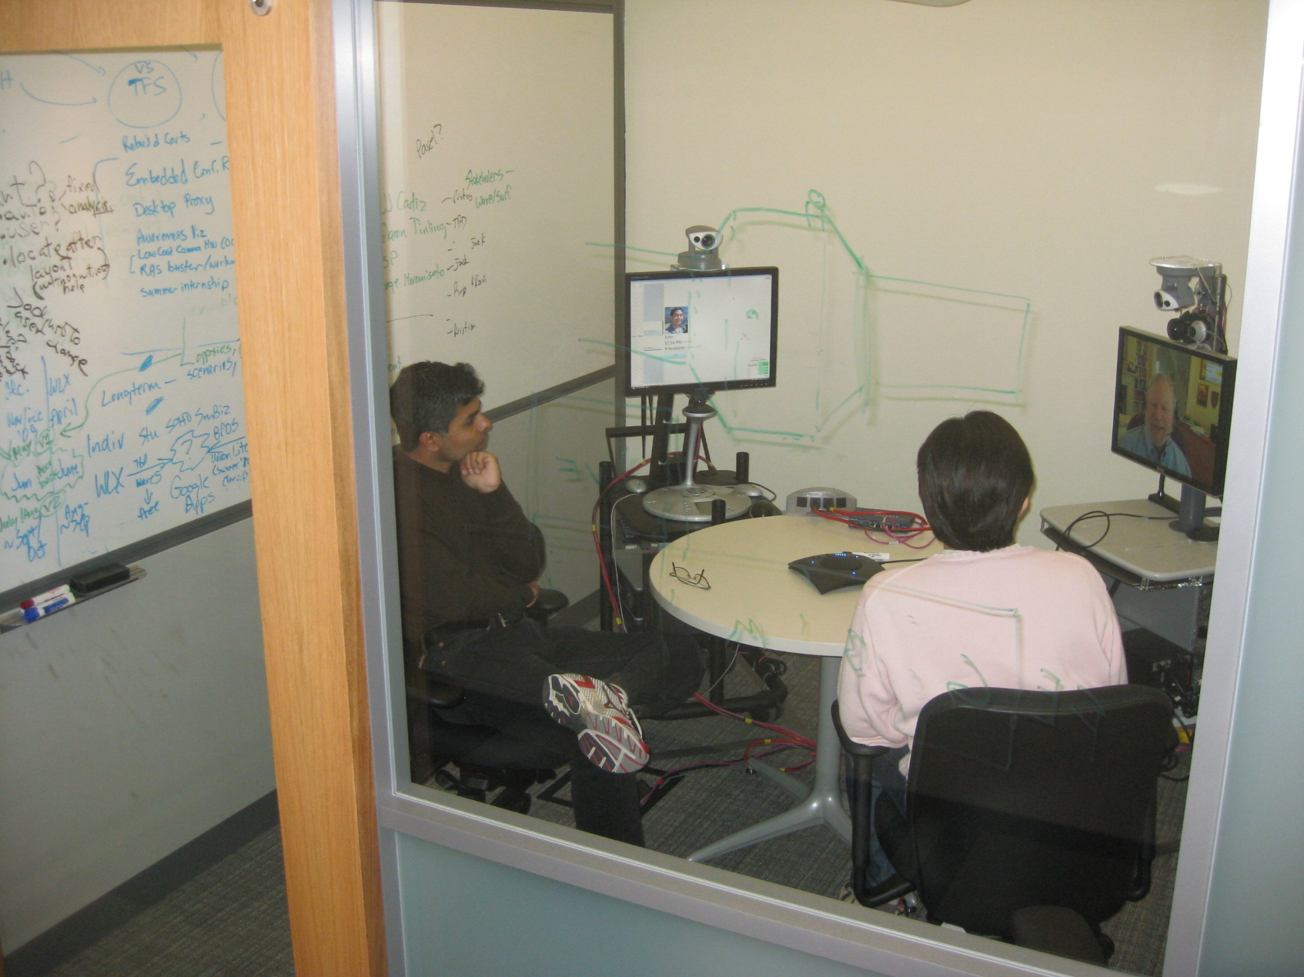
Home location

Slide 14
ESP Prototype
Deployment Study
Future Work and Conclusions

Slide 15
Summer deployment study
Four ESPs for four product teams
Language Design team
“Noah”
Senior Architect
8 months on team
Silicon Valley
Dedicated home location
Product Management team
“Robert”
Senior PM
3 years on team
Boston
Kept in manager’s office
Enterprise Software team
“Songyi”
Junior Developer
8 months on team
Vancouver
Kept in coworker’s office
Shared Components team
“Fernando”
Junior Developer
8 months on team
Vancouver
Dedicated home location
A-B-A study
Week 1 Baseline
Week 2 Deployment
Week 3 Deployment
Week 4 Deployment
Week 5 Deployment
Week 6 Deployment
Week 7 Deployment
Week 8 Withdrawal
Observations
Observations
Observations
Observations
Observations
Observations
Observations
Observations
Baseline Interviews
Midpoint Interviews
Final Interviews
Baseline Survey
Final Survey
Cart Log
Cart Log
Cart Log
Cart Log
Cart Log
Cart Log
Offer to Purchase
Notes:
We deployed 4 carts in 4 different product teams around Microsoft.
Teams varied in terms of kind of work, time zone difference, seniority of satellite, home location for cart
A-B-A study that looked at activity before deploying and after withdrawing ESPs
Direct Observation of meetings (42 hrs in total)
Interviewed before, during and after deployment:
Satellite workers
Handlers
Close collaborators
Surveyed before and after deployment; gather perceptions of hubs of meetings/awareness/social connection with satellite
Collected Cart logs
After week 8, team given option to buy ESP
---
Observed meetings (42 hrs in total)
Interviewed before, during and after deployment
Surveyed before and after deployment
Perceptions of hubs of meetings/awareness/social connection with satellite
Collected Cart logs

Slide 16
Logs: Usage varied considerably

Slide 17
Survey results: Perceived improvement
Notes:
Change in survey responses measured hub’s perceptions of various dimensions of social interaction, team awareness and effectiveness.
Responses grouped according to the four product teams: all show improvement, of varying amounts (Noah’s team shows most improvement)
Three main dimensions of interaction across all teams

Slide 18
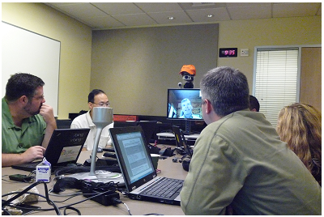
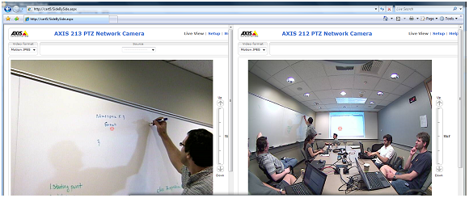
Better participation in meetings
Rapid turn-taking in conversations
Follow whiteboard, engage in brainstorming
Resolve issues now vs. defer to next visit
Reported saving two cross-country trips
Assisted non-native English speakers
Notes:
Surveys, interviews, direct observations documented how ESP enabled better participation in meetings.
And this results were all fine, expected in some ways.
But what we did not expected is by how much these results

Slide 19
ESP in meetings
“Through its combined properties, it actually succeeds in creating the workable illusion that Noah is in the room. It manifests his physical presence … it overcomes the barrier of his physical distance.”

Slide 20
ESP in meetings
“Even a picture of him on [a] laptop, or a RoundTable device, really does not give Songyi as much presence as an object whose sole purpose is to represent [him].”

Slide 21
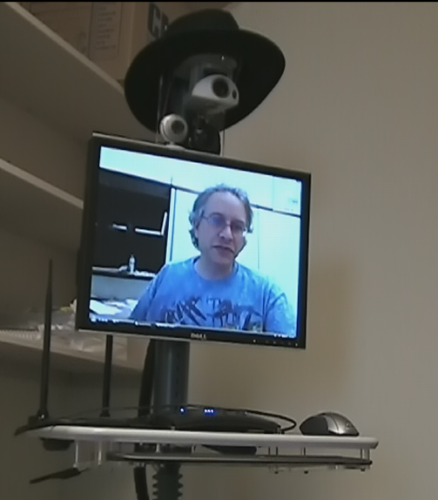
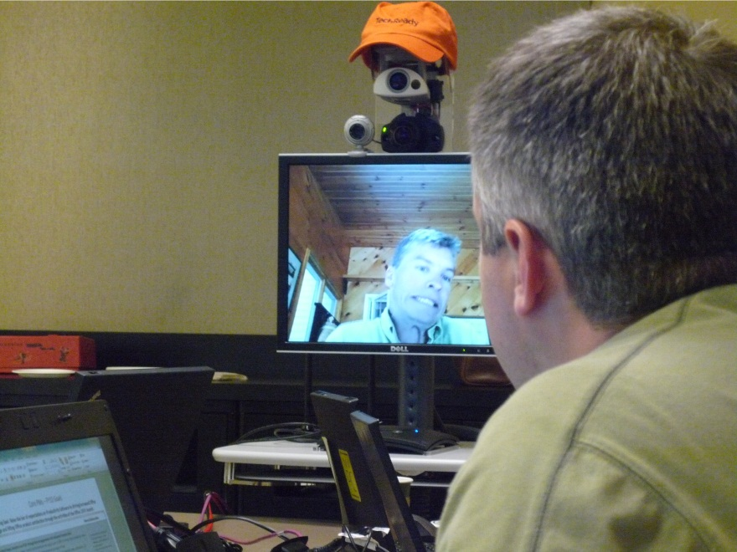
Catalyst for social interaction
Names
  Noah’s Dalek
  Robbatar
  Virtual Songyi
  Virtual Fernando
Hats
Humor and play
Notes:
We’ve come to see ESP as a catalyst for social interaction—clearly the interaction is still being done by people, but ESP encourages

Slide 22
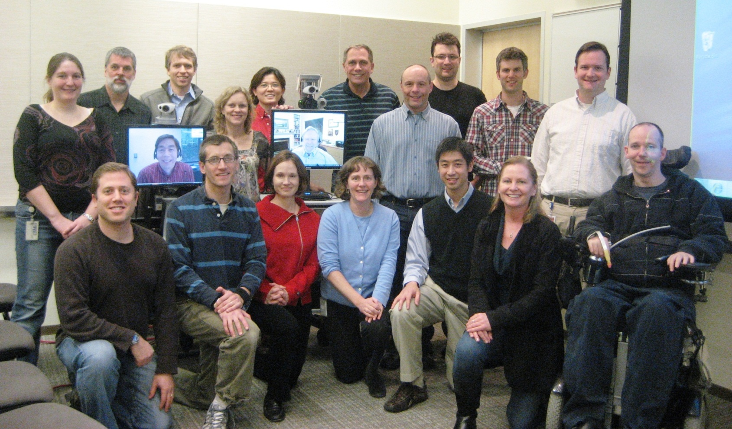
Building social ties over time
Cumulative effect of better meeting presence
Handling: Hub → satellite commitment
Inhabiting: Satellite → hub commitment

Slide 23
Joking
“[T]here is no end to the amount of jokes that people have told about the Dalek… It helps people overcome the barriers that always come with a new technology. It helps him be present on the team …”

Slide 24
Physical presence and social presence
“I think that they feel more familiar [with me]… I can see their face, and they can see my face. [With RoundTable], there was no space in the screen for displaying [the video OC window], so they were not able to see my face.”

Slide 25
Physical presence and social presence
“So his perceived relevance has skyrocketed in this period of time, from like ‘What is he actually doing in the team?’ […] to like ‘Wow, Noah is really one of us, and he is really contributing, and he is really deeply here’.”

Slide 26
ESP Prototype
Deployment Study
Future Work and Conclusions

Slide 27

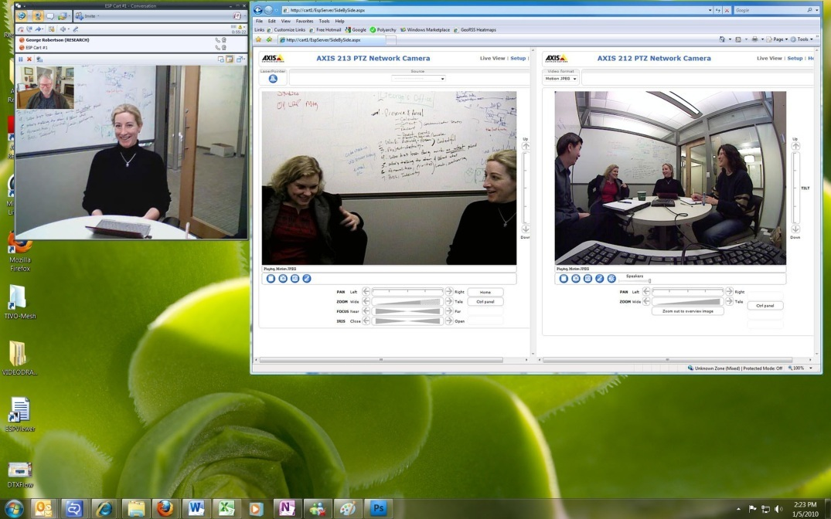
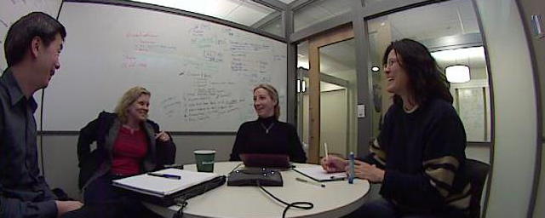
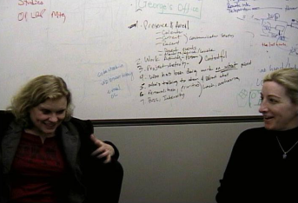
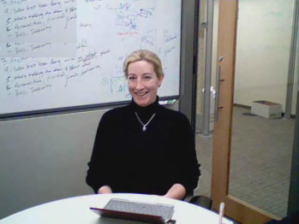
Gaze awareness miscue

Slide 28
Beyond ESP
Conference room proxy for any remote participant
Desktop PC as out-of-office proxy
Applying the ‘underdesign’ methodology to other team distribution patterns
Robotic mobility

Slide 29
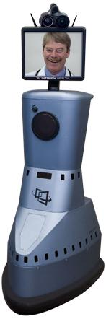
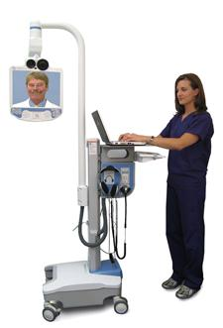
What about robotics?
InTouch Health RP-7
RP-Lite

Slide 30
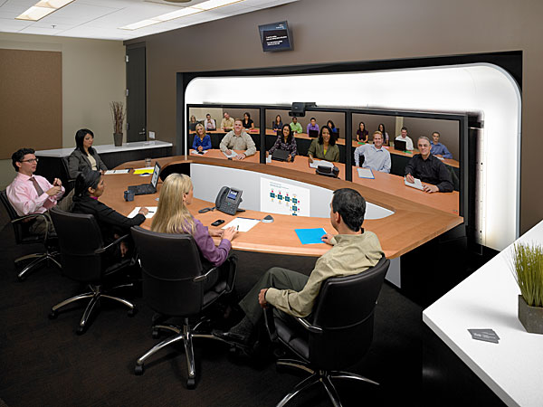
What about telepresence?
Notes:
Telepresence connects a place to another place
ESP connects a person to his team

Slide 31
Conclusion
Constant physical presence allowed hubs and satellite teammates to build stronger social ties
Affording better participation in meetings
Being a physical reminder of the satellite teammate
Serving as a catalyst for social interaction
Enabling building relationships over time
Notes:
FUTURE WORK
Limitations of current ESP
- High-quality audio from the conference-room to the remote
- Distributed whiteboarding
-- Reliability
++ Gaze awareness miscue
++ ‘Handler’ role - Robotic mobility
Other uses of ESP-like techniques
+ Conference room proxy for remote participants
-- Loaners
+ Out-of-Office proxy using desktop PC
Applying the same “underdesign” methodology to other team distribution patterns
TAKEAWAYS
ESP’s constant physical presence enabled the creation of social presence
Designing for long-term social effects (beyond the 60-minute meeting)
Underdesign-for-self is a powerful (if controversial) methodology

Slide 32
Find out more
ESP Project website (5-minute video)
  http://research.microsoft.com/projects/ESPProject/
We thank our research group colleagues and the participants in the four teams we studied.

Slide 33
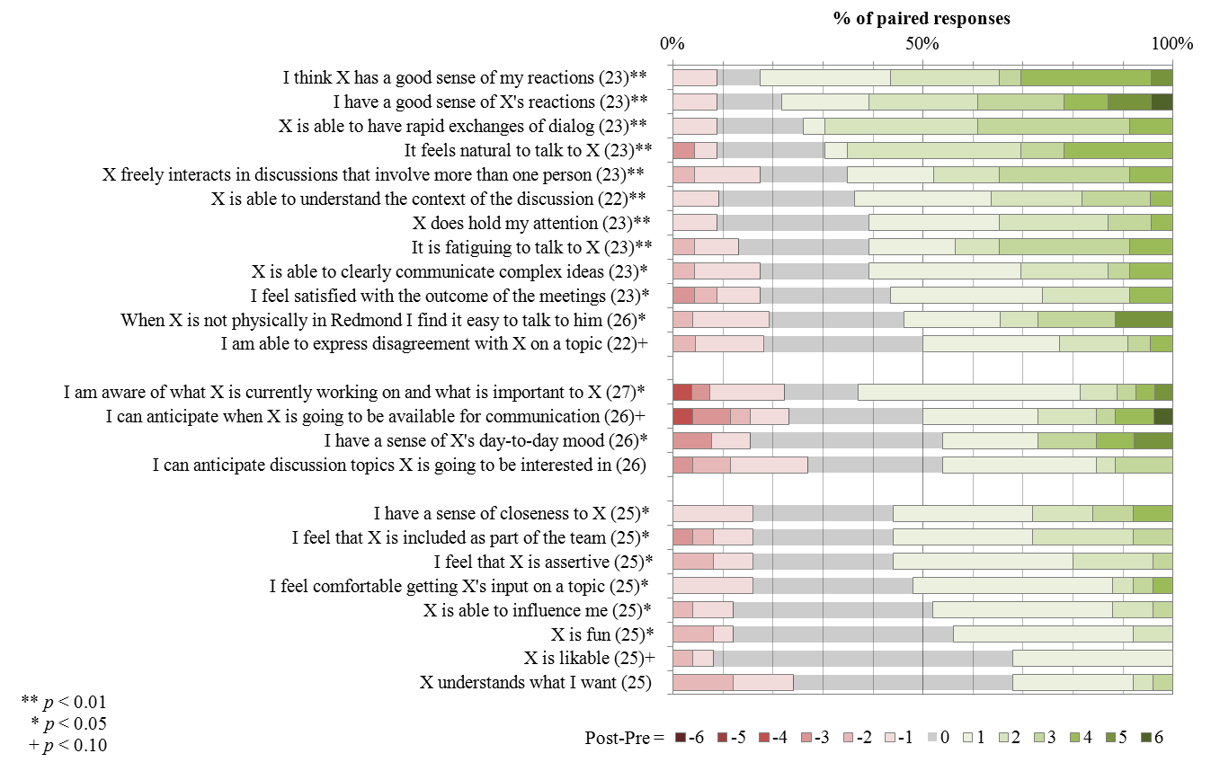
Survey results

