Slide 1
Migrating Server Storage to SSDs: Analysis of Tradeoffs
Dushyanth Narayanan
Eno Thereska
Austin Donnelly
Sameh Elnikety
Antony Rowstron
Microsoft Research Cambridge, UK

Slide 2
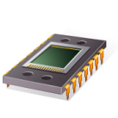
Solid-state drive (SSD)
Block storage interface
Persistent
Flash Translation Layer (FTL)
Random-access
NAND Flash memory
Low power
Cost, Parallelism, FTL complexity
USB drive
Laptop SSD
“Enterprise” SSD

Slide 3
Enterprise storage is different
Laptop storage
Low speed disks
Form factor
Single-request latency
Ruggedness
Battery life
Enterprise storage
High-end disks, RAID
Fault tolerance
Throughput under load (deep queues)
Capacity
Energy ($)

Slide 4
Replacing disks with SSDs
Match
performance
Match
capacity
Disks
$$
Flash
$
Flash
$$$$$

Slide 5
SSD as intermediate tier?
DRAM buffer cache
Capacity
Performance
Read cache + write-ahead log
$
$$$$

Slide 6
Other options?
Hybrid drives?
  Flash inside the disk →can pin hot blocks
  Volume-level tier more sensible for enterprise
Modify file system?
  Put metadata in the SSD?
We want to plug in SSDs transparently
  Replace disks by SSDs
  Add SSD tier for caching and/or write logging

Slide 7
Challenge
Given a workload
  Which device type, how many, 1 or 2 tiers?
We traced many real enterprise workloads
Benchmarked enterprise SSDs, disks
And built an automated provisioning tool
  Takes workload, device models
  And computes best configuration for workload

Slide 8
Roadmap
Introduction
Devices and workloads
Solving for best configuration
Results

Slide 9
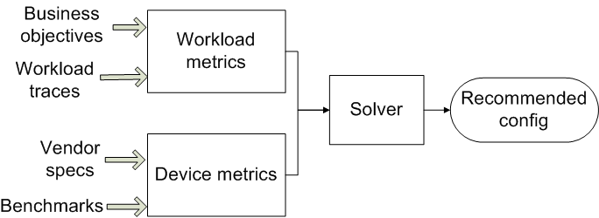
High-level design

Slide 10
Devices (2008)
Device | Price | Size | Sequential throughput | Random-access throughput
Seagate Cheetah 10K | $123 | 146 GB | 85 MB/s | 288 IOPS
Seagate Cheetah 15K | $172 | 146 GB | 88 MB/s | 384 IOPS
Memoright MR25.2 | $739 | 32 GB | 121 MB/s | 6450 IOPS
Intel X25-E (2009) | $415 | 32GB | 250 MB/s | 35000 IOPS
Seagate Momentus 7200 | $53 | 160 GB | 64 MB/s | 102 IOPS
Notes:
First two are enterprise disks. Next two are enterprise SSDs.
Last is a low power disk usually not used for enterprise. That’s for power, which is discussed in the paper but we won’t be going into it in detail in the talk. So we won’t be looking at the Momentus in this talk.
So: scaled by dollar cost. Disks win on capacity. SSDs win big on IOPS/$. Sequential is about comparable.
X25-E was not available at the time ... The perf numbers are marketing numbers from Intel. So we won’t be showing results from that, but we will come back to it later in the talk when we discuss cost/capacity of SSDs since it is significantly cheaper than the Memoright per gigabyte.

Slide 11
Characterizing devices
Sequential vs random, read vs write
  Some SSDs have slow random writes
  Newer SSDs remap internally to sequential
  We model both “vanilla” and “remapped”
Multiple capacity versions per device
  Different cost/capacity/performance tradeoffs
  We consider several versions when solving

Slide 12
Device metrics
Metric | Unit | Source
Price | $ | Retail
Capacity | GB | Vendor
Random-access read rate | IOPS | Measured
Random-access write rate | IOPS | Measured
Sequential read rate | MB/s | Measured
Sequential write rate | MB/s | Measured
Power | W | Vendor

Slide 13
Enterprise workload traces
I/O traces from live production servers
  Exchange server (5000 users): 24 hr trace
  MSN back-end file store: 6 hr trace
  13 servers from small DC (MSRC)
    File servers, web server, web cache, etc.
    1 week trace
15 servers, 49 volumes, 313 disks, 14 TB
  Volumes are RAID-1, RAID-10, or RAID-5
Notes:
More details in the paper.

Slide 14
Enterprise workload traces
Traces are at volume (block device) level
Below buffer cache, above RAID controller
Timestamp, LBN, size, read/write
Each volume’s trace is a workload
  We consider each volume separately

Slide 15
Workload metrics
Metric | Unit
Capacity | GB
Peak random-access read rate | IOPS
Peak random-access write rate | IOPS
Peak random-access I/O rate (reads+writes) | IOPS
Peak sequential read rate | MB/s
Peak sequential write rate | MB/s
Fault tolerance | Redundancy level

Slide 16
Workload trace → metrics
Capacity
  largest LBN accessed in trace
Performance = peak (or 99th pc) load
  Highest observed IOPS of random I/Os
  Highest observed transfer rate (MB/s)
Fault tolerance
  Set to same as current configuration
    1 redundant device

Slide 17
What is the best config?
Cheapest one that meets requirements
  Config → device type, #devices, #tiers
  Requirements →capacity, perf, fault-tolerance
Re-run/replay trace?
  Cannot provision h/w just to ask “what if”
  Simulators not always available/reliable
First-order models of device performance
  Based on measured metrics
Notes:
Workload and volume are interchangeable

Slide 18
Solver
For each workload, device type
  Compute #devices needed in RAID array
    Throughput, capacity scaled linearly with #devices
  Must match every workload requirement
    “Most costly” workload metric determines #devices
  Add devices need for fault tolerance
  Compute total cost

Slide 19
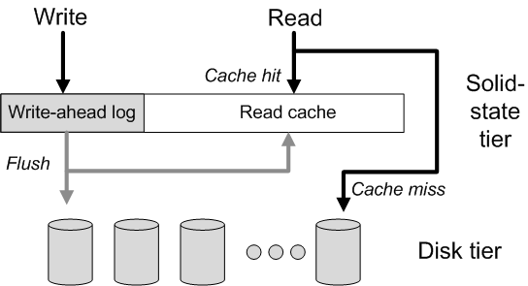
Two-tier model

Slide 20
Solving for two-tier model
Feed I/O trace to cache simulator
  Emits top-tier, bottom-tier trace → solver
Iterate over cache sizes, policies
  Write-back, write-through for logging
  LRU, LTR (long-term random) for caching
Inclusive cache model
  Can also model exclusive (partitioning)
  More complexity, negligible capacity savings

Slide 21
Model assumptions
First-order models
  Ok for provisioning → coarse-grained
  Not for detailed performance modelling
Open-loop traces
  I/O rate not limited by traced storage h/w
  Traced servers are well-provisioned with disks
  So bottleneck is elsewhere: assumption is ok

Slide 22
Roadmap
Introduction
Devices and workloads
Finding the best configuration
Analysis results

Slide 23
Single-tier results
Cheetah 10K best device for all workloads!
SSDs cost too much per GB
Capacity or read IOPS determines cost
  Not read MB/s, write MB/s, or write IOPS
  For SSDs, always capacity
  For disks, either capacity or read IOPS
Read IOPS vs. GB is the key tradeoff

Slide 24
Workload IOPS vs GB

Slide 25
SSD break-even point
When will SSDs beat disks?
  When IOPS dominates cost
Break even price point (SSD_{$/GB}) is when
  Cost of GB (SSD) = Cost of IOPS (disk)
Our tool also computes this point
  New SSD → compare its $/GB to break-even
  Then decide whether to buy it

Slide 26
Break-even point CDF

Slide 27
Break-even point CDF

Slide 28
Break-even point CDF

Slide 29
Capacity limits SSD
On performance, SSD already beats disk
$/GB too high by 1-3 orders of magnitude
  Except for small (system boot) volumes
SSD price has gone down but
  This is per-device price, not per-byte price
  Raw flash $/GB also needs to drop
  By a lot
Notes:
At the end of the talk I’ll talk a little bit about the economics of this.

Slide 30
SSD as intermediate tier
Read caching benefits few workloads
  Servers already cache in DRAM
  SSD tier doesn’t reduce disk tier provisioning
Persistent write-ahead log is useful
  A small log can improve write latency
  But does not reduce disk tier provisioning
  Because writes are not the limiting factor

Slide 31
Power and wear
SSDs use less power than Cheetahs
  But overall $ savings are small
  Cannot justify higher cost of SSD
Flash wear is not an issue
  SSDs have finite #write cycles
  But will last well beyond 5 years
    Workloads’ long-term write rate not that high
    You will upgrade before you wear device out

Slide 32
Conclusion
Capacity limits flash SSD in enterprise
  Not performance, not wear
Flash might never get cheap enough
  If all Si capacity moved to flash today, will only match 12% of HDD production [Hetzler2008]
  There are more profitable uses of Si capacity
Need higher density/scale (PCM?)

Slide 33
This space intentionally left blank

Slide 34
What are SSDs good for?
Mobile, laptop, desktop
Maybe niche apps for enterprise SSD
  Too big for DRAM, small enough for flash
    And huge appetite for IOPS
  Single-request latency
  Power
  Fast persistence (write log)

Slide 35
Assumptions that favour flash
IOPS = peak IOPS
  Most of the time, load << peak
    Faster storage will not help: already underutilized
Disk = enterprise disk
  Low power disks have lower $/GB, $/IOPS
LTR caching uses knowledge of future
  Looks through entire trace for randomly-accessed blocks

Slide 36
Supply-side analysis [Hetzler2008]
Disks: 14,000 PB/year, fab cost $1B
MLC NAND flash: 390 PB/year, $3.4B
If all Si capacity moved to MLC flash today
  Will only match 12% of HDD production
Revenue: $35B HDD, $280B Silicon
  No economic incentive to use fabs for flash
Notes:
Steven Hetzler is an IBM Fellow at IBM Almaden lab.

Slide 37
Device characteristics
Device | Memoright SSD | Cheetah 10K | Cheetah 15K | Momentus 7200
Price | $739 | $339 | $172 | $150
Capacity | 32 GB | 300 GB | 146 GB | 200 GB
Power | 1.0 W | 10.1 W | 12.5 W | 0.8 W
Read (seq) | 121 MB/s | 85 MB/s | 88 MB/s | 64 MB/s
Write (seq) | 126 MB/s | 84 MB/s | 85 MB/s | 54 MB/s
Read (random) | 6450 IOPS | 277 IOPS | 384 IOPS | 102 IOPS
Write (random) | 351 IOPS | 256 IOPS | 269 IOPS | 118 IOPS

Slide 38
9 of 49 benefit from caching

Slide 39
Energy savings << SSD cost

Slide 40
Wear-out times

