Slide 1
Will You Still Compile Me Tomorrow?
Static Cross-Version Compiler Validation
Chris Hawblitzel, Shuvendu K. Lahiri
(Microsoft Research)
Kshama Pawar, Hammad Hashmi, Sedar Gokbulut, Lakshan Fernando, Dave Detlefs, Scott Wadsworth
(Microsoft CLR Test Team)
Notes:
Tell a story of CLR/MSR collaboration...

Slide 2
Finding compiler bugs
Testing
Validation
Verification
Source program
Source program
Automated theorem prover
Interactive theorem prover
Compiler
Compiler
Compiler
Test
input
Assembly code
Assembly code
Output
+ high automation
- limited coverage
+ covers all inputs
- false alarms
+ covers all programs
- not automated
Notes:
...CLR test team, not surprisingly, uses testing to find bugs the CLR JIT compiler. The CLR test team approached us (MSR) with an idea: use verification technology (specifically, translation validation) on assembly language generated by CLR JIT.

Slide 3
Cross-version validation
mov EAX, EDX
and EAX, 255
push EAX
mov EDX, 0x100000
call WriteInternalFlag2
ret
push ESI
mov ESI, EDX
and ESI, 255
push ESI
mov EDX, 0x100000
call WriteInternalFlag2
pop ESI
ret
Source program
Source program
Compiler
version 4.0
Compiler
version 4.5
Assembly code
Assembly code
Automated theorem prover
compare similar code ⇒ fewer false alarms
Notes:
...but the biggest concern was the possibility of new bugs appearing in already-deployed code. (picture of WinDiff)

Slide 4
Validation across various dimensions
ARM
Assembly code
ARM
+optimizations
Assembly code
Assembly code
x86
x86
+optimizations
Assembly code
Assembly code
Assembly code
v1
v2
v3
v4
Versions

Slide 5
Tools: SymDiff, Boogie, Z3
Source program
Source program
Compiler
version 4.0
Compiler
version 4.5
...
push ESI
...
...
Mem := Store4(...esi...);
esp := SUB(esp, imm(4));
...
Assembly code
Assembly code
Boogie
program
Boogie
program
Z3
automated theorem
prover
Boogie program verifier
SymDiff equivalence verifier
Verification
condition
Combined Boogie program

Slide 6
Encoding assembly language
Encode one method at a time
  calls are uninterpreted
  inlining not yet supported
Our encoding is not entirely sound
  mathematical integers vs. 32-bit vectors
    Z3 supports both, but reasoning about integers is faster
  non-aliasing assumptions
    disjoint regions for stack, heap, static data
Floating point, switch tables, etc.
Complex instructions
  rep stosb: ∀i. edx ≤ i < edx+ecx ⇒ Mem[i] == al

Slide 7
Month-to-month results (ARM)

Slide 8
Cross-architecture, optimization

Slide 9
Fault injection (ARM)

Slide 10
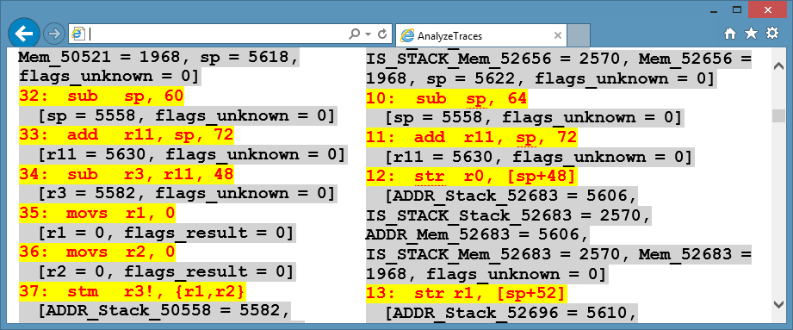
Counterexample traces
Helps user find where program execution diverged
Used by automated root cause analysis

Slide 11
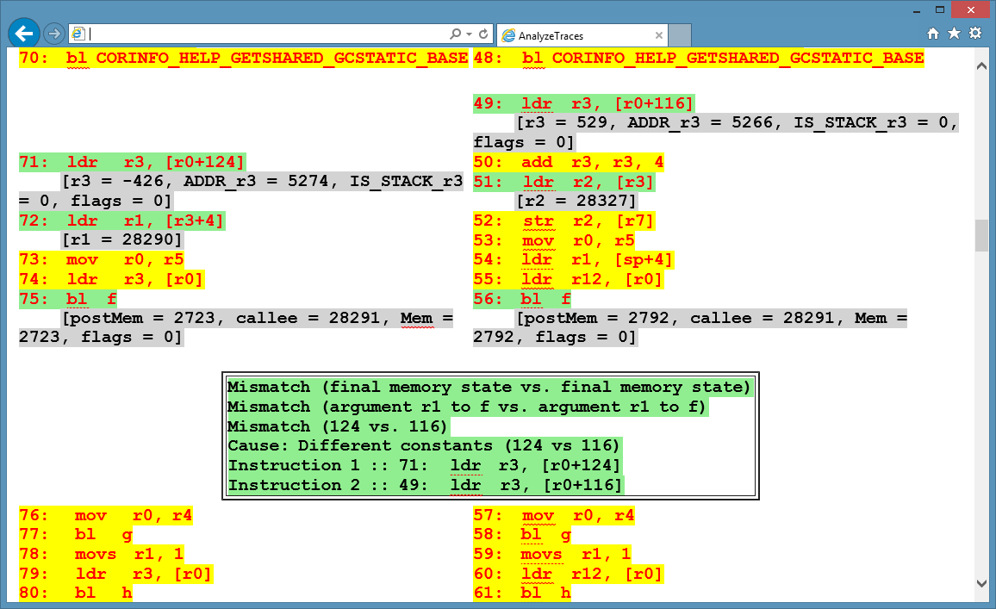
Root cause analysis

Slide 12
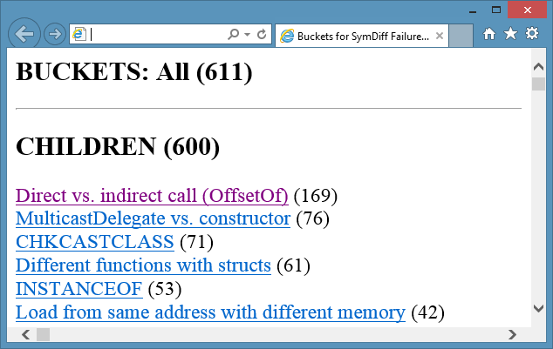
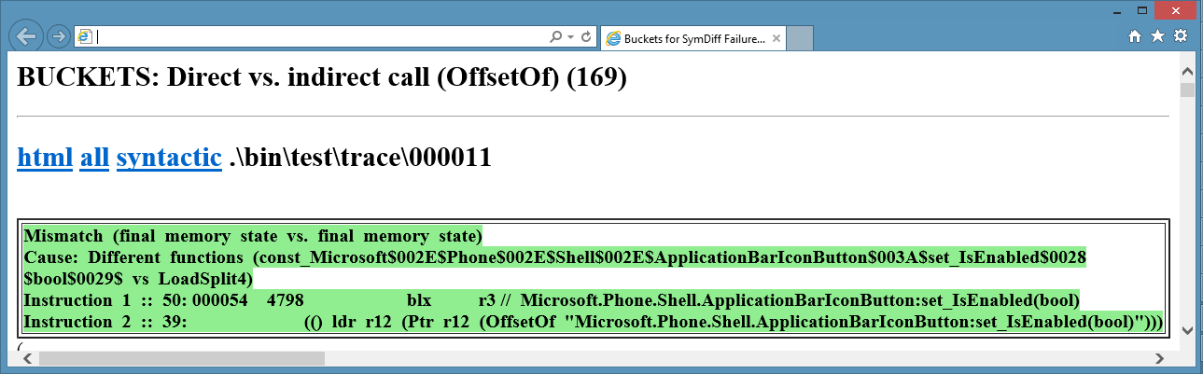
Bucketing
Based on root cause analysis
Users write bucket descriptions

Slide 13
Conclusions
Some statistics:
  methods analyzed: > 500,000
  new bugs found: 12
  false alarm rate, month-to-month versions: 2.2%
  false alarm rate, opt vs. unopt, ARM vs x86: > 20%
  speed: 13 seconds per method
Sources of false alarms:
  aliasing, run-time system calls, embedded addresses, ...
Counterexample traces, root cause analysis essential

