Slide 1
Reducing Uncertainty of Low-sampling-rate Trajectories
Kai Zheng, Yu Zheng, Xing Xie, Xiaofang Zhou
University of Queensland & Microsoft Research Asia
ICDE 2012, Washington D.C.

Slide 2
Outline
  Introduction
  Problem
  Methodologies
  Evaluation

Slide 3
Trajectories in mathematical and real worlds
  A location trajectory is a record of the path of a variety of moving objects, such as people, vehicles, animals and nature phenomena
  From mathematics point, a trajectory is a continuous mapping from time to space
  In real world, GPS devices can only report their locations on discrete time instants.
  Essentially, a real world trajectory is a sample of its counterpart in mathematical world.

Slide 4
Trajectories in mathematical and real worlds

Slide 5
Low-sampling-rate Issues
  Since we always use a sample to approximate the original trajectory of the moving object, higher sampling rate results in better approximation
  However, huge amount of low-sampling-rate trajectories exist in many scenarios

Slide 6
Low-sampling-rate Issues (Cont.)
  GPS devices report their location at low frequency to save battery and communication cost
Less than 17% of trajectories with sampling rate > every 2 mins, based on 30000+ taxicabs of Beijing
  Tourists can upload their photos with geo-tags to photo sharing services (Flickr etc), which also form trajectories of their travel routes

Slide 7
Impact of low-sampling-rate
  Detailed travel information is lost
  Uncertainty arise when querying against such kind of data
  Making decision solely based on these data can be unhelpful (e.g. traffic management, urban planning)

Slide 8
Traditional methodologies
  Just ignore this issue, and process as usual
  Uncertainty-awareness trajectory models, indexes, and queries
Space-time prism model, necklace model
Probabilistic queries (range and NN)

Slide 9
Our idea
  Can we reduce the uncertainty caused by the low-sampling-rate before the trajectories undergo further processing?
  To be more specific, can we estimate its original route from the samples?
  Our basic idea is to leverage the historical trajectory data as well as the following two observations.

Slide 10
Key Observation – 1
  Travel patterns between certain locations are often highly skewed
  we can find some popular routes between certain locations
  Limitation: we need a reasonably large set of quality trajectories with high-sampling-rate, so that we can know their routes
Notes:
when people travel, they often plan the route based on the experience of their own or others, rather than choosing randomly

Slide 11
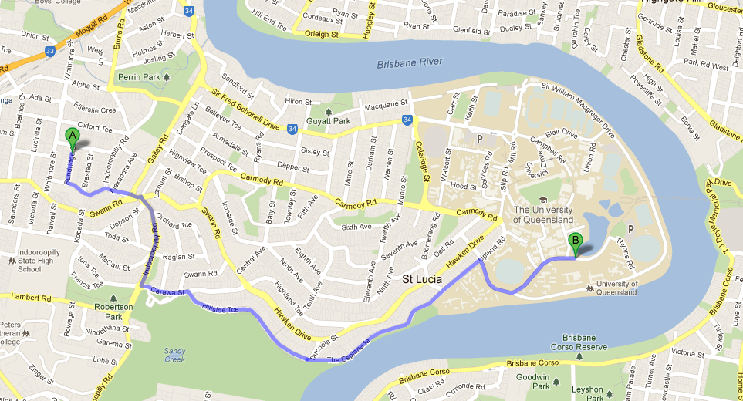
A
C
B

Slide 12
Key Observation – 2
  Trajectories sharing the same/similar routes can often complement each other to make themselves more complete
  In other words, it’s possible to interpolate a low-sampling-rate trajectory by cross-referring other trajectories on the same/similar route, so that they all become high-sampling-rate

Slide 13
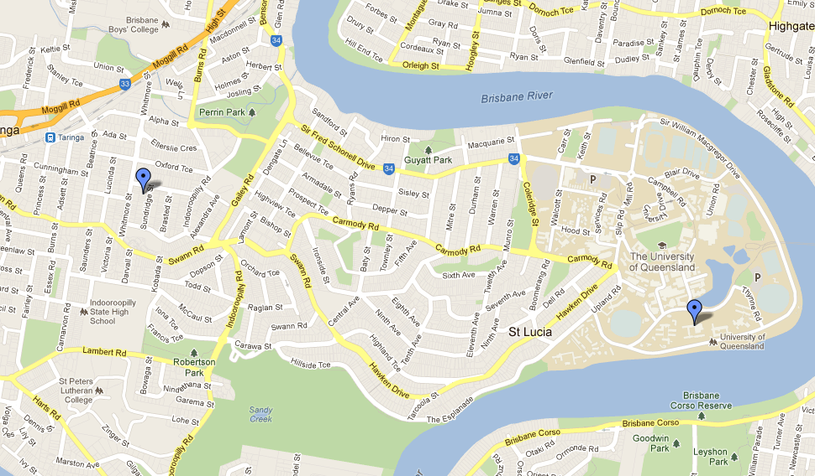

Slide 20
Challenges on real data
  Data sparseness
Trajectories are sparse compared with the space
A query can be given with any origin and destination, which may not exist in historical dataset
  Data quality
The trajectory dataset is mixed with high- and low-sampling-rate trajectories
GPS locations can be off-road (in most case they are!)
Outlier

Slide 21
Outline
  Introduction
  Problem
  Methodologies
  Evaluation

Slide 22
Problem statement
  Input
A set of historical trajectories (various qualities)
A road network
A user-given query trajectory with low-sampling-rate
  Output
A few possible routes of this query trajectory

Slide 23
Main contributions
  Propose a new idea and framework on how to deal with low-sampling-rate trajectories
  Develop a system based on real-world large trajectory dataset
Trajectories of taxicabs in Beijing

Slide 24
Outline
  Introduction
  Problem
  Methodologies
  Evaluation

Slide 25
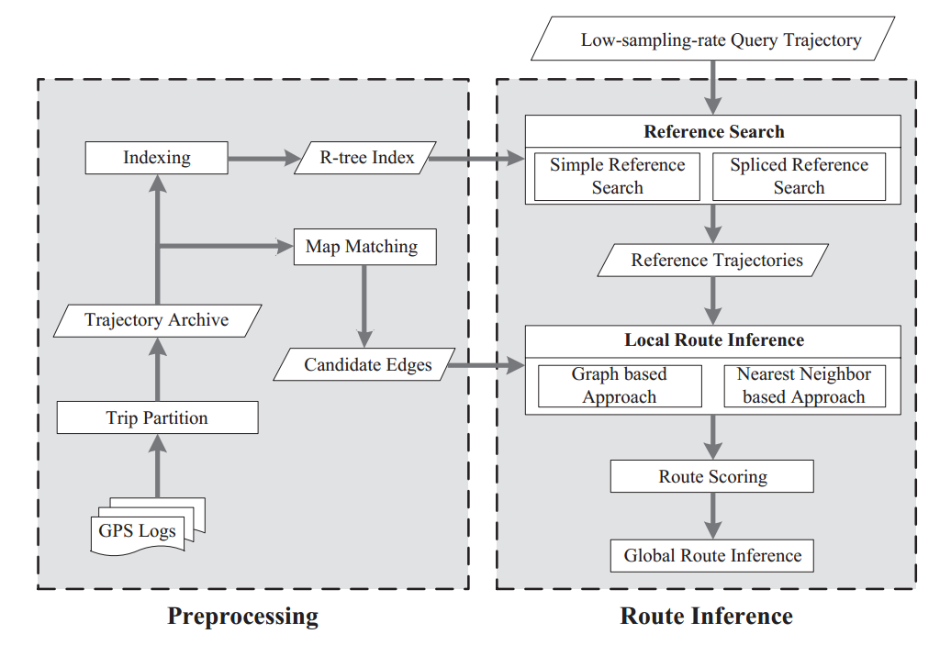
System Overview

Slide 26
Outline
  Introduction
  Problem
  Methodologies
Pre-processing
Reference trajectory search
Local route inference
Global route inference
  Evaluation

Slide 27
Preprocessing (on historical data)
  Trip partition
A GPS log contains the record of movement for a long period
Partition a long trajectory into meaningful trips
Concept: stay point [zheng2009mining]
  Map matching for GPS points
Candidate edges
  Indexing all the GPS points

Slide 28
Route inference
  Search for reference trajectories
Select the relevant historical trajectories that may be helpful in inferring the route of the query
  Local route inference
Inferring the routes between consecutive samples of query
  Global route inference
Inferring the whole routes by connecting the local routes

Slide 29
Outline
  Introduction
  Problem
  Methodologies
Pre-processing
Reference trajectory search
Local route inference
Global route inference
  Evaluation

Slide 30
Reference trajectory search
  Intuitively, we only need to utilize the ones in the surrounding area of the query since the relationship between two trajectories faraway from each other is usually
  Simple and spliced reference trajectory

Slide 31

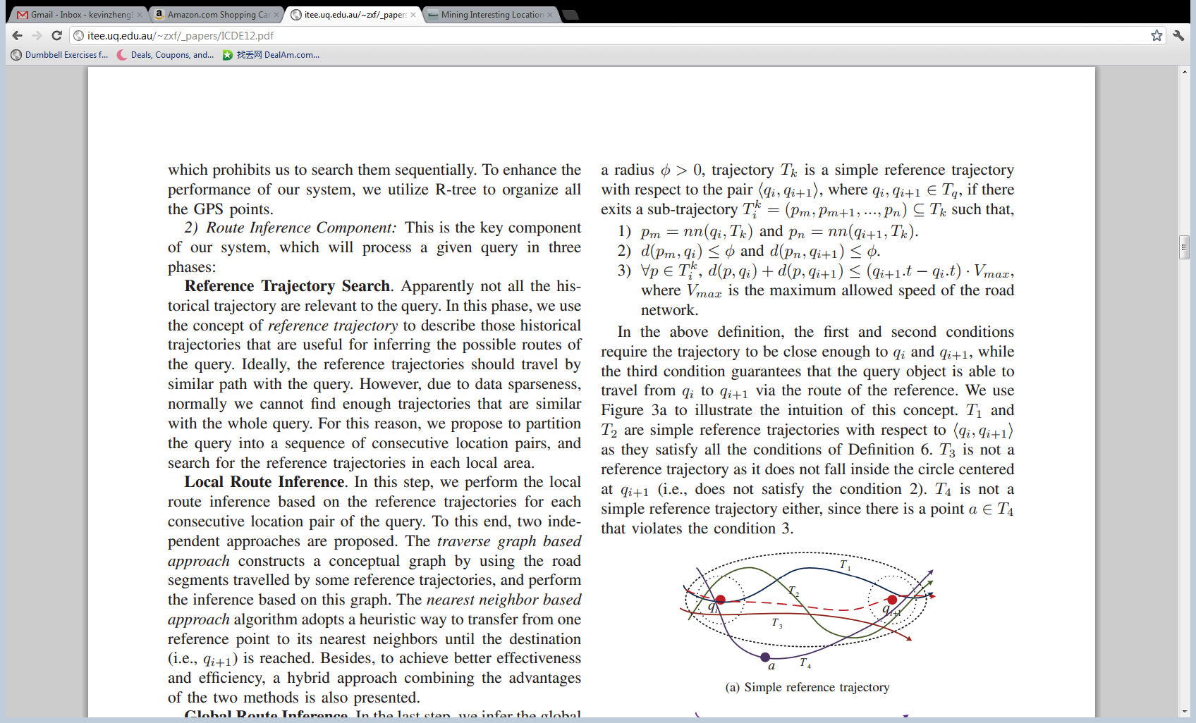
Reference trajectory search (cont.)
  Simple reference trajectory
  They natively exist in the trajectory archive

Slide 32
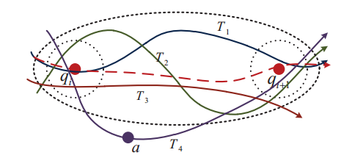
Reference trajectory search (cont.)
  T1, T2 -- yes
  T3, T4 – no

Slide 33

Reference trajectory search (cont.)
  Spliced reference trajectory
  They don’t exist in the trajectory archive by nature
  Formed by splicing two parts of trajectories

Slide 34
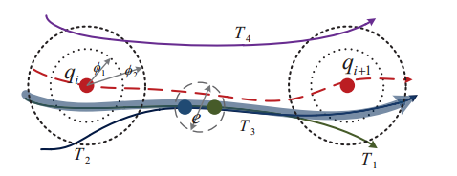
Reference trajectory search (cont.)
  T1, T2, T4 – not simple reference trajectory
  Parts of T1 and T2 can form a reference trajectory

Slide 35
Reference trajectory search (cont.)
  Why we only consider two consecutive points?
  Why we propose spliced reference trajectory?
Data sparseness!

Slide 36
Outline
  Introduction
  Problem
  Methodologies
Pre-processing
Reference trajectory search
Local route inference
Global route inference
  Evaluation

Slide 37
Local route inference
  Basic idea is to treat all the reference trajectories collectively
  Using the points from reference trajectories as the evidence of popularity of each road
  Traverse graph based approach
  Nearest neighbor based approach

Slide 38
Traverse graph based approach
  Intuition: if a road segment is not travelled by any reference, there is a high chance that the query object did not pass by it either
  Focus on the road segments traversed by some reference trajectories rather than all the edges in the road network

Slide 39
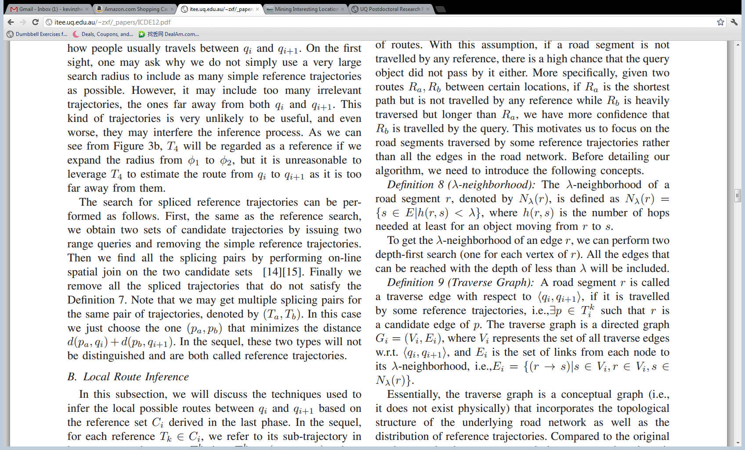
Traverse graph based approach (cont.)
Essentially, the traverse graph is a conceptual graph that incorporates the topological structure of the underlying road network as well as the distribution of reference trajectories

Slide 40
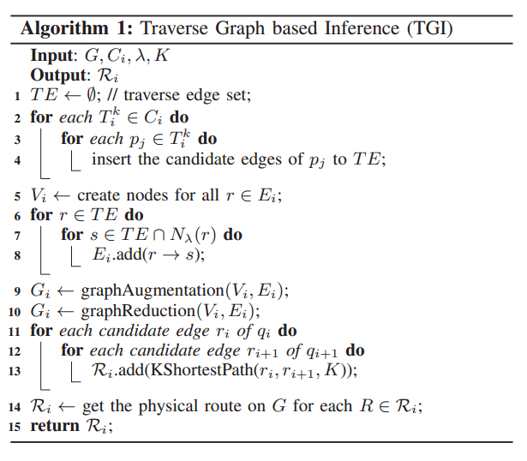
Traverse graph based approach (cont.)

Slide 41


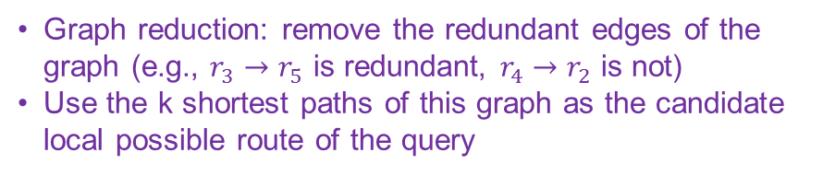
Traverse graph based approach (cont.)
$$λ=2$$
Graph reduction: remove the redundant edges of the graph (e.g., $r_{3}→r_{5}$ is redundant, $r_{4}→r_{2}$ is not)
Use the k shortest paths of this graph as the candidate local possible route of the query

Slide 42

Traverse graph based approach (cont.)
  Pros: inference is more reliable
  Cons: $λ$ is hard to specify when only a small amount of reference trajectories are available
Too low: low connectivity in the traverse graph
Too high: graph construction is not efficient

Slide 43
Nearest neighbor based approach
  Consider all the reference points in Euclidean space
  Try to find a continuous hops with shortest Euclidean distance from origin to destination via the reference points
  Recursively search for kNN of the current position and jump to one of the kNNs

Slide 44
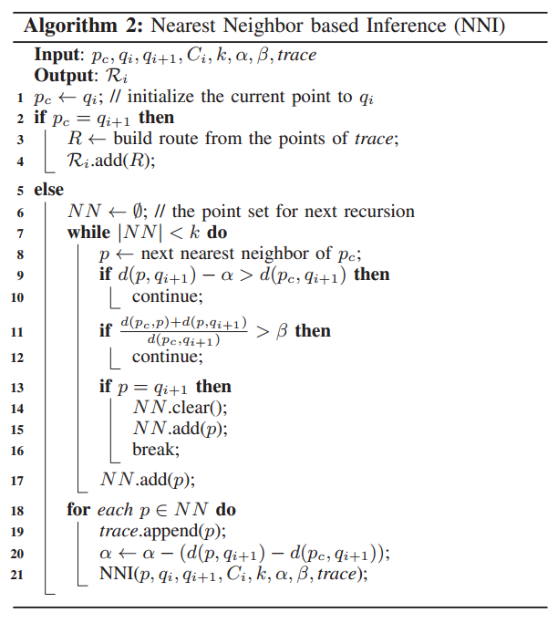
Nearest neighbor based approach (cont.)

Slide 45
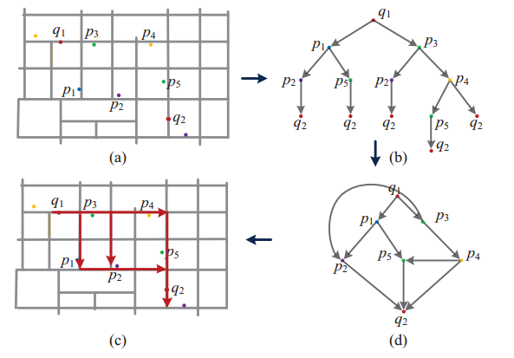
Nearest neighbor based approach (cont.)
  We will keep track of each path that has been built. So if another recursion hits any node of this path, we can re-use them

Slide 46
Nearest neighbor based approach (cont.)
  Pros: more adaptive to the distribution of the reference trajectories
  Cons: not as reliable as the traverse graph
  not efficient when the number of reference points increase

Slide 47
Hybrid approach
  Combine the advantage of both approaches
  Detect the density of reference points in surrounding area
  High density: traverse graph based
  Low density: nearest neighbor based

Slide 48
Outline
  Introduction
  Problem
  Methodologies
Pre-processing
Reference trajectory search
Local route inference
Global route inference
  Evaluation

Slide 49
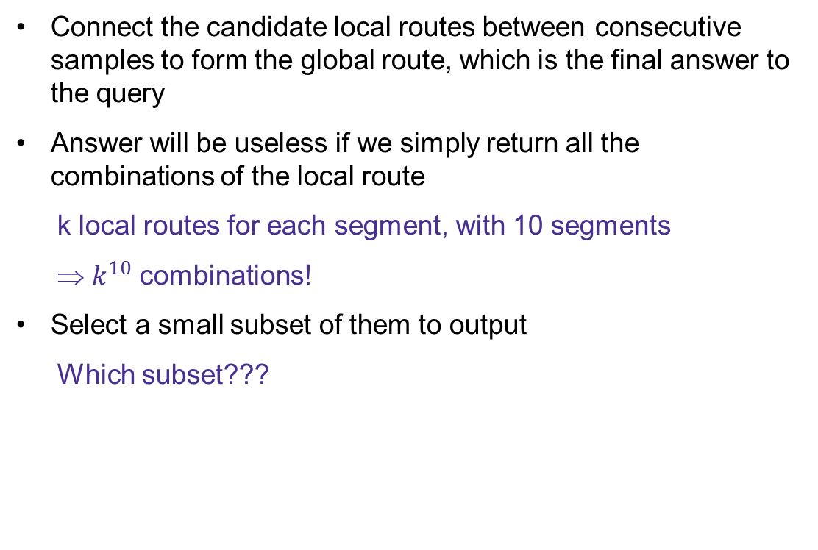
Global route inference
  Connect the candidate local routes between consecutive samples to form the global route, which is the final answer to the query
  Answer will be useless if we simply return all the combinations of the local route
k local routes for each segment, with 10 segments
$k^{10}$ combinations!
  Select a small subset of them to output
Which subset???

Slide 50
Global route inference (cont.)
  Connect the candidate local routes between consecutive samples to form the global route, which is the final answer to the query
  Answer will be useless if we simply return all the combinations of the local route
k local routes for each segment, with 10 segments
$k^{10}$ combinations!
  Select a small subset of them to output
Which subset???

Slide 51
Global route inference (cont.)
  The quality of a global route depends on
The quality of each local route
The quality of the connections between local routes
  Correspondingly,
popularity function for each local route
transition conﬁdence function for the connections

Slide 52
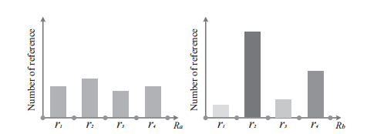
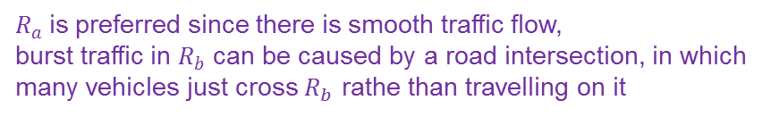
Global route inference (cont.)
  Popularity of a local route
How many traffic on the route
The distribution of the traffic on each road of the route
$R_{a}$is preferred since there is smooth traffic flow,
burst traffic in $R_{b}$ can be caused by a road intersection, in which many vehicles just cross $R_{b}$ rathe than travelling on it

Slide 53
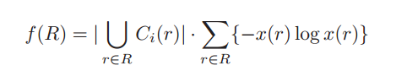

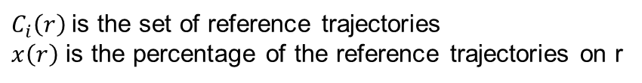
Global route inference (cont.)
  Popularity of a local route $R:r_{1},r_{2},…, r_{n}$
$C_{i}\left(r\right)$ is the set of reference trajectories
$x\left(r\right)$ is the percentage of the reference trajectories on r

Slide 54
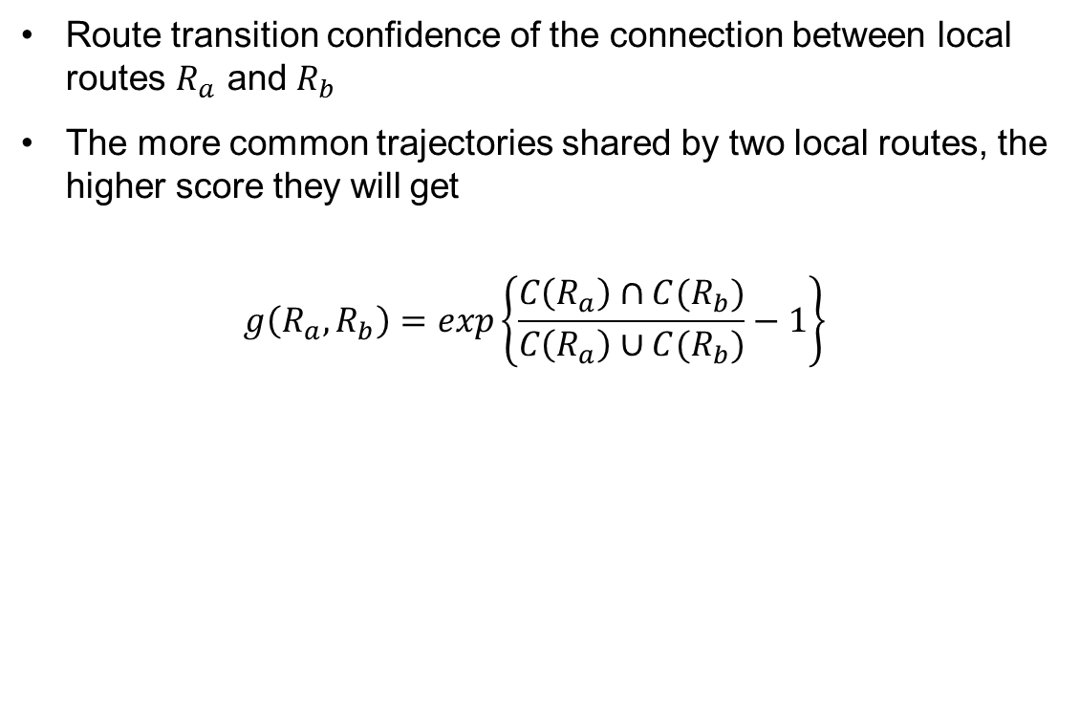
Global route inference (cont.)
  Route transition confidence of the connection between local routes $R_{a}$ and $R_{b}$
  The more common trajectories shared by two local routes, the higher score they will get
  $$g\left(R_{a}, R_{b}\right)=exp\left\{\frac{C\left(R_{a}\right)∩C(R_{b})}{C\left(R_{a}\right)∪C(R_{b})}−1\right\}$$

Slide 55
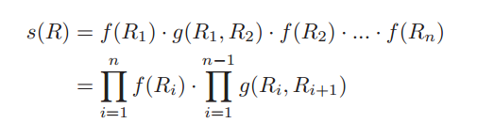

Global route inference (cont.)
  Global route score for $R:R_{1}⋄R_{2}⋄R_{3} …⋄R_{n}$

Slide 56
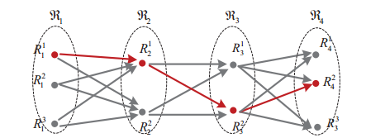
Global route inference (cont.)
  We try to find the subset of global routes that maximize the global route score
  Downward closure property holds: an optimal route implies an optimal sub-route
  Can be solved by Dynamic Programming method

Slide 57
Outline
  Introduction
  Problem
  Methodologies
  Evaluation

Slide 58
Experiment setup
  Historical dataset: 100K raw trajectories of 33,000+ Beijing taxicabs over 3 months as the historical trajectory set (about 10% have at least one sample point in every 2 minutes)
  Beijing digital map with 106,579 road nodes and 141,380 road segments
  Query trajectories are from Geolife project

Slide 59
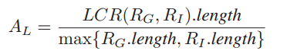
Evaluation approach
  Ground truth: query trajectories from Geolife are of high-sampling-rate, so we know their original routes
  We re-sample the queries using low-sampling-rate as the input of our system for test purpose
  Compare the route recovered by our methods against the original one

Slide 60
Evaluation approach
  As comparison, we use three map-matching algorithm to align the samples onto the road and interpolate by shortest path
Incremental method [Greenfeld2002matching]
ST-matching [lou2009map]
IVMM algorithm [yuan2010interactive]

Slide 61
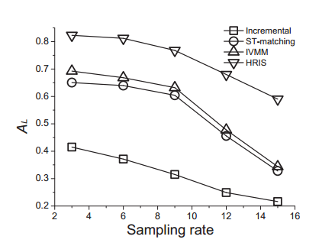
Results summary
Accuracy w.r.t. sampling rate
(sample/minute)

Slide 62
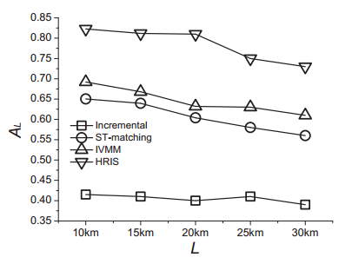
Results summary (cont.)
Accuracy w.r.t. query length

Slide 63
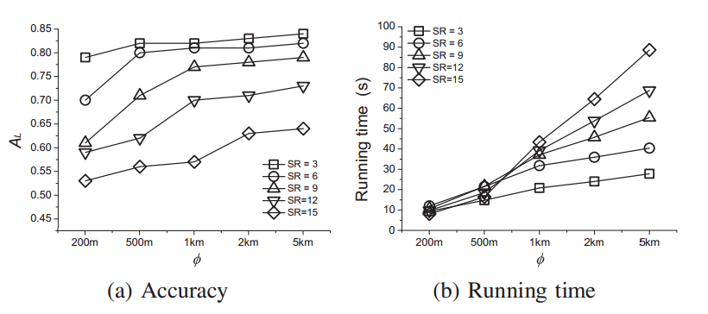
Results summary (cont.)
Effect of search radius for reference trajectories

Slide 64
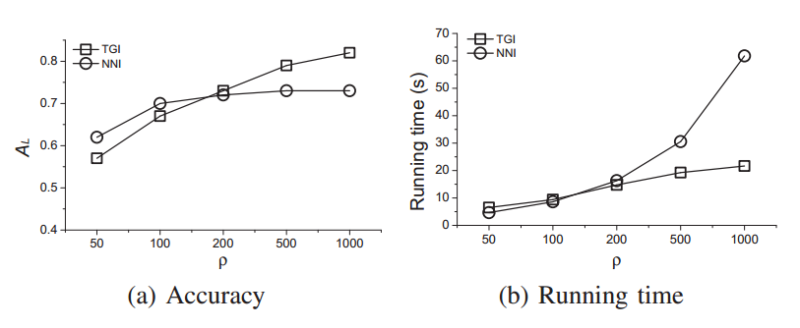

Results summary (cont.)
Effect of density of reference points
($\#point/km^{2}$)

Slide 65
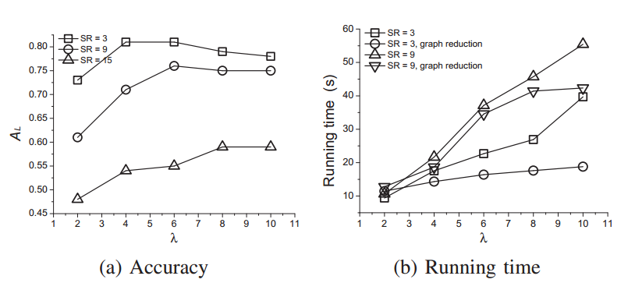

Results summary (cont.)
Effect of $λ$ in traverse graph construction

Slide 66
Conclusion and future work
  Adopt a new perspective to deal with the data quality issue in real trajectory base
  Develop a systematic framework based on real historical taxi data to demonstrate the feasibility of our proposals
  We haven’t considered personalization so far, which may be another interesting direction
  It may be helpful to incorporate more environmental factors into the system, such as the weather, time, real-time traffic condition, etc.

Slide 67


Thank you & welcome to Brisbane for ICDE’13!

