Slide 1
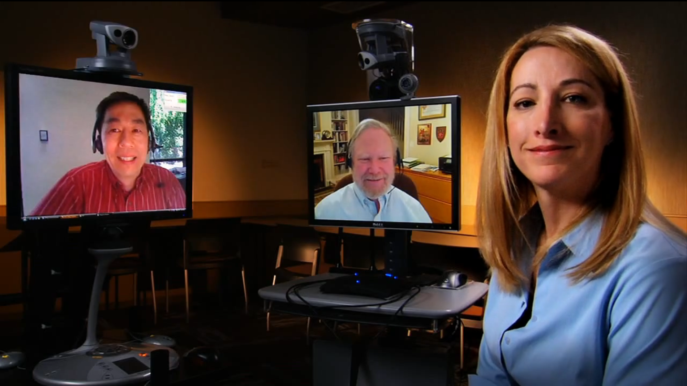
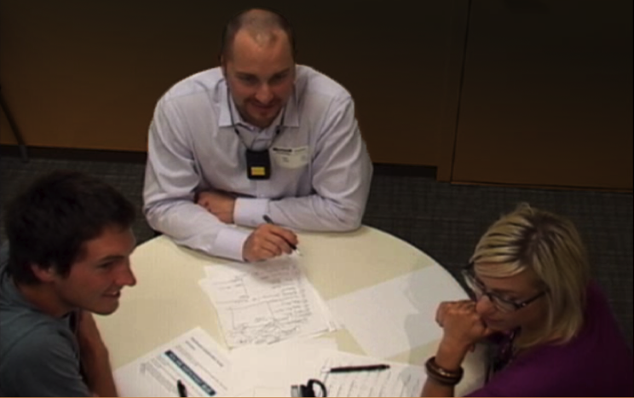
David M Sirkin, George G Robertson, Gina Venolia, John Tang,
Kori Inkpen Quinn, Mara Sedlins, Bongshin Lee, Taemie Kim, Mike Sinclair
Microsoft
Research
Motion and Attention
In a Kinetic Videoconferencing Proxy
Notes:
I’m going to be talking about telepresence, and an actuated—or as we’d call it, kinetic—proxy.
There are a variety of proxies in research and development now. They come from users being dissatisfied with PC-based video chat, which was designed and works well for 1-to-1 conversations, but scales poorly to larger meetings.
First, the PC sits on a tabletop, which is not where most polite people seat themselves. But more importantly, as people shift focus from the table to say, a whiteboard, someone has to turn the laptop. The view that worked well around a table doesn’t zoom in close enough to see the board. Because the screen is now facing the board, nobody can see the remote user anymore. Then later, someone has to turn the laptop back again.
So other than a few usability issues, why should we care about kinetic proxies?...

Slide 2
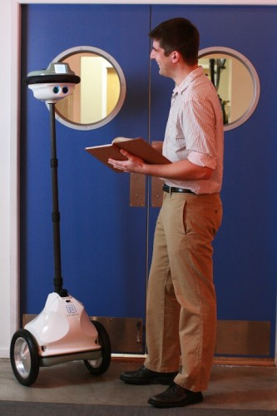
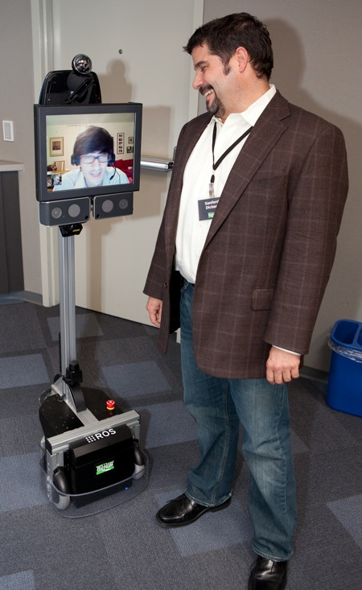
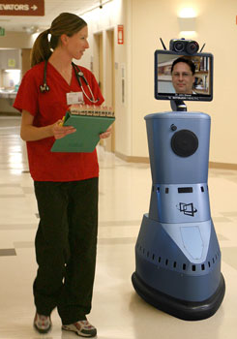
Commercial Proxies
of 17
Notes:
Because companies in the real-world are making and selling these things. One in CA has sold 400 (not cheap) devices for use by doctors in hospitals around the US.
We think that they’re better than the proxies that we use now, but for the most part, we don’t know what aspects of being face-to-face, or in video chat, work in this new context. And we wanted to find out…

Slide 3
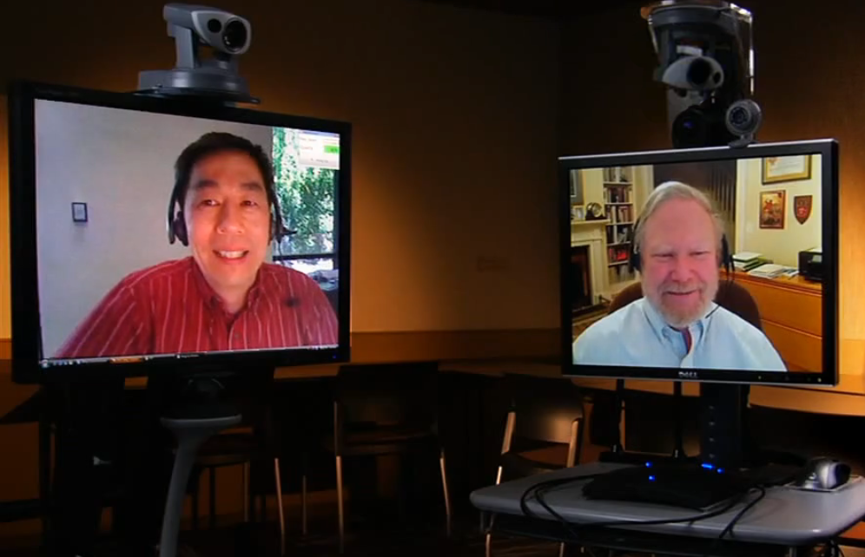
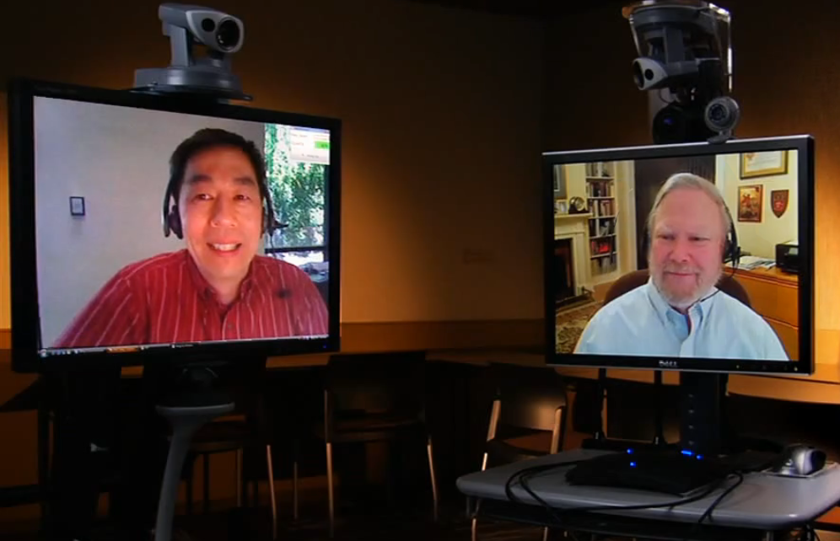
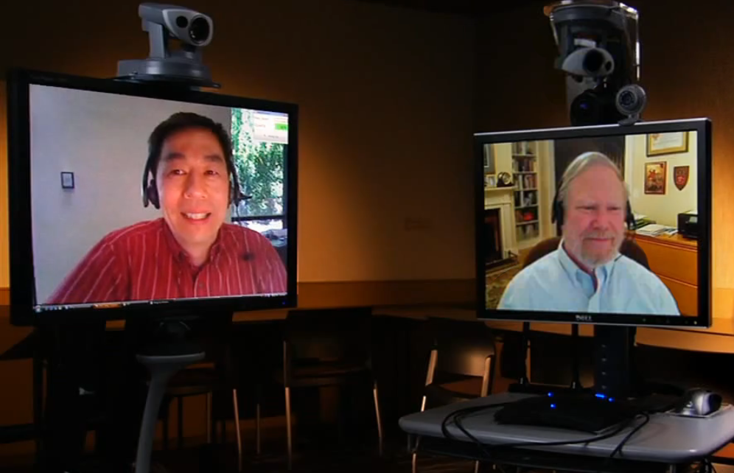
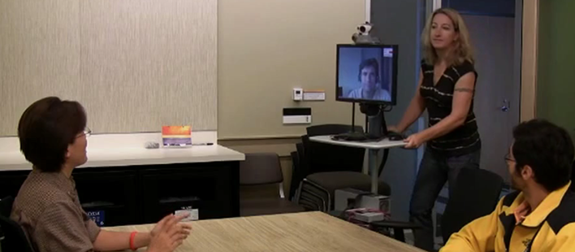
1 to 1
1 to Many
Many to Many
Hub-and-Satellite
of 17
Notes:
John and George are familiar remote members of our hub-and-satellite team. By hub-and-satellite, I mean teams where there’s a group at a central location (the hub) with one or a few individuals who connect in remotely, sometimes even with just each other.
The 2 proxies, which have been in use daily for a few years now, do ease communication, by giving John and George a physical presence in the room with everyone that’s local, as well as letting them move around the building. They’re just mobile carts that are wheeled around by local colleagues. The researchers at MSR call them ESPs, and they’re described in a paper at last year’s CHI.
But, like all proxies, they create their their own issues while trying to addressing others. 2 that I’ll talk about today are what we call the newscaster effect and the skip-over effect.
The newscaster effect is more commonly known as the Mona Lisa effect, and it’s an artifact of the flat screen. Let me try to describe it with the image on-screen:
John seems to be looking slightly left of center, maybe at you or the person just to your left. Does everyone see that? The problem is just that: it looks like that to everyone, wherever in the room you are. Even if you’re on the very left-hand side and nobody is just to your left. So who is he looking at? It’s confusing.
Over time, John has learned to artificially “throw a gaze” at someone to get around that perception. But everyone shouldn’t be expected to do that.
It turns out that without some kind of screen that say, provides a different view to each person, there’s no way to make the gaze appear spatially correct to everyone at the same time.
Partial help is provided by George’s camera, which you can see moves around when he changes his focus somewhere. That provides a cue, so you know where he’s looking, but it’s not a particularly visible indicator.

Slide 4
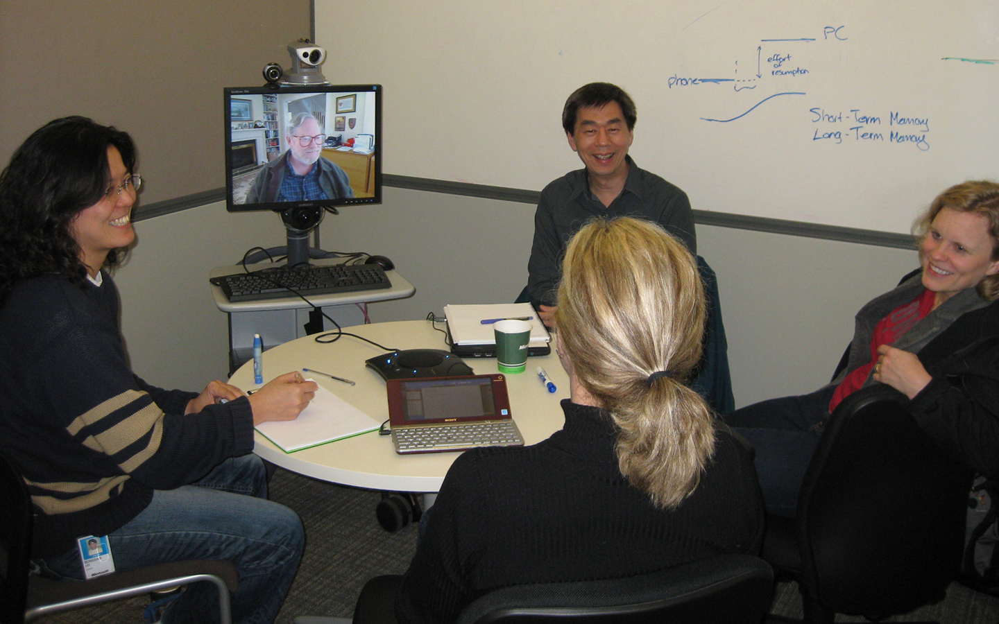
of 17
Notes:
The skip-over effect is where, even if a proxy is right in front of someone, there’s a tendency to skip-over giving that person a turn during something like introductions or discussion. I’m embarrassed to say that even I have done this, and I consider myself pretty sensitive to these devices.
We wanted to understand if adding physical motion to the proxy screens (kind of like we saw with George’s camera) would enhance favorable features—such as improving their sense of presence, and projecting their focus of attention—while lessening unfavorable features—such as the newscaster effect.
So we performed a lab study to explore it…

Slide 5
Study Questions
How should we control a kinetic proxy to work well for participants on both sides of the meeting?
  Intuitive, low cognitive effort, convey reactions
Which one works better: explicit or implicit control?
  Explicit: manual control (like a mouse)
  Implicit: does what you do (motion track)
Notes:
Once we started thinking about motion, we quickly became concerned about how to control that motion.
Given these, our hypothesis was that implicit control—just mirroring your actions—would be more natural. More of your personality would come through.
It turns out that more personality does come through, but that doesn’t necessarily make for better interactions. In fact, explicit control worked better along several of our measures. And we found that proxy motion, of either type, creates a tradeoff between: projecting what’s going on with the satellite, excluding particular hub participants, and the effort required to understand the meaning of motions.
In the end, we probably need an alternative, or enhancement, to both of these approaches. So, how’d we get there?...

Slide 6
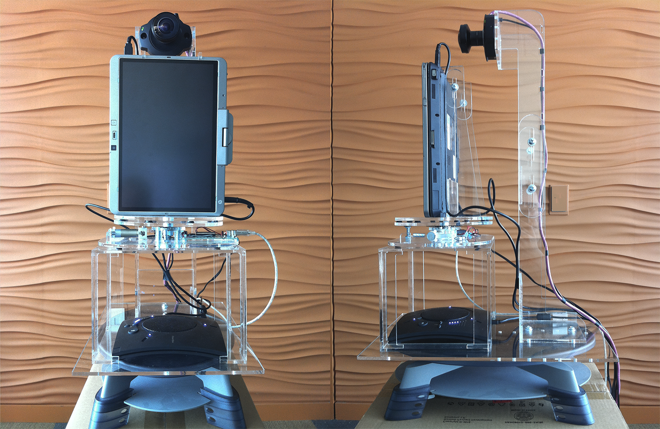
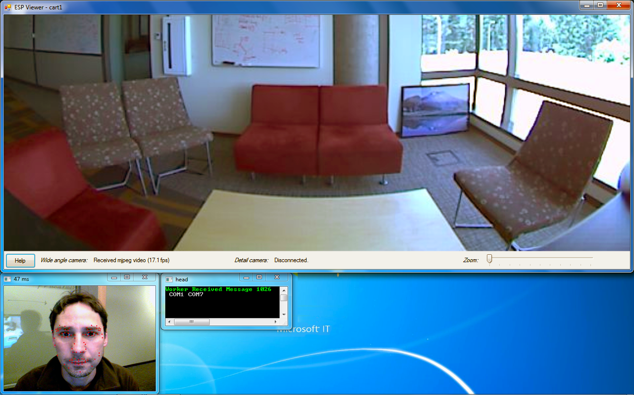
of 17
Notes:
We built a new proxy. At the top is a fixed-position wide-field camera. On the screen is a webcam. We wanted a simple design and experiment to isolate effects, so there’s only 1 DoF, a left-right swivel from this lazy-susan. At the bottom is a speakerphone. The proxy is positioned to match a seated eye height.

Slide 7
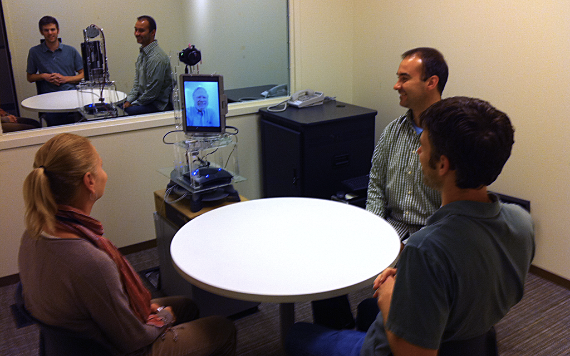
of 17
Notes:
Here you can see how left-right motion allows the remote participant to focus on different people during a meeting
The study had a total N of 18, made up of 6 groups of 3 locals with 1 ‘remote’ confederate. During the study, we always used the same confederate, which was Mara, not George as shown here. Each group was exposed to 3 gesturing conditions: no motion at all, explicit control, and implicit control.
Now I’ll show an overhead plan of this study and control room, to give you a better idea of the setup…

Slide 8
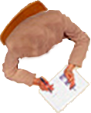


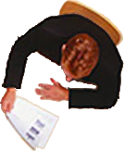
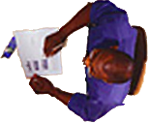
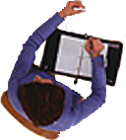
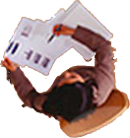
Control
Study
of 17
Notes:
Next, I’ll show a brief video of how the proxy looked while being operated…

Slide 9

of
of 17
Notes:
Note that because my head is turning, I’m not holding a direct gaze with the person screen is facing, but I’m looking slightly to the side. That’s an artifact of the widescreen we used, so that the user’s head would move enough to track.
But we also wanted to keep the type and amount of head motion consistent between conditions, especially the one where the screen didn’t move.

Slide 10
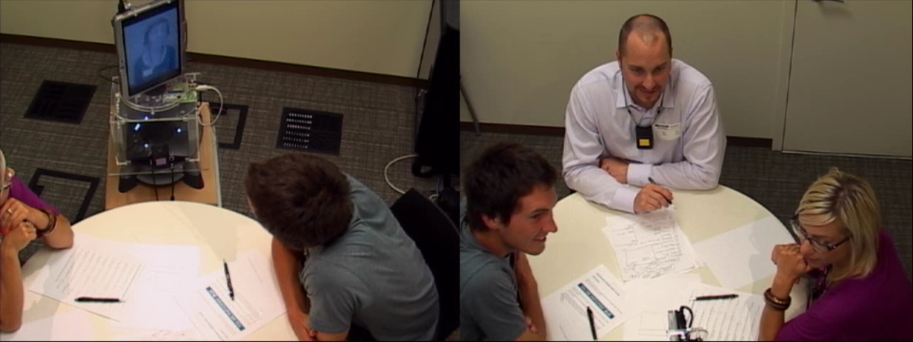
Procedure
3 activities, surveys during breaks, interview at end
Each was decision-making task with no right answer
of 17
Notes:
Here’s a view of the study in progress. These are 2 camera views of the same instant in time, 180 degrees across from each other.
We were careful to choose activities that required participants to look up and interact with each other. The activities were: to choose a place for the group to have dinner, select sites that an out-of-town friend should visit, and design a vanity license plate.

Slide 11
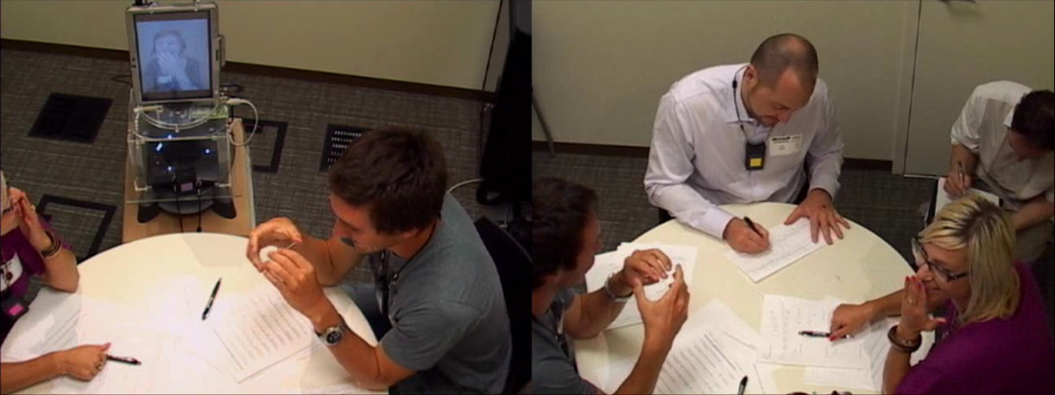
Measures
Subjective: 3 questionnaires, post-study interview
Objective: directed polling questions, sociometers
of 17
Notes:
For the polling, our confederate inserted directed questions in the conversation. So if the group was discussing where to have dinner, she’d ask ‘what’s your favorite restaurant?’ If she asked a follow-up to another person, we wouldn’t count it, because one person had already replied and the chance of being the correct person to answer was higher.
We used the sociometers to measure speech characteristics—including overall speaking time, speech energy, turn-taking and speech segment length. We found that the 2 motion conditions performed better than static condition for all of these, so there was significantly more conversational engagement, among locals but in particular, with the remote participant.
I like the way the 2 women are mirroring each other here.

Slide 12
Motion & Attention
Responses to directed polling prompts such as “what do you think?”
Condition
Percent of Responses
“Rotating made it more clear who the remote person was talking to.”
“When talking to other people, I couldn’t see her and felt excluded.”
Notes:
The vertical axis is the motion condition, and horizontal axis shows the responses. In the next 3 slides of charts, cool colors good, warm colors are bad.
Explicit probably performs better here because the remote user has a great deal of control over proxy motion. She can focus in on someone and stay there, with a bit more control than with implicit.
In person, turning to the side still reveals your face, and a general idea of what you can see. If you’re on a flat screen, turning to the side is closer to turning your back on someone. Also, it looks to the person you turn away from that you can’t see her anymore, even if you can.

Slide 13
Advantage: Explicit
I could easily tell when the remote person was talking directly to me
Condition
Percent of Responses
“There were less of the smaller subtle movements that I’d have to look up for and see where’s she looking now?”
Notes:
Explicit probably performs better here because of this quote.
We’re tracking movement. And people move a lot. If we look down to scratch our ankle, then our proxy also looks down at an ankle that isn’t there.
The issue here is that, all motion, even if it was just incidental, was read as communicative. And that increased effort to try to decipher what the remote really intended.

Slide 14
Advantage: Implicit
When did your group communicate best with the remote person?
Condition
Number of Responses
“The robotic movement added a degree of personality that was lacking in the (still) condition”
Notes:
Implicit probably performs better here because it does convey more natural movements, more personality.

Slide 15
Takeaways
Motion versus idle
  Better for projecting focus of attention and personality
  Has potential to be more exclusionary than in-person
Direct gazeline
  Proxy was able to project focus of attention without it
  Maybe not as relevant as for fixed conference displays
Notes:
(2) Even though the side-view gaze was exaggerated, projecting attention was much better in the motion conditions. We expect that this is what gave hub participants enough awareness of the satellite’s attention to include her in the conversation more often, which is what we were hoping regarding the skip-over effect. We still need a longer-term study to be sure this holds up over time.
(2) We didn’t remove the newscaster effect, but the movement of the display was effective enough that it wasn’t an issue.

Slide 16
Takeaways
Explicit control
  The remote operator found it easier to adjust to its use
Implicit control
  Provides greater sense of remote person’s personality
  But incidental motion is interpreted as communicative
Notes:
(2) After the study, our remote user Mara reported that during implicit control, she felt like she was using her head as an input device. Perhaps that’s part of it being a short-term study, but maybe gesture tracking isn’t as implicit as we had thought.

Slide 17
Design Implications
Actuated motion
  As nuanced as face-to-face, but with different ‘gotchas’
  Freedom from having to maintain direct gaze onscreen
Explicit interface
  More stable and easy to acclimate: but for novice user?
Implicit interface
  Track, but with a clutch; dwell time; recognize gestures
Notes:
(1) Gotchas include a tradeoff between attention and clarity. For example, in-person, typing on your phone, or not making eye contact with someone can be off-putting. But it’s like, expected during a remote conversation. But then, turning your screen to the side can be quite exclusionary, whereas turning your face is pretty normal.
(2) While it seems that being more stable and easy to acclimate, explicit control might be better for short-term users. But nothing comes for free. People don’t always have a hand on a mouse, and at those times, their behavior may seem rigid or inconsistent.
(2) But implicit seems so alluring, for the proxy to just work on its own. So we need to focus on making it work better.

Slide 18
Future Directions
Alternative ways motion can indicate attention
  Smaller gestures, maybe a ‘weathervane’ indicator
Alternative ways to represent a remote worker
  Face-forward view, more expressive, ability to point
Notes:
(1) We tried the weathervane with a small subset of participants, without telling them what it was, but they didn’t get it, and found the motion annoying.

Slide 19
Motion and Attention
In a Kinetic Videoconferencing Proxy
Don’t anthropomorphize computers. They hate that.

Slide 20
of 17
Notes:
Here’s the on-screen view that the remote participant saw.

