Slide 1
Differentially Private Aggregation of Distributed Time-Series
Vibhor Rastogi (University of Washington)
Suman Nath (Microsoft Research)

Slide 2
Participatory Data Mining
Untrusted
Aggregator
How many people visit google.com
and then visit yahoo.com on day i ?
google.com
private.com
hateBoss.com
Web History
Medical Info
GPS Traces
yahoo.com
likeBoss.com
espn.com
facebook.comfindDate.com
private.com
google.com
private.com
findGift.com
Alice
Bob
Charlie
Delta

Slide 3
Participatory Data Mining
Untrusted
Aggregator
How many people weigh > 200 pounds and have cholesterol > 80 in week i?
Week 10
Weight: 120
Cholesterol: 60
Web History
Medical Info
GPS Traces
Week 10
Weight: 120
Cholesterol: 60
Week 10
Weight: 120
Cholesterol: 60
Week 10
Weight: 120
Cholesterol: 60
Alice
Bob
Charlie
Delta

Slide 4
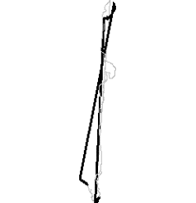
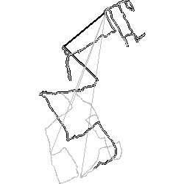
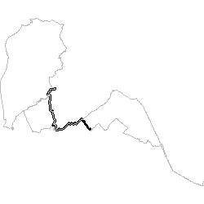
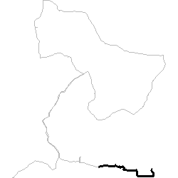
Participatory Data Mining
Untrusted
Aggregator
How many people take a particular route at 5 PM?
How many people take a particular route at 5:15PM?
…
Goal: Enable untrusted aggregator to query
users’ time-series data with formal privacy
Web History
Medical Info
GPS Traces
Privacy Concerns!
Alice
Bob
Charlie
Delta

Slide 5
Current State-of-the-art
Traffic Analyzer
How many people were at 148th Street & 36th Ave at 5PM?
Alice
Bob
Charlie
Delta

Slide 6
Current State-of-the-art
Traffic Analyzer
Trusted Server
How many people were at 148th Street & 36th Ave at 5PM?
Yes
No
No
Yes
Alice
Bob
Charlie
Delta

Slide 7
Current State-of-the-art
Noisy answer = 3.6
Traffic Analyzer
Trusted Server
How many people were at 148th Street & 36th Ave at 5PM?
Actual answer =2
Alice
Bob
Charlie
Delta
Formal Privacy achieved for right noise
Noise still small for a single query

Slide 8
Current State-of-the-art
Two Main Challenges
      1. Noise in each answer = O(# of queries)
      2. Trusted Server required
How many people at 148th Street & 36th Ave at 5PM?
Traffic Analyzer
Noisy answer = 3.6
Noisy answer = 203.6
How many people at 148th Street & 36th Ave at 5:15PM?
???
…
Trusted Server
At 5PM, were you at 148th Street & 36th Ave?
How many people at 148th Street & 36th Ave at 7AM?
Actual answer =2
Alice
Bob
Charlie
Delta
Formal Privacy achieved for right noise
Noise still small for a single query

Slide 9
Outline
Background: Differential Privacy
Challenge #1: Sequence of Queries
Challenge #2: No Trusted Server
Experimental Evaluation

Slide 10

Background: Differential privacy_{[Dwork} _{06]}
Name | Location | Time
….. | …. | ….
Smith | Building 99 | 5:00
Alice | 148 & 36 | 5:00
….. | …. | ….
How many in Bldng99 at 5?
Privacy
Algorithm
_{[Dwork 06]}
56 + Laplace Noise
Differential Privacy_{[Dwork 06]} : Output should be indistinguishable:
VS.
Name | Location | Time
….. | …. | ….
Smith | Building 99 | 5:00
Name | Location | Time
….. | …. | ….
Smith | Building 99 | 5:00
Alice | 148 & 36 | 5:00
Alice | 148 & 38 | 5:15
…. | …. | ….
  For a sequence of queries q₁,q_{2,}…,q_{N}
  Laplace random noise added to each query
  Worst case: noise has to increase linearly with N

Slide 11
Outline
Background: Differential Privacy
Challenge #1: Sequence of Queries
Challenge #2: No Trusted Server
Experimental Evaluation

Slide 12
Answering Sequence of Queries
Name | Location | Time
….. | …. | ….
Smith | Building 99 | 5PM
q₁ = # of people in 148th & Sr 520 at 5:00PM
q₂ = # of people in 148th & Sr 520 at 5:15PM
…
…
q_{N} = # of people in 148th & Sr 520 at 1:25AM
Name | Location | Time
….. | …. | ….
Smith | Building 99 | 5PM
Alice | 148th & Sr 520 | 5PM
Alice | 148th & Sr 520 | 5:15PM
…. | …. | ….
Alice | 148th & Sr 520 | 1:25AM
Standard algorithm_{[Dwork et. al. 06]} result in Θ(N) noise
Noise too large for long sequences!

Slide 13
Solution: Compress the sequence
Reduce effective N by compressing the sequence
Discrete Fourier Transform (DFT):
q₁,…,q_{N}
DFT
f₁,…,f_{N}
Inverse DFT
q₁,…,q_{N}
DFT-based Compression (NOT private):
q₁,…,q_{N}
DFT
f₁,..,f_{k},f_{k+1},..,f_{N}
Inverse DFT
q’₁,…,q’_{N}
f₁,..,f_{k},0,..,0
q’_{i} has some error compared to q_{i}
  Error is small if q_{i} has periodic nature
  k/N is the compression ratio

Slide 14
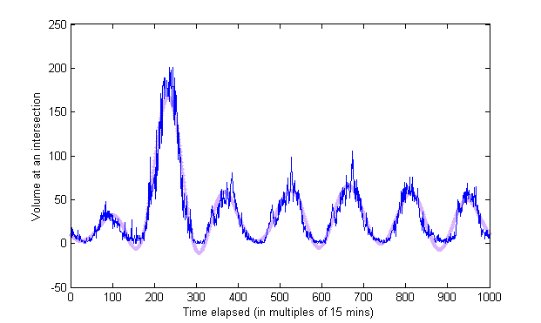
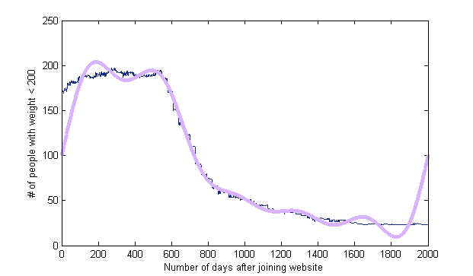
DFT-based Compression - Examples
k = 20
q_{i}
q_{i}’
N = 2000

Slide 15
DFT-based Compression - Examples
q_{i}’
q_{i}
k = 10
N = 2000
Day #

Slide 16
Our DFT-based Perturbation Algorithm
Perturbation error: O(N) to O(k)
  An improvement of k/N
Additional compression error often quite small
Our Algorithm
q₁,..,q_{N} f₁,..,f_{k}
Perturb ’f_{i}’ = f_{i} + noise
f₁',..,f_{k}',0,0,…,0 q’₁,…,q’_{N}
DFT
Inverse DFT
Main Result
Strong differential privacy achieved;
Error in q_{i}’ = O(k) + Compression error

Slide 17
Outline
Background: Differential Privacy
Challenge #1: Sequence of Queries
Challenge #2: No Trusted Server
Experimental Evaluation

Slide 18
No Trusted Server
No known efficient technique for distributed Laplace noise
Laplace noise = combination of Gaussian noise
Gaussian noise can be generated distributedly
Individual noise too small, = θ(total noise/m)
  Use cryptographic techniques to hide individual data despite small individual noise
Distributed Paillier Cryptosystem
Homomorphic encryption: add encrypted data
Threshold decryption: many private keys distributed among users
decryption requires a threshold # of users

Slide 19
Basic Protocol
Traffic Analyzer
How many were at 148th Street & 36th Ave at 5PM?
Alice
Bob
Charlie
Delta

Slide 20
Basic Protocol (Contd.)
Addition over encrypted data
Exploiting homomorphic property
E(sum) = E(user₁) * E(user₂) * …
Traffic Analyzer
Trusted Server
E(1+noise)
E(0+noise)
E(0+noise)
E(1+noise)
+noise
+noise
+noise
+noise
1
0
0
1
Alice
Bob
Charlie
Delta

Slide 21
Basic Protocol (Contd.)
Traffic Analyzer
E(sum)
Alice
Bob
Charlie
Delta

Slide 22
Basic Protocol (Contd.)
Finally combines all decryption
Exploiting threshold property
Sum=D₁[E(sum)] * D₂[E(sum)] * …
Traffic Analyzer
Each user partially decrypts
using her key
D₁[E(sum)]
D₂[E(sum)]
D₃[E(sum)]
D₄[E(sum)]
Alice
Bob
Charlie
Delta

Slide 23
One Tricky Challenge
During protocol, Encrypted aggregate sent back to the users
Alice’s data is breached
Third-party agent can be malicious
Traffic Analyzer
E(sum)
E(Alice’s Data)
D₁[E(Alice’s data)]
…
…
D₄[E(Alice’s data)]
Alice
Bob
Charlie
Delta

Slide 24
Outline
Challenge #1: Handling correlations
Challenge #2: No trusted Server
Experimental Evaluation
Conclusion

Slide 25
Experimental Evaluation
Implemented both solutions on
  2.8 GHz Intel Pentium PC with 1GB RAM
Evaluated:
  Accuracy improvement by Fourier perturbation
  Performance overhead in distributed noise-addition

Slide 26
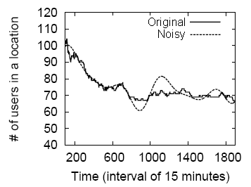
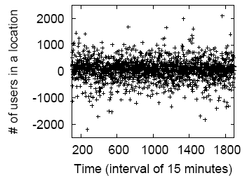
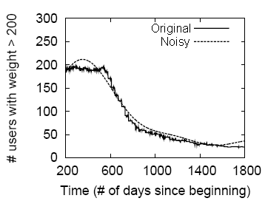
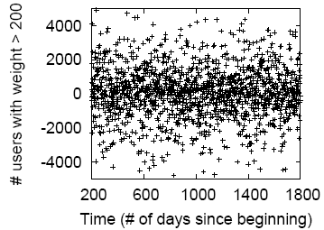
Fourier Perturbation: Real Datasets
GPS Traces
Source: Predestination _{[Krum et. al.} _{08]}
Fourier-based
Standard_{[Dwork et. al. 06]}
Weight Data
Source: hackers.com
Fourier-based
Standard_{[Dwork et. al. 06]}

Slide 27
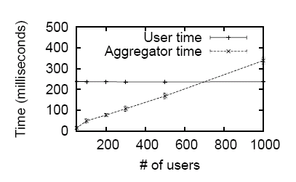
Distributed Noise Addition:
Performance Overhead
Computation Overhead
Space Overhead
  0.5 Kb for each user
  0.5 Kb/user for the aggregator

Slide 28
Conclusion
Participator Data Mining applications require
  Accurately answer sequence of queries
  Distributed noise-addition
We saw a solution based on
  Fourier compression & perturbation
  Cryptographic protocols

Slide 29
Backup slides

Slide 30
Current State-of-the-art
Two Main Challenges
Noise in each answer = O(# of queries)
Trusted Server required
Traffic Analyzer
Trusted Server
At 5PM, were you at 148th Street & 36th Ave?
At 5:15PM, were you at 148th Street & 36th Ave?
…
Yes
At 7AM, were you at 148th Street & 36th Ave?
No
No
No
Yes
No
No
Yes
Alice
Bob
Charlie
Delta
Formal Privacy achieved for right noise
Noise still small for a single query

Slide 31
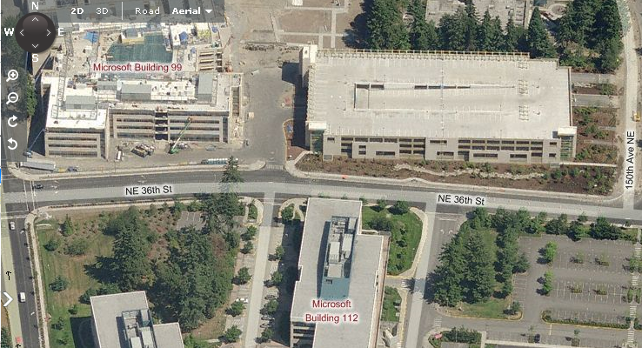
Two main challenges
Challenge #1: Correlations in Time-Series Data
Name | Age | Location | Time
Alice | 25 | Building 99 | 5 PM
Alice | 25 | 36th Street | 5:02 PM
Alice | 25 | Building 112 | 5:03 PM
Bob | 32 | Building 99 | 5:35 PM
Building 99
36th Street
Building 112
Lots of tuple correlations!
Current privacy techniques can’t handle tuple correlations!

Slide 32
Two main challenges
Challenge #2: No trusted server
Traffic Analyzer
Were you at 520 bridge at 5 PM?
Trusted Server
Users add noise individually
Yes
No
No
No
Yes
No
No
Yes
Alice
Bob
Charlie
Delta
Total error grows with # of users!

