Slide 1
Constructing Popular Routes from Uncertain Trajectories
Ling-Yin Wei¹, Yu Zheng², Wen-Chih Peng¹
¹National Chiao Tung University, Taiwan
²Microsoft Research Asia, China

Slide 2



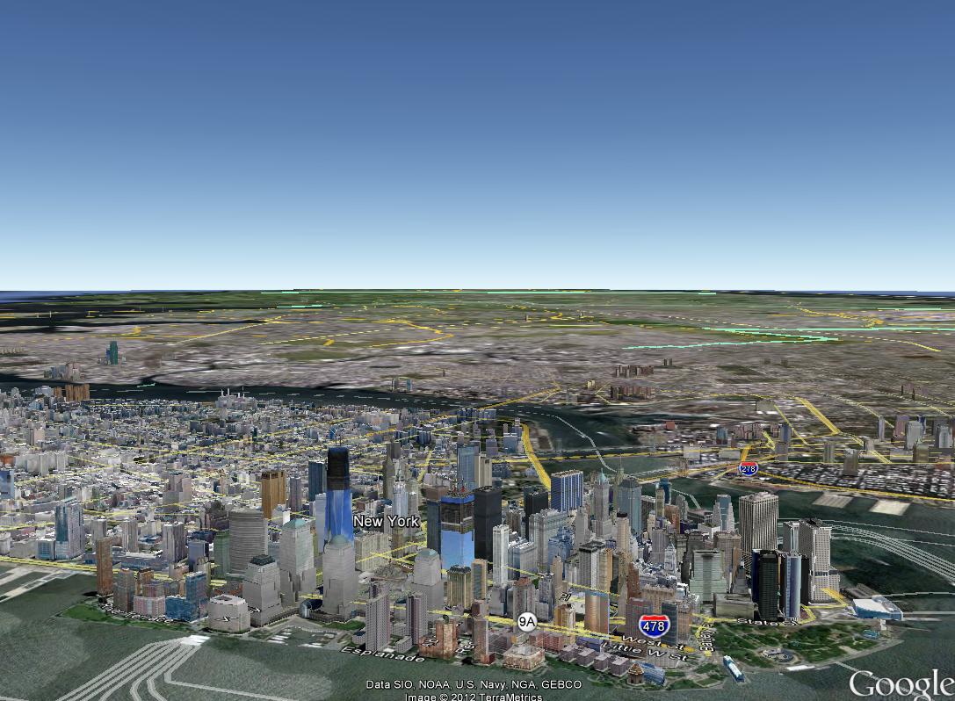




Introduction
GPS-enabled devices are popular
  E.g, GPS loggers, smart phones, GPS digital cameras etc.
Location-based services are popular
  Data: check-in records, geo-tagged photos etc.
    Spatial & temporal information
(40.7488,-73.9898), 11:23 AM

Slide 3
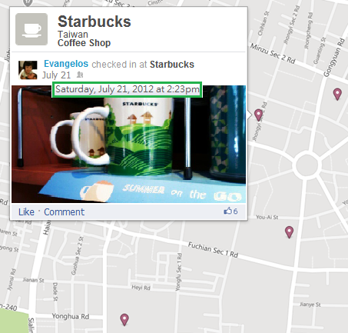
Uncertain Trajectory (1/3)
Check-in records
Geo-location
Time
(24.2331,120.89355)
Uncertain Trajectory

Slide 4
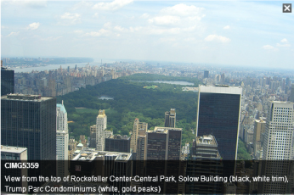
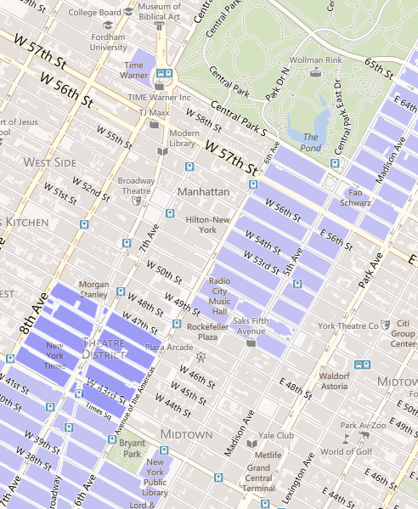




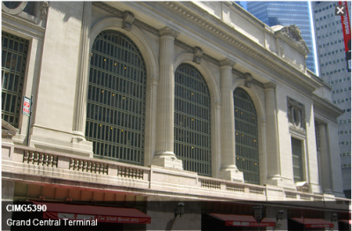

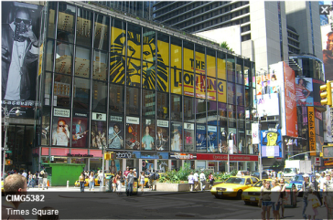

Uncertain Trajectory (2/3)
Geo-tagged photos
Apple Store
Rockefeller Center
Time Square
Grand Central Station

Slide 5
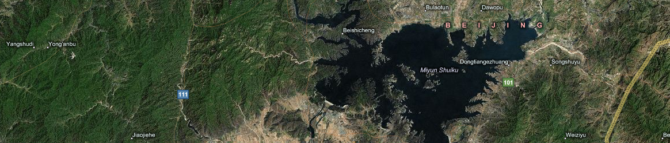
Uncertain Trajectory (3/3)
Trails of migratory birds

Slide 6
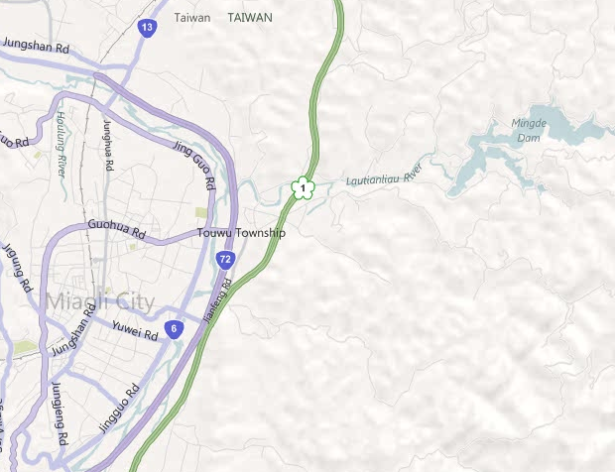
Problem Definition
Data
  Uncertain trajectories
User query
  Some locations & time constraint
q₁
q₂
Top 1 Popular Route
q₃

Slide 7
Application Scenarios
Trip planning
Advertisement placement
Route recovery

Slide 8
Using Collective Knowledge
Possible approach
  Concatenation
Ours
  Mutual reinforcement learning
• • •
• • •
• • •
q₁
• • •
q₁
• • •
• • •
• • •
• • •
• • •
• • •
• • •
• • •
• • •
• • •
• • •
• • •
q₂
q₂

Slide 9
Framework Overview
Routable graph construction (off-line)
Region: Connected geographical area
Edges in each region
Edges between regions
Routable Graph

Slide 10
Framework Overview
Routable graph construction (off-line)
Route inference (on-line)
q₁
Local Route Search
Global Route Search
q₂
q₃
Popular Route
Routable Graph

Slide 11
Region Construction (1/3)
Space partition
  Divide a space into non-overlapping cells with a given cell length
Trajectory indexing

Slide 12
Region Construction (2/3)
Region
  A connected geographical area
Idea
  Merge connected cells to form a region
Observation
  Tra₁ and Tra₂ follow the same route but have different sampled geo-locations
Spatially close
Temporal constraint

Slide 13

Region Construction (3/3)
Spatio-temporally correlated relation between trajectories
  Spatially close
  Temporal constraint
Connection support of a cell pair
  Minimum connection support C
Rule1
Rule2

Slide 14
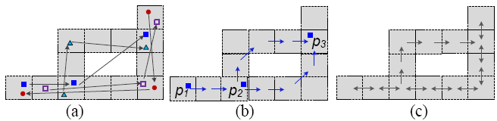
Edge Inference
[Edges in a region]
Step 1: Let a region be a bidirectional graph first
Step 2: Trajectories + Shortest path based inference
  Infer the direction, travel time and support between each two consecutive cells
[Edges between regions]
Build edges between two cells in different regions by trajectories

Slide 15


Route Inference
Route score (popularity)
  Given a graph , a route ,
  the score of the route is
  where
  and

Slide 16


Local Route Search
Goal
    Top K local routes between two consecutive geo-locations q_{i}, q_{i+1}
Approach
  Determine qualified visiting sequences of regions by travel times
  A*-like routing algorithm
    where a route
q₁
R₅
Sequences of Regions from q₁ to q₂:
R₁
q₂
R₁→ R₂ → R₃
R₁→ R₃
R₃
R₂
R₄

Slide 17
Global Route Search
Input
  Local routes between any two consecutive geo-locations
Output
  Top K global routes
Branch-and-bound search approach
  E.g., Top 1 global route
q₁
R₅
R₁
q₂
R₃
R₄
R₂
q₃

Slide 18
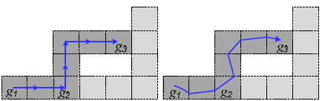
Route Refinement
Input
  Top K global routes: sequences of cells
Output
  Top K routes: sequences of segments
Approach
  Select GPS track logs for each grid
  Adopt linear regression to derive regression lines

Slide 19
Experiments
Real dataset
  Check-in records in Manhattan: 6,600 trajectories
  GPS track logs in Beijing: 15,000 trajectories
Effectiveness evaluation
  Routable graph: correctness of explored connectivity
  Inferred routes
    Error:
      T: top K routes (ours)
      T’: top K trajectories (ground truth)
Efficiency evaluation
  Query time
Competitor
  MPR [Chen et al., Discovering popular routes from trajectories, ICDE’11]

Slide 20
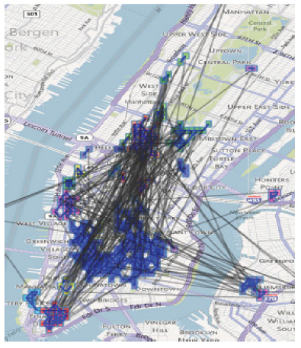
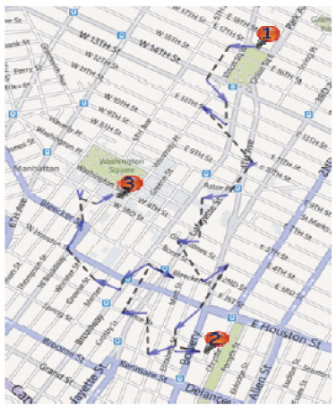
Results in Manhattan
Cell length: 500 m
Minimum connection support: 3
Temporal constraint: 0.2
Time span ∆t: 40 minutes
Routable Graph
Top 1 Popular Route
Union Square Park
Washington Square Park
New Museum of Contemporary Art

Slide 21
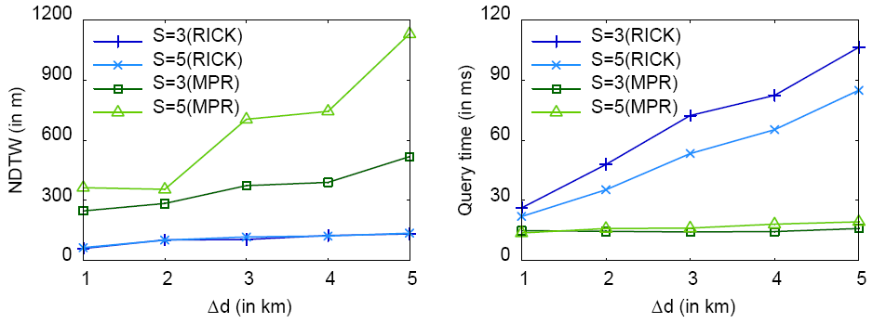
Performance Comparison
Competitor: MPR [Chen et al., Discovering popular routes from trajectories, ICDE’11]
Parameters
  |q|:2, K:1, cell length: 300 m
Factors
  sampling rate S (in minutes), query distance Δd

Slide 22
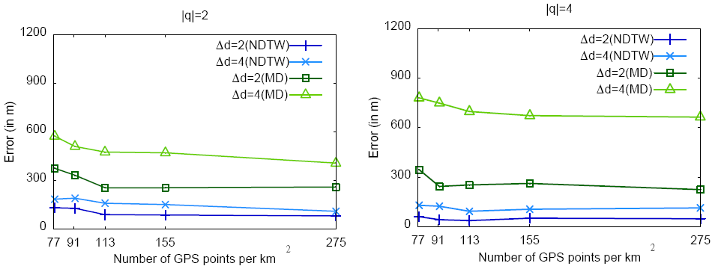
Impact of Data Sparseness
Parameters
  Cell length: 300 m
  K:3

Slide 23
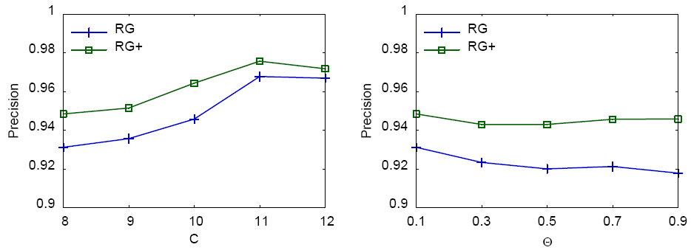
Evaluation of Graph Construction
Steps of graph construction
  RG: Region construction
  RG+: Region construction + Edge inference (Shortest path based inference)
Factors
  minimum connection support C, temporal constraint θ
Connectivity Accuracy
Connectivity Accuracy

Slide 24
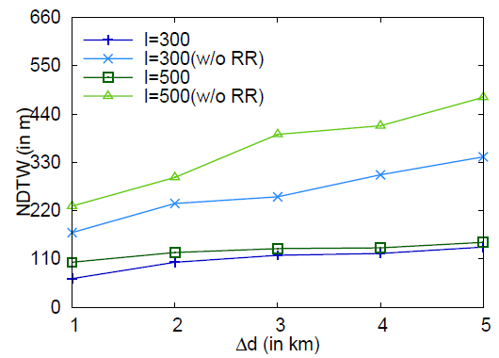
Effectiveness of Route Refinement
Parameters
  Sampling rate S: 5 minutes
  K:1
  |q|: 2

Slide 25
Conclusions
Developed a route inference framework without the aid of road networks
  Proposed a routable graph by exploring spatio-temporal correlations among uncertain trajectories
  Developed a routing algorithm to construct the top K popular routes
Future work
  Plan routes by considering time-sensitive factors
    Different departure times

Slide 26
Q & A
Thank You ☺

