Slide 1
Rex: Replication at the Speed of Multi-core
Zhenyu Guo, Chuntao Hong, Dong Zhou*, Mao Yang,
Lidong Zhou, Li Zhuang
Microsoft Research CMU*

Slide 2


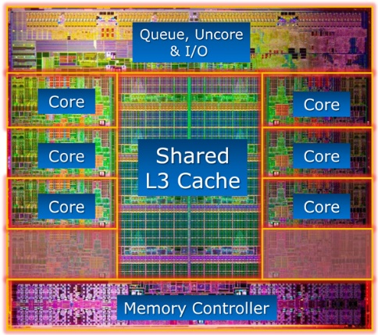




Tension between Replication and Multi-core
Most applications are multi-threaded
But, to replicate, you can only use single-thread
Sacrifices performance for replication
Replication
Database
Key-value Stores
Multi-core
File Server
Lock Server

Slide 3
Rex: Replication at the Speed of Multi-core
Replication
Multi-core

Slide 4
Outline
Motivation
System Overview
Implementation
Evaluation

Slide 5
State Machine Replication
To replicate a service:
  Model as deterministic state machine
  Order requests with consensus protocol
  Execute with single-thread
requests
Server
Server
Server
Server
Server
Sequential Execution Consistent States
Consensus
Server
Server
Server
Server
Parallel Execution
Inconsistent States
Server
Server
Server
Server
Server
Server
Multi-core

Slide 6
Why Multi-thread Breaks State Machine Replication
Non-deterministic decisions: locking order, etc…
Replicas make decisions independently
Performance
Consistency
Server 1
Server 2
Notes:
Let’s take a closer look at why…

Slide 7
Rex: Execute-Agree-Follow
Secondary
Primary
Traces
Traces
Consensus
Secondary
Traces
Execute
Agree
Follow
Notes:
The primary executes requests just like it does in a nonreplicated environment, except it collects traces. This minimizes the interference with the application, so that our system can achieve comparable performance with nonreplicated case.

Slide 8
Programming With Rex
Model app as RexRSM
Use Rex to make non-deterministic decisions
    RexLocks, RexCond, …
    RexTimeStamp, RexRand, etc.
Notes:
Rex APIs have the same semantics with their normal counterparts. So the programmer does not have to make too much change.

Slide 9
Outline
Motivation
System Overview
Implementation
Evaluation

Slide 10
Normal Execution: Primary
request 1
1
Trace:
(t1, 1, request 1)
…
Causal edge((t1, 3)->(t2, 2))
…
(t1, 4, reply 1)
...
…
lockA
2
request 2
1
unlockA
3
lockA
2
reply 1
4
3
unlockA
4
reply 2
Primary
Notes:
Use a logical clock to trace thread progress. Increases by one per event
Logs events, including causal edges
Then, transfer to secondary

Slide 11
Normal Execution: Secondary
1
request 2
(t1, 1, request 1)
…
Causal edge((t1, 3)->(t2, 2))
…
(t1, 4, reply 1)
...
…
request 1
1
2
lockA
lockA
2
unlockA
3
waited event
3
unlockA
reply 1
4
4
reply 2
Secondary

Slide 12
Primary Failover
Primary
  restart from checkpoint
  rejoin
Secondary
  upgrade to primary
  switch replay -> record
Committed
Uncommitted
Crash

Slide 13
Unique Challenges: Integrating Replication and Record/Replay
Inconsistency cut
“Holes” in logs
Causal edge pruning
Hybrid execution
…

Slide 14
The Inconsistent Cut Problem
Collects logs at each thread asynchronously
Inconsistent cut contains destination nodes without source node
Problem: not be able to follow

Slide 15
Solving Inconsistent Cut Problem
Define consensus on last consistent cut
Drop C1-C2 when primary fail
Reply only when reply contained in a committed consistent cut
  Use vector clock to track

Slide 16
Outline
Motivation
System Overview
Implementation
Evaluation

Slide 17
Experiment Setup
Real-world Applications
Micro-benchmark: for lock contention ratio
Servers: 12-core, 24-thread, 10GE network
App | Description
Thumbnail | Generating and storing thumbnails
XLock | Lock server similar to Chubby
File Server | File server
Kyoto Cabinet | Key-value store
LevelDB | Local storage behind BigTable
MemCached | Cache server

Slide 18
Performance Overview
Rex scales as nonreplicated
<24% overhead

Slide 19
LevelDB in Detail
overhead drops with more threads to schedule
Waited events grows with # threads, so does overhead
# cores

Slide 20
Lock Conflict Ratio
Overhead < 15%

Slide 21
Summary
Rex: execute-agree-follow
Applied to six real-world applications
Preserves scalability and low overhead

Slide 22
Thanks!
Q&A

Slide 23
Backups

Slide 24
Dealing with Data Races
Reply logging & compare
Resource version checking
Lock-free data structures: NATIVE_EXEC
Experience shows that getting rid of data races is doable

Slide 25
Workloads
Thumbnail:
  1 pic per request
K-V stores:
  1M pairs
  16 byte key, 100 byte value
  10% write
File system:
  16KB random requests
  20% write
Xlock:
  90% lease renew
  100B – 5KB file

Slide 26
Lock Granularity

Slide 27
Request Granularity
10% computation in locks
1% conflict ratio

Slide 28
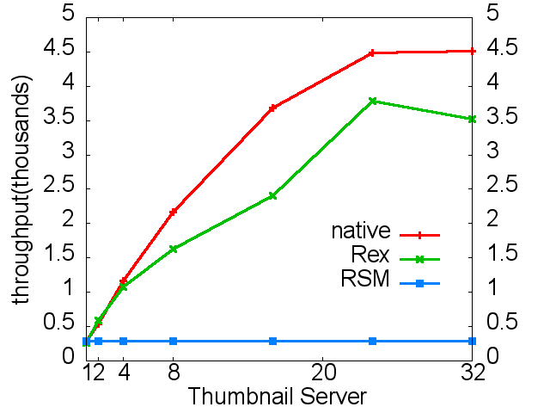
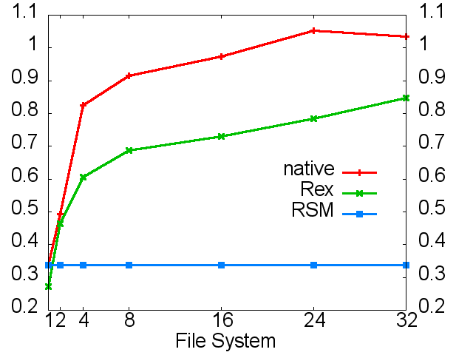
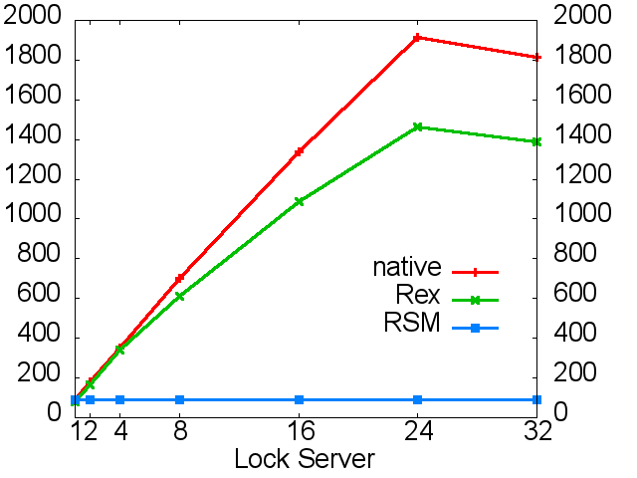
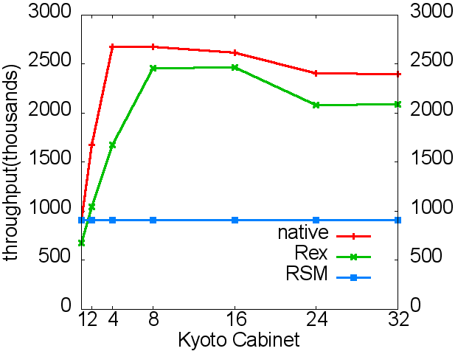
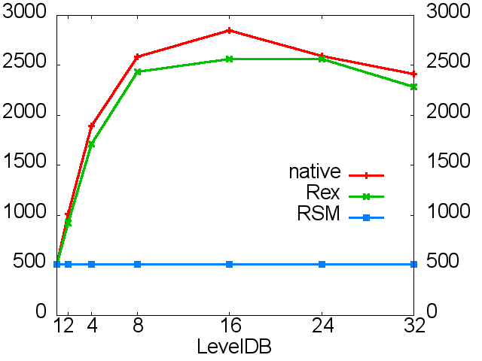
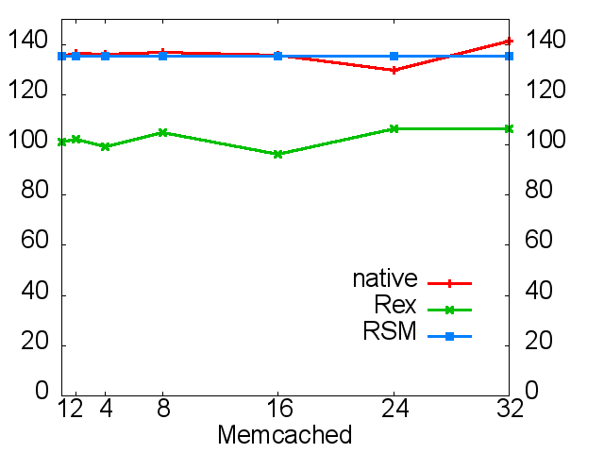
Experimental Results: Scalability

Slide 29
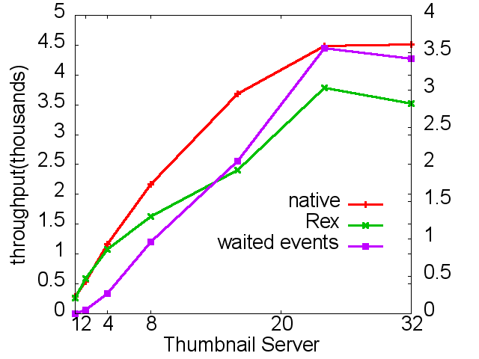
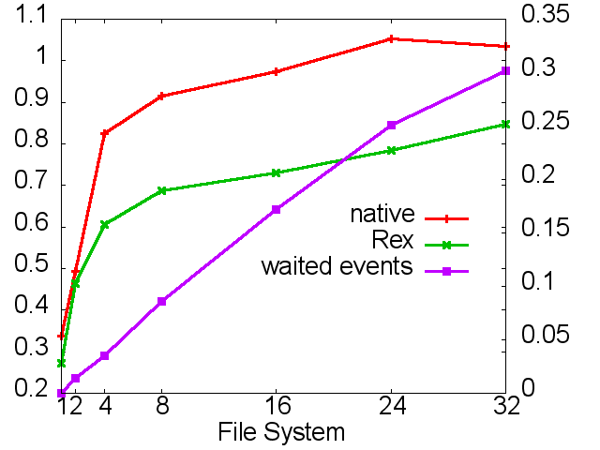
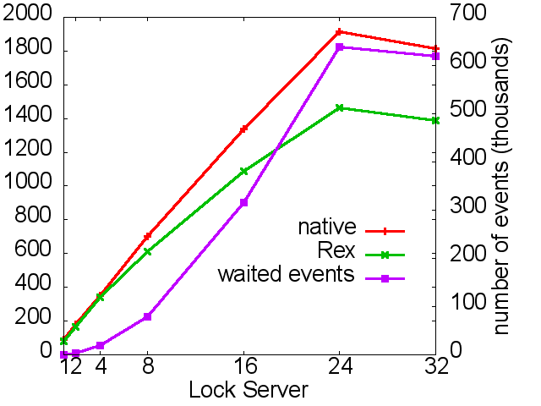
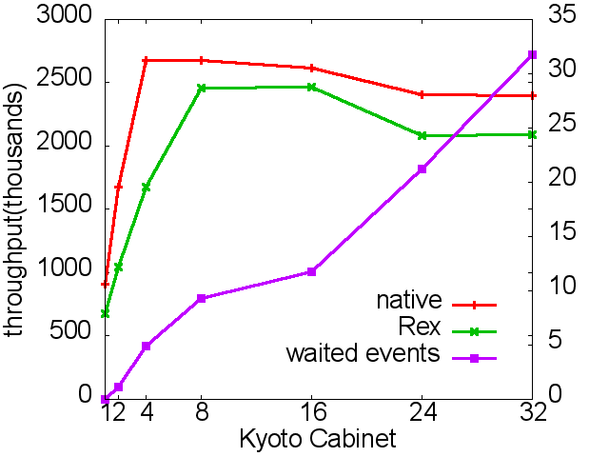
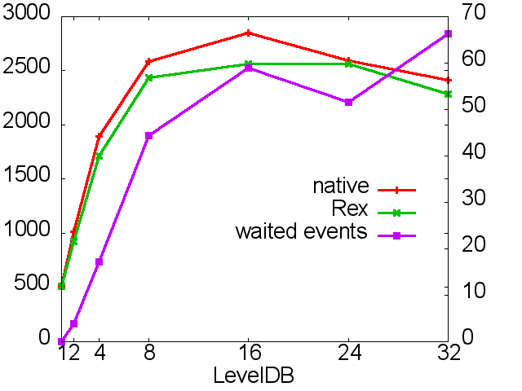
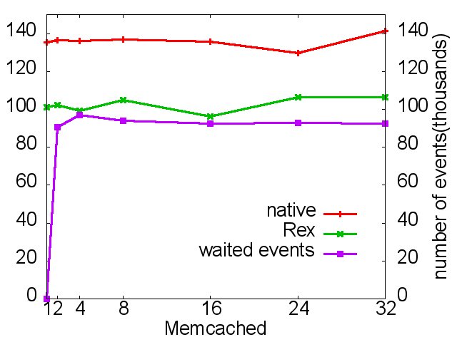
Causal Events & Performance

Slide 30
Improving Performance: Causal Edge Pruning with Vector Clock
More causal edges, more overhead
Causal edge pruning: trades primary performance for secondary
Reduces 58% ~ 99% causal edges

Slide 31
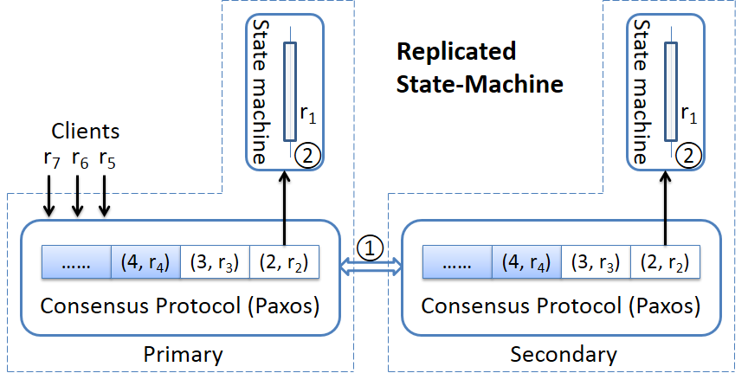
Replicated State Machine

Slide 32
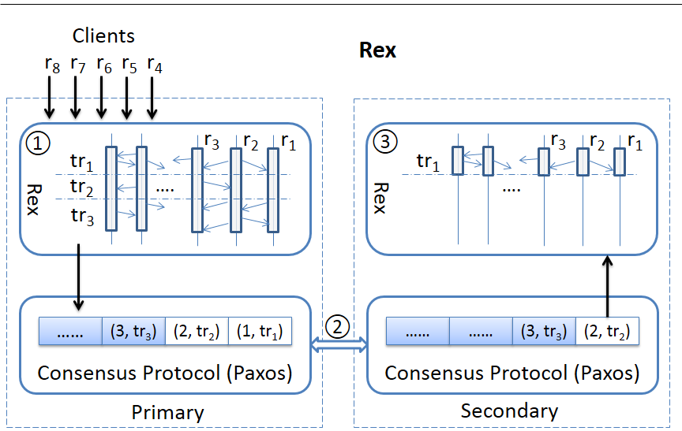
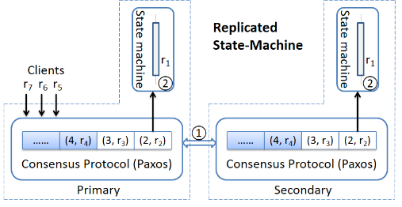
Rex: Causal Order Replication

Slide 33
Correctness
Correctness guaranteed by:
  Captures all non-determinism with Rex
  Consensus on traces
  Agreed trace is a continuous sequence (no holes)
Notes:
Determinism: same state + same trace = same output state
Prefix: ensures correctness when switch

Slide 34
Inconsistent Cut: Why Is It Bad?
Trace: t1 unlock -> t2 lock -> t2 unlock -> t3 lock reply: 0
Replay: t1 unlock -> t3 lock -> t3 unlock -> t2 lock reply: 1
Should we reply 0 or 1?

Slide 35
Inconsistent Cut:
Solving the Reply Problem
Reply only when reply and all its dependencies are committed
Use a vector clock to detect

