Slide 1
Two for the Price of One:
A Model for Parallel and
Incremental Computation
Sebastian Burckhardt, Daan Leijen, Tom Ball
(Microsoft Research, Redmond)
Caitlin Sadowski, Jaeheon Yi
(University of California, Santa Cruz )

Slide 2
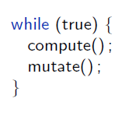
Motivation: Compute-Mutate Loops
Deterministic
No I/O
Potentially Parallel
Nondeterministic
I/O
Common pattern in applications
(e.g. browser, games, compilers, spreadsheets, editors, forms, simulations)
Goal: perform better (faster, less power)
Notes:
Start with the motivation: compute-mutate loop, a common pattern in applications
Browser : layout for CSS , mutate changes DOM (script, user)

Slide 3
Incremental
Computation
Parallel
Computation
input
input
input’
Computation
Computation
Computation
Computation
Computation’
output
output’
output
Which one would you choose?
Do we have to choose?
Notes:
Two ideas
Incremental computation
Which one would you pick?
- Neither one is easy
No Amdahl’s law
Power much better

Slide 4
Incremental + Parallel
Computation
input
Self-Adjusting Computation: Dynamic Dependence Graph
Computation
Computation
Computation
Work Stealing: Dynamic Task Graph
Computation
Computation
Computation
output
Notes:
Self-adj comp
Dynamic Dependence Graph
Work-Stealing
Dynamic Task Graph

Slide 5
Two for the Price of One
input
? Small set of primitives to express computation ?
output
Wanted: Programming Model for
Parallel & Incremental Computation

Slide 6
Compute-Mutate Loop Examples
 | Compute - Deterministic - May be parallel - No I/O | Mutate - Nondeterministic - I/O
Browser | CSS Layout | DOM changes
Ray-Tracer | Render Picture | Change objects
Morph | Compute Blend | Change blended pictures
Compiler | Compile project | Edit source files
Spellcheck | Check words | Change document

Slide 7
Our Primitives: fork, join, record, repeat
Start with Deterministic Parallel Programming
  Concurrent Revisions Model
  fork and join Revisions (= Isolated Tasks)
  Declare shared data and operations on it
Add Primitives for record and repeat
  c = record { f(); } for some computation f()
  repeat c is equivalent to calling f() again, but faster
  the compute-mutate loop does
  record – mutate – repeat – mutate – repeat …

Slide 8
Concurrent Revisions Model
[OOPSLA ‘10]
[ESOP ‘11]
[WoDet ‘11]
x.Set(1)
0
1
1
Deterministic Parallelism
by fork and join
(creates concurrent tasks called revisions)
Revisions are isolated
  fork copies all state
  join replays updates
Use optimized types
(copy on write, merge functions)
fork
1
1
1
1
fork
1
1
1
1
1
1
1
1
1
1
1
x.Set(2)
1
1
x.Add(3)
1
2
1
2
4
1
2
4
1
2
4
1
2
4
join
2
4
2
4
2
4
2
4
join
5
5

Slide 9
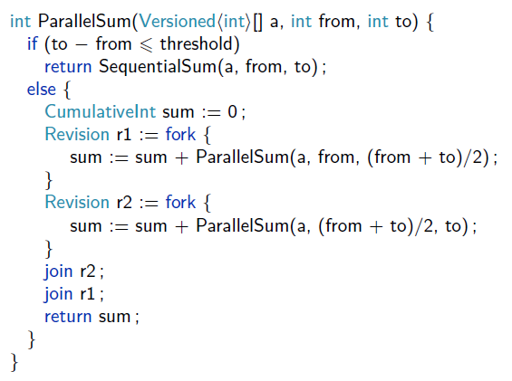
Example: Parallel Sum

Slide 10
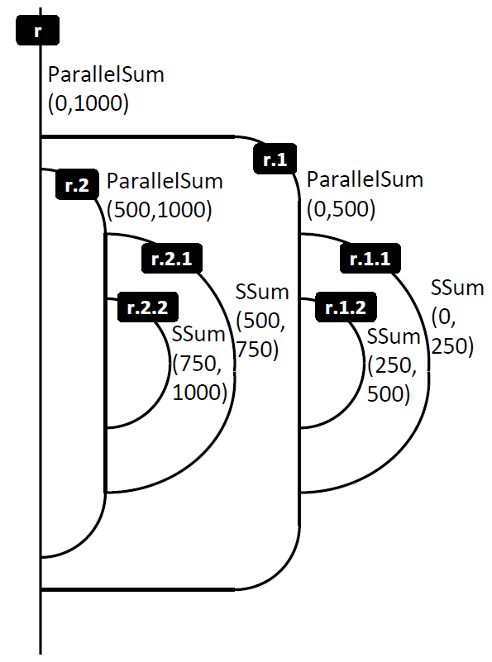
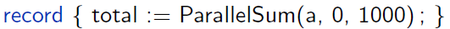
Example
Step 1: Record

Slide 11
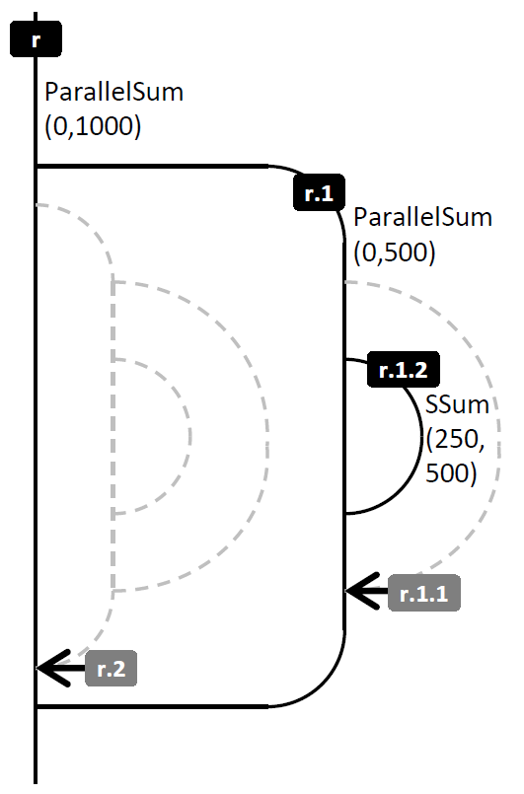


Example (Cont’d)
Step 2: Mutate
Step 3: Repeat

Slide 12
How does it work?
On Record
  Create ordered tree of summaries (summary=revision)
  Revisions-Library already stores effects of revisions
    Can keep them around to “reexecute” = join again
  Can track dependencies
    Record dependencies
    Invalidate summaries
    At time of fork, know if valid
r
r1
r2
r1.1
r1.2
r2.1
r2.2

Slide 13
Illustration Example
Consider computation shaped like this
(e.g. our CSS layout alg. with 3 passes)
r1.1
r1.2
r1
r2.1
r2
r2.2
c = record {
pass1();
pass2();
pass3();
}
reads x
r1.1
r1.2
r
r1
r2.1
r2
r2.2
r1.1
r1.2
r1
r2.1
r2
r2.2

Slide 14
Illustration Example
Consider computation shaped like this
(e.g. our CSS layout alg. with 3 passes)
r1.1
r1.2
r1
r2.1
r2
r2.2
c = record {
pass1();
pass2();
pass3();
}
x = 100;
r1.1
Dep. on x
r1.2
r
r1
r2.1
r2
r2.2
r1.1
r1.2
r1
r2.1
r2
r2.2

Slide 15
Illustration Example
Consider computation shaped like this
(e.g. our CSS layout alg. with 3 passes)
r1.1
r1.2
record
repeat
r1
r2.1
r2
r2.2
c = record {
pass1();
pass2();
pass3();
}
x = 100;
repeat c;
r1.1
r1.2
r
r1
r2.1
r2
r2.2
r1.1
r1.2
r1
r2.1
r2
r2.2

Slide 16
Illustration Example
Consider computation shaped like this
(e.g. our CSS layout alg. with 3 passes)
r1.1
r1.2
record
repeat
r1
r2.1
r2
r2.2
c = record {
pass1();
pass2();
pass3();
}
x = 100;
repeat c;
r1.1
r1.2
r
r1
r2.1
r2
r2.2
r1.1
r1.2
r1
r2.1
r2
r2.2

Slide 17
Illustration Example
Consider computation shaped like this
(e.g. our CSS layout alg. with 3 passes)
r1.1
r1.2
record
repeat
r1
r2.1
r2
r2.2
c = record {
pass1();
pass2();
pass3();
}
x = 100;
repeat c;
r1.1
r1.2
r
r1
r2.1
r2
r2.2
r1.1
r1.2
r1
r2.1
r2
r2.2

Slide 18
Illustration Example
Consider computation shaped like this
(e.g. our CSS layout alg. with 3 passes)
r1.1
r1.2
record
repeat
r1
r2.1
r2
r2.2
c = record {
pass1();
pass2();
pass3();
}
x = 100;
repeat c;
r1.1
r1.2
r
r1
r2.1
r2
r2.2
r1.1
r1.2
r1
r2.1
r2
r2.2

Slide 19
Invalidating Summaries is Tricky
May depend on external input
  Invalidate between compute and repeat
May depend on write by some other summary
  Invalidate if write changes
  Invalidate if write disappears
Dependencies can change
  Invalidate if new write appears between old write and read
And all of this is concurrent

Slide 20
Who has to think about what
Our runtime
The programmer
Detects nature of dependencies
  Dynamic tracking of reads and writes
Records and replays effects of revisions
Schedules revisions in parallel on multiprocessor
(based on TPL, a work-stealing scheduler)
  Explicitly structures the computation (fork, join)
Declares data that participates in
  Concurrent accesses
  Dependencies
Thinks about performance
  Revision granularity
  Applies Marker Optimization

Slide 21
Optimizations by Programmer
Granularity Control
  Problem: too much overhead if revisions contain not enough work
  Solution: Use typical techniques (e.g. recursion threshold) to keep revisions large enough
Markers
  Problem: too much overhead if tracking individual memory locations (e.g. bytes of a picture)
  Solution: Use marker object to represent a group of locations (e.g. a tile in picture)

Slide 22
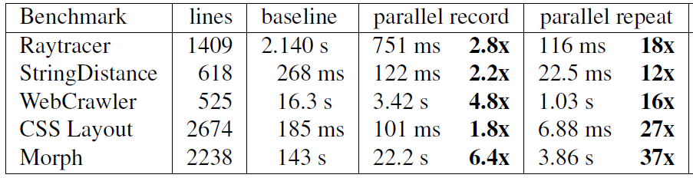
Results on 5 Benchmarks
On 8 cores,
  recording is still faster than baseline (1.8x – 6.4x)
  Repeat after small change is significantly faster than baseline (12x – 37x)
  Repeat after large change is same as record

Slide 23
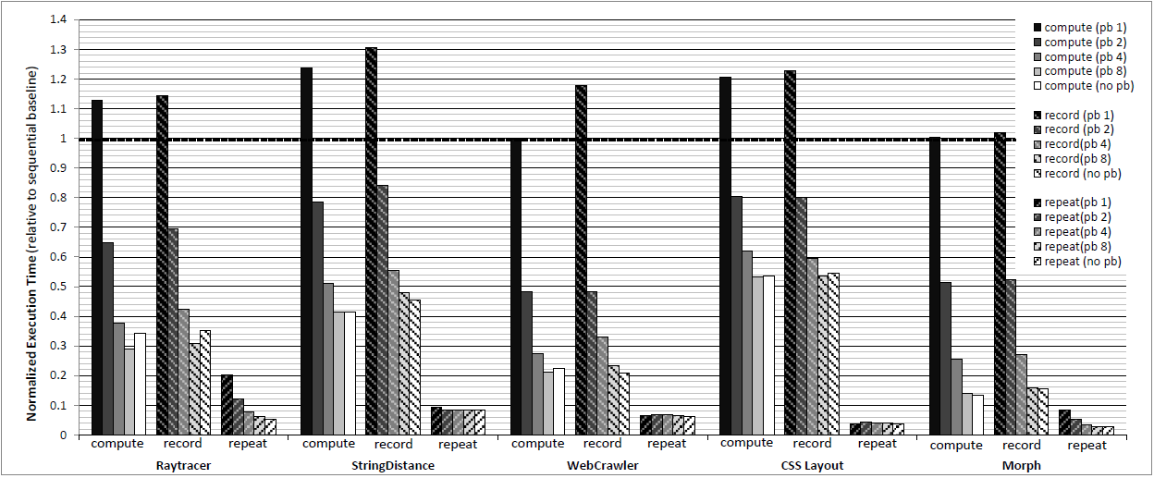
What part does parallelism play?
Without parallelism, record is up to 31% slower than baseline
Without parallelism, repeat after small change is still 4.9x – 24x faster than baseline

Slide 24
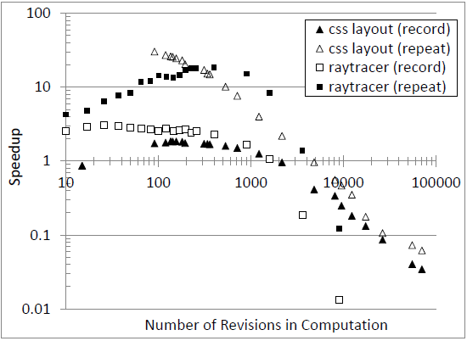
Controlling Task Granularity is Important

Slide 25
Contributions
Philosophical
  Connect incremental and parallel computation
Programming Model
  Concurrent Revisions + record/repeat
Algorithm
  Concurrent summary creation, invalidation, replay
Empirical
  Implement C# Prototype
  Measure on Examples
  Identify Important Optimizations

Slide 26
Thank You!

