Slide 1
SmartAds:
Bringing Contextual Ads to Mobile Apps
Suman Nath, Microsoft Research
Felix Xiaozhu Lin, Rice University
Lenin Ravindranath, MIT
Jitu Padhye, Microsoft Research

Slide 2
Mobile Apps and Ads
Ad spending proportional to time spent
Mobile is an exception
1.8x Web
In 2012
Sources: VSS, Mary Meeker (KPCB), ComScore, Alexa, Flurry

Slide 3

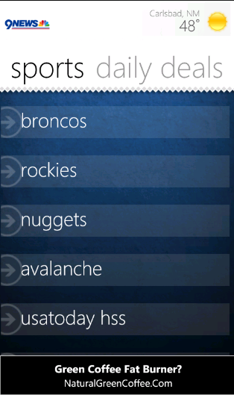
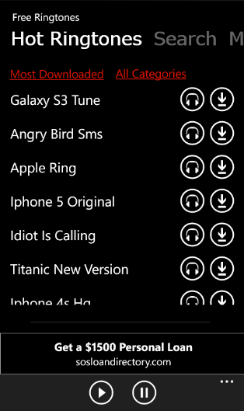
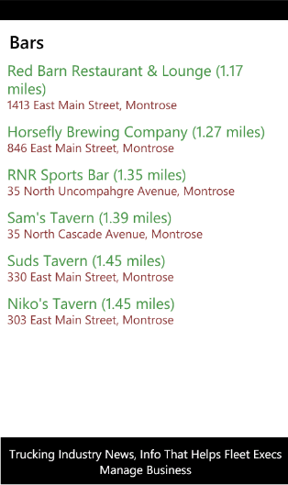

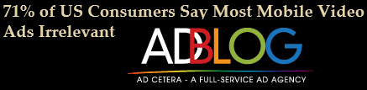
Consumers say mobile ads are “irrelevant”
“Spray and pray” ads just don’t cut it on mobile
Green coffee
Personal Loan
Trucking industry

Slide 4
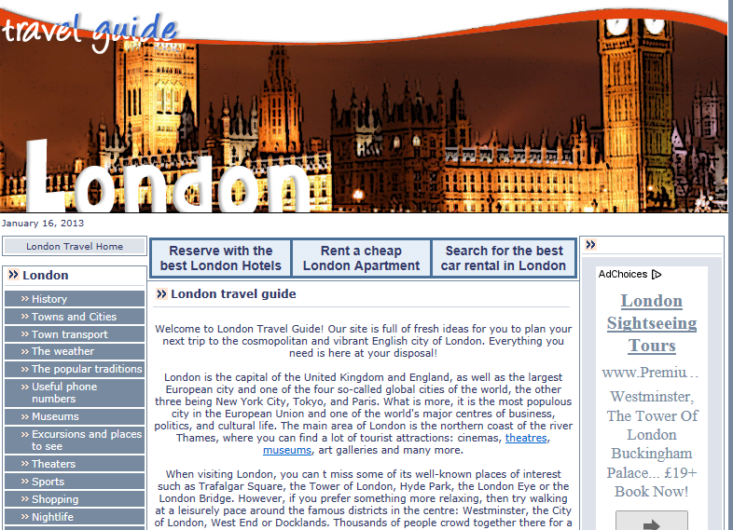
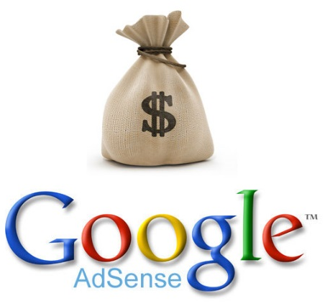


Contextual Ads on the Web

Slide 5
Enabling Contextual Ads
On Web
Advertising network crawls Web pages
Extracts advertising keywords offline
Use URL → keywords mapping online
On Mobile Apps
Offline crawling of data inside app is challenging
Need to run/interact with apps for Cloud data
Data may change with location and time
Online keyword extraction
(in client-server) is tricky
Accuracy, efficiency, and privacy trade-offs

Slide 6
Our goal: In-app Contextual Ad
Ringtone ads
Sports ads
Bars ads

Slide 7
Outline
Does contextual ads make sense for mobile apps?
  Measurements with 1200 Windows Phone Apps
How can we enable it?
  SmartAds system
How effective is contextual advertising?
  User study and measurements

Slide 8


Measurement Methodology
Are there prominent keywords in app pages that match available ads in ad network?
Phone
Advertising Keyword Extractor
App
Page
Data
Page data
keywords
Salon, Haircut
Top 1200 non-game Windows Phone apps (from overall top 2000)
One week bidding keywords trace from Microsoft’s ad network

Slide 9
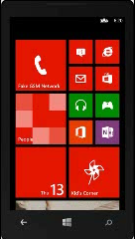

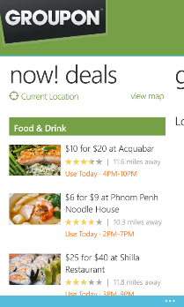
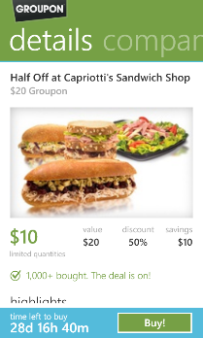
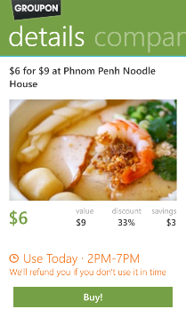
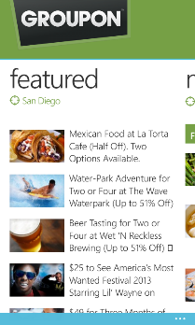


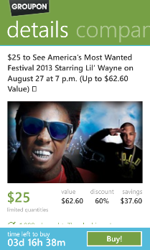

PhoneMonkey
Phone Monkey
Automatically runs and explores apps
Scrapes any data shown to user

Slide 10
Keywords in PageData
Half the apps have >20 keywords
PageData is a good source of ad keywords
  Contextual advertising has good potential

Slide 11
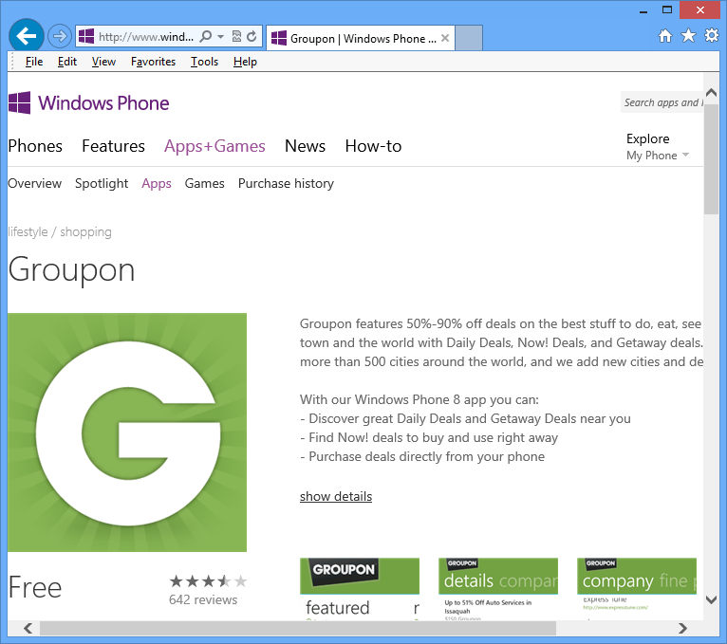
Is MetaData Good Enough?
85% apps have more keywords in PageData
PageData
(PhoneMonkey)
MetaData
(App Store)
PageData has more keywords than MetaData
PageData-based targeting has more potential than MetaData-based targeting

Slide 12
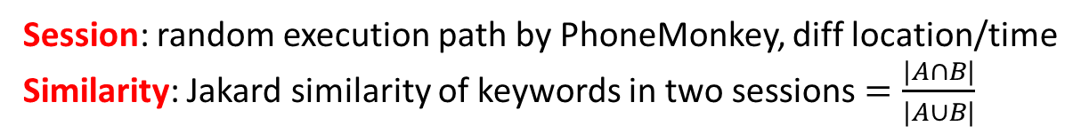
PageData Dynamics
Session: random execution path by PhoneMonkey, diff location/time
Similarity: Jakard similarity of keywords in two sessions $=\frac{|A∩B|}{|A∪B|}$
Half the apps have session similarity < 0.55
Page data is dynamic
Need online keyword extraction

Slide 13
Outline
Does contextual ads make sense for mobile apps?
  Extract keywords from PageData, during run time
How can we enable contextual ads in apps?
  SmartAds system
How effective is contextual advertising?
  User study and measurements

Slide 14



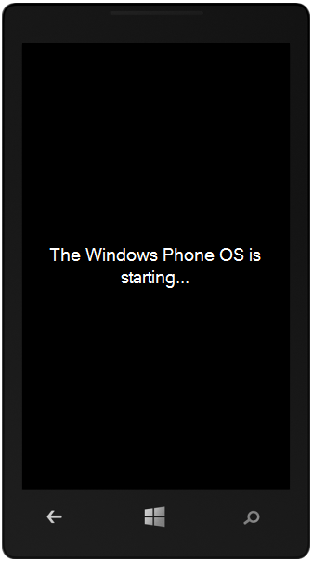

SmartAds
App → keywords
Offline Crawling
(Ad, keyword) inventory
Salon service
ads
details, haircut, up, to, salon, ..
Ad Control
Online Keyword extraction
SmartAds Server

Slide 15
SmartAds Goals
Accurate: ads relevant to page content
Efficient: small memory and network overhead
Private: don’t send sensitive page data out
Impossible to maximize all in a client-server design [Hardt, CCS’13]

Slide 16


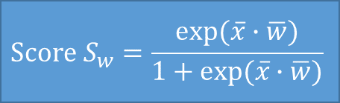
Accuracy
Use state-of-the-art ad-keywords extractor KEX
[Yih, WWW’06]
(See paper for our extensions)
Weight vector $\overline{w}$
0.4
0.2
0.3
0.7
Feature vector $\overline{x}$
PageFrequency
$$Score S_{w}=\frac{exp⁡(\overline{x}∙\overline{w})}{1+exp⁡(\overline{x}∙\overline{w})}$$
For each word:
Capitalization
FontSize
BidFrequency
Salon services, haircut

Slide 17
Where to extract keywords?
Do in phone?
  Large memory footprint: ~100 MB dictionary of bidding keywords
Do in Server?
  Bad privacy: send page content to Cloud
  ~5KB network bw per page
We do partly in phone, partly in server
  Achieve a reasonable balance
Server
Accuracy
Phone
Efficiency
Privacy

Slide 18
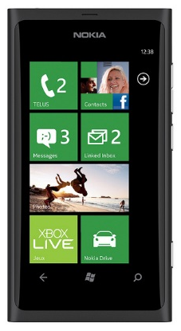

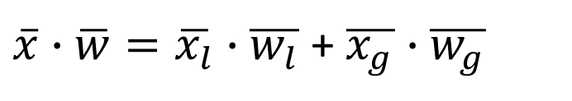
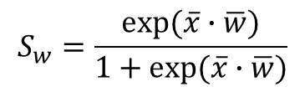
Accuracy + Memory efficiency
$$S_{w}=\frac{exp⁡(\overline{x}∙\overline{w})}{1+exp⁡(\overline{x}∙\overline{w})}$$
Partition the scoring function
  Dot product is partitionable
Bidding
Frequency
FontSize
Bidding
Database
Feature vector
Weight vector
$\overline{x}∙\overline{w}=\overline{x_{l}}∙$ $\overline{w_{l}}$ + $\overline{x_{g}}∙$ $\overline{w_{g}}$

Slide 19
Accuracy + Memory efficiency + Communication Efficiency + Privacy
Phone drops words that cannot be keywords
Local Pruning
Bloom filter
Phone drops word if local weight is too small
Correctness guarantee, with bounded weight and feature values
Phone maintains a filter with bidding keywords
Drop words if not in the filter

Slide 20
Bloom Filter Challenges
Bloom filter size
  Memory overhead at client
Update on keyword changes
  Network overhead at client
False positives
  Accidental leak of non-keywords
Analyze Microsoft’s ad network
Size: <2MB
Update: > 4 months
Use one-way hash

Slide 21
Outline
Does contextual ads make sense for mobile apps?
  Measurements with 1200 Windows Apps
How can we enable it?
  SmartAds system
How effective is SmartAds?
  User study and measurements

Slide 22
Performance measurement
Prototype implemented for Windows Phone (client) and Windows Azure (server)
Performance measured on a Samsung Focus phone
CPU | 50ms at client, <1ms at Server
Memory | 2.8 M
Network | <100 bytes
Battery | negligible

Slide 23
User study of relevance
User study: 80 users, 5000 ad impressions

Slide 24
Conclusion
In-app contextual ad is promising but challenging
SmartAds enables it with practical balance between accuracy, efficiency, and privacy
In practice, combine with context-aware targeting and behavioral targeting
More general than ads: Online keyword extraction can give valuable information about user’s context

Slide 25
Thank you
Questions?

Slide 26
Developer-provided keywords?
Developers can provide targeting keywords, but
  SmartAds automate the process
  Developer may fail to provide good keywords if contents change often
Ad network often ignores developer-provided keywords
  Due to keyword-spamming

Slide 27
Privacy
Privacy is at odds with targeting; but we give some privacy by local pruning and one-way hash
“Choose two of three: targeting, efficiency, and privacy” [Hardt CCS’13]
Existing works (based on PIR, crypto, differential privacy) can be used with SmartAds

Slide 28
Tail Bidding Keywords
SmartAds keeps 90% bidding keywords in Bloom filter
Remaining keywords can be served
  By serving when related keywords match Bloom filter
  By prioritizing them when no keywords in page
  By serving even if they dont match contextual signal
SmartAds
  Can be used without Bloom filter
  and with other signals: location and behavor

Slide 29
Frequently Asked Questions
What about Android phones and iPhones?
  Solution will work. No evaluation yet.
Why can’t apps/developers provide keywords?
  Too much work. They may not know the right keywords. Ad networks typically ignore them.
What if no keywords in a page (e.g., games)?
  Use keywords from app or related keywords or use other signals
Client Privacy?
  Use existing work [Hardt CCS’13]; (privacy at odds with relevance)
Is contextual ad alone going to be 80% effective?
  Probably not. Combine with location and behavior.
Is SmartAds used in real system?
  Currently in the process.

Slide 30
Optimizations
Lack of texts in a page
  Use keywords from other pages in the app
  Use other signal such as location and past behavior
Related keywords
  Extend keywords with related keywords
  {LED TV} -> {LED TV, HDTV, LCD TV}
    Use Bing search click logs
    Use the service :http://veryrelated.com

