Slide 1
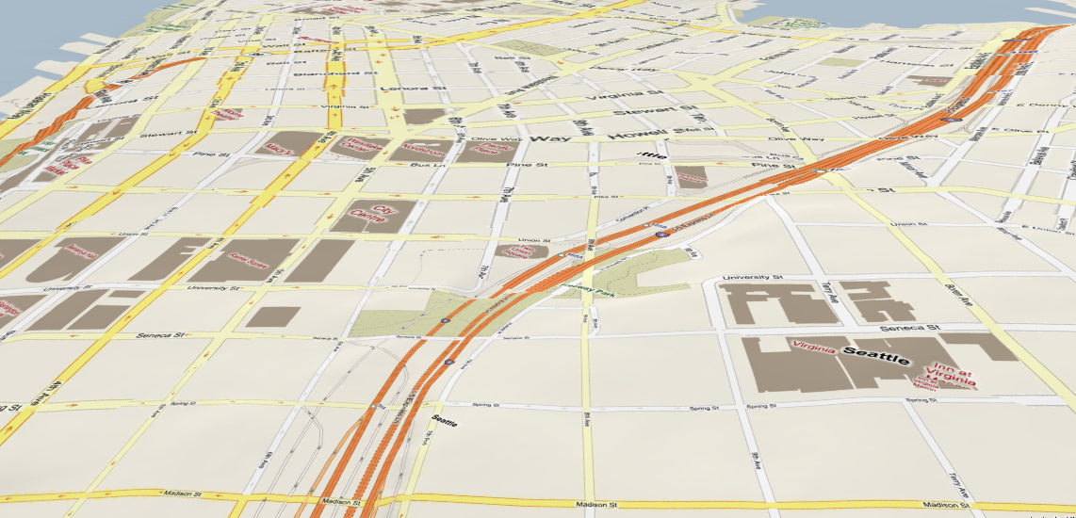
T-Drive: Driving Directions Based on Taxi Trajectories
Jing Yuan, Yu Zheng, Chengyang Zhang,
Xing Xie, Guanzhong Sun, and Yan Huang
Microsoft Research Asia
University of North Texas

Slide 2

What We Do
A smart driving direction service based on GPS traces of a large number of taxis
Find out the practically fastest driving directions with less online computation according to user queries

Slide 3
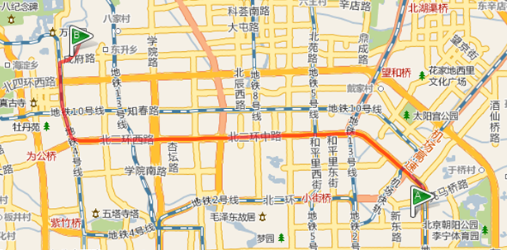
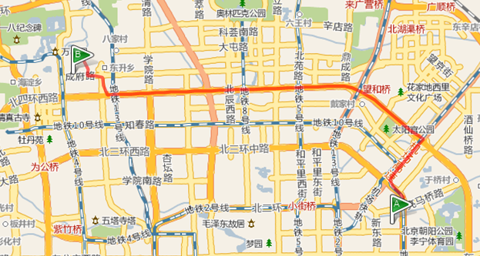

  Q=($q_{s}, q_{d}$ and t)
t =7:00am
t = 8:30am

Slide 4
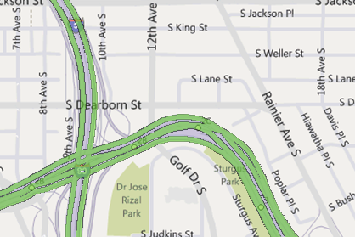
Background
Shortest path and Fastest path (speed constraints)
Real-time traffic analysis
  Methods
    Road sensors
    Visual-based (camera)
    Floating car data
  Open challenges: coverage, accuracy,…
  Have not been integrated into routing
parking
Traffic light
Human factor

Slide 5
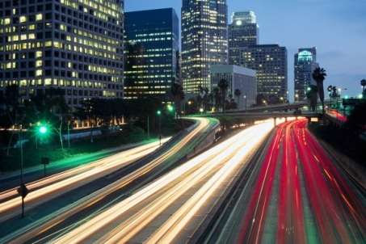

Background
What a drive really needs?
Finding driving direction > > Traffic analysis
Many open challenges
Traffic Estimation
(Speed)
Error Propagation
Sensor Data
Driving Directions
Physical Routes
Traffic flows
Drivers

Slide 6




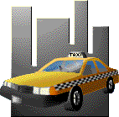

Observations
A big city with traffic problem usually has many taxis
  Beijing has 70,000+ taxis with a GPS sensor
  Send (geo-position, time) to a management center

Slide 7




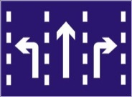


Motivation
Taxi drivers are experienced drivers
GPS-equipped taxis are mobile sensors
Human Intelligence
Traffic patterns

Slide 8
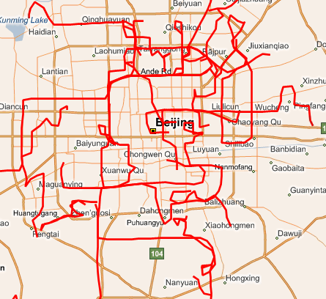
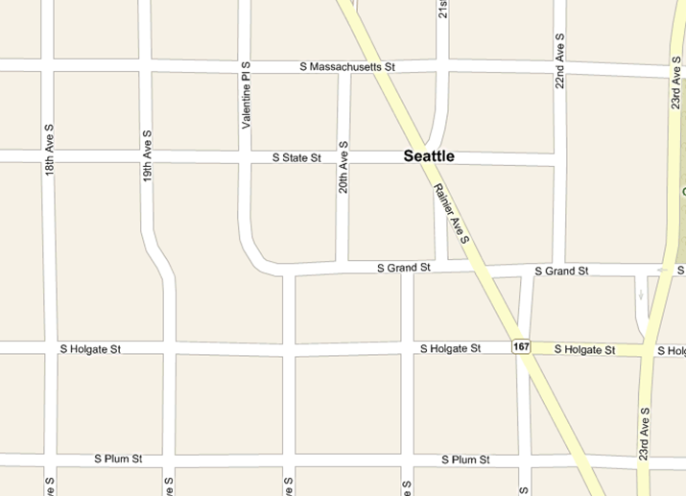




Challenges we are faced
Intelligence modeling
Data sparseness
Low-sampling-rate

Slide 9
Methodology
Pre-processing
Building landmark graph
Estimate travel time
Time-dependent two-stag routing

Slide 10
Step 1: Pre-processing
Trajectory segmentation
  Find out effective trips with passengers inside a taxi
  A tag generated by a taxi meter
Map-matching
  map a GPS point to a road segment
  IVMM method (accuracy 0.8, <3min)

Slide 11
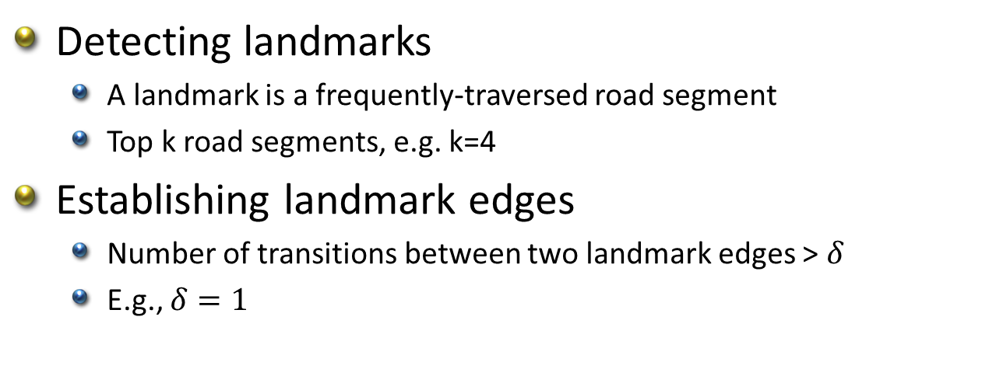
Step 2: Building landmark graphs
Detecting landmarks
  A landmark is a frequently-traversed road segment
  Top k road segments, e.g. k=4
Establishing landmark edges
  Number of transitions between two landmark edges > $δ$
  E.g., $δ=1$

Slide 12
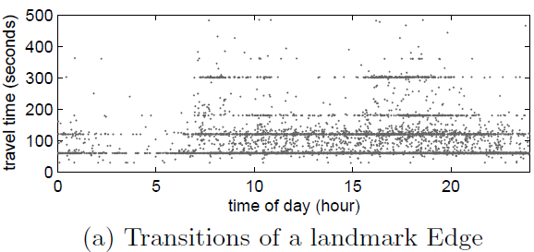
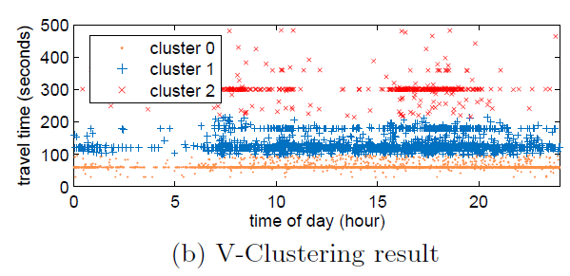
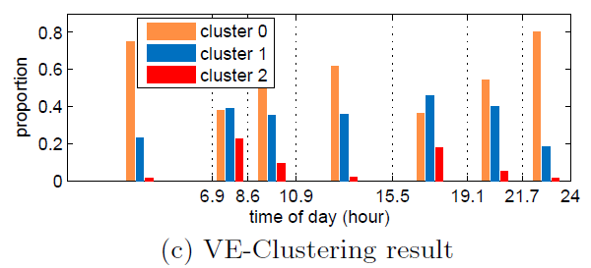
Step 3: Travel time estimation
The travel time of an landmark edge
  Varies in time of day
  is not a Gaussian distribution
  Looks like a set of clusters
  A time-based single valued function is not a good choice
  Data sparseness
  Loss information related to drivers
  Different landmark edges have different time-variant patterns
  Cannot use a predefined time splits
  VE-Clustering
  Clustering samples according to variance
  Split the time line in terms of entropy

Slide 13





Step 3: Travel time estimation
V-Clustering
  Sort the transitions by their travel times
  Find the best split points on Y axis in a binary-recursive way
E-clustering
  Represent a transition with a cluster ID
  Find the best split points on X axis iteratively

Slide 14
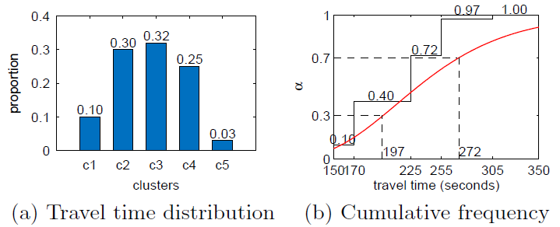

Step 4: Two-stage routing
Rough routing
  Search a landmark graph for
  A rough route: a sequence of landmarks
  Based on a user query ($q_{s}, q_{d}$, t, $α$)
  Using a time-dependent routing algorithm

Slide 15
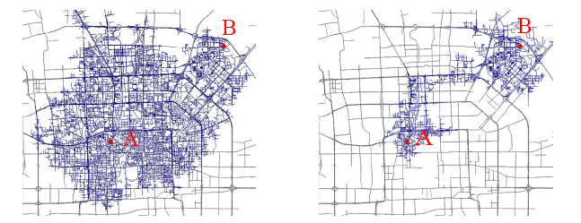
Step 4: Two-stage routing
Refined routing
  Find out the fastest path connecting the consecutive landmarks
  Can use speed constraints
  Dynamic programming
Very efficient
  Smaller search spaces
  Computed in parallel

Slide 16
Implementation & Evaluation
6-month real dataset of 30,000 taxis in Beijing
  Total distance: almost 0.5 billion (446 million) KM
  Number of GPS points: almost 1 billion (855 million)
  Average time interval between two points is 2 minutes
  Average distance between two GPS points is 600 meters
Evaluating landmark graphs
Evaluating the suggested routes by
  Using Synthetic queries
  In the field studies

Slide 17
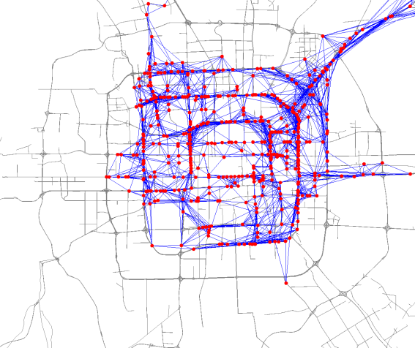
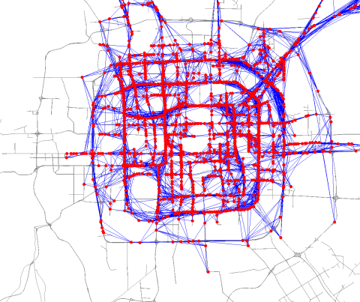
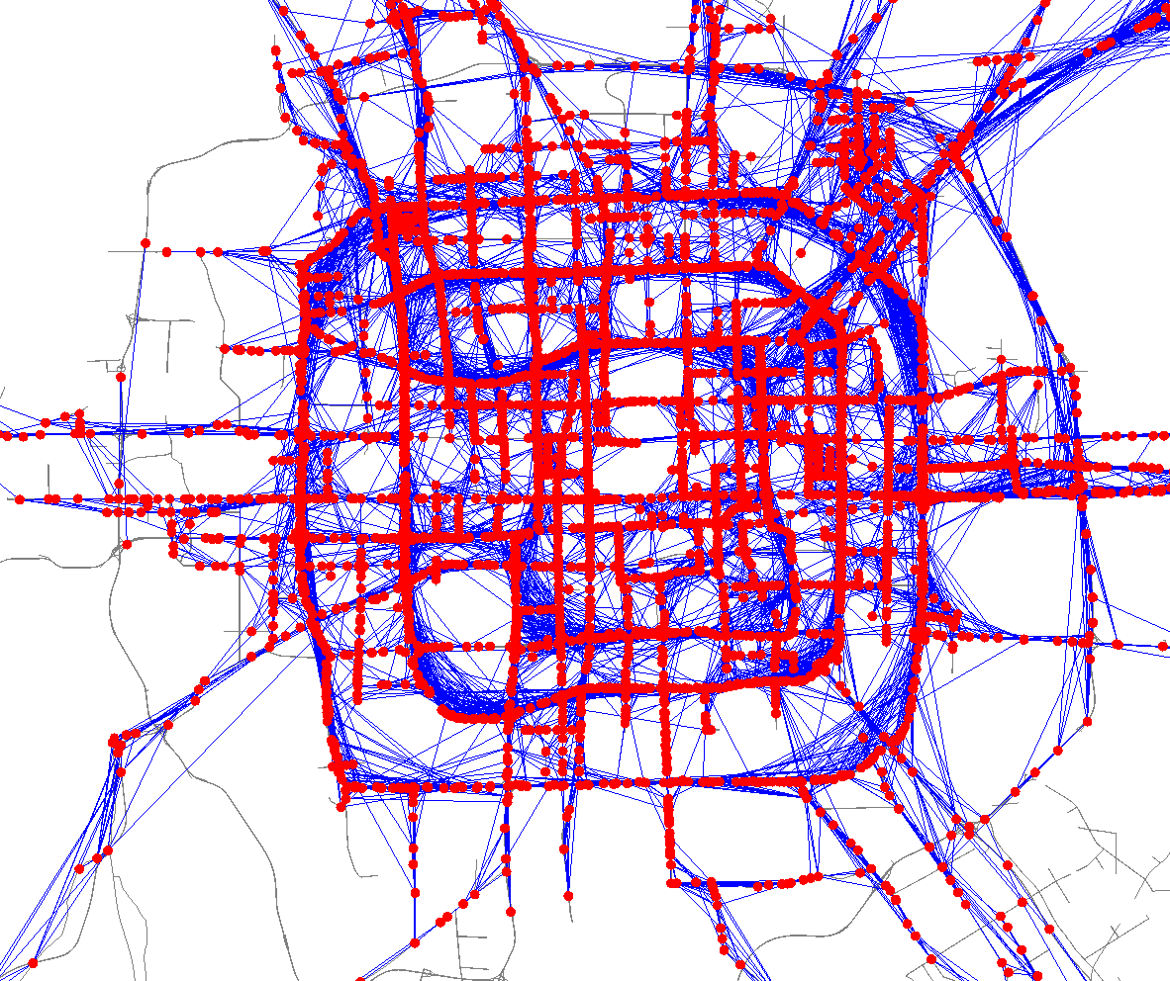
Evaluating landmark graphs
Estimate travel time with a landmark graph
Using real-user trajectories
  30 users’ driving paths in 2monts
  GeoLife GPS trajectories (released)
K=500
K=2000
K=4000

Slide 18
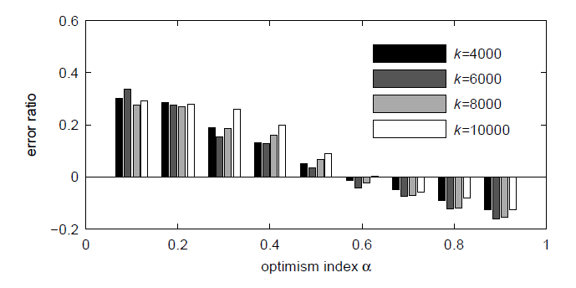
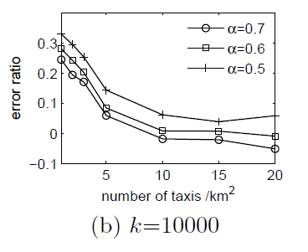
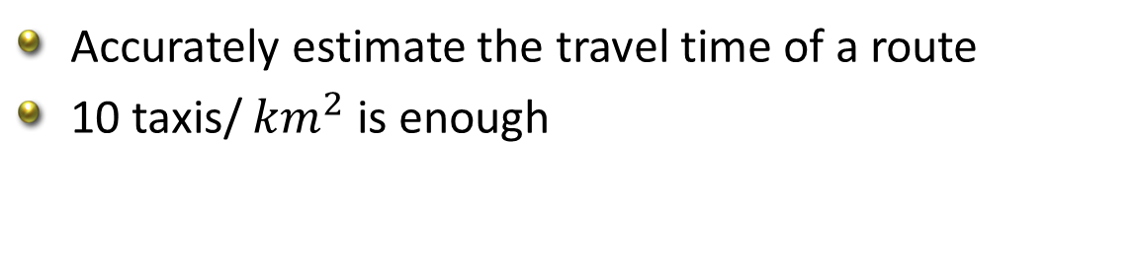
Evaluating landmark graphs
Accurately estimate the travel time of a route
10 taxis/ ${km}^{2}$ is enough

Slide 19
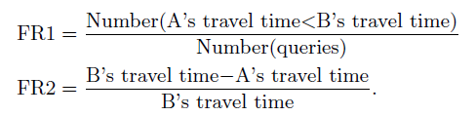
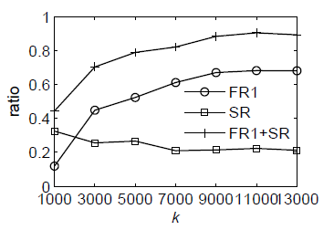
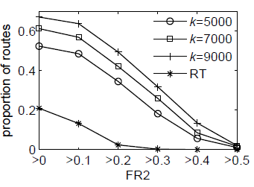
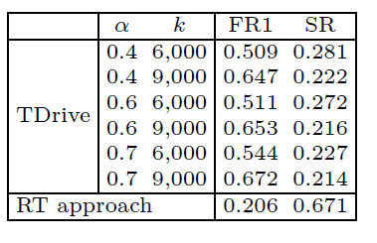
Synthetic queries
Baselines
  Speed-constraints-based method (SC)
  Real-time traffic-based method (RT)
Measurements
  FR1, FR2 and SR
  Using SC method as a basis

Slide 20
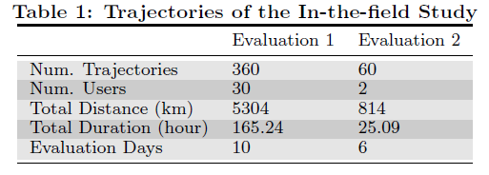
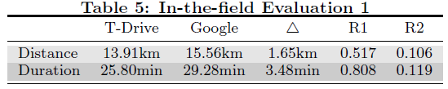
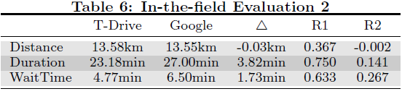
In the field study
Evaluation 1
  Same drivers traverse
  different routes at different times
Evaluation 2
  Different two users with similar driving skills
  Travers two routes simultaneously

Slide 21
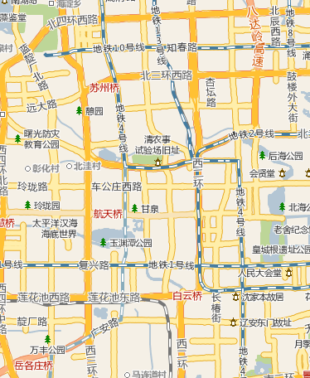


Results
More effective
  60-70% of the routes suggested by our method are faster than Bing and Google Maps.
  Over 50% of the routes are 20+% faster than Bing and Google.
  On average, we save 5 minutes per 30 minutes driving trip.
More efficient
More functional

Slide 22

A free dataset: GeoLife GPS trajectories
160+ users in a period of 1+ years
Thanks!
Yu Zheng
Microsoft Research Asia
yuzheng@microsoft.com
Notes:
Thanks!

Slide 23
References
[1] Jing Yuan, Yu Zheng, Chengyang Zhang, Wenlei Xie, Xing Xie, Guangzhong Sun, Yan Huang. T-Drive: Driving Directions Based on Taxi Trajectories. In Proceedings of ACM SIGSPATIAL Conference on Advances in Geographical Information Systems (ACM SIGSPATIAL GIS 2010).
[2] Yin Lou, Chengyang Zhang*, Yu Zheng, Xing Xie. Map-Matching for Low-Sampling-Rate GPS Trajectories. In Proceedings of ACM SIGSPATIAL Conference on Geographical Information Systems (ACM SIGSPATIAL GIS 2009).
[3] Jin Yuan, Yu Zheng. An Interactive Voting-based Map Matching Algorithm. In proceedings of the International Conference on Mobile Data Management 2010 (MDM 2010).

