Slide 1

U-Air: When Urban Air Quality Meets Big Data
Yu Zheng
Lead Researcher, Microsoft Research Asia

Slide 2
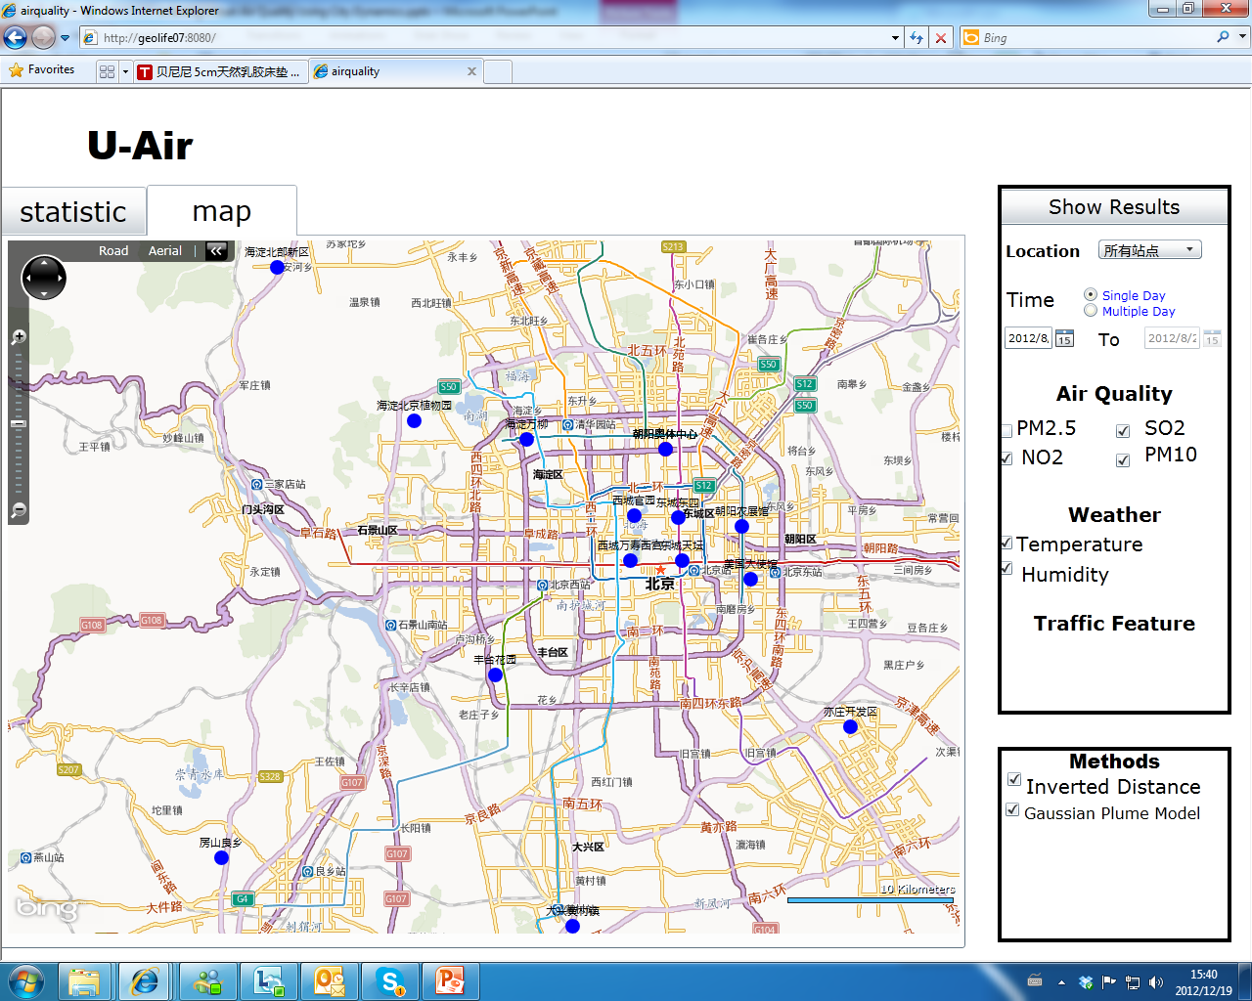
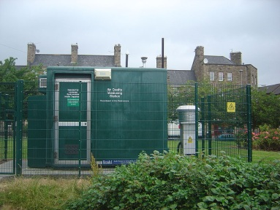
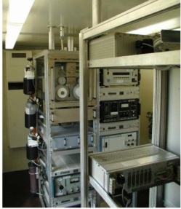
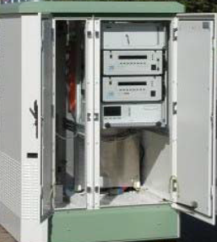
Background
Air quality monitor station
Air quality
  NO2, SO2
  Aerosols: PM2.5, PM10
Why it matters
  Healthcare
  Pollution control and dispersal
Reality
  Building a measurement station is not easy
  A limited number of stations (poor coverage)
Beijing only has 15 air quality monitor stations in its urban areas (50kmx40km)

Slide 3
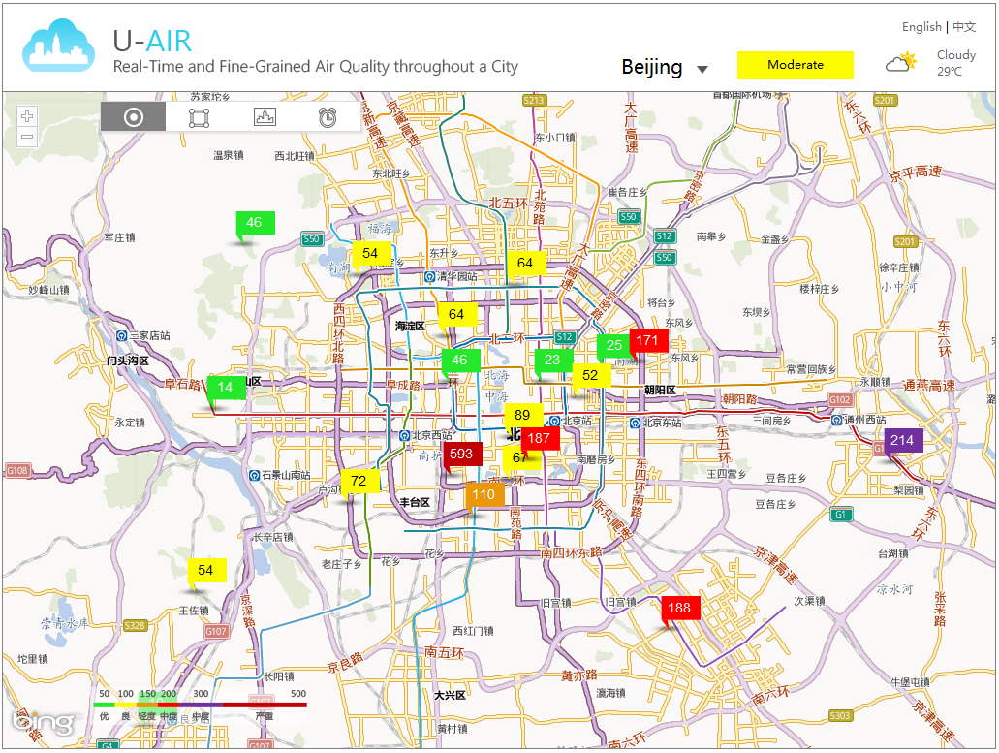
2PM, June 17, 2013

Slide 4
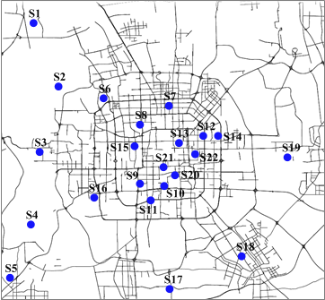
Challenges
Air quality varies by locations non-linearly
Affected by many factors
  Weathers, traffic, land use…
  Subtle to model with a clear formula
  Proportion
  >35%
Notes:
S11:Dongchengdongsi
S12: Nongzhanguan
Statistics. Two stations are supposed to be similar. However, according the data of the past 1 year, over 35% time, the deviation of pm2.5 between the two stations are larger than 100. which is about a 2 level distance. That is, when one station is moderate, the other one could be unhealthy.
It is not surprising…. So, we cannot do a simple interpolation.

Slide 5
We do not really know the air quality of a location without a monitoring station!

Slide 6
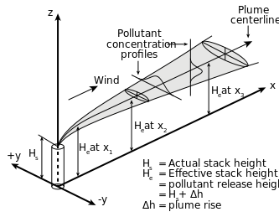


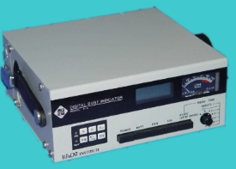
Challenges
Existing methods do not work well
  Linear interpolation
  Classical dispersion models
    Gaussian Plume models and Operational Street Canyon models
    Many parameters difficult to obtain: Vehicle emission rates, street geometry, the roughness coefficient of the urban surface…
  Satellite remote sensing
    Suffer from clouds
    Does not reflect ground air quality
    Vary in humidity, temperature, location, and seasons
  Outsourced crowd sensing using portable devices
    Limited to a few gasses: CO2 and CO
    Sensors for detecting aerosol are not portable: PM10, PM2.5
    A long period of sensing process, 1-2 hours
30,000 + USD, 10ug/m³
202×85×168（mm）

Slide 7
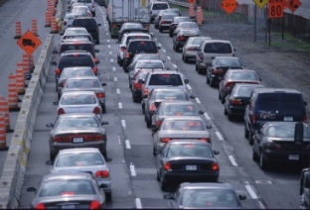
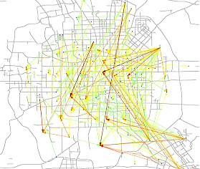
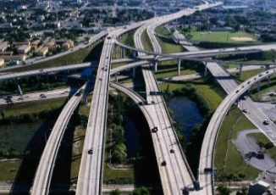


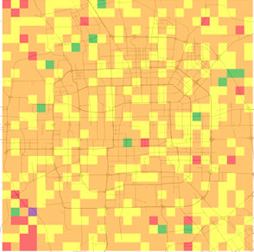
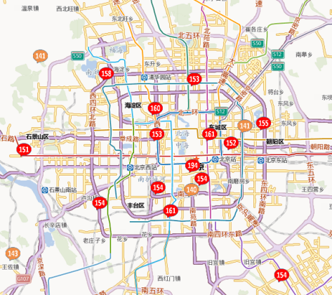



Inferring Real-Time and Fine-Grained air quality
throughout a city using Big Data
  Meteorology
  Traffic
  Human Mobility
  POIs
  Road networks
  Historical air quality data
  Real-time air quality reports
Notes:
Finer granularity inference

Slide 8
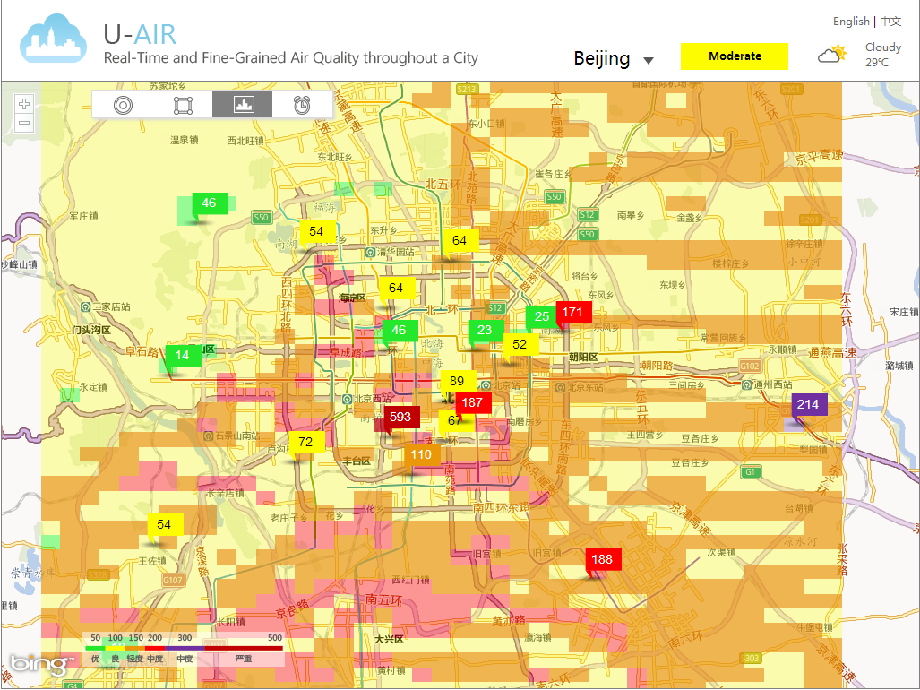

Slide 9
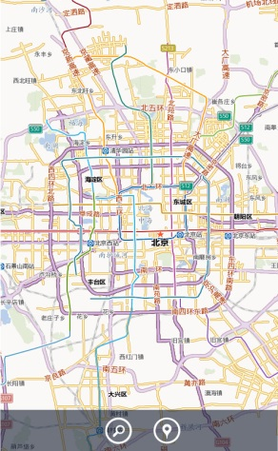

Applications
Location-based air quality awareness
  Fine-grained pollution alert
  Routing based on air quality
Identify candidate locations for setup new monitoring stations
A step towards identifying the root cause of air pollution

Slide 10
Difficulties
How to identify features from each kind of data source
Incorporate multiple heterogeneous data sources into a learning model
  Spatially-related data: POIs, road networks
  Temporally-related data: traffic, meteorology, human mobility
Data sparseness (little training data)
  Limited number of stations
  Many places to infer

Slide 11
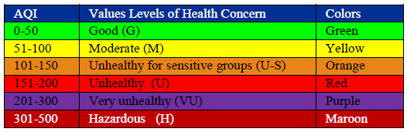
Methodology Overview
Partition a city into disjoint grids
Extract features for each grid from its affecting region
  Meteorological features
  Traffic features
  Human mobility features
  POI features
  Road network features
Co-training-based semi-supervised learning model for each pollutant
  Predict the AQI labels
  Data sparsity
  Two classifiers

Slide 12
Meteorological Features: F_{m}
Rainy, Sunny, Cloudy, Foggy
Wind speed
Temperature
Humidity
Barometer pressure
AQI of PM₁₀
August to Dec. 2012 in Beijing

Slide 13
Traffic Features: F_{t}
Distribution of speed by time: F(v)
Expectation of speed: E(V)
Standard deviation of Speed: D
GPS trajectories generated by over 30,000 taxis
From August to Dec. 2012 in Beijing

Slide 14

Extracting Traffic Features
Offline spatio-temporal indexing
  $t_{a}$: arrival time
  Traj: trajectory ID
  $l_{i}$: the index of the first GPS point (in the trajectory) entering a grid
  $l_{o}$: the index of the last GPS point (in the trajectory) leaving a grid

Slide 15

Human Mobility Features: F_{h}
Human mobility implies
  Traffic flow
  Land use of a location
  Function of a region (like residential or business areas)
Features:
  Number of arrivals $f_{a}$ and leavings $f_{l}$

Slide 16
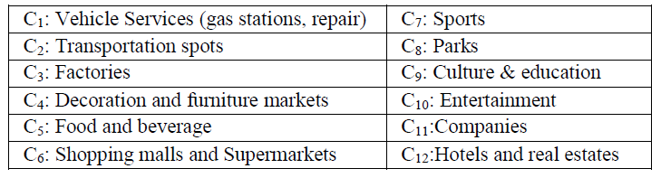
POI Features: F_{p}
Why POI
  Indicate the land use and the function of the region
  the traffic patterns in the region
Features
  Distribution of POIs over categories
  Portion of vacant places
  The changes in the number of POIs
    Factories, shopping malls,
    hotel and real estates
    Parks, decoration and furniture markets

Slide 17

Road Network Features: F_{r}
Why road networks
  Have a strong correlation with traffic flows
  A good complementary of traffic modeling
Features:
  Total length of highways $f_{h}$
  Total length of other (low-level) road segments $f_{r}$
  The number of intersections $f_{s}$ in the grid’s affecting region

Slide 18
Semi-Supervised Learning Model
Philosophy of the model
  States of air quality
    Temporal dependency in a location
    Geo-correlation between locations
  Generation of air pollutants
    Emission from a location
    Propagation among locations
  Two sets of features
    Spatially-related
    Temporally-related
Spatial Classifier
Co-Training
Temporal Classifier

Slide 19
Co-Training-Based Learning Model
Temporal classifier
  Model the temporal dependency of the air quality in a location
  Using temporally related features
  Based on a Linear-Chain Conditional Random Field (CRF)

Slide 20
Co-Training-Based Learning Model
Spatial classifier
  Model the spatial correlation between AQI of different locations
  Using spatially-related features
  Based on a BP neural network
Input generation
  Select n stations to pair with
  Perform m rounds

Slide 21
Learning Process
Temporally-related features
Labeled data
Unlabeled data
Training
Inference
Spatially-related features

Slide 22




Inference Process
Temporally-related features
Inference
${<p}_{c1},p_{c2}$, …, $p_{cn}>$
$$×$$
$c=\arg_{c_{i}∈𝒞}Max$(${p_{ci}× p′}_{ci}$)
${<p′}_{c1},{p′}_{c2}$, …, ${p′}_{cn}>$
Inference
Spatially-related features

Slide 23
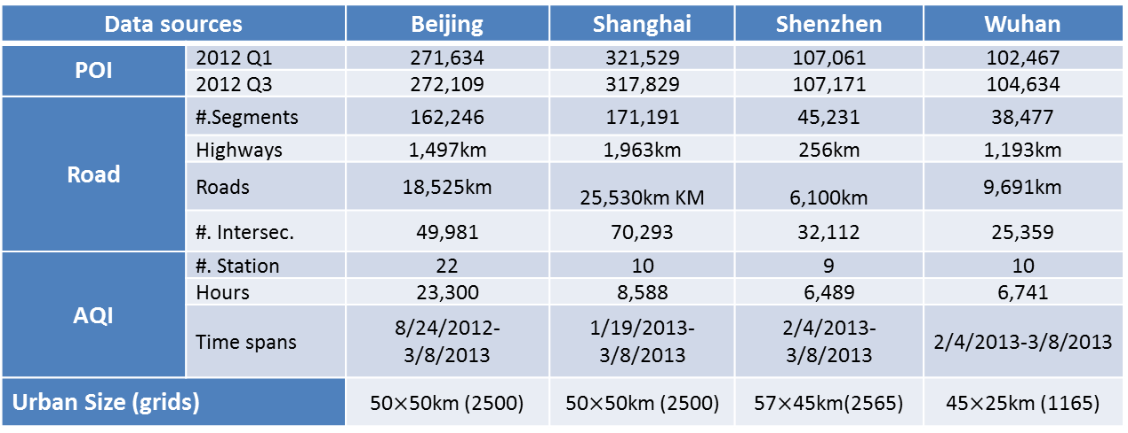
Evaluation
Datasets
Data sources |  | Beijing | Shanghai | Shenzhen | Wuhan
POI | 2012 Q1 | 271,634 | 321,529 | 107,061 | 102,467
 | 2012 Q3 | 272,109 | 317,829 | 107,171 | 104,634
Road | #.Segments | 162,246 | 171,191 | 45,231 | 38,477
 | Highways | 1,497km | 1,963km | 256km | 1,193km
 | Roads | 18,525km | 25,530km KM | 6,100km | 9,691km
 | #. Intersec. | 49,981 | 70,293 | 32,112 | 25,359
AQI | #. Station | 22 | 10 | 9 | 10
 | Hours | 23,300 | 8,588 | 6,489 | 6,741
 | Time spans | 8/24/2012-3/8/2013 | 1/19/2013-3/8/2013 | 2/4/2013-3/8/2013 | 2/4/2013-3/8/2013
Urban Size (grids) |  | 50$×$50km (2500) | 50$×$50km (2500) | 57$×$45km(2565) | 45$×$25km (1165)

Slide 24
Evaluation
Ground Truth
  Remove a station
  Cross cities
Baselines
  Linear and Gaussian Interpolations
  Classical Dispersion Model
  Decision Tree (DT):
  CRF-ALL
  ANN-ALL

Slide 25
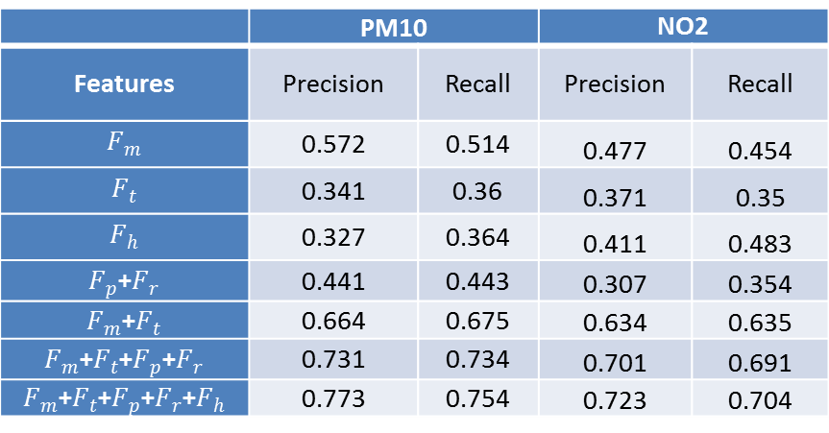
Evaluation
Does every kind of feature count?
 | PM10 |  | NO2
Features | Precision | Recall | Precision | Recall
$$F_{m}$$ | 0.572 | 0.514 | 0.477 | 0.454
$$F_{t}$$ | 0.341 | 0.36 | 0.371 | 0.35
$$F_{h}$$ | 0.327 | 0.364 | 0.411 | 0.483
$F_{p}$+$F_{r}$ | 0.441 | 0.443 | 0.307 | 0.354
$F_{m}$+$F_{t}$ | 0.664 | 0.675 | 0.634 | 0.635
$F_{m}$+$F_{t}$+$F_{p}$+$F_{r}$ | 0.731 | 0.734 | 0.701 | 0.691
$F_{m}$+$F_{t}$+$F_{p}$+$F_{r}$+$F_{h}$ | 0.773 | 0.754 | 0.723 | 0.704

Slide 26
Evaluation
Overall performance of the co-training
Accuracy

Slide 27
Evaluation
Confusion matrix of Co-Training on PM₁₀
Ground Truth | Predictions
 | G | M | S | U
G | 3789 | 402 | 102 | 0 | 0.883 | Recall
M | 602 | 3614 | 204 | 0 | 0.818
S | 41 | 200 | 532 | 50 | 0.646
U | 0 | 22 | 70 | 219 | 0.704
 | 0.855 | 0.853 | 0.586 | 0.814 | 0.828
 | Precision

Slide 28
Evaluation
Performance of Spatial classifier
Cities | PM2.5 |  | PM10 |  | NO2
 | Prec. | Rec. | Prec. | Rec. | Prec. | Rec.
Beijing | 0.764 | 0.763 | 0.762 | 0.745 | 0.730 | 0.749
Shanghai | 0.705 | 0.725 | 0.702 | 0.718 | 0.715 | 0.706
Shenzhen | 0.740 | 0.737 | 0.710 | 0.742 | 0.732 | 0.722
Wuhan | 0.727 | 0.723 | 0.731 | 0.739 | 0.744 | 0.719

Slide 29
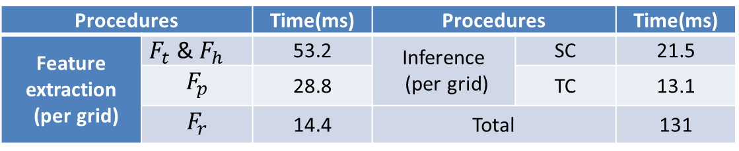
Evaluation
Efficiency study
Inferring the AQIs for entire Beijing in 5 minutes
Procedures |  | Time(ms) | Procedures |  | Time(ms)
Feature extraction (per grid) | $F_{t}$ & $F_{h}$ | 53.2 | Inference (per grid) | SC | 21.5
 | $$F_{p}$$ | 28.8 |  | TC | 13.1
 | $$F_{r}$$ | 14.4 | Total |  | 131

Slide 30
Conclusion
Infer fine-grained air quality with
  Real-time and historical air quality readings from existing stations
  Other data sources: meteorology, POIs, road network, human mobility, and traffic condition
Co-Training-based semi-supervised learning approach
  Deal with data sparsity by learning from unlabeled data
  Model the spatial correlation among the air quality of different locations
  Model the temporal dependency of the air quality in a location
Results
  0.82 with traffic data (co-training)
  0.76 if only using spatial classifier

Slide 31
Next Step
Predict the air quality in 1~2 hours
Identify the root cause of the air pollutions by
  Studying the correlations between AQIs and different features
  Data visualization across multiple-domain data sources

Slide 32

Thanks!
Yu Zheng
yuzheng@microsoft.com
Homepage

