Slide 1
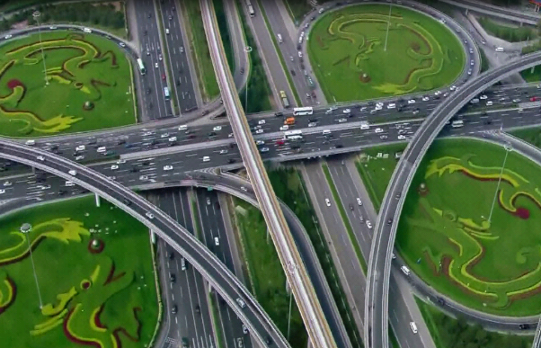
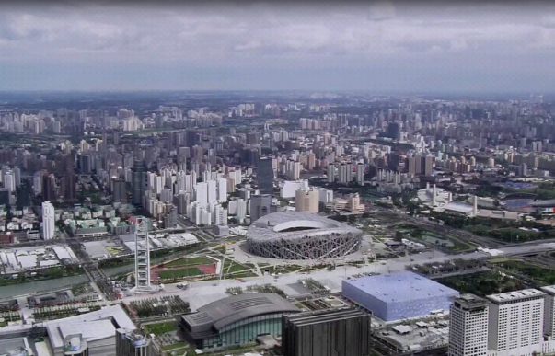
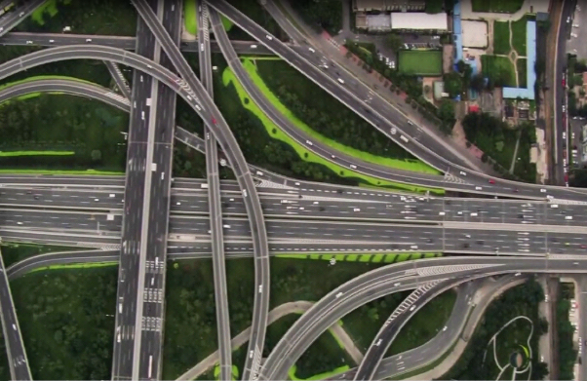
Urban Computing with Taxicabs
Yu Zheng
Microsoft Research Asia

Slide 2
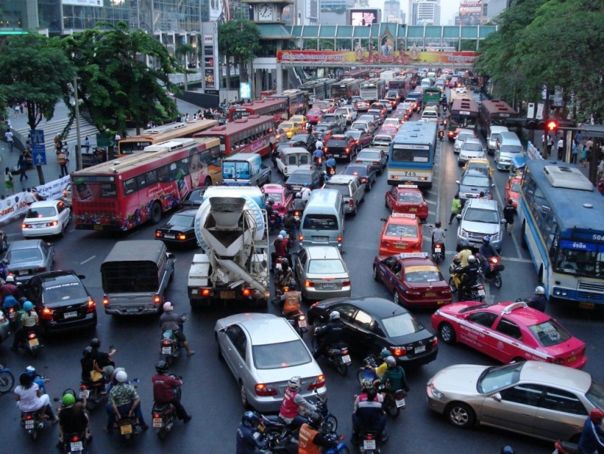
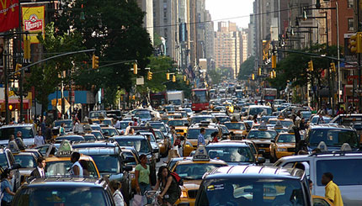
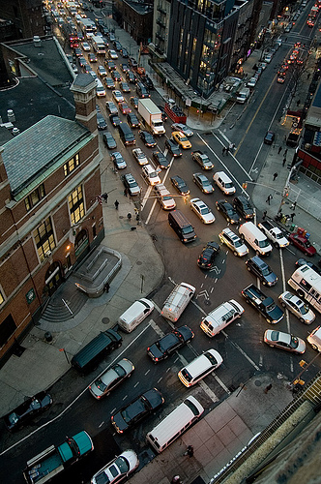
Motivation
Urban computing for Urban planning
  Developing countries: Urbanization and city planning
  Developed countries: Urban reconstruction, city renewal, and sub-urbanization
Questions
  What’s wrong with the city configurations?
  Does a carried out urban planning really works?
Notes:
Urban planning is comprised of land-use planning and transportation planning.
Urban computing for urban planning is important for both
On the one hand, .. One the other hand
Being stuck in a traffic jam, people usually ask questions:
In other words, we need innovative technologies that can automatically and unobtrusively sense urban dynamics, find the problem, and provide urban planners with crucial information for decision-making.

Slide 3
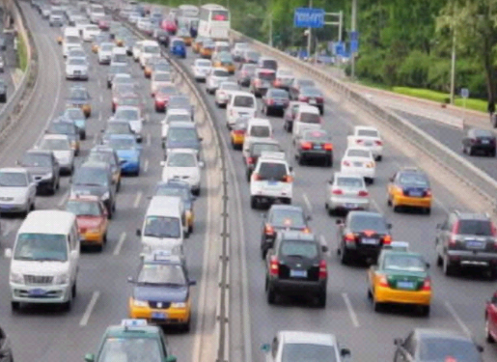
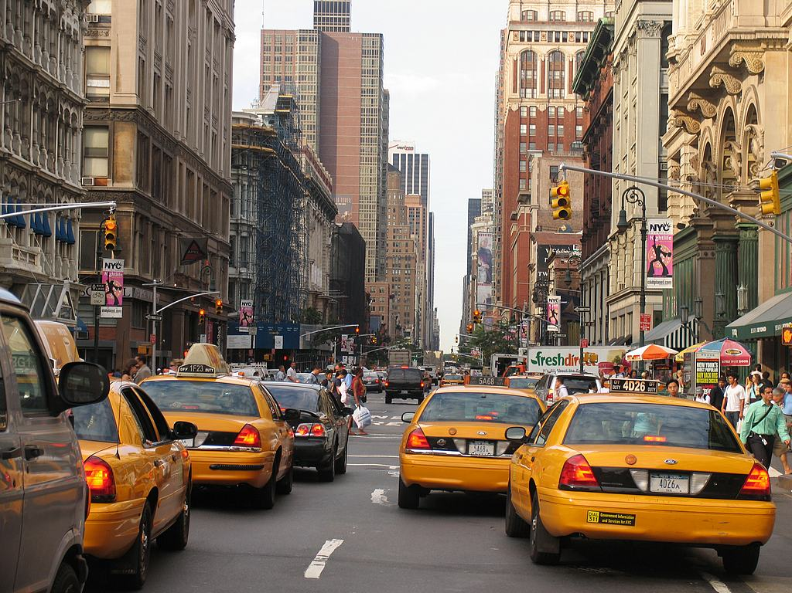
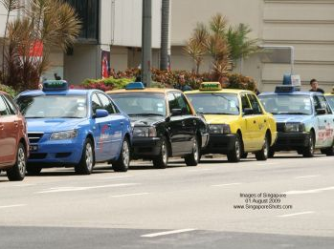
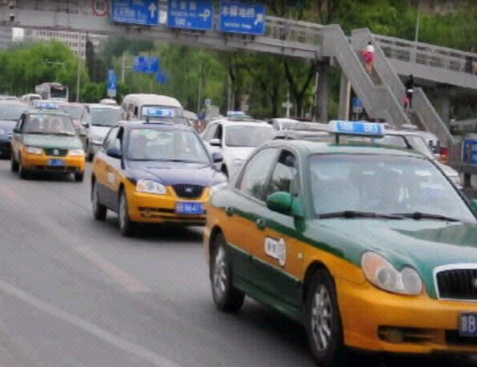
GPS-equipped taxis are mobile sensors
Notes:
Big cities faced with the challenges to urban planning usually have a large number of taxicabs traversing in urban areas
GPS-equipped taxicabs can be viewed as ubiquitous mobile sensors constantly probing a city’s rhythm and pulse, such as traffic flows on road surfaces and city-wide travel patterns of people.

Slide 4
Rank | Cities | Country/Region | Taxicabs
1 | The Mexico city | Mexico | 103,000+
2 | Bangkok | Thailand | 80,000+
3 | Seoul | South Korea | 73,000+
4 | Beijing | China | 67,000
5 | Tokyo | Japan | 60,000
6 | Shanghai | China | 50,000+
7 | New York City | USA | 48,300
8 | buenos aires | Argentina | 45,000
9 | Moscow | Russia | 40,000 (1000,000)
10 | St.Paul | Brazil | 37,000
11 | Tianjin | China | 35,000
12 | Taipei | Taiwan | 31,000+
13 | New Taipei City | Taiwan | 23,500
14 | Singapore | Singapore | 23,000
15 | Osaka | Japan | 20,000
16 | Hong Kong | China | 18,000+
17 | Wuhan | China | 18,000
18 | London | England | 17,000
19 | Harbin | China | 17,000
20 | Guangzhou | China | 16,000+
21 | Shenyang | China | 15,000+
22 | Paris | France | 15,000

Slide 5
What We Do
Detect flawed urban planning using taxi trajectories
  Evaluate the carried out city configurations
  Reminder city planners with the unrecognized problems
Challenges
  City-wide traffic modeling
  Embodying flaws and reveal their relationship

Slide 6
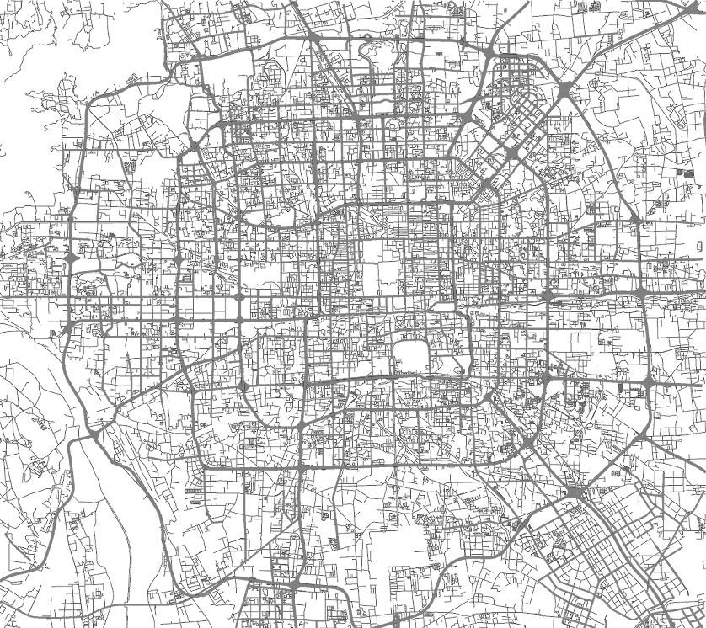
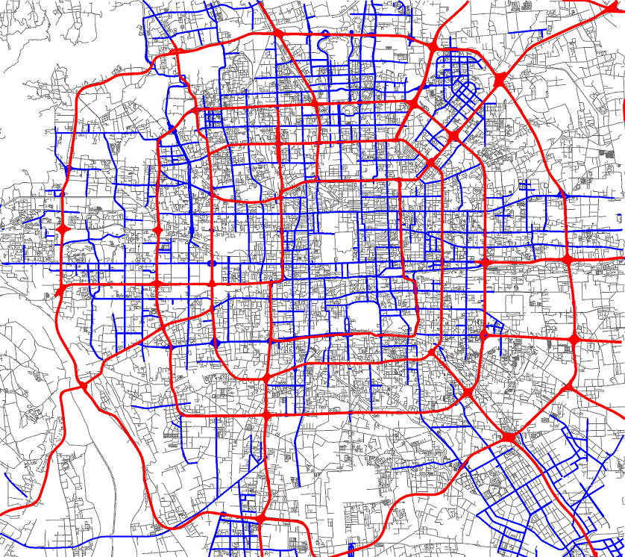


Methodology
Partition a city into regions with major roads
Notes:
Partition into regions
Each region stands for a community including some neighborhoods and low-level road segments
traffic problems appearing on roads are just observations, while regions carrying rich knowledge about people’s living and travel are the source of the problem.

Slide 7
Methodology
Partition the trajectory dataset into some portions
Workday
Rest day
Time | Work day | Rest day
Slot 1 | 7:00am-10:30am | 9:00am-12:30pm
Slot 2 | 10:30am-4:00pm | 12:30pm-7:30pm
Slot 3 | 4:00pm-7:30pm | 7:30pm-9:00am
Slot 4 | 7:30pm-7:00am
Notes:
Work day and rest day.
Further a day into some time slots according to the traffic patterns learned from the taxi trajectories.

Slide 8
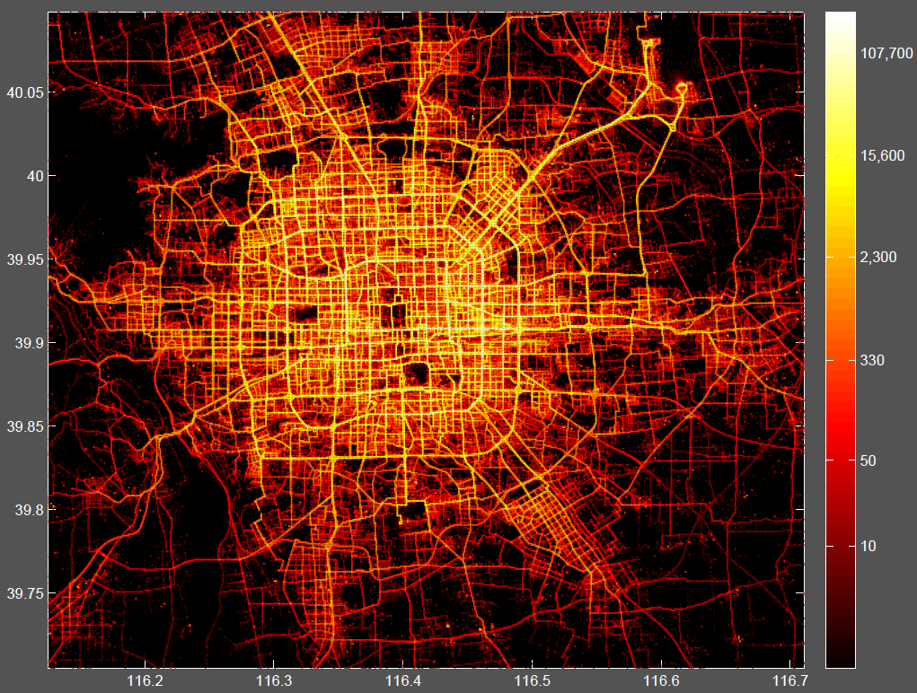
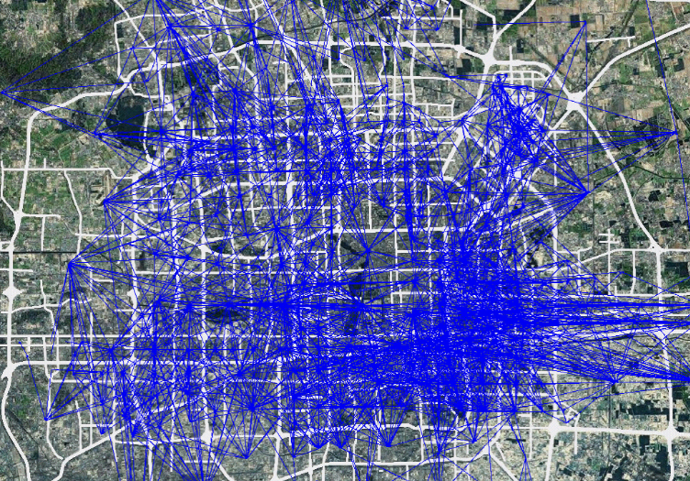
Methodology
Project taxi trajectories onto these regions
Building a region graph for each time slot

Slide 9



Methodology
Extracting features from each edge
  |S|: Number of taxis
  E(v): Expectation of speed
  $θ={E\left(D\right)}/{CenDist(r_{1},{ r}_{2})}$
$CenDist(r_{1},{ r}_{3}$)
$$a_{ij}=<\left|S\right|, E\left(V\right), θ>$$

Slide 10
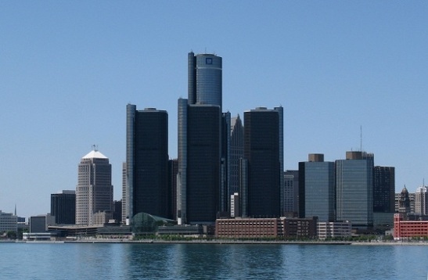

Methodology
Select edges with |S| above average
Detect Skyline edges according to < $E\left(V\right), θ$>
  Select edges with big $θ$ and small $E\left(V\right)$
  Any point from the skyline is not dominated by other points
Notes:
Large volume of traffic
Skyline
We do not need to identify

Slide 11
Methodology
Formulate skyline graphs
Mining frequent patterns
  To avoid false alert
  Deep understanding

Slide 12
Evaluations
Datasets |  | 2009. 3-5 | 2010.3-6
Number of taxis |  | 29,286 | 30,121
Effective days |  | 89 | 116
Number of points | Total | 679M | 1,730M
 | Per taxi/day | 306 | 528
Distance (KM) | Total | 310M | 600M
 | Per taxi/day | 128 | 171
Average sampling rate (s) |  | 100 | 74
Ave. dist. between two points (m) |  | 457 | 349

Slide 13
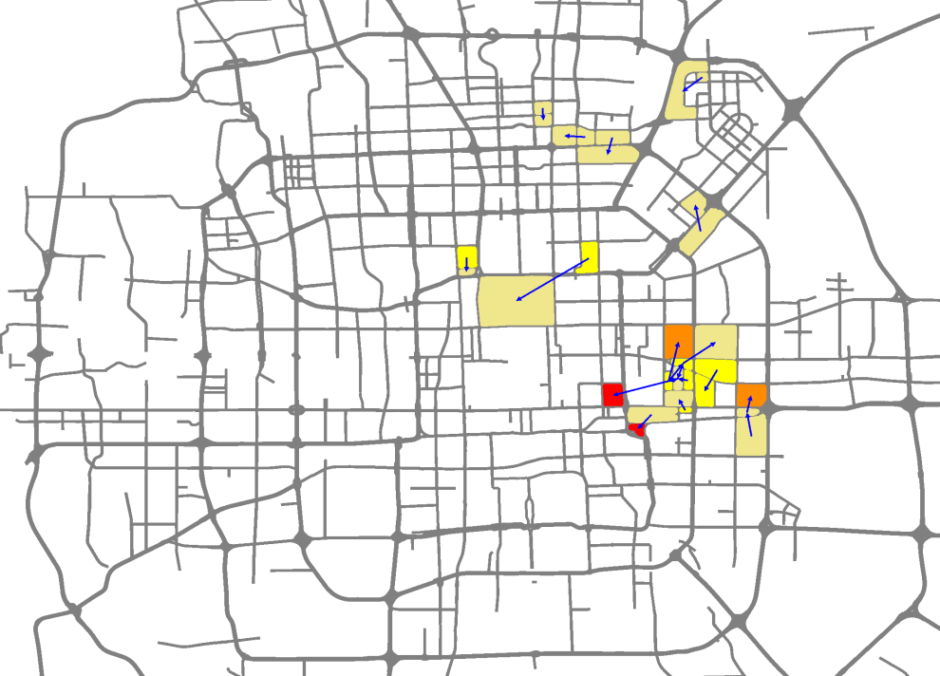
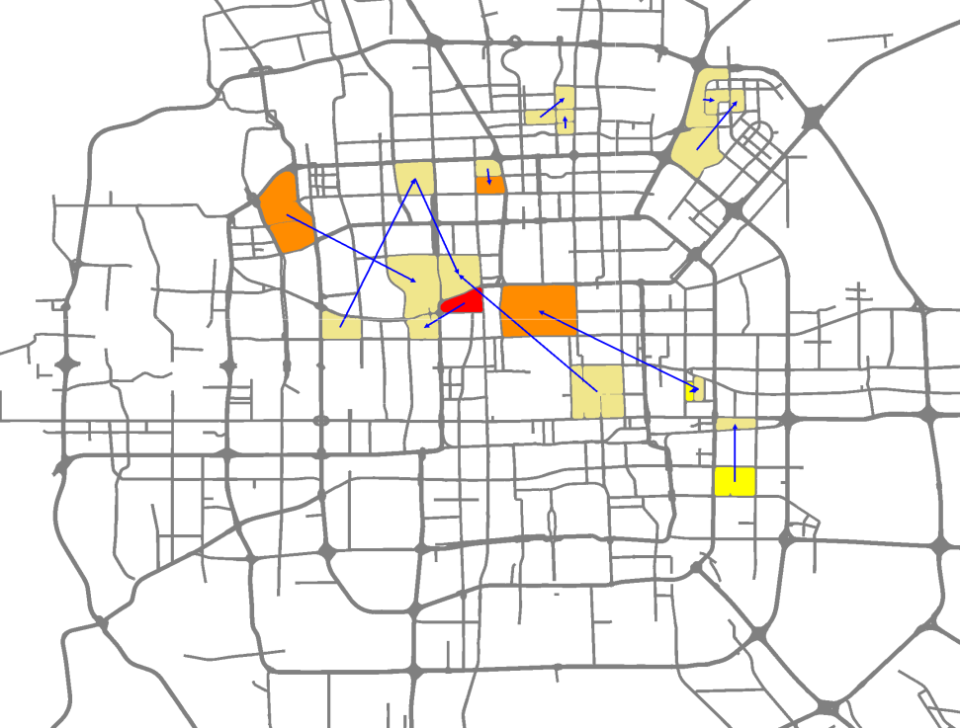
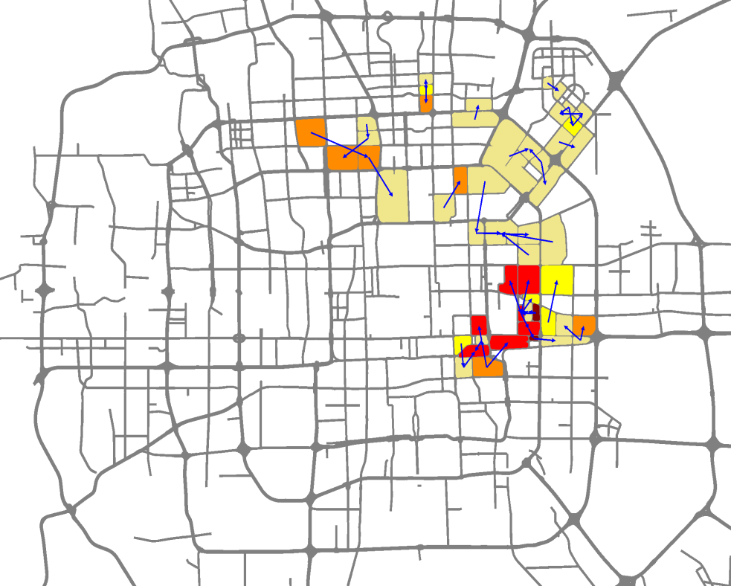
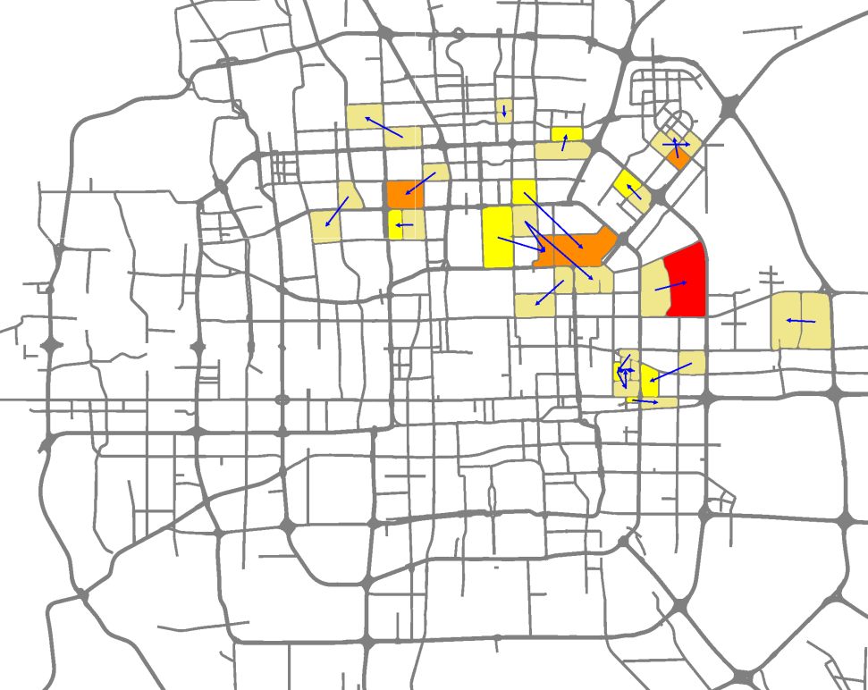
2009
Workdays
Rest Days
2010

Slide 14
Results
Some flaws occurring in 2009 disappeared
Example 1: Two roads launched in late 2009

Slide 15
Results
Some flaws occurring in 2009 still exist in 2010
Example 1: Subway line 14 and 15

Slide 16
Conclusion
Video

Slide 17


Thanks!
The Released Dataset: T-Drive taxi trajectories
A demo in the demo session on Sept. 20.
Yu Zheng
http://research.microsoft.com/en-us/people/yuzheng/

