Slide 1
ALTER: Exploiting Breakable Dependences for Parallelization
Kaushik Rajan
Abhishek Udupa
William Thies

Slide 2
Parallelization Reconsidered
Are there dependences between loop iterations?
No
DOALL Parallelism
Yes
Sequential program

Slide 3
Parallelization Reconsidered
Are there dependences between loop iterations?
No
DOALL Parallelism
Yes
Sequential program
SG3D
Floyd-Warshall
Our Technique:
2.0x speedup
on four cores
Agglomerative Clustering
Gauss Seidel
K-Means
Commutativity
Analysis
Break Dependences!
Speculation
No
Speedup
No
Speedup
Dependences are Imprecise
Dependences can
be Reordered
Dependences can
be Broken
Rigorous Software Engineering
Microsoft Research, India

Slide 4
Parallelization Reconsidered
Are there dependences between loop iterations?
No
DOALL Parallelism
Yes
Sequential program
SG3D
Floyd-Warshall
Our Technique:
2.0x speedup
on four cores
Agglomerative Clustering
ALTER
Gauss Seidel
K-Means
Commutativity
Analysis
Break Dependences!
Speculation
No
Speedup
No
Speedup
Dependences are Imprecise
Dependences can
be Reordered
Dependences can
be Broken
Rigorous Software Engineering
Microsoft Research, India

Slide 5
Outline
Breakable Dependences: Stale Reads
Deterministic Runtime System
Assisted Parallelization
Results
*other details in the paper*

Slide 6
Breakable Dependences in an Iterative Convergence Algorithm
Examples:
Floyd Warshall algorithm
Monotonic data-flow analyses
Linear algebra solvers
Stencil computations
  while(!converged) {
  for i = 1 to n {
  refine(soln[i])
  }
  }
sequential
ALTER: stale reads
privatized
DO WHILE
DO WHILE
DO WHILE
I(n)
I(n)
I(n)
…
…
…
I(2)
I(2)
I(2)
I(1)
I(1)
merge
shared
memory
I(1)

Slide 7

Stale Reads Execution Model
W₁
W₂
1
3
2
5
4
7
6
8
$$W_{1}∩ W_{2}=\{ \}$$
Stale reads
Execution valid under staleReads model iff
  Commit order is some serial order of iterations (can be different from sequential order)
  Each iteration reads a stale but consistent snapshot
  Staleness is bounded: no intersecting writes by intervening iterations
Akin to Snapshot Isolation for databases

Slide 8

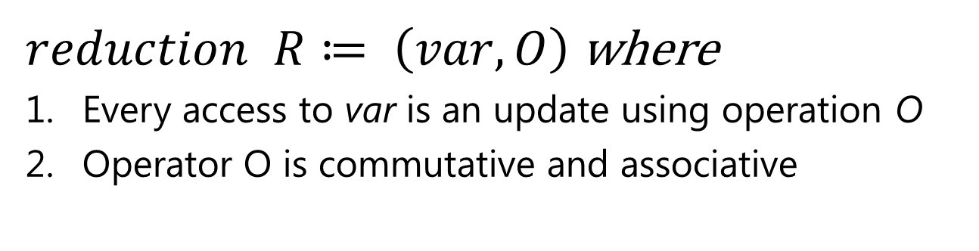


Stale Reads with Reduction
$$W_{1},W_{1}^{R}⊆W_{1}^{}$$
$$W_{2},W_{2}^{R}⊆W_{2}$$
1
3
2
5
4
7
6
8
$$(W_{1}^{}∖W_{1}^{R})∩ {(W}_{2}^{}∖W_{2}^{R})=\left\{ \right\}$$
$reduction$ $R≔ \left(var, O\right)$ where
Every access to var is an update using operation O
Operator O is commutative and associative
Notes:
We extend the model

Slide 9
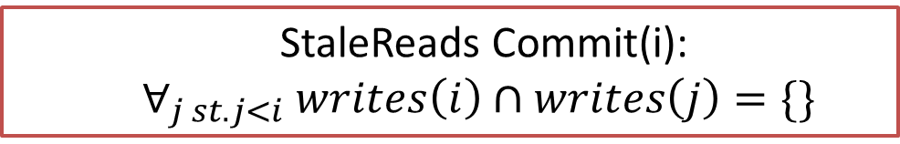
Deterministic Runtime System
state
FORK()
private
private
private
body(1) with RW logging
1
body(2) with RW logging
2
body(3) with RW logging
3
EXECUTE()
Commit?
2
Commit?
JOIN()
1
3
state
  StaleReads Commit(i): $∀_{j st. j<i} writes\left(i\right)∩writes\left(j\right)=\{\}$

Slide 10
Alter Annotations
while(error < EPSILON) { //convergence loop
error = 0.0;
for(uint32_t i = 1; i < grid->xmax - 1; ++i) {
[StaleReads, (error, max)]
for(uint32_t j = 1; j < grid->ymax - 1; ++j) {
for(uin32_t k = 1; k < grid->zmax - 1; ++k) {
oldValue = grid[i][j][k]
grid[i][j][k] = a * grid[i][j][k] + b * AddDirectNbr(grid)
+ c * AddSquareNbr(grid) + d * AddCubeNbr(grid);
error = max(error, (OldValue,GridPtr[i][j][k])));
}
}

Slide 11
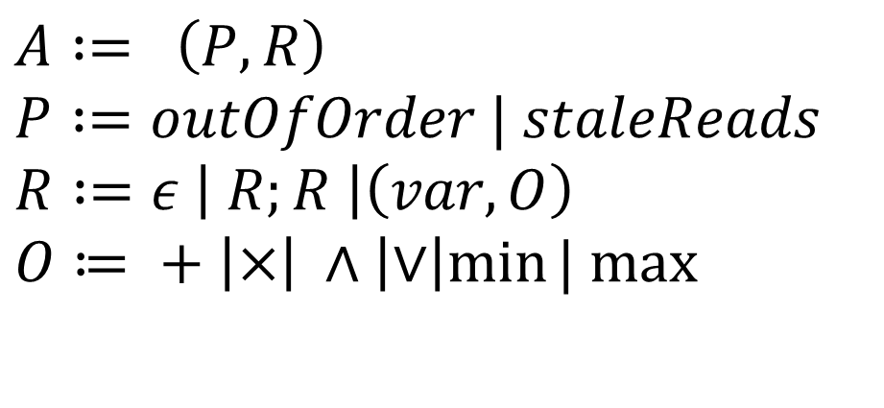
Alter Loop Annotation
Dependence guarantee
Reduction variable
$$A := \left(P, R\right)$$
$$P :=outOfOrder | staleReads$$
$$R :=ε \left| R;R \right|\left(var, O\right)$$
$$O≔ + \left|×\right| ∧\left|∨\right|min⁡| max⁡$$

Slide 12
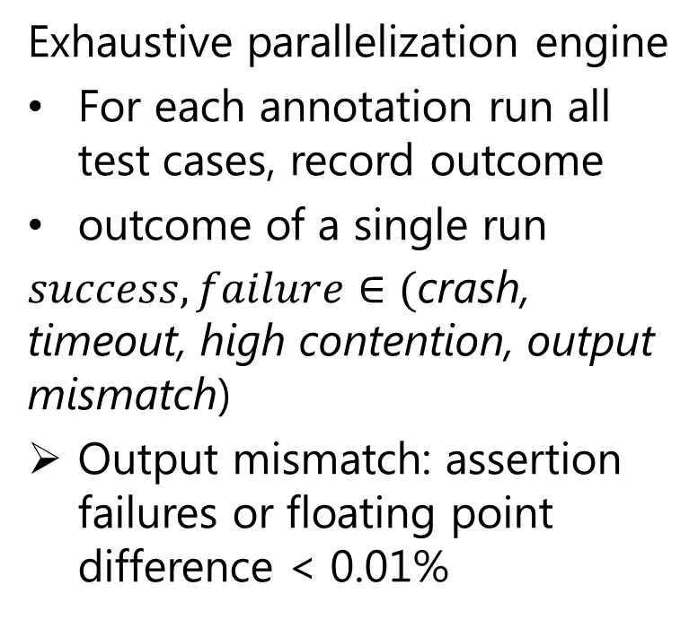
Test Driven Parallelism Inference
Exhaustive parallelization engine
For each annotation run all test cases, record outcome
outcome of a single run
$success, failure∈\text{(}\text{crash}\text{, }\text{timeout}\text{, }\text{high} \text{contention}\text{, }\text{output} \text{mismatch}$)
Output mismatch: assertion failures or floating point difference < 0.01%
Sequential program
Test suite
Exhaustive parallelization engine
Candidate Parallel program
User
validation

Slide 13
Assisted Parallelism
Prior art
Automatic parallelism
ALTER
Assisted parallelism
Sequential program
Test suite
Sequential program
Exhaustive parallelization engine
Conservative
Compiler analysis
Candidate Parallel program
Parallel program
User
validation
Auto tune for perf
Preserve program dependences
Preserve functionality

Slide 14
Benchmarks
BENCHMARK | ALGORITHM TYPE | PARALLELISM | LOOP WGT
AggloClust | Branch & bound | STALE READS | 89%
GSdense | Dense algebra | STALE READS | 100%
GSsparse | Sparse algebra | STALE READS | 100%
FloydWarshall | Dynamic programming | STALE READS | 100%
SG3D | Structured grids | STALE READS, (error, max) | 96%
BarnesHut | N-body methods | DOALL | 99.6%
FFT | Spectral methods | DOALL | 100%
HMM | Graphical models | DOALL | 100%
Genome | Bioinformatics | STALE READS | 89%
SSCA2 | Scientific | STALE READS | 76%
K-means | Data mining | STALE READS, (delta, +) | 89%
Labyrinth | Engineering | _ | 99%

Slide 15
Experimental Setup
Experiments on a 2 x quad core Xeon processor
Alter transformations in Microsoft Phoenix compiler framework
Comparison with dependence speculation and manual parallelization of 2 applications

Slide 16
Results : Baseline
No scope for dependence speculation
No scope for dependence speculation
Notes:
Speedup on 8 cores

Slide 17
Results : Alter
Notes:
speedup

Slide 18
Results: Manual Parallelization
Good speedup with fine grain locking
Comparable performance

Slide 19
In the Paper…
ALTER multi-process memory allocator
ALTER collections
Usage scenario’s for ALTER
Profiling and instrumentation overhead
DOALL parallelism and speculation within ALTER

Slide 20
Related Work
Test-driven parallelization
  QuickStep: similar testing methods for non-deterministic programs, offers accuracy bounds [Rinard 2010]
Assisted parallelization [Taylor 2011] [Tournavitis 2009]
  Paralax: annotations improve precision of analysis, but dependences respected [Vandierendonck 2010]
Implicit parallelization [Burckhardt 2010]
  Commutative annotation for reordering[August 2007, 11]
  Optimistic execution of irregular programs [Pingali 2008]
  As far as we know, stale reads execution model is new
Notes:
[Could remove the citations on the major bullet points, I don’t know if it is better to make these few people happy or to make other people mad that they are omitted in the presence of more citations.]
“There is a vast amount of related work, only a subset appears on this slide.
Test-driven parallelization is a relatively new field. One of the few works in this space is QuickStep…
Assisted parallelization has been explored by several researchers. One of the most closely related works is Paralax…
Implicit parallelization represents a very large body of research. For example, …”

Slide 21
Conclusions
Breakable dependences must be exploited in order to parallelize certain classes of programs
We propose a new execution model, StaleReads, that violates dependences in a principled way
Adopt database notion of Snapshot Isolation for loop parallelization
ALTER is a compiler and deterministic runtime system that discovers new parallelism in programs
We believe tools for assisted parallelism can help to overcome the limits of automatic parallelization
Notes:
Say: stale reads is akin to snapshot isolation in the database community. Yet another concept borrowed from databases, the first time in the context of loops.

