Slide 1
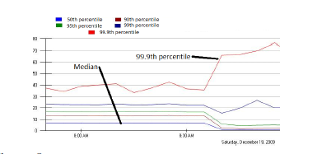
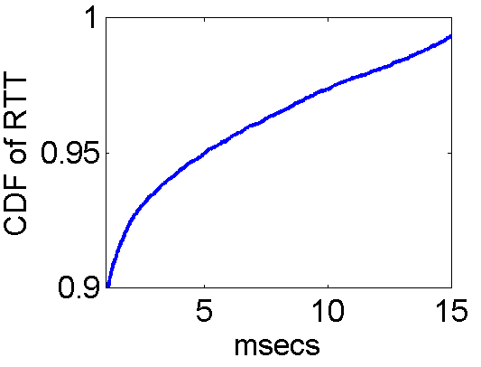
DCTCP: Transport Optimized for Data Centers
High throughput
  Continuous data update
High burst tolerance
  The Partition/Aggregate pattern is common
Low Latency (milliseconds matter)
  Soft real time app’s run close to SLA’s
  Indeed, reduce network latency ➔ more time for the algorithms, and for better results
Achieving the 3 together is the industry’s hard problem
  Our developers (e.g., at Bing) go to extreme lengths to try to roll their own partial solns at app or network layer
Bing tracks ms
to 3 nines
Partition/Aggregate
SLA = 250ms
request
SLA =50ms
…
SLA =10ms
…
…
…
Problems in commodity switches
Incast
Queue buildup
Buffer Pressure

Slide 2
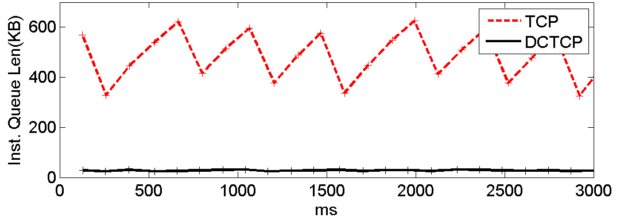
DCTCP: Transport Optimized for Data Centers
High throughput
  Creating multi-bit feedback at TCP sources
Low Latency (milliseconds matter)
  Small buffer occupancies due to early and aggressive ECN marking
Burst tolerance
  Sources react before packets are dropped
  Large buffer headroom for bursts
DCTCP achieves all three goals
Joint work with Bing Indexsrv on latency reduction
Queue
buildup
Incast
Sauce
Use full info in stream of ECN marks
Adapt quickly and in proportion to level of congestion
K
Don’t
Mark
DCTCP
Reduces variability
Reduces queuing
Mark
ECN Marks | DCTCP | TCP
1 0 1 1 1 1 0 1 1 1 | Cut window by 40% | Cut window by 50%
0 0 0 0 0 0 0 0 0 1 | Cut window by 5% | Cut window by 50%
→
Packet buffer
Notes:
Uses full info in the stream of ecn bits, instead of one
95th percentile numbers;
Latency
Short messages – command and control; queries
Dctcp (black) good.
TCP is OK on short messages
Terrible on queries (incast)
Deep Buffer – fixes queries; short messages goes up; stuck in long queues
AQM (RED) – reduce queue occupancy – helps on short messages
Short queues with low variability (reasonable fraction of the queries)
Rhs drops
Lhs queues
Short 100K to 1M
Query <10K
10ms RTO

