Slide 1





Crowd Sensing of Traffic Anomalies based on Human Mobility and Social Media
Bei Pan (Penny), University of Southern California
Yu Zheng, Microsoft Research
David Wilkie, University of North Carolina
Cyrus Shahabi, University of Southern California

Slide 2

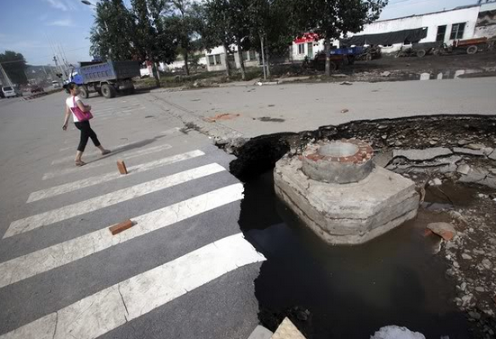
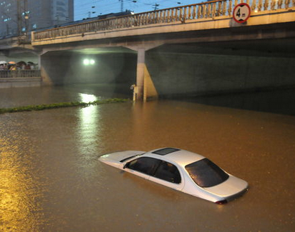
Background
2
The prevalence of location services
  Mobile phones, GPS
  Check-in services
“Crowd sensing” city rhythms
  Urban planning
  Activity understanding
Our interests:
  Dynamics of urban traffic
  Detect and Analyze
  traffic anomalies
Notes:
Human as sensors

Slide 3

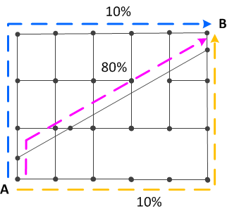
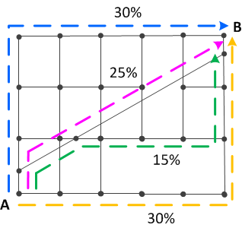
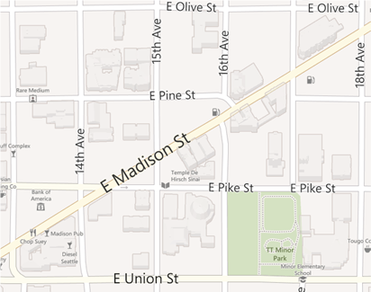
Insights
  When a traffic anomaly occurs:
  % of traveling on different routes may change
  People may discuss the anomaly on social media
rt₂
rt₂
rt₁
rt₁
rt₄
rt₃
rt₃
routing behavior in normal times
routing behavior
during the traffic anomaly

Slide 4
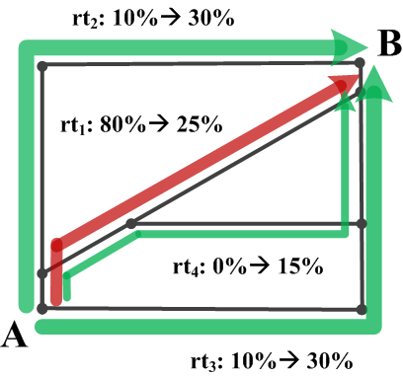
4
Goal - Detection
During regular times
During
anomalous event
Increase of routing behavior
Anomalous graph
Decrease of routing behavior

Slide 5

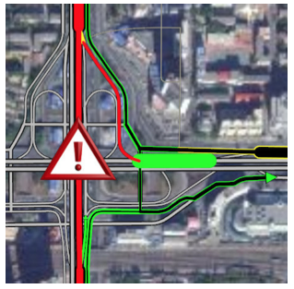
Goal - Analysis
Understand the traffic anomalies
  Describe the anomaly using social media
  Impact analysis on travel time delay
Detected anomalous graph

Slide 6
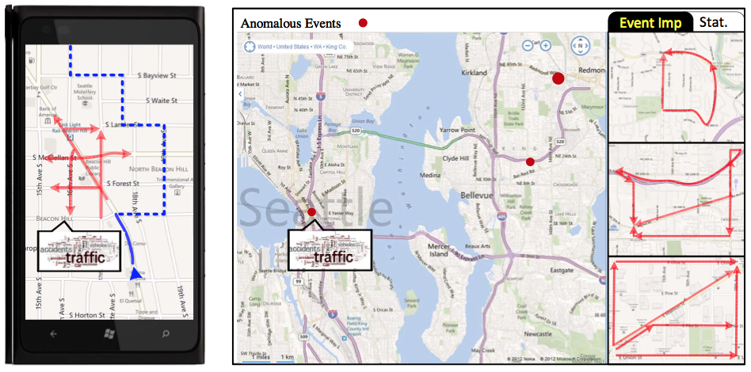
Applications
Individual users
Transportation authorities

Slide 7
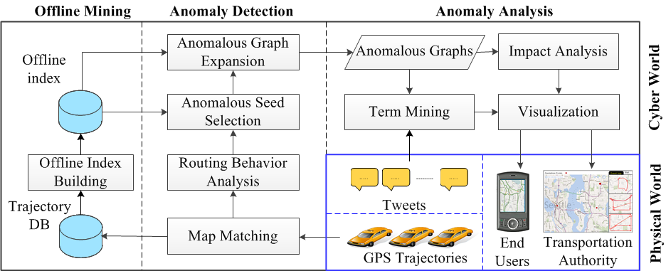
System Overview

Slide 8
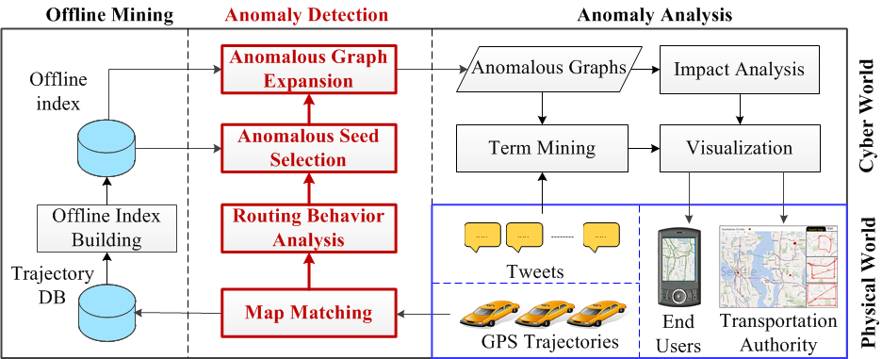
System Overview

Slide 9
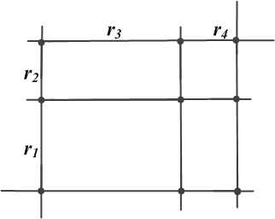

Preliminaries
Trajectory (tr)
  A sequence of GPS points
    E.g.,{<loc₁, t₁>, <loc₂, t₂>, <loc₃, t₃>}
  After map-matching & interpolation ^{[1][2]}
    E.g.,{<r₁, t’₁>, <r₂, t’₂>, <r₃, t’₃>, <r₄, t’₄>}
Route (rt) : a sequence of connected road segments
  E.g., < r₁, r₂ , r₃, r₄ >
Traffic flow on a route <r₁, r₂ , ..., r_{j}> during time interval [t₁, t₂]:
  sum of all trajectories satisfy the following:
  1)
  2)
[1] J. Yuan, Y. Zheng, C. Zhang, X. Xie, and G.-Z. Sun. An interactive-voting based map matching algorithm. In MDM ’10.
[2] L.-Y. Wei, Y. Zheng, and W.-C. Peng. Constructing popular routes from uncertain trajectories. In KDD ’12

Slide 10
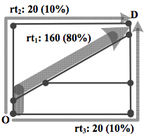
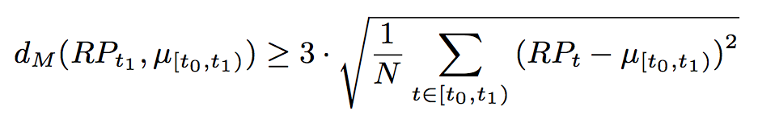
Routing Behavior Analysis
Routing Behavior:
  RP_{OD} =< f₁ , p₁ , f₂ , p₂ , ... , f_{n} , p_{n} >
  f : traffic flow / p: percentage
  e.g., RP_{OD} =<160, 0.8, 20, 0.1, 20, 0.1>
Anomaly Detection Problem Definition:
  Given a complete road network, trajectory set in [t₀, t₁], find graphs
    For each O, at least one D, that the RP_{OD} at time t₁ is anomalous compared with regular RP_{OD} at time [t₀, t₁):
Notes:
Why the coefficient is 3? Because we assume the data distribution is Gussian Distribution, 3 is the standard coefficient to detect outliers

Slide 11
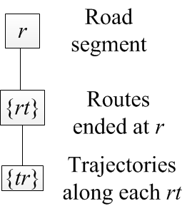
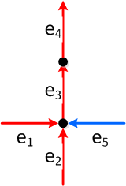

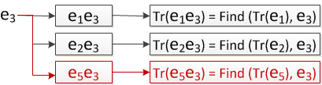



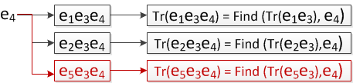

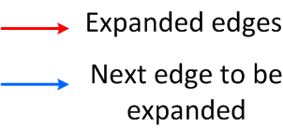
Anomaly Detection
Index:
Our solution:
  Priority Breadth Graph Expansion
  Verifications of anomalous RP on all OD pairs
11
Index Update: one edge at a time

Slide 12
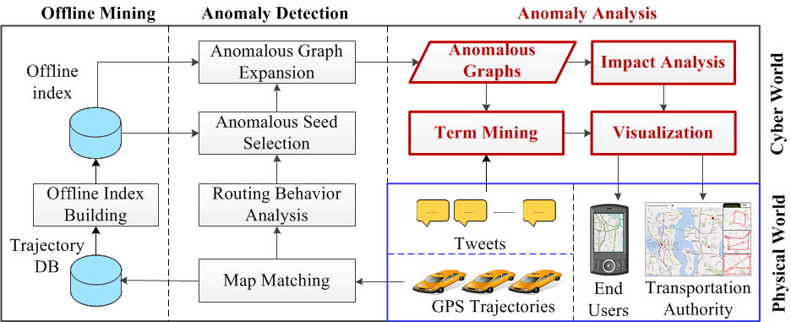
System Overview

Slide 13
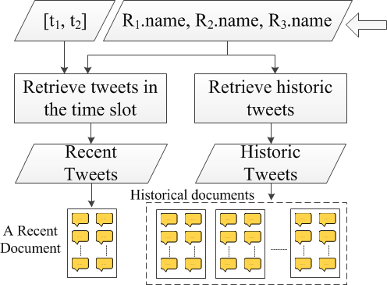
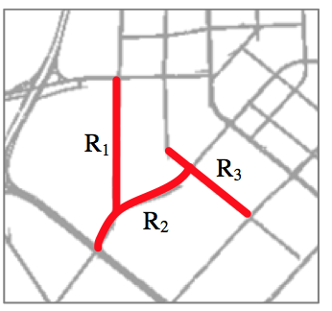
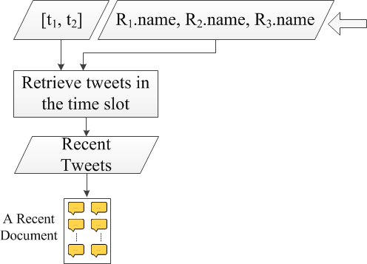


Term Mining
(T_{H})
(T_{C})
Notes:
In the beginning of the slides, need to specify the reduce of searching space. (we are not searching through entire pool of social media)
Trying to identify the set of key words that only in recent document but not in historical documents () ,

Slide 14
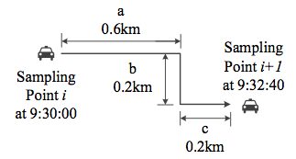

Impact Analysis & Visualization
Impact : Travel Time Delay
  Individual travel time calculation:
    E.g., travel time at segment a is : 96 sec.
  Mean travel time during
  time interval T :
  Delayed travel time for road segment r:
Visualization:
  Green: < 2x regular travel time
  Yellow: [2x, 3x] regular travel time
  Red: >3x regular travel time
Notes:
We assume each driver drives with constant velocity

Slide 15
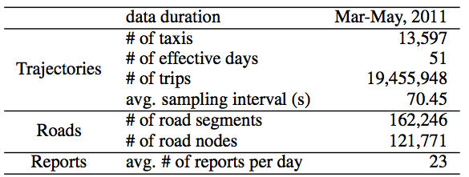
Evaluation
Traffic data set: (~ 20% of traffic flow on Beijing road network)
Social Media Data:
  Crawled from Chinese micro-blogging services called “Weibo”.
Anomaly detection baseline approach
  PCA – proposed in [1]: anomaly detection based on traffic volume
[1] S. Chawla, Y. Zheng, and J. Hu. Inferring the root cause in road traffic anomalies. In ICDM ’12.

Slide 16
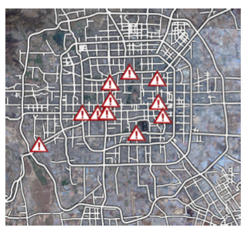
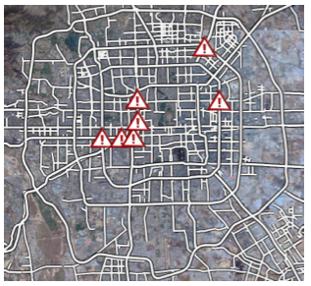
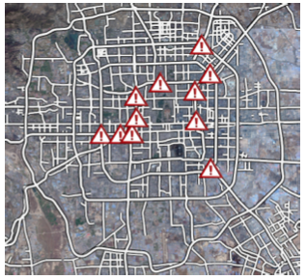
Effectiveness Evaluation
Recall： （percentage of actual events can be detected）
  Sampling time period: 4pm to 6pm on 5/12/2011
  Events reported from Beijing transportation authorities are not necessarily the entire set of ground truth
Reported events
Detected by baseline
Detected by our approach
Recall: 46.7%
Recall: 86.7%

Slide 17
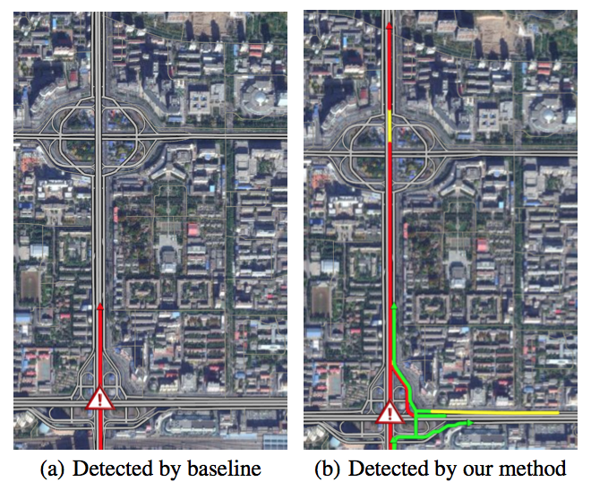
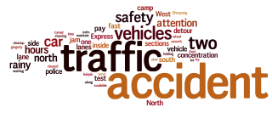
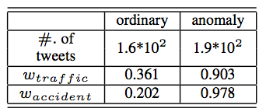
Case Study - 1
Traffic accidents – (reported by transportation agency)
Mined Terms:
Term weights:

Slide 18
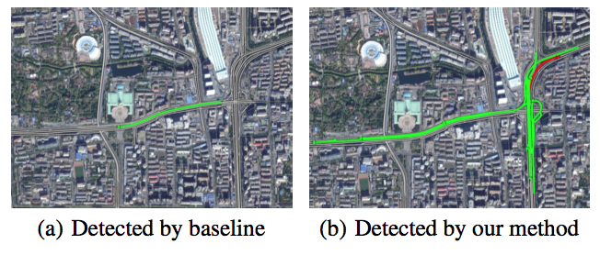
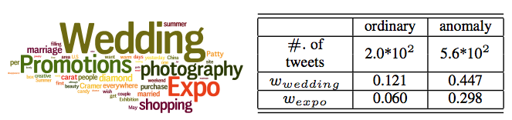
Case Study - 2
Wedding Expo – (not reported by transportation agency)
Mined Terms:

Slide 19
Conclusion
Anomaly detection using crowd sensing
  More precise, more meaningful than traffic volume based algor.
Anomaly analysis using social media
  Significant reduction of searching space
Enable new thoughts in urban computing
  Detect and describe traffic anomalies that is not reported
  Understand human’s behavior during traffic anomalies
Notes:
Significantly reduce the searching space

Slide 20

Q & A

Slide 21
Related Work
Anomaly detection based on trajectory data
  Driving fraud detection [GXL11] [ZLZ11]
    anomalous trajectories instead of anomalous events
  Traffic anomaly detection based on traffic volume [LZC11]
    Not considering routing behavior change
  Event detection based on people’s behavior [CZH12]
    Region level: our approach is based on street level (higher granularity)
Anomaly detection based on social media
  Earthquake shakes detection [SOM10]
  Social events detection[LZM10] [SHM09]
    Needs specific keywords to filter tweets, such as “earthquake”, our approach use time & location to reduce search space

Slide 22
Reference
[GXL11] Y. Ge, H. Xiong, C. Liu, and Z.-H. Zhou. A taxi driving fraud detection system. In ICDM ’11.
[LZC11] W. Liu, Y. Zheng, S. Chawla, J. Yuan, and X. Xing. Discovering spatio-temporal causal interactions in traffic data streams. In KDD ’11.
[CZH12] S. Chawla, Y. Zheng, and J. Hu. Inferring the root cause in road traffic anomalies. In ICDM ’12.
[ZLZ11] D. Zhang, N. Li, Z.-H. Zhou, C. Chen, L. Sun, and S. Li. iBAT: detecting anomalous taxi trajectories from GPS traces. In UbiComp ’11.
[LZM10] C. X. Lin, B. Zhao, Q. Mei, and J. Han. PET: a statistical model for popular events tracking in social communities. In KDD ’10.
[SOM10] T. Sakaki, M. Okazaki, and Y. Matsuo. Earthquake shakes twitter users: real-time event detection by social sensors. In WWW ’10.
[SHM09] H. Sayyadi, M. Hurst, and A. Maykov. Event detection and tracking in social streams. In ICWSM ’09). AAAI, 2009.

