Slide 1


Differential Assertion Checking
Shuvendu Lahiri
Kenneth McMillan
Rahul Sharma
Chris Hawblitzel

Slide 2
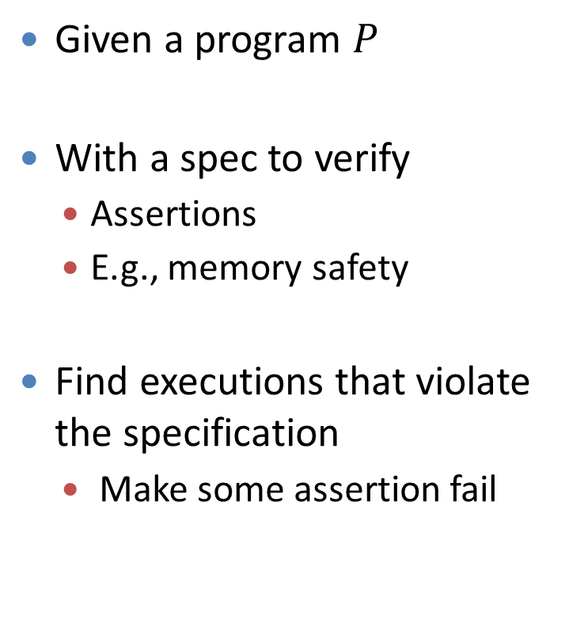
Assertion Checking
void strcopy
(char* dst, char*src, int size)
{
int i=0;
for(;i<size-1 &&
*src; i++)
*dst++ = *src++;
*dst = 0;
}
Given a program $P$
With a spec to verify
  Assertions
  E.g., memory safety
Find executions that violate the specification
  Make some assertion fail
assert(Valid(x)) before every *x
Notes:
First let us briefly recall assertion checking. We are given a program P, say this strcopy procedure, which copies characters from the src array to the destination array.
And we want to validate a specification. An example of a spec is that no assertion is violated.
Assertions are quite expressive and can represent several interesting properties, one example being memory safety.
For checking memory safety, we are interested in proving that all memory dereferences correspond to valid addresses.
One way to check memory safety, is to put an assertion before every dereference which ensures that the memory access is valid.
A memory safety checker will try to find executions that make some assertion fail and these correspond to violations of the specification.

Slide 3

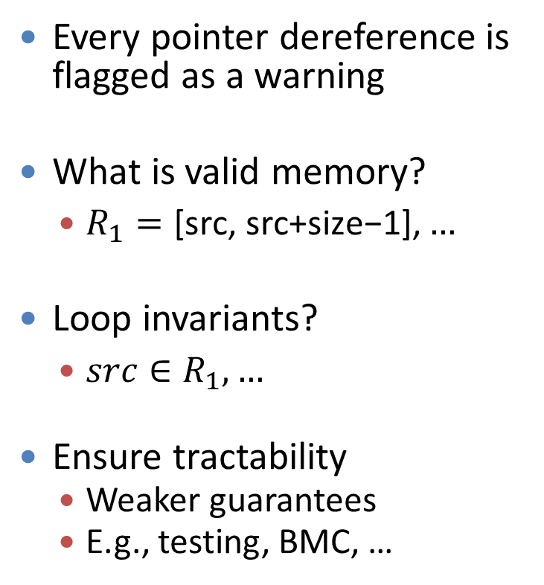
Assertion Checking is Hard
void strcopy
(char* dst, char*src, int size)
{
int i=0;
for(;i<size-1 &&
*src; i++)
*dst++ = *src++;
*dst = 0;
}
Every pointer dereference is flagged as a warning
What is valid memory?
  $R_{1}=\text{[}\text{src}\text{, }\text{src}\text{+}\text{size}\text{−1],}…$
Loop invariants?
  $src∈R_{1},…$
Ensure tractability
  Weaker guarantees
  E.g., testing, BMC, …
Notes:
If we take our program and give it to a memory safety checker as is then what will happen.
Well, every pointer dereference will be flagged as a warning. To be sound, a checker has to assume that all memory can be invalid.
To obtain useful results, we need to tell the checker what is valid memory at start of this procedure.
For example, we can say that the range of addresses from src to src+size-1 are valid.
Moreover, we might also need to provide loop invariants.
These can include among other things that some pointers are within some ranges.
Given such information, the checker might be able to prove memory safety.
From this small example, it is clear that this process can quickly become intractable and it seems that to ensure tractability, we might have to settle with weaker guarantees.

Slide 4

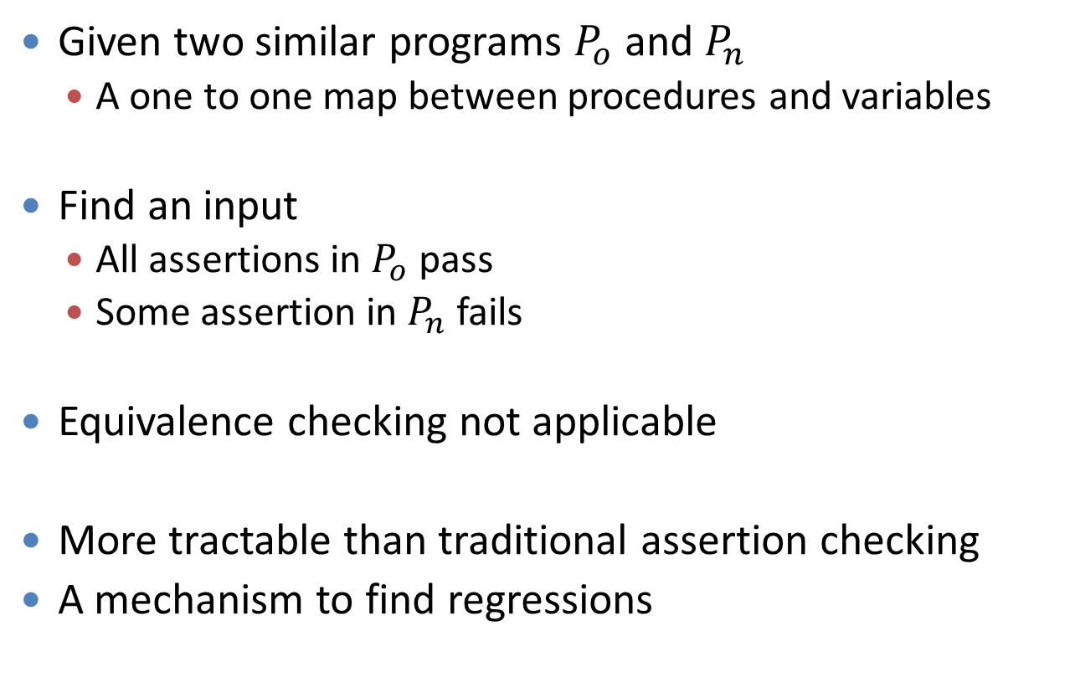
Correctness -> Relative Correctness
Given two similar programs $P_{o}$ and $P_{n}$
  A one to one map between procedures and variables
Find an input
  All assertions in $P_{o}$ pass
  Some assertion in $P_{n}$ fails
Equivalence checking not applicable
More tractable than traditional assertion checking
A mechanism to find regressions
Practical and useful
Notes:
We explore relative specifications as a means to provide weaker but useful guarantees.
So instead of proving a spec, we will prove a relative spec.
Assume that you are given two similar procedures Po and Pn.
You can think of P0 as an old version of a program and Pn as a new version.
Instead of proving memory safety of pn,
we prove the memory safety of Pn w.r.t. Po. That is we prove that Pn is memory safe if Po is memory safe.
We prove it by proving that the set of addresses dereferenced by Pn are a subset of Po. This can alleviates us from specifying to our checker that what is valid memory. We trust that our old version was working properly and any memory dereferenced by the old version is valid memory. And if the new program does not dereference any new address then it is also memory safe.
In general, a violation of a relative spec is an input for which all assertions in the old version pass and some assertion in the new version fails. Now this is a weaker guarantee than proving that all assertions hold in a program, but it is a useful guarantee as its violations correspond to regressions.

Slide 5

Relative Correctnesss (Bug)
void strcopy_correct
(char* dst, char*src, int size)
{
int i = 0;
for(;i<size-1 &&
*src; i++)
*dst++ = *src++;
*dst = 0;
}
void strcopy_buggy
(char* dst, char*src, int size)
{
int i = 0;
for(;*src &&
i<size-1; i++)
*dst++ = *src++;
*dst = 0;
}
CEX: size=0, src =0, dst= some valid location
Notes:
Consider this example. We have our strcopy procedure on the left. Now suppose I decide to flip the order of the predicates in the loop guard. Our tool for checking relative specification, when instantiated to check memory safety, will return a counter-example. For this input, the old version works fine and the new version dereferences an illegal memory location. Hence we are able to catch a regression bug.

Slide 6

Relative Correctness (Proof)
void strcopy_buggy
(char* dst, char*src, int size)
{
int i=0;
for(;*src &&
i<size-1; i++)
*dst++ = *src++;
*dst = 0;
}
void strcopy_correct
(char* dst, char*src, int size)
{
int i=0;
for(;i<size-1 &&
*src; i++)
*dst++ = *src++;
*dtmp = 0;
}
No need to constrain the inputs
Invariants: src.1=src.2, dst.1=dst.2, size.1=size.2, i.1=i.2
Notes:
Conversely, if the old version was the buggy version and we fixed the bug, by putting the order of predicates right,
then our checker can prove the relative memory safety. Now I am sure that I have not inadvertently not introduced any new illegal memory dereferences. Looking closer, the invariants used to prove the relative memory safety by our tool, are much simpler than what are required for proving the memory safety and hence seem possible to infer automatically rather than being manually provided by the user. They are just correspondence between variables of the two programs. Note that these correspondences are generally simple but might not always be symmetrical or just simple equalities.

Slide 7
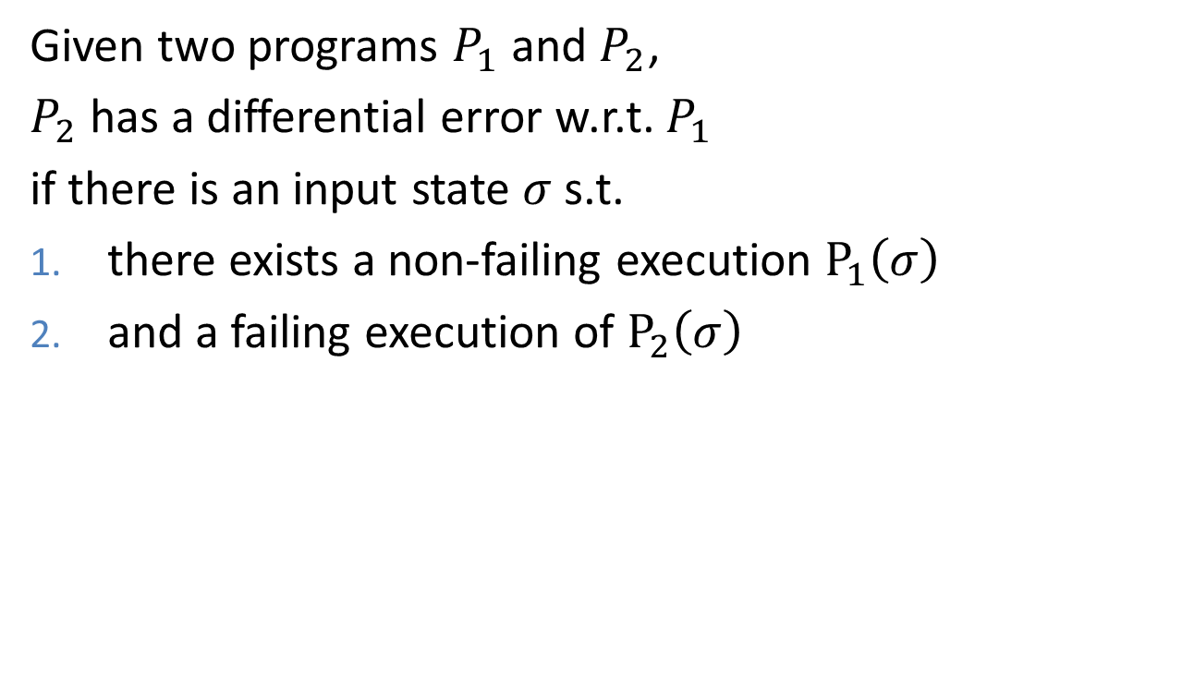
Differential Assertion Checking
Given two programs $P_{1}$ and $P_{2}$,
$P_{2}$ has a differential error w.r.t. $P_{1}$
if there is an input state $σ$ s.t.
there exists a non-failing execution $P_{1}\left(σ\right)$
and a failing execution of $P_{2}\left(σ\right)$
Notes:
We call the checking of relative specs, where the specs are given by assertions, as differential assertion checking. P2 has a differential error w.r.t. P1 denoted by DAC(P2,P1),
if there is an input state for which there is an execution of P1 starting from that state that does not violate any assertion and starting from the same input, P2 has an execution that can violate some assertion.

Slide 8
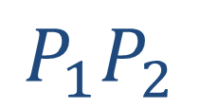
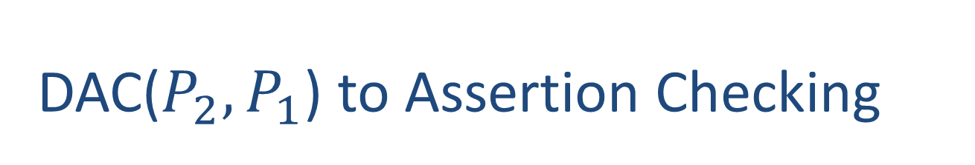
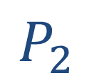




DAC($P_{2},P_{1}$) to Assertion Checking
$${P_{1}P}_{2}$$
$$P_{1}$$
$$P_{2}$$
bool ok1;
bool ok2;
ok1:=ok2:=true;
main1
main2
main1main2
n1
n2
assert ok1=>ok2
$$⋮$$
$$⋮$$
n1n2
assert b
assert b
$$⋮$$
ok1:=ok1 && b
ok2:=ok2 && b
Notes:
Now suppose you have an assertion checker. How do you use it for DAC ideally without making any changes to the implementation of your checker. We have two programs P1 and P2. The entry procedures are main1 and main2 respectively. n1, n2, and so on represent other procedures of the programs. We first introduce a new global boolean variable ok1 in P1 and similarly for P2. Next we perform a syntactic transformation. All assertions assert b in P1 are replaced by an assignment to OK variable. If an assertion gets violated then the ok variable will be assigned false. Similarly for P2. Now we construct the composed program p1p2. main1main2 corresponds to the entry procedure for the composed program. We prefix the body of main1main2 with an initialization to ok1 and ok2.
And we suffix main1main2 by an assertion ok1 implies ok2. Now any violation of this assertion provides a differential error: an input for which all assertions in P1 pass and some assertion in P2 fails. By using your favorite assertion checker on the composed program, you can find differential errors.

Slide 9
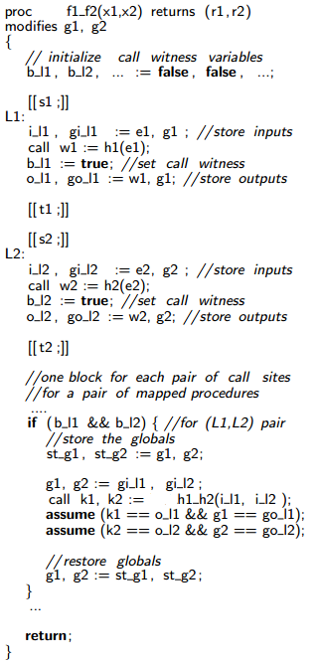
Composed Program
proc f1(x1): r1
modifies g1
{
s1;
L1:
w1 := call h1(e1);
t1
}
proc f2(x2): r2
modifies g2
{
s2;
L2:
w2 := call h2(e2);
t2
}
Notes:
Suppose we have two procedures f1 and f2 that call procedures h1 and h2 then we can compose them to obtain a joint procedure for f1 and f2 which looks like this. The details are in the paper but
the most important part of this composition is that the joint procedure of f1 and f2 calls the joint procedure for h1 and h2. This transformation helps us prove the following result.

Slide 10

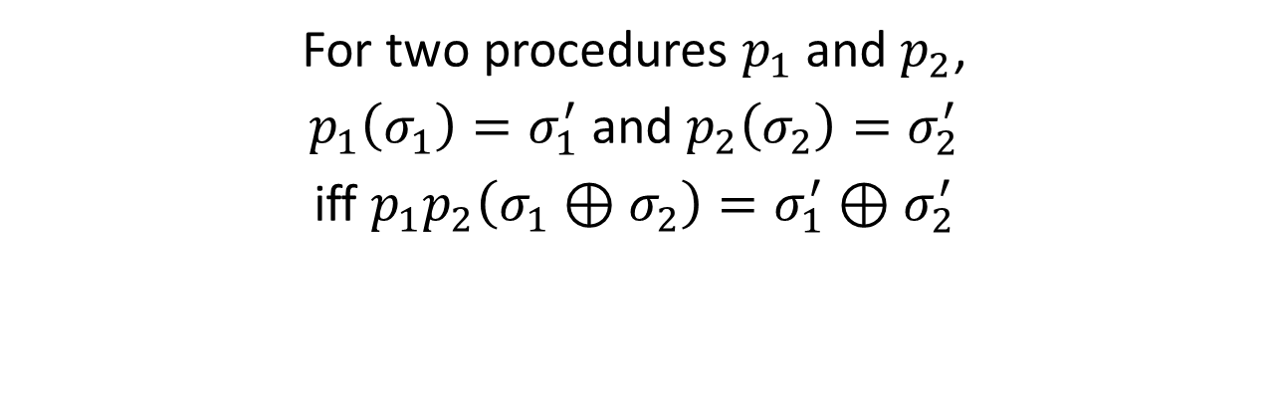
Main Result
For two procedures $p_{1}$ and $p_{2}$,
$p_{1}\left(σ_{1}\right)=σ_{1}^{′}$ and $p_{2}\left(σ_{2}\right)=σ_{2}^{′}$
iff $p_{1}p_{2}\left(σ_{1}⊕σ_{2}\right)=σ_{1}^{′}⊕σ_{2}^{′}$
The joint procedure $p_{1}p_{2}$ precisely captures $p_{1}$ and $p_{2}$
Holds even in the presence of loops and recursion
Notes:
If p1 transforms an input state sigma1 to sigma1prime and p2 transforms an input state sigma2 to sigma2prime,
then the joint procedure of p1 and p2 transforms the state given by disjoint sum of sigma1 and sigma2 to the disjoint sum of sigma1prime and sigma2prime. Hence the joint procedure precisely captures the executions of the individual procedures and this works even in the presence of loops and recursion.

Slide 11
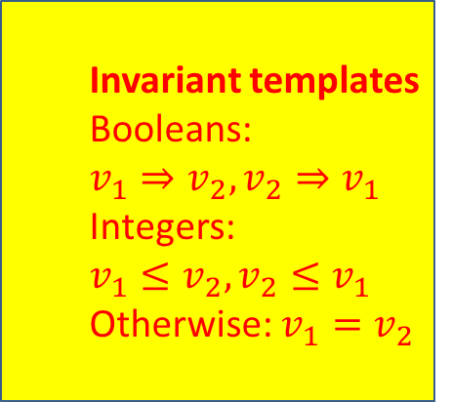
Implementation Workflow
  Invariant templates
  Booleans: $v_{1}⇒v_{2}, v_{2}⇒v_{1}$
  Integers: $v_{1}≤v_{2},v_{2}≤v_{1}$
  Otherwise: $v_{1}=v_{2}$
P1.bpl
SymDiff
Houdini
annotated
P1P2.bpl
P1P2.bpl
P2.bpl
Boogie
SMT
Verifying bug fixes
Filtering alarms
Z3
Notes:
We have instantiated this framework and
here is the workflow of our implementation. Our tool takes two C programs as input.
We use Havoc to compile them into Boogie programs, where boogie is an intermediate language with formal semantics.
Havoc can also be told to instrument the programs with relevant assertions, such as those corresponding to memory safety.
Next, we leverage SymDiff, which is an infrastructure for comparing two boogie programs.
Our implementation of about 800 lines of C# composes the two programs to obtain a joint program with the ok1=>ok2 assertion.
Next we use houdini to perform inference and obtain a file annotated with pre conditions, post conditions, and loop invariants.
This annotated program is consumed by boogie that generates verification conditions that are fed to an SMT solver.
We use Z3 as our SMT solver. If Z3 finds a violation of the assertion then we have a differential error. Otherwise, we have verified a relative specification. The result is a fully automatic tool and we use it for automatically verifying bug fixes and study the effectiveness of DAC in filtering alarms.

Slide 12
Verifying Bug Fixes
Did a fix inadvertently introduce new bugs
Verisec suite:
“snippets of open source programs which contain buffer overflow vulnerabilities, as well as corresponding patched versions.”
Relative buffer overflow checking
Examples include apache, madwifi, sendmail, …
Notes:
First, let us talk about verifying bug fixes. We are interested in answering the question whether a bug fix can inadvertently introduce new errors. For this case study we use the Verisec benchmark suite. This suite has buggy and patched versions of snippets of open source software. Since the bugs are buffer overflow errors, we validate relative buffer overflows in the patched version w.r.t. the buggy version.
Our tool is able to automatically prove the relative correctness of these snippets thus ensuring that a new buffer overflow vulnerability was not introduced during the fix. For more details please refer to the paper but to give an idea of these patches, I will show an example.

Slide 13
Example
int main_buggy()
{
…
fb := 0;
while(c1=read()!=EOF)
{
fbuf[fb] = c1;
fb++;
}
…
}
int main_patched()
{
…
fb := 0;
while(c1=read()!=EOF)
{
fbuf[fb] = c1;
fb++;
if(fb >= MAX)
fb = 0;
}
…
}
Buffer Overflow
Invariant: fb.2<=fb.1
Notes:
Here is a buggy version for one of the benchmarks in the verisec suite. The variable fb increases beyond bound and can overflow fbuf.
In the patched version, fb is re-initialized to zero when it exceeds a bound. Houdini is able to infer that fb of the patched version always has a value less than or equal to fb of the buggy version and use this invariant to automatically prove the relative buffer overflow specification.

Slide 14
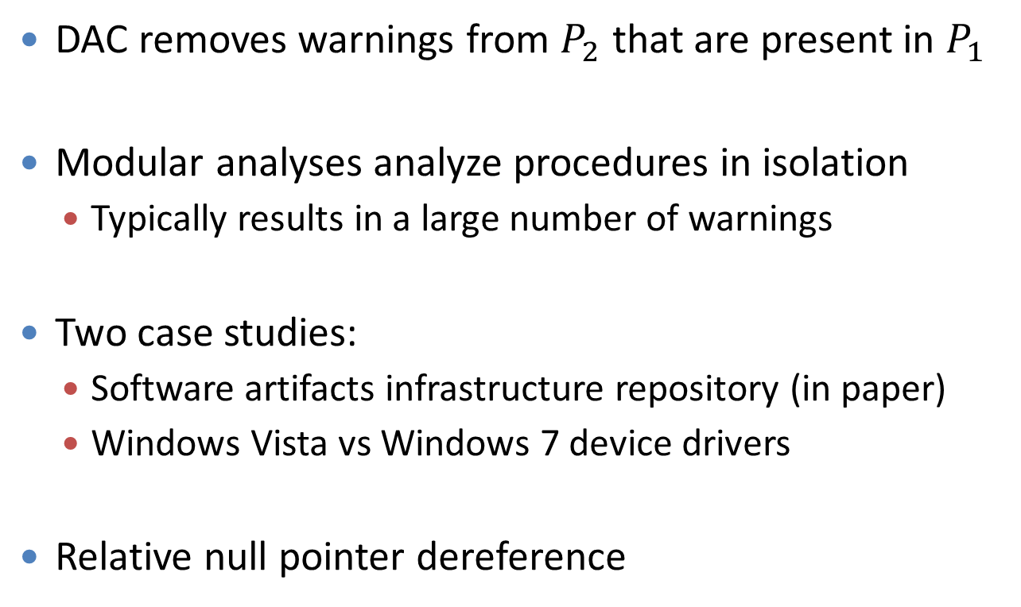
Filtering Warnings
DAC removes warnings from $P_{2}$ that are present in $P_{1}$
Modular analyses analyze procedures in isolation
  Typically results in a large number of warnings
Two case studies:
  Software artifacts infrastructure repository (in paper)
  Windows Vista vs Windows 7 device drivers
Relative null pointer dereference
Notes:
Another way to look upon is DAC that it helps us filter warnings. While checking P2, it omits the warnings that are present in P1.
This can avoid the unhappy situation in which a user of a tool sees the same old false positives whenever the tool is run on every new version of the same codebase. Analyses that are modular, that is analyze each procedure in isolation, generally suffer from a lot of false positives, since they try to soundly over-approximate the environment in which the procedure is executed. Here DAC can be useful in reducing the number of warnings. We perform two case studies to explore this hypothesis. We analyze different versions of the same program present in the software artifacts repository. We also check windows 7 drivers relative to windows vista drivers.
For each procedure in a vista driver, we take its corresponding function in win7 driver, and using dac try to find inputs for which the procedure in vista does not dereference a null pointer but the corresponding procedure in win7 does. Note that we analyze only a single procedure for differential errors rather than analyzing the whole program.

Slide 15
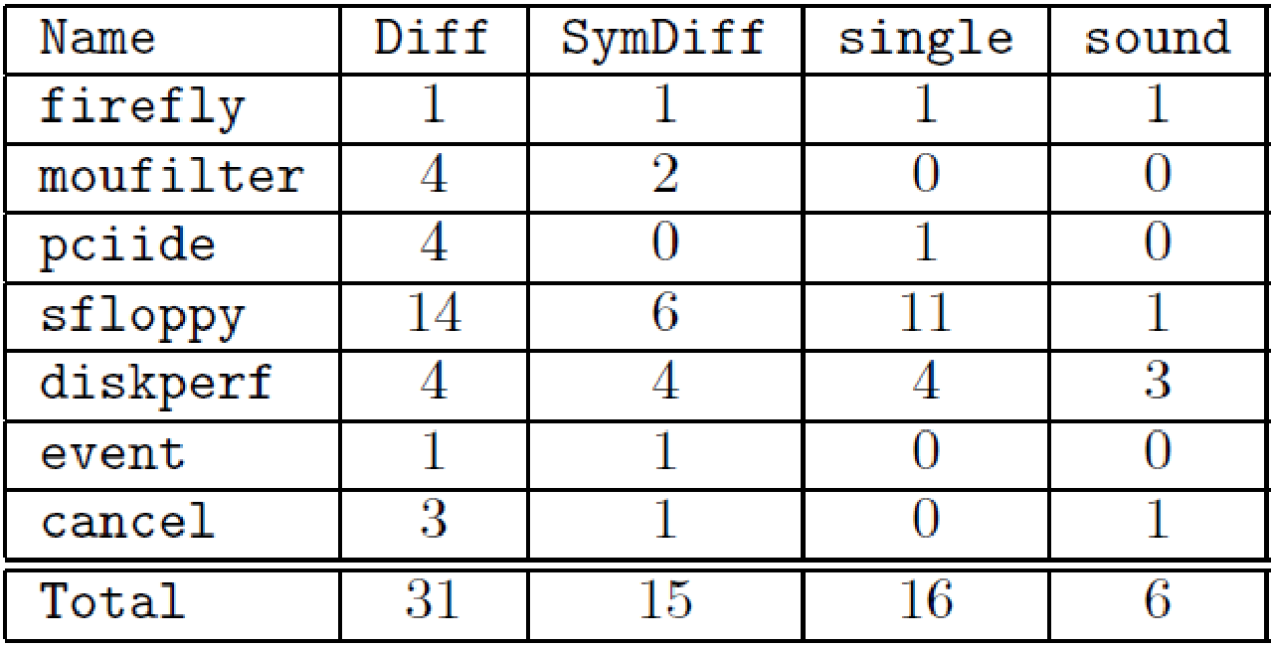
WDK results
Notes:
And here are our results. The first column is the name of drivers which range from 500 to 3000 lines. The first column shows the number of procedures that were syntactically modified in going from vista to win7. The next column shows the number of procedures for which symdiff failed to show semantic equivalence. Hence these are the procedures that may have different functionalities in vista and win7.
Next we ran havoc and boogie to check the changed procedures modularly for null pointer exceptions and the results are in the column single. Next we run DAC. But since we are modular and analyzing a procedure in isolation, we conservatively assume that the callee can dereference a null pointer if it is called with different arguments in win7 driver than what the arguments were passed in the vista driver. Even though this assumption is very conservative, we see a drop in the warnings. Next, we play around with some knobs. If we restrict ourselves to warnings in which the null pointer dereference has to happens in the procedure under analysis and not callees, given by the column unsound, then as expected we see a further drop in warnings. Hence DAC provides new knobs for weakening guarantees and decreasing the number of warnings.

Slide 16
Related Work
Joshi et al. ‘12: Differential errors for bounded programs
Relative properties of approx. program transformations (Carbin et al. ‘12, ‘13)
  No automatic tool for checking these
Equivalence checking:
  Translation validation, validating program refactorings
Product programs (Barthe et al. ‘11, Pnueli et al. ‘08)
Notes:
The idea of differential errors was also proposed in popl 2012 where the authors filtered the warnings obtained on analyzing a concurrent program using the sequential version of the same program. However, the approach could not handle loops and recursion soundly.
There is some interesting work coming out of MIT where they are exploring relative properties like relative progress and relative memory safety, and our contribution is that we have provided an automatic tool for checking these.
There is a rich literature on equivalence checking of two programs, but equivalence is a strong property and many a times two different versions of the same program or bug fixes violate equivalence. Construction of joint or product programs has been well studied. Our transformation is different from the previously known transformations as it is modular. Gu et al talk about completeness of a bug fix but they have no soundness guarantee in presence of loops and recursion.

Slide 17
Conclusion
A new form of relative correctness, from assertions
  Complementary to equivalence and refinement
A modular composition procedure
  Enables decomposition of the proof
  Use off-the-shelf verifiers for differential checking
Implementation inside SymDiff for automated proofs
Applications: bug fixes and filtering warnings
Notes:
To conclude, using similar programs instrumented with assertions, we have defined a new form of relative specification.
Previous work on comparing two programs has generally been limited to equivalence checking or showing refinement. But these properties do not cover the full spectrum of relative specs, say, they cannot be used to prove the correctness of bug fixes.
We have designed a new general composition procedure and we have shown how one can use it in combination with standard assertion checkers to find differential errors. Hence now you can start using your favorite assertion checker to find differential errors.
We have implemented our approach for automatically proving relative specs and have applied it to verification of bug fixes and filtering warnings. And now I will be happy to take any questions.

Slide 18
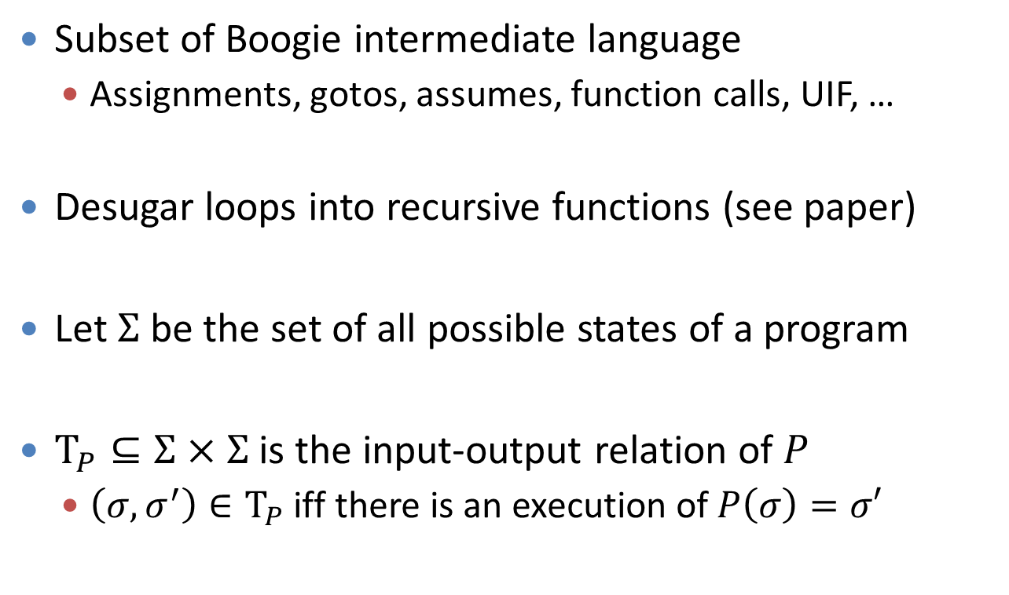
Syntax and Semantics
Subset of Boogie intermediate language
  Assignments, gotos, assumes, function calls, UIF, …
Desugar loops into recursive functions (see paper)
Let $Σ$ be the set of all possible states of a program
$Τ_{P}⊆Σ×Σ$ is the input-output relation of $P$
  $\left(σ,σ^{′}\right)∈Τ_{P}$ iff there is an execution of $P\left(σ\right)=σ′$

Slide 19
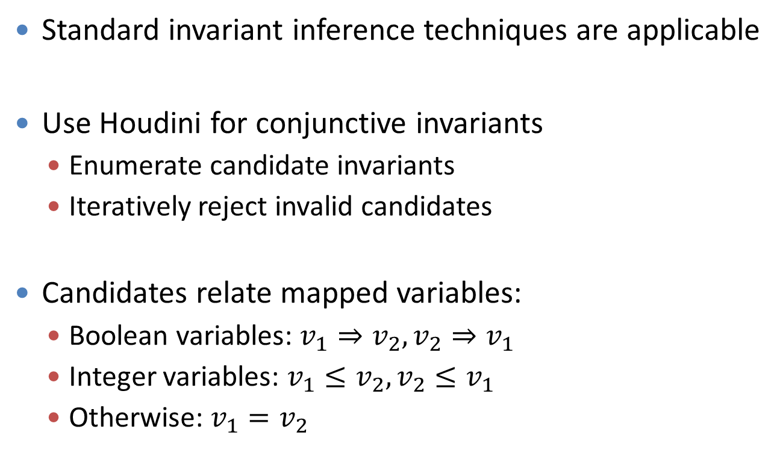
Invariant Inference
Standard invariant inference techniques are applicable
Use Houdini for conjunctive invariants
  Enumerate candidate invariants
  Iteratively reject invalid candidates
Candidates relate mapped variables:
  Boolean variables: $v_{1}⇒v_{2}, v_{2}⇒v_{1}$
  Integer variables: $v_{1}≤v_{2},v_{2}≤v_{1}$
  Otherwise: $v_{1}=v_{2}$

Slide 20
Composing Procedures
proc f1(x1)
modifies g1
{
w1 := call h1(e1);
}
proc f2(x2)
modifies g2
{
w2 := call h2(e2);
}

Slide 21
Composed Procedure
proc MS_f1_f2(x1,x2) modifies g1, g2
{
i1, g_i1 := e1, g1;
w1 := call h1(e1);
o1 := w1; g_o1 := g1;
…
g1, g2 := g_i1, g_i2;
k1, k2 := call MS_h1_h2(i1,i2);
assume(k1==o1 && g1==g_o1);
assume(k2==o2 && g2==g_o2);
}

Slide 22
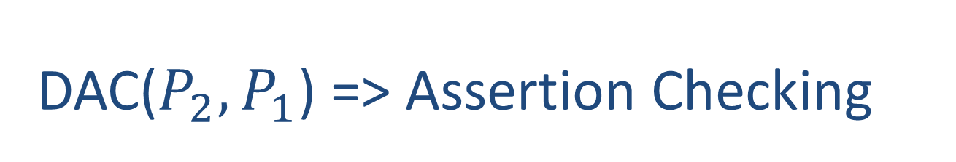
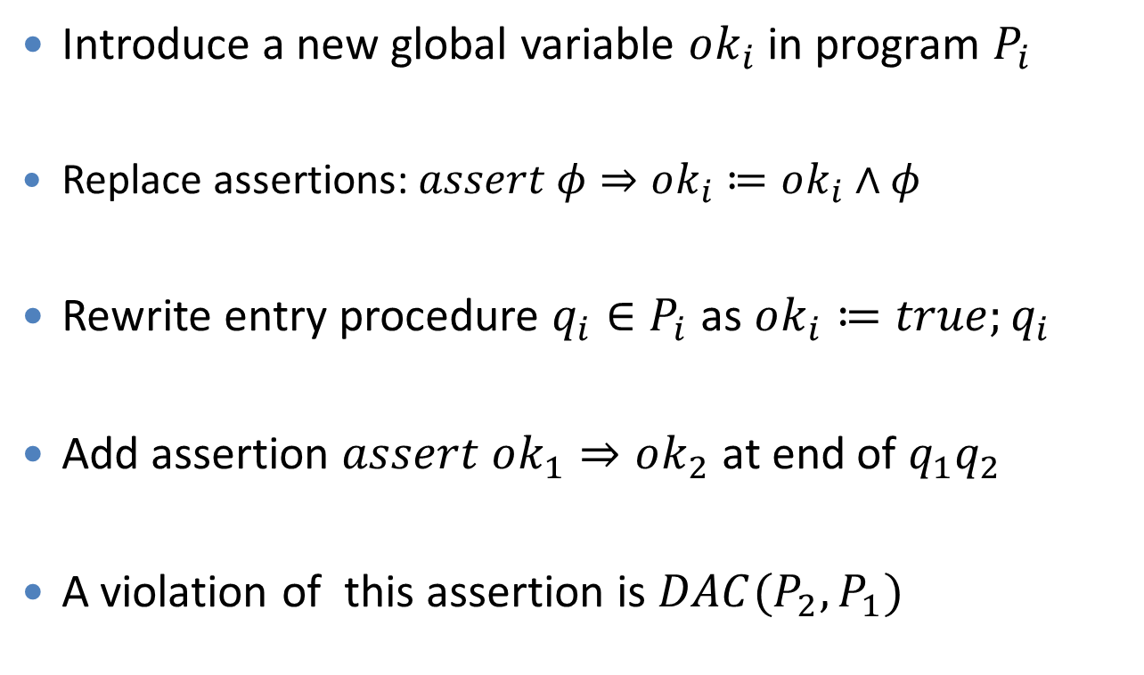
DAC($P_{2},P_{1}$) => Assertion Checking
Introduce a new global variable $ok_{i}$ in program $P_{i}$
  Replace assertions: $assert φ⇒ok_{i}≔ok_{i}∧φ$
Rewrite entry procedure $q_{i}∈P_{i}$ as $ok_{i}≔true;q_{i}$
Add assertion $assert ok_{1}⇒ok_{2}$ at end of $q_{1}q_{2}$
A violation of this assertion is $DAC(P_{2},P_{1})$
Notes:
Now we summarize the process of reducing checking DAC(P2,P1) to the problem of assertion checking that can be handled by standard checkers.
We introduce a new global variable OK1 in P1 and OK2 in P2. Then each assertion assert phi in P1 is replaced by ok1=ok1 and phi.
And a similar syntactic transformation is done for p2. The variables OK1 and OK2 are initialized to true in the entry procedures.
Next we generate a joint program by generating joint procedures. At the end of the joint procedure of the entry procedures, we add an assertion ok1 implies ok2. Now any violation of this assertion provides a differential error: an input for which all assertions in P1 pass and some assertion in P2 fails.

