Slide 1
Publicly verifiable Grouped Aggregation Queries on
Outsourced Data Streams
Cryptographer
Alert
Suman Nath
Microsoft Research, Redmond
Sensing and Energy Research Group
Ramarathnam Venkatesan
Microsoft Research India
Redmond

Slide 2
Publicly verifiable Grouped Aggregation Queries on
Outsourced Data Streams
Verification can not use secrets
TO UNTRUSTED COMPONENTS
Cryptographer
Alert
Too much data
Must use small memory
components
BY
UNTRUSTED
COMPONENTS
Advent of cloud, we will see this more and more

Slide 3
Databases, Data Engineering, Data X….
A.C
B.C
A.C
2011+x
Year of your choice

Slide 4
Outline
Contexts and Goals
Our Solution: DiSH
Various Extensions
Results
  Verification time should be comparable to downloading time

Slide 5


In-house Stream Processing
Clients
(Untrusted)
Results of
continuous query
Data Owner
Query
DataStream
Result

Slide 6
Motivation
Sensor network example
E-bay style example
Part of a bigger set of queries to be supported
  Max, min, average, top-k .
  Focus:Stream version, not the stored DB

Slide 7





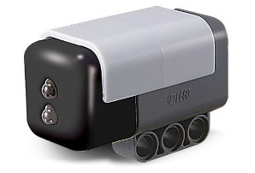
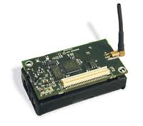
Motivating Examples
Owner
Purchase
events
Server
Sensing
events
Histogram of
<sensing event,
time>
Histogram of
<buyer demographic,
product id>
Client
Sensor network
Online marketplace

Slide 8
tasks
Move the computations to cloud
  (untrusted server)
A front end processing, processing on “encrypted data”
  This case, Small client, small memory
Streaming data
Security modeling
Excellent Problems in the Data Base Setting
Most of them Can not be Outsourced to Cryptographers as a black box

Slide 9
Outsourced Stream Processing
Data owner forwards data stream to Server
Server
(Untrusted)
Clients
(Untrusted)
Client can verify results with a small digest
Results of
continuous query
Data Owner
Outsourced
DataStream
Query
DataStream
Result
Small memory
Clients query Server and gets results

Slide 10
Model
Data owner forwards data stream to Server
Clients query Server and gets results
Client can verify results with a small digest
Public verifiability
  Clients (and Server) are untrusted,
  Clients can collude with Server
  Unlike most previous work
Solutions depend on aggregation functions

Slide 11
Grouped Aggregation Query
Histogram or Group-by, Sum queries
Aggregates
Groups
Stream of tuples <g_{i},v_{i}>
On seeing a tuple <g_{i},v_{i}>, increment the group g_{i} by value v_{i}
Return sums for all groups on demand
SELECT product_id, demographic_id, SUM(purchase_volume)
FROM purchase_stream
GROUP BY product_id, demographic_id

Slide 12

Security Goals
BTW: Crypto Preferred Symbol for an adversary
Dynamic
digest
T
χ
<g_{i},v_{i}>
w
χ
Server
(Untrusted)
Result
DataStream
Outsourced
DataStream
Clients
(Untrusted)
T
Data Owner
Digest
Client can use T to determine if w is correct

Slide 13
Desired properties of T
Should be small and discriminative
  Communication efficiency
Should be incrementally computable
  Works on streaming data
Should not reveal owner’s secret
  Enables public verifiability

Slide 14
Outline
Contexts and Goals
Our Solution: DiSH
Various Extensions
Results

Slide 15
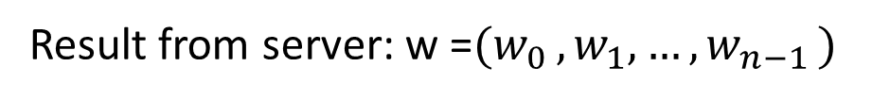
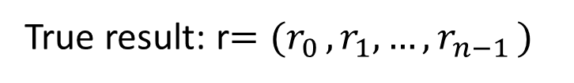
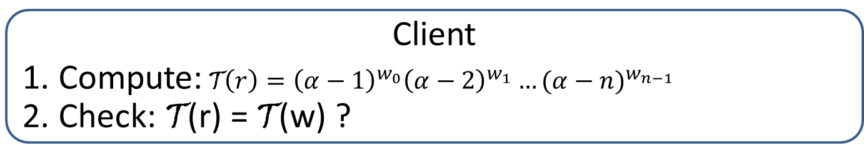
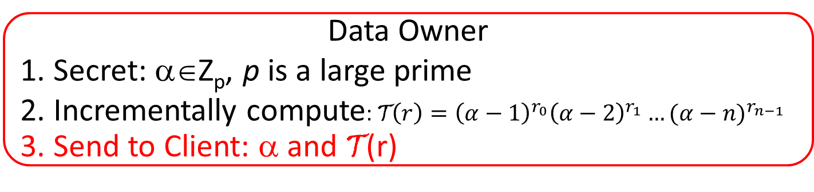
Prior Work (Yi et al. TODS’09)
Result from server: w =$(w_{0 },w_{1}, …,w_{n−1 })$
?
=
True result: r$=(r_{0 },r_{1}, …,r_{n−1 })$
Data Owner
1. Secret: α∈Z_{p}, p is a large prime
2. Incrementally compute:$\text{T}\left(r\right)={\left(α−1\right)}^{r_{0}}{\left(α−2\right)}^{r_{1}}…{(α−n)}^{r_{n−1}}$
3. Send to Client: α and T(r)
r_{k}: Sum of group k
Not publicly verifiable because the secret is needed for verification
Client
1. Compute:$\text{T}\left(r\right)={\left(α−1\right)}^{w_{0}}{\left(α−2\right)}^{w_{1}}…{(α−n)}^{w_{n−1}}$
2. Check: T(r) = T(w) ?
We will use Public Key Crypto.
Computationally Costlier

Slide 16
Structure of DiSH
DiSH: Digest for Streaming Histogram
Secret
g_{i} :Group id
v_{i} :Increment
← Initialized once
Digest
Updated with each tuple <g_{i},v_{i} > in stream
(Updated with Secret and <a,b>)
Publish
Encrypted Secret
from server
Digest
Digest
?

Slide 17
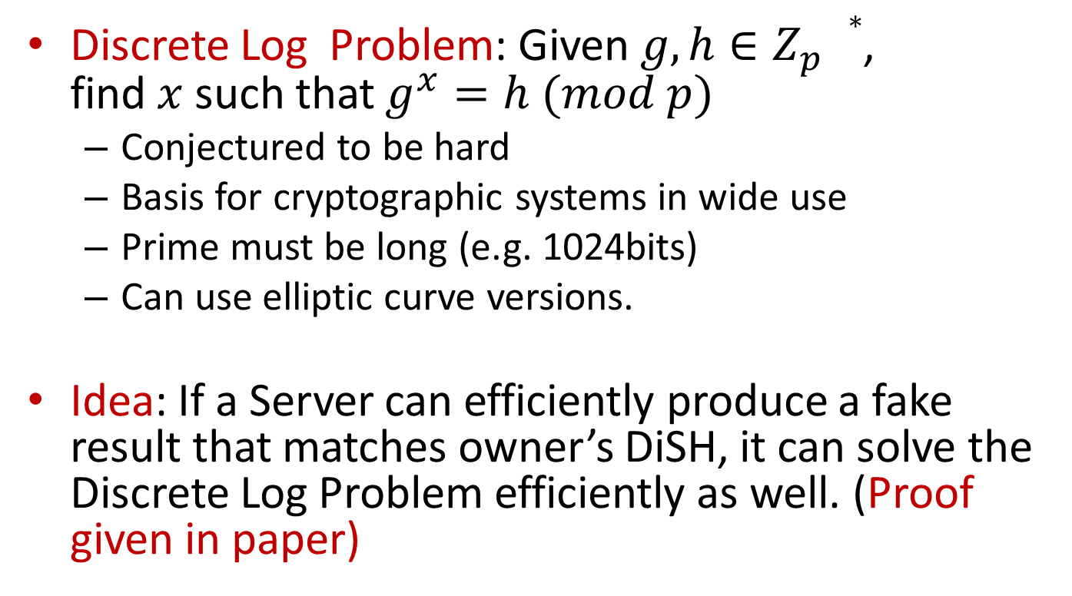
Security Analysis
Discrete Log Problem: Given $g, h∈Z_{p}^{}∗$,
find $x$ such that $g^{x}=h (mod p)$
  Conjectured to be hard
  Basis for cryptographic systems in wide use
  Prime must be long (e.g. 1024bits)
  Can use elliptic curve versions.
Idea: If a Server can efficiently produce a fake result that matches owner’s DiSH, it can solve the Discrete Log Problem efficiently as well. (Proof given in paper)

Slide 18
This is the discrete logarithm problem; considered hard for large values of prime.
There is also an elliptic curve version, whose use is nearly identical.

Slide 19
How to use the discrete log
We now outline the idea
“Linear Algebra in the exponents is HARD”

Slide 20


A terribly easy problem to solve: given${ (c}_{1},c_{2}, …c_{k })$
$${ (α}_{1},α_{2}, …,α_{k−1 })−−Pick any way you want$$
Adjust $c_{k } so that$
0$=\sum_{1}^{k}{c_{i }α_{i}}$
Easy linear algebra
THIS becomes Terribly hard if we are given only
“Linear Algebra in the exponents is HARD”

Slide 21

All multiplications are modulo the prime p
Moral: While verification, Don’t work with${ (c}_{1},c_{2}, …c_{k })$
Work with
PROVE THAT AN ATTACKER, TO FAKE A DIGEST, MUST SOLVE THE PROBLEM THE LEMMA SAYS IS HARD (assuming THE DISCRETE LOGARITHM PROBLEM IS HARD)

Slide 22
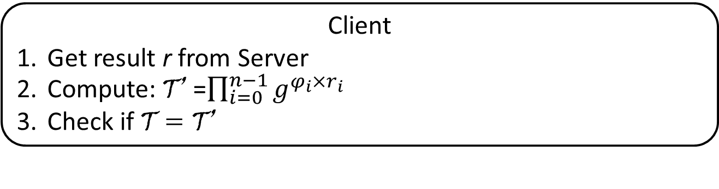
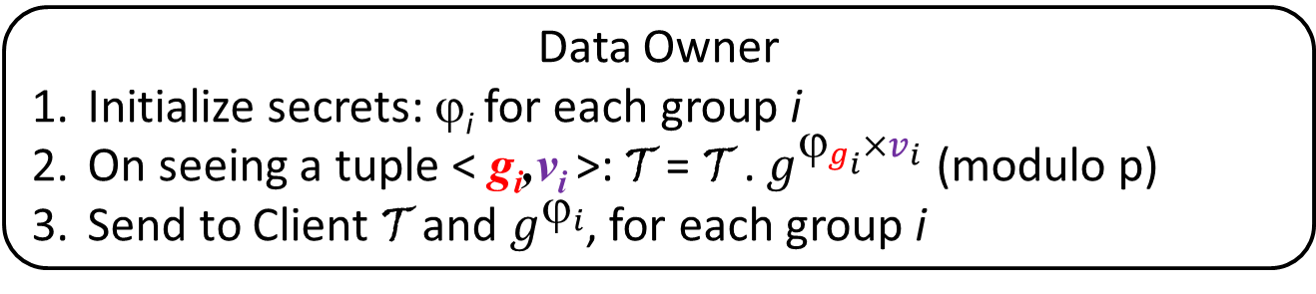

The Basic Protocol
Data Owner
Initialize secrets: ϕ_{i} for each group i
On seeing a tuple < g_{i},v_{i} >: T = T . $g^{_{g_{i}}×v_{i}}$ (modulo p)
Send to Client T and $g^{_{i}}$, for each group i
Too large to send to Client
Incremental computation
Client cannot guess $_{i}$ from $g^{_{i}}$; discrete log problem
Client
Get result r from Server
Compute: T’ =$\prod_{i=0}^{n−1}{g^{φ_{i}{×r}_{i}}}$
Check if T = T’

Slide 23
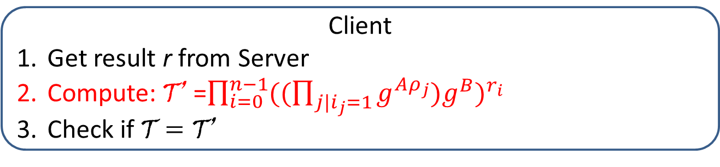
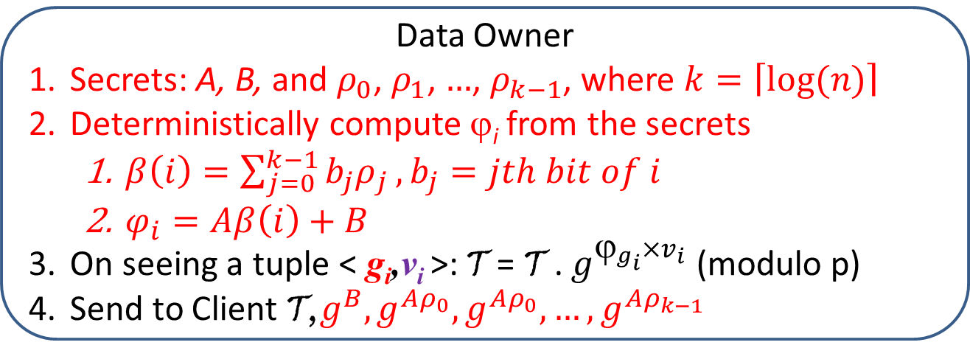
The Optimized Protocol
> #groups
Data Owner
Secrets: A, B, and $ρ_{0}$, $ρ_{1}$, $…$, $ρ_{k−1}$, where $k=\left\lceil log⁡(n)\right\rceil$
Deterministically compute ϕ_{i} from the secrets
  $β\left(i\right)=\sum_{j=0}^{k−1}{b_{j}ρ_{j}}, b_{j}=jth bit of i$
  $φ_{i}=Aβ\left(i\right)+B$
On seeing a tuple < g_{i},v_{i} >: T = T . $g^{_{g_{i}}×v_{i}}$ (modulo p)
Send to Client T,$g^{B},g^{{Aρ}_{0}},g^{{Aρ}_{0}},…,g^{{Aρ}_{k−1}}$
Client
Get result r from Server
Compute: T’ =$\prod_{i=0}^{n−1}{{((\prod_{j|i_{j}=1}{g^{Aρ_{j}}})g^{B})}^{r_{i}}}$
Check if T = T’

Slide 24

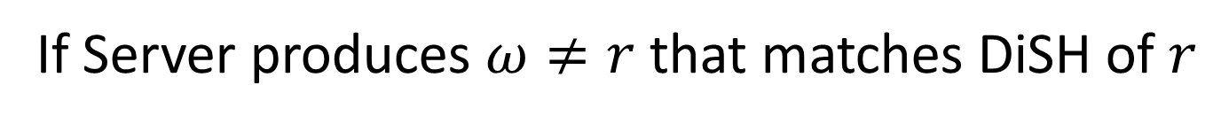

Security Analysis
If Server produces $ω≠r$ that matches DiSH of $r$
$$\prod_{i=0}^{n−1}{{((\prod_{j|i_{j}=1}{g^{Aρ_{j}}})g^{B})}^{ω_{i}}}=\prod_{i=0}^{n−1}{{((\prod_{j|i_{j}=1}{g^{Aρ_{j}}})g^{B})}^{r_{i}}}$$
$$A\sum_{i=0}^{n−1}{β\left(i\right)δ_{i}=−B\sum_{i=0}^{n−1}{δ_{i}}}→Compute A/B$$
Nonzero
$${Give: g}^{B},g^{{Aρ}_{0}},g^{{Aρ}_{1}},…,g^{{Aρ}_{n−1}}, Compute A/B$$
$$To solve DLP: θ=τ^{x}$$
$${Give: τ}^{1},τ^{{xγ}_{0}},τ^{{xγ}_{1}},…,τ^{{xγ}_{n−1}}, Compute x$$

Slide 25
Outline
Contexts and Goals
Our Solution: DiSH
Various Extensions
Results

Slide 26
Queries on Subset of Groups
Client 1
Client 2
Dynamic Subset Queries: Subsets are not known a priori
Our result: No limited-memory signature can verify arbitrary subsets, assuming
  Memory is too small to encode entire result
  Data generated by a stochastic process

Slide 27
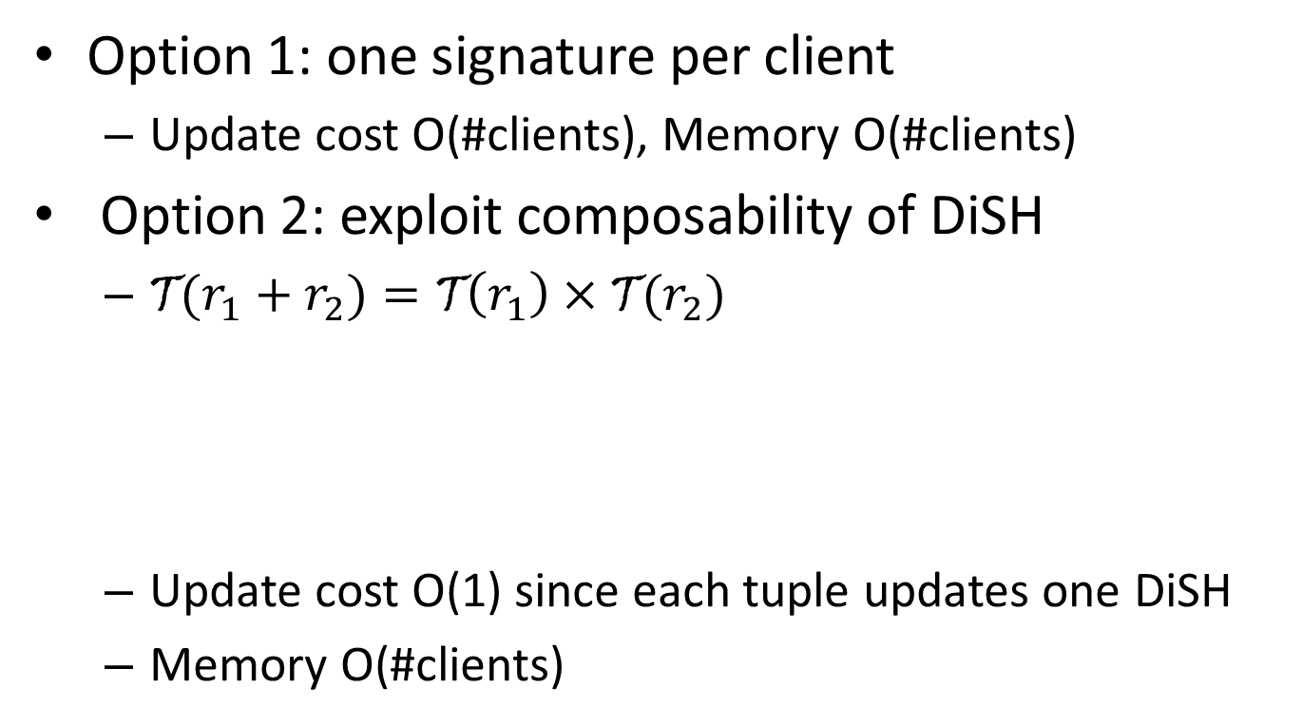
Static Subset Queries
Option 1: one signature per client
  Update cost O(#clients), Memory O(#clients)
Option 2: exploit composability of DiSH
  ${\text{T}(r}_{1}+r_{2})=\text{T}\left(r_{1}\right)×\text{T}(r_{2})$
  Update cost O(1) since each tuple updates one DiSH
  Memory O(#clients)
Three queries
Four DiSH on disjoint sets of groups

Slide 28
Concurrent Queries with
Multiple Grouping Schemes
Select Sum(sales)
Group By customer_age
Select Sum(sales)
Group By customer_income
A client has queries on u grouping schemes
Naïve solution: maintain u DiSH
  O(u) update, O(u) memory, O(u) verification costs
Optimized: maintain 1 DiSH with all groups
  O(u) update, O(1) memory, O(1) verification costs

Slide 29
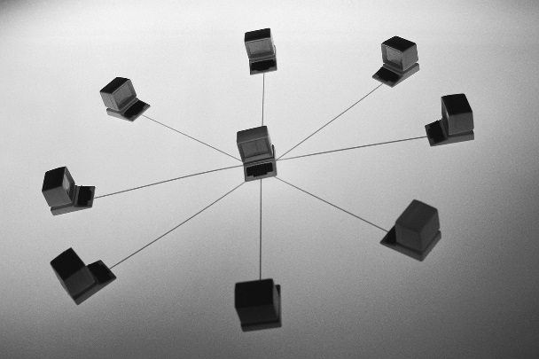
Other Extensions due to
Composability of DiSH
Distributed data collection
  Maintain DiSH at distributed sources, merge at a central place
(Hopping) sliding window
  One DiSH per each hopping window
  Merge to get DiSH for full window
Tolerating communication losses
  See paper
1 Week
Old
data
New
data
1 day

Slide 30
Outline
Contexts and Goals
Our Solution: DiSH
Various Extensions
Results

Slide 31
Experimental Setup
Desktop PC with Intel Core 2 Duo 2.5 GHz CPU
4GB RAM
GNU C++ and NTL library
512-bit prime number
  Typo in the paper: 64-bit
64 bit discrete logarithm is awfully easy.

Slide 32
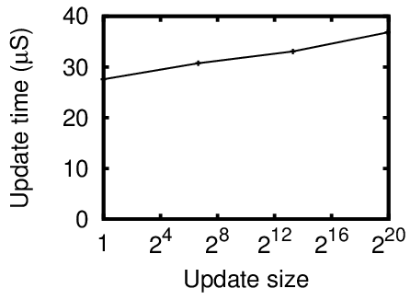
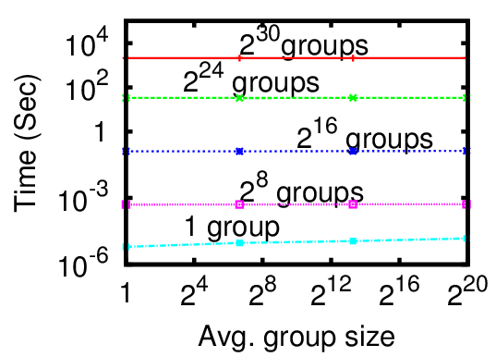
DiSH Overheads
Owner:
More than 30K tuples per second
Client:
Verification time ~1sec
Comparable to result download time

Slide 33
Subset Query Results
A Bing click log
Each Client makes three queries, on 300 random groups
Select Count(*)
Group by geo_location
Select Count(*)
Group by time-of-day
Select Count(*)
Group by clicked_business
 | 1 Query/client | 3 queries/client
 |  | Unoptimized | Optimized
Update time (at Owner) | ~80 μs | ~ 823μs (10 clients) ~ 8.2ms (100) ~ 81.1ms (1000) | ~81μs
Verification time/query (at Client) | ~15 sec | ~ 30 μs | ~ 12 μs

Slide 34
Conclusion
We proposed DiSH, a small digest to verify correctness of streaming histogram queries
  Models of trust in the new scenarios
  And a few extensions
Soundness based on Discrete Log Problem
  Future speed up may come from using other hard problems
Experiments show efficiency

