Slide 1

Z3¹⁰:
Applications
Enablers
Challenges
Directions
Nikolaj Bjørner
Microsoft Research
FSE &

Slide 2
This Talk
Z3 – An Efficient SMT Solver
10 x
  Applications of Z3 (at Microsoft)
  Enabling Technologies – what was important
  Challenges – what is compelling future work
  Directions – emerging applications

Slide 3
An update
on Z3

Slide 4
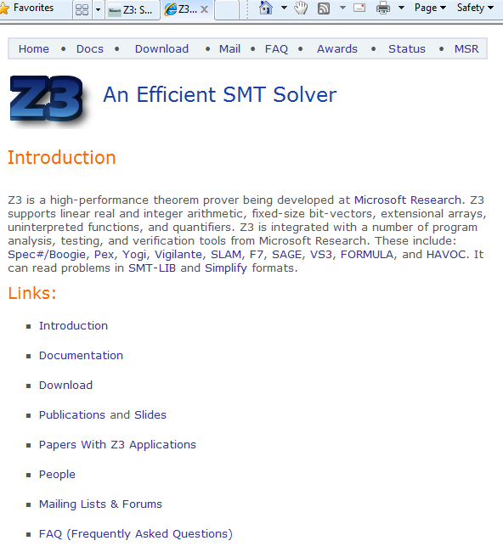
What is Z3?
Text
C
.NET
OCaml
Theories
Bit-Vectors
Rewriting Simplification
Arithmetic
Core Theory
Arrays
Leonardo de Moura &
Nikolaj Bjørner
Microsoft Research
Redmond
E-matching
Data-types
SAT solver
Free functions

Slide 5
What is Z3?
Simplify
Theories
OCaml
Bit-Vectors
Arrays
SMT-LIB
.NET
Lin-arithmetic
Tuples
Native
Uninterpreted functions
C
Quantifiers:
E-matching
Model Generation:
Finite Models
Arithmetic
Arrays
Free Functions

Slide 6
Z3 2.0 released last week
What is new?
Theories
Groebner-basis
for non-linear
arithmetic
Recursive
data-types
Combinatory
Array
Logic
Quantifiers:
Super-position
Proof objects
Parallel Z3
Assumption tracking

Slide 7
Z3¹⁰:
Applications
Enablers
Challenges
Directions

Slide 8
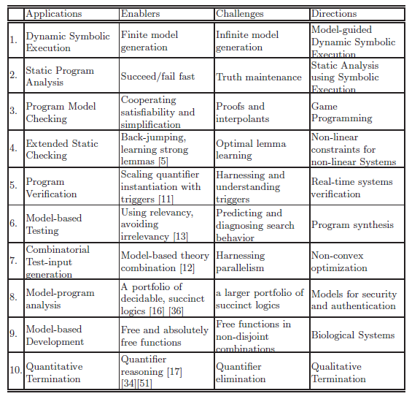

Slide 9

Z3: Some Microsoft Clients
.NET BCL
Hyper-V
Drivers
PEX
VCC
SLAM/SDV
Is this path feasible?
Hoare
Triples
Finite Program abstraction
Model
Proof

Slide 10






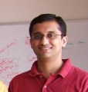


#1 App: Dynamic Symbolic Execution
Run Test and Monitor
Execution Path
Path Condition
seed
Test
Inputs
Known
Paths
New input
Constraint System
Solve
Unexplored path
Vigilante
SAGE
Nikolai Tillmann Peli de Halleux (Pex), Patrice Godefroid (SAGE)
Aditya Nori (Yogi), Jean Philippe Martin, Miguel Castro,
Manuel Costa, Lintao Zhang (Vigilante)

Slide 11

Test-case generation with SAGE for exploring x86 binaries
Internal user: “WEX Security team”
Use 100s of dedicated machines 24/7 for months
Apps: image processors, media players, file decoders,…
Bugs: Write/read A/Vs, Crash,…
Uncovered bugs not possible
with “black-box” methods.
Patrice Godefroid, SPIN workshop Sunday

Slide 12
Test Input Generation by
Dynamic Symbolic Execution
Initially, choose Arbitrary
Run Test and
Monitor
Solve
Test
Inputs
Constraint System
Execution Path
Known
Paths
Choose an
Uncovered Path
Record
Path Condition
Result: small test suite,
high code coverage
Finds only real bugs
No false warnings

Slide 13
Test Input Generation by
Dynamic Symbolic Execution
a[0] = 0;
a[1] = 0;
a[2] = 0;
a[3] = 0;
…
Initially, choose Arbitrary
Run Test and
Monitor
Solve
Test
Inputs
Constraint System
Execution Path
Known
Paths
Choose an
Uncovered Path
Record
Path Condition
Result: small test suite,
high code coverage
Finds only real bugs
No false warnings

Slide 14

Test Input Generation by
Dynamic Symbolic Execution
Initially, choose Arbitrary
Path Condition:
… ⋀ magicNum != 0x95673948
Run Test and
Monitor
Solve
Test
Inputs
Constraint System
Execution Path
Known
Paths
Choose an
Uncovered Path
Record
Path Condition
Result: small test suite,
high code coverage
Finds only real bugs
No false warnings

Slide 15
Test Input Generation by
Dynamic Symbolic Execution
Initially, choose Arbitrary
Run Test and
Monitor
… ⋀ magicNum != 0x95673948
… ⋀ magicNum == 0x95673948
Solve
Test
Inputs
Constraint System
Execution Path
Known
Paths
Choose an
Uncovered Path
Record
Path Condition
Result: small test suite,
high code coverage
Finds only real bugs
No false warnings

Slide 16
Test Input Generation by
Dynamic Symbolic Execution
a[0] = 206;
a[1] = 202;
a[2] = 239;
a[3] = 190;
Initially, choose Arbitrary
Run Test and
Monitor
Solve
Test
Inputs
Constraint System
Execution Path
Known
Paths
Choose an
Uncovered Path
Record
Path Condition
Result: small test suite,
high code coverage
Finds only real bugs
No false warnings

Slide 17
Test Input Generation by
Dynamic Symbolic Execution
Initially, choose Arbitrary
Run Test and
Monitor
Solve
Test
Inputs
Constraint System
Execution Path
Known
Paths
Choose an
Uncovered Path
Record
Path Condition
Result: small test suite,
high code coverage
Finds only real bugs
No false warnings

Slide 18
Automatic Test Input Generation:
Whole-program, white box code analysis
Initially, choose Arbitrary
Run Test and
Monitor
Solve
Test
Inputs
Constraint System
Execution Path
Known
Paths
Choose an
Uncovered Path
Record
Path Condition
Result: small test suite,
high code coverage
Finds only real bugs
No false warnings

Slide 19
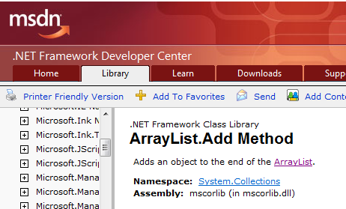
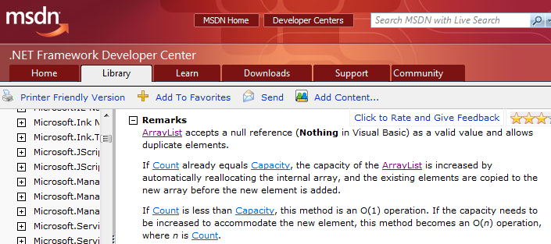
ArrayList with Pex: The Spec
Nikolai Tillmann,
RV workshop, Saturday

Slide 20
ArrayList: AddItem Test
class ArrayListTest {
[PexMethod]
void AddItem(int c, object item) {
var list = new ArrayList(c);
list.Add(item);
Assert(list[0] == item); }
}
class ArrayList {
object[] items;
int count;
ArrayList(int capacity) {
if (capacity < 0) throw ...;
items = new object[capacity];
}
void Add(object item) {
if (count == items.Length)
ResizeArray();
items[this.count++] = item; }
...

Slide 21
ArrayList: Starting Pex …
class ArrayListTest {
[PexMethod]
void AddItem(int c, object item) {
var list = new ArrayList(c);
list.Add(item);
Assert(list[0] == item); }
}
 | Inputs
class ArrayList {
object[] items;
int count;
ArrayList(int capacity) {
if (capacity < 0) throw ...;
items = new object[capacity];
}
void Add(object item) {
if (count == items.Length)
ResizeArray();
items[this.count++] = item; }
...

Slide 22
ArrayList: Run 1, (0,null)
class ArrayListTest {
[PexMethod]
void AddItem(int c, object item) {
var list = new ArrayList(c);
list.Add(item);
Assert(list[0] == item); }
}
 | Inputs
 | (0,null)
class ArrayList {
object[] items;
int count;
ArrayList(int capacity) {
if (capacity < 0) throw ...;
items = new object[capacity];
}
void Add(object item) {
if (count == items.Length)
ResizeArray();
items[this.count++] = item; }
...

Slide 23
ArrayList: Run 1, (0,null)
class ArrayListTest {
[PexMethod]
void AddItem(int c, object item) {
var list = new ArrayList(c);
list.Add(item);
Assert(list[0] == item); }
}
 | Inputs | Observed Constraints
 | (0,null) | !(c<0)
class ArrayList {
object[] items;
int count;
ArrayList(int capacity) {
if (capacity < 0) throw ...;
items = new object[capacity];
}
void Add(object item) {
if (count == items.Length)
ResizeArray();
items[this.count++] = item; }
...
c < 0 → false

Slide 24
ArrayList: Run 1, (0,null)
class ArrayListTest {
[PexMethod]
void AddItem(int c, object item) {
var list = new ArrayList(c);
list.Add(item);
Assert(list[0] == item); }
}
 | Inputs | Observed Constraints
 | (0,null) | !(c<0) && 0==c
class ArrayList {
object[] items;
int count;
ArrayList(int capacity) {
if (capacity < 0) throw ...;
items = new object[capacity];
}
void Add(object item) {
if (count == items.Length)
ResizeArray();
items[this.count++] = item; }
...
0 == c → true

Slide 25
ArrayList: Run 1, (0,null)
class ArrayListTest {
[PexMethod]
void AddItem(int c, object item) {
var list = new ArrayList(c);
list.Add(item);
Assert(list[0] == item); }
}
 | Inputs | Observed Constraints
 | (0,null) | !(c<0) && 0==c
item == item → true
class ArrayList {
object[] items;
int count;
ArrayList(int capacity) {
if (capacity < 0) throw ...;
items = new object[capacity];
}
void Add(object item) {
if (count == items.Length)
ResizeArray();
items[this.count++] = item; }
...
This is a tautology,
i.e. a constraint that is always true,
regardless of the chosen values.
We can ignore such constraints.

Slide 26
ArrayList: Picking the next branch to cover
class ArrayListTest {
[PexMethod]
void AddItem(int c, object item) {
var list = new ArrayList(c);
list.Add(item);
Assert(list[0] == item); }
}
Constraints to solve | Inputs | Observed Constraints
 | (0,null) | !(c<0) && 0==c
!(c<0) && 0!=c
class ArrayList {
object[] items;
int count;
ArrayList(int capacity) {
if (capacity < 0) throw ...;
items = new object[capacity];
}
void Add(object item) {
if (count == items.Length)
ResizeArray();
items[this.count++] = item; }
...

Slide 27
ArrayList: Solve constraints using SMT solver
class ArrayListTest {
[PexMethod]
void AddItem(int c, object item) {
var list = new ArrayList(c);
list.Add(item);
Assert(list[0] == item); }
}
Constraints to solve | Inputs | Observed Constraints
 | (0,null) | !(c<0) && 0==c
!(c<0) && 0!=c | (1,null)
class ArrayList {
object[] items;
int count;
ArrayList(int capacity) {
if (capacity < 0) throw ...;
items = new object[capacity];
}
void Add(object item) {
if (count == items.Length)
ResizeArray();
items[this.count++] = item; }
...
Z3
Constraint solver
Z3 has decision procedures for
Arrays
Linear integer arithmetic
Bitvector arithmetic
…
(Everything but floating-point numbers)

Slide 28
ArrayList: Run 2, (1, null)
class ArrayListTest {
[PexMethod]
void AddItem(int c, object item) {
var list = new ArrayList(c);
list.Add(item);
Assert(list[0] == item); }
}
Constraints to solve | Inputs | Observed Constraints
 | (0,null) | !(c<0) && 0==c
!(c<0) && 0!=c | (1,null) | !(c<0) && 0!=c
class ArrayList {
object[] items;
int count;
ArrayList(int capacity) {
if (capacity < 0) throw ...;
items = new object[capacity];
}
void Add(object item) {
if (count == items.Length)
ResizeArray();
items[this.count++] = item; }
...
0 == c → false

Slide 29
ArrayList: Pick new branch
class ArrayListTest {
[PexMethod]
void AddItem(int c, object item) {
var list = new ArrayList(c);
list.Add(item);
Assert(list[0] == item); }
}
Constraints to solve | Inputs | Observed Constraints
 | (0,null) | !(c<0) && 0==c
!(c<0) && 0!=c | (1,null) | !(c<0) && 0!=c
c<0
class ArrayList {
object[] items;
int count;
ArrayList(int capacity) {
if (capacity < 0) throw ...;
items = new object[capacity];
}
void Add(object item) {
if (count == items.Length)
ResizeArray();
items[this.count++] = item; }
...

Slide 30
ArrayList: Run 3, (-1, null)
class ArrayListTest {
[PexMethod]
void AddItem(int c, object item) {
var list = new ArrayList(c);
list.Add(item);
Assert(list[0] == item); }
}
Constraints to solve | Inputs | Observed Constraints
 | (0,null) | !(c<0) && 0==c
!(c<0) && 0!=c | (1,null) | !(c<0) && 0!=c
c<0 | (-1,null)
class ArrayList {
object[] items;
int count;
ArrayList(int capacity) {
if (capacity < 0) throw ...;
items = new object[capacity];
}
void Add(object item) {
if (count == items.Length)
ResizeArray();
items[this.count++] = item; }
...

Slide 31
ArrayList: Run 3, (-1, null)
class ArrayListTest {
[PexMethod]
void AddItem(int c, object item) {
var list = new ArrayList(c);
list.Add(item);
Assert(list[0] == item); }
}
Constraints to solve | Inputs | Observed Constraints
 | (0,null) | !(c<0) && 0==c
!(c<0) && 0!=c | (1,null) | !(c<0) && 0!=c
c<0 | (-1,null) | c<0
class ArrayList {
object[] items;
int count;
ArrayList(int capacity) {
if (capacity < 0) throw ...;
items = new object[capacity];
}
void Add(object item) {
if (count == items.Length)
ResizeArray();
items[this.count++] = item; }
...
c < 0 → true

Slide 32
ArrayList: Run 3, (-1, null)
class ArrayListTest {
[PexMethod]
void AddItem(int c, object item) {
var list = new ArrayList(c);
list.Add(item);
Assert(list[0] == item); }
}
Constraints to solve | Inputs | Observed Constraints
 | (0,null) | !(c<0) && 0==c
!(c<0) && 0!=c | (1,null) | !(c<0) && 0!=c
c<0 | (-1,null) | c<0
class ArrayList {
object[] items;
int count;
ArrayList(int capacity) {
if (capacity < 0) throw ...;
items = new object[capacity];
}
void Add(object item) {
if (count == items.Length)
ResizeArray();
items[this.count++] = item; }
...

Slide 33
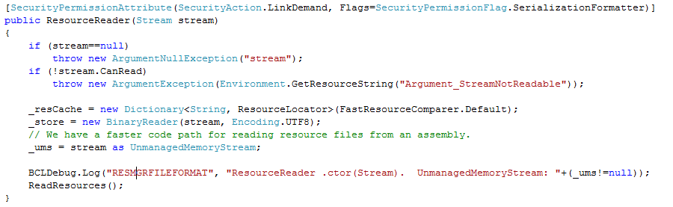
White box testing in practice
How to test this code?
(Real code from .NET base class libraries.)

Slide 34
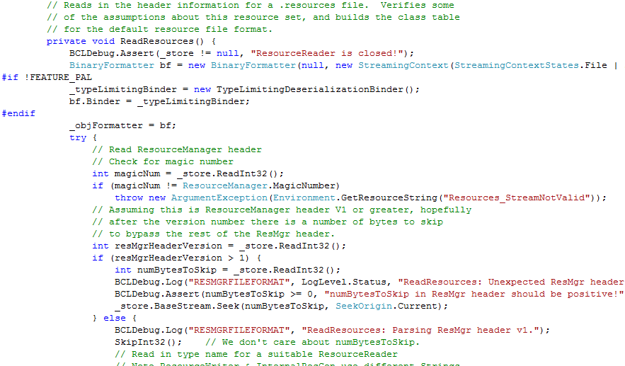
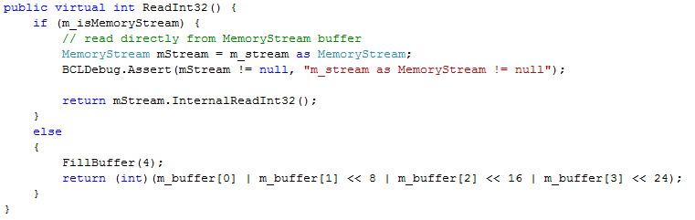
White box testing in practice

Slide 35
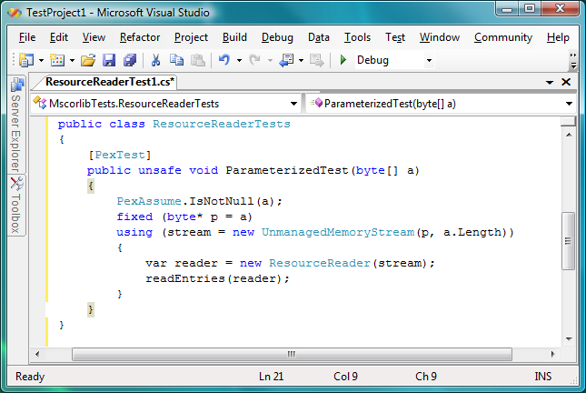
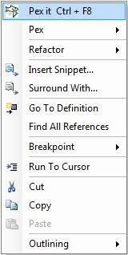
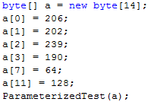
Pex – Test Input Generation Demo
Test input, generated by Pex
35

Slide 36
#1 Enabler: finite model-finding
Model generation
  Models used as test inputs
Incremental solving
  Given a formula F, find a model M, that minimizes the value of the variables x₀ … x_{n}
  Push / Pop of contexts for model minimization
Demo: Example Z3 model
#1 Challenge: non-finite model-finding
#1 Direction: Model-driven
Dynamic Symbolic Execution

Slide 37
#2 Static Program Analysis
3(INT_MAX+1)/4 +
(INT_MAX+1)/4
= INT_MIN
-INT_MIN= INT_MIN
Application: PREfix Static Analysis
Enabler: Bit-precise support
Challenge: Speed
More about PREfix & Z3 by Yannick Moy
int binary_search(int[] arr, int low,
int high, int key)
while (low <= high) {
// Find middle value
int mid = (low + high) / 2;
int val = arr[mid];
// Refine range
...
string itoa(int n) {
string s = “”;
if (n < 0) {
s += “-”;
n = -n;
}
// Add digits to s
….

Slide 38




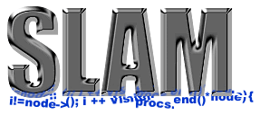

#3 Program Model Checking
Z3 is part of SDV 2.0 (Windows 7) and Yogi
Z3 is used for:
  Predicate abstraction (c2bp)
  Counter-example refinement (newton)
  Maintaining symbolic state summaries
An enabling feature: Term Simplification.
Ella Bounimova, Vlad Levin, Jakob Lichtenberg,
Tom Ball, Sriram Rajamani, Byron Cook, and team

Slide 39














#4 Extended Static Checking
#5 Program Verification
Hyper-V
VCC
Boogie
Win. Modules
HAVOC
Verification
condition
Bug path
Rustan Leino, Mike Barnet, Michał Moskal, Shaz Qadeer,
Shuvendu Lahiri, Herman Venter,
Wolfram Schulte, Ernie Cohen,
Khatib Braghaven, Cedric Fournet, Andy Gordon, Nikhil Swamy
F7

Slide 40

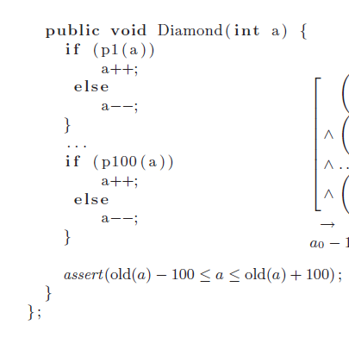
A Program formula
p1(a)
false
true
a = a-1
a = a+1
p2(a)

Slide 41
A Program formula
wp( assert (old(a) – 100 ≤ a ≤ old(a) + 100),
true)

Slide 42
A Program formula
old(a) – 100 ≤ a ≤ old(a) + 100
wp( assert (ψ), ϕ) = ψ ∧ϕ

Slide 43
A Program formula
wp( if (p100(a))
a++;
else
a--;,
old(a) – 100 ≤ a ≤ old(a) + 100)

Slide 44
A Program formula
wp( assume (p100(a)); a++
assume (!p100(a)); a--,
old(a) – 100 ≤ a ≤ old(a) + 100)
wp( if p then S else T, Q ) = wp( assume(p); S assume(!p); T, ϕ)

Slide 45
A Program formula
wp( assume (p100(a)); a++;
old(a) – 100 ≤ a ≤ old(a) + 100)
∧
wp( assume (!p100(a)); a--;,
old(a) – 100 ≤ a ≤ old(a) + 100)
wp( S T, Q ) = wp( S, ϕ) ∧ wp( T, ϕ)

Slide 46
A Program formula
wp( assume (p100(a));
wp( a++,
old(a) – 100 ≤ a ≤ old(a) + 100))
∧
wp( assume (!p100(a));
wp( a--,
old(a) – 100 ≤ a ≤ old(a) + 100))
wp( S ; T, ϕ ) = wp( S, wp( T, ϕ))

Slide 47
A Program formula
wp( assume (p100(a));
old(a) – 100 ≤ a+1 ≤ old(a) + 100)
∧
wp( assume (!p100(a));
wp( a--,
old(a) – 100 ≤ a ≤ old(a) + 100))
wp( x := E, ϕ ) = ϕ[E/x]

Slide 48
A Program formula
wp( assume (p100(a)),
old(a) – 100 ≤ a+1 ≤ old(a) + 100)
∧
wp( assume (!p100(a)),
old(a) – 100 ≤ a-1 ≤ old(a) + 100))
wp( x := E, ϕ ) = ϕ[E/x]

Slide 49
A Program formula
p100(a) ⇒
old(a) – 100 ≤ a+1 ≤ old(a) + 100
∧
!p100(a) ⇒
old(a) – 100 ≤ a-1 ≤ old(a) + 100
wp( assume p, ϕ ) = p ⇒ ϕ

Slide 50
A Program formula
p100(a) ⇒
a100 = a+1 ∧
old(a) – 100 ≤ a100 ≤ old(a) + 100
∧
!p100(a) ⇒
a100 = a-1 ∧
old(a) – 100 ≤ a100 ≤ old(a) + 100
Introduce proxy name for a-1,a+1

Slide 51
A Program formula
old(a) – 100 ≤ a100 ≤ old(a) + 100 ∧
(p100(a) ∨ a100 = a-1) ∧
(!p100(a) ∨ a100 = a+1)
Simplify (for purpose of this presentation)

Slide 52
A Program formula
wp( if (p99(a))
a++;
else
a--,
old(a) – 100 ≤ a₁₀₀ ≤ old(a) + 100 ∧
(p100(a) ∨ a₁₀₀ = a-1) ∧
(!p100(a) ∨ a₁₀₀ = a+1)
)
Next Diamond

Slide 53
A Program formula
old(a) – 100 ≤ a₁₀₀ ≤ old(a) + 100 ∧
(p100(a₉₉) ∨ a₁₀₀ = a₉₉-1) ∧
(!p100(a₉₉) ∨ a₁₀₀ = a₉₉+1) ∧
(p99(a) ∨ a₉₉ = a-1) ∧
(!p99(a) ∨ a₉₉ = a+1)
Next Diamond

Slide 54
A Program formula
old(a) – 100 ≤ a₁₀₀ ≤ old(a) + 100 ∧
(p100(a₉₉) ∨ a₁₀₀ = a₉₉-1) ∧
(!p100(a₉₉) ∨ a₁₀₀ = a₉₉+1) ∧
(p99(a₉₈) ∨ a₉₉ = a₉₈-1) ∧
(!p99(a₉₈) ∨ a₉₉ = a₉₈+1)
…
(p1(a) ∨ a1 = a-1) ∧
(!p1(a) ∨ a1 = a+1)
Last Diamond

Slide 55
A Program formula
a-3 a-2 a-1 a a+1 a+2 a+3
old(a) – 100 ≤ a₁₀₀ ≤ old(a) + 100 ∧
(p100(a₉₉) ∨ a₁₀₀ = a₉₉-1) ∧
(!p100(a₉₉) ∨ a₁₀₀ = a₉₉+1) ∧
(p99(a₉₈) ∨ a₉₉ = a₉₈-1) ∧
(!p99(a₉₈) ∨ a₉₉ = a₉₈+1)
…
(p1(a) ∨ a1 = a-1) ∧
(!p1(a) ∨ a1 = a+1)
a
a₁
a₁
a₂
a₂
a₂
a₃
a₃
a₃
a₃

Slide 56
DPLL(T) is brittle on diamond formulas
The Diamond program formula is easy (for Z3). But, similar problems are hard

Slide 57
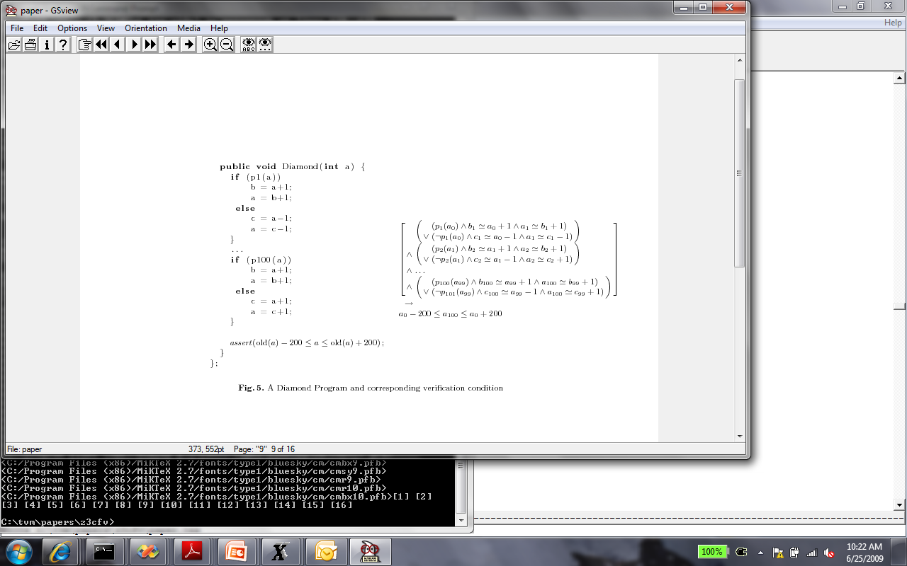
DPLL(T) is brittle on diamond formulas
The Diamond program formula is easy (for Z3). But, similar problems are hard

Slide 58
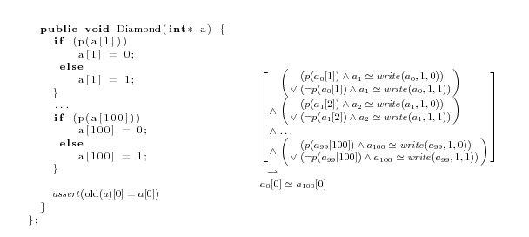
DPLL(T) is brittle on diamond formulas
The Diamond program formula is easy (for Z3). But, similar problems are hard

Slide 59
DPLL(T) is brittle on diamond formulas
A problem:
  Most SMT solvers implement DPLL(T).
  It uses only existing literals.
  Can we learn useful new literals and lemmas?
S
p₁(a₀)
¬ p₁(a₀)
S₁
S₂
a₁ = a₀+2
a₁ = a₀-2
S₁ S₂
a₀ -2 ≤ a₁ ≤ a₀+2

Slide 60
Some recent approaches
  Difference logic: new literals based on activity
        [Wang, Gupta, Ganai, DAC 2006]
  DPLL()
        [Bjorner, Dutertre, de Moura, LPAR 2008]
  1-consistent resolution
        [Cotton, Thesis, Verimag, Yesterday 2009]
  Abstract DPLL/Generalizing DPLL to Richer Logics
        [Kuehlmann, McMillan, Sagiv, CAV 2009]

Slide 61
#6 Model-based Testing
#7 Test-input generation
#8 Model-program exploration
Example MSFT protocol
SMB2 (= remote file) Protocol Specification
200+ other Microsoft Protocols
#6: Symbolic Exploration of protocol models to generate
tests.
#7: Pair-wise independent input
generation for constrained algebraic data-types.
#8: Design time model debugging using Bounded Model Checking
Adapter for testing
Scenarios (slicing)
Behavioral modeling
Scenarios (slicing)

Slide 62
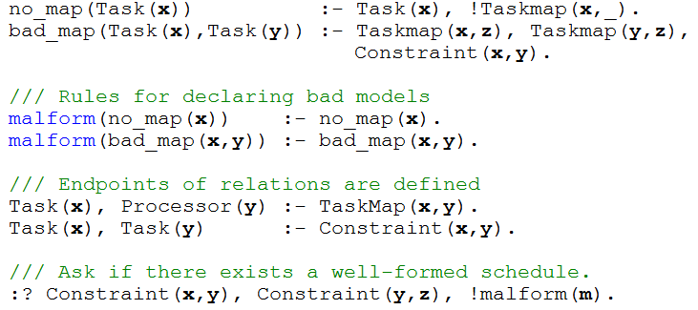
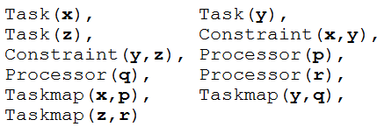

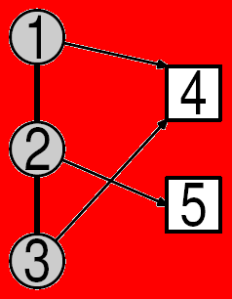
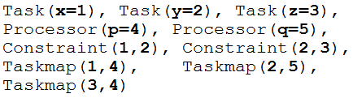
#9 Model-based development
The model finding procedure in FORMULA allows to:
Determine if a composition of abstractions contains inconsistencies
Construct (partial) architectures that satisfy many domain constraints.
Generate design spaces of architectural invariants.
Reduction to Z3 works as follows:
6
5
S =
4
3
S
2
1
Q
Symbolic backwards chaining yields a set of candidate terms S with the following property:
A finite instance exists that satisfies the query Q iff some subset of S satisfies the query Q.
Once the finite set S is calculated, then S + Q is reduced to SMT and evaluated by Z3.

Slide 63


#10 Quantitative Termination
Termination
Runtime & Invariants
[PLDI, CAV 2009]
http://www.foment.net/byron/fsharp.shtml

Slide 64
Conclusions
SMT solvers are a great fit for software tools
Current main applications:
  Test-case generation.
  Verifying compilers.
  Model Checking & Predicate Abstraction.
  Model-based testing and development
Future opportunities in SMT research and applications abound

Slide 66
Extra slides

Slide 67
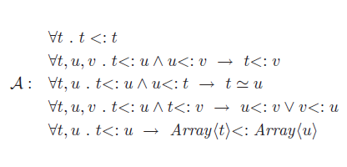
Harnessing Triggers
Example: A theory of Object Inheritance
Z
A
B
Array(B)
C
D
Array(C)

Slide 68
Harnessing Triggers
Example: A theory of Object Inheritance
Z
A
B
Array(B)
C
D
Array(C)

Slide 69
Constraint Solving: Preprocessing
Independent constraint optimization + Constraint caching (similar to EXE)
Idea: Related execution paths give rise to "similar" constraint systems
Example: Consider x>y ⋀ z>0 vs. x>y ⋀ z<=0
If we already have a cached solution for a "similar" constraint system, we can reuse it
  x=1, y=0, z=1 is solution for x>y ⋀ z>0
  we can obtain a solution for x>y ⋀ z<=0 by
    reusing old solution of x>y: x=1, y=0
    combining with solution of z<=0: z=0

Slide 70






More Z3 Microsoft Clients
Bounded model-program checking
Termination
Runtime & Invariants
Security protocols, F#/7
Business application modeling
Cryptography
Model Based Testing (2 groups)
Verified garbage collectors
PREfix Static Analysis

Slide 71
Monitoring by Code Instrumentation
ldtoken Point::X
call __Monitor::LDFLD_REFERENCE
ldfld Point::X
call __Monitor::AtDereferenceFallthrough
br L2
L1:
call __Monitor::AtBranchTarget
call __Monitor::LDC_I4_M1
ldc.i4.m1
L2:
call __Monitor::RET
stloc.0
leave L4
} catch NullReferenceException {
‘ call __Monitor::AtNullReferenceException
rethrow
}
L4: leave L5
} finally {
call __Monitor::LeaveMethod
endfinally
}
L5: ldloc.0
ret
class Point { int x; int y;
public static int GetX(Point p) {
if (p != null) return p.X;
else return -1; } }
ldtoken Point::GetX
call __Monitor::EnterMethod
brfalse L0
ldarg.0
call __Monitor::NextArgument<Point>
L0: .try {
.try {
call __Monitor::LDARG_0
ldarg.0
call __Monitor::LDNULL
ldnull
call __Monitor::CEQ
ceq
call __Monitor::BRTRUE
brtrue L1
call __Monitor::BranchFallthrough
call __Monitor::LDARG_0
ldarg.0
…
Prologue
Record concrete values
to have all information
when this method is called
with no proper context
(The real C# compiler
output is actually more
complicated.)
Calls to build
path condition
Calls will perform
symbolic computation
Epilogue
Calls to build
path condition

Slide 72
DPLL(QT) – cute quantifiers
We can use DPLL(T) for ϕ with quantifiers.
  Treat quantified sub-formulas as atomic predicates.
  In other words, if ∀x.ψ(x) is a sub-formula if ϕ, then introduce fresh p. Solve instead
  ϕ[∀x.ψ(x) ← p]

Slide 73
DPLL(QT)
Suppose DPLL(T) sets p to false
  ⇒ any model M for ϕ must satisfy:
  M ⊨ ¬ ∀x.ψ(x)
  ⇒ for some sk_{x}: M ⊨ ¬ ψ(sk_{x})
  In general: ⊨ ¬ p → ¬ ψ(sk_{x})

Slide 74
DPLL(QT)
Suppose DPLL(T) sets p to true
  ⇒ any model M for ϕ must satisfy:
  M ⊨ ∀x.ψ(x)
  ⇒ for every term t: M ⊨ ψ(t)
  In general: ⊨ p → ψ(t)
  For every term t.

Slide 75
DPLL(QT)
Summary of auxiliary axioms:
  ⊨ ¬ p → ¬ ψ(sk_{x}) For fixed, fresh sk_{x}
  ⊨ p → ψ(t) For every term t.
Which terms t to use for auxiliary axioms of the second kind?

Slide 76
DPLL(QT) with E-matching
  ⊨ p → ψ(t) For every term t.
Approach:
  Add patterns to quantifiers
  Search for instantiations in E-graph.
  ∀a,i,v { write(a,i,v) } . read(write(a,i,v),i) = v

Slide 77
DPLL(QT) with E-matching
  ⊨ p → ψ(t) For every term t.
Approach:
  Add patterns to quantifiers
  Search for pattern matches in E-graph.
  ∀a,i,v { write(a,i,v) } . read(write(a,i,v),i) = v
    Add equality every time there is a write(b,j,w) term in E.

Slide 78
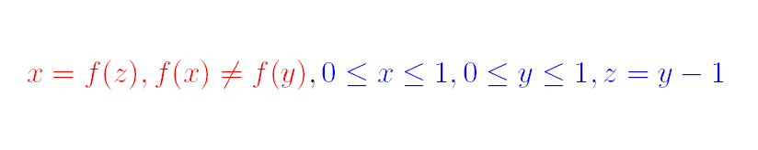
Model-based - Example

Slide 79
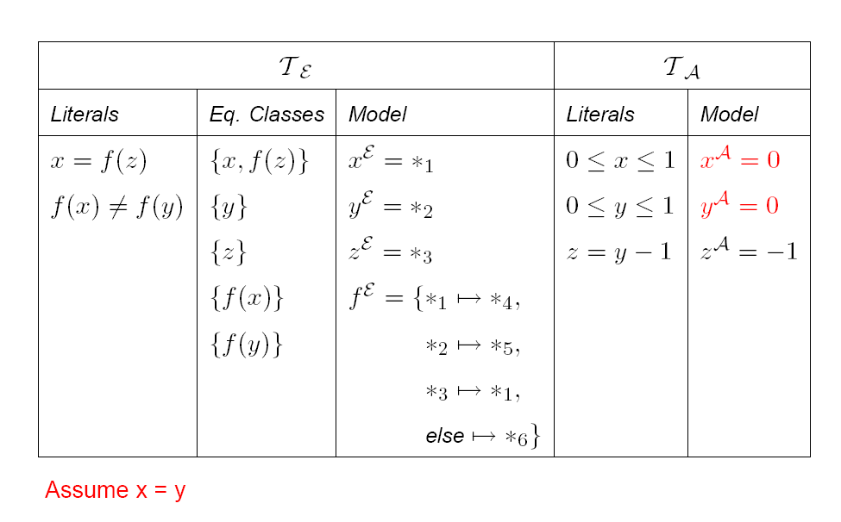
Model-based - Example

Slide 80
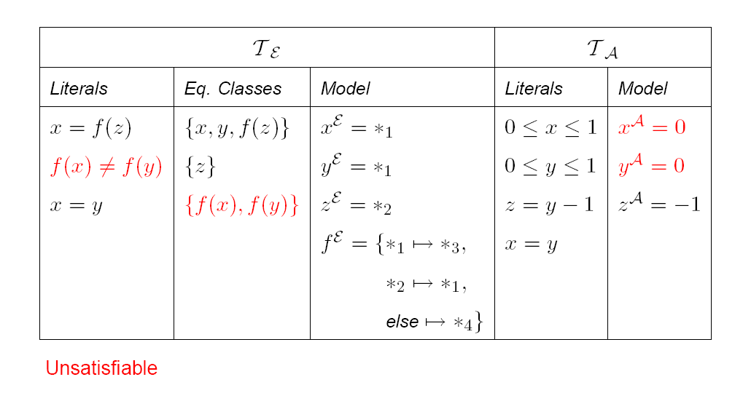
Model-based - Example

Slide 81
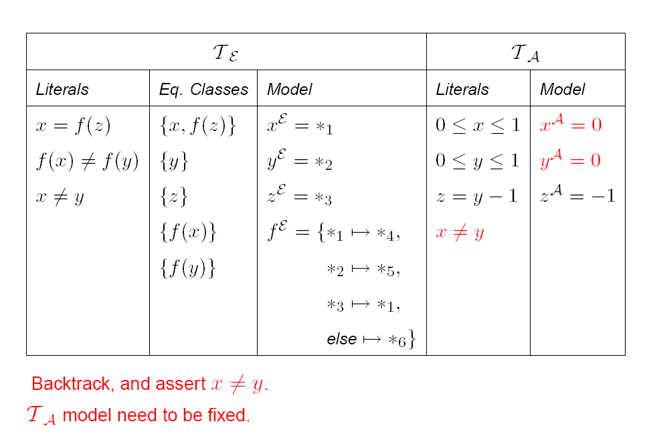
Model-based - Example

Slide 82
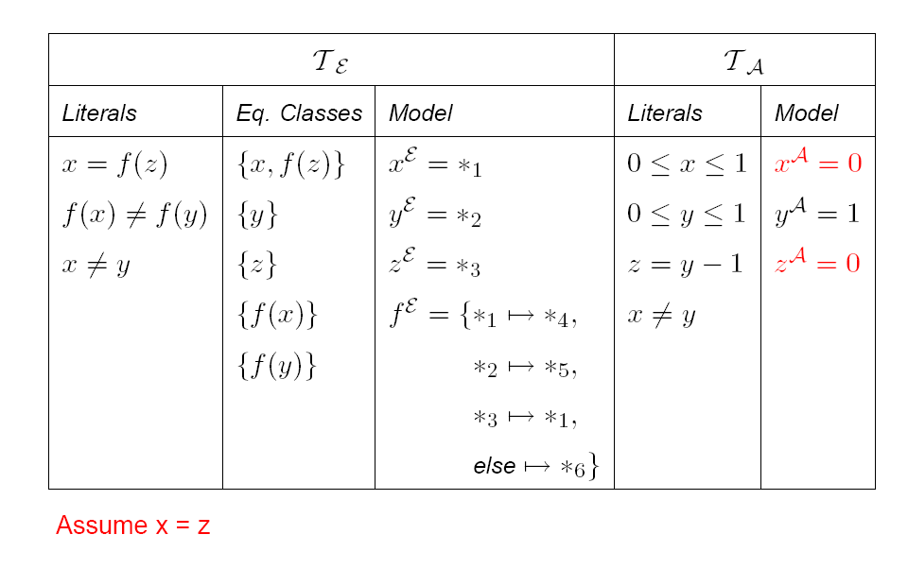
Model-based - Example

Slide 83
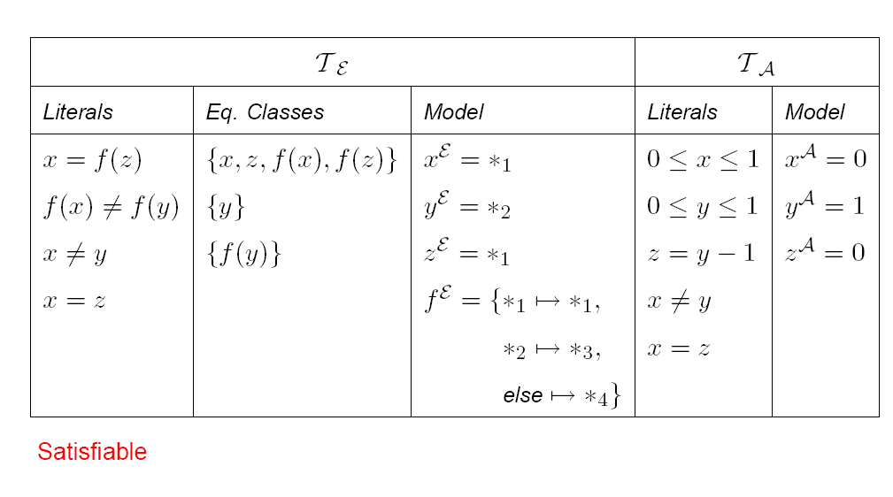
Model-based - Example

