Slide 1
Symbolic program analysis as Satisfiability Modulo Theories
Nikolaj Bjørner
Microsoft Research
Based on joint work with Kryštof Hoder, Ken McMillan, Leonardo de Moura, Andrey Rybalchenko

Slide 2
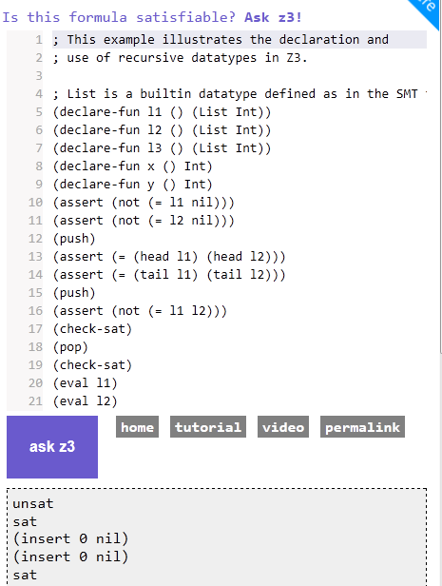
Background:
Z3 - Efficient SMT Solver
Many custom solvers:
Free functions
Linear Arithmetic
Bit-vectors
Algebraic data-types
Arrays
Polynomials
Quantifiers
Several Applications:
Analysis, Testing, …
Leonardo de Moura, B, Christoph Wintersteiger
from http://rise4fun.com/z3

Slide 3






Tools using Z3 features
Engine
Arrrays
SLAyer
API
Bit-
Vectors
Simplifier
Arith
metic
Cores
Quanti-
fier Inst
Models
SAGE
Quanti-
fier-elim
Proofs
Isabelle
HOL4

Slide 4
Tools using Z3 for fixedpoints
Methodology
SLAyer
Fixed-Point
Sep. Logic
Abstract Interpretation
Logic Programming
Simulation
Relation
GateKeeper
Predicate Based MC
Summaries
SAGE
BDD MC
Abstraction
Refinement
Datalog
Houdini
Havoc Poirot Corral
Interpolating MC

Slide 5
Engines for Recursive Predicates
Contract Checking
Points-to analysis
Symbolic Software Checking
µZ3
Datalog +
Relational domains
Property Directed
Reachability solver
Services for
other solvers
(Quantifier elimination,
Fold-unfold simplification)

Slide 6
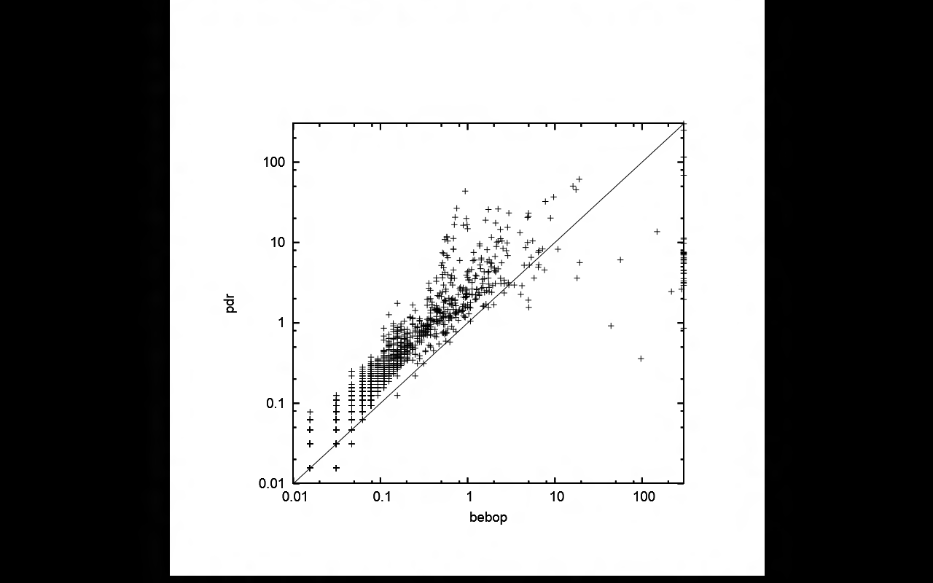
Engines for Recursive Predicates
Some “anecdotal” experience
Recursive predicates:
Expressed as Horn clauses + query
µZ: Portfolio of solvers and services for fixed-points:
Bottom-up Datalog Engine
  - Finite Tables (e.g., Hash-tables, B-Trees)
  - Symbolic Tables (e.g., BDDs)
  - Composition of Relations:
  - Abstract interpretation domains
  - Reduced products
Symbolic Engine Modulo Theories
  - Generalized Property Directed Reachability
GateKeeper
(sparse hash-tables)
Magnus Madsen
Points-to analysis
KOP2 database
(using magic sets)
Contract Checking
DKAL
(encoding Primal Infon Logic)
CAV 2011
[Hoder, Bjørner,
de Moura]
Bebop benchmarks
(evaluate PDR
generalized to PDA)
Symbolic Software Checking
Corral samples
(evaluate PDR
Modulo Arithmetic)
SAT 2012
[Hoder, Bjørner]

Slide 7
Motivation: Recursive Procedures
mc(x) = x-10 if x > 100
mc(x) = mc(mc(x+11)) if x ≤ 100
assert (mc(x) ≥ 91)

Slide 8
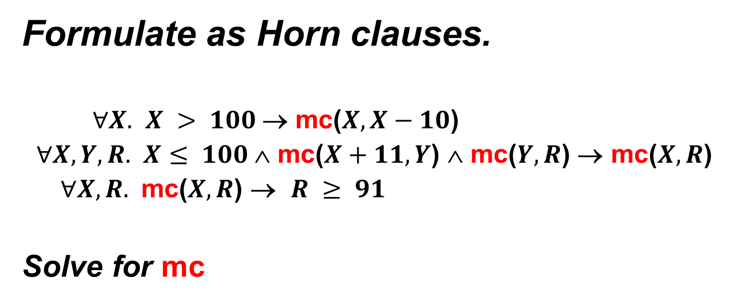
Motivation: Recursive Procedures
Formulate as Horn clauses.
$∀X.$ $X > 100$→ mc($X,X−10$)
$∀X,Y,R.$ $X≤ 100$∧ mc($X+11,Y$) ∧ mc($Y,R$) → mc($X,R$)
$∀X,R.$ mc($X,R$) → $R ≥ 91$
Solve for mc

Slide 9
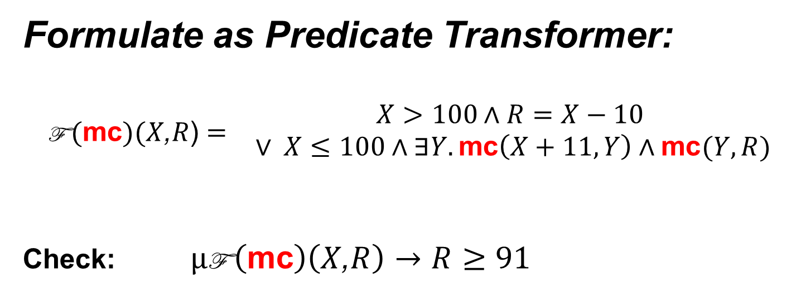
Motivation: Recursive Procedures
Formulate as Predicate Transformer:
$$\begin{matrix}\text{F} (\text{mc})(X\text{,}R\text{)}= & \begin{matrix}X>100∧R=X−10 \\ ∨ X≤100∧∃Y. \text{mc}\left(X+11,Y\right)∧\text{mc}(Y,R)\end{matrix}\end{matrix}$$
Check: $μ\text{F} \left(\text{mc}\right)\left(X\text{,}R\right)→R≥91$

Slide 10
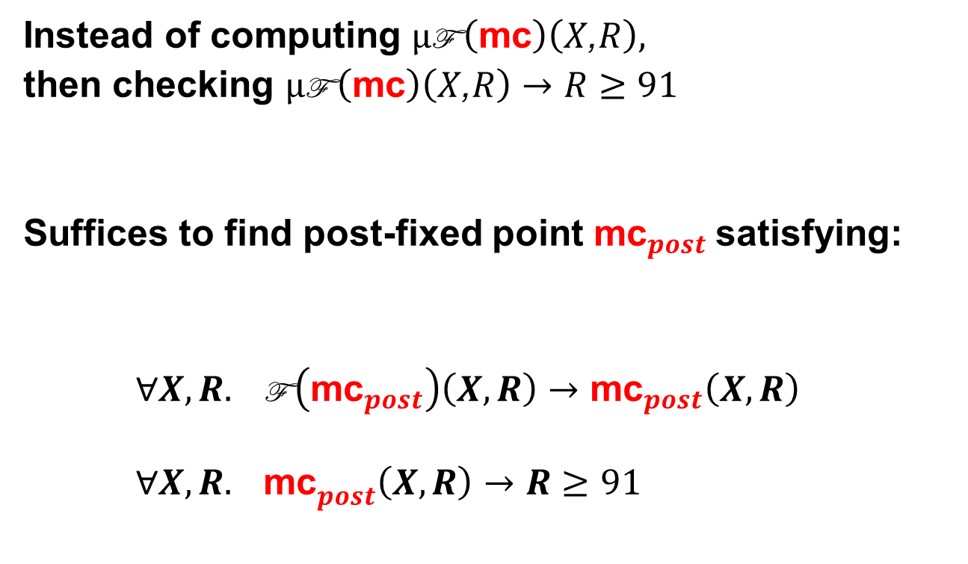
Motivation: Recursive Procedures
Instead of computing $μ\text{F} \left(\text{mc}\right)\left(X\text{,}R\right),$
then checking $μ\text{F} \left(\text{mc}\right)\left(X\text{,}R\right)→R≥91$
Suffices to find post-fixed point ${\text{mc}}_{post}$satisfying:
$∀X,R. \text{F} \left({\text{mc}}_{post}\right)\left(X,R\right)→{\text{mc}}_{post}\left(X,R\right)$
${∀X,R. \text{mc}}_{post}\left(X,R\right)→R≥91$

Slide 11
Program Verification as SMT
Program Verification (Safety)
as Solving least fixed-points
as Satisfiability of Horn clauses
[Bjørner, McMillan, Rybalchenko, SMT workshop 2012]
Hilbert Sausage Factory: [Grebenshchikov, Lopes, Popeea, Rybalchenko et.al. PLDI 2012]

Slide 12
Old but New
Should really not be a surprise:
90’s Program Analyses using Datalog
Existential Fixedpoint Logic for Hoare Logic [Blass, Gurevich]
Induction-less induction, …
Under-appreciated:
Many language-specific tools using custom analysis
“.. but there has to be a catch” [FOL < FOL+Transitivity]
A flurry of recent progress on Modern Symbolic Model checking tools/algorithms.
Claim: they are all strategies for Horn Clause satisfiability.
The Quest: Horn Clause Satisfiability

Slide 13






Verification Tool Workflow
HAVOC
Dafny
Program
annotated with
inductive invariants
Verification
condition

Slide 14
Verification Tool Workflow
Inductive variable
selection
Houdini
Slicing
HAVOC
Corral
Dafny
Program
partially
annotated with
inductive invariants
Verification
condition

Slide 15

Envisioned: Verification Tool Workflow
Verification Condition Generators can already produce Horn Clauses
HAVOC
Corral
Dafny
Program
partially
annotated with
inductive invariants
Why, LLVM
…
Horn Clauses
Kind
Leon
HSF
Duality
Aligator
Synergy
UFO
MCMTSAFARI
IC3

Slide 16
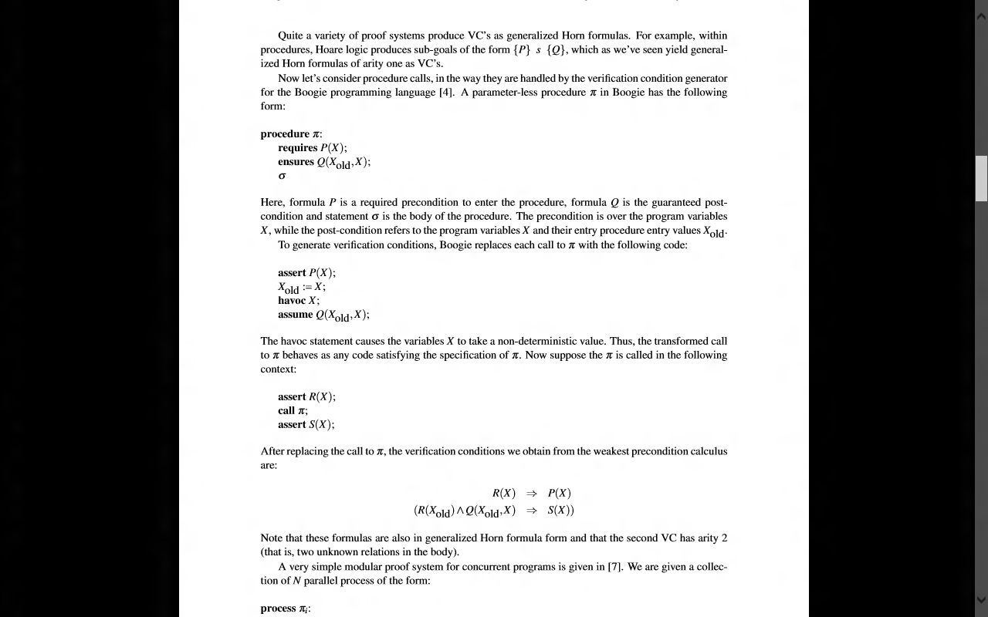
Procedures ⇒ Horn Formulas
Summary as commands
Verifying procedure calls

Slide 17
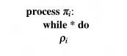
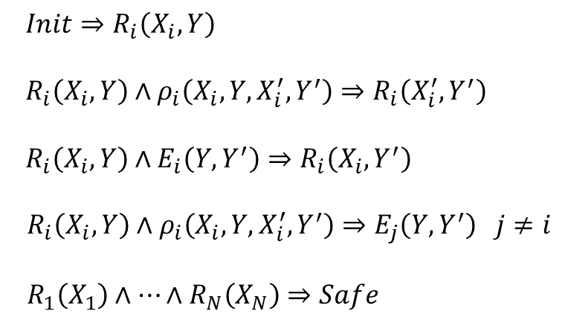
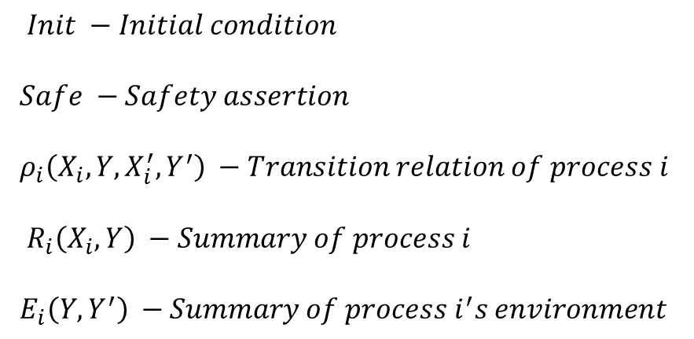

Modular Concurrency ⇒ Horn Clauses
$Init −Initial condition$
$Safe −Safety assertion$
$ρ_{i}\left(X_{i}, Y,X_{i}^{′},Y^{′}\right) −Transition relation of process i$
${ R}_{i}\left(X_{i}, Y\right) −Summary of process i$
$E_{i}\left(Y,Y^{′}\right) −Summary of process i^{′}s environment$
$Init⇒R_{i}\left(X_{i}, Y\right)$
${ R}_{i}\left(X_{i},Y\right)∧ρ_{i}\left(X_{i}, Y,X_{i}^{′},Y^{′}\right)⇒R_{i}\left(X_{i}^{′},Y^{′}\right)$
$R_{i}\left(X_{i}, Y\right)∧E_{i}\left(Y,Y^{′}\right)⇒R_{i}\left(X_{i}, Y^{′}\right)$
$R_{i}\left(X_{i},Y\right)∧ρ_{i}\left(X_{i}, Y,X_{i}^{′},Y^{′}\right)⇒E_{j}\left(Y,Y^{′}\right) j≠i$
$R_{1}\left(X_{1}\right)∧…∧R_{N}\left(X_{N}\right)⇒Safe$
[Predicate Abstraction and
Refinement for Verifying
Multi-Threaded Programs
Gupta, Popeea, Rybalchenko,
POPL 2011]

Slide 18
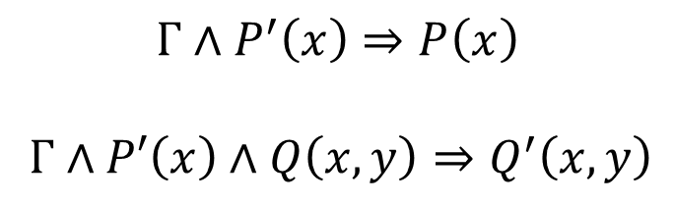
⇒ Horn Clauses
$$Γ⊢\left\{ x:τ \right|P(x)\}→\left\{ y:σ \right| Q(x,y) \}≺\left\{ x:τ \right|P′(x)\}→\left\{ y:σ \right| Q′(x,y) \}$$
Extract sufficient Horn Conditions
$$Γ∧P^{′}\left(x\right)⇒P\left(x\right)$$
$Γ∧P′\left(x\right)∧Q\left(x,y\right)⇒Q^{′}\left(x,y\right)$

Slide 19
Verification Tool Workflow - summary
Many front-ends exist.
Verification Condition Generators:
- used for Checking Inductive Invariants
re-used for Synthesizing Inductive Invariants

Slide 20
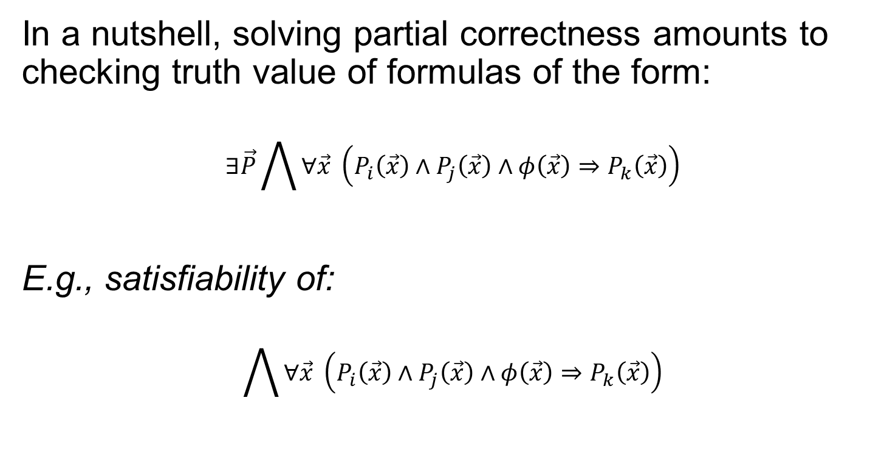
Generalized Horn Formulas
In a nutshell, solving partial correctness amounts to checking truth value of formulas of the form:
$$∃\vec{P}\bigwedge{∀\vec{x} \left(P_{i}\left(\vec{x}\right)∧P_{j}\left(\vec{x}\right)∧φ\left(\vec{x}\right)⇒P_{k}\left(\vec{x}\right)\right)}$$
E.g., satisfiability of:
$$\bigwedge{∀\vec{x} \left(P_{i}\left(\vec{x}\right)∧P_{j}\left(\vec{x}\right)∧φ\left(\vec{x}\right)⇒P_{k}\left(\vec{x}\right)\right)}$$

Slide 21
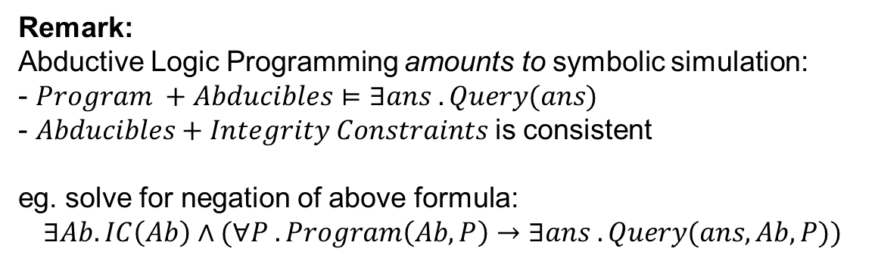
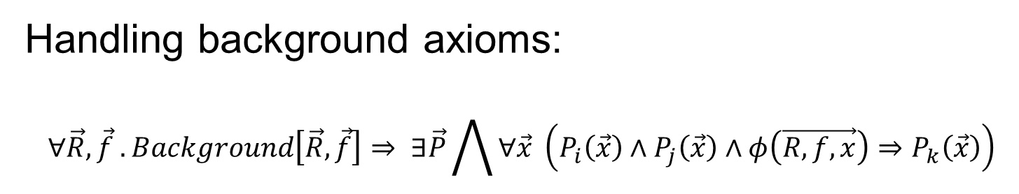
Generalized Horn Formulas
Handling background axioms:
$$∀\vec{R},\vec{f} . Background\left[\vec{R},\vec{f}\right]⇒ ∃\vec{P}\bigwedge{∀\vec{x} \left(P_{i}\left(\vec{x}\right)∧P_{j}\left(\vec{x}\right)∧φ\left(\vec{R, f, x}\right)⇒P_{k}\left(\vec{x}\right)\right)}$$
Remark:
Abductive Logic Programming amounts to symbolic simulation:
- $Program +Abducibles⊨∃ans . Query(ans)$
- $Abducibles+Integrity Constraints$is consistent
eg. solve for negation of above formula:
$$∃Ab. IC\left(Ab\right)∧(∀P . Program\left(Ab,P\right)→∃ans .Query(ans,Ab,P))$$

Slide 22
A New PDR Engine for Fixedpoints
PDR (aka. IC3) – Property Directed Reachability algorithm
Breakthrough in Symbolic Model Checking of Hardware [Aaron Bradley, VMCAI 2011]
Transition Decomposes main steps
System ÷ priority queue
Formulation
Procedures Regular vs. Push Down systems
Beyond Linear Real Arithmetic
Propositional - Timed Automata Decision Procedure
Logic - Interpolants from models
Original Algorithm Description in code.
Tough to digest. Rule + strategy description could help deconstruct the steps.
Original Algorithm Applies to Hardware (Finite State Automata).
Software has procedure calls.
Original Algorithm is for Finite State Systems
Open question what it meant to incorporate
Infinite State systems (= theories)
[Hoder & Bjørner, SAT 2012]

Slide 23
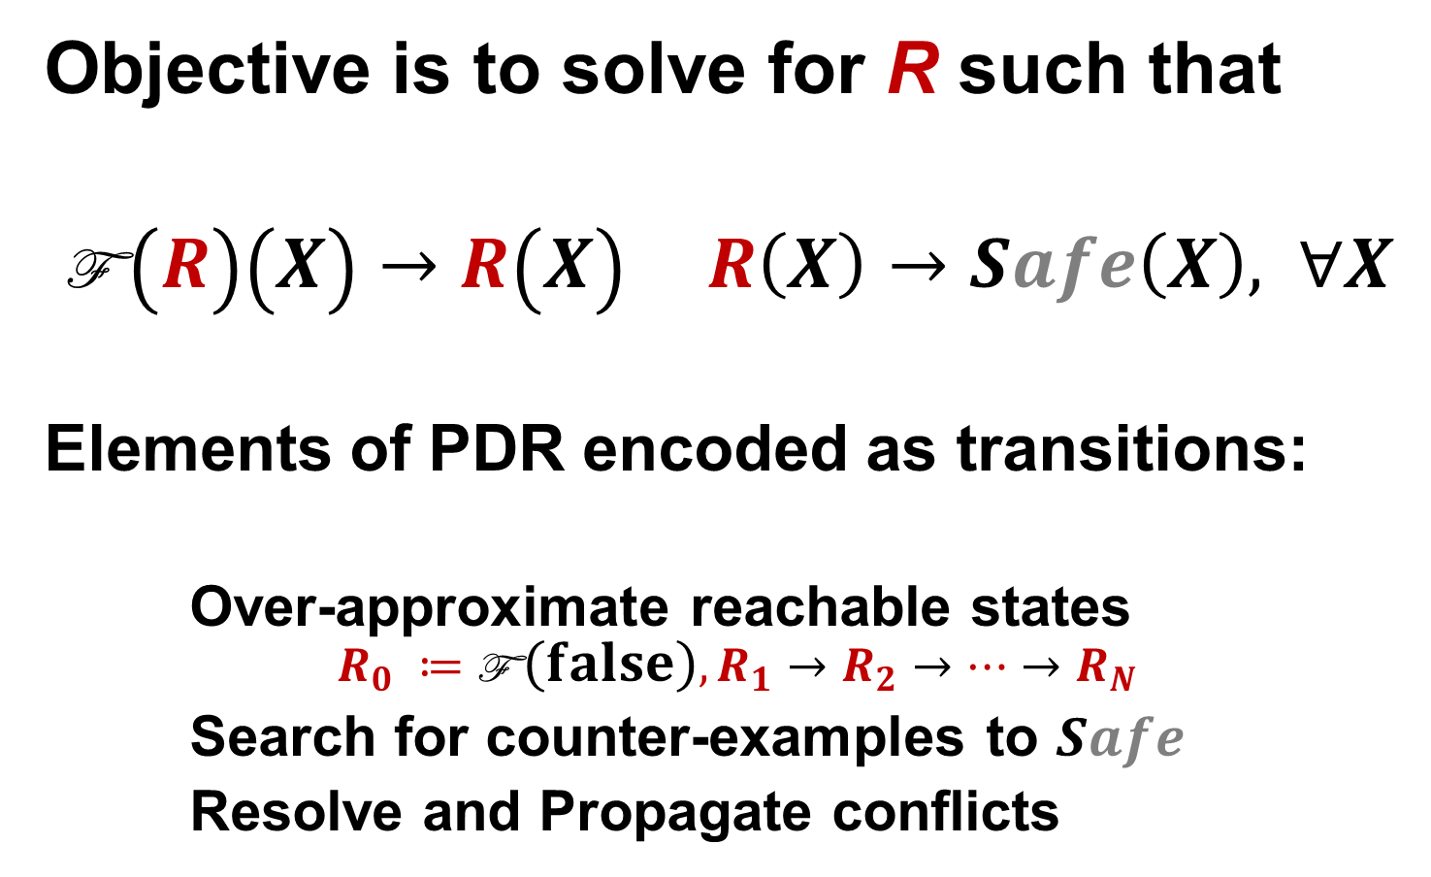
PDR as a Transition System
Objective is to solve for R such that
$\text{F} \left(R\right)\left(X\right)→R\left(X\right)$ $R\left(X\right)→Safe\left(X\right), ∀X$
Elements of PDR encoded as transitions:
Over-approximate reachable states
$$R_{0} ≔\text{F} \left(false\right), R_{1}→R_{2}→…{→R}_{N}$$
Search for counter-examples to $Safe$
Resolve and Propagate conflicts

Slide 24
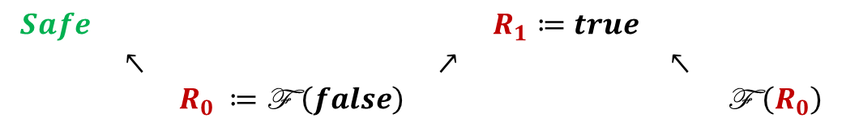
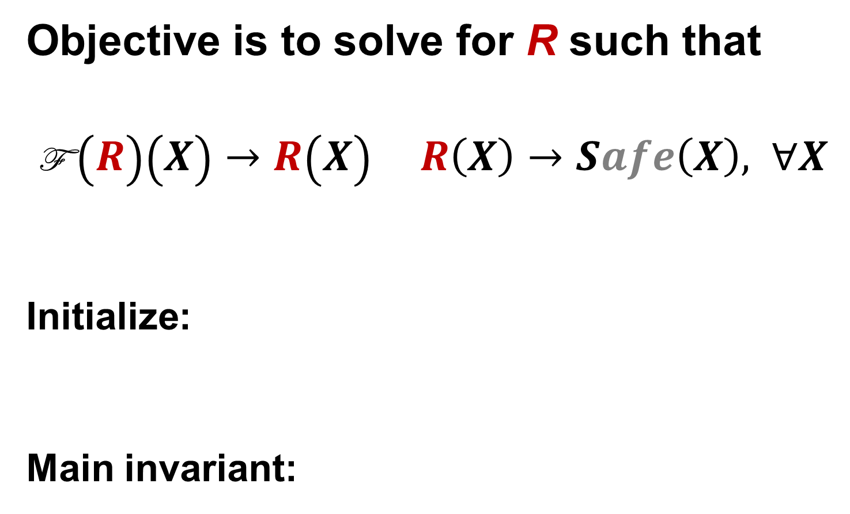
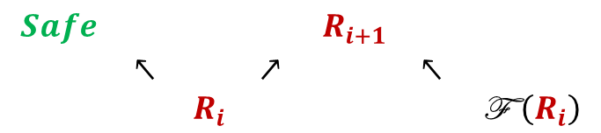
PDR as a Transition System
Objective is to solve for R such that
$\text{F} \left(R\right)\left(X\right)→R\left(X\right)$ $R\left(X\right)→Safe\left(X\right), ∀X$
Initialize:
Main invariant:
$$\begin{matrix}Safe & & & & R_{1}≔true & & \\ & ↖ & & ↗ & & ↖ & \\ & & R_{0} ≔\text{F} \left(false\right) & & & & \text{F} \left(R_{0}\right)\end{matrix}$$
$$\begin{matrix}Safe & & & & R_{i+1} & & \\ & ↖ & & ↗ & & ↖ & \\ & & R_{i} & & & & \text{F} \left(R_{i}\right)\end{matrix}$$

Slide 25
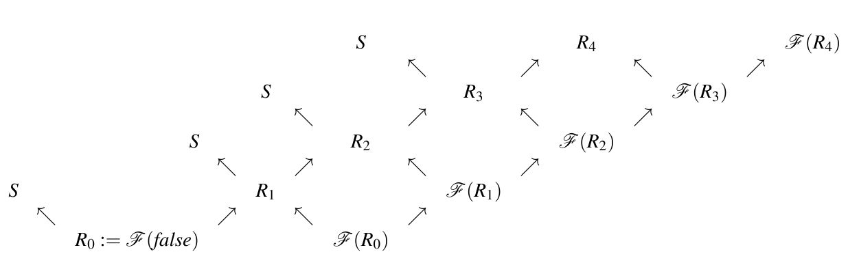
PDR a visual overview
Is valid?
Search for over-approximations of states

Slide 26

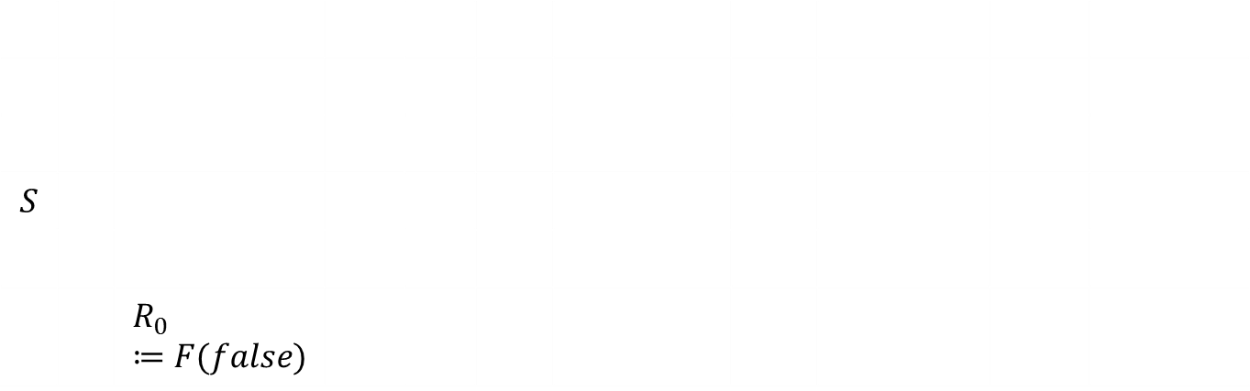
PDR
Is valid?
$$S$$
 |  | $$R_{0}≔F(false)$$
Initially: N = 0, start with $R_{0}$

Slide 27


PDR
Is valid?
$$S$$
 | $$↖$$
 |  | $$R_{0}≔F(false)$$
Unfold to the next level if $R_{0}⇒S$

Slide 28
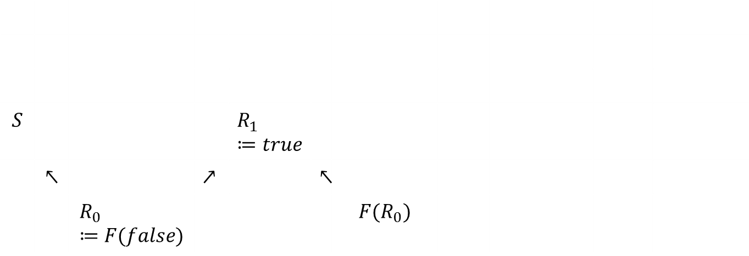
PDR
Is valid?
$$S$$ |  |  |  | $$R_{1}≔true$$
 | $$↖$$ |  | $$↗$$ |  | $$↖$$
 |  | $$R_{0}≔F(false)$$ |  |  |  | $$F(R_{0})$$
Main Invariant is established for N = 1

Slide 29
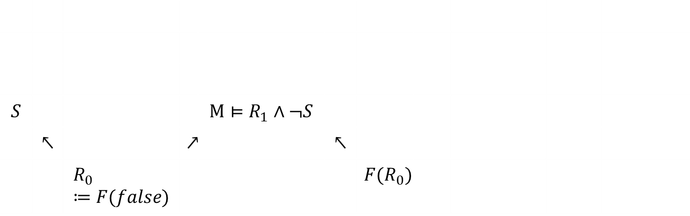
PDR
Is valid?
$$S$$ |  |  |  | $${M⊨R}_{1}∧¬S$$
 | $$↖$$ |  | $$↗$$ |  | $$↖$$
 |  | $$R_{0}≔F(false)$$ |  |  |  | $$F(R_{0})$$
Model $candidate when R_{1}∧¬S is SAT with model M$

Slide 30

PDR
Is valid?
$$S$$ |  |  |  | $$R_{1}≔R_{1}∧φ$$
 | $$↖$$ |  | $$↗$$ |  | $$↖$$
 |  | $$R_{0}≔F(false)$$ |  |  |  | $$F(R_{0})$$
C$onflict when {F(R}_{0})⇒φ, φ⇒¬M are Valid$,$for some ¬φ⊆M$

Slide 31
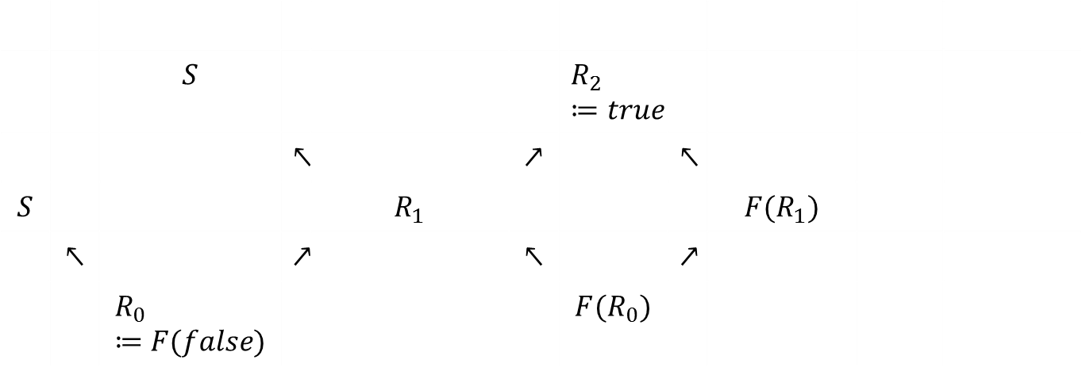

PDR
Is valid?
 |  | $$S$$ |  |  |  | $$R_{2}≔true$$
 |  |  | $$↖$$ |  | $$↗$$ |  | $$↖$$
$$S$$ |  |  |  | $$R_{1}$$ |  |  |  | $$F(R_{1})$$
 | $$↖$$ |  | $$↗$$ |  | $$↖$$ |  | $$↗$$
 |  | $$R_{0}≔F(false)$$ |  |  |  | $$F(R_{0})$$
Unfold to the next level if $R_{1}⇒S$

Slide 32
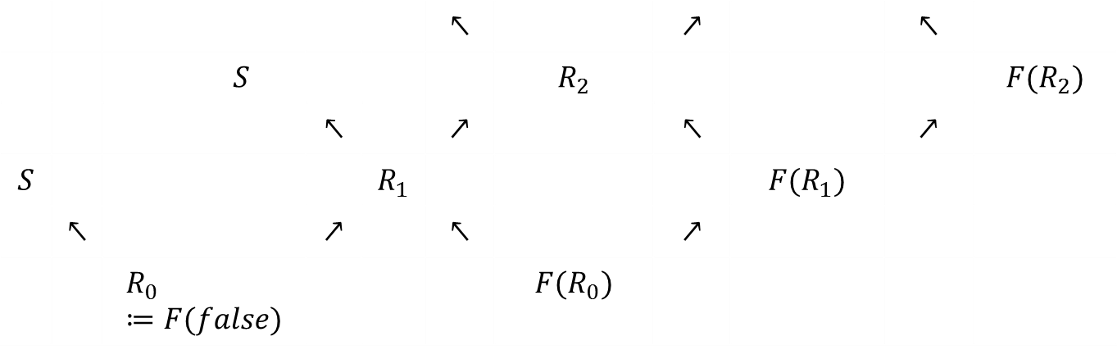
PDR
Is valid?
 |  |  |  |  | $$↖$$ |  | $$↗$$ |  | $$↖$$
 |  | $$S$$ |  |  |  | $$R_{2}$$ |  |  |  | $$F(R_{2})$$
 |  |  | $$↖$$ |  | $$↗$$ |  | $$↖$$ |  | $$↗$$
$$S$$ |  |  |  | $$R_{1}$$ |  |  |  | $$F(R_{1})$$
 | $$↖$$ |  | $$↗$$ |  | $$↖$$ |  | $$↗$$
 |  | $$R_{0}≔F(false)$$ |  |  |  | $$F(R_{0})$$
Etc.

Slide 33
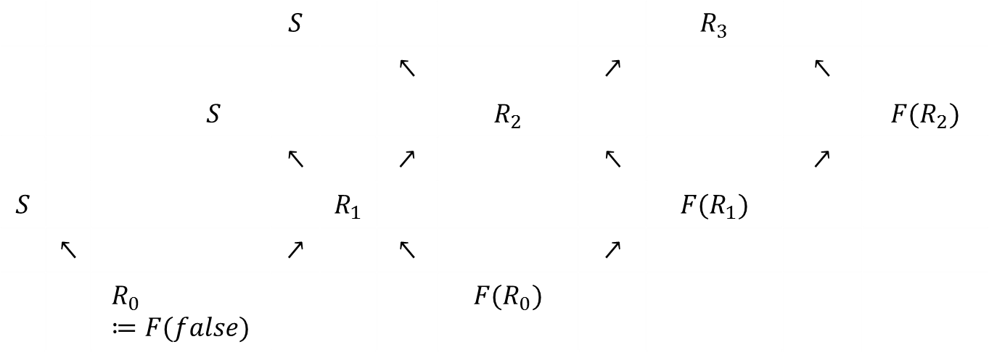
PDR
Is valid?
 |  |  | $$S$$ |  |  |  |  | $$R_{3}$$
 |  |  |  |  | $$↖$$ |  | $$↗$$ |  | $$↖$$
 |  | $$S$$ |  |  |  | $$R_{2}$$ |  |  |  | $$F(R_{2})$$
 |  |  | $$↖$$ |  | $$↗$$ |  | $$↖$$ |  | $$↗$$
$$S$$ |  |  |  | $$R_{1}$$ |  |  |  | $$F(R_{1})$$
 | $$↖$$ |  | $$↗$$ |  | $$↖$$ |  | $$↗$$
 |  | $$R_{0}≔F(false)$$ |  |  |  | $$F(R_{0})$$
Etc.

Slide 34




PDR
Is valid?
$R_{2}$ implies $S$
$R_{2}$ is a post-fixed point
 |  |  | $$S$$ |  |  |  |  | $$R_{3}$$
 |  |  |  |  | $$↖$$ |  | $$↗↙$$ |  | $$↖$$
 |  | $$S$$ |  |  |  | $$R_{2}$$ |  |  |  | $$F(R_{2})$$
 |  |  | $$↖$$ |  | $$↗$$ |  | $$↖$$ |  | $$↗$$
$$S$$ |  |  |  | $$R_{1}$$ |  |  |  | $$F(R_{1})$$
 | $$↖$$ |  | $$↗$$ |  | $$↖$$ |  | $$↗$$
 |  | $$R_{0}≔F(false)$$ |  |  |  | $$F(R_{0})$$
Valid Formula is valid if $R_{3}⇒R_{2}$

Slide 35
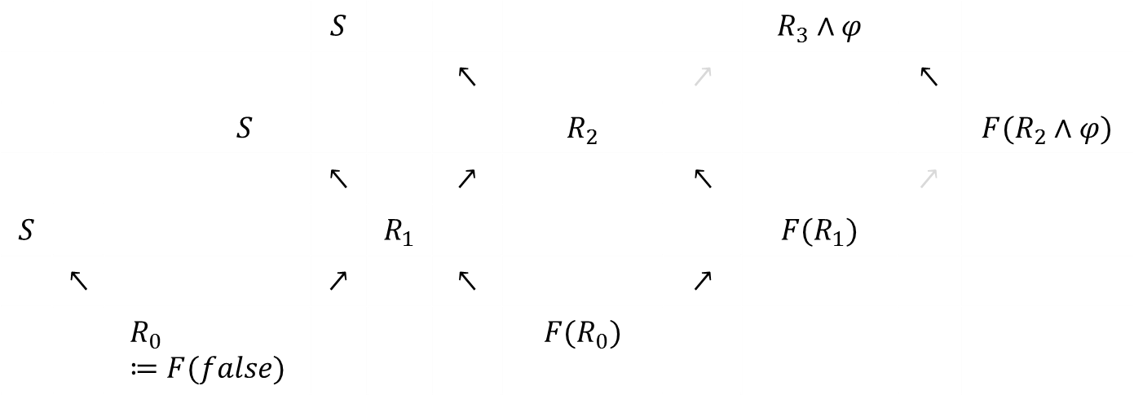

PDR
Is valid?
 |  |  | $$S$$ |  |  |  |  | $$R_{3}∧φ$$
 |  |  |  |  | $$↖$$ |  | $$↗$$ |  | $$↖$$
 |  | $$S$$ |  |  |  | $$R_{2}$$ |  |  |  | $$F(R_{2}∧φ)$$
 |  |  | $$↖$$ |  | $$↗$$ |  | $$↖$$ |  | $$↗$$
$$S$$ |  |  |  | $$R_{1}$$ |  |  |  | $$F(R_{1})$$
 | $$↖$$ |  | $$↗$$ |  | $$↖$$ |  | $$↗$$
 |  | $$R_{0}≔F(false)$$ |  |  |  | $$F(R_{0})$$
Induction w$hen {F(R}_{2}∧φ)⇒φ$

Slide 36
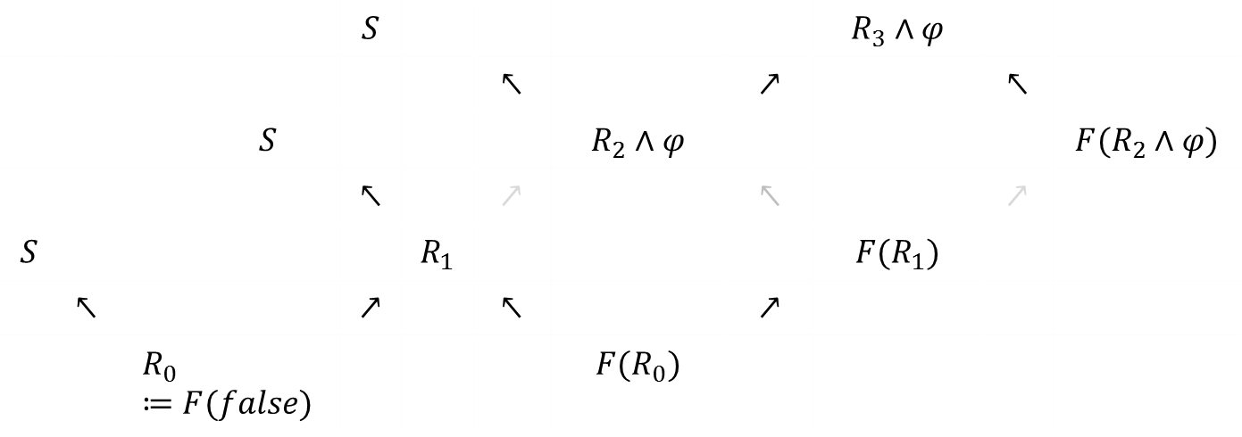

PDR
Is valid?
 |  |  | $$S$$ |  |  |  |  | $$R_{3}∧φ$$
 |  |  |  |  | $$↖$$ |  | $$↗$$ |  | $$↖$$
 |  | $$S$$ |  |  |  | $$R_{2}∧φ$$ |  |  |  | $$F(R_{2}∧φ)$$
 |  |  | $$↖$$ |  | $$↗$$ |  | $$↖$$ |  | $$↗$$
$$S$$ |  |  |  | $$R_{1}$$ |  |  |  | $$F(R_{1})$$
 | $$↖$$ |  | $$↗$$ |  | $$↖$$ |  | $$↗$$
 |  | $$R_{0}≔F(false)$$ |  |  |  | $$F(R_{0})$$
Induction w$hen {F(R}_{2}∧φ)⇒φ$

Slide 37
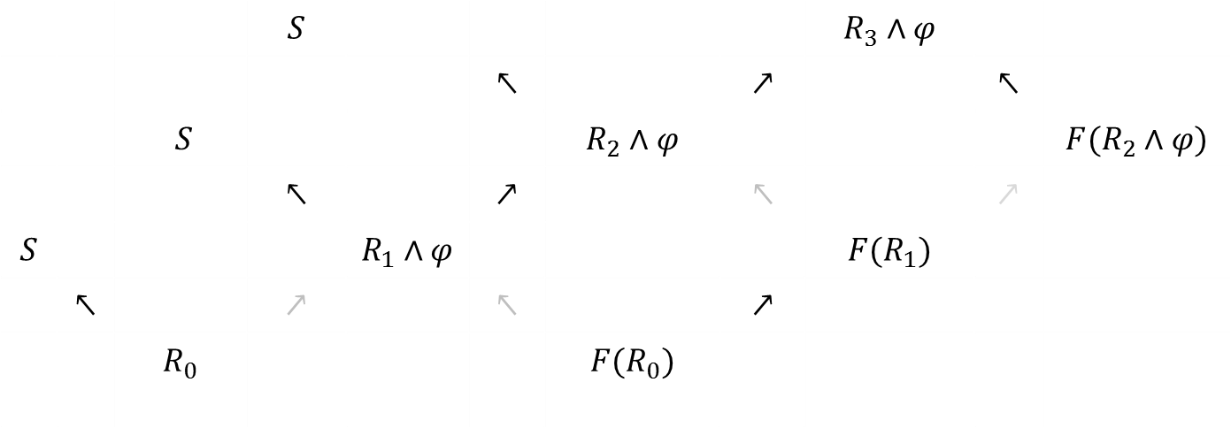
PDR
Is valid?
 |  |  | $$S$$ |  |  |  |  | $$R_{3}∧φ$$
 |  |  |  |  | $$↖$$ |  | $$↗$$ |  | $$↖$$
 |  | $$S$$ |  |  |  | $$R_{2}∧φ$$ |  |  |  | $$F(R_{2}∧φ)$$
 |  |  | $$↖$$ |  | $$↗$$ |  | $$↖$$ |  | $$↗$$
$$S$$ |  |  |  | $$R_{1}∧φ$$ |  |  |  | $$F(R_{1})$$
 | $$↖$$ |  | $$↗$$ |  | $$↖$$ |  | $$↗$$
 |  | $$R_{0}$$ |  |  |  | $$F(R_{0})$$
Induction w$hen {F(R}_{2}∧φ)⇒φ$

Slide 38
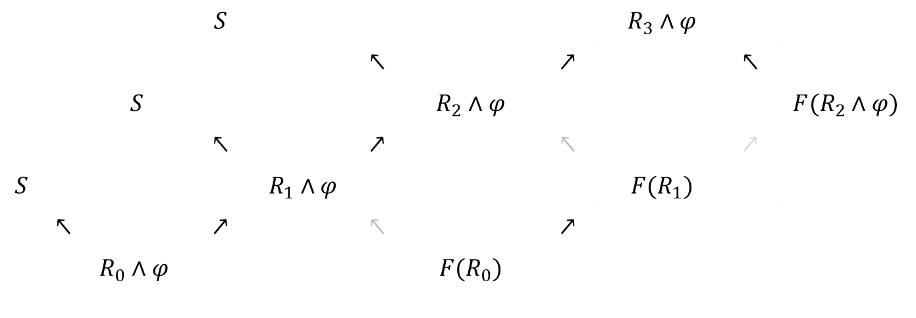
PDR
Is valid?
 |  |  | $$S$$ |  |  |  |  | $$R_{3}∧φ$$
 |  |  |  |  | $$↖$$ |  | $$↗$$ |  | $$↖$$
 |  | $$S$$ |  |  |  | $$R_{2}∧φ$$ |  |  |  | $$F(R_{2}∧φ)$$
 |  |  | $$↖$$ |  | $$↗$$ |  | $$↖$$ |  | $$↗$$
$$S$$ |  |  |  | $$R_{1}∧φ$$ |  |  |  | $$F(R_{1})$$
 | $$↖$$ |  | $$↗$$ |  | $$↖$$ |  | $$↗$$
 |  | $$R_{0}∧φ$$ |  |  |  | $$F(R_{0})$$
Induction w$hen {F(R}_{2}∧φ)⇒φ$

Slide 39
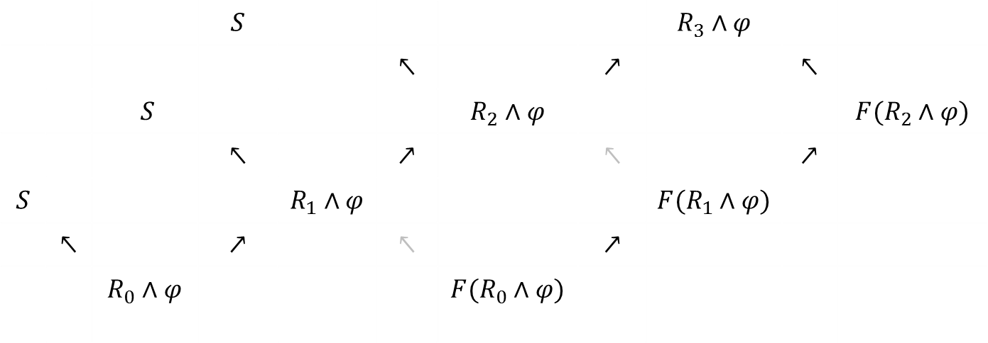
PDR
Is valid?
Monotonicity of F
 |  |  | $$S$$ |  |  |  |  | $$R_{3}∧φ$$
 |  |  |  |  | $$↖$$ |  | $$↗$$ |  | $$↖$$
 |  | $$S$$ |  |  |  | $$R_{2}∧φ$$ |  |  |  | $$F(R_{2}∧φ)$$
 |  |  | $$↖$$ |  | $$↗$$ |  | $$↖$$ |  | $$↗$$
$$S$$ |  |  |  | $$R_{1}∧φ$$ |  |  |  | $$F(R_{1}∧φ)$$
 | $$↖$$ |  | $$↗$$ |  | $$↖$$ |  | $$↗$$
 |  | $$R_{0}∧φ$$ |  |  |  | $$F(R_{0}∧φ)$$
Induction w$hen {F(R}_{2}∧φ)⇒φ$

Slide 40
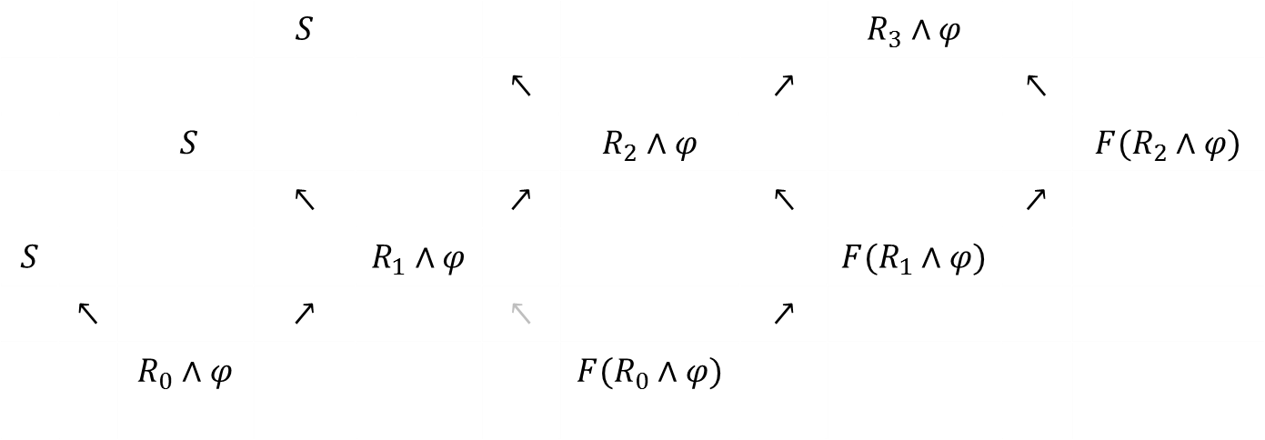
PDR
Is valid?
 |  |  | $$S$$ |  |  |  |  | $$R_{3}∧φ$$
 |  |  |  |  | $$↖$$ |  | $$↗$$ |  | $$↖$$
 |  | $$S$$ |  |  |  | $$R_{2}∧φ$$ |  |  |  | $$F(R_{2}∧φ)$$
 |  |  | $$↖$$ |  | $$↗$$ |  | $$↖$$ |  | $$↗$$
$$S$$ |  |  |  | $$R_{1}∧φ$$ |  |  |  | $$F(R_{1}∧φ)$$
 | $$↖$$ |  | $$↗$$ |  | $$↖$$ |  | $$↗$$
 |  | $$R_{0}∧φ$$ |  |  |  | $$F(R_{0}∧φ)$$
Induction w$hen {F(R}_{2}∧φ)⇒φ$

Slide 41
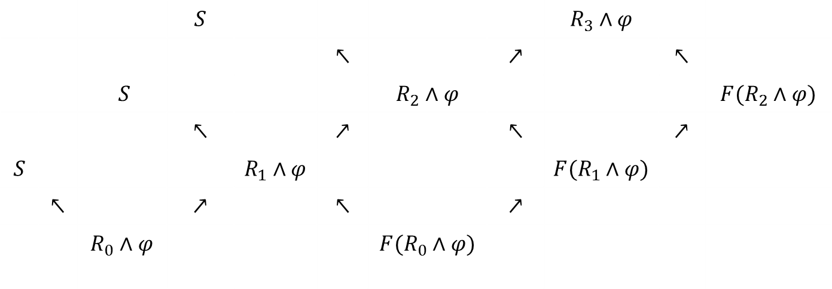
PDR
Is valid?
 |  |  | $$S$$ |  |  |  |  | $$R_{3}∧φ$$
 |  |  |  |  | $$↖$$ |  | $$↗$$ |  | $$↖$$
 |  | $$S$$ |  |  |  | $$R_{2}∧φ$$ |  |  |  | $$F(R_{2}∧φ)$$
 |  |  | $$↖$$ |  | $$↗$$ |  | $$↖$$ |  | $$↗$$
$$S$$ |  |  |  | $$R_{1}∧φ$$ |  |  |  | $$F(R_{1}∧φ)$$
 | $$↖$$ |  | $$↗$$ |  | $$↖$$ |  | $$↗$$
 |  | $$R_{0}∧φ$$ |  |  |  | $$F(R_{0}∧φ)$$
Induction w$hen {F(R}_{2}∧φ)⇒φ$

Slide 42
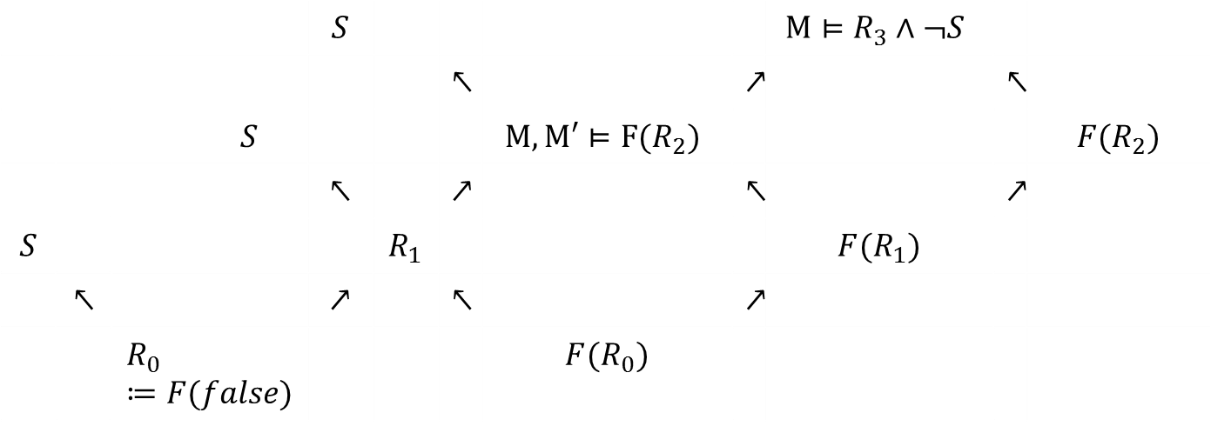

PDR
Is valid?
 |  |  | $$S$$ |  |  |  |  | $${M⊨R}_{3}∧¬S$$
 |  |  |  |  | $$↖$$ |  | $$↗$$ |  | $$↖$$
 |  | $$S$$ |  |  |  | $${M, M′⊨F(R}_{2})$$ |  |  |  | $$F(R_{2})$$
 |  |  | $$↖$$ |  | $$↗$$ |  | $$↖$$ |  | $$↗$$
$$S$$ |  |  |  | $$R_{1}$$ |  |  |  | $$F(R_{1})$$
 | $$↖$$ |  | $$↗$$ |  | $$↖$$ |  | $$↗$$
 |  | $$R_{0}≔F(false)$$ |  |  |  | $$F(R_{0})$$
Decide $next unfolding of model, backwards$

Slide 43
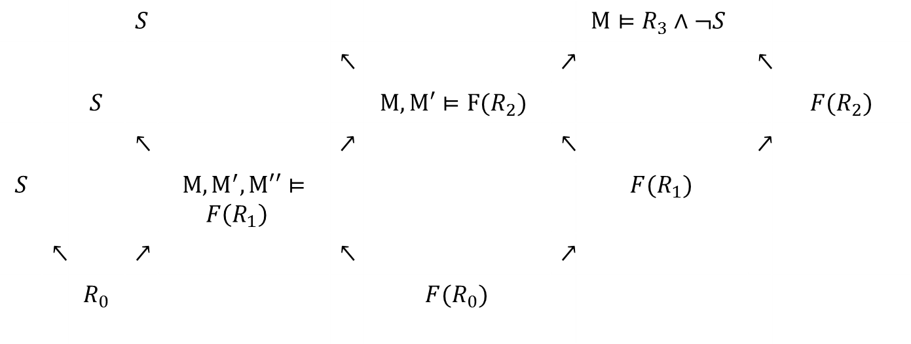

PDR
Is valid?
 |  |  | $$S$$ |  |  |  |  | $${M⊨R}_{3}∧¬S$$
 |  |  |  |  | $$↖$$ |  | $$↗$$ |  | $$↖$$
 |  | $$S$$ |  |  |  | $${M, M′⊨F(R}_{2})$$ |  |  |  | $$F(R_{2})$$
 |  |  | $$↖$$ |  | $$↗$$ |  | $$↖$$ |  | $$↗$$
$$S$$ |  |  |  | $$M, M^{′},M′′⊨$$ $$F\left(R_{1}\right)$$ |  |  |  | $$F(R_{1})$$
 | $$↖$$ |  | $$↗$$ |  | $$↖$$ |  | $$↗$$
 |  | $$R_{0}$$ |  |  |  | $$F(R_{0})$$
Decide $next unfolding of model, backwards$

Slide 44
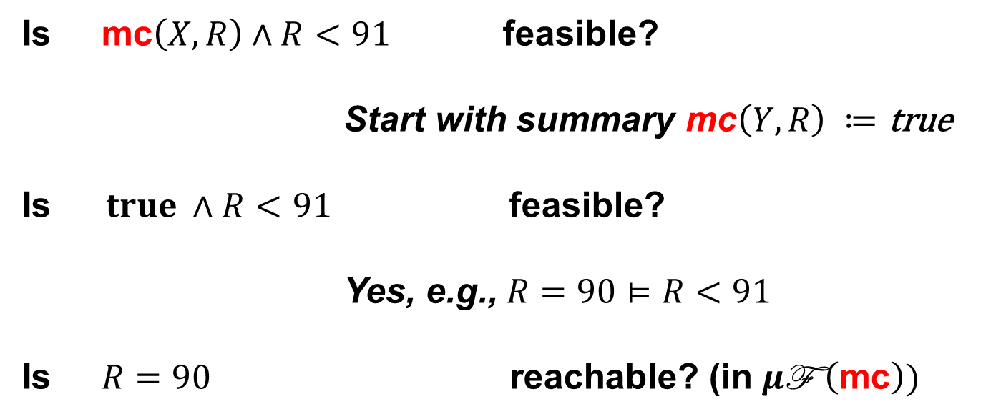
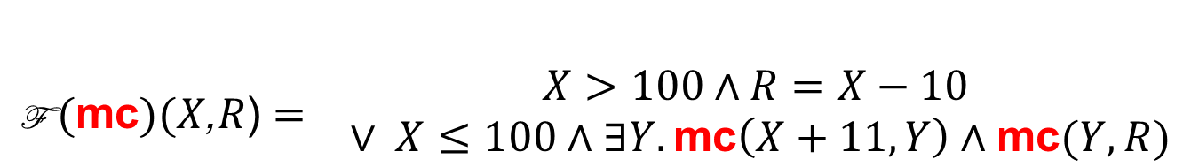
Non-linear fixed-points
Recall:
$$\begin{matrix}\text{F} (\text{mc})(X\text{,}R\text{)}= & \begin{matrix}X>100∧R=X−10 \\ ∨ X≤100∧∃Y. \text{mc}\left(X+11,Y\right)∧\text{mc}(Y,R)\end{matrix}\end{matrix}$$
Is $\text{mc}\left(X,R\right)∧R<91$ feasible?
Start with summary $\text{mc}\left(Y,R\right) ≔\text{true}$
$\text{Is} true ∧R<91$ feasible?
Yes, e.g., $R=90⊨$ $R<91$
Is $R=90$ reachable? (in $μ\text{F} \left(\text{mc}\right))$

Slide 45
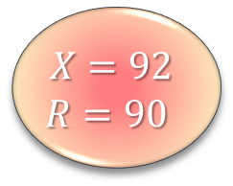
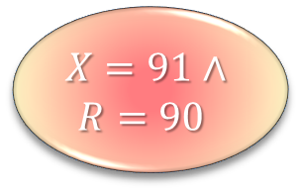
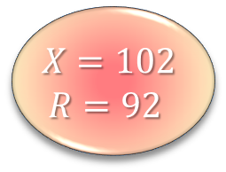

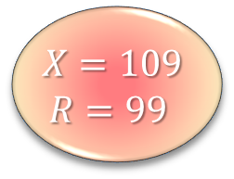
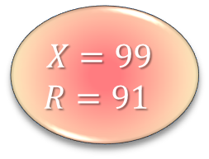
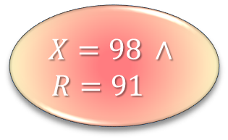

Non-linear transformers
M(87)
= M(M(98))
= M(M(M(109)))
= M(M(99))
= M(M(M(110)))
= M(M(100))
= M(M(M(111)))
= M(M(101))
= M(91)
= M(M(102))
= M(92)
= M(M(103))
= M(93) …
$$R=90$$
$$X=98 ∧$$
$$R=91$$
$$X=91∧$$
$$R=90$$
Benchmarks
from the SLAM
Research toolkit
$$X=109$$
$$R=99$$
$$X=99$$
$$R=91$$
$$X=102$$
$$R=92$$
$$X=92$$
$$R=90$$
Checking against $R_{1}, R_{2}, …{,R}_{N}$ controls depth, but potentially wide tree.
Our approach: build DAG by sharing states.
Sharing is cheap, even no sharing works on Bebop

Slide 46
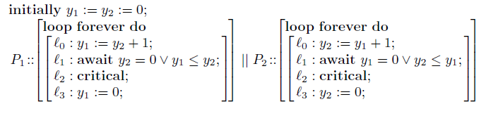
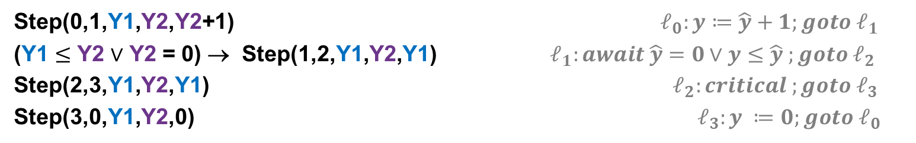

Arithmetic
Mutual Exclusion
$$⇔$$
Clauses have model
R(0,0,0,0). Initial states
T(L,M,Y1,Y2,L’,M’,Y1’,Y2’)∧R(L,M,Y1,Y2) → R(L’,M’,Y1’,Y2’) Reachable states
R(2,2,Y1,Y2) → false Is unsafe state reachable?
Step(L,L’,Y1,Y2,Y1’) → T(L,M,Y1,Y2,L’,M,Y1’,Y2) P₁ takes a step
Step(M,M’,Y2,Y1,Y2’) → T(L,M,Y1,Y2,L,M’,Y1,Y2’) P₂ takes a step
Step(0,1,Y1,Y2,Y2+1) $ℓ_{0}:y≔\hat{y}+1;goto ℓ_{1}$
(Y1 $≤$ Y2 $∨$ Y2 = 0) → Step(1,2,Y1,Y2,Y1) $ℓ_{1}:await \hat{y}=0∨y≤\hat{y} ;goto ℓ_{2}$
Step(2,3,Y1,Y2,Y1) $ℓ_{2}:critical ;goto ℓ_{3}$
Step(3,0,Y1,Y2,0) $ℓ_{3}:y ≔0;goto ℓ_{0}$

Slide 47

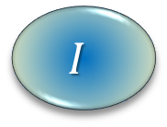
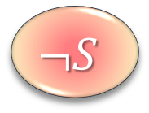
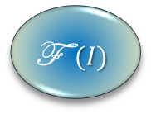
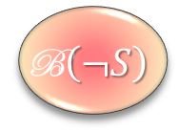
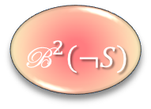
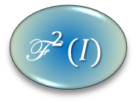
Search: Mile-high perspective
Conflict Resolution
Conflict Propagation
Conflict Propagation
$$I$$
$$\text{F} (I)$$
$${\text{F}}^{ 2}(I)$$
${\text{B}}^{2}\left(¬S\right)$
$$\text{B}\left(¬S\right)$$
$$¬S$$

Slide 48
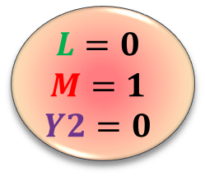










PDR(T): Conflict Resolution
Conflict Resolution
$$L=1$$
$$M=1$$
$$Y1=1$$
$$Y2=0$$
$$L=2$$
$$M=2$$
$$L=0$$
$$M=0$$
$$Y2=0$$
$$Y1=0$$
$$L=0$$
$$M=1$$
$$Y2=0$$
$$L=1$$
$$M=2$$
$$Y2=0$$
$$Y2≥Y1+1∧Y1≥0$$
$$Y2≤0$$
$$Y2≥1$$
$$Y2≤0$$
$$∧$$
$∧$ $∧$
Conflict Resolution
Get Generalization from Farkas Lemma
Eg., resolve away blue internal variables

Slide 49



PDR(T): Conflict Resolution
Conflict Resolution
Conflict Propagation
Conflict Propagation
$$L=0$$
$$M=0$$
$$Y2=0$$
$$Y1=0$$
$$L=0$$
$$M=1$$
$$Y2=0$$
$$L=1$$
$$M=1$$
$$Y1=1$$
$$Y2=0$$
$$L=1$$
$$M=2$$
$$Y2=0$$
$$L=2$$
$$M=2$$
$$M=1 →Y2≥1$$
$$M=1 →Y2≥1$$
$$M=1 →Y2≥1$$

Slide 50

PDR(T): Generalization from T-lemmas
Can we satisfy?
$R(0,0,0,0).$ Initial states
$T\left(L,M,Y1,Y2,L’,M’,Y1’,Y2’\right), R\left(L,M,Y1,Y2\right)→R\left(L’,M’,Y1’,Y2’\right)$ Reachable states
$R\left(L,M,Y1,Y2\right) → ¬\left(L=2∧M=2\right).$ Unsafe state is unreachable
$\underset{\text{M}}{\underbrace{L=0∧M=1∧Y2=0}} ∧\underset{Pre}{\underbrace{\text{F} \left(R_{0}\right)}}$ is unsatisfiable
E.g., there is unsat core of: $\underset{\text{M}}{\underbrace{\bigwedge_{j}{{c_{j}≤x}_{j}≤c_{j}}}} ∧$ $\underset{Pre}{\underbrace{\text{F} \left(R_{i}\right)}}$
Unsat proof uses T-lemmas
$$\left(\underset{From ¬\text{M}}{\underbrace{5>x_{1}∨3<x_{3}}}∨\underset{From ¬Pre}{\underbrace{x_{1}−x_{2}>2∨{2x}_{2}−x_{3}>1}}\right)$$

Slide 51

PDR(T): Generalization from T-lemmas
Can we satisfy?
$R(0,0,0,0).$ Initial states
$T\left(L,M,Y1,Y2,L’,M’,Y1’,Y2’\right), R\left(L,M,Y1,Y2\right)→R\left(L’,M’,Y1’,Y2’\right)$ Reachable states
$R\left(L,M,Y1,Y2\right) → ¬\left(L=2∧M=2\right).$ Unsafe state is unreachable
Unsat proof uses T-lemmas
$$\left(\underset{From ¬\text{M}}{\underbrace{5>x_{1}∨3<x_{3}}}∨\underset{From ¬Pre}{\underbrace{x_{1}−x_{2}>2∨{2x}_{2}−x_{3}>1}}\right)$$
$\begin{matrix}2⋅\left(−x_{1}≤−5\right) \\ x_{3}≤3 \\ {2⋅(x}_{1}−x_{2}≤2) \\ {2x}_{2}−x_{3}≤1 \\ \end{matrix}$ $\begin{matrix}−2x_{1}≤−10 \\ x_{3}≤3 \\ {2x}_{1}−{2x}_{2}≤4 \\ \begin{aligned}{2x}_{2}−x_{3}≤1 \\ −−−−−−\end{aligned} \\ 0≤−2\end{matrix}$ ${ \underset{\begin{aligned}Block any model \\ satisfying this \end{aligned}}{\underbrace{2x_{1}−x_{3}≤5}}}_{}$

Slide 52

PDR(LRA): Timed automata
Observation:
PDR + Model refinement using Farkas strengthening
is a decision procedure for timed push-down systems
Justification:
Every lemma produced is a sum of differences from the input
~
Acyclic path in difference graph.
$⇒$ Finite set of Farkas lemmas possible.

Slide 53
N+1 degrees of separation
Objective:
synthesize inductive invariant proving property.
Reaching objective with interpolants:
Synthesize interpolants, use for proving invariants. Be admired.
Synthesize interpolants, evaluate on random formulas. Admire them.
Write papers about interpolants. Admire the theorems.
Review papers about generating interpolants. Watch Kevin Bacon.
Reaching objective with PDR:
…. Nevertheless, interpolants sneak in.

Slide 54

What is a Craig Interpolant?
Suppose $A⇒B$
A Craig Interpolant is formula $I:$
$Lang\left(I\right)⊆Lang\left(A\right)∩Lang\left(B\right)$
$A⇒I, I⇒B$
Horn version. Establish satisfiability of:
$∀x,y. A[x,y]⇒I\left(x\right),$
$∀x,z. I\left(x\right)⇒B[x,z]$
and find solution for $I.$

Slide 55

PDR(T): Interpolants as a side-effect
Intermediary solutions: $∀X. \text{F} \left(false\right)\left(X\right)→R_{1}\left(X\right),$
$∀X. \text{F} \left(R_{1}\right)\left(X\right)→R_{2}\left(X\right),$
$∀X. \text{F} \left(R_{2}\right)\left(X\right)→R_{3}\left(X\right),$
$∀X.$ ${ R}_{3}\left(X\right)→Safe\left(X\right),$
Observation: Farkas strengthening computes
a “DAG interpolant” for LRA
i.e., solves for non-recursive Horn clauses

Slide 56
Summary
The question is:
Quantified Horn Clause Satisfiability Modulo Theories
PDR Generalized:
as an abstract Transition System
for Horn Clause Satisfiability over Theory of Arithmetic
  Using Farkas to generalize failed counter-example traces
  Difference Logic – a Model Checking algorithm for Timed Automata
  Interpolants from Model refinements
  - Propagate also properties for predicates (so far inefficient)
http://rise4fun.com/Z3Py/tutorial/fixedpoints

Slide 57

PDR as a Transition System

Slide 58


Non-linear PDR - Algorithm

Slide 59


Slide 60


Bottom-up Datalog: Engine
Parser
Early preprocessing
Rule normalization
Late preprocessing
Compilation
Execution
Results
Rule transformations
Compilation
⇓
Restarts
Relational
Algebra
Abstract
Machine

Slide 61






Bottom-up Datalog: Relations
Tables
Hash-table
BDD
Relations
Bit-vectors
Abstractions
Intervals
Bounds
SMT
Explanations
Compositions
Finite
product
Relation product
External
x
0
1
y
z
0
1
$$R∪S≡R∨S$$
$$π_{x}R≡∃x R$$
$$δ_{x=a}R≡R∧x=a$$
Intervals
Bounds
Pentagons
=
+
+
=

