Slide 1
Linear Functional
Fixed-Points
Nikolaj Bjørner Joe Hendrix
Microsoft Research & Corporation

Slide 2
Overview
Linear Functional Fixed-Point Logic (FFP)
Complexity results for FFP:
  FFP(Propositional) – PSPACE/NP
  FFP(Linear/Equalities) – PSPACE
    By a reduction to LTL
  FFP(Non-linear)– NEXPTIME hard/undecidable
Integrating FFP with an SMT solver (Z3)

Slide 3
A list-manipulating program
curr
T
T
F
curr := head
T
head
head
head
head
T
T
F
F
F
F
F
F
T
F
F
F
data(curr) := true;
curr := f(curr)
T
T
T
F
T
F
F
F
curr
curr
curr
curr = head
Loop invariant:
Every data element between
head and curr is set to true

Slide 4
The loop invariant
Loop invariant:
Every data element between
head and curr is set to true
head
T
F
F
F
f
∀x ∈ [head → curr] . data(x)
T
T
invariant(head) where
invariant(x) =
x = curr ∨ (data(x) ∧ invariant(f(x)))
curr
LFP Inv , x. [ x = curr ∨ (data(x) ∧ Inv(f(x))) ] (head)
μ Inv λ x [ x = curr ∨ (data(x) ∧ Inv(f(x))) ] (head)
What are practical ways of reasoning with such fixed-points?

Slide 5
Some solutions
f
f
u
v
w
f
f
f
f
f
u→v
[Nelson 80]
w

Slide 6
Some solutions
u
v
w
f
f
f
f
f
f
f
btwn_{f}(u,v,w)
[Rakamarić07+]
u→v
[Nelson 80]
w

Slide 7
Some solutions
¬BSet(u)
¬BSet(f(f(u)))
B(u) = v ⬄
u
v
From u reach v
and v is the first
element satisfying
BSet(v)
f
f
f
f
¬BSet(f(u))
BSet(v)
¬BSet(f(f(u)))
From u reach v
and everything after
u and up to v satisfies
¬ BSet
R(u,v)⬄
u
v
f
f
f
f
¬BSet(f(u))
f
wf. Reachability
[Lahiri, Qadeer 06]
btwn_{f}(u,v,w)
[Rakamarić07+]
u→v
[Nelson 80]
w

Slide 8
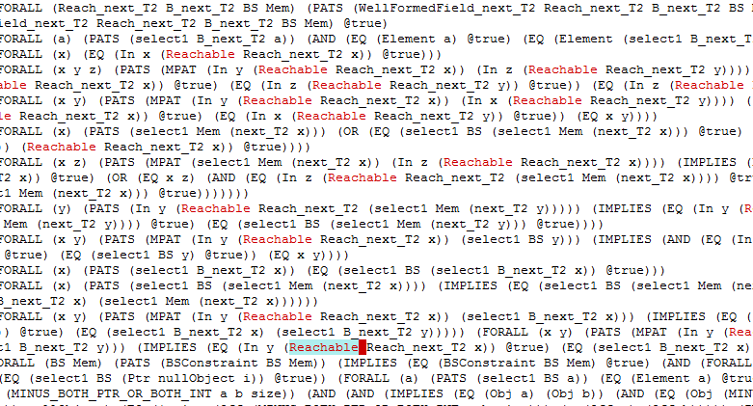
Some solutions
Use first-order axioms to encode quantifier-free theory of
reachability.
[LQ08] rely on SMT solver Z3 for instantiating axioms using
triggers.
Required quantifier support by solver is not so off-the-shelf.
Interpreted sets &
Bounded quant.
[Lahiri, Qadeer 08]
f
wf. Reachability
[Lahiri, Qadeer 06]
btwn_{f}(u,v,w)
[Rakamarić07+]
u→v
[Nelson 80]
w

Slide 9
Some solutions
SnS
(inf. Trees)
SO(f)
(infinite trees)
S1S
(inf. Acyclic lists)
wSnS
(finite trees)
wSO(f)
(finite linked lists)
wS1S
(fin. Acyclic lists)
FFP(Non-linear)
Reachable Patterns
[Yorsh+ 06]
Lin. FFP(Eq)
Interpreted sets &
Bounded quant.
[Lahiri, Qadeer 08]
FFP(Prop)
f
wf. Reachability
[Lahiri, Qadeer 06]
btwn_{f}(u,v,w)
[Rakamarić07+]
u→v
[Nelson 80]
w

Slide 10
Many other solutions
[Immerman+ 04] First-order transitive closure
[Møller+ 05] Pointer assertion logic
[Lev-Ami+ 05] Acyclic transtive closure
[McPeak+ 05] Linked lists
[Ranise+ 05] Linked lists
[Balaban+ 07] Single parent heaps
[Bouajjani+ 06-09] Reachability + arithmetic + T
Apologies for relevant omissions.

Slide 11
A Quest for an SMT solver integration
T
Existing decision procedures
for fixed-points use
Encoding with first-order axioms
  Rely on first-order instantiation
  engine for completeness
Reduction to automata
  Powerful combination with some theories, but
  flexible combination approach and “low-order” complexity
  results unclear to us
head
F
F
F
T
T
curr

Slide 12

The DPLL(T) setting for SMT
Specialized theory solvers interoperate
by exchanging learned equalities and
clauses with a common
congruence closure core
T
head
F
F
F
T
T
curr
Formula
Theories
Bit-Vectors
Rewriting Simplification
Arithmetic
E-matching
Core Theory
Arrays
Data-types
SAT solver
Core ⇒ Theory: Equalities, asserted literals
Theory ⇒ Core: Equalities, asserted literals, new clauses

Slide 13
Back to the loop invariant
Loop invariant:
Every data element between
head and curr is set to true
T
head
F
F
F
f
∀x ∈ [head → curr] . data(x)
T
T
invariant(head) where
invariant(x) =
x = curr ∨ (data(x) ∧ invariant(f(x)))
curr
LFP Inv , x. [ x = curr ∨ (data(x) ∧ Inv(f(x))) ] (head)
μ Inv λ x [ x = curr ∨ (data(x) ∧ Inv(f(x))) ] (head)

Slide 14
Question:
Is there a convenient propositional-like abstraction of fixed-points?
Our Approach: establish and
use a connection with
Linear Time Temporal Logic
for linear functional fixed-points
T
head
F
F
F
T
T
curr
A Until B
[data(x) Until_{f,x} x = curr] (head)
⇔
B ∨ [A ∧ ο(A Until B)]
⇔
⇔
μ X . B ∨ [A ∧ ο X]
μ Inv λ x [ x = curr ∨ (data(x) ∧ Inv(f(x))) ] (head)

Slide 15
FFP Temporal Macros
  [A(x) Until_{f,x} B(x)] (a) ⬄
  μ Rλ x [B(x) ∨ (A(x) ∧ R(f(x)))] (a)
  [◊_{f,x} A(x)] (a) ⬄ [true Until_{f,x} A(x)] (a)
  [_{f,x} A(x)] (a) ⬄ ¬[◊_{f,x} ¬A(x)] (a)

Slide 16
Some solutions
SnS
(inf. Trees)
SO(f)
(infinite trees)
S1S
(inf. Acyclic lists)
wSnS
(finite trees)
wSO(f)
(finite linked lists)
wS1S
(fin. Acyclic lists)
FFP(Non-linear)
Reachable Patterns
[Yorsh+ 06]
Lin. FFP(Eq)
Interpreted sets &
Bounded quant.
[Lahiri, Qadeer 08]
FFP(Prop)
f
wf. Reachability
[Lahiri, Qadeer 06]
btwn_{f}(u,v,w)
[Rakamanic07+]
u→v
[Nelson 80]
w

Slide 17
Our approach – a tighter sandwich
Propositional Linear Time Temporal Logic
?
FFP(Non-linear)
Reachable Patterns
[Yorsh+ 06]
Lin. FFP(Eq)
Interpreted sets &
Bounded quant.
[Lahiri, Qadeer 08]
FFP(Prop)
f
wf. Reachability
[Lahiri, Qadeer 06]
btwn_{f}(u,v,w)
[Rakamanic07+]
u→v
[Nelson 80]
w

Slide 18
FFP(Propositional Logic): basic results
  [◊_{f,x} P(f(x))](a) ∧ [ _{f,x} P(x)](b) ∧ [Q(x) Until _{f,x} P(f(x))](b)
  - Distinguished function f
  - Unary predicate symbols, P, Q, R
  - At most one bound variable in scope at any time
  [Q(x) Until _{f,x} [P(f(x)) Until _{f,y} R(y)]](b)

Slide 19
FFP(PL): basic results
From LTL to FFP(PL)
  ◊ΟP → ◊_{f,x f,x} P(f(x))(anchor)
From FFP(PL) to LTL
  ◊_{f,x} P(f(x))(a) ∧ _{f,x} P(x)(b) → ◊ΟP_{a} ∧ P_{b}
Complexity(FFP(PL)) = Complexity(pLTL)

Slide 20
FFP(Equalities): propositions and equalities
f
f
u → v
u
v
f
f
f
f
[True Until _{f,x} x = v](u)
⬄
◊_{f,x} (x = v)(u)

Slide 21
FFP(E): propositions and equalities
f
f
f
u → v
w
u
v
w
f
f
f
f
[x ≠ w Until _{f,x} x = v](u)

Slide 22
FFP(E): propositions and equalities
btwn_{f}(u,v,w)
u
v
w
f
f
f
f
f
f
[x ≠ w Until _{f,x} x = v](u) ∧ ◊_{f,x} (x = w)(v)

Slide 23
FFP(E): propositions and equalities
¬BSet(u)
¬BSet(f(f(u)))
B(u) = v ⬄
u
v
f
f
f
f
¬BSet(f(u))
BSet(v)
[¬BSet(x) Until _{f,x} x = v](u) ∧ BSet(v)
¬BSet(f(f(u)))
R(u,v)⬄
u
v
f
f
f
f
¬BSet(f(u))
[¬BSet(f(x)) Until _{f,x} x = v](u)

Slide 24
FFP(E): propositions and equalities
  [ _{f,x} x ≠ c](b) ∧
  [◊_{g,x} P(g(x))](a) ∧ [◊_{f,x} P(f(x))](a) ∧
  [x ≠ fff(x) Until _{f,x} x = a](b) ∧
  [◊_{g,x} g(g(x)) = x](c)
  Distinguished functions f, g
    As long as f and g are separate
  Unary predicate symbols, P, Q, R
  At most one bound variable in scope at any time

Slide 25
FFP(E): A litmus test. Closure under updates.
wp(f(u) := v, [A Until _{f,x} B](w))
f’ := λx. if x = u then v else f(x)
= [A Until _{f,x} B](w)[f → f’]
A’ := A[f → f’], B’ := B[f → f’]
= [A’ Until _{f’,x} B’](w)
= ….
= [A’’ Until _{f,x} B’’](w)
A’’ := A’∧ u ≠ x
B’’ := B’ ∨ (u = x ∧ [(u ≠ x ∧ A’) Until _{f,x} B’](v))

Slide 26
FFP(E) : reduction to LTL?
From LTL to FFP(E)
  ◊ΟP → ◊_{f,x f,x} P(f(x))(anchor)
From FFP(E) to LTL?
  [◊_{f,x} x = c ∧ ◊_{f,x} P(x)](a) ∧ → a and b reach c
  [◊_{f,x} x = c ∧ ◊_{f,x} P(x)](b) after that there is a
  common P state.

Slide 27
FFP(E) : reduction to LTL?
From LTL to FFP(E)
  ◊ΟP → ◊_{f,x f,x} P(f(x))(anchor)
From FFP(E) to LTL
  [◊_{f,x} (T(x) ∨ U(x)) ∧ f(x) = b](a) ∧
  [◊_{f,x} (T(x) ∨ U(x)) ∧ f(x) = c](b) ∧
  [◊_{f,x} (T(x) ∨ U(x)) ∧ f(x) = a](c)
a
U
c
T
U
T
Obstacle: f is a function.-
The Temporal Next Ο operator does
not encode functionality by itself.
U
T
b

Slide 28
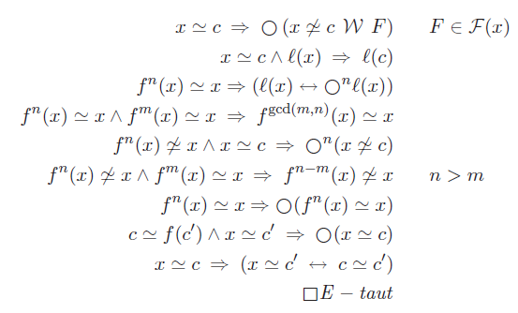
FFP(E) encoding forcing functionality
Normalize
f Erasure
Functionality
axioms
ϕ
Tableau(ϕ)
F – acc. cond
ϕ_{PTL}
ϕ_{PTL*}
Functionality
axioms

Slide 29
FFP(E) encoding forcing functionality
Normalize
f Erasure
Functionality
axioms
ϕ
Tableau(ϕ)
F – acc. cond
ϕ_{PTL}
ϕ_{PTL*}
Pure pLTL
formula
Proposition:
Validity for FFP(E) is PSPACE complete
Size of ϕ_{PTL*} is quadratic in ϕ

Slide 30
FFP(E) extensions
  FFP(NL) – more than one variable in nested bound context
  [ _{f,x} [ _{f,y} f(x) ≠ y](x)] (a)
  NEXPTIME hard ≤ FFP(NL) ≤ MSO(f)
  2FFP(E) – allow nested use of functions f g:
  [ _{f,x} g(f(x)) = f(g(x))] (a)
  2FFP(E) is undecidable
a
f
f
f
f
f
f
f
a
f
g
f
g
f
g
f
g
f
f
g
g
g
f
g
f
g
f
g
f
g
f
g
f

Slide 31
SMT solver Integration
Most SMT solvers use a DPLL(T) architecture
  SAT Equality Core Theories
  SAT Equality Core Theories
Literal assignments
Literal assignments
Equalities
Literal assignments
Equalities
Literal assignments
Lemmas (Conflict Clauses)

Slide 32
SMT solver Integration (Theory)
Property: FFP(E) is stably infinite
  If FFP(E) formula ϕ has a model, it has a model of size N, it has a model of size N+1
Theorem: Let T be stably infinite, decidable, and have disjoint signature
from f, g,
Then quantifier-free formulas over
FFP(E) + T are decidable

Slide 33
SMT solver Integration (Incremental)
  pLTL Equality Core Theories
  pLTL Equality Core Theories
Trace σ of
Literal assignments
Equalities
Literal assignments
Equalities
Literal assignments
Invariants
Safety properties

Slide 34
Summary
Linear Functional Fixed-Point Logic (FFP)
Complexity results for FFP:
  FFP(Propositional) – PSPACE/NP
  FFP(Linear/Equalities) – PSPACE
    By a reduction to LTL
  FFP(Non-linear)– NEXPTIME hard/undecidable
Integrating FFP with the SMT solver

Slide 35
Conclusions
We established a sandwich link between
  Linear Functional Fixed-Point Logic and
  Propositional Linear Time Temporal Logic
  More sandwiched links plausible, but open.
  From DPLL(T) to SMC(T)
  We show how to integrate a solver based on LTL with an SMT Solver
  A prototype using CUDD and shows signs of life

Slide 36
