Slide 1
Automatic theorem proving and SMT
Nikolaj Bjørner
Microsoft Research
HCSS, May 8, 2013

Slide 2


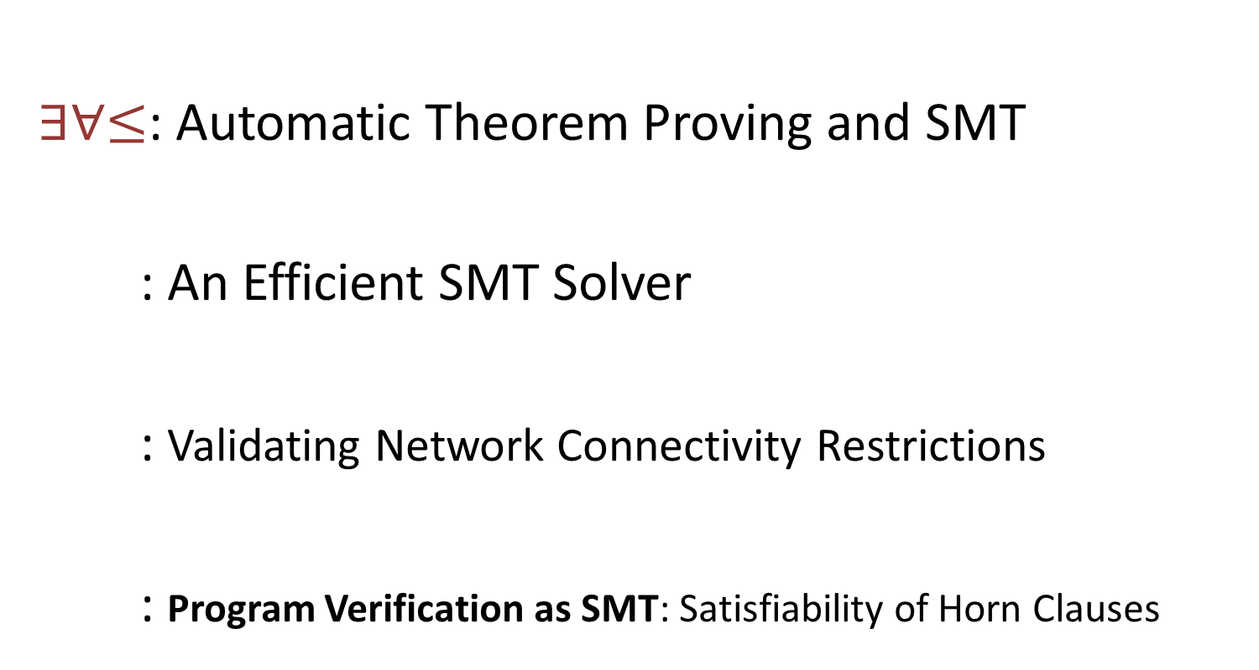
Outline
$∃∀≤$: Automatic Theorem Proving and SMT
: An Efficient SMT Solver
: Validating Network Connectivity Restrictions
: Program Verification as SMT: Satisfiability of Horn Clauses
SecGuru

Slide 3

Automatic Theorem Proving and SMT
ATP&SMT
Z3
SecGuru
Horn SAT
$$∃∀≤$$

Slide 4

Symbolic Engines: SAT, FTP and SMT
SAT: Propositional Satisfiability.
(Tie ∨ Shirt) ∧ ( ¬Tie ∨ ¬Shirt) ∧ (¬Tie ∨ Shirt)
FTP: Automatic First-order Theorem Proving.
∀X,Y,Z [X*(Y*Z) = (X*Y)*Z]
∀X [X*inv(X) = e] ∀X [X*e = e]
SMT: Satisfiability Modulo background Theories
b + 2 = c ∧ A[3] ≠ A[c-b+1]
SMT solvers have specialized algorithms for theories
$$∃∀≤$$

Slide 5
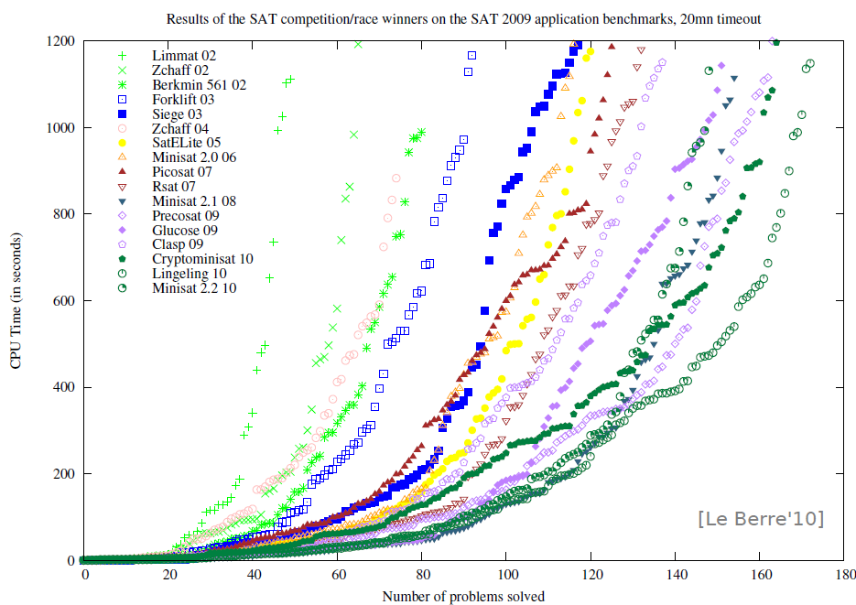
SAT - Milestones
Problems impossible 10 years ago are trivial today
year | Milestone
1960 | Davis-Putnam procedure
1962 | Davis-Logeman-Loveland
1984 | Binary Decision Diagrams
1992 | DIMACS SAT challenge
1994 | SATO: clause indexing
1997 | GRASP: conflict clause learning
1998 | Search Restarts
2001 | zChaff: 2-watch literal, VSIDS
2005 | Preprocessing techniques
2007 | Phase caching
2008 | Cache optimized indexing
2009 | In-processing, clause management
2010 | Blocked clause elimination
Concept
2002
2010
Millions of
variables from
HW designs
Courtesy Daniel le Berre
$$∃∀≤$$

Slide 6
FTP - Milestones
Year | Milestone | Who | Year | Milestone | Who
1930 | Hebrand's theorem | Herbrand | 1970 | Completion and saturation procedures | many people and provers
1934 | Sequent calculi | Gentzen | 1970 | Knuth-Bendix ordering | Knuth; Bendix
1934 | Inverse method | Gentzen | 1971 | Selection function | Kowalski; Kuehner
1955 | Semantic tableaux | Beth | 1972 | Built-in equational theories | Plotkin
1960 | Herbrand-based theorem proving | Wang Hao | 1972 | Prolog | Colmerauer
1960 | Ordered resolution | Davis; Putnam | 1974 | Saturation algorithms | Overbeek
1962 | DLL | Davis; Logemann; Loveland | 1975 | Completeness of paramodulation | Brand
1963 | First-order inverse method | Maslov | 1975 | AC-unification | Stickel
1965 | Unification | J. Robinson | 1976 | Resolution as a decision procedure | Joyner
1965 | First-order resolution | J. Robinson | 1979 | Basic paramodulation | Degtyarev
1965 | Subsumption | J. Robinson | 1980 | Lexicographic path orderings | Kamin; Levy
1967 | Orderings | Slagle | 1985 | Theory resolution | Stickel
1967 | Demodulation or rewriting | Wos; G. Robinson; Carson; Shalla | 1986 | Definitional clause form transformation | Plaisted; Greenbaum
1968 | Model elimination | Loveland | 1988 | Superposition | Zhang
1969 | Paramodulation | G. Robinson; Wos | 1988 | Model construction | Zhang
 |  |  | 1989 | Term indexing | Stickel; Overbeek
 |  |  | 1990 | General theory of redundancy | Bachmair; Ganzinger
 |  |  | 1992 | Basic superposition | Nieuwenhuis; Rubio
 |  |  | 1993 | First instance-based methods | Billon; Plaisted
 |  |  | 1993 | Discount saturation algorithm | Avenhaus; Denzinger
 |  |  | 1998 | Finite model finding using SAT | McCune
 |  |  | 2000 | First-order DPLL | Baumgartner
 |  |  | 2003 | iProver method | Ganzinger; Korovin
 |  |  | 2008 | Sine selection | Hoder
Some success stories:
Open Problems (of 25 years):
XCB: X ≡ ((X ≡ Y) ≡ (Z ≡ Y)) ≡ Z)
is a single axiom for equivalence
Knowledge Ontologies
GBs of formulas
Courtesy Andrei Voronkov, U of Manchester

Slide 7
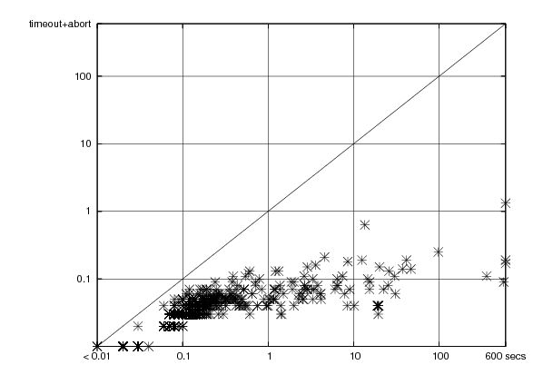
SMT - Milestones
year | Milestone
1977 | Efficient Equality Reasoning
1979 | Theory Combination Foundations
1979 | Arithmetic + Functions
1982 | Combining Canonizing Solvers
1992-8 | Systems: PVS, Simplify, STeP, SVC
2002 | Theory Clause Learning
2005 | SMT competition
2006 | Efficient SAT + Simplex
2007 | Efficient Equality Matching
2009 | Combinatory Array Logic, …
Z3
(of ’07)
Time
On
Boogie
Regression
1sec
Simplify (of ’01) time
Z3
Time
On
VCC
Regression
Includes progress from SAT:
SAT
Theory
Solvers
SMT
15KLOC + 285KLOC = Z3
Nov 08
March 09

Slide 8
Symbolic Reasoning
High Computational Complexity
Practical problems often have structure that can be exploited.
Undecidable (FOL + LIA)
Semi Decidable (FOL)
NEXPTIME (EPR)
PSPACE (QBF)
NP (SAT)
$$∃∀≤$$
Notes:
Logic is about deriving irrefutable conclusions from a set of premises.

Slide 9

– An Efficient SMT Solver
ATP&SMT
Z3
SecGuru
Horn SAT

Slide 10






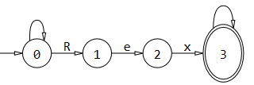






Some Microsoft Tools using
SAGE
HAVOC
SecGuru
SymDiff

Slide 11



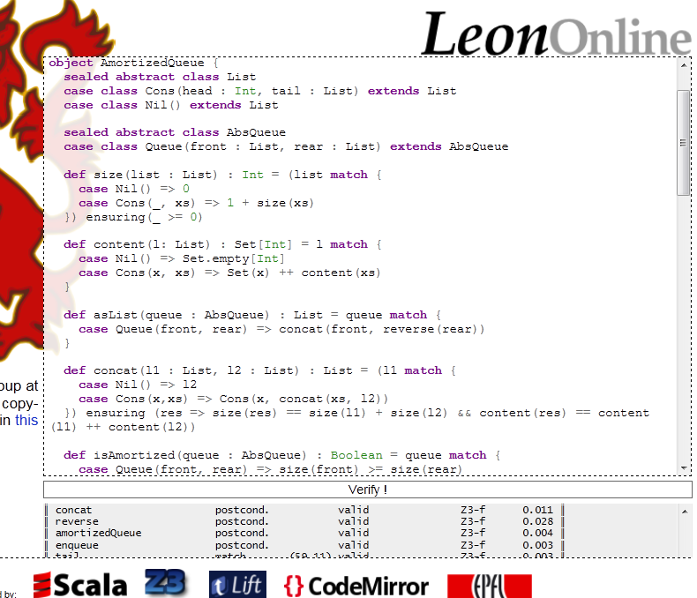


Other Cool tools using
Sledge Hammer
ESBMC
PUG
Scala^{Z3}
MetiTarski
KeYmaera
Jeves

Slide 12

SAGE by numbers
100s CPU-years - largest dedicated fuzz lab in the world
100s apps - fuzzed using SAGE
100s previously unknown bugs found
Billion+ computers updated with bug fixes
Millions of $ saved for Users and Microsoft
10s of related tools (incl. Pex), 100s DART citations
3+ Billion constraints - largest usage for any SMT solver
Dr. Strangelove?
Bug: ***433
“2/29/2012 3:41 PM Edited by *****
SubStatus -> Local Fix
I think the fuzzers are starting to become sentient.
We must crush them before it is too late.
In this case, the fuzzer figured out that if
[X was between A and B then Y would get
set to Z triggering U and V to happen……]
…..
And if this fuzzer asks for the nuclear launch
codes, don’t tell it what they are …”
Adapted from [Patrice Godefroid, ISSTA 2010]

Slide 13




Feature Usage
Arrrays
Engine
SLAyer
API
Bit-
Vectors
Simplifier
Arith
metic
Cores
Quanti-
fier Inst
Models
SAGE
Quanti-
fier-elim
Proofs
Isabelle
HOL4

Slide 14
: Little Engines of Proof
Quant.
Instances
Simplex
Bit-Arith
Congruence
Closure
SAT
Solver
Simplifier
Tactics
Arrays
Datatypes
Q- Elim
MBQI
User-Theories

Slide 15
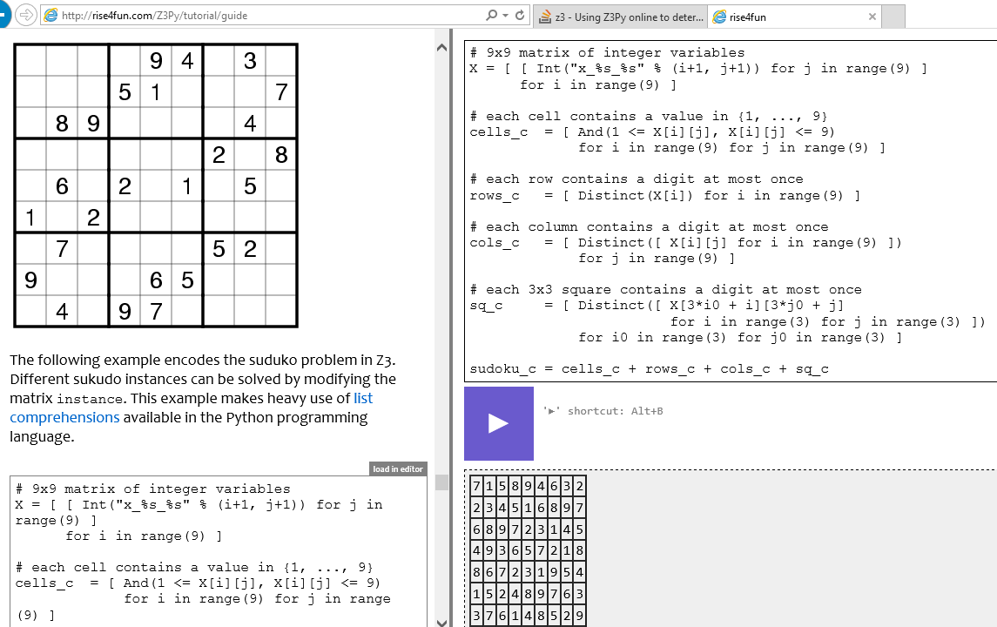
Online & Tutorial on Friday

Slide 16

What people say about
is powerful: Thank you for your advise and your powerful Z3 !
is a crown jewel.
is not just a car: Der neue Z3 is höllisch schnell (und ich meine kein Auto).
is smarter than the speaker: I just meant that I am part of the PC to which you sent email so writing me that you sent email to the PC is ... well, redundant ☺. Even Z3 should be able to derive it. [Andrei Voronkov]

Slide 17
Z3 architecture - original
Simplify
Theories
Utilities
OCaml
SMT-LIB
Bit-Vectors
Arrays
.NET
Lin-arithmetic
Grobner bases
C
Native
Recursive Datatypes
User theories
Free (uninterpreted) functions
F# quote
Python
Quantifiers:
E-matching
Model Generation:
Finite/parametric
Quantifiers:
Super-position
Proof objects
Quantifiers:
Elimination
Assumption tracking

Slide 18
Z3 architecture - new
Tactics
SMT-LIB
SMT (legacy core)
Bit-Vectors
Arrays
Lin-arithmetic
Recursive Datatypes
Record & replay
Free (uninterpreted) functions
OCaml
Quantifier instantiation
And-then
SAT core for Bit-vectors
.NET
Or-else
∃R: Non-linear real arithmetic
C
Try-for
Floating point arithmetic
Java
Par-or
Horn clauses
Par-then
Simplification
Python

Slide 19
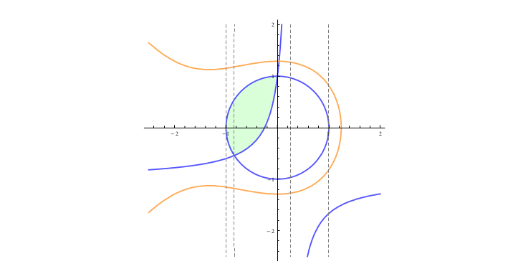


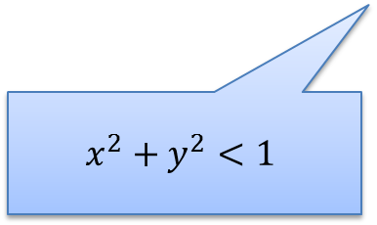
Solving ∃R Efficiently
A key idea: Use partial solution to guide the search
Feasible Region
$$x^{3}+2x^{2}+3y^{2}−5<0$$
$$−4xy −4x+y>1$$
x = 0.5
Extract small core
$$x^{2}+y^{2}<1$$
Dejan Jojanovich & Leonardo de Moura, IJCAR 2012

Slide 20
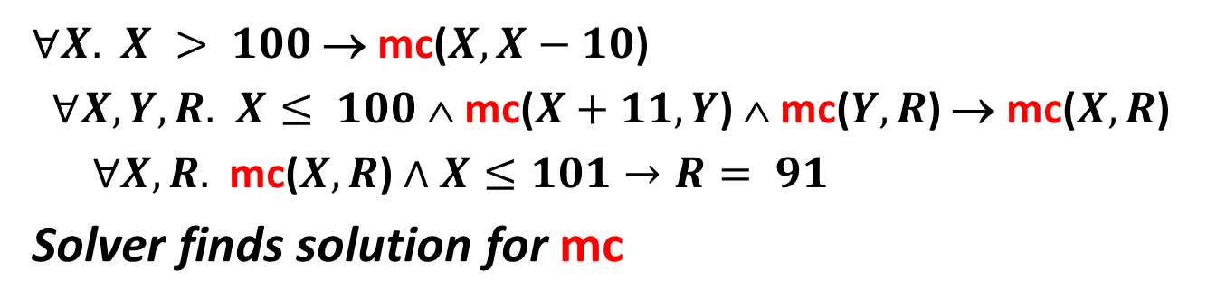
Horn Clause Satisfiability
mc(x) = x-10 if x > 100
mc(x) = mc(mc(x+11)) if x ≤ 100
assert (x ≤ 101 ⇒ mc(x) = 91)
$∀X.$ $X > 100$→ mc($X,X−10$)
$∀X,Y,R.$ $X≤ 100$∧ mc($X+11,Y$) ∧ mc($Y,R$) → mc($X,R$)
$∀X,R.$ mc($X,R$) $∧X≤101→R= 91$
Solver finds solution for mc
Krystof Hoder & Nikolaj Bjorner, SAT 2012
Bjorner, McMillan, Rybalchenko, SMT 2012

Slide 21
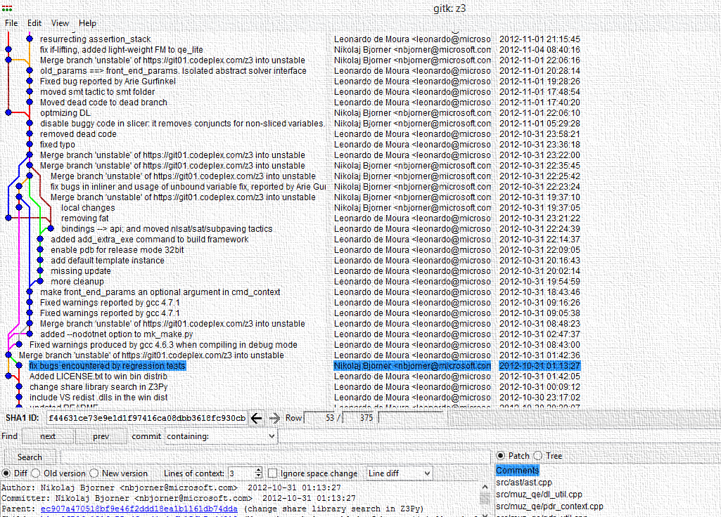
is open shared source
http://z3.codeplex.com/

Slide 22
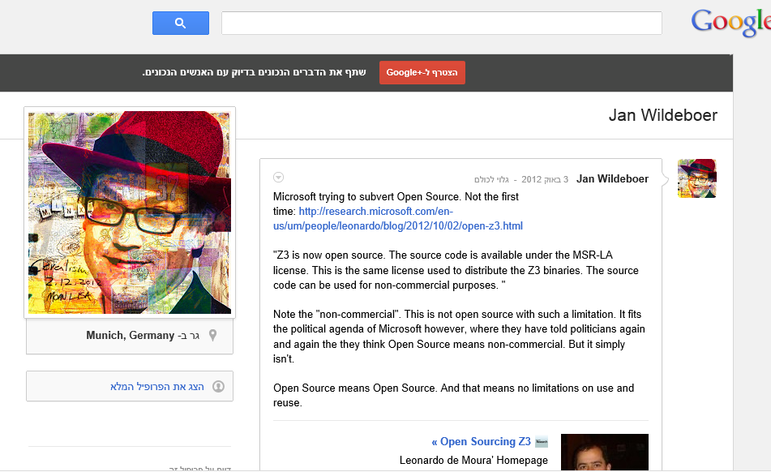
source is (evil) subverting 8/

Slide 23


SecGuru
SecGuru: Validating Network
Connectivity Restrictions
… powered non-stop by Z3
Karthick Jayaraman, Charlie Kaufman,
and Ramanathan Venkatapathy
Nikolaj Bjørner
ATP&SMT
Z3
SecGuru
Horn SAT

Slide 24
Network Policies:
Complexity, Challenge and Opportunity
SecGuru
Several devices, vendors, formats
Net filters
Firewalls
Routers
Challenge in the field
Do devices enforce policy?
Ripple effect of policy changes
Arcane
Low-level configuration files
Mostly manual effort
Kept working by
“Masters of Complexity”
Human errors > 4 x DOS attacks

Slide 25
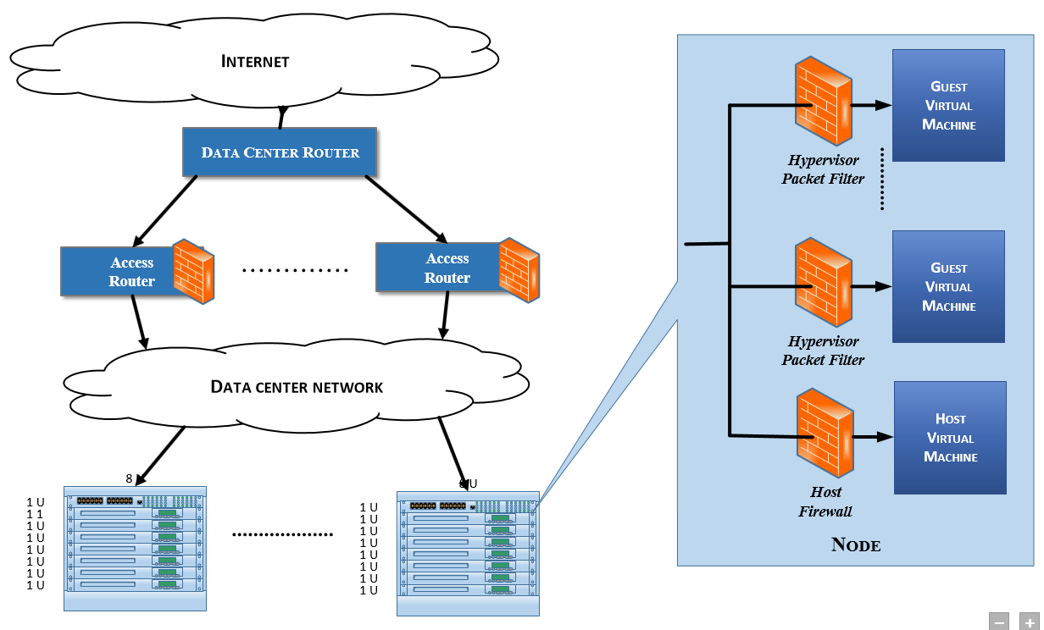
A Data-center Architecture
SecGuru
Policy
Policy
Policy
Policy
Policy
Policy
Policy
Policy

Slide 26
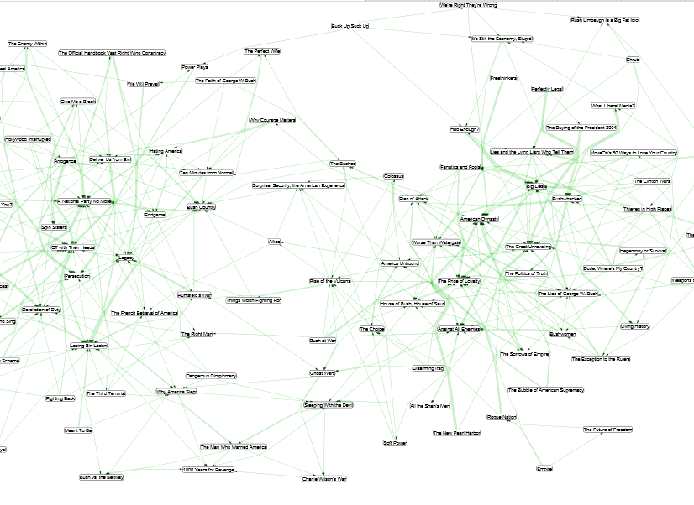
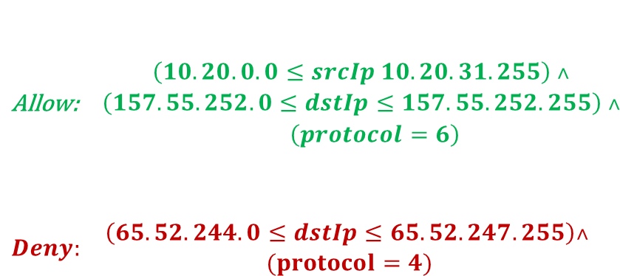
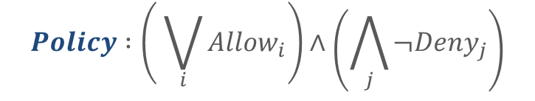
Policies as Bit-Vector Formulas
SecGuru
Type | Src Address | Src Port | Remote Address | Remote Port | Protocol
Allow | 10.20.0.0/19 | * | 157.55.252.0/22 | * | 6
Allow | 10.20.0.0/19 | * | 157.55.252.0/22 | * | 17
Allow | 10.20.0.0/19 | * | 157.55.252.0/22 | * | 4
Allow | 10.20.0.0/19 | * | 157.55.252.0/22 | * | 1
Deny | * | * | 65.52.244.0/22 | * | 4
$$\begin{matrix}\text{Allow}\text{:} & \begin{aligned}\left(10.20.0.0≤srcIp 10.20.31.255\right) ˄ \\ \left(157.55.252.0≤dstIp≤157.55.252.255\right) ˄ \\ \left(protocol=6\right)\end{aligned}\end{matrix}$$
$$\begin{matrix}Deny: & \begin{aligned}\left(65.52.244.0≤dstIp≤65.52.247.255\right)˄ \\ (protocol=4) \end{aligned}\end{matrix}$$
IP, Port, and Protocol: bit vectors
Policy: Bit-vector logic
$$Policy :\left( \bigvee_{i}{Allow_{i}}\right)∧\left(\bigwedge_{j}{¬Deny_{j}}\right)$$

Slide 27

Policies as Bit-Vector Formulas
SecGuru
Type | Src Address | Src Port | Remote Address | Remote Port | Protocol
Allow | 10.20.0.0/19 | * | 157.55.252.0/22 | * | 6
Allow | 10.20.0.0/19 | * | 157.55.252.0/22 | * | 17
Allow | 10.20.0.0/19 | * | 157.55.252.0/22 | * | 4
Allow | 10.20.0.0/19 | * | 157.55.252.0/22 | * | 1
Deny | * | * | 65.52.244.0/22 | * | 4
$$\begin{matrix}\text{Allow}\text{:} & \begin{aligned}\left(10.20.0.0≤srcIp 10.20.31.255\right) ˄ \\ \left(157.55.252.0≤dstIp≤157.55.252.255\right) ˄ \\ \left(protocol=6\right)\end{aligned}\end{matrix}$$
$$\begin{matrix}Deny: & \begin{aligned}\left(65.52.244.0≤dstIp≤65.52.247.255\right)˄ \\ (protocol=4) \end{aligned}\end{matrix}$$
IP, Port, and Protocol: bit vectors
Policy: Bit-vector logic
$Policy_{0}=false$
$Policy_{i+1}=if IsAlllow_{i}$
$$then Rule_{i}∨Policy_{i} \\ else ¬Rule_{i}∧Policy_{i}$$

Slide 28
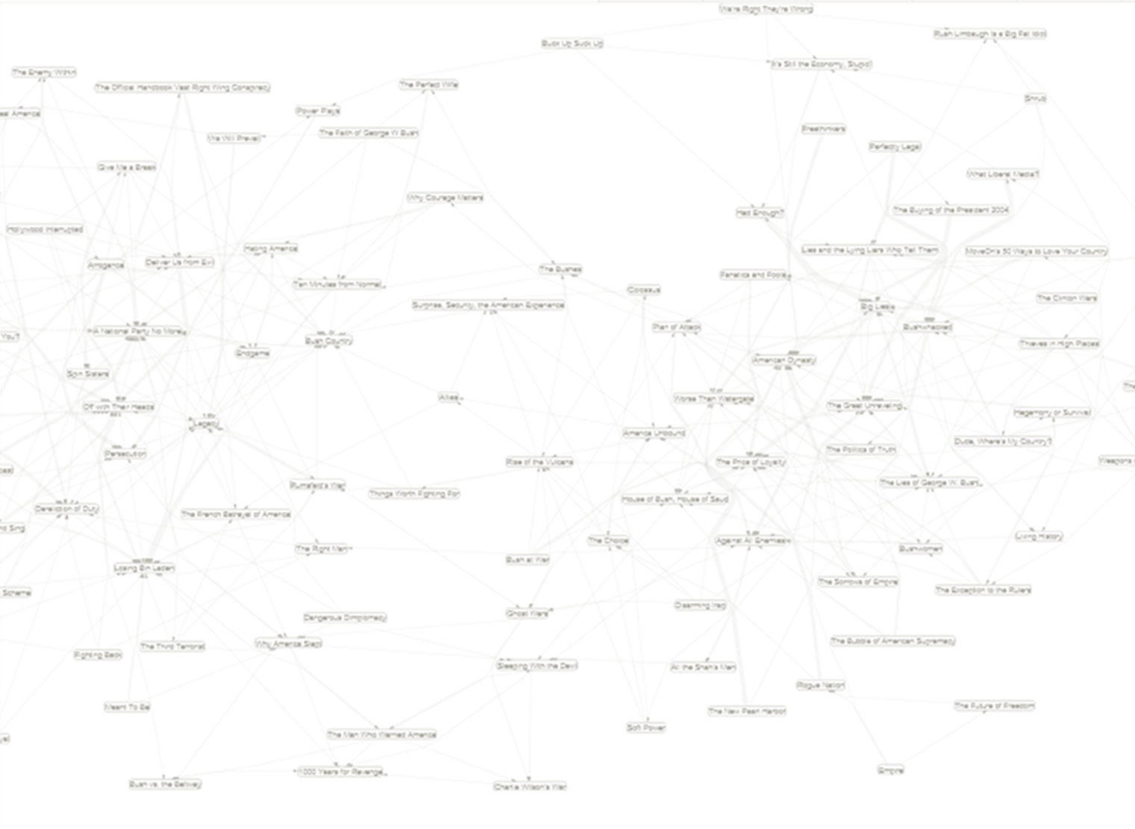
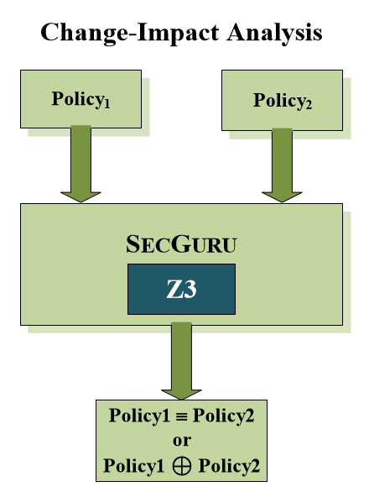

Semantic Diff with SecGuru
SecGuru
  Semantic diff between policies
Is $Policy_{1}≡Policy_{2}?$
If not, print $Policy_{1}⊕Policy_{2}$
Traffic accepted by $P_{1}$, but not $P_{2}$. Models for $P_{1}∧¬P_{2}$
Traffic accepted by $P_{2}$, but not $P_{1}$.
Models for $P_{2}∧¬P_{1}$

Slide 29
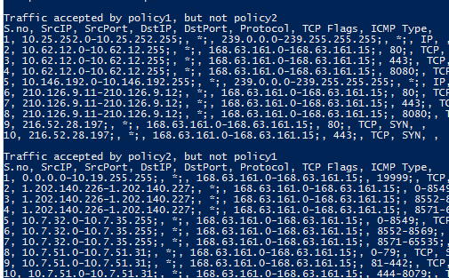
Semantic Diff with SecGuru
SecGuru
  Semantic diff between policies

Slide 30
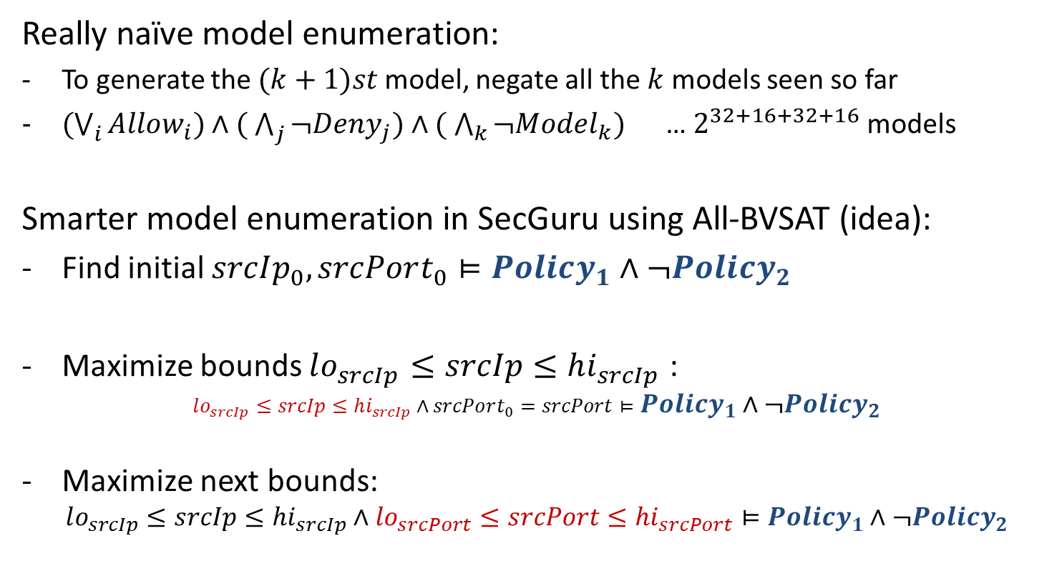
All-BVSAT: A compact model enumeration
SecGuru
Really naïve model enumeration:
To generate the $(k+1)st$model, negate all the $k$ models seen so far
$(\bigvee_{i}{Allow_{i})∧( \bigwedge_{j}{¬Deny_{j})∧( \bigwedge_{k}{¬Model_{k}) }}}$ … $2^{32+16+32+16}$ models
Smarter model enumeration in SecGuru using All-BVSAT (idea):
Find initial $srcIp_{0},srcPort_{0}⊨Policy_{1}∧¬Policy_{2}$
Maximize bounds $lo_{srcIp}≤srcIp≤hi_{srcIp}$ :
$lo_{srcIp}≤srcIp≤hi_{srcIp}∧srcPort_{0}=srcPort⊨Policy_{1}∧¬Policy_{2}$
Maximize next bounds:
$lo_{srcIp}≤srcIp≤hi_{srcIp}∧lo_{srcPort}≤srcPort≤hi_{srcPort}⊨Policy_{1}∧¬Policy_{2}$
Notes:
Explain in detail about the unsatisfiability check in Z3

Slide 31

All-BVSAT: A compact model enumeration
SecGuru
Maximize bounds:
$\begin{matrix}\begin{aligned}lo_{srcIp}≤srcIp≤hi_{srcIp}∧ \\ lo_{srcPort}≤srcPort≤hi_{srcPort}∧ \\ lo_{dstIp}≤dstIp≤hi_{dstIp}\end{aligned} & ⊨ & Policy_{1}∧¬Policy_{2}\end{matrix}$
Result is a cube:
dstIp
srcPort
srcIp
Notes:
Explain in detail about the unsatisfiability check in Z3

Slide 32
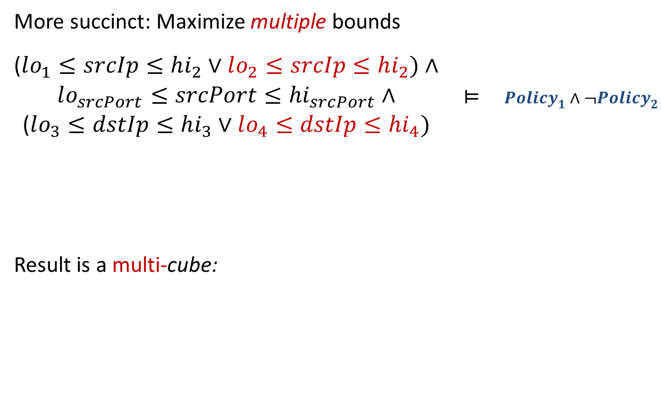
All-BVSAT: A compact model enumeration
SecGuru
More succinct: Maximize multiple bounds
$\begin{matrix}\begin{aligned}\text{(}lo_{1}≤srcIp≤hi_{2}∨lo_{2}≤srcIp≤hi_{2})∧ \\ lo_{srcPort}≤srcPort≤hi_{srcPort}∧ \\ \text{(}lo_{3}≤dstIp≤hi_{3}∨lo_{4}≤dstIp≤hi_{4})\end{aligned} & ⊨ & Policy_{1}∧¬Policy_{2}\end{matrix}$
Result is a multi-cube:
dstIp
dstIp
srcPort
srcIp
srcIp
Notes:
Explain in detail about the unsatisfiability check in Z3

Slide 33
Program Verification as SMT:
Satisfiability of Horn Clauses
ATP&SMT
Z3
SecGuru
Horn SAT

Slide 34
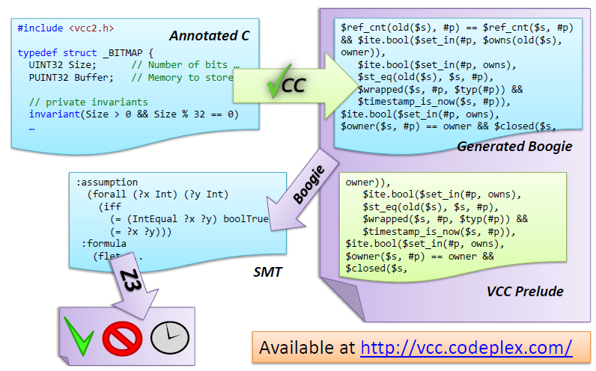

Divide and Conquer
Front-end
Programming
language
semantics
SMT solver checks verification condition
Back-end
Logic engine

Slide 35





Verification Tool Workflow
Inductive variable
selection
Houdini
Slicing
HAVOC
Corral
Dafny
Program
partially
annotated with
inductive invariants
Verification
condition

Slide 36
Envisioned: Verification Tool Workflow
Verification Condition Generators can already produce Horn Clauses
HAVOC
Corral
Dafny
Program
partially
annotated with
inductive invariants
Why, LLVM
…
Horn Clauses
Kind
Leon
HSF
Duality
Aligator
Synergy
UFO
MCMTSAFARI
IC3

Slide 37
Motivation: Recursive Procedures
mc(x) = x-10 if x > 100
mc(x) = mc(mc(x+11)) if x ≤ 100
assert (mc(x) ≥ 91)

Slide 38
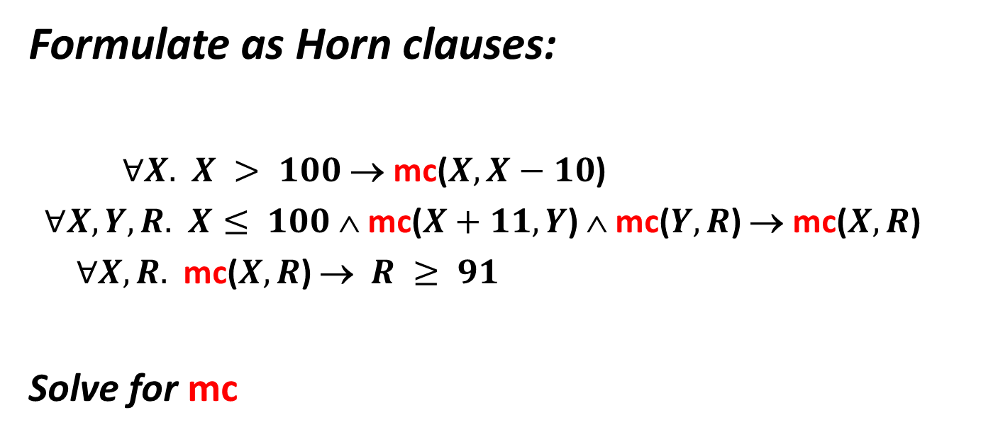
Motivation: Recursive Procedures
Formulate as Horn clauses:
$∀X.$ $X > 100$→ mc($X,X−10$)
$∀X,Y,R.$ $X≤ 100$∧ mc($X+11,Y$) ∧ mc($Y,R$) → mc($X,R$)
$∀X,R.$ mc($X,R$) → $R ≥ 91$
Solve for mc

Slide 39
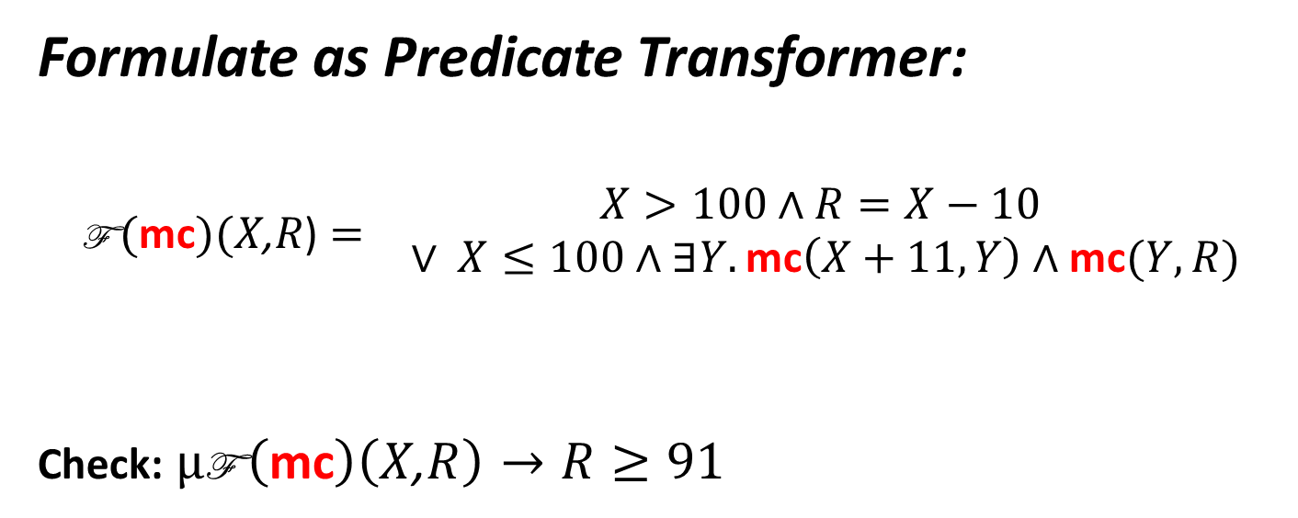
Motivation: Recursive Procedures
Formulate as Predicate Transformer:
$$\begin{matrix}\text{F} (\text{mc})(X\text{,}R\text{)}= & \begin{matrix}X>100∧R=X−10 \\ ∨ X≤100∧∃Y. \text{mc}\left(X+11,Y\right)∧\text{mc}(Y,R)\end{matrix}\end{matrix}$$
Check: $μ\text{F} \left(\text{mc}\right)\left(X\text{,}R\right)→R≥91$

Slide 40
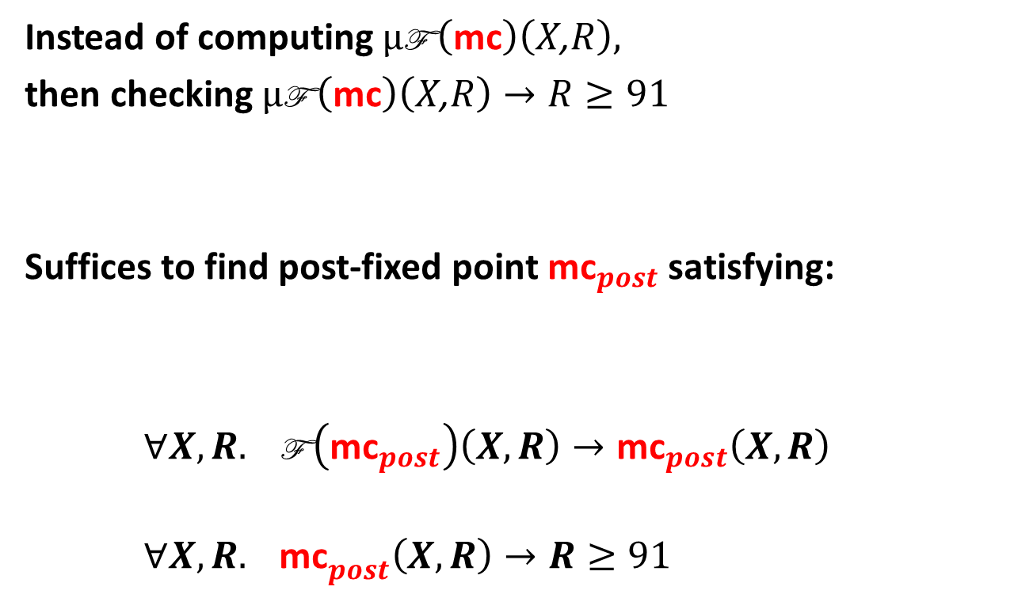
Motivation: Recursive Procedures
Instead of computing $μ\text{F} \left(\text{mc}\right)\left(X\text{,}R\right),$
then checking $μ\text{F} \left(\text{mc}\right)\left(X\text{,}R\right)→R≥91$
Suffices to find post-fixed point ${\text{mc}}_{post}$satisfying:
$∀X,R. \text{F} \left({\text{mc}}_{post}\right)\left(X,R\right)→{\text{mc}}_{post}\left(X,R\right)$
${∀X,R. \text{mc}}_{post}\left(X,R\right)→R≥91$

Slide 41
Program Verification as SMT
[Bjørner, McMillan, Rybalchenko, SMT workshop 2012]
Hilbert Sausage Factory: [Grebenshchikov, Lopes, Popeea, Rybalchenko, PLDI 2012]
Program Verification (Safety)
as Solving fixed-points
as Satisfiability of Horn clauses

Slide 42
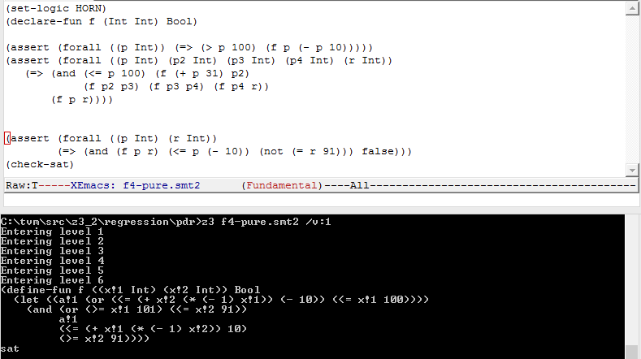
Many problems expressible in SMT-LIB2

Slide 43
Solvers for recursive Horn Clauses
Several newer tools:
  PDR in Z3 [Hoder, B] (more about this later)
  Duality [McMillan]
  HSF [Rybalchenko et.al.]
  Eldarica [Rümmer, Hojjati, Kuncak]
  SPACER [Komuravelli, Gurﬁnkel, Chaki, Clarke]
Many cousins (indirectly solve Horn clauses)
  FLATA, Corral, Yogi, UFO, Kind, Leon, Safari, MCMT

Slide 44
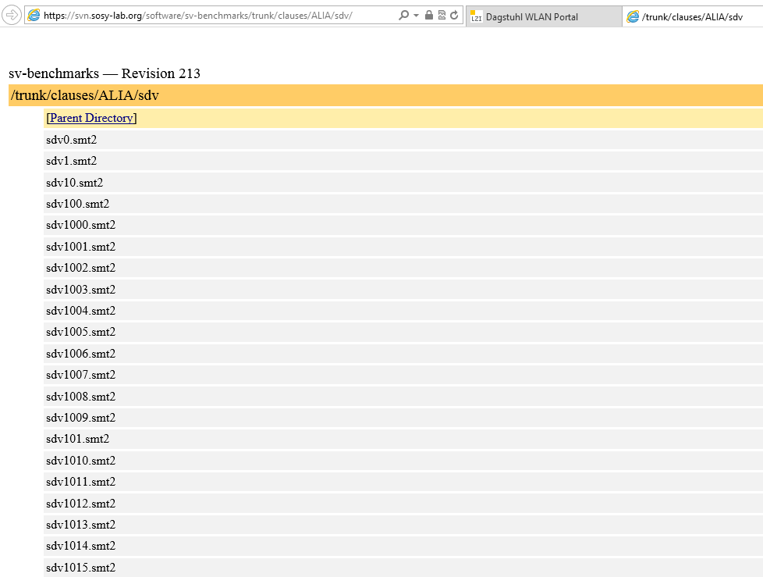

Slide 45
IC3/PDR: Property Directed Reachability in Z3
The IC3 Algorithm for Symbolic Model Checking by Aaron Bradley
Procedures Regular vs. Push Down systems
As a Conflict-driven solver for
recursive Horn clauses
Beyond Linear Real Arithmetic
Propositional - Timed Automata Decision Procedure
Logic - Interpolants from models
[SAT 2012. Kryštof Hoder & Nikolaj Bjørner]

Slide 46
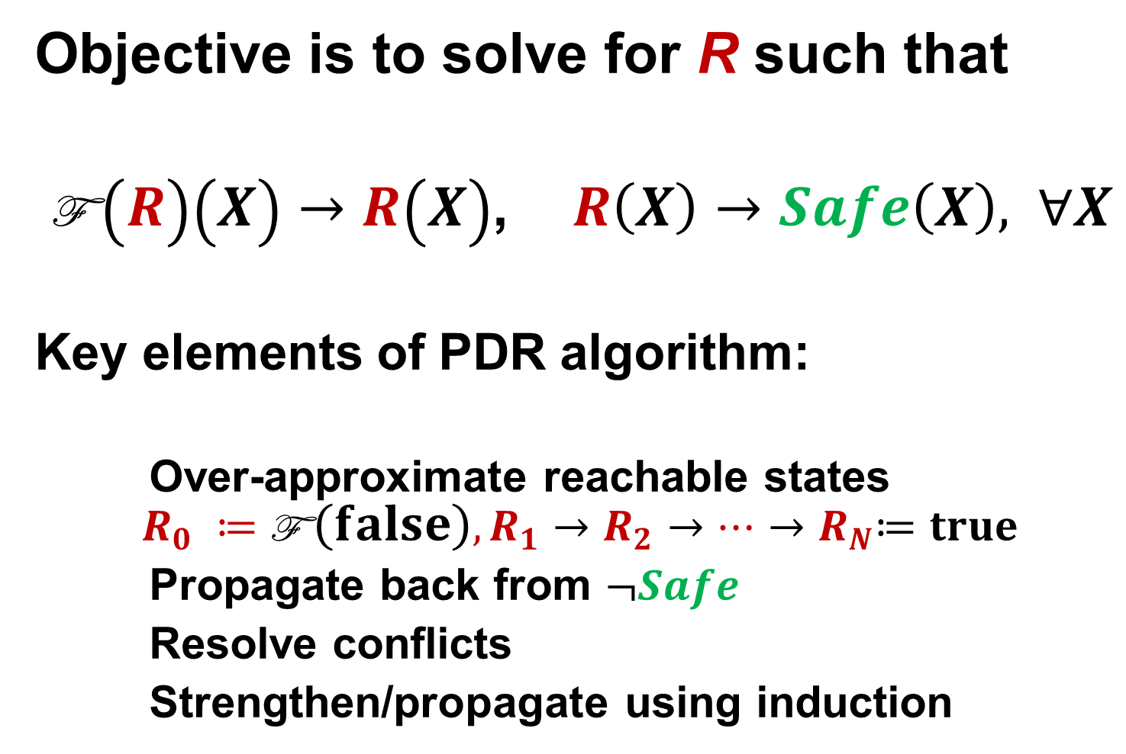
PDR – the algorithm
Objective is to solve for R such that
$\text{F} \left(R\right)\left(X\right)→R\left(X\right)$, $R\left(X\right)→Safe\left(X\right), ∀X$
Key elements of PDR algorithm:
Over-approximate reachable states
$$R_{0} ≔\text{F} \left(false\right), R_{1}→R_{2}→…{→R}_{N}≔true$$
Propagate back from $¬Safe$
Resolve conflicts
Strengthen/propagate using induction

Slide 47
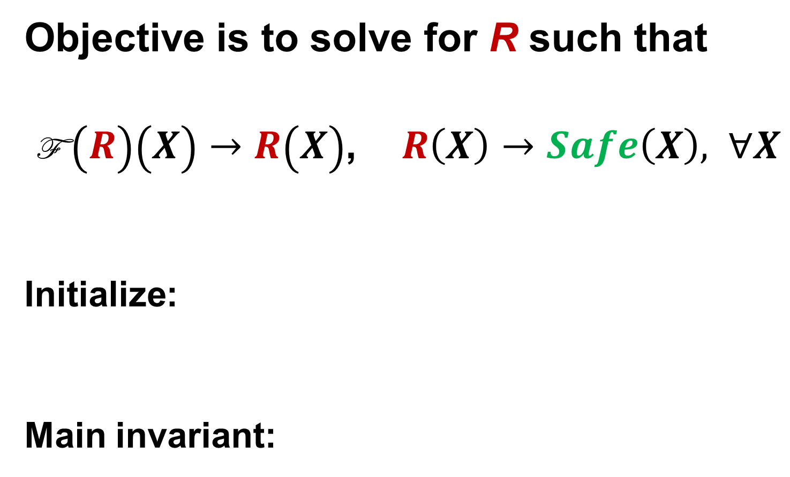

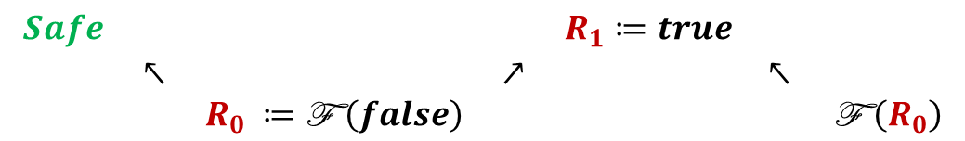
PDR – the algorithm
Objective is to solve for R such that
$\text{F} \left(R\right)\left(X\right)→R\left(X\right)$, $R\left(X\right)→Safe\left(X\right), ∀X$
Initialize:
Main invariant:
$$\begin{matrix}Safe & & & & R_{1}≔true & & \\ & ↖ & & ↗ & & ↖ & \\ & & R_{0} ≔\text{F} \left(false\right) & & & & \text{F} \left(R_{0}\right)\end{matrix}$$
$$\begin{matrix}Safe & & & & R_{i+1} & & \\ & ↖ & & ↗ & & ↖ & \\ & & R_{i} & & & & \text{F} \left(R_{i}\right)\end{matrix}$$

Slide 48
Mile High: Modern SAT/SMT search
Backjump
Models
literal assignments
Proofs
Conflict Clauses
Conflict Resolution
Propagate

Slide 49

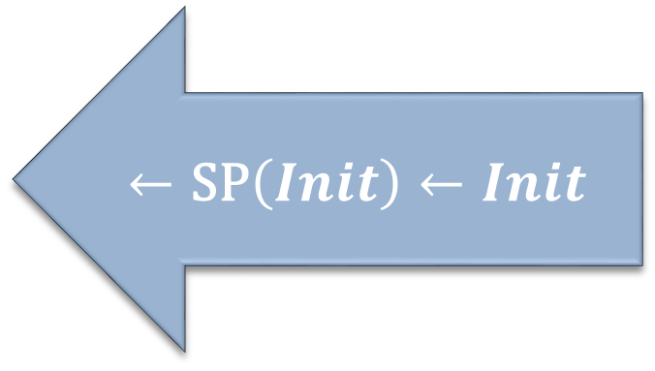
Search: Mile-high perspective
Modern SMT solver
Decisions: Assignments
Conflict Clauses
Conflict
Resolution
$$Bad →\text{WP}\left(Bad\right)→$$
$$←\text{SP}\left(Init\right)←Init$$
Fixedpoint solver
Conflict
Resolution

Slide 50

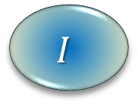
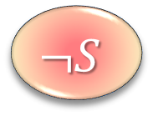

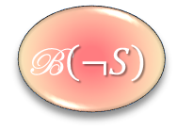
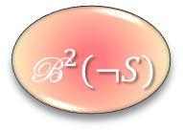
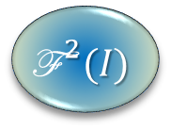
Search: Mile-high perspective
Conflict Resolution
Conflict Propagation
Conflict Propagation
$$I$$
$$\text{F} (I)$$
$${\text{F}}^{ 2}(I)$$
${\text{B}}^{2}\left(¬S\right)$
$$\text{B}\left(¬S\right)$$
$$¬S$$

Slide 51
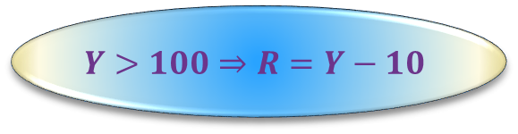


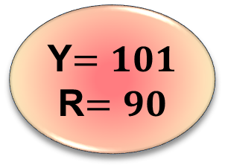
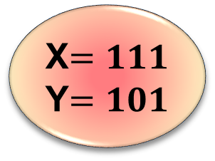
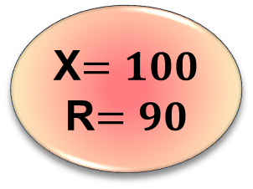

PDR(LRA): Conflict resolution
$∀X.$ $X > 100$→ mc($X,X−10$)
$∀X,Y,R.$ $X≤ 100$∧ mc($X+11,Y$) ∧ mc($Y,R$) → mc($X,R$)
$∀X,R.$ mc($X,R$) → $R ≥ 91$
X$=100$
R$=90$
Conflict
X$=111$
Y$=101$
Y$=101$
R$=90$
$$Y>100⇒R=Y−10$$
$$∧$$
Conflict Resolution
Resolution
Get Generalization from Farkas Lemma
$$Y>101⇒R>90$$

Slide 52
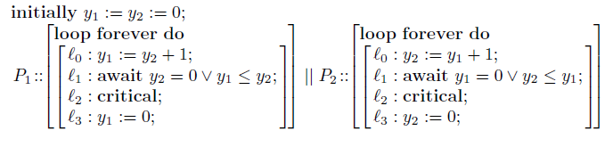
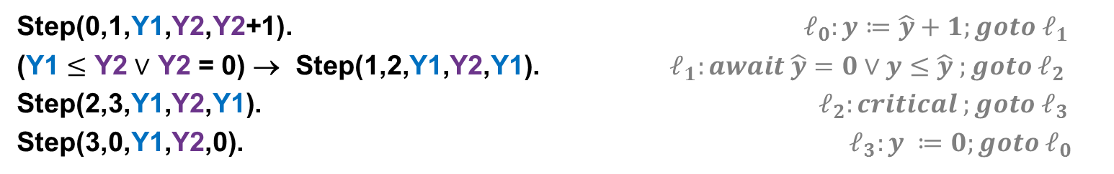

Conflict resolution with arithmetic
Mutual Exclusion
$$⇔$$
Clauses have model
R(0,0,0,0). Initial states
T(L,M,Y1,Y2,L’,M’,Y1’,Y2’)∧R(L,M,Y1,Y2) → R(L’,M’,Y1’,Y2’) Reachable states
R(2,2,Y1,Y2) → false Is unsafe state reachable?
Step(L,L’,Y1,Y2,Y1’) → T(L,M,Y1,Y2,L’,M,Y1’,Y2) P₁ takes a step
Step(M,M’,Y2,Y1,Y2’) → T(L,M,Y1,Y2,L,M’,Y1,Y2’) P₂ takes a step
Step(0,1,Y1,Y2,Y2+1). $ℓ_{0}:y≔\hat{y}+1;goto ℓ_{1}$
(Y1 $≤$ Y2 $∨$ Y2 = 0) → Step(1,2,Y1,Y2,Y1). $ℓ_{1}:await \hat{y}=0∨y≤\hat{y} ;goto ℓ_{2}$
Step(2,3,Y1,Y2,Y1). $ℓ_{2}:critical ;goto ℓ_{3}$
Step(3,0,Y1,Y2,0). $ℓ_{3}:y ≔0;goto ℓ_{0}$

Slide 53
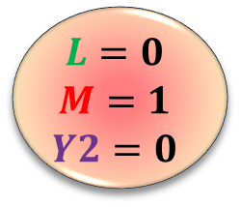
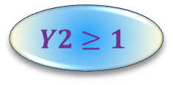
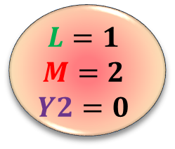








PDR(T): Conflict Resolution
Conflict Resolution
$$L=1$$
$$M=1$$
$$Y1=1$$
$$Y2=0$$
$$L=2$$
$$M=2$$
$$L=0$$
$$M=0$$
$$Y2=0$$
$$Y1=0$$
$$L=0$$
$$M=1$$
$$Y2=0$$
$$L=1$$
$$M=2$$
$$Y2=0$$
$$Y2≥Y1+1∧Y1≥0$$
$$Y2≤0$$
$$Y2≥1$$
$$Y2≤0$$
$$∧$$
$∧$ $∧$
Conflict Resolution
Get Generalization from Farkas Lemma
Eg., resolve away blue internal variables

Slide 54



PDR(T): Conflict Resolution
Conflict Resolution
Conflict Propagation
Conflict Propagation
$$L=0$$
$$M=0$$
$$Y2=0$$
$$Y1=0$$
$$L=0$$
$$M=1$$
$$Y2=0$$
$$L=1$$
$$M=1$$
$$Y1=1$$
$$Y2=0$$
$$L=1$$
$$M=2$$
$$Y2=0$$
$$L=2$$
$$M=2$$
$$M=1 →Y2≥1$$
$$M=1 →Y2≥1$$
$$M=1 →Y2≥1$$

Slide 55

PDR(T): Generalization from T-lemmas
Can we satisfy?
$R(0,0,0,0).$ Initial states
$T\left(L,M,Y1,Y2,L’,M’,Y1’,Y2’\right), R\left(L,M,Y1,Y2\right)→R\left(L’,M’,Y1’,Y2’\right)$ Reachable states
$R\left(L,M,Y1,Y2\right) → ¬\left(L=2∧M=2\right).$ Unsafe state is unreachable
$\underset{\text{M}}{\underbrace{L=0∧M=1∧Y2=0}} ∧\underset{Pre}{\underbrace{\text{F} \left(R_{0}\right)}}$ is unsatisfiable
E.g., there is unsat core of: $\underset{\text{M}}{\underbrace{\bigwedge_{j}{{c_{j}≤x}_{j}≤c_{j}}}} ∧$ $\underset{Pre}{\underbrace{\text{F} \left(R_{i}\right)}}$
Unsat proof uses T-lemmas
$$\left(\underset{From ¬\text{M}}{\underbrace{5>x_{1}∨3<x_{3}}}∨\underset{From ¬Pre}{\underbrace{x_{1}−x_{2}>2∨{2x}_{2}−x_{3}>1}}\right)$$

Slide 56

PDR(T): Generalization from T-lemmas
Can we satisfy?
$R(0,0,0,0).$ Initial states
$T\left(L,M,Y1,Y2,L’,M’,Y1’,Y2’\right), R\left(L,M,Y1,Y2\right)→R\left(L’,M’,Y1’,Y2’\right)$ Reachable states
$R\left(L,M,Y1,Y2\right) → ¬\left(L=2∧M=2\right).$ Unsafe state is unreachable
Unsat proof uses T-lemmas
$$\left(\underset{From ¬\text{M}}{\underbrace{5>x_{1}∨3<x_{3}}}∨\underset{From ¬Pre}{\underbrace{x_{1}−x_{2}>2∨{2x}_{2}−x_{3}>1}}\right)$$
$\begin{matrix}2⋅\left(−x_{1}≤−5\right) \\ x_{3}≤3 \\ {2⋅(x}_{1}−x_{2}≤2) \\ {2x}_{2}−x_{3}≤1 \\ \end{matrix}$ $\begin{matrix}−2x_{1}≤−10 \\ x_{3}≤3 \\ {2x}_{1}−{2x}_{2}≤4 \\ \begin{aligned}{2x}_{2}−x_{3}≤1 \\ −−−−−−\end{aligned} \\ 0≤−2\end{matrix}$ ${ \underset{\begin{aligned}Block any model \\ satisfying this \end{aligned}}{\underbrace{2x_{1}−x_{3}≤5}}}_{}$

Slide 57

Side-effect: Timed automata
Observation:
PDR + Model refinement using Farkas strengthening
is a decision procedure for timed push-down systems
Justification:
Every lemma produced is a sum of differences from the input
~
Acyclic path in difference graph.
$⇒$ Finite set of Farkas lemmas possible.

Slide 58
N+1 degrees of separation
Objective: Synthesize inductive invariant to prove property.
Reaching objective with interpolants:
Synthesize interpolants, use for proving invariants. Admirable
Synthesize interpolants, evaluate on random formulas. Admire them
Write papers about theory of interpolants. Admire the theorems
Review papers about generating interpolants. Write admirable review
Participate in PC discussion about paper. Admire Kevin Bacon
Write paper about proof transformations,
maybe good for interpolation. Who knows, it may be used?
Reaching objective with PDR:
…. Nevertheless, interpolants arise.

Slide 59

Side-effect: Horn Craig Interpolants
Suppose $A⇒B$
A Craig Interpolant is formula $I:$
$Lang\left(I\right)⊆Lang\left(A\right)∩Lang\left(B\right)$
$A⇒I, I⇒B$
Horn version. Establish satisfiability of:
$∀x,y. A[x,y]⇒I\left(x\right),$
$∀x,z. I\left(x\right)⇒B[x,z]$
and find solution for $I.$

Slide 60


Side-effect: Horn Craig Interpolants
Suppose $A⇒B$
A Craig Interpolant is formula $I:$
$Lang\left(I\right)⊆Lang\left(A\right)∩Lang\left(B\right)$
$A⇒I, I⇒B$
$∀X.$ $X > 100$→ mc₀($X,X−10$)
$∀X,Y,R.$ $X≤ 100$∧ mc₀($X+11,Y$) ∧ mc₀($Y,R$) → mc₁($X,R$)
$∀X.$ $X > 100$→ mc₁($X,X−10$)
$∀X,Y,R.$ $X≤ 100$∧ mc₁($X+11,Y$) ∧ mc₁($Y,R$) → mc₂($X,R$)
$∀X.$ $X > 100$→ mc₂($X,X−10$)
$∀X,R.$ mc₂($X,R$) → $R ≥ 91$
Solve for mc₀, mc₁, mc₂

Slide 61

PDR(T): Interpolants as a side-effect
Intermediary solutions: $∀X. \text{F} \left(R_{0}\right)\left(X\right)→R_{1}\left(X\right),$
$∀X. \text{F} \left(R_{1}\right)\left(X\right)→R_{2}\left(X\right),$
$∀X. \text{F} \left(R_{2}\right)\left(X\right)→Safe\left(X\right),$
Observation: Farkas strengthening computes
a “Horn Interpolant” for LRA
i.e., solves for non-recursive Horn clauses

Slide 62

PDR(T): Interpolants as a side-effect

Slide 63



Universally Quantified Horn Clauses
Bjorner, McMillan, Rybalchenko, SAS 2013
void init(int n, int[] A, int c) {
for (int i = 0; i < n; ++i) {
A[i] = c;
}
assert($∀j. 0≤j<n⇒A\left[j\right]=c$);
}
Find $R$ to satisfy:
$∀c,n,A. R\left(0,c,n,A\right).$
$∀i,c,n,A. R\left(i,c,n,A\right)⇒R\left(i+1,c,n,A\left[i↦c\right]\right)$
$∀i,c,n,A,j. R\left(i,c,n,A\right)∧0≤j< n=i ⇒A\left[j\right]=c$
Problem: Inductive invariant is quantified
$$R(i,c,n,A)≡∀j. 0≤j<i⇒A\left[j\right]=c$$
Horn clause solvers compute quantifier-free symbolic solutions.

Slide 64

Universally Quantified Horn Clauses
Bjorner, McMillan, Rybalchenko, SAS 2013
void init(int n, int[] A, int c) {
for (int i = 0; i < n; ++i) {
A[i] = c;
}
assert($∀j. 0≤j<n⇒A\left[j\right]=c$);
}
Find instead $Q$ to satisfy:
$∀c,n,A. ∀k .Q\left(0,c,n,A\left[k\right],k\right).$
$∀i,c,n,A,k. \left(∀k.Q\left(i,c,n,A\left[k\right],k\right)\right)⇒Q\left(i+1,c,n,A\left[i↦c\right]\left[k\right],k\right)$
$∀i,c,n,A,j. (∀k.Q\left(i,c,n,A\left[k\right],k\right))∧0≤j< n=i ⇒A\left[j\right]=c$
Problem: Our Horn clause solvers don’t handle $∀k .Q$(..) formulas

Slide 65



Universally Quantified Horn Clauses
Bjorner, McMillan, Rybalchenko, SAS 2013
void init(int n, int[] A, int c) {
for (int i = 0; i < n; ++i) {
A[i] = c;
}
assert($∀j. 0≤j<n⇒A\left[j\right]=c$);
}
SAS 2013 paper approach: Pre-instantiate $∀k. Q$ using pattern matching
$∀c,n,A,k. Q\left(0,c,n,A\left[k\right],k\right).$
$∀i,c,n,A,k. Q\left(i,c,n,A\left[k\right],k\right)⇒Q\left(i+1,c,n,A\left[i↦c\right]\left[k\right],k\right)$
$∀i,c,n,A,j. Q\left(i,c,n,A\left[j\right],j\right)∧0≤j< n=i ⇒A\left[j\right]=c$
Solution: $Q(i,c,n,a,j)≡0≤j<i⇒a=c$

Slide 66
Other Horn-clause solving methods in Z3
DATALOG engine over abstract tables
  Hash-tables for JavaScript points-to analysis
  Header-space algebra tables (ternary simulation) for checking routers [Lopes, Varghese & B]
Tabulation as Infinite Descent
(a.k.a. cyclic induction proofs)
Popular in CLP community
New super-acceleration [Voronkov & B]
Bounded Model Checking for Horn Clauses

Slide 67
Summary
An efficient SMT solver http://research.microsoft.com/projects/z3
  Testing, Verification, Validation, Modeling http://rise4fun.com
  Fixedpoints:
  Satisfiability of Horn Clauses Modulo Theories
  http://rise4fun.com/z3py/tutorial/fixedpoints.htm

