Slide 1
Satisfiability Modulo Theories solvers in
Program Analysis and Verification
Nikolaj Bjørner
Microsoft Research
Lecture 1

Slide 2
Overview of the lectures
Day | Topics | Lab
1 | Overview of SMT and applications. SAT solving, Z3 | Introduction to encoding problems with Z3
2 | Congruence closure, Pex | Encoding combinatorial problems with Z3,
3 | A solver for arithmetic. | Pex, Encoding arithmetic problems
4 | Theory combination. Arrays (part 1) | Arrays
5 | Arrays, (part 2) and quantifiers | Build a theory solver on top of Z3

Slide 3
Summary of Day 1
What do SMT solvers do?
Some applications of SMT solvers in program analysis, verification and testing.
Fundamentals: Logics and theories.
Core: Modern SAT solving technologies.
Lab: Try out SAT problems with Z3.

Slide 4
Summary of Day 2
Functions and equalities:
Congruence closure
Pex: Program EXploration
Lab: Encode combinatorial problems.
  Longest paths
  A Sudoku solver
  Rush hour

Slide 5
Summary of Day 3
A solver for Arithmetic
Lab:
  Explore Pex
  Rush hour and bounded model checking

Slide 6
Summary of Day 4
Theory combination methods for combining decision procedures
A decision procedure for Arrays
Lab:
  Encode queues using arrays

Slide 7
Summary of Day 5
Array decision procedures (part 2)
Quantifiers and SMT solvers
Lab:
  Build your own theory decision procedure on top of Z3

Slide 8
SMT
An appetizer
Gachhe kanthal, gonfe tel
গাছে কাঁঠাল, গোঁফে তেল।
  Make castles in air.

Slide 9
Domains from programs
Bits and bytes
Numbers
Arrays
Records
Heaps
Data-types
Object inheritance

Slide 10
Satisfiability Modulo Theories (SMT)
Uninterpreted Functions
Array Theory
Arithmetic

Slide 11
SMT Applications
Logic is the Calculus of Computation
Zohar Manna

Slide 12












Program Verification
Hyper-V
VCC
Boogie
Win. Modules
HAVOC
Verification
condition
Bug path
Rustan Leino, Mike Barnet, Michal Mosƙal, Shaz Qadeer,
Shuvendu Lahiri, Herman Venter, Peter Muller,
Wolfram Schulte, Ernie Cohen

Slide 13
Z3 & Program Verification
Quantifiers, quantifiers, quantifiers, …
  Modeling the runtime
  Frame axioms (“what didn’t change”)
  Users provided assertions (e.g., the array is sorted)
  Prototyping decision procedures (e.g., reachability, heaps, …)
Solver must be fast in satisfiable instances.
Trade-off between precision and performance.
Candidate (Potential) Models

Slide 14






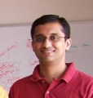


Test case generation
Run Test and Monitor
Execution Path
Path Condition
seed
Test
Inputs
Known
Paths
New input
Constraint System
Solve
Unexplored path
Vigilante
Nikolai Tillmann, Peli de Halleux, Patrice Godefroid
Aditya Nori, Jean Philippe Martin, Miguel Castro,
Manuel Costa, Lintao Zhang

Slide 15
Z3 & Test case generation
Formulas may be a big conjunction
  Pre-processing step
  Eliminate variables and simplify input format
Incremental: solve several similar formulas
  New constraints are asserted.
  push and pop: (user) backtracking
  Lemma reuse
“Small Models”
  Given a formula F, find a model M, that minimizes the value of the variables x₀ … x_{n}

Slide 16
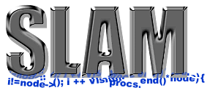


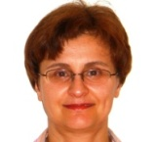


Static Driver Verifier
Z3 is part of SDV 2.0 (Windows 7)
It is used for:
  Predicate abstraction (c2bp)
  Counter-example refinement (newton)
Ella Bounimova, Vlad Levin, Jakob Lichtenberg,
Tom Ball, Sriram Rajamani, Byron Cook

Slide 17
Z3 & Static Driver Verifier
All-SAT
  Fast Predicate Abstraction
Unsatisfiable cores
  Why the abstract path is not feasible?

Slide 18






More applications
Bounded model-checking of model programs
Termination
Security protocols, F#
Business application modeling
Cryptography
Model Based Testing (SQL-Server)

Slide 19

Background
Notation, conventions, fundamentals
Kaiyila Kaasu Vayila Dosa
  Once you pay the money, you will receive the dosa.

Slide 20
Acknowledgment
    Much of the material was assembled from several sources:
    Leonardo de Moura,
    Clark Barrett,
    Natarajan Shankar,
    Ashish Tiwari,
    Cesare Tinelli,
    Lintao Zhang.

Slide 21
Questions are allowed
"Bíonn ciúin ciontach"
  The quiet are guilty

Slide 22
Language of logic - summary
Functions , Variables, Predicates
  f, g, x, y, z, P, Q, =
Atomic formulas, Literals
  P(x,f(y)), ¬Q(y,z)
Quantifier free formulas
  P(f(a), b) ∧ c = g(d)
Formulas, sentences
  ∀x . ∀y . [ P(x, f(x)) ∨ g(y,x) = h(y) ]

Slide 23
Language: Signatures
A signature Σ is a finite set of:
  Function symbols:
  Σ_{F} = { f, g, … }
  Predicate symbols:
  Σ_{P} = { P, Q,=, true, false, … }
  And an arity function:
  Σ → N
Function symbols with arity 0 are constants
A countable set V of variables
  disjoint from Σ

Slide 24
Language: Terms
The set of terms T(Σ_{F} ,V) is the smallest set formed by the syntax rules:
  t ∈ T ::= v v ∈ V
    | f(t₁, …, t_{n}) f ∈ Σ_{F} t₁, …, t_{n} ∈ T
Ground terms are given by T(Σ_{F} ,∅)

Slide 25
Language: Atomic Formulas
a ∈ Atoms ::= P(t₁, …, t_{n})
  P ∈ Σ_{P} t₁, …, t_{n} ∈ T
  An atom is ground if t₁, …, t_{n} ∈ T(Σ_{F} ,∅)
  Literals are (negated) atoms:
l ∈ Literals ::= a | ¬ a a ∈ Atoms

Slide 26
Language: Quantifier free formulas
The set QFF(Σ,V) of quantifier free formulas is the smallest set such that:
ϕ ∈QFF ::= a ∈ Atoms atoms
| ¬ ϕ negations
| ϕ ↔ ϕ’ bi-implications
| ϕ ∧ ϕ’ conjunction
| ϕ ∨ ϕ’ disjunction
| ϕ → ϕ’ implication

Slide 27
Language: Formulas
The set of first-order formulas are obtained by adding the formation rules:
ϕ ::= …
| ∀ x . ϕ universal quant.
| ∃ x . ϕ existential quant.
Free (occurrences) of variables in a formula are theose not bound by a quantifier.
A sentence is a first-order formula with no free variables.

Slide 28
Theories
A (first-order) theory T (over signature Σ) is a set of (deductively closed) sentenes (over Σ and V)
Let DC(Γ) be the deductive closure of a set of sentences Γ.
  For every theory T, DC(T) = T
A theory T is constistent if false ∉ T
We can view a (first-order) theory T as the class of all models of T (due to completeness of first-order logic).

Slide 29
Models (Semantics)
A model M is defined as:
  Domain S; set of elements.
  Interpretation, f^{M} : S^{n} →S for each f ∈ Σ_{F} with arity(f) = n
  Interpretation P^{M} ⊆ S^{n} for each P ∈ Σ_{P} with arity(P) = n
  Assignment x^{M} ∈ S for every variable x ∈ V
A formula ϕ is true in a model M if it evaluates to true under the given interpretations over the domain S.
M is a model for the theory T if all sentences of T are true in M.

Slide 30
T-Satisfiability
A formula ϕ(x) is T-satisfiable in a theory T if there is a model of DC(T ∪ ∃ x ϕ(x)). That is, there is a model M for T in which ϕ(x) evaluates to true.
Notation:
M ⊨_{T} ϕ(x)

Slide 31
T-Validity
A formula ϕ(x) is T-valid in a theory T if ∀ x ϕ(x) ∈ T. That is, ϕ(x) evaluates to true in every model M of T.
T-validity:
⊨_{T} ϕ(x)

Slide 32
Checking validity
Checking the validity of ϕ in a theory T:
  ϕ is T-valid
  ≡ T-unsat: ¬ϕ
  ≡ T-unsat: ∀x∃y∀z∃u . φ (prenex of ¬ϕ)
  ≡ T-unsat: ∀x∀z . φ[f(x),g(x,z)] (skolemize)
  ⇐ T-unsat: φ[f(a₁),g(a₁,b₁)] ∧ … (instantiate)
  ∧ φ[f(a_{n}),g(a_{n},b_{n})] (⇒ if compactness)
  ≡ T-unsat: φ₁ ∨ … ∨ φ_{m} (DNF)
  where each φ_{i} is a conjunction.

Slide 33
Checking Validity – the morale
Theory solvers must minimally be able to
  check unsatisfiability of conjunctions of literals.

Slide 34
Clauses – CNF conversion
We want to only work with formulas in Conjunctive Normal Form CNF.
is not in CNF.

Slide 35
Clauses – CNF conversion
Equi-satisfiable CNF formula

Slide 36
Clauses – CNF conversion
cnf(ϕ) = let (q,F) = cnf’(ϕ ) in q ∧ F
cnf’(a) = (a, true)
cnf’(ϕ ∧ ϕ’) = let (q,F₁) = cnf’(ϕ)
(r, F₂) = cnf’(ϕ’)
p = fresh Boolean variable
in
(p, F₁ ∧ F₂ ∧ (¬ p ∨ q ) ∧
(¬ p ∨ r) ∧
(¬ p ∨ ¬ q ∨ ¬ r))
Exercise: cnf’(ϕ ∨ ϕ’), cnf’(ϕ ↔ ϕ’), cnf’(¬ ϕ)

Slide 37
Clauses - CNF
Main properties of basic CNF
  Result F is a set of clauses.
  ϕ is T-satisfiable iff cnf(ϕ) is.
  size(cnf(ϕ)) ≤ 4(size(ϕ))

Slide 38
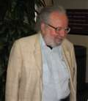
SAT Solving
Martin Davis
NY University

Slide 39
Breakthrough in SAT solving
Breakthroughs in SAT solving influenced the way SMT solvers are implemented.
Modern SAT solvers are based on the DPLL algorithm.
Davis-Putnam-Logemann-Loveland
Modern implementations add several sophisticated search techniques.
  Backjumping
  Learning
  Restarts
  Wached literals

Slide 40
DPLL - classique
Incrementally build a model M for a CNF formula F (set of clauses).
Initially M is the empty assignment
Propagate: M: M(r) ← false
  if (p ∨¬q ∨¬r) ∈ F, M(p) = false, M(q) = true
Decide M(p) ← true or M(p) ← false,
  if p is not assigned.
Backtrack:
  if (p ∨¬q ∨¬r) ∈ F, M(p) = false, M(q) = M(r)= true, (e.g. M ⊨_{T} ¬C)

Slide 41
DPLL - example
F : (¬p∨ q)∧(¬r∨¬s)∧(¬t∨¬u)∧ (u∨¬t∨¬q)
M = ∅
A state during search is a pair M || F.

Slide 42
DPLL - example
F : (¬p∨ q)∧(¬r∨¬s)∧(¬t∨¬u)∧ (u∨¬t∨¬q)
∅ || F
⇒ { Decide M(p) ← true }
p || F
⇒ { Propagate M(q) ← true }
p, q || F
⇒ { Decide M(r) ← true }
p, q, r || F

Slide 43
DPLL - example
F : (¬p∨ q)∧(¬r∨¬s)∧(¬t∨¬u)∧ (u∨¬t∨¬q)
p, q, r || F
⇒ { Propagate M(s) ← false }
p,q,r,¬s || F
⇒ { Decide M(t) ← true }
p,q,r,¬s, t || F
⇒ { Propagate M(u) ← false }
p,q,r,¬s, t, ¬u || F

Slide 44
DPLL - example
F : (¬p∨ q)∧(¬r∨¬s)∧(¬t∨¬u)∧ (u∨¬t∨¬q)
p,q,r,¬s, t, ¬u || F
⇒ { Backtrack}
p,q,r,¬s,¬t, || F
Improvement 1: The conflict does not depend on r or s.
⇒ Analyze conflict for further back-jumping.

Slide 45
DPLL - example
F : (¬p∨ q)∧(¬r∨¬s)∧(¬t∨¬u)∧ (u∨¬t∨¬q)
p, q, r, ¬s, t, ¬u || F
⇒ { Backjump}
p, q, ¬t || F
Improvement 2: Learn from Propagate.

Slide 46
DPLL - example
F : (¬p∨ q)∧(¬r∨¬s)∧(¬t∨¬u)∧ (u∨¬t∨¬q)
With the learned clause (¬p∨ ¬t) we could use Propagate to infer ¬t

Slide 47
DPLL – learning
"Is leor nod don eolach"
A hint is sufficient for the wise
F : (¬p∨ q)∧(¬r∨¬s)∧(¬t∨¬u)∧ (u∨¬t∨¬q)
How do you learn the right clauses?
  Answer – maintain implication graph.
  Implication graph = clause that was used for propagation:
  p || F
⇒ { Propagate M(q) ← true }
p, q^{(¬p∨ q)} || F

Slide 48
Modern DPLL – as transitions
Maintain states of the form:
  M || F - during search
  M || F || C – for backjumping
  M a partial model, F are clauses, C is a clause.
Decide M || F ⇒ Mp^{d} || F if p ∈ F \ M
d is a decision marker
Propagate M || F ⇒ Mp^{C} || F
  if p ∈ C ∈ F, C = (C’ ∨ p), M ⊨_{T} ¬C’

Slide 49
Modern DPLL – as transitions
Conflict M || F ⇒ M || F || C if C ∈ F, M ⊨_{T} ¬C
Learn M || F || C ⇒ M || F, C || C i.e, add C to F
Resolve Mp^{(C’ ∨p)} || F || C ∨ ¬p ⇒ M || F || C ∨ C’
Skip Mp || F || C ⇒ M || F || C if ¬p∉C
Backjump MM’p^{d}|| F || C ⇒ M¬p^{C} || F
if ¬p∈C and M’ does not intersect with ¬C

Slide 50
Modern DPLL – as transitions
Other transitions:
Restart M || F ⇒ ∅ || F
Clause minimization …

Slide 51
Modern DPLL - implementation
Watch literals for Propagate and Conflict
  Naïve: For every literal l maintain map:
    Watch(l) = {C₁ … C_{m}} where ¬l ∈ C_{i}
    If l is assigned to true, check each C_{j} ∈ Watch(l) for Conflict or Propagate
  But most of the time, some other literal in C_{j} is either:
    Unassigned (not yet assigned)
    Assigned to true.

Slide 52
Modern DPLL - implementation
Insight:
  No need to include clause C in every set Watch(l) where ¬l ∈ C.
  It suffices to include C in at most 2 such sets.
  Maintain invariant:
    If some literal l in C unassigned, or assigned to true, then C belongs to the Watch(l’) of some literal that is unassigned or true.

Slide 53
Modern DPLL - implementation

Slide 54
Modern DPLL - implementation
  Maintain 2-watch invariant:
    Set l to true (¬l to false).
    For each C ∈ Watch(l)
      If all literals in C are assigned to false, then Backjump
      Else, if all but one literal in C is assigned to false, then Propagate
      Else, if the other literal in l’ ∈ C where C ∈ Watch(l’) is assigned to true, then do nothing.
      Else, some other literal l’ is true or unassigned, and not watched. Set Watch(l’) ← Watch(l’) ∪ { C }, set
      Watch(l) ← Watch(l) \ { C }.

Slide 55
Modern DPLL - implementation
Heuristic: Phase caching
  Remember the last truth value assigned to propositional atom.
  If using rule Decide, then re-use the old assignment.
Why should this be good (in practice)?
  Dependencies follow clusters.
  Truth values in a cluster are dependent.
  Truth values between clusters are independent.
  Decide is mainly used when jumping between clusters.
विनाशकाले विपरित बुध्दी
When doomsday comes,
one takes wrong decisions

Slide 56
Modern DPLL - tuning
Tune between different heuristics:
  Restart frequency
    Why is restarting good?
  Phase to assign to decision variable
  Which variable to split on
    Use simulated annealing based on activity in conflicts
    Feedback factor from phase changes
  Which lemmas to learn
    Not necessarily unique
    Minimize lemmas

Slide 57
Z3 -An Efficient
SMT Solver
By Leonardo de Moura and Nikolaj Bjørner

Slide 58
Main features
Linear real and integer arithmetic.
Fixed-size bit-vectors
Uninterpreted functions
Extensional arrays
Quantifiers
Model generation
Several input formats (Simplify, SMT-LIB, Z3, Dimacs)
Extensive API (C/C++, .Net, OCaml)

Slide 59
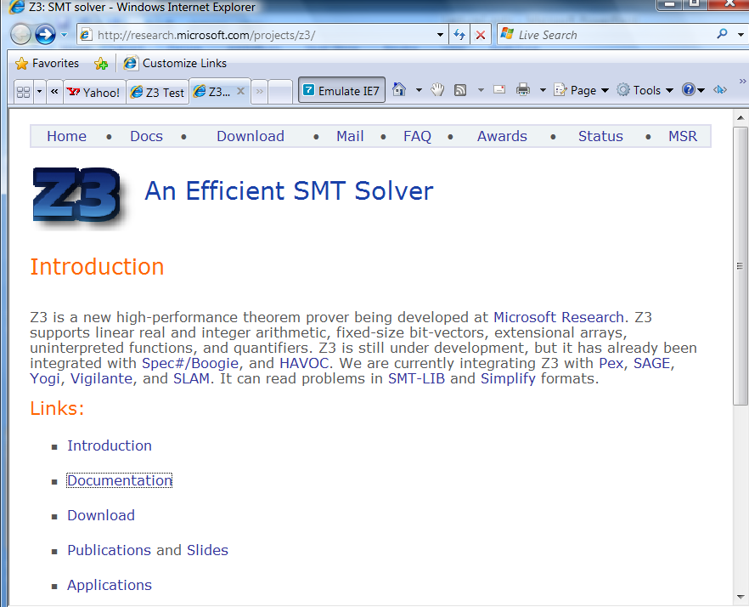
Web

Slide 60
Supporting material
http://research.microsoft.com/projects/z3/documentation.html

Slide 61
Z3: Core System Components
Text
C
.NET
OCaml
Theories
Bit-Vectors
Rewriting Simplification
Arithmetic
Arrays
E-matching
Core Theory
Partial orders
Tuples
SAT solver

Slide 62
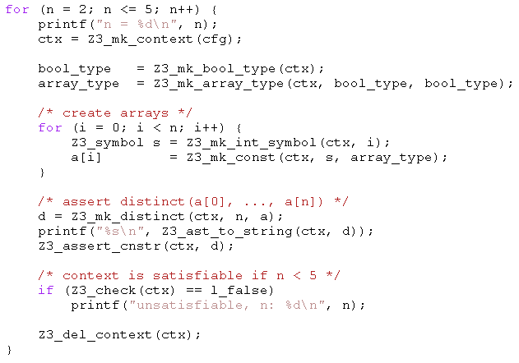
Example: C API
Given arrays:
bool a1[bool];
bool a2[bool];
bool a3[bool];
bool a4[bool];
All can be distinct.
Add:
bool a5[bool];
Two of a1,..,a5 must be equal.

Slide 63
Example: SMT-LIB
(benchmark integer-linear-arithmetic
:status sat
:logic QF_LIA
:extrafuns ((x1 Int) (x2 Int) (x3 Int)
(x4 Int) (x5 Int))
:formula (and (>= (- x1 x2) 1)
(<= (- x1 x2) 3)
(= x1 (+ (* 2 x3) x5))
(= x3 x5)
(= x2 (* 6 x4)))
)
(benchmark array
:logic QF_AUFLIA
:status unsat
:extrafuns ((a Array) (b Array) (c Array))
:extrafuns ((i Int) (j Int))
:formula (and
(= (store a i v) b)
(= (store a j w) c)
(= (select b j) w)
(= (select c i) v)
(not (= b c))
)

Slide 64
SMT-LIB syntax – basics
benchmark ::= (benchmark name
[:status (sat | unsat | unknown)]
:logic logic-name
declaration*)
declaration ::= :extrafuns (func-decl*)
| :extrapreds (pred-decl*)
| :extrasorts (sort-decl*)
| :assumption fmla
| :formula fmla
sort-decl ::= id - identifier
func-decl ::= id sort-decl* sort-decl - name of function, domain, range
pred-decl ::= id sort-decl* - name of predicate, domain
fmla ::= (and fmla*) | (or fmla*) | (not fmla)
| (if_then_else fmla fmla fmla) | (= term term)
| (implies fmla fmla) (iff fmla fmla) | (predicate term*)
Term ::= (ite fmla term term)
| (id term*) - function application
| id - constant

Slide 65
SMT-LIB syntax - basics
Logics:
  QF_UF – Un-interpreted functions. Built-in sort U
  QF_AUFLIA – Arrays and Integer linear arithmetic.
    Built-in Sorts:
      Int, Array (of Int to Int)
    Built-in Predicates:
      <=, >=, <, >,
    Built-in Functions:
      +, *, -, select, store.
    Constants: 0, 1, 2, …

Slide 66
SMT-LIB – encodings
Q: There is no built-in function for max or min. How do I encode it?
  (max x y) is the same as (ite (> x y) x y)
  Also: replace (max x y) by fresh constant max_x_y add assumptions:
  :assumption (implies (> x y) (= max_x_y x))
  :assumption (implies (<= x y) (= max_x_y y))
Q: Encode the predicate (even n), that is true when n is even.

Slide 67
Quantifiers
Quantified formulas in SMT-LIB:
  fmla ::= …
  | (forall bound* fmla)
  | (exists bound* fmla)
  Bound ::= ( id sort-id )
Q: I want f to be an injective function. Write an axiom that forces f to be injective.
Patterns: guiding the instantiation of quantifiers (Lecture 5)
  fmla ::= …
  | (forall (?x A) (?y B) fmla :pat { term })
  | (exists (?x A) (?y B) fmla :pat { term })
Q: what are the patterns for the injectivity axiom?

Slide 68
Using the Z3 (managed) API
open Microsoft.Z3
open System.Collections.Generic
open System
let par = new Config()
do par.SetParamValue("MODEL", "true")
let z3 = new TypeSafeContext(par)
Create a context z3:
let check (fmla) =
z3.Push();
z3.AssertCnstr(fmla);
(match z3.Check() with
| LBool.False -> Printf.printf "unsat\n"
| LBool.True -> Printf.printf "sat\n"
| LBool.Undef -> Printf.printf "unknown\n"
| _ -> assert false);
z3.Pop(1ul)
Check a formula
Push
AssertCnstr
Check
Pop

Slide 69
Using the Z3 (managed) API
let (===) x y = z3.MkEq(x,y)
let (==>) x y = z3.MkImplies(x,y)
let (&&) x y = z3.MkAnd(x,y)
let neg x = z3.MkNot(x)
let a = z3.MkType(“a”)
let f_decl = z3.MkFuncDecl("f",a,a)
let x = z3.MkConst(“x”,a)
let f x = z3.MkApp(f_decl,x)
Declaring z3 shortcuts,
constants and functions
Proving a theorem
let fmla1 = ((x === f(f(f(f(f(f x))))) && (x === f(f(f x)))) ==> (x === (f x))
do check (neg fmla1)
(benchmark euf
:logic QF_UF
:extrafuns ((f U U) (x U))
:formula (not (implies (and (= x (f(f(f(f(f x)))))) (= x (f(f(f x))))) (= x (f x))))
compared to

Slide 70
Enumerating models
  We want to find models for
  But we only care about different

Slide 71
Enumerating models
Representing the problem
void Test() {
Config par = new Config();
par.SetParamValue("MODEL", "true");
z3 = new TypeSafeContext(par);
intT = z3.MkIntType();
i1 = z3.MkConst("i1", intT); i2 = z3.MkConst("i2", intT);
i3 = z3.MkConst("i3", intT);
z3.AssertCnstr(Num(2) < i1 & i1 <= Num(5));
z3.AssertCnstr(Num(1) < i2 & i2 <= Num(7));
z3.AssertCnstr(Num(-1) < i3 & i3 <= Num(17));
z3.AssertCnstr(Num(0) <= i1 + i2 + i3 & Eq(i2 + i3, i1));
Enumerate();
par.Dispose();
z3.Dispose();
}

Slide 72
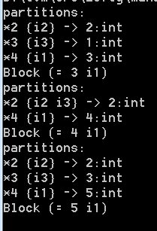
Enumerating models
  Enumeration:
void Enumerate() {
TypeSafeModel model = null;
while (LBool.True == z3.CheckAndGetModel(ref model)) {
model.Display(Console.Out);
int v1 = model.GetNumeralValueInt(model.Eval(i1));
TermAst block = Eq(Num(v1),i1);
Console.WriteLine("Block {0}", block);
z3.AssertCnstr(!block);
model.Dispose();
}
}
TermAst Eq(TermAst t1, TermAst t2) { return z3.MkEq(t1,t2); }
TermAst Num(int i) { return z3.MkNumeral(i, intT); }

Slide 73
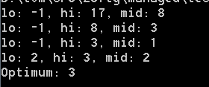
Push, Pop
int Maximize(TermAst a, int lo, int hi) {
while (lo < hi) {
int mid = (lo+hi)/2;
Console.WriteLine("lo: {0}, hi: {1}, mid: {2}",lo,hi,mid);
z3.Push();
z3.AssertCnstr(Num(mid+1) <= a & a <= Num(hi));
TypeSafeModel model = null;
if (LBool.True == z3.CheckAndGetModel(ref model)) {
lo = model.GetNumeralValueInt(model.Eval(a));
model.Dispose();
}
else hi = mid;
z3.Pop();
}
return hi;
}
Maximize(i3,-1,17):

Slide 74
Push, Pop – but reuse search
int Maximize(TermAst a, int lo, int hi) {
while (lo < hi) {
int mid = (lo+hi)/2;
Console.WriteLine("lo: {0}, hi: {1}, mid: {2}",lo,hi,mid);
z3.Push();
z3.AssertCnstr(Num(mid+1) <= a & a <= Num(hi));
TypeSafeModel model = null;
if (LBool.True == z3.CheckAndGetModel(ref model)) {
lo = model.GetNumeralValueInt(model.Eval(a));
model.Dispose();
lo = Maximize(a, lo, hi);
}
else hi = mid;
z3.Pop();
}
return hi;
}

