Slide 1
SMT solvers in
Program Analysis and Verification
Nikolaj Bjørner
Microsoft Research
Lecture 2

Slide 2
Overview of the lectures
Day | Topics | Lab
1 | Overview of SMT and applications. SAT solving, Z3 | Encoding combinatorial problems with Z3
2 | Congruence closure | Program exploration with Pex
3 | A solver for arithmetic. | Encoding arithmetic problems
4 | Theory combination. Arrays (part 1) | Arrays.
5 | Arrays, (part 2) and quantifiers | Build a theory solver on top of Z3

Slide 3
Summary of Day 2
Functions and equalities:
Congruence closure
Pex: Program EXploration
Lab: Encode combinatorial problems.
  Longest paths
  A Sudoku solver
  Rush hour

Slide 4
Review
SAT – Satisfiability of Propositional Logic
SMT – Satisfiability Modulo Theories
SMT = SAT +
Un-interpreted functions +
Linear arithmetic +
Bit-vectors + …
SAT is so 2001, SMT is the next SAT

Slide 5
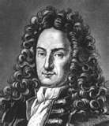

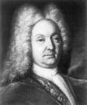

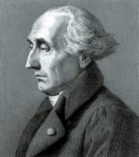
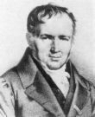
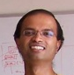
Functions and equalities
Congruence closure
Leibniz → Bernoulli Sr → Bernoulli Jr → Euler → Lagrange → Poisson →
Chasles → H.A. Newton → Moore → Veblen → Franklen → Perlis →
Manna → Henzinger → Rajamani

Slide 6
Terms and E-satisfiability
Recall terms T(Σ_{F} ,V):
  t ∈ T ::= v v ∈ V
    | f(t₁, …, t_{n}) f ∈ Σ_{F} t₁, …, t_{n} ∈ T
Ground terms are given by T(Σ_{F} ,∅)
Atomic predicates: t₁ = t₂ - just equalities
E-satisfiability t₁ = t₂ ∧t₃ = t₄ ∧ t₅ ≠ t₆

Slide 7
Terminology
E-satisfiability is more often called EUF-satisfiability
  EUF : Equality and Un-interpreted Functions.
E is just shorter to say than EUF.

Slide 8
E-satisfiability - example
f(f(a)) = a, f(a) ≠a
  Satisfied by Model :
  a^{M} =a₀ f^{M} ={a₀ → a₁, a₁ → a₀}
f(f(f(a)) = a, f(f(f(f(f(a))))) = a, a ≠ f(a)
  Unsatisfiable: a = f(f(f(f(f(a))))) = f(f(a))
  a = f(f(f(a)) = f(a)

Slide 9
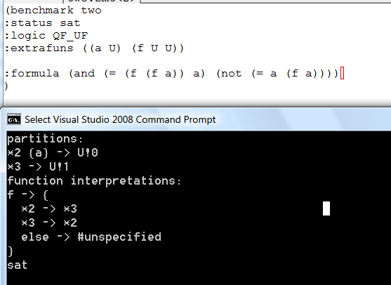
E-satisfiability - example
f(f(a)) = a, a ≠ f(a)

Slide 10
E - The theory of equality
Reflexivity: t = t
Symmetry: t = s ⇒ s = t
Transitivity: t = s ∧ s= u⇒ t = u
Congruence: t₁= s₁ ∧.. ∧ t_{n} =s_{n} ⇒
f(t₁, …, t_{n}) = f(s₁, …, s_{n})
E – the (infinite) conjunction of these axioms

Slide 11
Congruence Closure
E-satisfiability can be decided with a simple algorithm known as congruence closure.
  Congruence closure creates a finite quotient for DC(E + L).
  E – Equality axioms
  L – Literals: extra equalities in input

Slide 12
Congruence Closure Graph

Slide 13
Congruence Closure Graph

Slide 14
Congruence Closure Graph

Slide 15
Congruence Closure Graph

Slide 16
Congruence Closure Graph

Slide 17
Congruence Closure Graph

Slide 18
Conguruence Closure Graph
Recall congruence rule:
Congruence:
t₁= s₁ ∧.. ∧ t_{n} =s_{n} ⇒
f(t₁, …, t_{n}) = f(s₁, …, s_{n})

Slide 19
Congruence Closure Graph

Slide 20
Congruence Closure Graph

Slide 21
Congruence Closure Graph

Slide 22
Congruence Closure Graph

Slide 23
Congruence Closure Graph

Slide 24
Congruence Closure Graph

Slide 25
Congruence closure graph
Let G = (V,E) be a directed graph such that for each vertex v in G, the successors (children) of v are ordered.
Let C be any equivalence relation on V.
The congruence closure C* of C is the finest equivalence relation on V,
  that contains C : v ≡_{C} w then v ≡_{C*} w
  Closed: If
    children(v) = v₁ ..v_{n}
    children(w) = w₁ ..w_{n} Then v ≡_{C*} w
    v₁ ≡_{C*} w₁ … v_{n} ≡_{C*} w_{n}

Slide 26
Congruence closure graph
From literals L to a congruence graph.
  For each subterm t in L create a vertex v_{t}
  For each function symbol f create vertex v_{f}
  If t = f(t₁, …, t_{n}), let children(v_{t}) = v_{f}, vt1, …, vtn
From literals L to an initial equivalence C
  Initially C = { { v } | v ∈ V }
  For each equality t = s ∈ L:
    Merge equivalence classes for v_{t} and v_{s}

Slide 27
Computing congruence closure
From the definition, we can read off that Congruence closure is the least fixed-point of the operator CongClos:
  CongClos(C* )(v,w) =
  v ≡_{C} w
  or let v₁ .. v_{n} = children(v)
  let w₁ ..w_{n} = children(w) in
  CongClos(C* )(v₁, w₁) ∧ .. ∧
  CongClos(C* )(v_{n}, w_{n})

Slide 28
Computing Congruence closure
Fixed-point characterization suggests (dynamic programming) algorithm:
  Maintain root vertex for each equivalence class.
  Maintain sig(nature) of each vertex:
  sig(v_{f(t1,..,tn)}) = ⟨root(v_{f} ), root(v_{t1}).. root(v_{tn}) ⟩
  Initialize C* ← C
  while ∃ v,w ∈ V s.t. v ≡_{C*} w, but sig(v) = sig(w):
  C* ← C* with classes for v, w merged

Slide 29
Computing Congruence closure
A more efficient implementation of congruence closure
  Use union-find for maintaining roots
  Maintain use (a list) for set of parent vertices.
  Set todo = {}
  def merge(v, w):
  C* ← C* with classes for v, w merged
  foreach v_{p} ∈ use(v), w_{p} ∈ use(w):
  add ⟨ v_{p}, w_{p} ⟩ to todo
  foreach asserted equality (v,w): merge(v,w)
  while some ⟨ v, w ⟩ ∈ todo :
  remove ⟨ v, w ⟩ from todo
  if v ≡_{C*} w, but sig(v) = sig(w) then merge(v,w)

Slide 30
Using congruence closure
Back to the main problem.
  E-satisfiability t₁ = t₂ ∧ t₃ = t₄ ∧ t₅ ≠ t₆
Form graph using {t₁, t₂, t₃ , t₄ , t₅ , t₆ }
Initialize C from equalities
Compute C* from C
Check that v_{t5} ≡_{C*} v_{t6}

Slide 31
Congruence closure algorithm
Soundness: C* just simulates axioms of E.
Completeness: From C* build model M.
    f^{M}(v₁, …, v_{n}) = root(v),
    if there is a v, such that sig(v) = ⟨ f^{M},v₁, …, v_{n}⟩
    f^{M}(v₁, …, v_{n}) = *
    otherwise
    Then all axioms in E are true in M.
    All equalities in L are true in M.

Slide 32
DPLL(E)
Congruence closure just checks satisfiability of conjunction of literals.
How does this fit together with Boolean search DPLL?
DPLL builds partial model M incrementally
  Use M to build C*
    After every Decision or Propagate, or
    When F is propositionally satisfied by M.
  Check that disequalities are satisfied.

Slide 33
E - conflicts
Recall Conflict:
Conflict M || F ⇒ M || F || C if C∈F, M ⊨_{T} ¬C
A version more useful for theories:
Conflict M || F ⇒ M || F || C if C⊆ ¬M, ⊨_{T} C

Slide 34
E - conflicts
Example
M = fff(a) = a, g(b) = c, fffff(a)= a, a ≠ f(a)
¬ C = fff(a) = a, fffff(a)=a, a ≠ f(a)
⊨_{E} fff(a)≠ a∨ fffff(a)≠ a ∨ a = f(a)
Use C as a conflict clause.

Slide 35
E - conflicts
How can one mine M for E-conflicts?

Slide 36
Convexity
The theory E is convex.
  Convexity:
  Let L be a set of equalities and disequalities
  If L ⊨_{E} s₁ = t₁ ∨ … ∨ s_{n} = t_{n}
  Then for some i: L ⊨_{E} s_{i} = t_{i}
  (proof: use soundess and completeness of Congruence Closure).
  A consequence:
    To check satisfiability it suffices to check each disequality in isolation.

Slide 37
and uninterpreted functions
Using equalities

Slide 38
Abstraction
Use E as the penultimate approximation:
Let T be a theory with signature Σ_{F} .
If L is E-unsatisfiable, where Σ_{F} is only axiomatized using E,
  then L is T-unsatisfiable.

Slide 39
Incremental abstraction
Idea, roughly:
  Treat some operator occurrences as uninterpreted function symbols.
  Generate model M with mix of interpreted and un-interpreted modes.
  Check that M also satisfies T.
  If M violates T on some equality t = s, where t contains an abstracted function occurrence,
    Then expand interpretation of such occurrence.
More in exercises

Slide 40

Program EXploration
Application: Using decision procedures for generating test inputs
Thanks to Nikolai Tillmann and Peli de Halleux

Slide 41
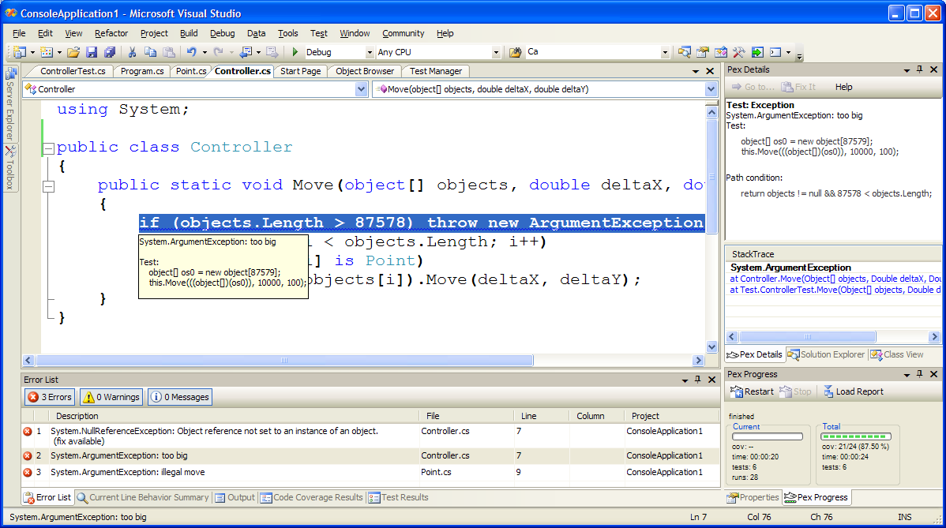
Pex - demo

Slide 42
How does Pex work?
Pex monitors program runs
  Instruments code, injects callbacks
  Callbacks evolve symbolic ‘shadow state’,
  including path condition over symbolic inputs
Pex solves generates new test inputs
  Constraint systems consists of feasible path condition prefix, plus negation of known feasible continuation
  Constraint solver to generate new tests
Result: Minimal test suites with high coverage

Slide 43

Pex – Test Input Generation
Run Test and Monitor
Execution Path
Path Condition
seed
Test
Inputs
Known
Paths
New input
Constraint System
Solve
Unexplored path
Test inputs may be …
Arguments of Parameterized Tests
Return values of mock-object methods
Web-service requests or replies
Injected exceptions and mutated values
Few test inputs generated,
high code coverage

Slide 44
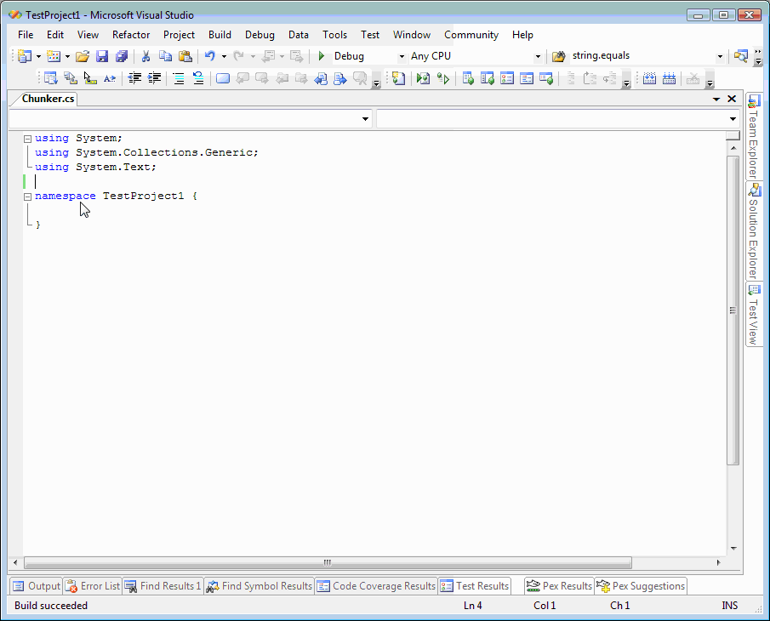

Slide 45
How Pex finds errors
  int Complicated( int x, int y) { int Obfuscate (int y) {
  if (x == Obfuscate(y)) return y * 567 % 2347;
  throw; }
  return 0;
  }
Pex combines testing and symbolic analysis.
1 Call Complicated() with random values, e.g. -312 for x, 513 for y
  Record branch condition “x != y * 567 % 2347”
  throw is not hit
  Compute values such that “x == y * 567 % 2347” (using constraint solver)
2 Call Complicated() with computed value 513 * 567 % 2347 for x, 513 for y
  throw is hit; coverage goal is reached
  Editors note: This Obfuscate is actually not too obfuscated.

Slide 46
Extended Reflection & Monitoring
Overview
User application,
Managed
Safe
callbacks
Pex analysis,
Managed
Insert safe
callbacks after each
MSIL instruction
.Net runtime,
Unmanaged
Unsafe C++
callbacks
COR_PROFILER, Unmanaged:
Rewrites every managed
user method about to be JITed
Notes:
MSIL = bytecode

Slide 47
Code instrumentation for symbolic analysis
ldtoken Point::X
call __Monitor::LDFLD_REFERENCE
ldfld Point::X
call __Monitor::AtDereferenceFallthrough
br L2
L1:
call __Monitor::AtBranchTarget
call __Monitor::LDC_I4_M1
ldc.i4.m1
L2:
call __Monitor::RET
stloc.0
leave L4
} catch NullReferenceException {
‘ call __Monitor::AtNullReferenceException
rethrow
}
L4: leave L5
} finally {
call __Monitor::LeaveMethod
endfinally
}
L5: ldloc.0
ret
class Point { int x; int y;
public static int GetX(Point p) {
if (p != null) return p.X;
else return -1; } }
ldtoken Point::GetX
call __Monitor::EnterMethod
brfalse L0
ldarg.0
call __Monitor::NextArgument<Point>
L0: .try {
.try {
call __Monitor::LDARG_0
ldarg.0
call __Monitor::LDNULL
ldnull
call __Monitor::CEQ
ceq
call __Monitor::BRTRUE
brtrue L1
call __Monitor::BranchFallthrough
call __Monitor::LDARG_0
ldarg.0
…
Prologue
Record concrete values
to have all information
when this method is called
with no proper context
(The real C# compiler
output is actually more
complicated.)
Calls to build
path condition
Calls will perform
symbolic computation
Epilogue
Calls to build
path condition

