Slide 1
SMT solvers in
Program Analysis and Verification
Nikolaj Bjørner
Microsoft Research
Lecture 4

Slide 2
Overview of the lectures
Day | Topics | Lab
1 | Overview of SMT and applications. SAT solving, Z3 | Encoding combinatorial problems with Z3
2 | Congruence closure | Program exploration with Pex
3 | A solver for arithmetic. | Encoding arithmetic problems
4 | Theory combination. Arrays (part 1) | Arrays.
5 | Arrays, (part 2) and quantifiers | Build a theory solver on top of Z3

Slide 3
Summary of Day 4
Theory combination methods for combining decision procedures
A decision procedure for Arrays
Lab:
  Encode queues using arrays

Slide 4
Combining Solvers

Slide 5
DPLL(T)
Previous lectures covered:
  DPLL – pure propositional satisfiability
  DPLL(E) – Propositional + Equations + functions.
  DPLL(LA) – Propositional + Linear arithmetic
How can we combine DPLL(E + LA)?
DPLL(T₁+ T₂)?

Slide 6
The SMT Solver Super-Highway
      Quiz: Who invented the SMT Solver Super-Highway?
Congruence
closure
Simplex
What information to share?

Slide 7
The basic combination problem
Examples:
Given:
Σ_{F} = Σ₁ ∪ Σ₂ T₁ , T₂ : Theories over Σ₁, Σ₂
T = DC(T₁ ∪ T₂) – deductive closure
Is T consistent?
Given separate solvers for T₁ and T₂ produce combined solver for T.

Slide 8
Some basics
Disjoint signatures
Σ₁ ∩ Σ₂ = ∅
{ +, -, .. } ∩ { read, write} = ∅
Stably-Infinite Theories.
Convex Theories.

Slide 9
Stably-Infinite Theories
Theorem:
  The union of two consistent, disjoint, stably-infinite theories is consistent.

Slide 10
Stably-Infinite Theories
A theory is stably-infinite if every satisfiable QFF is satisfiable in an infinite model.
We can glue together models M₁ and M₂ from stably infinite theories:
  we can extend the size of models M₁ and M₂ to each have |M₁ | + |M₂ | elements.

Slide 11
Stably-Infinite Theories
A theory is stably-infinite if every satisfiable QFF is satisfiable in an infinite model.
Theories with only finite models are not stably infinite:
T = DC(∀x,y,z. (x = y) ∨ (x = z) ∨ (y = z) )
has only models with at most 2 elements
Is this a problem in practice?
  We want to support finite types found in programming languages.

Slide 12
Stably-Infinite Theories
Are finite domains a problem in practice?
Not really. Add a type predicate, to scope finite sorts.
T’ = DC(∀x,y,z. in₂(x) ∧ in₂(y) ∧ in₂(z) ⇒ (x = y) ∨ (x = z) ∨ (y = z) )
T’ is stably infinite.

Slide 13
Convex Theories
Theorem:
  The union of two convex theories can be solved in time O(n⁴ x T₁(n) x T₂(n)).
  The combination of a non-convex theory with another can incur exponential cost.

Slide 14
Convexity
A theory T is convex iff:
for all finite sets L of literals and
for all non-empty disjunctions
L ⊨_{T}
iff L ⊨_{T} for some i ∈ I
Every convex theory T with non-trivial models (i.e., ⊨_{T} ∃x,y . x ≠ y) is stably-infinite
All Horn theories are convex – this includes all (conditional) equational theories.
Linear rational arithmetic is convex

Slide 15
Convexity: Horn theories
Suppose H is a set of horn axioms.
H |= P(t) ∨ Q(t’)
Then there is a resolution proof of [] given:
  H ∧ ¬P(t) ∧ ¬ Q(t’)
Horn resolution maintains invariant:
  Every clause has at most one positive literal.
Either P(t) or Q(t’) consume the only available positive literal.
Notes:
Horn equalities are convex.
Proof: convert the horn equalities into predicate calculus without equality by adding the horn axioms:
E(x,y) :- E(y,x)
E(x,z) :- E(x,y), E(y,z)
E(x,x)
E(f(x),f(y)) :- E(x,y)…. For every f.
The resulting system H is still Horn.
Suppose H |= E(s,t) or E(u,v). Then by FO completeness H & !E(s,t) && !E(u,v) is unsat with a finite resolution derivation.
Now notice that any resolvent with !E(s,t) or !E(u,v) contains no positive literals. Hence, clauses resolved with one cannot be resolved with the other.
The finite resolution derivation must therefore only require one of the equalities.

Slide 16
Convexity: LRA
Suppose A is a matrix, b is a vector, f₁ (x) and f₂ (x) are linear functions and that Ax ≤ b |= f₁ (x) = c₁ or f₂ (x) = c₂ for every x.
Let Ax₁ ≤ b and Ax₂ ≤ b and f₁(x₁) = c₁ and f₂ (x₂) = c₂. We show that either f₁(x₂) = c₁ or f₂(x₁) = c₂.
Proof: let y = (x₁+x₂)/2, then
Ay = A(x₁+x₂)/2 = Ax₁/2 + Ax₂/2 ≤ b/2 + b/2 = b, so either f₁(y) = c₁ or f₂(y) = c2.
Assume wlog f₁ (y) = c₁, then
c₁ = 2*c₁ – c₁ = 2*f₁ (y) – f₁ (x₁) =
f₁ (2y-x₁) = f₁ (2(x₁+x₂)/2 – x₁) = f₁ (x₂) .

Slide 17
Many theories are not convex
  Linear integer arithmetic
  1 ≤ x ≤ 2 ⊨ x = 1 ∨ x = 2
  Non-linear arithmetic
  x² = 1, y = 1, z = -1 ⊨ x = y ∨ x = z
  Theory of bit-vectors
  ch : BitVec[8] ⊨ ch = 0 ∨ … ∨ ch = 255
  Theory of arrays
  v = read(write(a,i,w),j) ⊨ v = w ∨ v = read(a,j)

Slide 18
Convexity - combination
Let T = T₁ ∪ T₂ where T₁ is E, O(nlog(n)), and T₂ is Integer Difference Logic, O(nm).
T₁ is convex, but T₂ is not.
Satisfiability of T is NP-complete:
  Reduce 3CNF satisfiability to T-satisfiability
  For each Boolean variable p_{i} add the atomic formulas 0 ≤ x_{i} ≤ 1
  For a clause p₁ ∨ -p₂ ∨ p₃ add the atomic formula:
  f(x₁,x₂,x₃) ≠ f(0,1,0)

Slide 19
Nelson-Oppen Combination
Let T₁ and T₂ be consistent, stably infinite theories over disjoint (countable) signatures. Assume satisfiability of conjunction of literals can be decided in time T₁(n), respectively T₂(n). Then,
  The combined theory T is consistent and stably infinite.
  Satisfiability of quantifier-free conjunction of literals in T can be decided in O(2^{n*n} x T₁(n) x T₂(n)).
  If T₁ and T₂ are convex, then so is T. Satisfiability is in O(n⁴ x T₁(n) x T₂(n)).

Slide 20
Nelson-Oppen procedure
Initial state: L is set of literals over Σ₁ ∪ Σ₂
Purify: Preserving satisfiability,
convert L into L’ = L₁ ∪ L₂ such that
L₁ ∈ T(Σ₁,V), L₂ ∈ T(Σ₂,V)
So L₁ ∩ L₂ = V_{shared} ⊆ V
Interaction:
Guess a partition of V_{shared}
Express the partition as a conjunction of equalities.
Example, { x₁ }, { x₂ , x₃ }, { x₄ } is represented as:
ψ: x₁ ≠ x₂ ∧x₁ ≠ x₄ ∧x₂ ≠ x₄ ∧x₂ = x₃
Component Procedures:
Use solver 1 to check satisfiability of L₁ ∧ ψ
Use solver 2 to check satisfiability of L₂ ∧ ψ

Slide 21
Purification
Use ϕ[t] for a sub-term t in ϕ
Purify: ϕ[f(t,g(s))] → ϕ[f(t,x)] ∧ x = g(s)
whenever f ∈ Σ₁, g ∈ Σ₂, x is fresh
Purification terminates.
Purification preserves satisfiability.

Slide 22
Purification
Purify: ϕ[f(t,g(s))] → ϕ[f(t,x)] ∧ x = g(s)
Example:
  f(x – 1) – 1 = x ∧ f(y) + 1 = y →
  f(z) – 1 = x ∧ f(y) + 1 = y ∧ z = x - 1 →
  u – 1 = x ∧ f(y) + 1 = y ∧ z = x - 1 ∧ u = f(z) →
  u – 1 = x ∧ v + 1 = y ∧ z = x - 1 ∧ u = f(z) ∧ v = f(y)
  L₁ = u – 1 = x ∧ v + 1 = y ∧ z = x - 1
  L₂ = u = f(z) ∧ v = f(y)

Slide 23
Purification – is really a conceptual tool
Just color each sub-term by the theory of the function symbol.
Each solver treats sub-terms colored by the wrong color as a variable.

Slide 24
NO procedure - soundess
Each step is satisfiability preserving
Say L is satisfiable (in the combination).
  Purification: L₁ ∧ L₂ is satisfiable by M.
  Interaction: M induces a partition ψ
  ψ ∧ L₁ ∧ L₂ is satisfiable
  Component: Each ψ ∧ L₁ and ψ ∧ L₂ are satisfiable.
Therefore, if the procedures return unsatisfiable, then L is unsatisfiable.

Slide 25
NO procedure: correctness
Suppose both procedures return satisfiable:
A ⊨ ψ ∧ L₁
B ⊨ ψ ∧ L₂ A, B are models.
Each theory is stably-infinite. So assume A, B have infinite domains S_{A}, S_{B} (of same cardinality).
Let h be a bijection S_{A} ↔ S_{B} such that h(x^{A}) = x^{B} for each shared variable.
Extend B to B’ to interpret functions in Σ₁ :
f^{B’}(b₁ .. b_{n}) = h(f^{A}(h⁻¹(b₁),…, h⁻¹(b_{n}))
B’ is a model.

Slide 26
NO – reduced guessing
Instead of guessing, we can often deduce the equalities to be shared.
Interaction: T₁ ∧ L₁ ⊨ x = y
then add equality to ψ.
If theories are convex, then we can:
  Deduce all equalities.
  Assume every thing not deduced is distinct.
  Complexity: O(n⁴ x T₁(n) x T₂(n)).

Slide 27
NO – convex case correctness
Assume the theories are convex.
  Suppose L₁ is satisfiable
  Let E be the set of pairs x_{j}, x_{k}, such that
  M₁ ⊨ L₁ ⇒ x_{j} = x_{k}
  By convexity:
    M₁ ⊨ L₁ ⇒ ∨ _{E} x_{j} = x_{k}
  So L₁ ∧ ∧_{E} x_{j} ≠ x_{k} is satisfiable

Slide 28
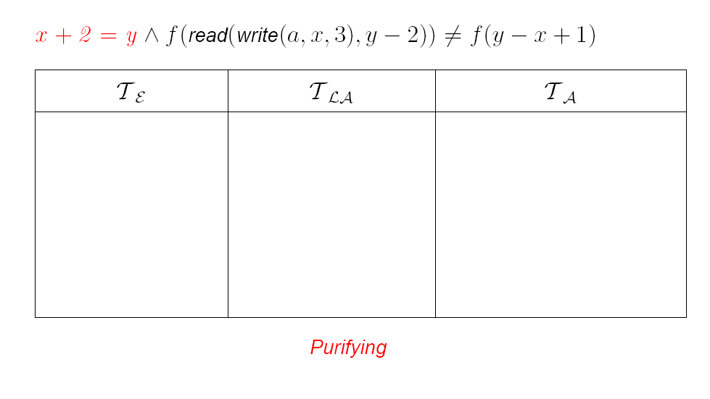
NO procedure - Example

Slide 29
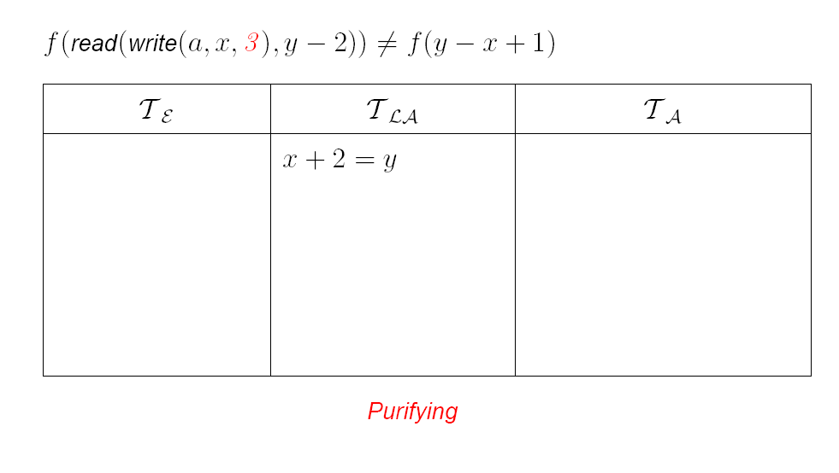
NO procedure - Example

Slide 30
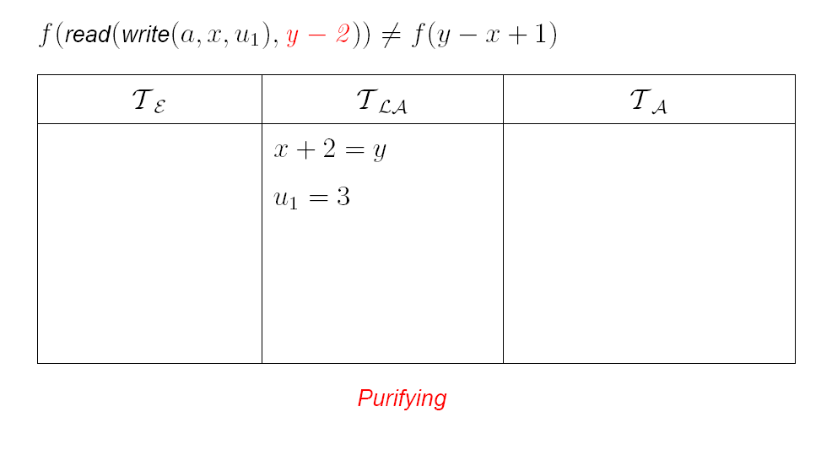
NO procedure - Example

Slide 31

NO procedure - Example

Slide 32
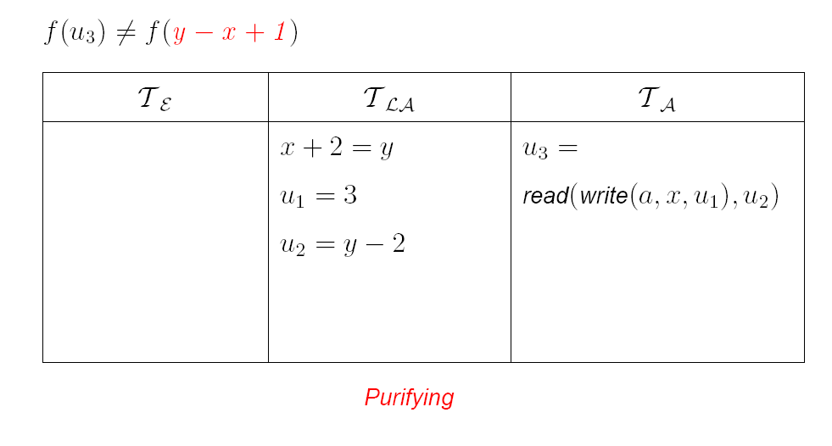
NO procedure - Example

Slide 33

NO procedure - Example

Slide 34

NO procedure - Example

Slide 35

NO procedure - Example

Slide 36
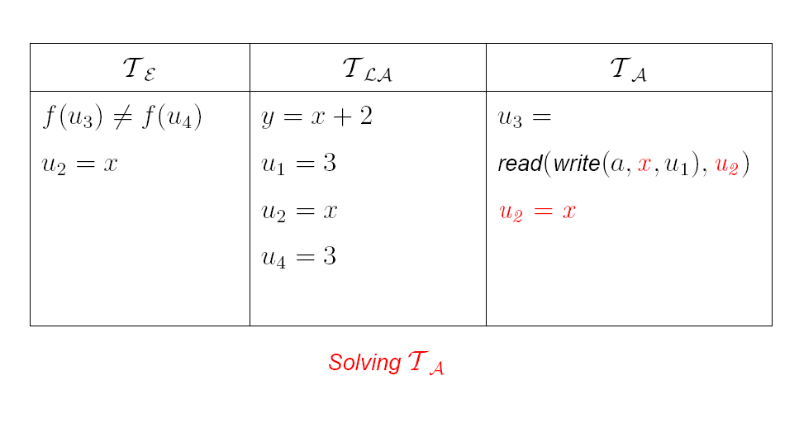
NO procedure - Example

Slide 37
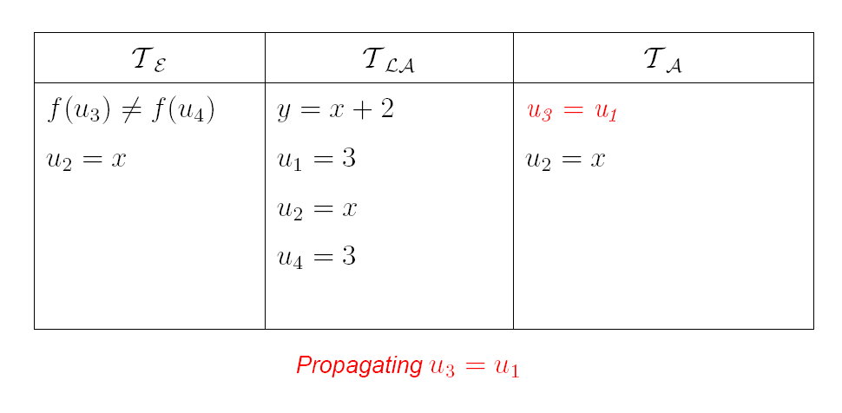
NO procedure - Example

Slide 38
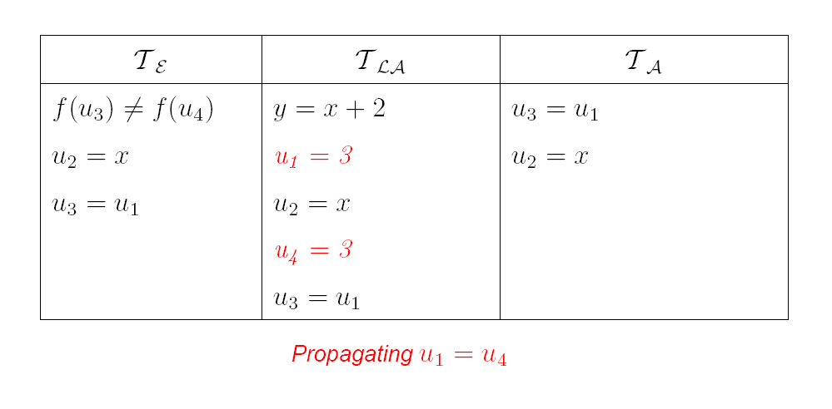
NO procedure - Example

Slide 39
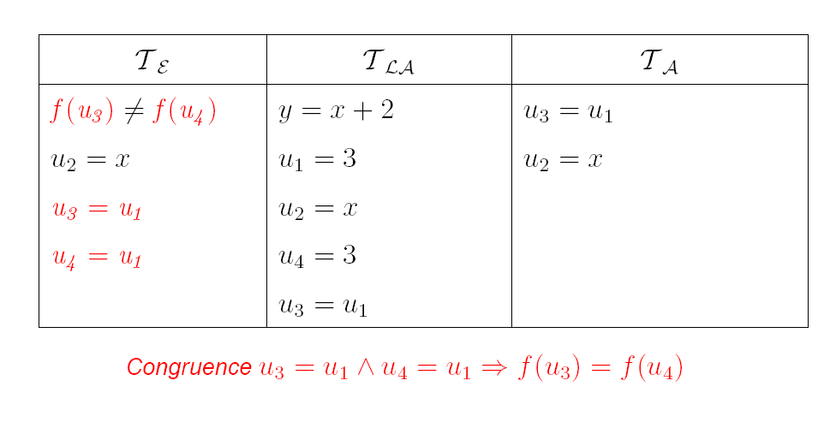
NO procedure - Example

Slide 40

NO procedure - Example

Slide 41
Model-based combination
Reduced guessing is only complete for convex theories.
Deducing all implied equalities may be expensive.
  Example: Simplex – no direct way to extract from just bounds and β
But: backtracking is pretty cheap nowadays:
  If β(x) = β(y), then x, y are equal in arithmetical component.

Slide 42
Model-based combination
Backjumping is cheap with modern DPLL:
  If β(x) = β(y), then x, y are equal in arithmetical model.
  So let’s add x = y to ψ, but allow to backtrack from guess.
In general: if M₁ is the current model
  M₁ ⊨ x = y then add literal (x = y)^{d}

Slide 43
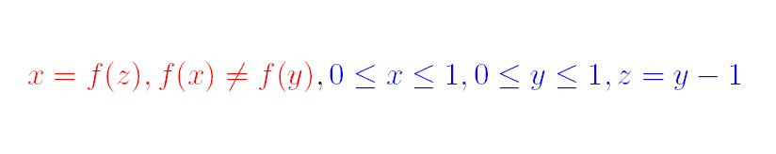
Model-based - Example

Slide 44
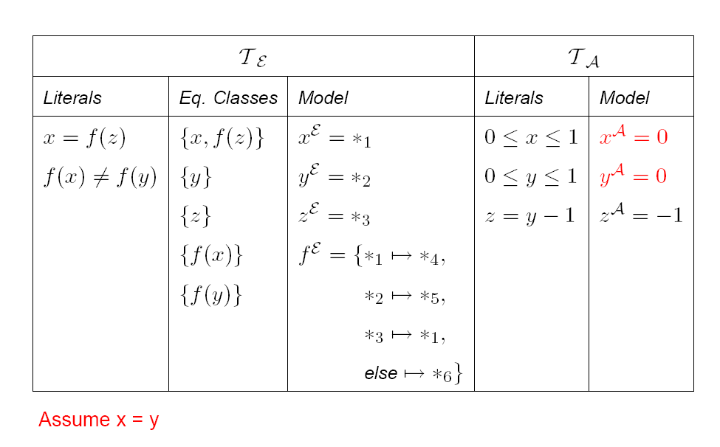
Model-based - Example

Slide 45
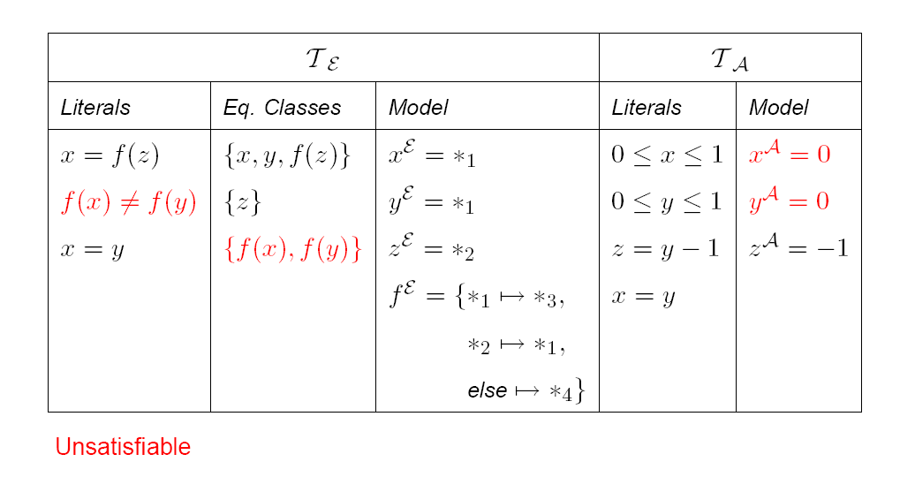
Model-based - Example

Slide 46
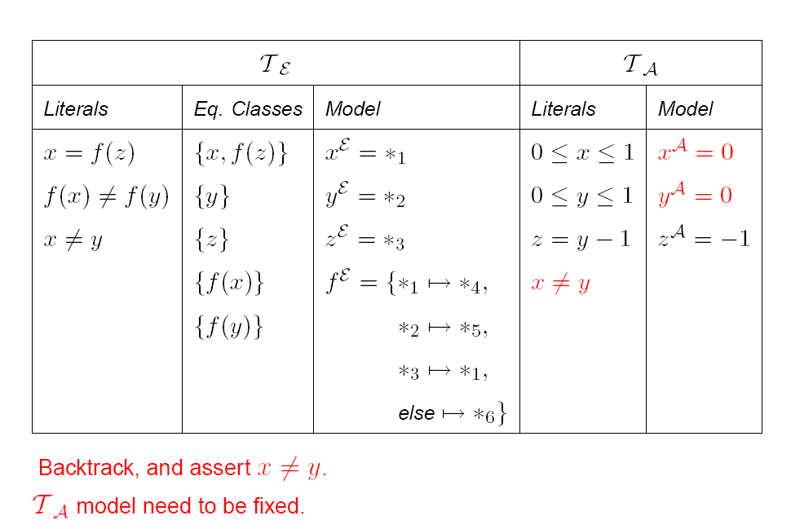
Model-based - Example

Slide 47
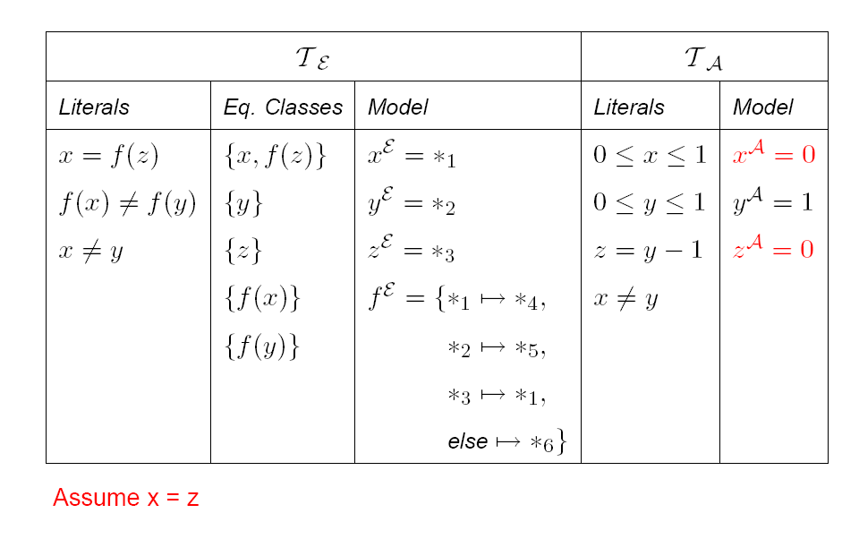
Model-based - Example

Slide 48
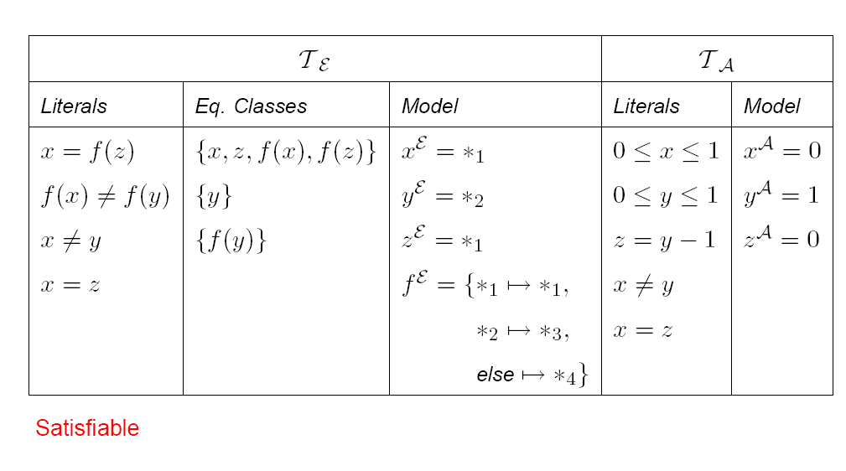
Model-based - Example

Slide 49
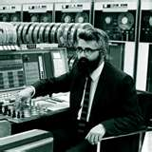

Arrays

Slide 50
Why use abstract arrays?
def swap(a, i, j):
tmp = a[i];
a[i] = a[j];
a[j] = tmp;
new(a)[i] = a[j]
new(a)[j] = a[i]
k ≠i, k ≠j ⇒a[k] = new(a)[k]
new(a)[i] =
write(write(a,i,a[j]),j,a[i])[i] =
if i = j then a[i] else write(a,i,a[j])[i] =
if i = j then a[i] else a[j] =
a[j]
new(a)[j] = write(write(a,i,a[j]),j,a[i])[j] = a[i]
new(a) = write(write(a,i,a[j]),j,a[i])
new(a) =
let tmp = a[i]
a1= write(a,i,a[j]);
a2= write(a1,j,tmp);
in a2
def swap(a, i, j):
tmp = a[i];
a1= write(a,i,a[j]);
a2= write(a1,j,tmp);
new(a) = a2
def swap(a, i, j):
tmp = a[i];
a = write(a,i,a[j]);
a= write(a,j,tmp);

Slide 51
Theory of arrays
Functions: Σ_{F} = { read, write }
Predicates: Σ_{P} = { = }
Convention a[i] means: read(a,i)
Non-extensional arrays T_{A}:
  ∀a, i, v . write(a,i,v)[i] = v
  ∀a, i, j, v . i ≠ j ⇒ write(a,i,v)[j] = a[j]
Extensional arrays: T_{EA} = T_{A} +
  ∀a, b. ((∀i. a[i] = b[i]) ⇒ a = b)

Slide 52
Array examples

Slide 53
Decision procedures for arrays
Let L be literals over Σ_{F} = { read, write }
Find M such that: M ⊨_{TA} L
Basic algorithm, reduce to E:
  for every sub-term read(a,i), write(b,j,v) in L
    i ≠ j ∧ a = b ⇒ read(write(b,j,v),i) = read(a,i)
    read(write(b,j,v),j) = v
  Find M_{E}, such that
  M_{E} ⊨_{E} L ∧ AssertedAxioms

Slide 54
Decision procedures for arrays
Correctness of basic algorithm:
  M_{E} satisfies array axioms on terms in L.
  To show that M_{E} can be extended to model for arrays:
    From Congurence Closure C* build model:
      a^{M} = [| *_{d1} → *_{r1} , *_{d2} → *_{r2} , *_{d3} → .., else → v_{root(a)} |]
      Where read^{M}(a^{M}, *_{di} ) = *_{r1}
      e.g., *_{r1} = root(read(root(a),root(i)) under C*
    Model satisfies array axioms.
      For every store(a,i,v) the model satisfies store(a,i,v)[j] = a[j] whenever i^{M}≠ j^{M} (first axiom) and also store(a,i,v)[i] = v (second axiom).
      v_{root(a)} was added to make arrays different unless they were forced to be (no extensionality)

Slide 55
Non-extensionality
A non-theorem
a and b need not be equal even if the array axioms hold.

Slide 56
Extensional arrays
  To enforce:
  ∀a, b. ((∀i. a[i]= b[i]) ⇒ a = b
For every pair a, b in L,
  Add fresh constant i_{ab}
  Add axiom a ≠ b ⇒ a[i_{ab}] ≠ b[i_{ab}]

Slide 57
Arrays galore
Arrays may be more than just read/write.
  The constant array:
  ∀v, i . const(v)[i] = v
  Generalized store:
  ∀a,b,c, i . a[i] = b[i] ⇒ store♣(a,b,c)[i] = c[i]
  ∀a,b,c, i . a[i] ≠ b[i] ⇒ store♣(a,b,c)[i] = b[i]
  We now have sets:
    ∅ = const(false), T = const(true),
    A ∪ B = store♣(∅,A,B)[i]
    A ∩ B = store♣(T,A,B)[i]
  Ranges:
    ∀l,u, x . range(l,u)[x] ⇔ l ≤ x ≤ u

