Slide 1
SMT solvers in
Program Analysis and Verification
Nikolaj Bjørner
Microsoft Research
Lecture 5

Slide 2
Overview of the lectures
Day | Topics | Lab
1 | Overview of SMT and applications. SAT solving part I. | Program exploration with Pex
2 | SAT solving part II. Congruence closure | Encoding combinatorial problems
3 | Combining solvers. A solver for arithmetic. | Encoding arithmetic problems
4 | Solvers for Bit-vectors, arrays, data-types, and other theories | Build your own solver
5 | Solvers part II. Extended topics: Pattern matching | Program verification with Spec#/Boogie

Slide 3
Summary of Day 5
Array decision procedures (part 2)
Quantifiers and SMT solvers
Lab:
  Build your own theory decision procedure on top of Z3

Slide 4
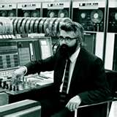

Arrays

Slide 5
Theory of arrays
Functions: Σ_{F} = { read, write }
Predicates: Σ_{P} = { = }
Convention a[i] means: read(a,i)
Non-extensional arrays T_{A}:
  ∀a, i, v . write(a,i,v)[i] = v
  ∀a, i, j, v . i ≠ j ⇒ write(a,i,v)[j] = a[j]
Extensional arrays: T_{EA} = T_{A} +
  ∀a, b. ((∀i. a[i] = b[i]) ⇒ a = b)

Slide 6
Array examples

Slide 7
Array examples
Is valid
Is unsat
Is unsat
(array
axiom)
Is unsat
(congruence)

Slide 8
Array examples
Is valid
Is unsat

Slide 9
Array examples
Is unsat
Array axiom

Slide 10
Array examples
Is unsat

Slide 11
Array examples
Case:

Slide 12
Array examples
Case:
Array axiom

Slide 13
Array examples
Case:

Slide 14
Array examples
Case:
Congruence

Slide 15
Array examples – a few steps
Case:

Slide 16
Array examples
Case:

Slide 17
Array examples
Case:
Extensionality

Slide 18
Array examples
Case:
Extensionality

Slide 19
Array examples
Case:
Skolemize

Slide 20
Array examples
Case:
Array axiom

Slide 21
Array examples
Case:

Slide 22
Decision procedures for arrays
Let L be literals over Σ_{F} = { read, write }
Find M such that: M ⊨_{TA} L
Basic algorithm, reduce to E:
  for every sub-term read(a,i), write(b,j,v) in L
    i ≠ j ∧ a = b ⇒ read(write(b,j,v),i) = read(a,i)
    read(write(b,j,v),j) = v
  Find M_{E}, such that
  M_{E} ⊨_{E} L ∧ AssertedAxioms

Slide 23
Decision procedures for arrays
Correctness of basic algorithm:
  M_{E} satisfies array axioms on terms in L.
  To show that M_{E} can be extended to model for arrays:
    From Congurence Closure C* build model:
      a^{M} = [| *_{d1} → *_{r1} , *_{d2} → *_{r2} , *_{d3} → .., else → v_{root(a)} |]
      Where read^{M}(a^{M}, *_{di} ) = *_{r1}
      e.g., *_{r1} = root(read(root(a),root(i)) under C*
    Model satisfies array axioms.
      For every write(a,i,v) the model satisfies write(a,i,v)[j] = a[j] whenever i^{M}≠ j^{M} (first axiom) and also write(a,i,v)[i] = v (second axiom).
      v_{root(a)} was added to make arrays different unless they were forced to be (no extensionality)

Slide 24
Non-extensionality
A non-theorem
a and b need not be equal even if the array axioms hold.

Slide 25
Extensional arrays
  To enforce:
  ∀a, b. ((∀i. a[i]= b[i]) ⇒ a = b)
For every pair a, b in L,
  Add fresh constant i_{ab}
  Add axiom a ≠ b ⇒ a[i_{ab}] ≠ b[i_{ab}]

Slide 26
Arrays galore
Arrays may be more than just read/write.
  The constant array:
  ∀v, i . const(v)[i] = v
  Generalized write:
  ∀a,b,c, i . a[i] = b[i] ⇒ write♣(a,b,c)[i] = c[i]
  ∀a,b,c, i . a[i] ≠ b[i] ⇒ write♣(a,b,c)[i] = b[i]
  We now have sets:
    ∅ = const(false), T = const(true),
    A ∪ B = write♣(∅,A,B)[i]
    A ∩ B = write♣(T,A,B)[i]
  Ranges:
    ∀l,u, x . range(l,u)[x] ⇔ l ≤ x ≤ u

Slide 27
Arrays galore
Claim: Same kind of reduction to E (and arithmetic) works
  Integer ranges, require slightly more
    ¬range(l,u)[l-1], ¬range(l,u)[u+1]
    range(l,u)[l], range(l,u)[u]
Is there a general principle underpinning such extensions?

Slide 28
Arrays galore
Consider a more general formulation.
  ϕ is a conjunction of:
    Equalities, disequalities
    ∀ i, j, k . G(i,j,k) ⇒ F(i,j,k)
      Where G is a guard formula comparing indices:
        And-or formula of i ≠ j, i ≠ c
        Claim: We can always eliminate i =j from the guard.
      Where F is a general formula with arrays,
      Restriction: no nested array formulas.
  Example:
    ∀ j . if i = j then b[i] = v else b[i] = a[i]
    Encodes that b = write(a,i,v)

Slide 29
Arrays galore
∀ i, j, k . G(i,j,k) ⇒ F(i,j,k)
  Where G is a guard formula comparing indices:
    And-or formula of i ≠ j, i ≠ c
    Claim: We can always eliminate i =j or i = c from the guard.
  ∀ i, j, k . i = j ∧ k ≠ c ∧ j ≠ c’ ⇒ F(i,j,k)
  ⇔ ∀ i, k . k ≠ c ∧ i ≠ c ⇒ F(i,i,k)

Slide 30
Arrays galore
∀ i, j, k . G(i,j,k) ⇒ F(i,j,k)
  Where G is a guard formula comparing indices:
    And-or formula of i ≠ j, i ≠ c
    Claim: We can always or from the guard
  ∀ i, j, k . G(i,j,k) ∨ G’(i,j,k) ⇒ F(i,j,k)
  ⇔ ∀ i, j, k . G(i,j,k) ⇒ F(i,j,k)
  ∧∀ i, j, k . G’(i,j,k) ⇒ F(i,j,k)

Slide 31
Arrays galore
∀ i, j, k . G(i,j,k) ⇒ F(i,j,k)
  Where G is conjunction of i ≠ j, i ≠ c
Decision procedure:
  Collect all c, where a[c] or c = i
  Instantiate quantifiers by all combinations of such indices.
  Check for E – satisfiability of ground formula.
Correctness: All quantified formulas are satisfied by C* .

Slide 32
Arrays galore - Arithmetic
∀ i, j, k . G(i,j,k) ⇒ F(i,j,k)
  Where G is conjunction of i < j, i < c, i > c
Decision procedure:
  Collect all c, where a[c], c < i , c > i occurs in formula.
  For each c, also add c-1, c+1 to collection.
  Instantiate quantifiers by all combinations of collected indices.
  Check for ILA + E – satisfiability of ground formula.

Slide 33
Other theories

Slide 34
Other theories common in program analysis
Bit-vectors
Algebraic data-types
Queues
Partial orders
Binary relations
Heaps (reachability)

Slide 35
Quantifiers and E-graph matching

Slide 36
Checking validity
Checking the validity of ϕ in a theory T:
  ϕ is T-valid
  ≡ T-unsat: ¬ϕ
  ≡ T-unsat: ∀x∃y∀z∃u . φ (prenex of ¬ϕ)
  ≡ T-unsat: ∀x∀z . φ[f(x),g(x,z)] (skolemize)
  ⇐ T-unsat: φ[f(a₁),g(a₁,b₁)] ∧ … (instantiate)
  ∧ φ[f(a_{n}),g(a_{n},b_{n})] (⇒ if compactness)
  ≡ T-unsat: φ₁ ∨ … ∨ φ_{m} (DNF)
  where each φ_{i} is a conjunction.

Slide 37
DPLL(QT) – cute quantifiers
We can use DPLL(T) for ϕ with quantifiers.
  Treat quantified sub-formulas as atomic predicates.
  In other words, if ∀x.ψ(x) is a sub-formula if ϕ, then introduce fresh p. Solve instead
  ϕ[∀x.ψ(x) ← p]

Slide 38
DPLL(QT)
Suppose DPLL(T) sets p to false
  ⇒ any model M for ϕ must satisfy:
  M ⊨ ¬ ∀x.ψ(x)
  ⇒ for some sk_{x}: M ⊨ ¬ ψ(sk_{x})
  In general: ⊨ ¬ p → ¬ ψ(sk_{x})

Slide 39
DPLL(QT)
Suppose DPLL(T) sets p to true
  ⇒ any model M for ϕ must satisfy:
  M ⊨ ∀x.ψ(x)
  ⇒ for every term t: M ⊨ ψ(t)
  In general: ⊨ p → ψ(t)
  For every term t.

Slide 40
DPLL(QT)
Summary of auxiliary axioms:
  ⊨ ¬ p → ¬ ψ(sk_{x}) For fixed, fresh sk_{x}
  ⊨ p → ψ(t) For every term t.
Which terms t to use for auxiliary axioms of the second kind?

Slide 41
DPLL(QT) with E-matching
  ⊨ p → ψ(t) For every term t.
Approach:
  Add patterns to quantifiers
  Search for instantiations in E-graph.
  ∀a,i,v { write(a,i,v) } . read(write(a,i,v),i) = v

Slide 42
DPLL(QT) with E-matching
  ⊨ p → ψ(t) For every term t.
Approach:
  Add patterns to quantifiers
  Search for pattern matches in E-graph.
  ∀a,i,v { write(a,i,v) } . read(write(a,i,v),i) = v
    Add equality every time there is a write(b,j,w) term in E.

Slide 43
DPLL(QT) with E-matching
Array example
  ∀a,i,v { write(a,i,v) } . write(a,i,v)[i] = v
  Add equality every time there is a write(b,j,w) term in E.
  ∀a,i,j,v { write(a,i,v)[j] } . i ≠ j → write(a,i,v)[j]=a[j]
  Add implication every time there is a read of a write.
  ∀a,i,j,v { write(a,i,v), a[j] } . i ≠ j → write(a,i,v)[j]=a[j]
  Add implication every time there is both a write and a read of a.

Slide 44
The E-matching problem
Input
  A set of ground equations E
  a ground term t and
  a pattern pat, with variables.
Output
  The set of substitutions θ modulo E over the variables in pat, such that
E ╞ t = θ(pat)

Slide 45
An E-matching Example
Given:
  ∀A,I,J,V { write(A,I,V), A[J] } . I ≠ J → write(A,I,V)[J]=A[J]
  E = { g(a) = f(b, c), b = d, a = c }
Match:
  E ╞ write(g(c),2,1) = θ(write(A,I,V)),
  f(d,a)[4] = θ(A[J])
  For θ = [ A → g(c), I → 2, V →1, J → 4 ]

Slide 46
An E-matching algorithm
Review: Standard matching
match(t, X, θ) = θ ∪ [ X → t] if X ∉dom(θ)
match(t, X, θ) = θ if θ(X) = t
match(t, X, θ) = fail if θ(X) ≠ t
match(t, t , θ) = θ
match( f(..), g(..), θ) = fail
match(f(t₁,..,t_{n}), f(pat₁,..,pat_{n}), θ) =
match(t₁,pat₁, … match(t_{n}, pat_{n},θ))

Slide 47
An E-matching algorithm
E-matching generalizes standard matching:
  Every term t can be congruent to a set of other terms class(t) = {t₁,..,t_{n}} in the E-graph.
  Each congruent term is tried.
  Terms are equal if they are in the same class.
    find(t) is the equivalence class root.
    t and t’ are equal if: find(t) = find(t’)

Slide 48
E-matching example
E-graph:
Term:
Pattern:

Slide 49
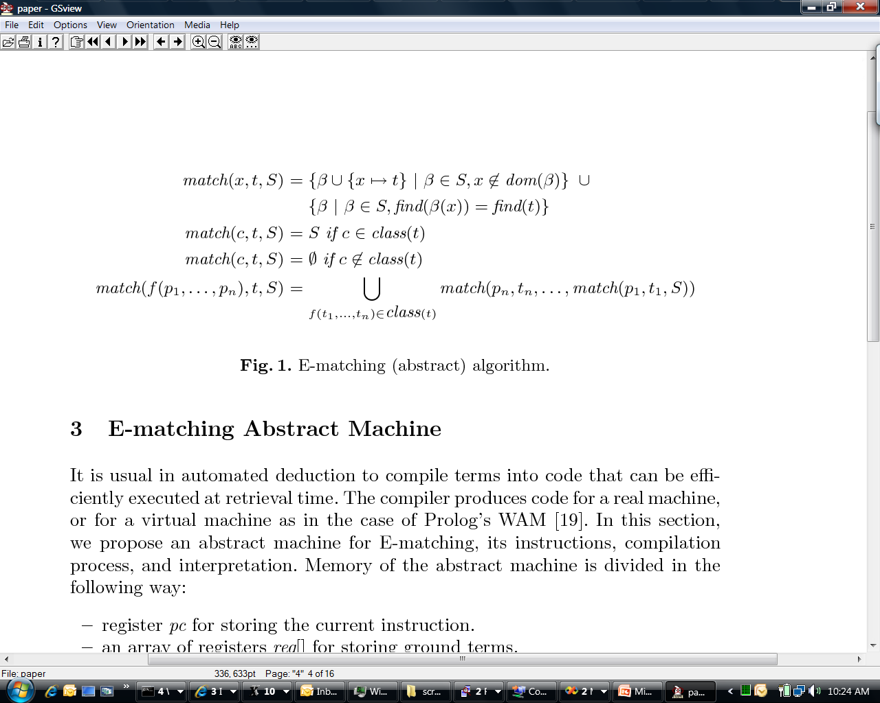
Abstract E-matching

Slide 50
The E-matching challenge
E-matching is in theory NP-hard
The real challenge is finding new matches
  Incrementally during a backtracking search
  In a large database of patterns, many sharing substantial structure
  [de Moura & Bjørner CADE 2007]

Slide 51
A more efficient approach
Match is invoked for every pattern in database.
To avoid common work:
  Compile set of patterns into instructions.
    By partial evaluation of naïve algorithm
  Instruction sequences share common sub-terms.
  Substitutions are stored in registers, backtracking just updates the registers.

Slide 52
Efficiency through Partial Evaluation
Pattern
Specialize
pat1: write(A,I,V)[I]
Instructions(pat1)
Term

Slide 53
Efficiency through Partial Evaluation
Pattern
Specialize
pat2: write(A,I,V)
Instructions(pat1)
Term
Term
Instructions(pat2)

Slide 54
Efficiency through Partial Evaluation
Pattern
Specialize
pat2: write(A,I,V)
Instructions(pat1+pat2)
Term

Slide 55
E-matching code-trees
Pattern f(x₁, g(x₁, a), h(x₂), b):
Instruction | f(h(a),g(h(c),a),h(c), b)
init(f) | reg[1] ← h(a), reg[2] ←g(h(c),a), reg[3] ← h(c), reg[4] ← b 
check(4, b) | reg[4] = b 
bind(2, g, 5) | reg[5] ← h(c), reg[6] ← a 
compare(1, 5) | h(a) = reg[1] ≠ reg[5] = h(c) 
Pc | Instructions
pc0 | init(f, pc1)
pc1 | check(4, b, pc2)
Pc2 | bind(2, g, 5, pc3)
Pc3 | compare(1, 5, pc4)
Pc4 | check(6, a, pc5)
Pc5 | bind(3, h, 7, pc6)
Pc6 | yield(1,7)

Slide 56
E-matching code-trees
Pattern f(x₁, g(x₁, a), h(x₂), b):
Instruction | f(h(a),g(h(a),a),h(c), b)
init(f) | reg[1] ← h(a), reg[2] ←g(h(a),a), reg[3] ← h(c), reg[4] ← b 
check(4, b) | reg[4] = b 
bind(2, g, 5) | reg[5] ← h(a), reg[6] ← a 
compare(1, 5) | h(a) = reg[1] =reg[5] = h(a) 
check(6, a) | a = reg[6] = a 
bind(3, h, 7) | reg[7] ← c 
yield(1,7) | X₁ → h(a), X₂ → c 
Pc | Instructions
pc0 | init(f, pc1)
pc1 | check(4, b, pc2)
Pc2 | bind(2, g, 5, pc3)
Pc3 | compare(1, 5, pc4)
Pc4 | check(6, a, pc5)
Pc5 | bind(3, h, 7, pc6)
Pc6 | yield(1,7)

Slide 57
Instructions
First execute init:
pc: init(f, pc’) - match term f(t₁,.. t_{n})
store t₁,.., t_{n} into reg[1],..,reg[n].
goto pc’
If pattern is a ground term:
pc: check(i, t, pc’) – check that reg[i] = t,
on success goto pc’
on failure goto backtrack
For repeated variables in pattern:
pc: compare(i, j, pc’) – check that reg[i] = reg[j],
on success goto pc’
on failure goto backtrack

Slide 58
Instructions
pc: bind(i, f, o, pc’) –
for each term f(t₁,.. t_{n}) in reg[i] do
store t₁,.., t_{n} into reg[o],..,reg[o+n-1].
goto pc’
pc: choose(pc’’,pc’) -
first go to pc’ and perform matching
then go to pc’’ and perform matching
pc: yield(i₁,…,i_{k}) –
produce substitution x₁ →reg[x₁],.., x_{k} →reg[i_{k}]

Slide 59
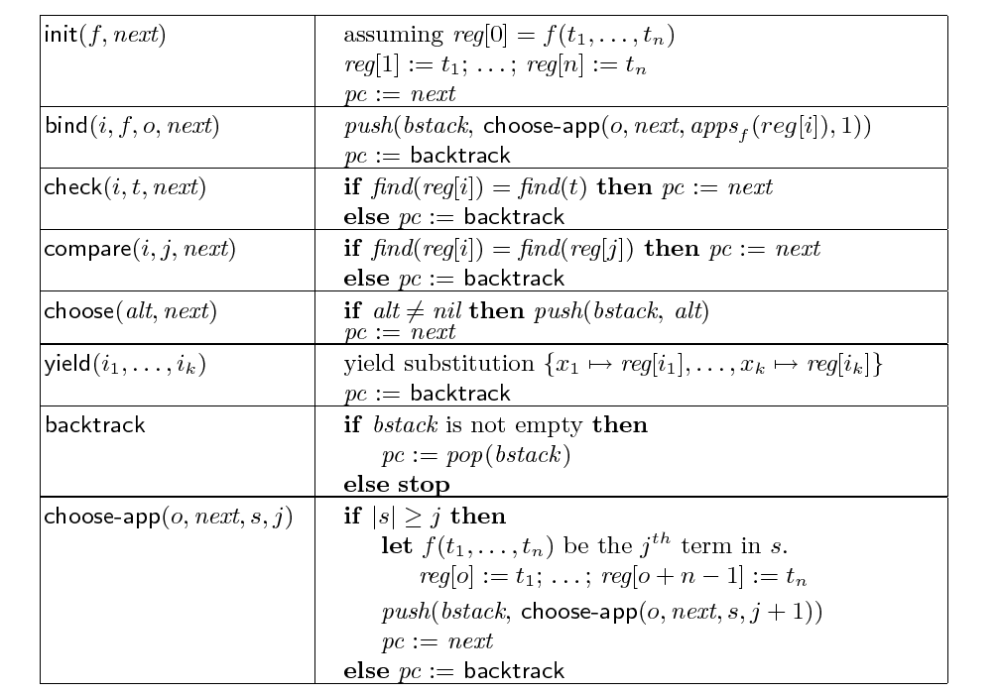
The E-matching abstract machine

Slide 60
Additional instructions
Forward pruning
  Prune exponential search early on
    f(g(x,y), h(x,z)) – first check that t₁ = g(…) and t₂ = h(…) when matching f(t₁, t₂)
Multi-patterns
  Continue
  Join = continue + compare

Slide 61
Incremental matching
5 = read(b, 2) E₁ = { {5, read(b,2)} , {b} }
c = write(a, 2, 4) E₂ = E₁ ∪ { {c, write(a,2,4) }
b = c E₃ = { {b, c, write(a,2,4)},
{5, read(b,2)} }
E₃ ╞ 5 = read(b,2) = read(write(a,2,4),2)
Observation: pattern read(write(x, i, v), i) gets enabled when child of read is merged with term labeled by write.

Slide 62
Inverted path indices
Index all patterns with f(…g(…)…) sub-term, that may become enabled when
merge(n₁, n₂) where
∃ parent p₁ of n₁ . Label(p₁) = f(…n₁…)
∃ sibling m₂ of n₂ . Label(m₂) = g(…)
Pattern id | pattern | Path to g under f | Inverted paths
p1 | f(f( g(x) ,a),x) | p1 → g: f.1.f.1 | (f,g): f.1.f.1 → p1
p2 | h(c, f( g(y) , x)) | p2 → g: h.2.f.1 | (f,g): f.1.h.2 → p2
p3 | f(f( g(x) ,b),y) | p3 → g: f.1.f.1 | (f,g): f.1.f.1 → p3
p4 | f(f(a, g(x) ), g(y) ) | p4 → g: f.1.f.2, f.2 | (f,g): f.2.f.1 → p4, (f,g): f.2→ p4

Slide 63
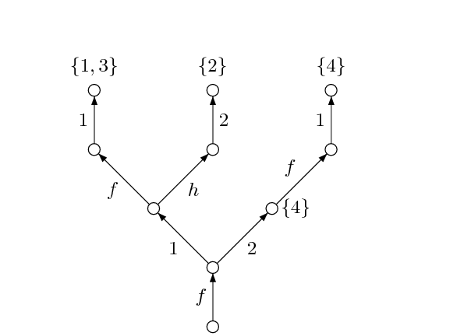
Inverted path index

Slide 64
When to apply E-matching
Lazy Instantiation:
  Have SAT core assign all Boolean variables.
  Then find new quantifier instantiations.
  Useful if most instantiations are useless and explode the search space.
Eager Instantiation:
  Find new quantifier instantiations whenever new terms are created and new equalities are asserted.
  Useful if instantiations help pruning the search space.
Hybrid:
  Uses scoring on useful quantifiers to promote/demote instantiation time.

Slide 65
E-matching limitations
E-matching needs ground (seed) terms.
It fails to prove simple properties when ground (seed) terms are not available.
Example:
(∀x . f(x) ≤ 0) ∧ (∀x . f(x) > 0)
Matching loops:
(∀x . f(x) = g(f(x))) ∧ (∀x . g(x) = f(g(x)))
Inefficiency and/or non-termination.
Some solvers have support for detecting matching loops based on instantiation chain length.
Our technology for inferring patterns is weak. Strong reliance on (Spec#/Boogie) compiler or theory supplied patterns.

Slide 66
Conclusions
Matching-time significantly reduced for DPLL(T) search when using E-matching code trees and inverted path indices.
Inverted path indices: Pay for what you use, not for what you might.
Lazy vs. Eager depends on quality of patterns.

Slide 67
Conclusions
DPLL(QT) is (blatantly) incomplete.
  E-matching is a heuristic.
  Saturation calculi offer a strong (and in principle complete) alternative.
  Plug: Engineering DPLL(T) + Saturation.
  [de Moura & Bjørner IJCAR 2008]

Slide 68
Symbolic Reasoning - complexity
Undecidable
(First-order logic)
NEXPTime-complete
(EPR)
PSpace-complete
(QBF)
NP-complete
(Propositional logic)
P-time
(Equality)
Notes:
All these applications require symbolic reasoning, software verification needs massive case analysis.
Symbolic reasoning have high computational complexity.
This is the worst case complexity of each of one of these problems. They are all supported in Z3.
In practice, a smart implementation can avoid the worst case and scale.
Some of the tools described in the previous slide used ad-hoc solutions that did not scale.
Example of naïve solution: truth table

Slide 69
Reading material

Slide 70
Books
Bradley & Manna: The Calculus of Computation
Kroening & Strichman: Decision Procedures An Algorithmic Point of View

Slide 71
Web links
Http://research.microsoft.com/projects/z3
http://smt-lib.org
http://wiki.org/smt
Some SMT solvers:
Barcelogic, CVC3, Mathsat, Yices

Slide 72
Reading material
[Ack54] W. Ackermann. Solvable cases of the decision problem. Studies in Logic and the Foundation of
Mathematics, 1954
[ABC+02] G. Audemard, P. Bertoli, A. Cimatti, A. Kornilowicz, and R. Sebastiani. A SAT based approach
for solving formulas over boolean and linear mathematical propositions. In Proc. of CADE’02, 2002
[BDS00] C. Barrett, D. Dill, and A. Stump. A framework for cooperating decision procedures. In 17th
International Conference on Computer-Aided Deduction, volume 1831 of Lecture Notes in Artificial
Intelligence, pages 79–97. Springer-Verlag, 2000
[BdMS05] C. Barrett, L. de Moura, and A. Stump. SMT-COMP: Satisfiability Modulo Theories Competition.
In Int. Conference on Computer Aided Verification (CAV’05), pages 20–23. Springer, 2005
[BDS02] C. Barrett, D. Dill, and A. Stump. Checking satisfiability of first-order formulas by incremental
translation to SAT. In Ed Brinksma and Kim Guldstrand Larsen, editors, Proceedings of the 14th
International Conference on Computer Aided Verification (CAV ’02), volume 2404 of Lecture Notes in
Computer Science, pages 236–249. Springer-Verlag, July 2002. Copenhagen, Denmark
[BBC+05] M. Bozzano, R. Bruttomesso, A. Cimatti, T. Junttila, P. van Rossum, S. Ranise, and
R. Sebastiani. Efficient satisfiability modulo theories via delayed theory combination. In Int. Conf. on
Computer-Aided Verification (CAV), volume 3576 of LNCS. Springer, 2005
[Chv83] V. Chvatal. Linear Programming. W. H. Freeman, 1983

Slide 73
Reading material
[CG96] B. Cherkassky and A. Goldberg. Negative-cycle detection algorithms. In European Symposium on
Algorithms, pages 349–363, 1996
[DLL62] M. Davis, G. Logemann, and D. Loveland. A machine program for theorem proving.
Communications of the ACM, 5(7):394–397, July 1962
[DNS03] D. Detlefs, G. Nelson, and J. B. Saxe. Simplify: A theorem prover for program checking. Technical
Report HPL-2003-148, HP Labs, 2003
[DST80] P. J. Downey, R. Sethi, and R. E. Tarjan. Variations on the Common Subexpression Problem.
Journal of the Association for Computing Machinery, 27(4):758–771, 1980
[dMR02] L. de Moura and H. Rueß. Lemmas on demand for satisfiability solvers. In Proceedings of the
Fifth International Symposium on the Theory and Applications of Satisfiability Testing (SAT 2002).
Cincinnati, Ohio, 2002
[dMB07] L. de Moura and N. Bjørner. Model-based Theory Combination (SMT 2007)
[dMB07] L. de Moura and N. Bjørner. Efficient E-matching for SMT solvers (CADE 2007)
[dMB08] L. de Moura and N. Bjørner. Z3: An Efficient SMT Solver (TACAS 2008)
[DdM06] B. Dutertre and L. de Moura. Integrating simplex with DPLL(T). Technical report, CSL, SRI
International, 2006
[GHN+04] H. Ganzinger, G. Hagen, R. Nieuwenhuis, A. Oliveras, and C. Tinelli. DPLL(T): Fast decision
procedures. In R. Alur and D. Peled, editors, Int. Conference on Computer Aided Verification (CAV
04), volume 3114 of LNCS, pages 175–188. Springer, 2004

Slide 74
Reading material
[MSS96] J. Marques-Silva and K. A. Sakallah. GRASP - A New Search Algorithm for Satisfiability. In Proc.
of ICCAD’96, 1996
[NO79] G. Nelson and D. C. Oppen. Simplification by cooperating decision procedures. ACM Transactions
on Programming Languages and Systems, 1(2):245–257, 1979
[NO05] R. Nieuwenhuis and A. Oliveras. DPLL(T) with exhaustive theory propagation and its application to
difference logic. In Int. Conference on Computer Aided Verification (CAV’05), pages 321–334.
Springer, 2005
[Opp80] D. Oppen. Reasoning about recursively defined data structures. J. ACM, 27(3):403–411, 1980
[PRSS99] A. Pnueli, Y. Rodeh, O. Shtrichman, and M. Siegel. Deciding equality formulas by small
domains instantiations. Lecture Notes in Computer Science, 1633:455–469, 1999
[Pug92] William Pugh. The Omega test: a fast and practical integer programming algorithm for
dependence analysis. In Communications of the ACM, volume 8, pages 102–114, August 1992
[RT03] S. Ranise and C. Tinelli. The smt-lib format: An initial proposal. In Proceedings of the 1st
International Workshop on Pragmatics of Decision Procedures in Automated Reasoning
(PDPAR’03), Miami, Florida, pages 94–111, 2003

Slide 75
Reading material
[RS01] H. Ruess and N. Shankar. Deconstructing shostak. In 16th Annual IEEE Symposium on Logic in
Computer Science, pages 19–28, June 2001
[SLB03] S. Seshia, S. Lahiri, and R. Bryant. A hybrid SAT-based decision procedure for separation logic
with uninterpreted functions. In Proc. 40th Design Automation Conference, pages 425–430. ACM
Press, 2003
[Sho81] R. Shostak. Deciding linear inequalities by computing loop residues. Journal of the ACM,
28(4):769–779, October 1981

