Slide 1

Engineering Satisfiability Modulo Theories Solvers for Intractable Problems
Nikolaj Bjørner
Microsoft Research
Tractability Workshop – MSR Cambridge July 5,6 2010
FSE &

Slide 2
This talk
Z3 – An Efficient SMT solver:
Overview and Applications.
A “hands on” example of Engineering SMT solvers:
Efficient Theory Resolution using DPLL(T).

Slide 3





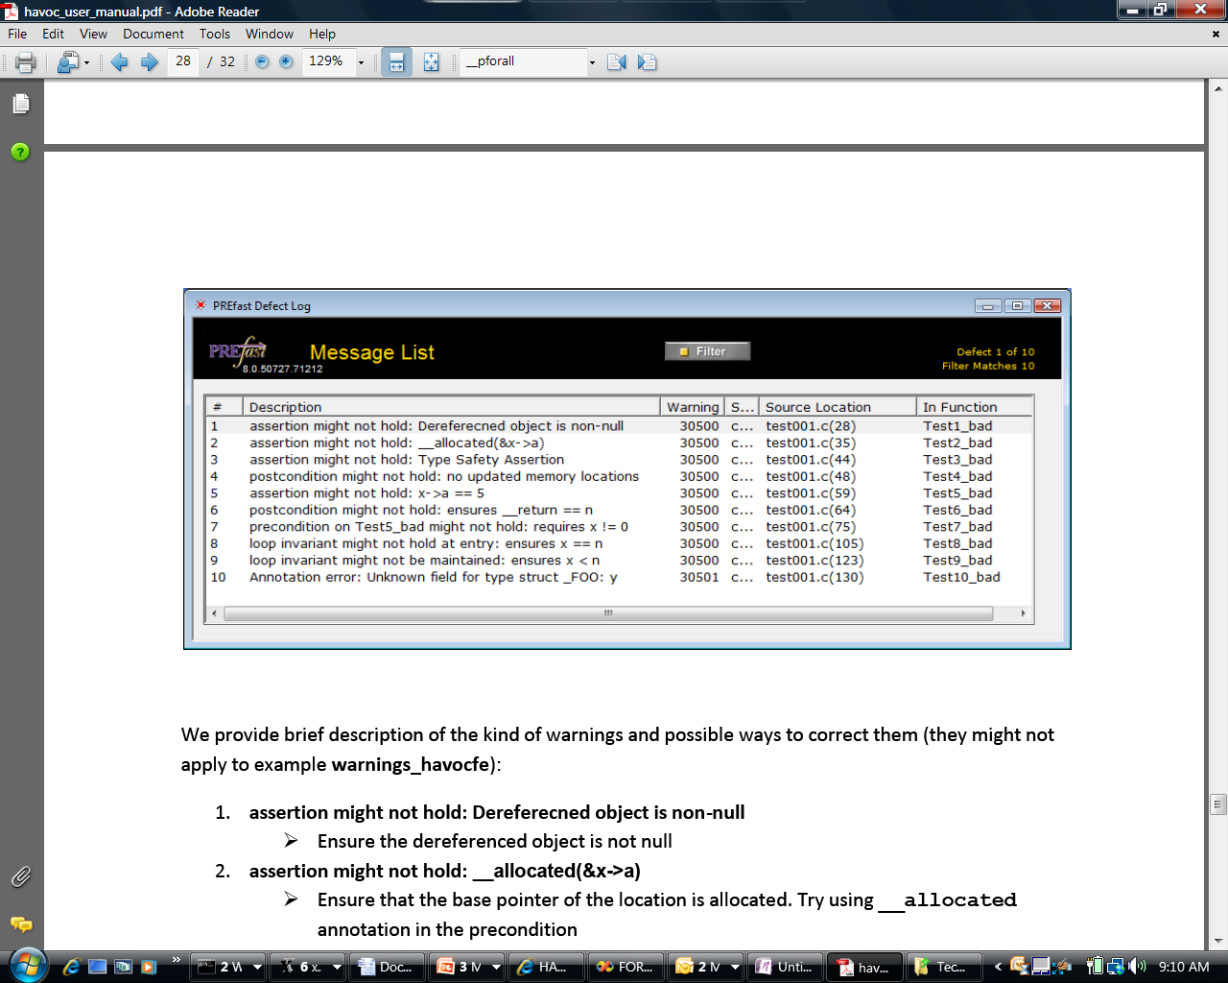

Some Microsoft Engines using Z3
SDV: The Static Driver Verifier
PREfix: The Static Analysis Engine for C/C++.
Pex: Program EXploration for .NET.
SAGE: Scalable Automated Guided Execution
Spec#: C# + contracts
VCC: Verifying C Compiler for the Viridian Hyper-Visor
HAVOC: Heap-Aware Verification of C-code.
SpecExplorer: Model-based testing of protocol specs.
Yogi: Dynamic symbolic execution + abstraction.
FORMULA: Model-based Design
F7: Refinement types for security protocols
M3: Model Program Modeling
VS3: Abstract interpretation and Synthesis
VERVE: Verified operating system
FINE: Proof carrying certified code
Hyper-V

Slide 4
SAGE by the numbers
Slide shamelessly stolen and adapted from [Patrice Godefroid, ISSTA 2010]
100+ CPU-years - largest dedicated fuzz lab in the world
100s apps - fuzzed using SAGE
100s previously unknown bugs found
1,000,000,000+ computers updated with bug fixes
Millions of $ saved for Users and Microsoft
10s of related tools (incl. Pex), 100s DART citations
100,000,000+ constraints - largest usage for any SMT solver

Slide 5
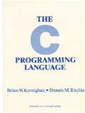
PREfix [Moy, B., Sielaff]
-INT_MIN= INT_MIN
3(INT_MAX+1)/4 +
(INT_MAX+1)/4
= INT_MIN
int binary_search(int[] arr, int low,
int high, int key)
while (low <= high)
{
// Find middle value
int mid = (low + high) / 2;
int val = arr[mid];
if (val == key) return mid;
if (val < key) low = mid+1;
else high = mid-1;
}
return -1;
}
void itoa(int n, char* s) {
if (n < 0) {
*s++ = ‘-’;
n = -n;
}
// Add digits to s
….
Package: java.util.Arrays
Function: binary_search
Book: Kernighan and Ritchie
Function: itoa (integer to ascii)

Slide 6
Example: an overflowed allocation size
Overflow check
ULONG AllocationSize;
while (CurrentBuffer != NULL) {
if (NumberOfBuffers > MAX_ULONG / sizeof(MYBUFFER)) { return NULL;
}
NumberOfBuffers++;
CurrentBuffer = CurrentBuffer->NextBuffer;
}
AllocationSize = sizeof(MYBUFFER)*NumberOfBuffers;
UserBuffersHead = malloc(AllocationSize);
Increment and exit from loop
Possible overflow
…
Overflow((nb+1)*sizeof(MYBUFFER))
CurrentBuffer == NULL
nb <= MAX_ULONG/sizeof(MYBUFFER)
Bug is simple and local
within a large program

Slide 7

Building Verve
9 person-months
Source file
Kernel.cs
Verification tool
Compilation tool
C# compiler
Verified
Nucleus.bpl (x86)
Kernel.obj (x86)
Boogie/Z3
TAL checker
Translator/
Assembler
Linker/ISO generator
Verve.iso
Notes:
In additions to the Nucleus we have the kernel and applications in C#, which we compiled to typed assembly using Bartok. We check this using the Tal checker.
The C# code is untrusted: we do not have to trust its correctness because any C# code that runs goes through the TAL checker.
To create the bootable CD-ROM image, we translate and assembly the Nucleus and link it with the kernel.
Other than the trusted specification, all other instructions in the system have been verified.
TRANSITION: Now we will show that we have indeed built a real system using a scalable approach.

Slide 8
What is Satisfiability Modulo Theories?
Array Theory
Arithmetic
Uninterpreted Functions

Slide 9

What is Z3?
Simplify
Theory Solvers
OCaml
Bit-Vectors
Arrays
SMT-LIB
.NET
Lin-arithmetic
Groebner basis
Recursive Datatypes
Comb. Array Logic
C
Native
Free (uninterpreted) functions
F# quote
SAT core
Model Generation:
Finite Models
Quantifiers:
Super-position
Proof objects
Quantifiers:
E-matching
Parallel Z3
Cores: Assumption tracking
By Leonardo de Moura & Nikolaj Bjørner http://research.microsoft.com/projects/z3

Slide 10
Tractability and Applications
Constraints from Software
Applications are
in spite of
Constraint language highly intractable
Algorithms high worst case complexity
Tractable

Slide 11
VCC Performance Trends Nov 08 – Mar 09
Modification in invariant checking
Switch to Z3 v2
Z3 v2 update
Attempt to improve Boogie/Z3 interaction
Switch to Boogie2

Slide 12

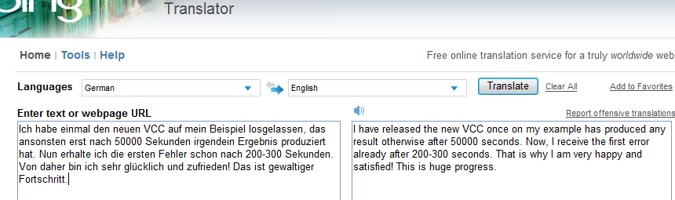
The Importance of Speed

Slide 13
Tractability and Applications
Constraint languages highly intractable
Algorithms high worst case complexity
Undecidable
(FOL + LA)
Semi-decidable
(First-order logic)
NEXPTime-complete
(EPR)
PSpace-complete
(QBF)
NP-complete
(Propositional logic)
P-time
(Equality)

Slide 14
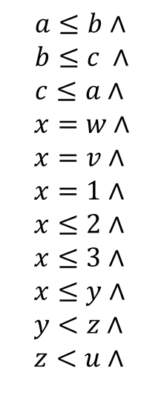
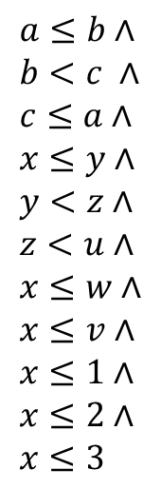

Tractability and Applications
Constraints from Software
Applications are Tractable
$$a≤b∧ \\ b<c ∧ \\ c≤a∧ \\ x≤y∧ \\ y<z∧ \\ z<u∧ \\ x≤w∧ \\ x≤v∧ \\ x≤1∧ \\ x≤2∧ \\ x≤3$$
$$a≤b∧ \\ b≤c ∧ \\ c≤a∧$$
$$x=w∧ \\ x=v∧ \\ x=1∧ \\ x≤2∧ \\ x≤3∧ \\ x≤y∧ \\ y<z∧ \\ z<u∧$$
Unsat
a = b = c
x, v, w = 1
x = 1 $≤$2,3
y,z,u “free”
Proofs are small
Models are determined or free

Slide 15
Tractability and Applications
What is then important for engineering solvers?
Solve tractable parts - efficient theory solvers
Strong Simplification - reduce the clutter
Efficient Indexing - minimize & reuse work
Avoid getting stuck - restarts, parallel search

Slide 16
Tractability and Applications
What is then important for engineering solvers?
Solve tractable parts - efficient theory solvers
Strong Simplification - reduce the clutter
Efficient Indexing - minimize & reuse work
Avoid getting stuck - restarts, parallel search
[Efficient, Generalized Array Decision Procedures de Moura & B]
[Z3 An Efficient SMT Solver de Moura & B]
[Efficient E-matching de Moura & B]
[Parallel Portfolio, Wintersteiger, Hamadi & de Moura]

Slide 17
Tractability and Applications
Constraints from Software
Applications are Tractable
Problem solved, end of talk

Slide 18
Tractability and Applications
Constraints from Software
Applications are Tractable
sometimes quite intractable for
existing techniques

Slide 19
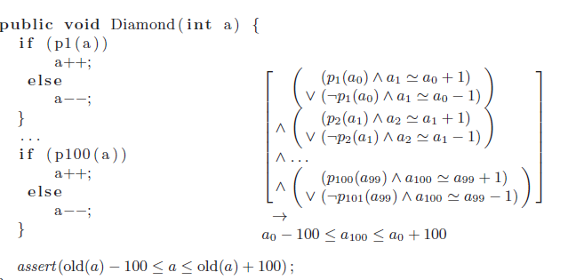
Symptom of a problem
Poses a challenge to Z3

Slide 20
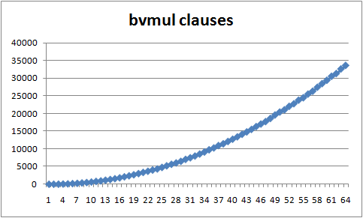
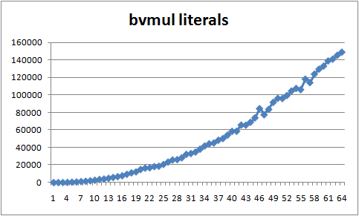
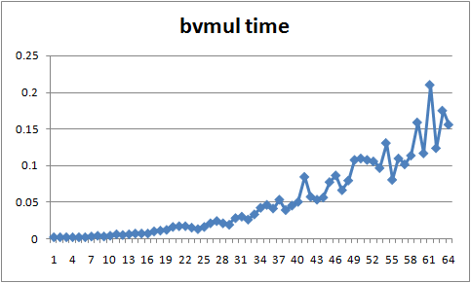

Another challenge
Bit-vector multiplication using SAT
a₀∧b₃
a₀∧b₂
a₀∧b₁
a₀∧b₀
O(n²) clauses
SAT solving time increases exponentially. Similar for BDDs.
[Bryant, MC25, 08]
Brute-force enumeration + evaluation faster for 20 bits.
[Matthews, BPR 08]
HA
a₁∧b₂
HA
a₁∧b₁
HA
a₁∧b₀
FA
a₂∧b₁
FA
a₂∧b₀
FA
a₃∧b₀
out₃
out₂
out₁
out₀
$${{out}_{\left[N\right]}=a}_{\left[N\right]} ∗b_{\left[N\right]}$$

Slide 21
A Framework and its limitations
DPLL(T) is Z3’s main core search framework
  Efficient SAT technologies
    DPLL + CDCL + Restart = Space Efficient Resolution
  Efficient integration of incremental theory solvers
    Theory lemmas (T-Conflicts)
    Theory propagation (T-Propagation)
  But we claim
    Contemporary DPLL(T) < Resolution

Slide 22
A Framework and its limitations
  But … DPLL(T) < Resolution
  Possible remedies:
  - Forget DPLL(T). Use other core engine.
  - Adapt DPLL(T). Elaboration here. We call it:
    Conflict Directed Theory Resolution

Slide 23






Review: SAT made “tractable”
Resolve
Learn $¬q$
Conflict
Conflict
$$¬p∨¬q, p∨¬q, ¬p∨q, p∨q$$
Propagate $¬p$
Backjump
$$¬q$$
$$q$$
Propagate $¬q$
Guess q
$$⊥⊥$$

Slide 24
Review: SAT made “tractable”
Abstract DPLL
  A convenient way to summarize DPLL
$$p, ¬q | ¬p∨¬q, p∨¬q, ¬p∨q, p∨q$$
M
A partial model
Set of clauses

Slide 25
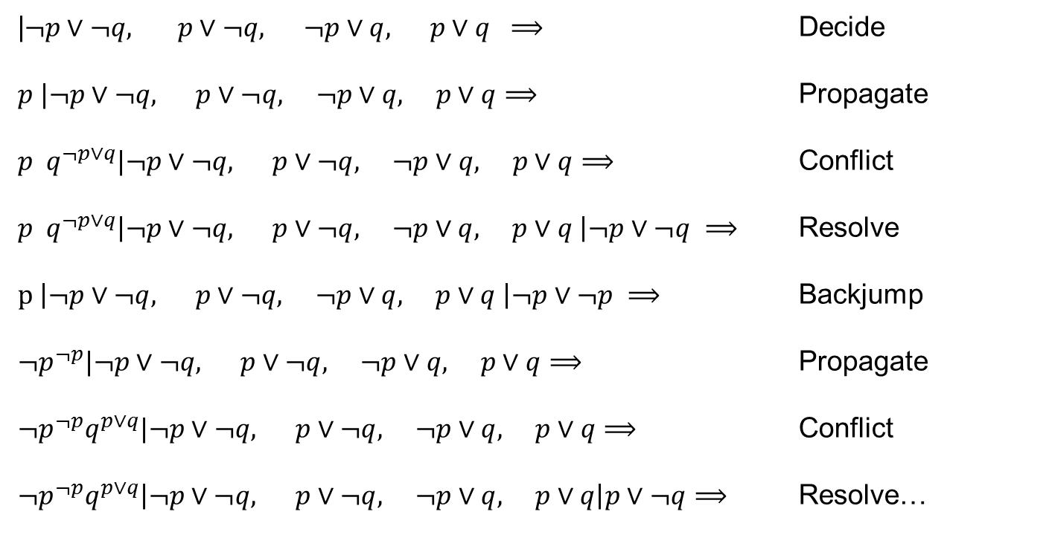
Review: SAT made “tractable”
|$¬p∨¬q, p∨¬q, ¬p∨q, p∨q ⟹$ Decide
$p |¬p∨¬q, p∨¬q, ¬p∨q, p∨q⟹$ Propagate
${p q}^{¬p∨q}|¬p∨¬q, p∨¬q, ¬p∨q, p∨q⟹$ Conflict
${p q}^{¬p∨q}\left|¬p∨¬q, p∨¬q, ¬p∨q, p∨q \right|¬p∨¬q ⟹$ Resolve
$p \left|¬p∨¬q, p∨¬q, ¬p∨q, p∨q \right|¬p∨¬p ⟹$ Backjump
$¬p^{¬p}|¬p∨¬q, p∨¬q, ¬p∨q, p∨q⟹$ Propagate
$¬p^{¬p}q^{p∨q}|¬p∨¬q, p∨¬q, ¬p∨q, p∨q⟹$ Conflict
$¬p^{¬p}q^{p∨q}\left|¬p∨¬q, p∨¬q, ¬p∨q, p∨q\right|p∨¬q⟹$ Resolve…

Slide 26
Review: SAT made “tractable”
Builds resolution proof
  General Resolution ≡ DPLL + CDCL + Restart
  (CDCL: Conflict Directed Clause Learning)
Space Efficient
  DPLL does not create intermediary clauses
Efficient indexing and heuristics
  2-watch literals, Restarts, phase selection, clause minimization

Slide 27
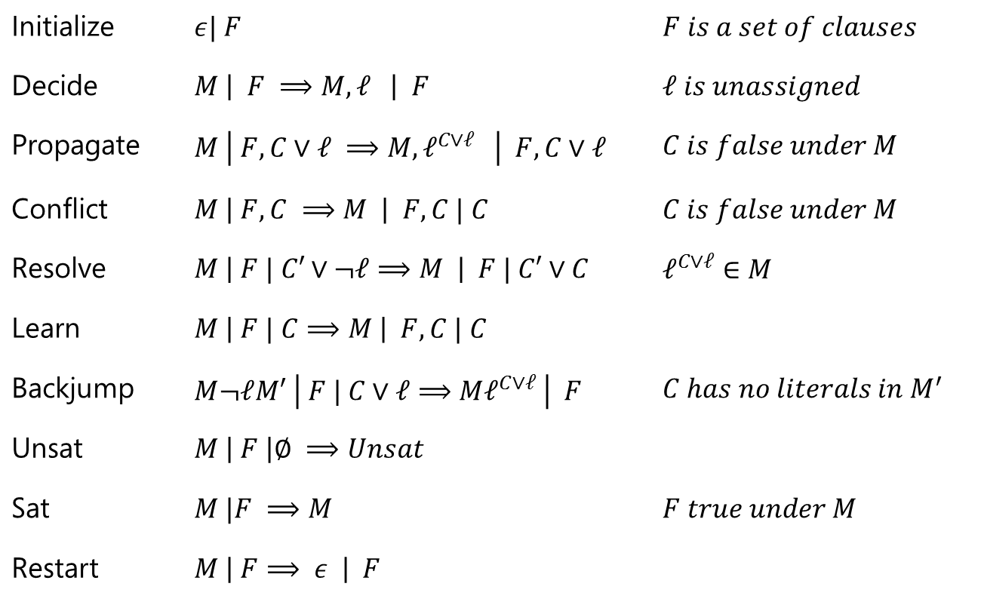
Review: Modern DPLL in a nutshell
Initialize | $ε| F$ | $F is a set of clauses$
Decide | $M \left| F ⟹M, ℓ \right| F$ | $ℓ is unassigned$
Propagate | $M \left| F, C∨ℓ ⟹M, ℓ^{C∨ℓ} \right| F,C∨ℓ$ | $C is false under M$
Conflict | $M \left| F, C ⟹M \right| F,C | C$ | $C is false under M$
Resolve | $M \left| F | C′∨¬ℓ⟹M \right| F | C′∨C$ | $ℓ^{C∨ℓ}∈M$
Learn | $M \left| F | C⟹M \right| F, C | C$
Backjump | $M¬ℓM′ \left| F | C∨ℓ⟹Mℓ^{C∨ℓ} \right| F$ | ${C has no literals in M}^{′}$
Unsat | $M \left| F \right|∅ ⟹Unsat$
Sat | $M |F ⟹M$ | $F true under M$
Restart | $M \left| F⟹ ε \right| F$
Adapted and modified from [Nieuwenhuis, Oliveras, Tinelli J.ACM 06]

Slide 28
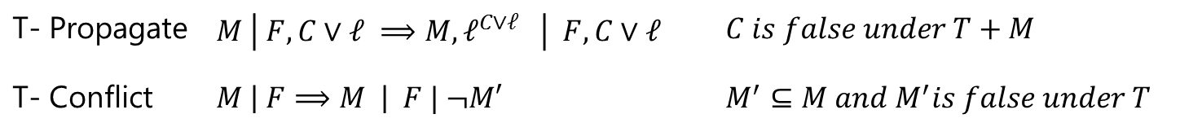
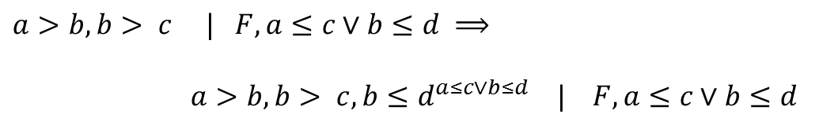

DPLL(T) in a nutshell
T- Propagate | $M \left| F, C∨ℓ ⟹M, ℓ^{C∨ℓ} \right| F,C∨ℓ$ | $C is false under T+M$
T- Conflict | $M \left| F⟹M \right| F | ¬M′$ | $M^{′}⊆M and M^{′}is false under T$
T- Propagate
$a>b, b> c | F, a≤c∨b≤d ⟹$
$a>b, b> c, b≤d^{a≤c∨b≤d} | F, a≤c∨b≤d$
T- Conflict
$M | F⟹$ $M | F, a≤b∨b≤c∨c<a$
$$where a>b, b> c, a≤c⊆M$$
Introduces no new literals - terminates

Slide 29
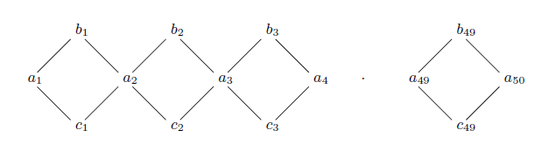
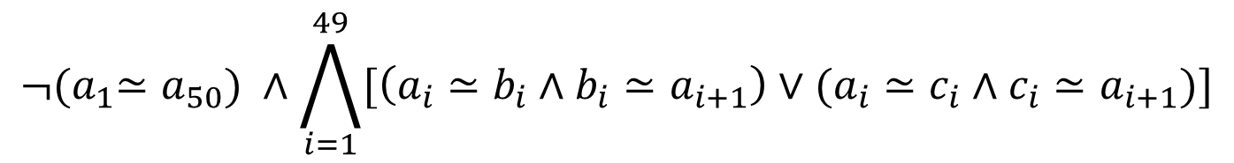
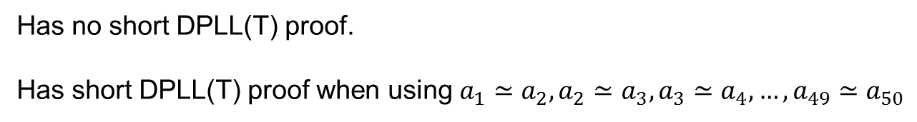
DPLL(T) misses short proofs
The Black Diamonds of DPLL(T)
$${¬(a}_{1}≃a_{50}) ∧\bigwedge_{i=1}^{49}{[\left(a_{i}≃b_{i}∧b_{i}≃a_{i+1}\right)∨(a_{i}≃c_{i}∧c_{i}≃a_{i+1})]}$$
Has no short DPLL(T) proof.
Has short DPLL(T) proof when using $a_{1}≃a_{2}, a_{2}≃a_{3},a_{3}≃a_{4},…, a_{49}≃a_{50}$
Example from [Rozanov, Strichman, SMT 07]

Slide 30
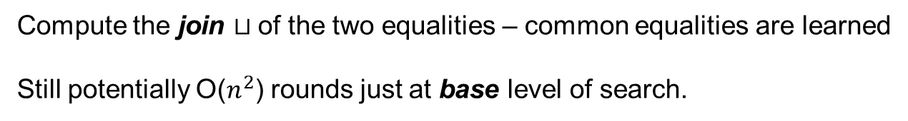
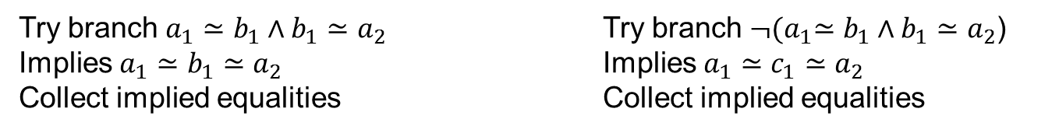
DPLL(T) misses short proofs
Idea: DPLL($⊔$) [B, Dutertre, de Moura 08]
Try branch $a_{1}≃b_{1}∧b_{1}≃a_{2}$ Try branch ${¬(a}_{1}≃b_{1}∧b_{1}≃a_{2}$)
Implies $a_{1}≃b_{1}≃a_{2}$ Implies $a_{1}≃c_{1}≃a_{2}$
Collect implied equalities Collect implied equalities
Compute the join $⊔$of the two equalities – common equalities are learned
Still potentially O($n^{2}$) rounds just at base level of search.

Slide 31
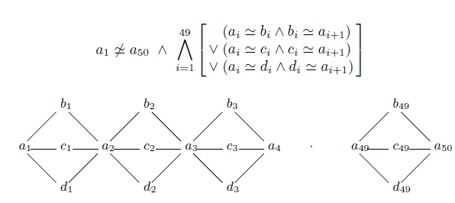

DPLL($⊔base$) misses short proofs
Single case splits don’t suffice
Requires 2 case splits to collect implied equalities

Slide 32

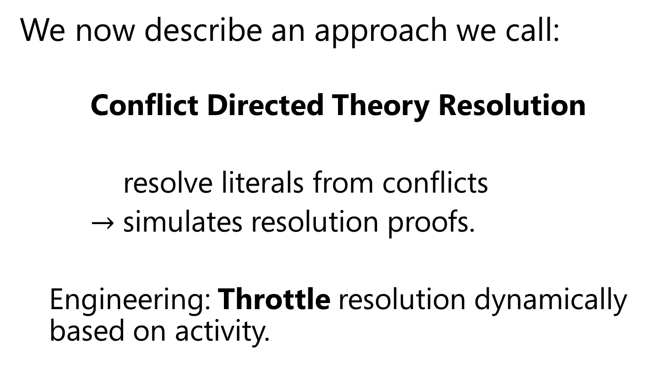
Conflict Directed Theory Resolution
We now describe an approach we call:
  Conflict Directed Theory Resolution
  resolve literals from conflicts
  $→$ simulates resolution proofs.
  Engineering: Throttle resolution dynamically based on activity.

Slide 33

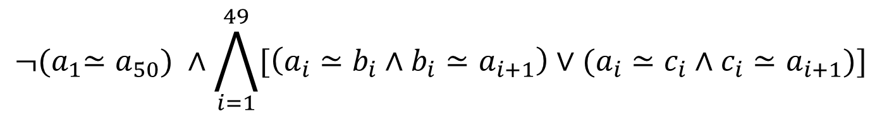
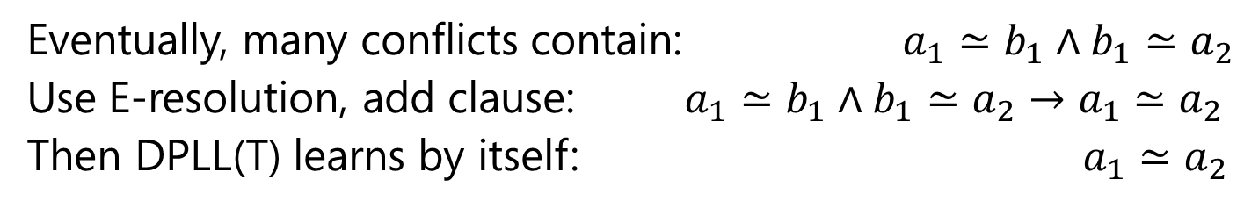
Th(Equality) - Example
$${¬(a}_{1}≃a_{50}) ∧\bigwedge_{i=1}^{49}{[\left(a_{i}≃b_{i}∧b_{i}≃a_{i+1}\right)∨(a_{i}≃c_{i}∧c_{i}≃a_{i+1})]}$$
Eventually, many conflicts contain: $a_{1}≃b_{1}∧b_{1}≃a_{2}$
Use E-resolution, add clause: $a_{1}≃b_{1}∧b_{1}≃a_{2}→a_{1}≃a_{2}$
Then DPLL(T) learns by itself: $a_{1}≃a_{2}$

Slide 34
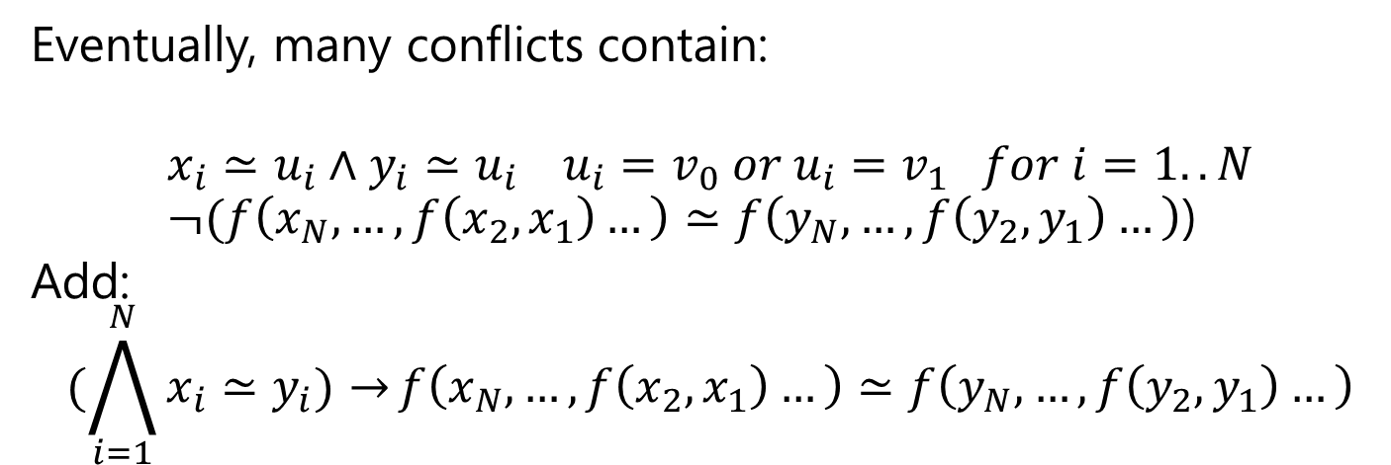
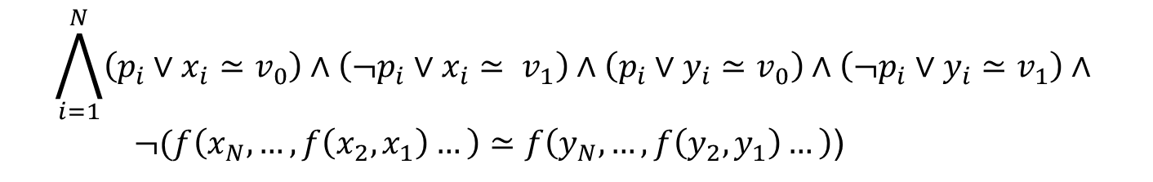
Th(Equality) - Example
$$\bigwedge_{i=1}^{N}{\left(p_{i}∨x_{i}≃v_{0}\right)∧\left(¬p_{i}∨x_{i}≃ v_{1}\right)∧\left(p_{i}∨y_{i}≃v_{0}\right)∧\left(¬p_{i}∨y_{i}≃v_{1}\right)∧ }$$
$¬(f\left(x_{N},…, f\left(x_{2},x_{1}\right)…\right)≃f\left(y_{N}, …, f\left(y_{2},y_{1}\right)…\right)$)
Eventually, many conflicts contain:
$$x_{i}≃u_{i}∧y_{i}≃u_{i} u_{i}=v_{0} or u_{i}=v_{1} for i=1..N \\ ¬(f\left(x_{N},…, f\left(x_{2},x_{1}\right)…\right)≃f\left(y_{N}, …, f\left(y_{2},y_{1}\right)…\right)\text{)}$$
Add:
$$(\bigwedge_{i=1}^{N}{x_{i}≃y_{i})→}f\left(x_{N},…, f\left(x_{2},x_{1}\right)…\right)≃f\left(y_{N}, …, f\left(y_{2},y_{1}\right)…\right)$$

Slide 35
Deciding Th(Equality)
a = f(f(a)), a = f(f(f(a))), a ≠ f(a)
First Step: “Naming” subterms

Slide 36
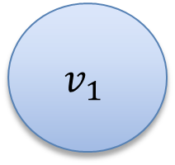
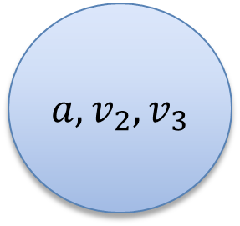
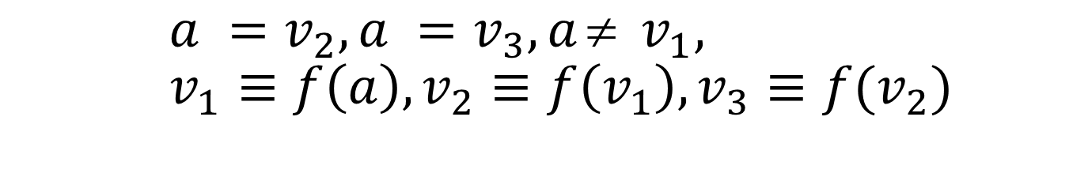
Deciding Th(Equality)
$$a =v_{2}, a =v_{3}, a ≠ v_{1}, \\ v_{1}≡f\left(a\right), v_{2}≡f\left(v_{1}\right), v_{3}≡f(v_{2})$$
… and merge equalities
$a, v_{2}, v_{3}$
$$v_{1}$$

Slide 37
Deciding Th(Equality)
$$a =v_{2}, a =v_{3}, a ≠ v_{1}, \\ v_{1}≡f\left(a\right), v_{2}≡f\left(v_{1}\right), v_{3}≡f(v_{2})$$
Second step. Apply Congruence Rule:
x₁ = y₁, …, x_{n} = y_{n} implies f(x₁, …, x_{n}) = f(y₁, …, y_{n})
$a, v_{2}, v_{3}$
$$v_{1}$$

Slide 38
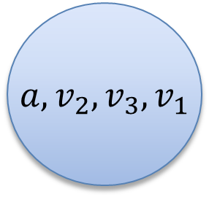
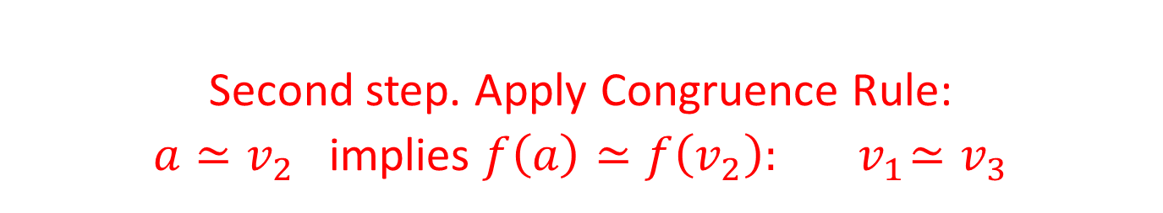
Deciding Th(Equality)
$$a =v_{2}, a =v_{3}, a ≠ v_{1}, \\ v_{1}≡f\left(a\right), v_{2}≡f\left(v_{1}\right), v_{3}≡f(v_{2})$$
Second step. Apply Congruence Rule:
$a≃v_{2}$ implies $f\left(a\right)≃f\left(v_{2}\right):{ v}_{1}≃v_{3}$
$a, v_{2}, v_{3}, v_{1}$

Slide 39
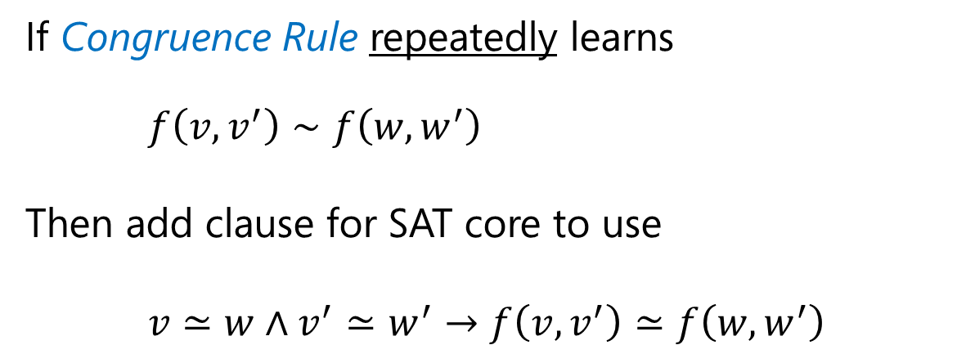
CDTR for Th(Equalities)
Dynamic Ackermann Reduction
If Congruence Rule repeatedly learns
$f\left(v,v^{′}\right)∼f\left(w,w^{′}\right)$
Then add clause for SAT core to use
$v≃w∧v^{′}≃w^{′}→f\left(v,v^{′}\right)≃f\left(w,w^{′}\right)$
Used in Yices and Z3 to find short congruence closure proofs
[Yices Tool 06, Dutertre, de Moura]
[Model-based Theory Combination 07, de Moura, B]

Slide 40
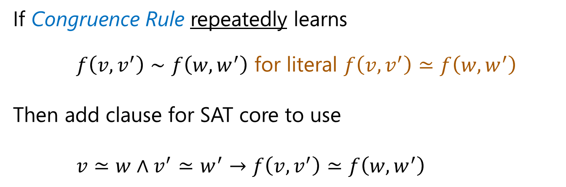
CDTR for Th(Equalities)
Dynamic Ackermann Reduction
If Congruence Rule repeatedly learns
$f\left(v,v^{′}\right)∼f\left(w,w^{′}\right)$ for literal $f\left(v,v^{′}\right)≃f\left(w,w^{′}\right)$
Then add clause for SAT core to use
$v≃w∧v^{′}≃w^{′}→f\left(v,v^{′}\right)≃f\left(w,w^{′}\right)$
Leo identified the following useful
optimization filter heuristic used in Z3
“Peel the onion from outside”

Slide 41
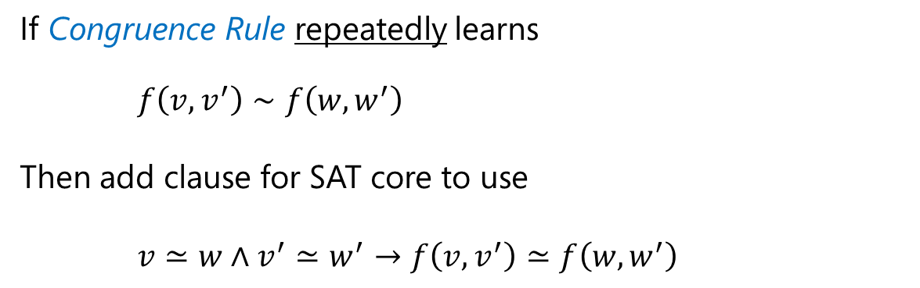
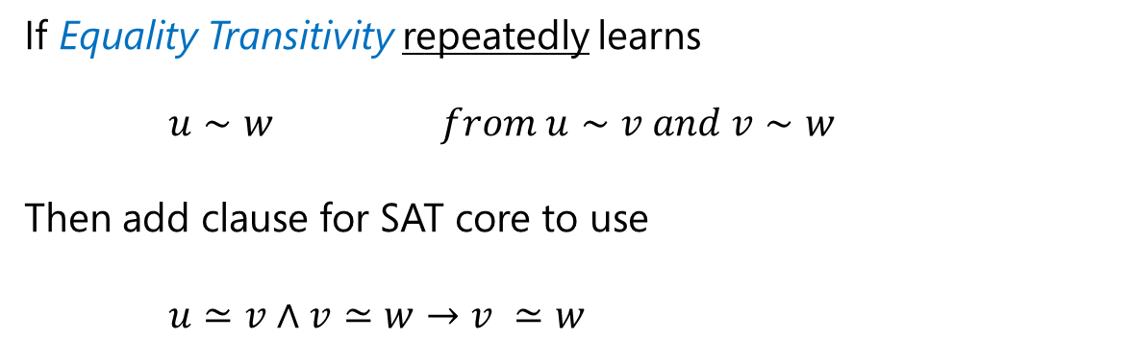
CDTR for Th(Equalities)
Dynamic Ackermann Reduction
If Congruence Rule repeatedly learns
$f\left(v,v^{′}\right)∼f\left(w,w^{′}\right)$
Then add clause for SAT core to use
$v≃w∧v^{′}≃w^{′}→f\left(v,v^{′}\right)≃f\left(w,w^{′}\right)$
Dynamic Ackermann Reduction with Transitivity
If Equality Transitivity repeatedly learns
$u∼w from u∼v and v∼w$
Then add clause for SAT core to use
$u≃v∧v≃w→v ≃w$

Slide 42
CDTR: Th(Equalities)
Claim:
Ground E-Resolution
≡
DPLL(E) + Dynamic Ackermann Reduction with Transitivity
Effect on the Diamond Example:.
sec.
Alternative: Static Ackermann Reduction
[Singerman, Pnueli, Velev, Bryant, Strichman,
Lahiri, Seisha, Bruttomesso,Cimatti, Franzen,
Griggio, Santuari, Sebastiani],
P-simulates ground E-Resolution.
But it has high up-front space overhead.

Slide 43
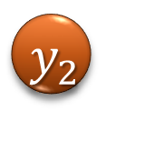




















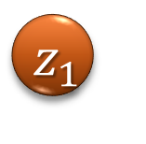







CDTR for Linear Difference Arithmetic
$a<x_{1}∧a<x_{2}∧\left(x_{1}<b∨x_{2}<b\right)∧$
b $<y_{1}∧b<y_{2}∧\left(y_{1}<c∨y_{2}<c\right)∧$
$\text{c}<z_{1}∧c<z_{2}∧\left(z_{1}<a∨z_{2}<a\right)$
$${ x}_{1}$$
$${ y}_{1}$$
$$z_{1}$$
$$<$$
$$<$$
$$<$$
$$<$$
$$<$$
$$<$$
$$a$$
$$∧$$
$$∨$$
$$b$$
$$∧$$
$$∨$$
$$c$$
$$∧$$
$$∨$$
$$a$$
$$<$$
$$<$$
$$<$$
$$<$$
$$<$$
$$<$$
$${ x}_{2}$$
$${ y}_{2}$$
$$z_{2}$$

Slide 44

CDTR: Linear Difference Arithmetic
$${ x}_{1}$$
$$<$$
$$<$$
$$a$$
$$b$$
$$c$$
$$a$$
$$<$$
$$<$$
$$<$$
$$<$$
$${ y}_{2}$$
$$z_{2}$$

Slide 45












CDTR: Linear Difference Arithmetic
$${ x}_{1}$$
$$<$$
$$<$$
$$b$$
$$c$$
$$a$$
$$<$$
$$<$$
$$<$$
$$<$$
$${ y}_{2}$$
$$z_{2}$$

Slide 46



CDTR: Linear Difference Arithmetic
$${ x}_{1}$$
$$<$$
$$<$$
$$b$$
$$a$$
$$<$$
$$<$$
$${ y}_{2}$$
$$z_{2}$$
$$<$$
$$c$$
$$<$$

Slide 47

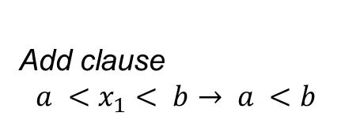
CDTR: Linear Difference Arithmetic
Top Two Most Active
vertices
$${ x}_{1}$$
$$<$$
$$<$$
$$b$$
$$a$$
Add clause
$$a <x_{1}< b→ a <b$$
$$<$$
$$<$$
$$<$$
$${ y}_{2}$$
$$z_{2}$$
$$<$$
$$c$$
$$<$$

Slide 48
Context and Extensions
Z3 supported theories all reduce to one of
Arithmetic Equality Booleans
CDTR
  Th(Equalities): Extended Dynamic Ackermann
  Th(Differences): Cutting loops
  Th(LRA): Fourier-Motzkin resolution
  Th(LIA): Perhaps: Integer FM [B. IJCAR 10]
CDTR and theory combinations:
  Theories communicate equalities between shared variables.
  Build clauses using these equalities.

Slide 49
Summary
Modern SMT solvers are tuned to
but limitations of basic proof
calculus shows up.
Presented a technique to close the gap
  Dynamic - to make it practical.
  Based on applying Resolution to conflicts.
Just one of many possible optimizations.
  The quest for improving search continues
  e.g. cutting plane proofs, arbitrary cuts (Frege)

